Slide 1

Welcome to CHEER!
Diversity, Democratisation and Difference: Theories and Methodologies
Professor Louise Morley
www.sussex.ac.uk/education/cheer

Slide 2
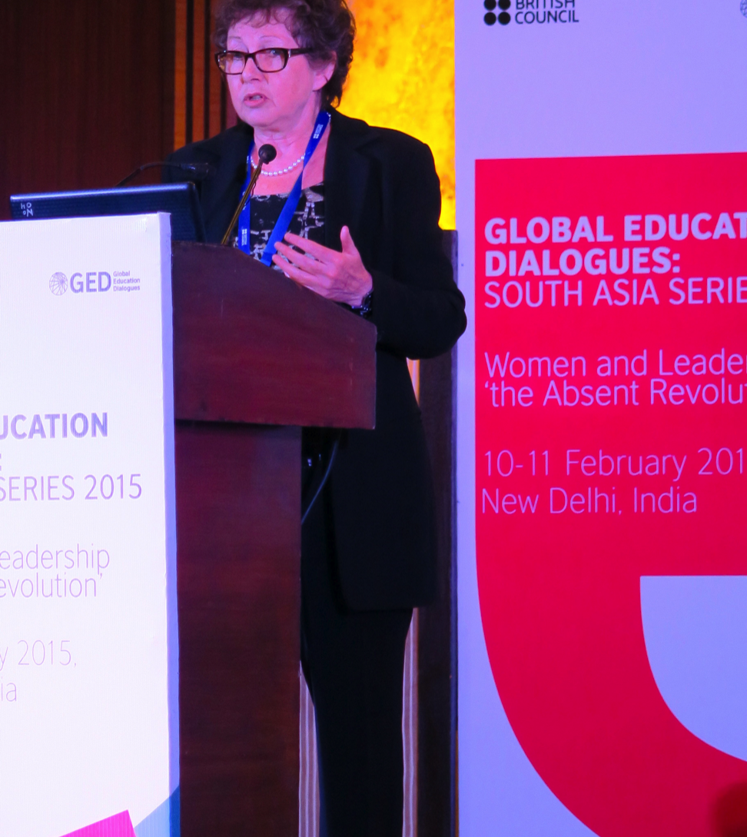
Centre for Higher Education and Equity Research (CHEER)
Aims to promote equity, inclusion and diversity in the global academy.
Committed to examining and reviewing the:
systems
structures
cultures
experiences
consequences
of inequities within higher education.

Slide 3
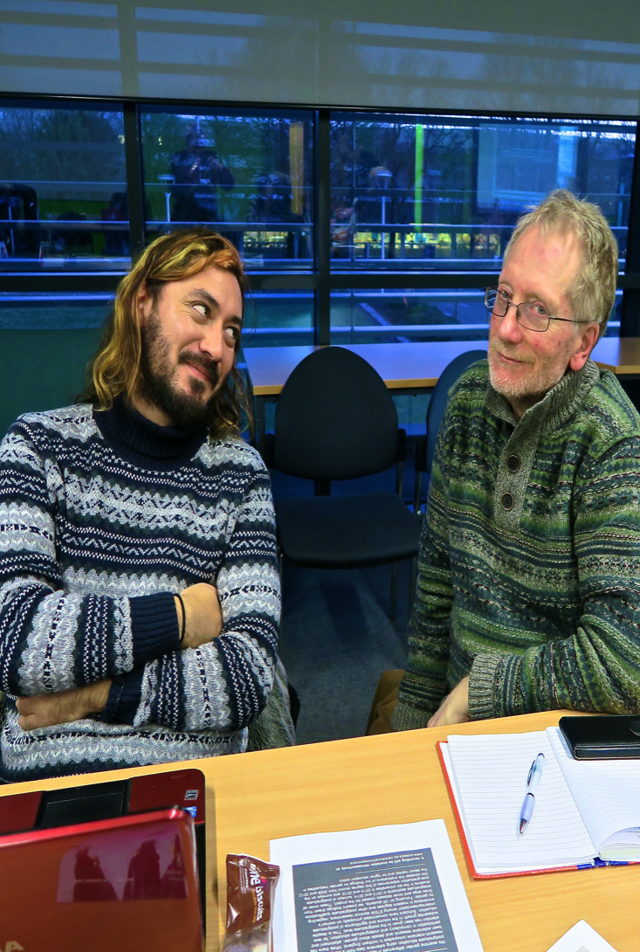
Critically Informed Social Change
New interdisciplinary understandings of higher education policy, practices and processes.
Apply critical, creative and feminist epistemologies as a means of investigating and interrupting social, educational and cognitive injustice.
Identify newly emergent , as well as persistent forms of exclusion in the context of turbulent local, national, international conditions.
Aspire to bring intellectual work, high-impact research findings and new insights to diverse audiences.
Work with students, policymakers, national and international organisations, NGOs, and campaigners, as well as cognate social scientists and scholars globally building a shared vision of imagining alternative futures.

Slide 4
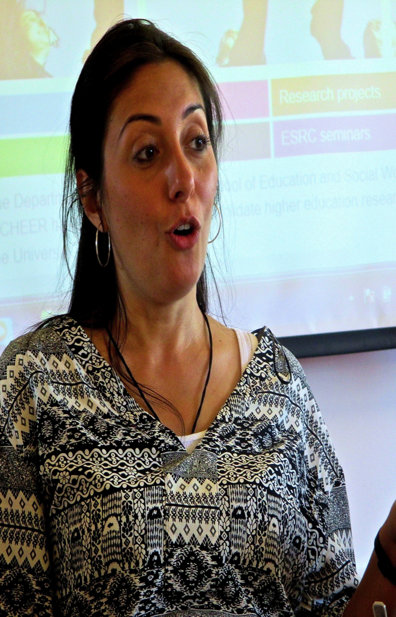
What We Do
Conduct high-quality, high-impact national and international research.
Develop theory and inform practice on equity.
Produce quality publications.
Offer expertise and consultancy at national and international levels.
Contribute to national and international policy debates.
Promote national and international networks and academic links .
Build the research capacity of early-career researchers and postgraduate students.
Host regular seminars and conferences (www.sussex.ac.uk/education/cheer/events

Slide 5
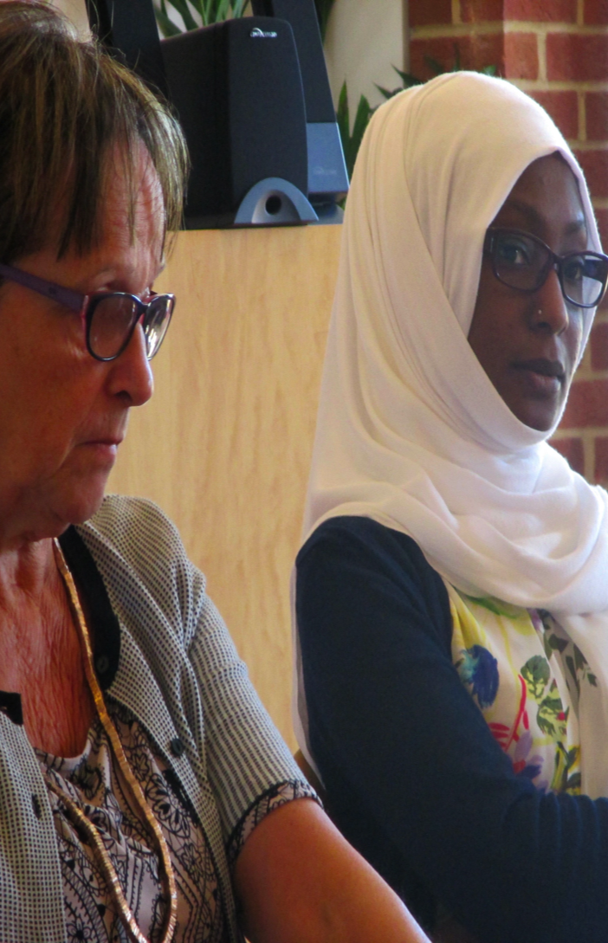
Current Research
Internationalisation (inclusion, spatial, social and affective dimensions and dynamics of mobility)
Leadership (gender, exclusion, affective economies)
The Neo-Liberal Global Academy (equity consequences of marketization, privatization, financialisation, audit)

Slide 6
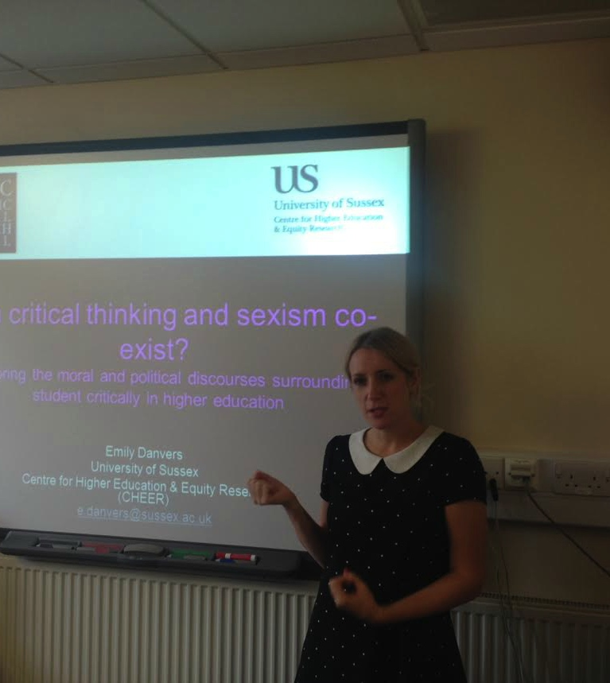
CHEER Seminars
Addressing female students' fear of sexual assault at a South African university residence
Dr Shakila Singh, Senior Lecturer, School of of Education, University of KwaZulu Natal.
Widening access to postgraduate study and the professions
Dr Paul Wakeling, Senior Lecturer & Dr Sally Hancock, Research Associate, Department of Education, University of York.
Enterprising, enduring, enabling? The entrepreneurial university: Engaging publics, intersecting impacts
Professor Yvette Taylor, Head of the Weeks Centre for Social and Policy Research, London South Bank University
See no evil, hear no evil and report no evil: Sexual and gender-based violence in Sri Lankan universities
Professor Maithree Wickramasinghe, University of Kelaniya
Developing intellectual histories in educational research
Helen Gunter, Professor of Education Policy, University of Manchester
Is Iceland the promised land for feminism?
Dr Steinunn Helga Lárusdóttir, University of Iceland

Slide 7
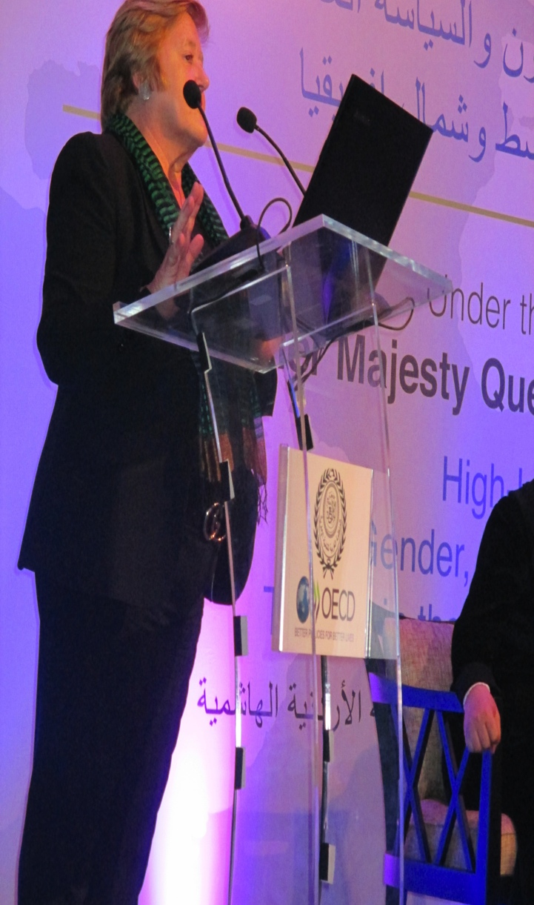
Join US
In our attempts to develop:
A new conceptual grammar;
New vocabularies for examining equity;
New visions for more equitable and inclusive higher education systems.

Slide 8
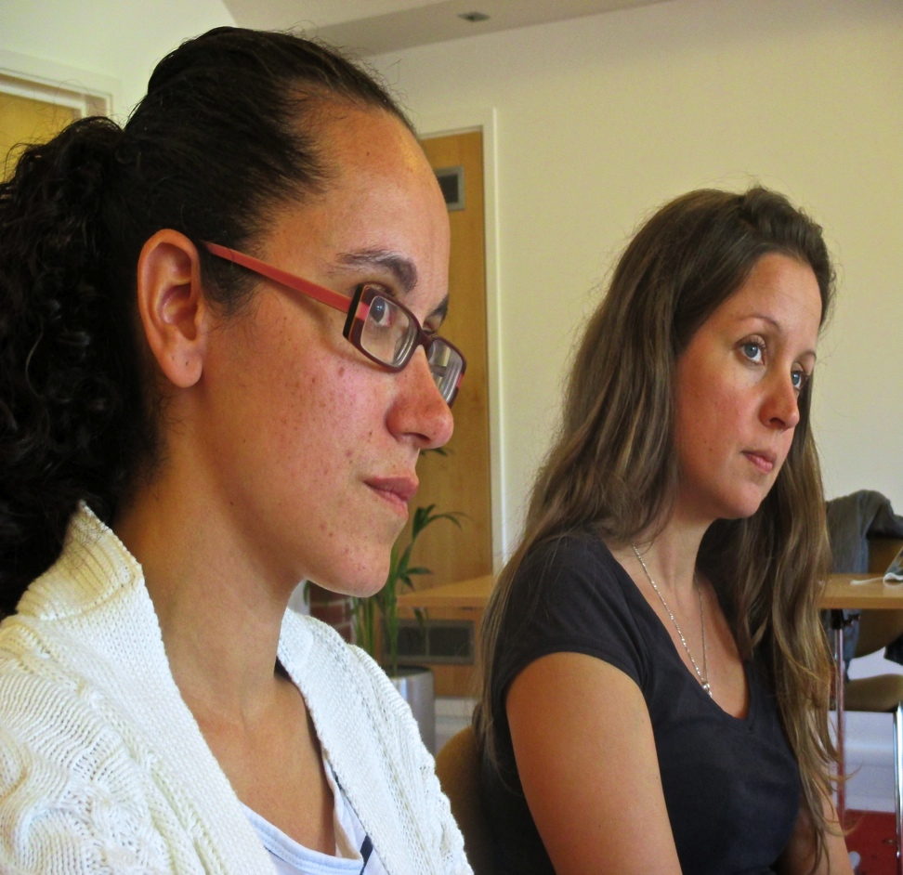
http://www.sussex.ac.uk/education/cheer
CHEER
Developing Theory
Informing Practices
Contributing to Policy

