Slide 1

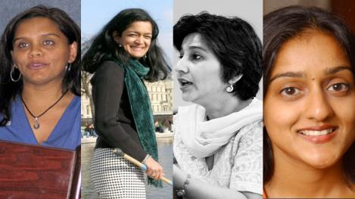
Lost Leaders:
Women in the Global Academy
Diversity, Democratisation and Difference: Theories and Methodologies
Professor Louise Morley
Centre for Higher Education
and Equity Research (CHEER)
University of Sussex, UK
http://www.sussex.ac.uk/education/cheer

Slide 2
Women Vice-Chancellors: Leading or Being Led?
EU | UK | IRL | HONG KONG | JAPAN | INDIA
15.5% | 17% | 14% | 0% | 2.3% | 3%

Slide 3

Where are the Women?
Adjunct/assistant roles
(Bagilhole and White, 2011; Davis, 1996).
‘Velvet ghettos’
(Guillaume & Pochic, 2009)
‘Glass cliffs’ (Ryan & Haslam, 2005)
Middle management:
e.g. quality assurance

Slide 4
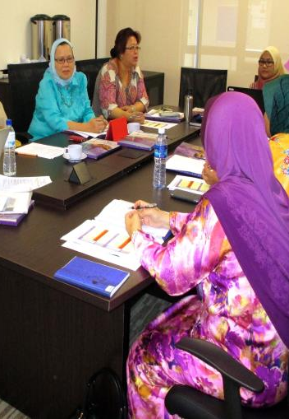
Diversity = Representational Space?
Norm-saturated (essentialised) policy narratives
Add under-represented groups
into current HE systems
=
distributive justice/ smart economics
organisational and epistemic transformation.
Gender = demographic variable.
Diversity = business case?
Sociology of absences?

Slide 5
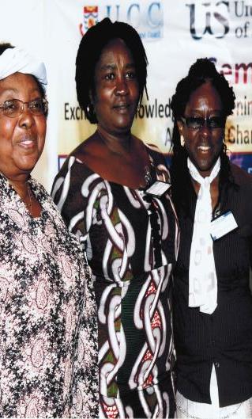
Provocations: How/ Why
Has gender escaped the policy logic of the turbulent global academy?
Is women’s capital devalued/ misrecognised in the knowledge economy?
Is leadership legitimacy identified?
Do cultural scripts for leaders coalesce/collide with normative gender performances?
Do decision-making and informal practices lack transparency/ accountability/ reproduce privilege?
Are leadership narratives understood?
Power, influence, privilege?
Loss, sacrifice, conflict?
Unliveable lives?

Slide 6

Evidence
South Asia
Rigorous Literature Review
Interviews- 19 women and 11 men
Afghanistan, Bangladesh, India, Nepal, Pakistan and Sri Lanka.
Malaysia
36 Questionnaires/ 1 Discussion Group
East Asia and MENA
20 Questionnaires/ 3 Discussion Groups Australia, China, Egypt, Hong Kong, Indonesia, Japan, Jordan, Kuwait, Malaysia, Morocco, Pakistan, Palestine, the Philippines, Singapore, Thailand and Turkey (Morley, 2014).
What makes leadership attractive/unattractive to women?
What enables/ supports women to enter leadership positions?
Personal experiences of being enabled/ impeded from entering leadership?

Slide 7

Leading the Global Academy
Australia (White, 2013)
Canada (Acker, 2012)
China (Chen, 2012)
Finland (Husu et al, 2012)
Ghana (Ohene, 2010)
Hong Kong (Aiston, 2014)
India (Chanana , 2012)
Ireland (O’Connor, 2013)
Japan (Shirahase, 2013)
Kenya (Onsongo, 2004)
Nigeria (Odejide, 2007)
Norway (Benediktsdottir, 2008)
Pakistan (Rab, 2010)
South Africa (Shackleton et al., 2006)
South Korea (Kim et al., 2010)
Sri Lanka (Gunawardena et al., 2006)
Sweden (Peterson, 2011)
Turkey (Özkanli, 2009)
Uganda (Kwesiga & Ssendiwala, 2006)
UK (Bagilhole, 2009)
USA (Madsen, 2011 )

Slide 8
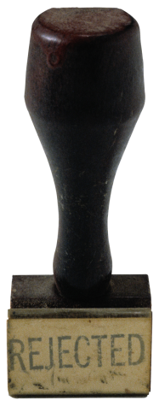
Berating/ Explaining Absences
Gendered Divisions of Labour
Gender Bias/ Misrecognition
Cognitive errors in assessing merit/leadership suitability/ peer review
Institutional Practices
Management & Masculinity
Greedy Organisations
Women’s Missing Agency/ Deficit Internal Conversations
Socio-cultural messages
Counting more women into existing systems, structures and cultures =
an unquestioned good.
(Morley, 2012, 2013, 2014)

Slide 9

Consequences of Absence of Leadership Diversity
Employment/ Opportunity Structures
Democratic Deficit/ Decision-making
Distributive injustice
Depressed career opportunities.
Misrecognition of leadership potential/ wasted talent.
Service Delivery
Knowledge Distortions, Cognitive/ Epistemic injustice (Fricker, 2007)
Reproduction of Institutional Norms/ Practices.
Margins/ Mainstream hegemonies, with women, minority staff seen as Organisational ‘Other’

Slide 10
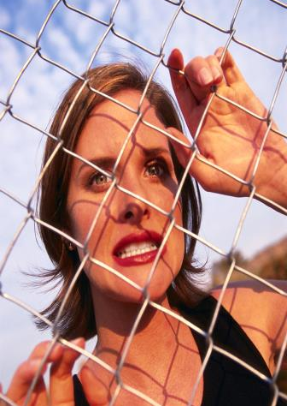
Vertical Career Success or Incarceration in an Identity Cage?
Leadership
Punishment/Reward
Morality of turn-taking, sacrifice, domestic labour
Rotational /fixed term
Can Involve
Multiple/ conflicting affiliations
Resignifications
Unstable engagements with hierarchy & power
(Cross & Goldenberg, 2009)

Slide 11
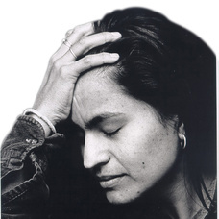
An Affective Load/ Identity Work
Working with resistance, recalcitrance, truculence, ugly feelings.
Colonising colleagues’ subjectivities towards the goals of managerially inspired discourses.
Managing self-doubt, conflict, anxiety, disappointment & occupational stress.
=
Restricting, not
Building capacity and creativity.

Slide 12

Leaderism: Resilience, not Resistance
Evolution of Managerialism?
Disguises corporatisation/ values shift in HE
Transformative leadership is value-laden/ not neutral.
Diverts attention to personal qualities/ skills.
Certain
Subjectivities
Values
Behaviours
Dispositions
Characteristics
Can
Strategically overcome institutional inertia
Outflank resistance/ recalcitrance
Provide direction for new university futures
(O’Reilly and Reed, 2010, 2011).

Slide 13
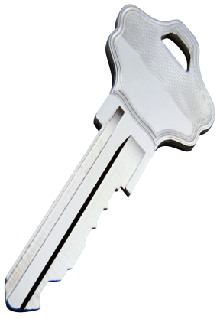
Expanding the Theoretical Lexicon
Barad’s (2007) theory of ‘intra-action’
how differences are made and remade
stabilised and destabilised
how individuals exist because of the existence of given interactions
Leaders made via power relations/ politics of difference.
Ahmed’s (2010) theory of happiness:
is a technology/ instrument
re-orientates individual desires towards a common good.
Leadership = sign of vertical career success.
Berlant’s (2011) theory of cruel optimism:
Depending on objects that block thriving.
Leadership = normative fantasy and/or a bad object of desire .

Slide 14
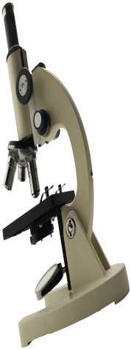
Optics and Apparatus
What is it that people don’t see?
Why don’t they see it?
What do current optics/ practices/ specifications reveal and obscure?
Leadership Potential
Observable, separate static structure?
Struggle for value/ intelligibility? contingent, contextual
Co-produced?

Slide 15
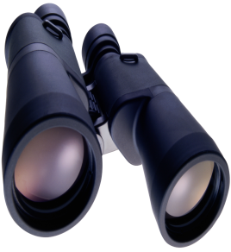
A Two-Way Gaze?
How are women being seen e.g. as deficit men?
How are women viewing leadership e.g. via the lens of neo-liberalism/ austerity?

Slide 16

What Attracts Women to Senior Leadership?
Power
Influence
Values
Rewards
Recognition

Slide 17

Why is Senior Leadership Unattractive to Women?
Neo-liberalism
Being ‘Other’ in male-dominated cultures.
Leadership v scholarship.
Disrupting the symbolic order.
Socio-cultural messages.
Navigating professional and domestic responsibilities.
Gendered Networks/ Lobbying
Women lack capital (economic, political, social and symbolic) to redefine the requirements of the field (Corsun & Costen, 2001).

Slide 18
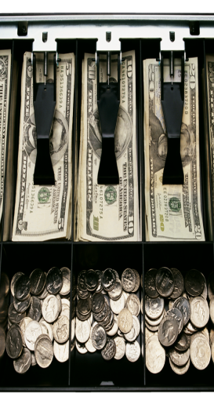
Leadership = Installation of the Neo-liberal Gaze?
Knowledge = the New Capital/ Global Commodity
Financialisation/ Market Values
Audit/ Performance Management
Prestige Economy/ League Tables
Instrumentalisation/ Mobilisation/Utility of Research e.g. Impact, Rates of Return

Slide 19

Neo-liberalism as a Relationship of Entanglement?
Academic profession complicit in promoting indexes/ indicators that regulate the profession
(Gill, 2010; Leathwood & Read, 2013).
Truth telling via peer review, appraisal, auditors, search agents (Ball, 2014).
Academic Identity via metrics/ management by numbers (Cooke, 2013).
Empty signifier of excellence invoked/ value indicators = unstable, transitory, contingent and contextualised.
Research = object of surveillance/ income.
Knowledge capitalism generating arbitrary and unsustainable inequalities/ epistemic and social closures.
Logic of Relationality= winners and losers.

Slide 20
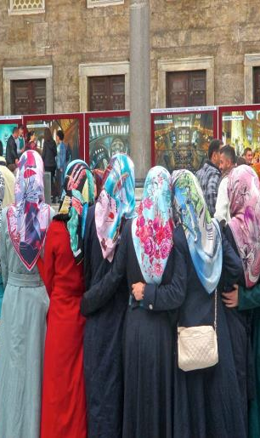
Gendered Pathways: Research/ Prestige Economy
Women less likely to be:
Journal editors/cited in top-rated journals (Tight, 2008).
Principal investigators (EC, 2011)
On research boards
Awarded large grants (Husu, 2014)
Awarded research prizes (Nikiforova, 2011)
Be conference keynote speakers (Schroeder et al., 2013 )
Women likely to be:
Cast as unreliable knowers (Longino, 2010).
Tasked with inward-facing responsibilities.
Research resources/opportunities:
Competitively structured
Replicate/reproduce gender hierarchies.

Slide 21
Rejection, Refusal and Reluctance
Reluctance
I would much prefer not having to deal with people administratively
(Female Professor, Sri Lanka)
What I have felt is that when you are in the leadership position or you’re aiming at it you have rather too much pressure to deal with (Female Professor, India)
I don't want to get tangled in administrative issues…this management and that management, and I think I wouldn't get much time to do my own study, and then do other things that I would like to do (Female Associate Professor, Nepal)
Well you know like I said the mentality of your male colleagues. That’s a deterrent like I said he’ll call you pushy, he’ll call you vicious you know and all that because a woman at the leadership or a woman boss is not readily acceptable. ( Female Pro Vice- Chancellor, Bangladesh)
What makes leadership unattractive is the cultural pressures, also fear of the unknown, and family pressures, having to sacrifice other important aspects of her life to devote to her work (Male Associate Dean, Pakistan).
Rejection
UK- women 2.5 times likely to be unsuccessful in applications for senior posts (Manfredi et al, 2014)
Afghanistan is a war locked and also men locked country and men dominate it; men has a main role in all places (Female Deputy Dean, Afghanistan).
Refusal
I think at some point in time in my career I think when I was pretty young I decided that I will not work for others, I will work for my satisfaction (Female Professor, India).
I find it difficult to control people…I know this so every time I am offered this position I say no…You are not trained to do that kind of thing, you know - we have only been trained in working in our discipline (Female Professor, Sri Lanka).

Slide 22

Enablers: Recognition/ Investment
Support/ Encouragement
Training/ Development/ Capacity-Building
Mentorship, Advice and Sponsorship
Policy contexts
Legislative frameworks
Effective advocacy
Accountability
Affirmative Action
Gender Mainstreaming
Specific Programmes

Slide 23
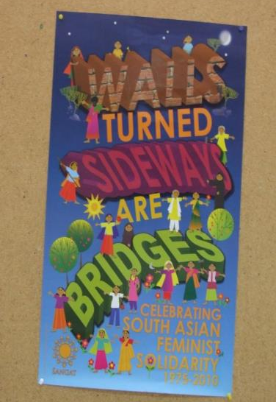
Change Interventions
Athena Swan/ Gender Charter Marks/ Aurora, UK (http://www.ecu.ac.uk/our-projects/gender-charter-mark)
Excellentia, Austria
(Leitner and Wroblewski, 2008)
Gender Programme, Association of Commonwealth Universities
(Morley et al., 2006)
Norwegian University of Science and Technology (NTNU)
(Benediktsdotir, 2008)

Slide 24
Women Reflexively Scanning
Women Are Not/ Rarely
Entering middle management.
Often located on career pathways that do not lead to senior positions.
Burdened with affective load:
being ‘other’ in masculinist cultures
navigating between professional and domestic responsibilities.
Hearing leadership narratives as unliveable lives
Demanding change.
Identified, supported, encouraged and developed for leadership.
Achieving the most senior leadership positions in prestigious, national co-educational universities.
Personally/ collectively desiring senior leadership.
Intelligible/ seen as leaders?
Women Are

Slide 25

Making Alternativity Imaginable/ Leading Otherwise?
Can leadership:
narratives
technologies
practices
Be more than discursive performances/repetitions of:
values
regulative norms
of new public governance/neo-liberal/HE reform narratives?
equate more with liveable lives for women?
be more generous, generative and gender free?

Slide 26
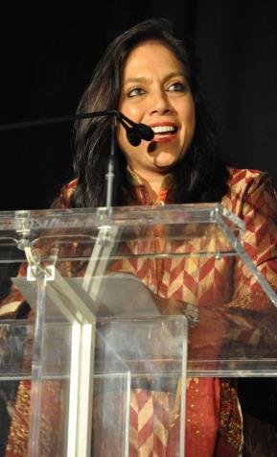
Follow Up?
Morley, L. (2014) Lost Leaders: Women in the Global Academy. Higher Education Research and Development 33 (1) 111–125.
Morley, L. (2013) "The Rules of the Game: Women and the Leaderist Turn in Higher Education " Gender and Education. 25(1):116-131.
Morley, L. (2013) Women and Higher Education Leadership: Absences and Aspirations. Stimulus Paper for the Leadership Foundation for Higher Education.
Morley, L. (2013) International Trends in Women’s Leadership in Higher Education In, T. Gore, and Stiasny, M (eds) Going Global. London, Emerald Press.

