Slide 1

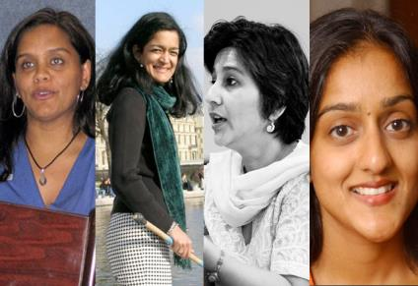
Lost Leaders:
Women in the Global Academy
Diversity, Democratisation and Difference: Theories and Methodologies
Centre for Higher Education
and Equity Research (CHEER)
University of Sussex, UK
Professor Louise Morley
http://www.sussex.ac.uk/education/cheer

Slide 2

Evidence
South Asia
Rigorous Literature Review
Interviews- 19 women and 11 men
Afghanistan, Bangladesh, India, Nepal, Pakistan and Sri Lanka.
Malaysia
36 Questionnaires/ 1 Discussion Group
East Asia and MENA
20 Questionnaires/ 3 Discussion Groups Australia, China, Egypt, Hong Kong, Indonesia, Japan, Jordan, Kuwait, Malaysia, Morocco, Pakistan, Palestine, the Philippines, Singapore, Thailand and Turkey (Morley, 2014).
What makes leadership attractive/unattractive to women?
What enables/ supports women to enter leadership positions?
Personal experiences of being enabled/ impeded from entering leadership?

Slide 3
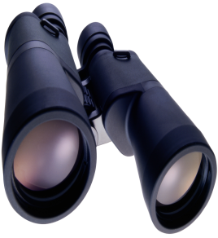
A Two-Way Gaze?
How are women being seen e.g. as deficit men?
How are women viewing leadership e.g. via the lens of neo-liberalism/ austerity?

Slide 4
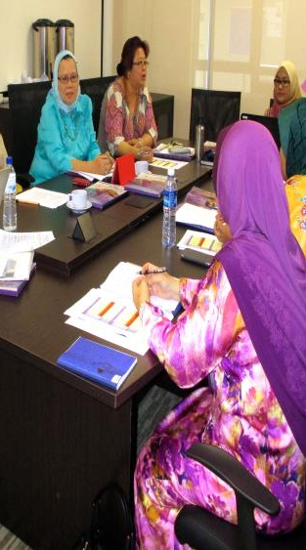
Gender as a Noun, not a Verb
Norm-saturated (essentialised) policy narratives
Add under-represented groups
into current HE systems
=
distributive justice/ smart economics
organisational and epistemic transformation.
Gender = demographic variable.
Diversity = business case?
Sociology of absences?
(Morley, 2012, 2013, 2014)

Slide 5

What Attracts Women to Senior Leadership?
Power
Influence
Values
Rewards
Recognition

Slide 6
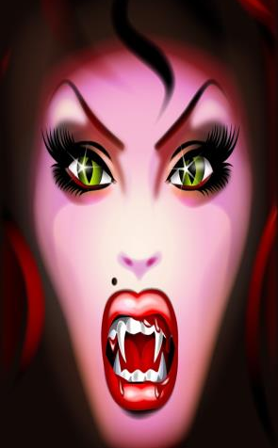
Why is Senior Leadership Unattractive to Women?
Neo-liberalism
Being ‘Other’ in male-dominated cultures.
Leadership v scholarship.
Disrupting the symbolic order.
Socio-cultural messages.
Navigating professional and domestic responsibilities.
Gendered Networks/ Lobbying
Women lack capital (economic, political, social and symbolic) to redefine the requirements of the field (Corsun & Costen, 2001).

Slide 7
Women Reflexively Scanning
Women Are Not/ Rarely
Entering middle management.
Often located on career pathways that do not lead to senior positions.
Burdened with affective load:
being ‘other’ in masculinist cultures
navigating between professional and domestic responsibilities.
Hearing leadership narratives as unliveable lives
Demanding change.
Identified, supported, encouraged and developed for leadership.
Achieving the most senior leadership positions in prestigious, national co-educational universities.
Personally/ collectively desiring senior leadership.
Intelligible/ seen as leaders?
Women Are

Slide 8

Enablers
Legislative Frameworks and Policy Contexts
Gender Mainstreaming
Gender Budgeting/ Auditing
Gender Impact Assessment
Affirmative Action
Professional Development/ Investment
Capacity-Building
Mentorship, Advice and Sponsorship
Women-only Leadership Development e.g. Aurora/ ACU Programme
Accountability/ Sanctions/ Rewards
Excellentia, Austria
(Leitner and Wroblewski, 2008)
Athena Swan/ Gender Charter Marks, UK
(http://www.ecu.ac.uk/our-projects/gender-charter-mark)

Slide 9
Accountable/Attractive
Review
Question
Can leadership:
Equate more with liveable lives for women and men?
Be more generous, generative and gender free?
Institutional Practices
Recruitment and Selection
Gendered Divisions of Labour
Audit Culture
How HE interacts with the international policy architecture on gender.

Slide 10
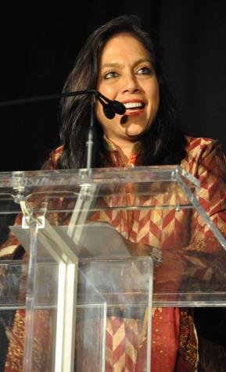
Follow Up?
Morley, L. et al. (2015) Managing Modern Malaysia: Women in Higher Education Leadership. In, Eggins, H. (Ed) The Changing Role of Women in Higher Education. Dordrecht: Springer.
Morley, L. (2014) Lost Leaders: Women in the Global Academy. Higher Education Research and Development 33 (1) 111–125.
Morley, L. (2013) "The Rules of the Game: Women and the Leaderist Turn in Higher Education " Gender and Education. 25(1):116-131.
Morley, L. (2013) Women and Higher Education Leadership: Absences and Aspirations. Stimulus Paper for the Leadership Foundation for Higher Education.
Morley, L. (2013) International Trends in Women’s Leadership in Higher Education In, T. Gore, and Stiasny, M (eds) Going Global. London, Emerald Press.

