Slide 1

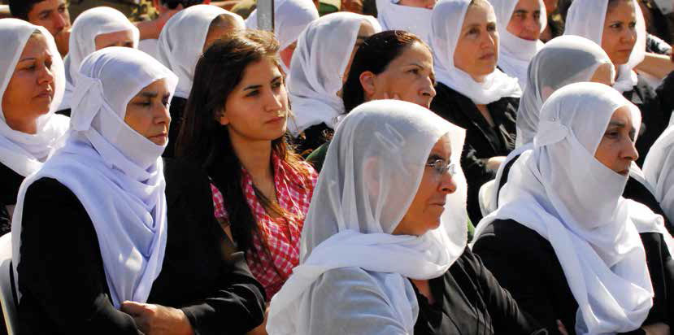
Lost Leaders: Women in the Global Academy
Diversity, Democratisation and Difference: Theories and Methodologies
Professor Louise Morley
Centre for Higher Education
and Equity Research (CHEER)
University of Sussex, UK
http://www.sussex.ac.uk/education/cheer

Slide 2
Women Vice-Chancellors: Leading or Being Led?
EU | UK | KUW | HONG KONG | JAPAN | INDIA
15.5% | 17% | 2% | 0% | 2.3% | 3%

Slide 3

Consequences of Absence of Leadership Diversity?
Wasted talent/ Misrecognition of leadership potential
Democratic Deficit/ Decision-making
Distributive injustice
Depressed career opportunities
Reproduction of Institutional Norms/ Practices.

Slide 4
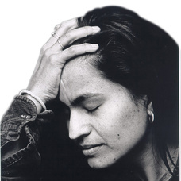
A Two-Way Gaze?
How are women being seen e.g. as deficit men?
How are women viewing leadership e.g. sacrifice, loss, conflict, unliveable lives?

Slide 5

Evidence
South Asia
Critical Literature Review
Interviews- 19 women and 11 men
Afghanistan, Bangladesh, India, Nepal, Pakistan and Sri Lanka.
Malaysia
36 Questionnaires/ 1 Discussion Group
East Asia and MENA
20 Questionnaires/ 3 Discussion Groups Australia, China, Egypt, Hong Kong, Indonesia, Japan, Jordan, Kuwait, Malaysia, Morocco, Pakistan, Palestine, the Philippines, Singapore, Thailand and Turkey (Morley, 2014).
What makes leadership attractive/unattractive to women?
What enables/ supports/ impedes women?

Slide 6
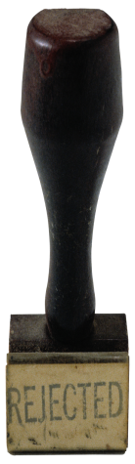
Explaining Absences
Gendered Divisions of Labour
Gender Bias/ Misrecognition
Institutional Practices
Management & Masculinity
Greedy Organisations
Socio-cultural messages
(Morley, 2012, 2013, 2014)

Slide 7

What Attracts Women to Senior Leadership?
Power
Influence
Values
Rewards
Recognition

Slide 8

Why is Senior Leadership Unattractive to Women?
Neo-liberalism
Being ‘Other’ in male-dominated cultures
Disrupting the symbolic order
Socio-cultural messages
Navigating professional/ domestic responsibilities
Gendered Networks/ Lobbying
Women lack capital (economic, political, social and symbolic) to redefine the requirements of the field (Corsun & Costen, 2001).

Slide 9

Enablers: Recognition/ Investment
Policy e.g. Affirmative Action & Gender Mainstreaming
Legislative frameworks
Gender Disaggregated Statistics
Training/ Development/ Capacity-Building
Accountability/ Transparency
Mentorship/Advice/Sponsorship
International Networks

Slide 10
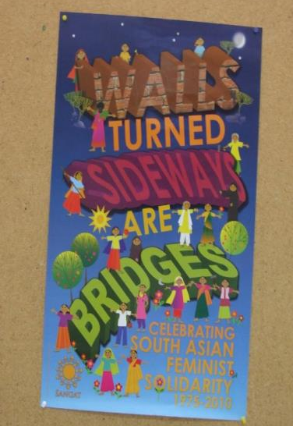
Change Interventions
Athena Swan/ Gender Charter Marks/ Aurora, UK
(http://www.ecu.ac.uk/our-projects/gender-charter-mark)
Excellentia, Austria
(Leitner and Wroblewski, 2008)
Norwegian University of Science and Technology (NTNU)
(Benediktsdotir, 2008)
Gender Programme, Association of Commonwealth Universities
(Morley et al., 2006)

Slide 11
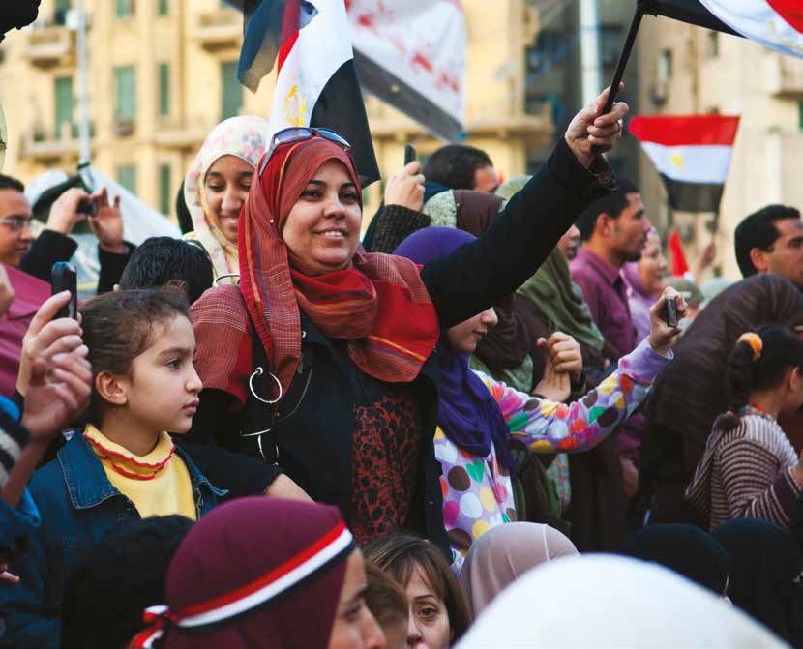
OECD Action?
Data
Accountability Measures
Policy Dialogues in MENA
Policy Co-ordination
Monitoring and Evaluation
Research
Leadership Development Programmes
(OECD-CAWTAR Report, 2014)

Slide 12
Invest in Women

Slide 13
Equality is Quality

Slide 14
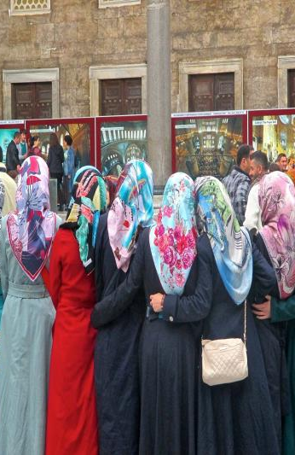
Follow Up?
Morley, L. (2014) Lost Leaders: Women in the Global Academy. Higher Education Research and Development 33 (1) 111–125.
Morley, L. (2013) "The Rules of the Game: Women and the Leaderist Turn in Higher Education " Gender and Education. 25(1):116-131.
Morley, L. (2013) Women and Higher Education Leadership: Absences and Aspirations. Stimulus Paper for the Leadership Foundation for Higher Education.
Morley, L. (2013) International Trends in Women’s Leadership in Higher Education In, T. Gore, and Stiasny, M (eds) Going Global. London, Emerald Press.

