Slide 1
Changing the Shape of Higher Education: Troubling Neoliberalism and Imagining Alternativity
CENTRE FOR HIGHER EDUCATION AND EQUITY RESEARCH
Professor Louise Morley

Slide 2

The Affective Ecology of Deconstruction: ‘Grievance Studies’?
Naming the Problem, you become the Problem.
How do we:
Analyse the Political Economy of Neoliberalism without activating misery narratives?
Acknowledge and celebrate resistance without relying on a compliance or critique binary?
Imagine a post-neoliberal university?

Slide 3
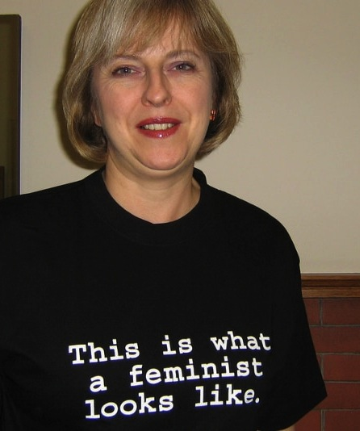
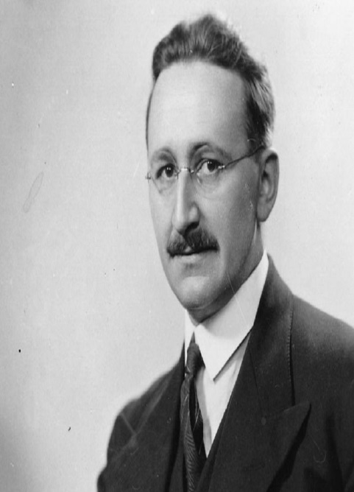
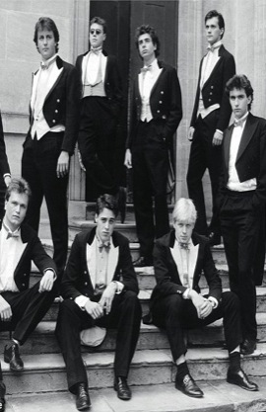
The Political Economy of Neoliberalism:
Whose Imaginary?
Linguistic Omnivore/ Overdetermined/ Anthropomorphised Category/ Conceptual Aggregation?
Late Capitalist Economy (Deregulation/ Markets)
Globally Circulating Cluster of Policy Measures (Privatisation)
Cultural Regime/ Governing Rationality that Privileges Price and Profit
(Uberisation/ Unbundling/ Precarity/ Disposability/ Gig Economy)

Slide 4
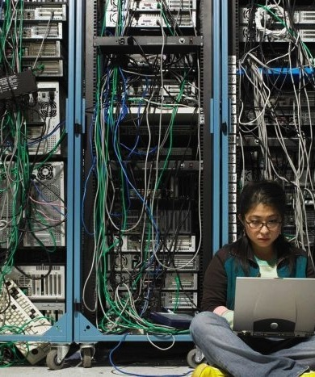
Entangling and Installing Neoliberalism in Higher Education
MATERIAL
Funding: linked to policy narratives/priorities
Audit: condensed quality indicators
Employment Regimes: Performance pay/ tenure/ promotion = epistemic hierarchies
DISCURSIVE
Truth-telling: peer review/ impact/ appraisal/ search agencies/ esteem/ reputation
Closure of the political universe/ TINA Effect
Performative Repetition
Reputation and Impression Management

Slide 5

The Affective Economy
Drive for Distinction/ Differentiation
Crisis Discourse/ Disaster Capitalism/ Catastrophising
FOMO in Policy Formation
Affective Contagion/ Circulation
Shame/ Guilt / Pride / Fear/ Desire/ Happiness
How do these interact with structures of inequality?
Trial by public exposure
Success / Failure narratives
Competition erodes solidarity?
Neoliberalism cultivates and optimises differences
Passionate Attachment/ Pleasure
Rewards and Injuries.
Visceral reactions of the ’losers’.

Slide 6



Provocations: Neoliberal Intellectual Culture is …
Making academic labour, activity and productivity intelligible via metrics and norms?
Eroding counter-hegemonic knowledges?
Reducing leadership to the amplification of dominant messaging systems?
Creating and promoting ontological antagonisms?
Re-evaluating value?
In a market calculus, what is not measured? Gender Equality?

Slide 7

(Lack of) Resistance?
Neoliberalization is generally more termitelike than lionlike (Brown 2015: 35/36)
Capillary Power – everywhere and nowhere
Govermentality - regulate ourselves
Monetarising desires and makes us desire what is monetarised
Sacrifice/ austerity/ regulation via finance
Illusio = investing in the game involves performativities
Assemblage of discursive, symbolic and material rewards for those servile to the priorities of the market.

Slide 8

The Accelerated Academy
Cognitive Triage
The incapacitation of daydream or of any mode of absent-minded introspection that would otherwise occur in intervals of slow or vacant time
(Carrigan 2015)

Slide 9

Capitalism Masquerading as Democratisation/ Participation/ Consumer Rights?
Linguistic hijacking disguises class power: choice, diversity, freedom, excellence, inclusion.
Universities
Cultivating popularist approaches to students/ research funders.
Relying on customer satisfaction surveys/ evaluative data to promote services in competitive markets.
Encouraging microentrepreneurs (who often lack employment rights).
Providing digitally mediated, transnational services.
Re-purposing participation and inclusion.

Slide 10

Governing Through Unhappiness
Heat Up The Floor To See Who Can Keep Hopping The Longest
(Davies 2014)

Slide 11

Resilience
Embracing danger/ precarity/ austerity as inevitable.
Plasticity and Ontological Antagonisms: Contort rather than Challenge.
Responsivity over Signification.
Encouraging unhealthy practices – narcissism, self-promotion, boasting, attribution.
Mental Health = technologies of self-management - mindfulness, positivity.
Fragility and Vulnerability.
Distractions from policy failures?

Slide 12

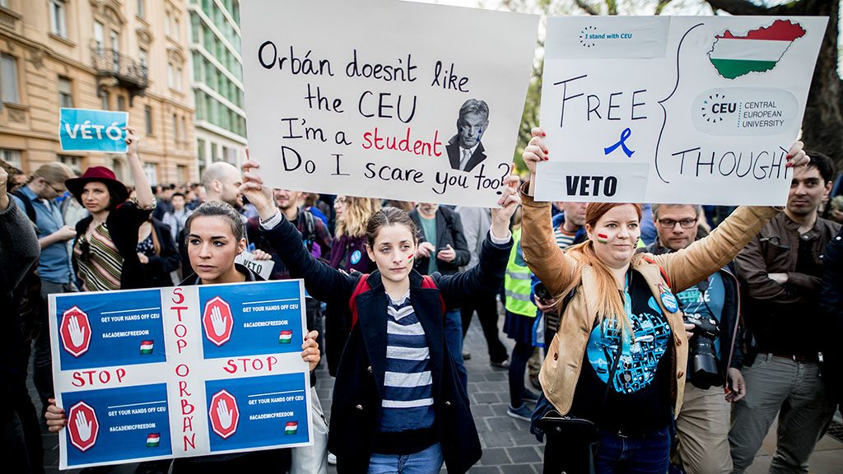
Scholars at Risk: Suffering at a Distance?
Globalisation = Global Obligations?
The Criminalisation of Knowledge
Anti-intellectualism/ Censorship/ Retaliation
Erosion of Academic Freedom
Exile and Displacement
Calls for Democracy = Sedition
Affective Overload/ Receptivity?

Slide 13
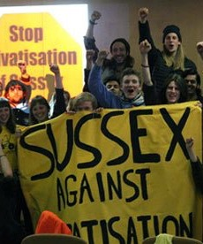
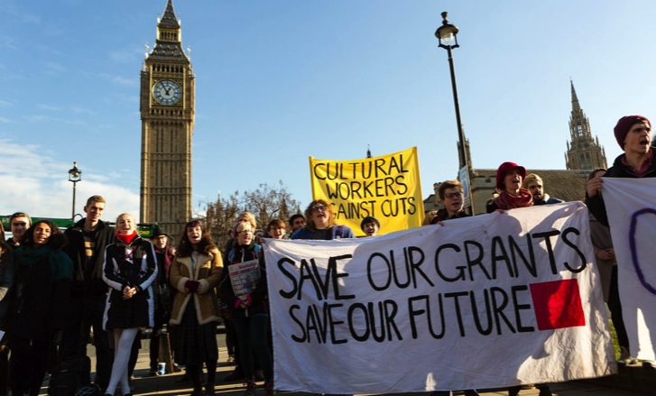

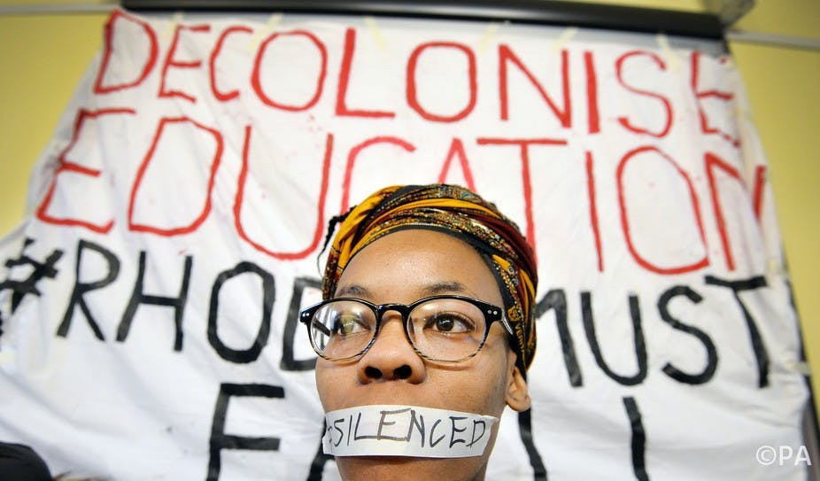
Democratic Disruption and Denunciatory Analyses?
Opposition/ Industrial Action to Neoliberal policies- privatisation, pension reform, student loans
Alternative Sites of Higher Education: Occupy movements/ People’s Universities
Decolonisation
# Me Too/ Time’s Up!
Ironic productivity of critical texts
(1000 academic articles between 2002-2005)

Slide 14
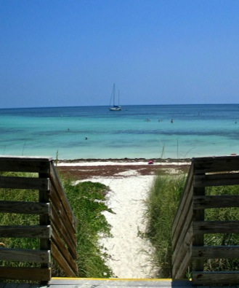
Constituted by Discourse?
Making Alternativity Imaginable:
How Can We ….
Trouble neoliberal realism
Expand the horizons of possibility and purpose
Fashion a new political imaginary
De-commodify social and intellectual imaginations
Identify new discursive formations / lexicons/ knowledge for imagining alternative higher education futures?

Slide 15

CHEER Website: www.sussex.ac.uk/education/cheer
Twitter: @SussexCHEER
Facebook: www.facebook.com/groups/CHEERSussex/

