Slide 1
Can Women Make a Difference in University Leadership?
CENTRE FOR HIGHER EDUCATION AND EQUITY RESEARCH
Professor Louise Morley, University of Sussex, UK

Slide 2
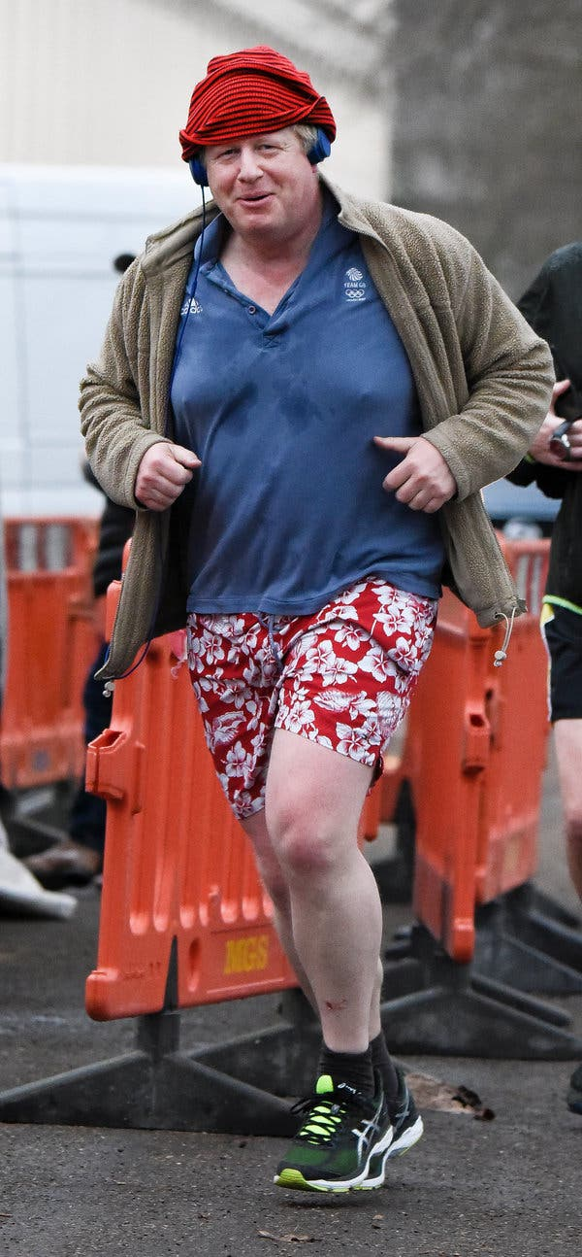
Glass Cliff?
Is the global pandemic is an example of a glass cliff - allowing women in when there is a crisis, but in times of plenitude and non-crisis, it all changes?
Binary logics have emerged in the pandemic crisis leadership e.g. essentialised and socio-politically decontextualised discourses about the effective antinormativity of women leaders in Finland, Germany, New Zealand, Norway, and Taiwan (Dudman, 2020).
Women’s difference from toxically masculine leaders is now a cause for celebration and appreciation.
The competent, decisive, caring ‘safe parent’ leadership style has been sharply exposed in the media in contrast to the incompetent, complacent, bumbling, modes of unknowing and unsafe approaches of the male leadership of the countries with high infection rates, enmeshed with human rights crises, including Johnson in the UK, Trump in the USA, Piñera in Chile, Putin in Russia, and Bolsanaro in Brazil (Johnson & Williams, 2020; Tisdall, 2020).

Slide 3

Leading Otherwise?
Dangers of homogenising and essentialising women and treating women leaders as one category of analysis, with an emphasis on counting more women into existing models of leadership, rather than examining leadership itself?
In relation to higher education, a key task is to re-imagine university leadership for the post pandemic period.
Will the pandemic reinforce the political economy of neoliberalism, for example, with its marketisation, financialisation and precarity?
Is this an opportunity for women to enter and do leadership differently?

Slide 4
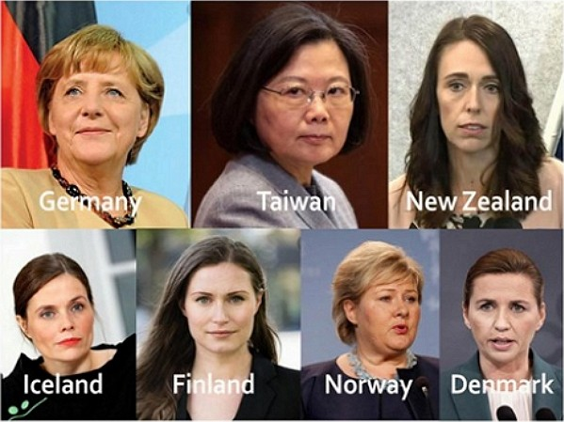
Questions
What are your views on the recent valorisation of women leaders in the global pandemic?
How can we promote women’s leadership without degenerating into binary logics, homogenisation and essentialisation?
Rather than focussing on counting more women into university leadership as it stands, let’s consider what type of leadership is required for universities in the post-pandemic period? What values, principles, and processes do we wish to see?

Slide 5
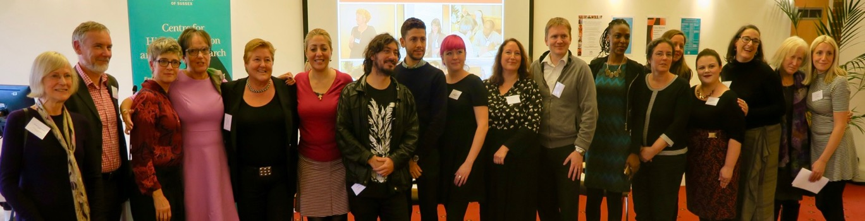
Follow Up?
Boyer, E.L. (1990). A special report. Campus life. Princeton, NJ:The Carnegie Foundation for the Advancement of Teaching.
Bull, A., & Rye, R. (2018). Silencing students: institutional responses to staff sexual misconduct in higher education. The 1752 Group. https://pure.port.ac.uk/admin/files/11631036/Silencing_Students_The_1752_Group.pdf
Cantor, D., et al.(2020). Report on the AAU Campus Climate Survey on Sexual Assault and Misconduct.
https://www.osu.edu/assets/buckeyesact/2019_campus_climate_survey.pdf.
Dziech, B., & Weiner, L. (1984). The lecherous professor: Sexual harassment on campus. Chicago, IL: University of Illinois Press.
MacKinnon, C. (1979). Sexual harassment of working women: A case of sex discrimination. New Haven, CT: Yale University Press.
Morley, L. and Crossouard, B. (2016). "Gender in the Neoliberalised Global Academy: the Affective Economy of Women and Leadership in South Asia." British Journal of Sociology of Education 37(1): 149-168.
Morley, L. (2014) Lost Leaders: Women in the Global Academy. Higher Education Research and Development 33 (1) 111–125.
Morley, L. (2013) "The Rules of the Game: Women and the Leaderist Turn in Higher Education " Gender and Education. 25(1):116-131.
Morley, L., and Lund, R. (2020). The affective economy of feminist leadership in Finnish universities: class-based knowledge for navigating neoliberalism and neuroliberalism. Discourse 42 (01). https://doi.org/10.1080/01596306.2020.1855567
Morley, L. (2011) Sex, Grades and Power in Higher Education in Ghana and Tanzania. Cambridge Journal of Education 41(1): 101-115.
Paludi, M.A., & Barickman, R. (Eds.). (1991). In their own voices. In M.A. Paludi, & R.B. Barickman, Academic and workplace sexual harassment: a resource manual. Albany, NY: State University of New York Press.
Thomas, A.M., & Kitzinger, C. (Eds.). (1997). Sexual harassment: Contemporary feminist perspectives. Buckingham: Open University Press.
WHO (2021) Violence Against Women https://www.who.int/news-room/fact-sheets/detail/violence-against-women.
CHEER Website: www.sussex.ac.uk/education/cheer
Twitter: @SussexCHEER
Facebook: www.facebook.com/groups/CHEERSussex/

