Slide 1
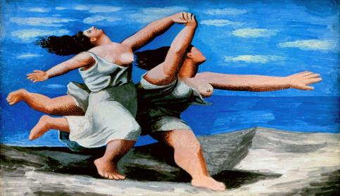

The Psycho- Social Orders of Supervision: Ignorance and Ignominy
Rebecca Webb and Valerie Hey
CHEER
Department of Education
University of Sussex
April 15th 2015
R.C.Webb@sussex.ac.uk and V.Hey@sussex.ac.uk
Notes:
Focus on the ‘doing’ of supervision captured in ‘difficult’ affect-loaded moments.
It was prompted by a specific invitation to think about ‘Shame and Writing’.
It expresses differences : of power (both then and now); career stage; status, as well as differential risks of ‘exposure’ –
it also is shaped more obliquely by social & autobiographical differences of class as well as commitments to care, growing knowledge and pleasurable (and at times painful) identification.

Slide 2

The Thesis Under Supervision:
from Action Research to Deconstruction
A Distance Travelled…
Shifting from; a critical and participatory action research project which involving working with teachers in order to better ‘do’ ideas of ‘equality and ‘diversity’ within the curriculum
To: an ethnographic and deconstructive interrogation of discourses of rights, equality and diversity as performed and practiced in one primary school by a range of actors
Notes:
What was the original project and what did this project become?
A shift of perspective and position : from that of the dynamic orchestrator and critical ‘transformer’ of ‘more effective’ classroom pedagogies : to that of reflexive, post-structural, feminist deconstructor (of dominant schooling discourses of ideas of liberal rights/respect and equality/diversity).
This was not a painless ‘conversion’. It involved messy encounters and entanglements with prior histories, curiosities, and politics. Some of this remaking lay in bringing enduring (unconscious?) ontological and epistemologies commitments into critical scrutiny. This meant ‘letting go’ of some cherished ways of ‘being’ and ‘seeing’ and trying on new ideas.

Slide 3
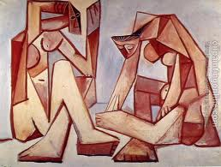
Resources for Thinking With…
Structures, policies and practices of HE
  The changing terrain of HE (Gornall & Salisbury, (2012)
Morphology of internationalised HE domain
  Constructions of supervisor/supervisee relationship (Gilles & Lucey, 2007; Crossouard, 2009)
Micro-social – doing of HE or The Affective Turn
  The ‘emotional labour’ of supervision (Aitchison & Mowbray, 2013);
  Shame as potentially productive (Probyn, 2010)
  Shame as performative and interwoven with processes of subjectification (Butler, 1990, 1993)
  Ideas of privilege, agency and affect (Hey, 2013)
  ‘Discourse’ as mutually constitutive of language/social life, governing the shape and affect of the social (Webb, 2014)
Thinking ‘difference’ and ‘agency’ in teaching and learning
  ‘Baroque’ qualities of shame as affect within Educational (MacLure, 2011)
  Shame as the disrupting of a social ordering (Rancière, 1995)
Notes:
The field of HE studies can be read at multiple scales :
Macro, meso and micro-social – focus on micro offers a more granular analysis of ‘doing’ HE within doc studies, e.g. the way in which gendered, hierarchical power relations operate here, mediated as they are by a range of intersectional ‘differences’ – ‘the pleasures and difficulties, satisfactions and frustrations’ (p.16);
Moreover, the psychosocial or affective turn – a turn within Critical theory that
could be seen to effect how we theorise power – in particular, in Cultural Studies
Elspeth Probyn, on ‘shame’ defined as ‘the body’s feeling of being out-of-
place’). And significantly the influential work of Sarah Ahmed.
Judith Butler conceptualises shame as performative: constitutive of identity
formation and subjectification - an ongoing process and one in which shame may
have it’s place, entailing – as it does – a ‘necessary vulnerability to the other’ .

Slide 4
Where Are We Coming From?
We are both:
Responding to the intersubjective dynamic of the supervisor/supervisee relationship which concerns processes and reflexivity and affects
Reacting against the individualised and individualising management of shame in many: ‘How To’ blogs of managing emotions in HE contexts
Notes:
Working from the premise that affects always intrude that have particular temporalities (there are though particular moments that can be identified in which they are played out; as well as moments in which they can be spoken of) and maybe spoken of as performativities of ‘shame’ (that is – they are not just ‘there’ but they also ’do’ and ‘re-do’).
In particular, Probyn suggests that :
‘shame compels a re-thinking of how we conceptualize the everyday as it is lived’ in ways that can helpfully challenge a ‘moral normativity’ that can seep into the supervisor/supervisee relationship in order to
undermine ‘habitual concepts of guilt’ (2010, p.328)
to which we can all fall prey. These we will come on to explore.
But this presentation is also something of a reaction against the instructive tone of some academic blogs dealing with ideas of ‘shame’. So in these blogs some challenge what is read as a ‘conformity’ of shame, instructing us therefore to be ‘bold and be your authentic self’ http://pittsburghphd.com/tag/shame-based-culture/> [12 April 2013]); while others – such as The Life Coaching blog tells us not to play ball: ‘Most importantly, don’t participate’ in order that we don’t ‘pass the shame along’. We are enlisted to be ‘honour bound to stop it [shame] when it gets to you…’So when you disagree with a colleague, do it with respect’…’Just stop’. Sounds easy, doesn’t it? However, we are not advocating is a line on ‘shame’ taken by the ‘postee’ of this blog on ‘Legally Sociable – pleasant musings on sociology’…May 2012‘ which suggests the application of ‘shame’ as a mode or register that could be: ‘ultimately a labour-saving device for the faculty as well as the student’…’with less wasted effort for all concerned’ (because) the students doesn’t lose time on ‘unproductive lines of inquiry’..

Slide 5
What ideas are we exploring in the vignettes we draw on?
‘Moments’ of sharing writing as piquant, loaded affective/affecting episodes (engagements of the ‘opaque complexity of life and things’) (MacLure, 2010, p. 998)
a ‘one off’ encounter between the supervisor/supervisee outside a supervisory session early on in the relationship. The supervisor responds to a piece of the supervisee’s writing in which the affects of ‘shame’ are integral to the process of writing itself
ongoing over several months within a series of supervisory sessions in which the supervisee struggles with the shame of not being able to shape and craft a chapter of her thesis

Slide 6
Launching…
Rebecca – Supervisee
‘Valerie burst into the room: ‘You can write!’ she declared.
She broke into her ‘Cilla Black Meets Michel Foucault’ ‘gig’.
I was amazed.
Valerie – Supervisor
‘I’m surprised – I suppose - to see just how impactful that banal, convivial moment actually was…But I’m also reminded of the power at work and the echoes of my relationship with my own supervisor’.
Notes:
RW READS THE NOTES – VH RESPONDS THEN
VH - This vignette literally serves as a punctuation mark – almost a reprimand – brings me up short so I experience myself as ‘strange’ – a version of making the ‘familiar’ –i.e. me ‘strange’ – goes to the heart of standing outside the self as a figure of power to an/other.
Education in universities at a doctoral level is intense/ intensely personal in all senses of the word – it is risky – as are the relations which mediate it – but if learning about how knowledge is made and how knowledge changes the self and the world you have to risk shame –
Jacqueline Rose argues ; I would like to live in a world where you didn't have to be ashamed of shame, where we could admit the failings, ambiguities, politically and psychically, that operate in the world - instead of putting people up and shooting them down." And, "A lot of modern political identity is an attempt to get away from the idea that shame is not only something we do (as in to shame) but also something we should be allowed to feel."
And I wonder about the ‘gig’ and what prompted me to shift from ‘the remote figure’ into a ‘clown’? Perhaps I felt that I could risk it under less of an illusion of having to be ‘authoritative’ since Rebecca had ‘got it’?

Slide 7
Landing…
Rebecca – Supervisee
‘I felt so stupid going in and defending my efforts and then feeling that hot, choking sensation as the tears began to well and then break loose…why couldn’t I get this piece of writing ‘right’? God, I felt ashamed…’
Valerie – Supervisor
‘Oh dear – there is certainly something about the irony of overachieving deconstruction…I recognised the paradox implicit in these uncomfortable moments as Rebecca grappled with some reconstitution of her deconstructed text ‘
Notes:
RW This slide is about working my way back into an ongoing supervisory encounter where I struggled with a particular chapter which introduced my own ‘thinking resources’. This aimed to tell a story of ‘rights’ and where they came from using a Foucauldian genealogical approach. Sharing and reflecting upon the writing of this chapter with Valerie became both a reflexive and political act: the writing of ‘shame’ as an integral dynamic of our s/s/ experience (I began the chapter with an ethnographic vignette to this effect); and the responsibility I had to my ‘unknown’ reader/s to ‘make sense’ – building on the expectations of western propositional logics about words being ‘in order’. That there is no escaping this regulatory gaze. In trying to get a balance between deconstruction and the logic of words ‘in order’, I acknowledged the shame of my ‘body’s feeling of being out of place in the everyday’ (Probyn). Importantly, however, the way in which it could rip ‘the habitual out of its everyday stasis’ (ibid) to allow for the sharing with my supervisor the ‘emotional labour’ (Aitchison and Mowbray). I had the sense of sharing my writing in a new way with Valerie at this time: I suspect I yearned for the reassurance of this figure ‘to hold’ me – ‘it’s okay; you’re okay’ and her reassurance in the guise of master craftswoman – ‘it’s meant to go/feel like this. But the vignette I suggest above was never as politically conscious as I may have suggested. My exposure to these emotions in front of Valerie made me feel ‘ashamed’. The breaching the supposed ‘borders between self and other’ (Probyn) were risky – how tiresome they might have been for a supervisor to deal with. But, at some level I clearly judged I could risk this affect and that I needed to risk this – to write better, and to acknowledge the act of writing within supervision as that which is always co-constituted, and dialogically at stake, worried over and ‘improved’: affects play their part in urging me to do better. Aitchison and Mowbray acknowledge the place of emotional labour to motivate students through ‘the discomfort of negative emotions’.
Ranciere might illuminate tension in these 2 episodes – through a reading of supervision as political, anti-foundational resisting practice which is always in the making – working against the logics of the hyper-rational space of a certain knowledge requirement with resultant measures and impacts. And perhaps – like writing – as always work in progress – working against closure as MacLure suggests in evocations of the ‘baroque’ & re-imaginings of the role of educational research.
But we might also read Valerie here as invested in me but not beyond my capability: here she represents another of Ranciere’s idea of ‘the police order,’ albeit of the ‘good’ variety (ref?)

Slide 8
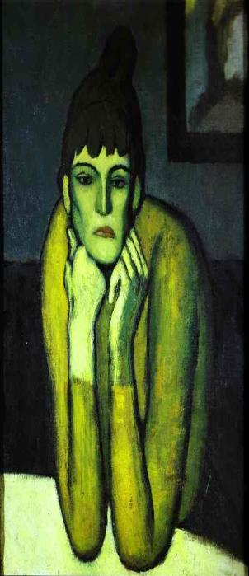
Concluding: So What?
The affects of shame as ‘the body’s feeling of being out-of-place in the every day’ (Probyn, 2010, p.328) are intrinsic to the social such that they can’t be disinfected away…
This is especially so in the intimate confines of the HE supervisor/supervisee relationship where…
‘agency is affectively charged by the distribution of affects…so that power relations can better be grasped and contested if we see emotion, desire and feelings as their currency and consequence…’
(Hey, 2013, p. 121)
Notes:
In conclusion - I think we want to go back to our central propositions of shame as productive - that which is inherent to an affective register which suffuses the head, heart, body business of ‘doing’ pg study. ‘Shame’ just ‘is’ part of the way in which we make sense of the social world.
And writing is social : ‘Perhaps the most crucial discovery, and this applies to the dissertation as a whole is that I cannot write without hearing others' voices -the voices that make up my entire reading history. I have a very real sense that these words are not my words and my reading of Bakhtin tells me that in a sense they are not. ‘ (June Levinson, quoted in Miller, 1996, 274 emphasis added, and taken from Hey, 2013, p.115 )
But more than this we want to go a step further, to invoke affects so they become more prominence in understanding the tussles of pedagogy ; here being deconstructive can be used as a pedagogic supervisory practice that is inextricably relational, can be reflexively acknowledged not least because these encounters are unlikely to be inconsequential to how power, learning and labour are experienced.

