Slide 1

Boys from the Black Country
The educational expectations of white working-class males
at a school in the West Midlands
Alex Blower, PhD student
Supervisors: Dr Maria Tsouroufli, Professor Nazira Karodia, Professor Jackie Dunne

Slide 2
Background
Only around 10% of white British men from the most disadvantaged backgrounds go into higher education; they are five times less likely to go into higher education than the most advantaged white men. Participation by this group is also significantly lower than participation by the most disadvantaged from BME backgrounds: the participation rates for men of black Caribbean heritage are over 20%; for men of Indian heritage they are nearly 50%; and for men of Chinese heritage they are over 60%. (p.38)
Department for Business, Innovation and skills (2015)

Slide 3
Study progress
Data collection completed
Began preliminary analysis
Entering third and (hopefully) final year
Department for Business, Innovation and skills (2015)

Slide 4
How do white working-class males negotiate educational success?
Willis (1977)
Ingram (2018)
Ball (2005)
Archer (2014)
Khattab (2015)
Reay (2002)
Gender
Ethnicity
Class

Slide 5
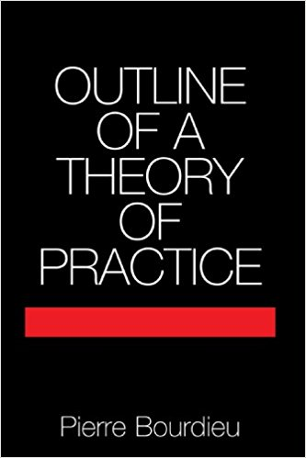
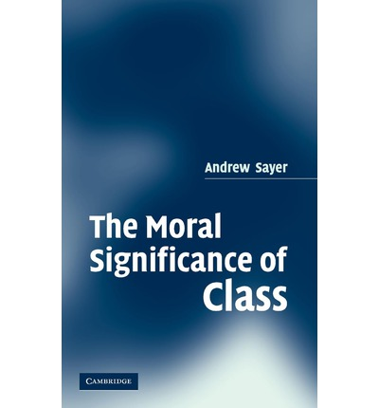
Conceptual Framework
Ethical Dispositions
Habitus
Field
Capital
Bourdieu (1977), Sayer (2005)

Slide 6
Research Questions
• How do teaching staff at the school understand the expectations of white working-class male students for their future in education?
• How are the expectations of a white working-class male student about the future shaped by the experiences of their social networks?
• How do white working class males negotiate expectations regarding their educational future within the institution of the school?

Slide 7
Qualitative Method
The task is to investigate some aspect of the lives of people who are being studied, and this includes finding out how these people view the situations they face, how they regard one another, and also how they see themselves (2007, p.3)
‘Pascal warns us, writes Bourdieu, against ‘two extremes: to exclude reason, to admit reason only’ (1999:72). Most basically we are interested in recording and presenting the ‘nitty gritty’ of everyday life, of how the ‘meat is cut close to the bone’ in ordinary cultural practices, and presenting them in ways which provide maximum illumination for readers (2000, p.12)
Hammersley and Atkinson (2007), Willis and Trondman (2000)

Slide 8
Participant Observation
(4 months)
Semi structured interviews
(19 participants)
Hammersley and Atkinson (2007), Spradley (2016)
Notes:
Initial participant observation with white working-class male students currently in year 10 at West Midlands Academy. Aims to build rapport and trust amongst students and teachers. Also provide rich contextual information to inform interviews
Semi structured interviews with teachers, students and social networks with a relationship to West Midlands Academy

Slide 9
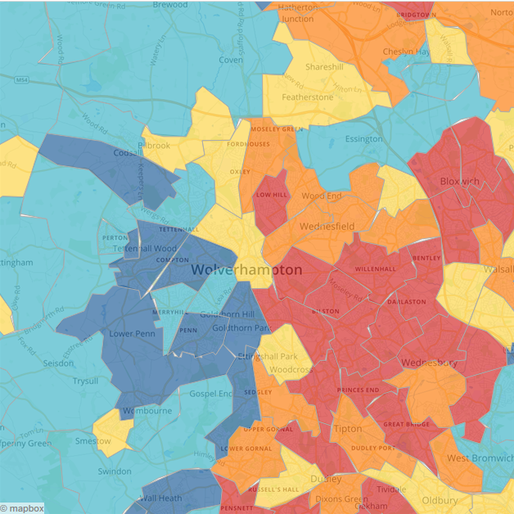
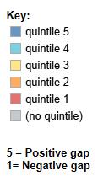
Locating the study
http://www.hefce.ac.uk/analysis/yp/gaps
http://www.hefce.ac.uk/analysis/yp/gaps/

Slide 10
Social Conditions of Young People in
Wolverhampton
“It may be that in order to grapple with the ‘new social condition’ of the young unemployed we need a fundamental shift in perspective and philosophy. The really fundamental thing to recognise is that unemployment amongst young adults is a social structural condition in to which the young people are thrown, rather than an individual phenomenon which is produced by indolence or incapacity in the individual. We need to attend to the nature and needs of this collective condition” (p.235)
Willis (1984)

Slide 11
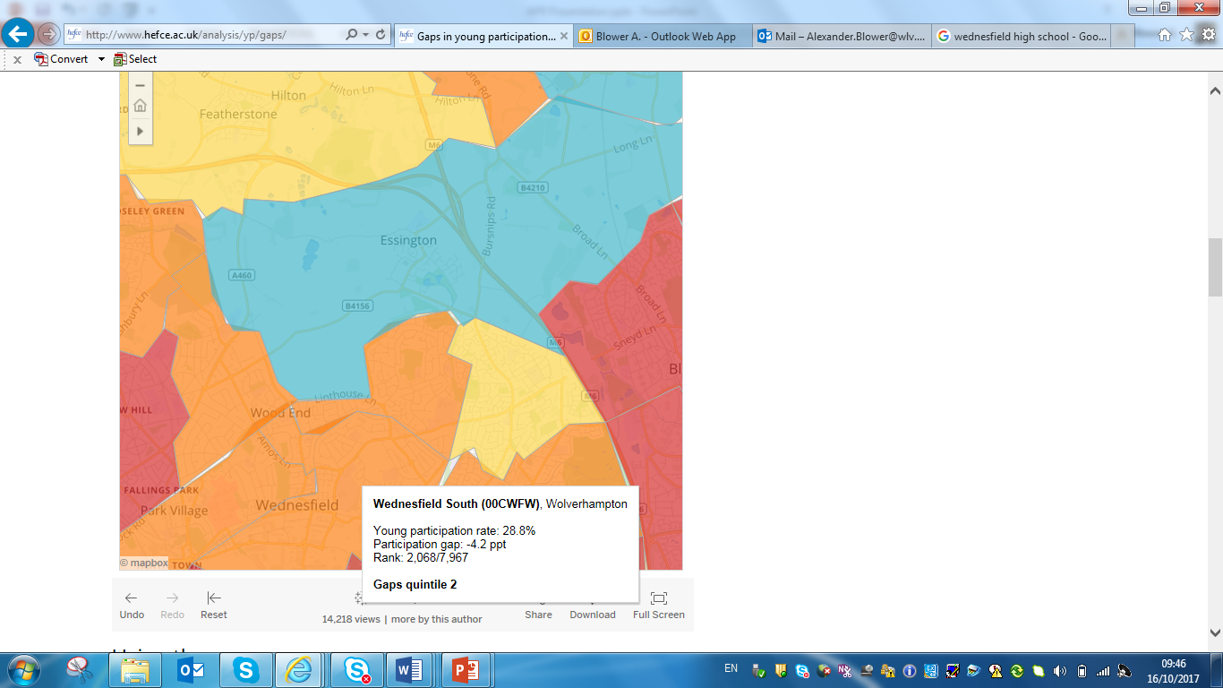
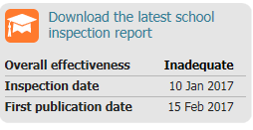
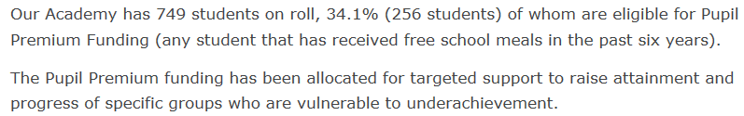
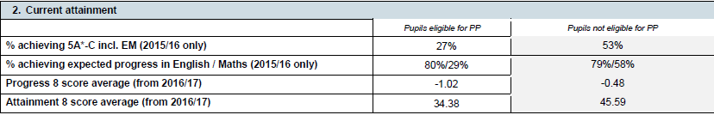
The School

Slide 12
Data Collection
Participants | School Roles | Method of Data Collection
Mr CJ | Head teacher | Semi structured interview
Miss B | Head of Sixth Form | Semi structured interview
Miss D | Teacher and Ex SLT | Semi structured interview
Mrs DJ | Behaviour Lead (KS3) | Semi structured interview
Mr Jamerson | PE Teacher and ex Assistant Head | Semi structured interview
Mrs Pol | School careers advisor | Semi structured interview
Mr AD | Teacher | Semi structured interview
7 interviews with teaching staff at the West Midlands High School

Slide 13
Data Collection
Participants | Methods of Data Collection | Network Members Interviewed
JC ( year 10/11 student) | Participant Observation 2 interviews | Mom and Gran
DV (year 10/11 student) | Participant Observation 2 interviews | Mom and 2 cousins
Mr D (staff member and ex student) | 1 Interview | Mom, Dad, Wife, Mentor
4 months participant observation (weekly hour long one to one sessions)
Semi structured interviews with core participants and members of their social network
Heath et al. (2008)

Slide 14
Mr D
White working-class background
First in his family to enter in to HE
Ex student of West Midlands High School
Attended Midlands University and qualified as a teacher
Worked as a PE teacher at the school for the last 9 years
Interview focused on his journey in education and his reasons for making decisions about his future education and career

Slide 15
Accruement of resources through education
Relationship with the local community
Negotiating expectations within social network

Slide 16
Accruement of resources through education
‘Well it’s a, it’s a stage by stage process isn’t it you know. Securing my degree, getting the right grades for that. Next challenge was to secure my teacher training, now that in PE is not an easy thing to do. PE is a hugely popular subject and so you really do have to set yourself apart to be able to get on to those post graduate courses’
‘So at that point then I knew if I wanted to be a teacher I needed a degree so I would have to go to university. But it was also the financial aspect as well. So you know we were constantly being told that financially in 5,10,15 years you will be better off compared to someone without a degree so there was those 2 main factors really’
‘yeah obviously that, the year here as a teaching assistant really really helped me to secure that teacher training course, erm and again sort of allowed me to decide whether or not this was the right thing for me’
Notes:
Shaped his future pathway by breaking down his end goal in to a stage by stage process. In doing so the aspiration of being a teacher gained substance, becoming more tangible.
Perceived engagement in education as a vehicle toward a secure financial future, bought in to the narrative around deferred gratification.
Engaging in experience as a teaching assistant at the school equipped Mr D with necessary social and cultural resources after his degree to secure a place on his PGCE and allowed him to give teaching a ‘test run’.
Later also contributed to his success gaining paid employment at the school

Slide 17
Relationship with the local community
‘So I decided not to stay on campus, decided to commute purely because it was at Midlands University. If it was elsewhere further out, I would have definitely stopped on campus and secured some form of accommodation, but at the time I just didn’t think it was financially worthwhile when I could commute and it would only take sort of half an hour to drive to the campus’
‘the students can identify with the way I am, the way I talk, you know, my demeanour. They know, you know, they know if you’re from here or not, they ent stupid. Erm and that has helped me I think along the way, particularly in the role I’m in you know, dealing with erm behaviour, talking to parents and so on. You know you can sort of relate to that’
‘You know parents still live near to the school, that that group of friends that I mentioned to you earlier all live in this area. Every single one of them. Brother lives across the road, erm, you know so so it is, West Midlands Village is a massive part of my life, yeah it’s a huge part of my life’
Notes:
Decided to stay at home to study to avoid financial burden of extra debt, as the drive was only half an hour commuting to university was convenient. Staying local also allowed Mr D to maintain pre existing relationships with friends and maintain link to the local community.
Although Mr D now lives with his wife approximately 10 miles away his immediate family still live in West Midlands Village and views the town as an important part of his life
Mr D views his links to the local area as an advantage in his role as a teacher at West Midlands High. He believes the students identify with him as a ‘local lad’ and this helps with his rapport with parents.

Slide 18
Negotiating expectations within social
network
‘So you’ve got carpenters, erm one of my friends works for an energy supplier in sales, erm one of my friends is an architect but didn’t go to university after school……… but in terms of my peer group now, and my friends that I see regularly on a week to week basis, I’m literally the only one who went to university out of that group’
‘my mom had a little more, more knowledge of it (education). Didn’t go to university herself but erm, but went to a girls high school and obviously was exposed to you know, further education a little bit more, and she was the one who erm who sort of guided me’
‘Mr Jamerson was my PE teacher when I was here at school, and he was my main point of contact, so anything I needed to know, I could pop in anytime. Right what degree do I need? Where do you do your coaching qualifications? Can I come and do this? Can I come and help with this? And he was always you know, it was always there for me if I needed it’
Notes:
In attending university Mr D followed a very different educational trajectory to his friendship group, with him being the only one who entered in to HE.
Having attended a Grammar School herself, Mr D’s mother placed a high value on Higher Education and Mr D drew on her as a resource when engaging in educational decision making
Mr D’s engagement with Mr Jamerson provided an informal source of knowledge about the teaching profession, and opportunities to engage in activities which equipped Mr D with the tools he needed to realise his ambitions. Mr D still engaged with Mr Jamerson after he left school to secure experience with teaching and coaching.

Slide 19
Through Mr D’s choices with regard to education and work he has maintained a strong ties within the local community of West Midlands Village, whilst at the same time accruing resources which have allowed him to secure a job as a teacher.
Mobilising the knowledge and networks of Mr D’s mother and his old PE teacher equipped Mr D with the resources required to strategically engage with educational opportunities in order to shape his expectations toward his future career.
Access to such resources facilitated an educational trajectory which differed from the rest of his peer group.

Slide 20
Social Network Interviews
Mr D’s Mother
From a working-class background
Born in West Midlands Village
Attended a local Grammar School for girls.
Left education at 16 (first year of A Levels) after securing an apprenticeship
Mr D’s Father
From a working-class background
Born in West Midlands Village
Attended a local Secondary Modern
Left education at 16 after securing an apprenticeship as a press tool maker
Mr D’s Wife
From a working-class background
Born in a town 10 miles from West Midlands Village
Attended University and qualified as a teacher
Met Mr D at West Midlands High where she was head of Sixth Form
Mr Jamerson
From a working-class background
Attended a school located 1.5 miles from West Midlands Village
Went to university
Works as a PE teacher West Midlands High and mentored Mr D when he was a student

Slide 21
Challenges
Access to a suitable location for the study
Building rapport with 14/15 year old boys
Continual evaluation of my positionality throughout data collection
Defensiveness from certain staff with regard to my role as a researcher
Being very far down the staff’s list of priorities when it came to setting up/sticking to agreed timings for meetings and interviews
Maintaining clarity on my role as a researcher within the school
Notes:
Design
Why have I decided to adopt a stance that’s informed by a Bourdieusian model, as opposed to one that is more heavily positivist or less structural and aligned to methodology such as CDA?
What design frame am I adopting i.e. Case Study and Evaluation as opposed to action research or an experiment?
Participants
Have I taken a representative sample or have I just selected these people at random?
How have I decided that it was white working class males in the Black Country region and those that were within their networks that would participate in the study?
Positionality
A reflexive account of how my experiences both inside and outside of academia may have a bearing on the study:
Upbringing
Educational experience
Values as an outreach professional
Political views?
Ethics
How have I started to address ethical issues since I started to consider them?
What steps am I staking to make sure that I’m working within ethical guidelines?
Data Gathering and Materials
Why am I using the tools that I am in order to gather data?
Am I ensuring my methods will allow for triangulation?
What software will I be using to analyse the data?
How will I operationalise Bourdieu’s tools of capital, habitus and field in order to analyse the data?
Procedure
What is it exactly that I’m asking the participants to do?
How and when am I going to use my instruments for data gathering and analysis?
What steps am I taking, and in what order?

Slide 22
References
Archer, L., DeWitt, J. and Wong, B. (2014) Spheres of influence: what shapes young people's aspirations at age 12/13 and what are the implications for education policy? JOURNAL OF EDUCATION POLICY [online], 29(1), pp. 58-85
Ball, S.J. (2005) Education policy and social class: The selected works of Stephen J. Ball. [online] Routledge.
Bourdieu, P. (1977) Outline of a Theory of Practice. [online] Cambridge university press.
GREAT BRITAIN, Department for Business, Innovation and skills (2015) Fulfilling our potential: Teaching Excellence, Social Mobility and Student Choice, [online]. Cm 9141.
Hammersley, M. and Atkinson, P. (2007) Ethnography: Principles in practice. [online] Routledge.
Heath, S., Fuller, A. and Paton, K. (2008) Network-based ambivalence and educational decision-making: a case study of 'non-participation' in higher education. Research Papers in Education [online], 23(2), pp. 219-229
Ingram, N. (2018) Working-Class Boys and Educational Success : Teenage Identities, Masculinity and Urban Schooling. [online] London: Palgrave Macmillan Limited
Khattab, N. (2015) Students’ aspirations, expectations and school achievement: what really matters? British Educational Research Journal , 41(5), pp. 731-748 .
Reay, D. (2002) Shaun's Story: Troubling discourses of white working-class masculinities. Gender and Education , 14(3), pp. 221-234 .
Sayer, R.A. (2005) The moral significance of class. [online] Cambridge: Cambridge University Press
Spradley, J.P. (2016) Participant observation. [online] Waveland Press.
Willis, P.E. (1977) Learning to labor: How working class kids get working class jobs. [online] Columbia University Press
Willis, P. and Trondman, M. (2000) Manifesto for ethnography. Ethnography [online], 1(1), pp. 5-16

Slide 23

Questions?

