Slide 1



Diversity, Democratisation and Difference: Theories and Methodologies
“What We See Never Resides in What it Says”:
Desirable Subjectivities in Affirmative Action Policies in Chilean Higher Education
“The Treachery of Images”, Magritte
“False Mirror”, Magritte

Slide 2
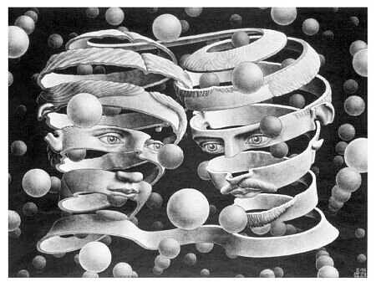
Introduction
Describe main governing rationalities
  Assemblage of specific affirmative action programmes
  Desirable subjects of higher education
Locus of Power:
Sociology
Behavioural Psychology
Management: Ontological Coaching

Slide 3
What are said to be affirmative action policies
Measures favouring groups recognised as harmed by institutional workings of the education system.
Challenges policy discourses that favoured inequality
“Look, I've seen the figures, the charts, the evidence showing that these students do better or similar as the traditional students. But I cannot imagine those kids in this university. Can you imagine! it's impossible” (Vice-Chancellor of Academic Affairs, Policy leader, Public University, my own translation)
% of Students Inscribed for taking the National Entrance Test and got selected by Universities according to students' schools type. Admission Process, 2013

Slide 4
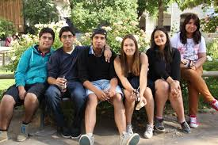
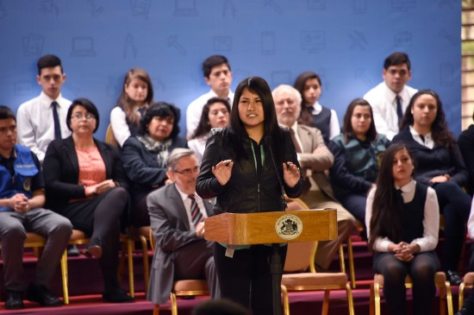
What are The UNESCO Induction Access Programmes?
Aim of the programmes:
  to restore the right to higher education to students from vulnerable sectors, guaranteeing places in higher education to students who meet the requirements of the programme (MINEDUC, 2016)
  Legitimacy: Re-engaging with meritocracy ≠ inequality
How?
  Selecting the best students from low socioeconomic school backgrounds, according to their academic performance
      Pre-entry interventions: Maths, Language, and Personal Management (Ontological Coaching)

Slide 5

What is a Desirable Subjectivity
Discourse:
  Epistemological and ontological assumptions, and related social knowledges, which configure unexamined forms or regimes of truth from which policies and subjects are formed and practiced- (see, Bacchi and Goodwin, 2016).
  How a subject is shaped by a discourse or multiple discourses?
Desirable subjectivities
Desirable | Undesirable
Wanted Valued Attractive’ Appealing’ Useful’ Necessary Advantageous Profitable Recommendable Preferable Sensible | Disposable Rejected Abject Unfavourable Foolish Out of reasonability (insane) Imprudent

Slide 6

What is the desirable subject produced in the formation of this affirmative action policy?
Sociological rationality
Sociological discourse as meaningful context of desire of AAP
Social mobility as the “rationality of inclusion”
“Social mobility occurs when individuals from traditionally excluded socio-economic groups access high-status positions and / or manage to develop into social positions of greater well-being ... In general, social mobility is associated with merit, that is, promotion in the stratification through their own efforts. In other words, it is the opposite of concepts such as classism and social exclusion” (2011, my own translation)”

Slide 7

What is the desirable subject produced in the formation of this affirmative action policy?
Psychological Rationality
fabricating, visualising, and inscribing working class as talented, proper subjects of higher
Attitudinal and motivations scales
Overcoming classism in HE by rejecting working class lives?
“Be a professional”. This constitutes a positive identity…education in the university, acquires a relevant assessment and opposes “being a worker” as this situation is associated with people who are outside the university or do not study in it. To be professional (+): In the university, good salary, with knowledge, happy, to have family, to be a contribution. Proud of myself. Being a worker (-): out of college, poor, ignorant, frustrated, unbalanced, being a burden (2013, p. 270, my own translation).
... these young people are represented and presented as a different type of student. A student who stands out because his merits and gifts are not associated with the social class from which they come (2013, p. 276, my own translation).

Slide 8

What is the desirable subject produced in the formation of this affirmative action policy?
Managerial Rationalities: Ontological Coaching
Dominant technology of emotional and dispositional "activation" of working class students
From business/management field
Emotional capitalism/therapeutic governmentalities
Attacks suffering and inefficiency
[These world maladies are the result] of our own blindness, incompetence and ignorance…and [the result of] not realizing the immense transformative potential we have. This results in a significant loss of our effectiveness and productive capacity (Echeverria 2011, p. 13).
The solution: To transform ourselves unleashing our “will to power” through ‘[our] own self-improvement, transforming oneself into the kind of being that each aspires to be." (Echeverria 2011, pp. 46-47).

