Slide 1

Embodying Critically - Who Gets to be a Critical Thinker in Higher Education?
BERA 2017 - DISRUPTING AND DISTURBING DOMINANT DISCOURSES IN HIGHER EDUCATION
DR EMILY DANVERS
e.danvers@sussex.ac.uk

Slide 2
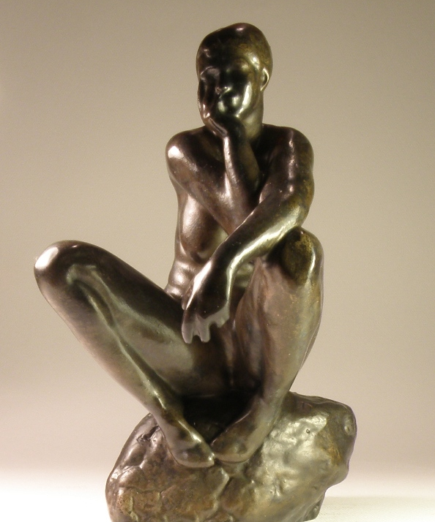
‘The melancholic migrant holds onto the unhappy objects of differences, such as the turban, or at least the memory of being teased about the turban, which ties it to a history of racism. Such differences become sore points or blockage points, where the smooth passage of communication stops. The melancholic migrant is the one who is not only stubbornly attached to difference, but who insists on speaking about racism, where such speech is heard as laboring over sore points’.
(Ahmed, 2010, p. 48)
CENTRE FOR HIGHER EDUCATION AND EQUITY RESEARCH
The Contingency of Criticality?

Slide 3
CENTRE FOR HIGHER EDUCATION AND EQUITY RESEARCH
Dominant Discourses of Criticality
Critical thinking as a desirable graduate outcome e.g.
    ‘The skills that great higher education provides – the ability to think critically and to assess and present evidence – last a lifetime and will be increasingly in demand’(Department for Business, Innovation and Skills, 2016, p. 5).
Critical ‘beings’ (Barnett, 1997) predominantly conceptualised as unspecified bodies in policy, pedagogical practice and in ‘rationalist’ theorisations of CT (e.g. Halpern, 2003; Bailin and Siegel, 2003; Paul and Elder, 2006).
CT as embodied, contextual and contingent (Danvers, 2016) - a negotiated process sustained by ‘multifarious capillaries of associations and action’ of texts, materials and bodies’ (Fenwick and Edwards, 2013, p.37).

Slide 4

CENTRE FOR HIGHER EDUCATION AND EQUITY RESEARCH
Critical, feminist analysis
Research with 1st year UK social science students (15 interviews, a focus group with 4 students, 3 months of participantish classroom observations).
Following around critical thinking, interrogating how it is conceptualised, embodied and regulated.
Using Sara Ahmed’s (2010, 2012) and Karen Barad’s (2007) feminist theorisations to explore how criticality legitimates itself through/with structures of power

Slide 5
1. Critical beings as gendered beings
90% students associated criticality with masculinity. Students reproducing traditional gendered discourses about knowledge and authority e.g. the association of rationality and masculinity:
‘He’s a huge reflector, he’ll always sit quietly, take everything in, churn it over, think about it and then he’ll come back to you, several days later when you’ve completely forgotten about the conversation and he’ll suddenly want to talk to you about it and he’s been thinking about it. And he’ll come out with more points and ask you what your feelings are on it. I think he’s naturally a critical thinker – if there is such a thing - I think if anyone is, it’s my Dad.
… My sister has noticed that my vocabulary has already changed; she said you already sound like a professional, coming out with more theories and ideas and questioning things…I don’t want to come across as the sister who is at university who is telling her what to do. [Laughs]. Know it all Kate again!’
Kate, Interview

Slide 6
2. A polished performance
Becoming critical as a polished performance, reliant on the intersection of classed, gendered and racialised norms about what constitutes a legitimate critical voice:
‘I think you are more likely to offend…if you go in like a bull in a china shop and say ‘I think this’ and ‘I think that’. So instead of just throwing your opinions out without any sort of education, you are learning how to say things, when to say them and where to get the information from to support you…and the whole sort of, your body language, the way that you talk, what you wear. Because everyone judges everyone, you can’t help it. Whether you discriminate against them or not, you do judge people. So if I walked in here wearing a headscarf you'd think a different thing than if I was wearing a mini-skirt and a crop top. It’s just different. To know in different situations how to dress, how to speak, how to maintain eye contact.’
Carly, Interview

Slide 7
3. Working harder to become ‘confidently’ critical
Bodies marked as ‘Others’ have to work harder to construct themselves as confidently critical voices:
‘Well, I’d want to know my facts because it concerns me when I sit in things like seminars, I think I’m not confident with my answer, I don’t want to say…I’m very aware of that I think. So I think I’d want to be sure that I really had looked into it and I was confident in what I was saying. Because otherwise it is going to show and it feels rubbish when you don’t feel confident. So I think in the story, because I wasn’t familiar with it…I can honestly tell you that I’d been completely unaware of who is on the bank notes. So I’m really uninformed of this, so it is kind of a bit hard to put an opinion when I actually don’t have the knowledge behind it…It does force you to really know your stuff doesn’t it?’
Bronwyn, Focus Group

Slide 8
Disrupting/Disturbing Criticality
CENTRE FOR HIGHER EDUCATION AND EQUITY RESEARCH
Critical thinking is not undertaken by generic critical beings) but critical bodies located in the particularities of their social characteristics and the multiple intersecting impacts of these differences upon their own experiences (Danvers, forthcoming).
What a critical thinker is like circulates and gets reproduced along normative lines through powerful discourses of what and whose knowledge counts (Barad, 2007)
Becoming and feeling legitimate as a critical thinker in higher education is more problematic for marginalised students than those traditionally at home in the academy (‘ideal’ theorised by Leathwood and O'Connell, 2003).
Access to higher education’s intellectual premiums as inequitable!

Slide 9
References
CENTRE FOR HIGHER EDUCATION AND EQUITY RESEARCH
Ahmed, S. (2012). On Being Included: Racism and Diversity in Institutional Life. Durham [N.C]: Duke University Press.
Bailin, S. and Siegel, H. (2003) Critical Thinking. In N. Blake, P. Smeyers, R. Smith and P. Standish (eds.) The Blackwell Guide to the Philosophy of Education. Oxford: Blackwell, pp. 181-193.
Barad, K. (2007) Meeting the Universe Halfway: Quantum Physics and the Entanglement of Matter and Meaning. Durham, NC: Duke University Press.
Barnett, R. (1997) Higher Education: A Critical Business. Buckingham: SRHE.
Danvers, E. (2018) Re-thinking pedagogies of critical thinking. In: Scantlebury, K. & Taylor, C. (eds.) Turning feminist theory into practice: enacting material change in education. Sense Publishers, Rotterdam.
Danvers, E. (Forthcoming) Who Occupies a Desirable Subjectivity as a Critical Thinking Student? Teaching in Higher Education – (Under Review)
Department for Business Innovation and Skills (BIS) (2016). Success as a Knowledge Economy: Teaching Excellence, Social Mobility and Student Choice. London: BIS.
Fenwick, T. and Edwards, R. (2013) Networks of Knowledge, Matters of Learning and Criticality in Higher Education. Higher Education, 67, pp. 35-50.
Halpern, D.F. (2003) Though and Language: An Introduction to Critical Thinking. Mahwah, NJ: Lawrence Erlbaum.
Leathwood, C. & O'Connell, P. (2003) ‘It's a Struggle’: The Construction of the ‘New Student’ in Higher Education. Journal of Education Policy, 18 (6), 597-615.
Paul, R. & Elder, L. (2006) The Miniature Guide to Critical Thinking: Concepts and Tools. Tomales, CA: Foundation for Critical Thinking.

