Slide 1
Women and Higher Education Leadership:
An Object of Desire or Something to be Avoided?
CENTRE FOR HIGHER EDUCATION AND EQUITY RESEARCH
Professor Louise Morley

Slide 2
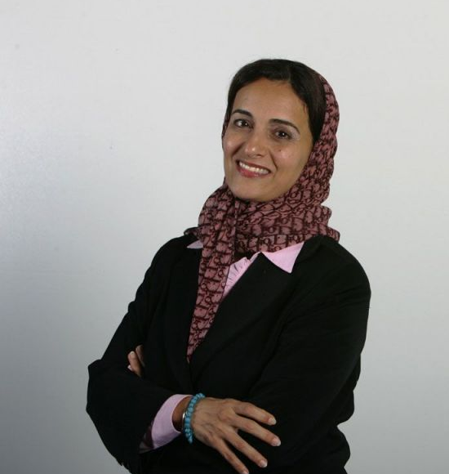
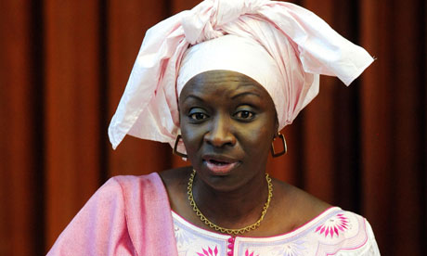
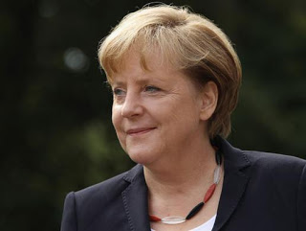
Making Women Intelligible as Leaders?
Why so few?
What is it that people don’t see?
Why don’t they see it?
What do current practices reveal and obscure?

Slide 3
Women Vice-Chancellors:
Leading or Being Led?
SWD | UK | EU | HK | JAP | USA
50% | 22% | 15.5% | 0% | 2.3% | 26%

Slide 4
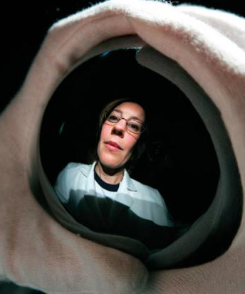
Leadership Potential
Observable
Separate
Static structure?
OR
Contingent
Contextual
Co-produced?

Slide 5
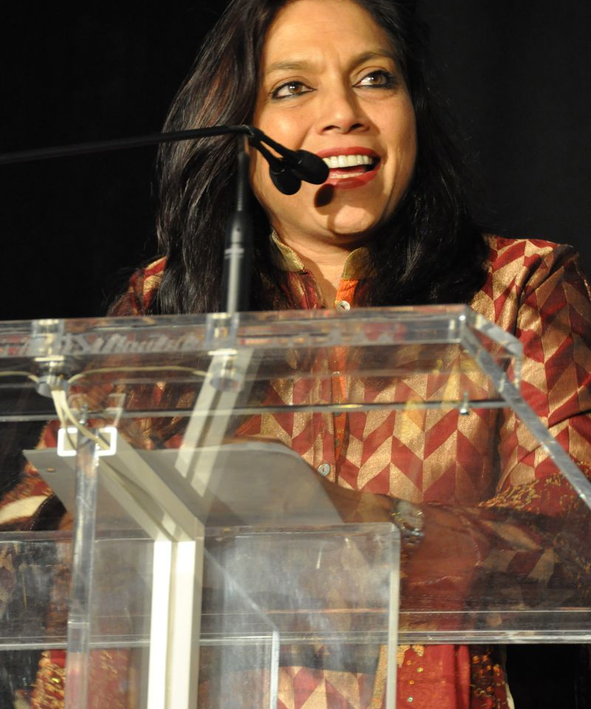
Gendered Pathways: Prestige Economy
Women less likely to be:
Journal editors/cited in top journals
Principal investigators
On research boards
Awarded large grants
Awarded research prizes
Conference keynote speakers
High earners e.g. 16.5% Gender Pay Gap in UK universities
(compared to 9.7% for all sectors).

Slide 6
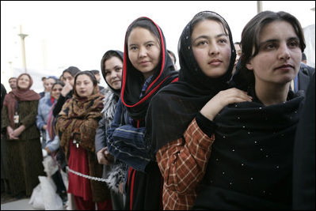
Consequences of Absences?
Employment / Opportunity Structures
Misrecognition of Leadership
Potential / Wasted Talent
Distributive Injustice
Gender Pay Gap
Depressed Career Opportunities
Service Delivery
Knowledge Distortions
Cognitive / Epistemic Injustice
Reproduction of Institutional Norms and Practices

Slide 7
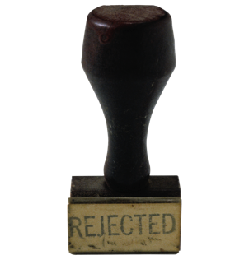
Explaining the Absences
Poor assessment practices of merit/leadership suitability
Gender Bias/ Misrecognition
Management & Masculinity
Institutional Practices
Greedy Organisations
Socio-cultural messages
Gendered Divisions of Labour
Women’s Missing Agency/ Deficit Internal Conversations
Counting more women into existing systems, structures and cultures = an unquestioned good/ transformative?

Slide 8

A Two-Way Gaze?
How are women being seen e.g. as deficit men?
How are women viewing leadership e.g. unliveable lives?
What narratives circulate about:
Women’s Capabilities?
Leadership?

Slide 9

Gender as a Verb
Gender:
Not just a noun or demographic variable.
Formed/ Reformed in
Organisational Cultures
Social contexts
Sociology of Absences?

Slide 10

The Affective Economy of Identity Work
Expectation of Excoriation (Roth 2016)
Working with resistance, recalcitrance, truculence, ugly feelings
Authority - Does not ‘stick’ to (some) women?
Colonising colleagues’ subjectivities towards the goals of managerially inspired discourses
Managing self-doubt, conflict, anxiety, disappointment & occupational stress
=
Restricting not
Building capacity and creativity

Slide 11
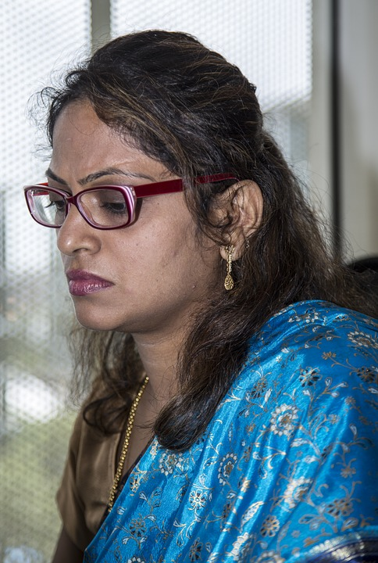
Willfulness and Willingness (Ahmed, 2014)
Leadership often experienced as:
Fragile
Precarious
Conflict-ridden
Refusal to aspire to leadership:
Strategic decision-making
Resistance

Slide 12

Evidence
South Asia
Literature/ Policy Review
Interviews- 19 women and 11 men
Afghanistan, Bangladesh, India, Nepal, Pakistan and Sri Lanka (Morley & Crossouard, 2016).
Malaysia
36 Questionnaires/ 1 Focus Group (Morley et al, 2016)
East Asia and MENA
20 Questionnaires/ 3 Discussion Groups
Australia, China, Egypt, Hong Kong, Indonesia, Japan, Jordan, Kuwait, Malaysia, Morocco, Pakistan, Palestine, the Philippines, Singapore, Thailand and Turkey (Morley, 2014, 2015).
What makes leadership attractive/unattractive to women?
What enables/ supports women to enter leadership positions?
Personal experiences of being enabled/ impeded from entering leadership??

Slide 13
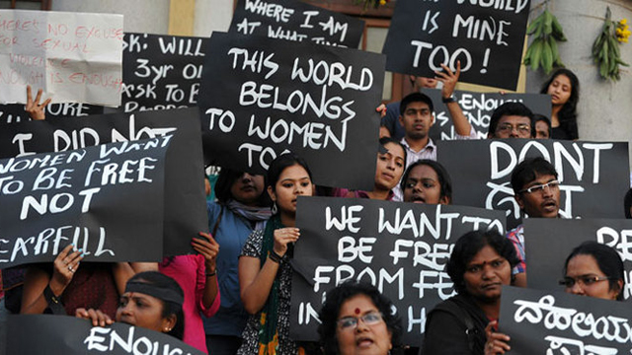
What Attracts Women to Senior Leadership?
Power
Influence
Values
Rewards
Recognition

Slide 14

Why is Senior Leadership Unattractive to Women?
Neoliberalism/ Performance Cultures
Being ‘other’ in male-dominated cultures
Misogyny
Gendered authority
Disrupting the symbolic order
Financialisation
Pre-determined scripts

Slide 15
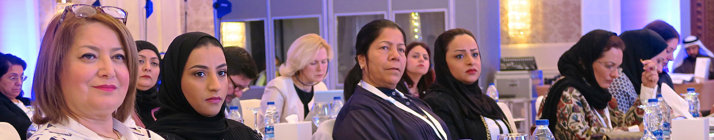
Barriers
Power of the Socio-Cultural/ Gender Appropriate
Social Class and Caste
Lack of Investment in Women
Organisational Cultures
Perceptions of Leadership
Recruitment and Selection
Family
Gender and Authority
Financialisation/Corruption
Enablers
Policies (and accountability)
(Affirmative action, gender mainstreaming, work/life balance, gender pay)
Women-only Provision
(Leadership development/ universities)
Mentoring
Professional Development
Family
Evidence
(Research/ Gender-Disaggregated Statistics)
Investment/ Resources
Internationalisation

Slide 16
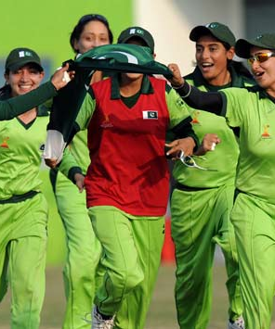
Moving On: What are We Asking Women to Lead?
Women are
Rejected
Refusing/ Self-Excluding
Reluctant
Change
Not counting more women into existing structures/ scripts/systems/gendered cultures.
Can Leadership:
Narratives
Practices
Be more than discursive performances/repetitions of:
Values
Regulative norms
of the neoliberal global academy?
Need for
Re-visioning of Leadership
Generative, Generous and Gender-free.

Slide 17

Follow Up?
CHEER Website: www.sussex.ac.uk/education/cheer
Twitter:
@SussexCHEER
Facebook: www.facebook.com/groups/CHEERSussex

Slide 18
Follow Up?
Morley, L. & Crossouard, B. (2017) Women in Higher Education Leadership in South Asia: Willfulness and Willingness. In, Morley, L. (ed) Europa World of Learning 2017 Essays on Gender Equality. London: Routledge.
Morley, L. and Crossouard, B. (2016). "Gender in the Neoliberalised Global Academy: the Affective Economy of Women and Leadership in South Asia." British Journal of Sociology of Education 37(1): 149-168.
Morley, L., & Crossouard, B. (2016). Rejection, Refusal, Reluctance, Revisioning: Women in Higher Education Leadership in South Asia. Studies in Higher Education. 46(5), 801-814.
Morley, L. Berma, M., and Dato' Hj Abdul Hamid, B. (2017) Managing Modern Malaysia: Women in Higher Education Leadership. In, Eggins, H. (Ed) The Changing Role of Women in Higher Education: Academic and Leadership Challenges. Dordrecht: Springer Publications.
Morley, L. & Crossouard, B. (2015) Women in Higher Education Leadership in South Asia: Rejection, Refusal, Reluctance, Revisioning. Pakistan: British Council.
Morley, L. (2014) Lost Leaders: Women in the Global Academy. Higher Education Research and Development 33 (1) 111–125.
Morley, L. (2013) "The Rules of the Game: Women and the Leaderist Turn in Higher Education " Gender and Education. 25(1):116-131.
Morley, L. (2013) Women and Higher Education Leadership: Absences and Aspirations. Stimulus Paper for the Leadership Foundation for Higher Education.
Morley, L. (2013) International Trends in Women’s Leadership in Higher Education In, T. Gore, and Stiasny, M (eds) Going Global. London, Emerald Press.

