Slide 1
Coaching in Higher Education: Light and Shadow
CENTRE FOR HIGHER EDUCATION AND EQUITY RESEARCH
Dr Mariam Attia

Slide 2

The Drive to Thrive
Whether one calls it a growth tendency, a drive toward self-actualisation, or a forward-moving directional tendency, it is the mainspring of life … It is the urge which is evident in all organic and human life – to expand, extend, become autonomous, develop, mature – the tendency to express and activate all the capacities of the organism, to the extent that such activation enhances the organism or the self” (Rogers, 2004, p. 35)
What is Coaching?
Notes:
Draws on different disciplines

Slide 3

What is Coaching?
“Partnering with clients in a thought-provoking and creative process that inspires them to maximize their personal and professional potential”
(Grant, 2007)
Ethical and non-judgmental
Facilitating the coachee’s progression from exploration to discovery to action following a set of specific moves.

Slide 4

Reflect

Slide 5

Relate

Slide 6

Focus

Slide 7

Clarify a Goal

Slide 8

Trail Procedure

Slide 9
Coaching in Higher Education
Adopted by several universities in the UK with some investing in building in-house capacity
Offers a safe space for thinking and reflection
Can be applied to purely intellectual matters, to project planning or career progression, to the formulation of research ideas or funding proposals, or to other issues of personal or interpersonal significance.
Recognised as an effective approach to staff development in higher education (Iordanou, Lech and Barnes, 2015).

Slide 10
A Changing Higher Education
Increasingly governed by market ethos
Academic cultures of performativity
(Ball, 2012; Olssen & Peters, 2005)
Knowledge as a commodity and students as customers
International students as primarily revenue-generating
Fierce competition (e.g. league tables) and close auditing
Academics having to work in environments of low-trust and high-pressure.

Slide 11
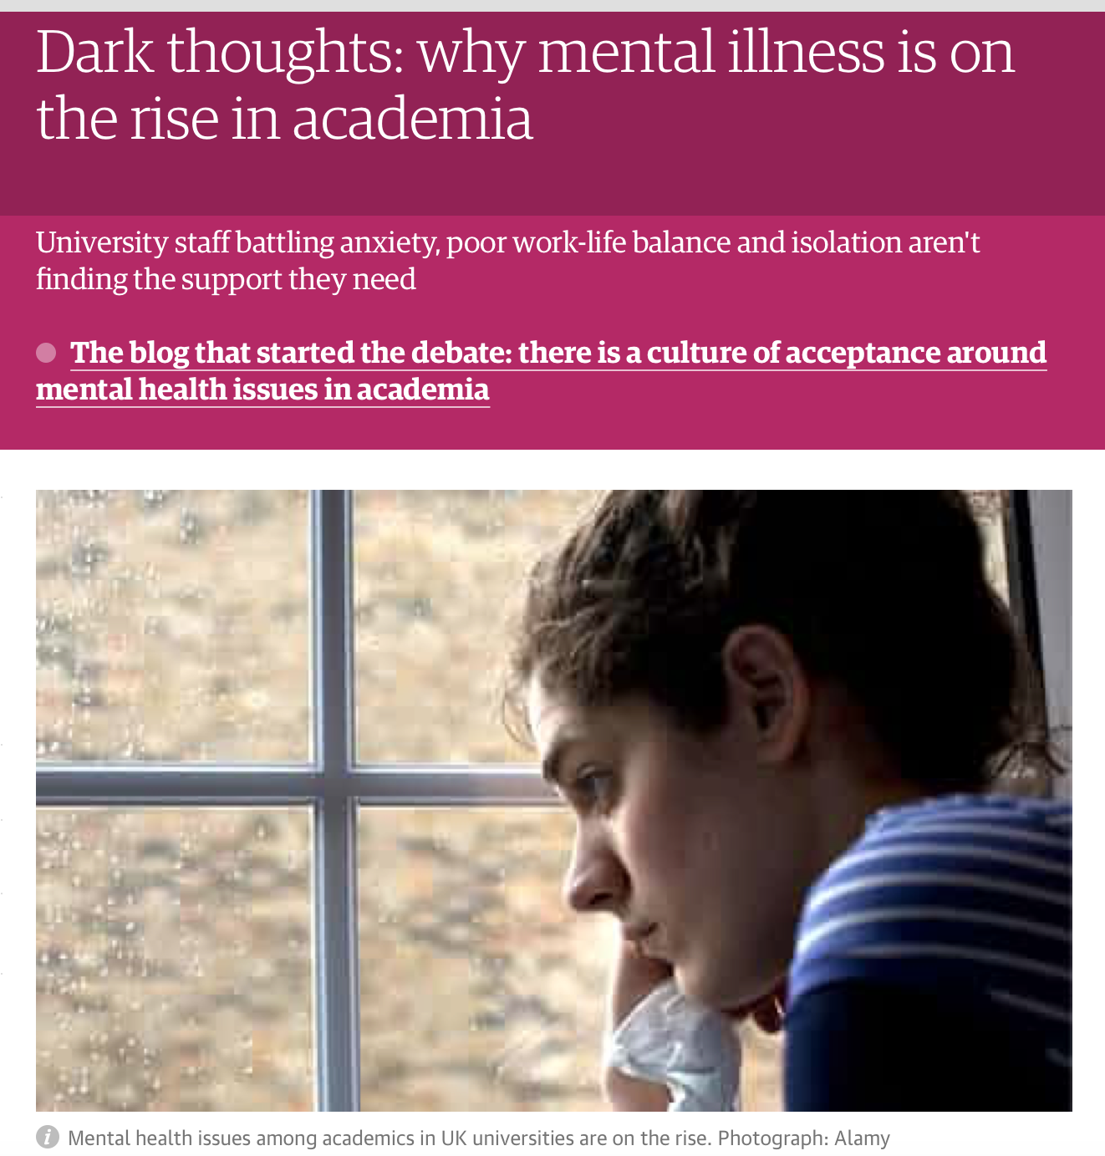
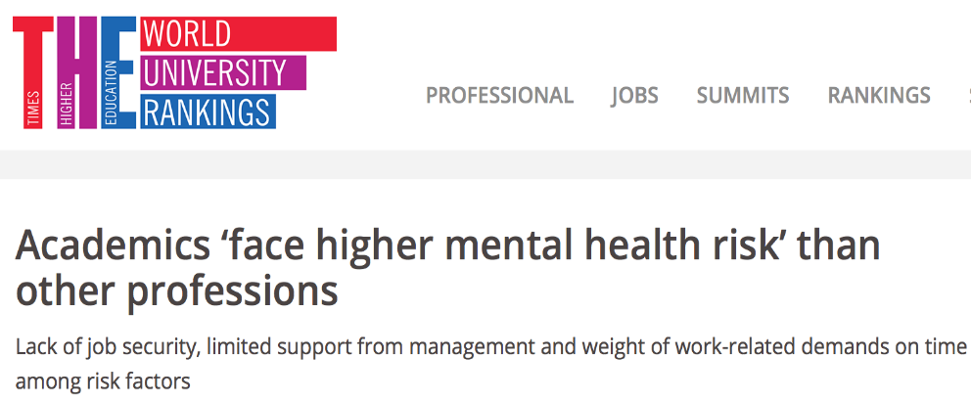
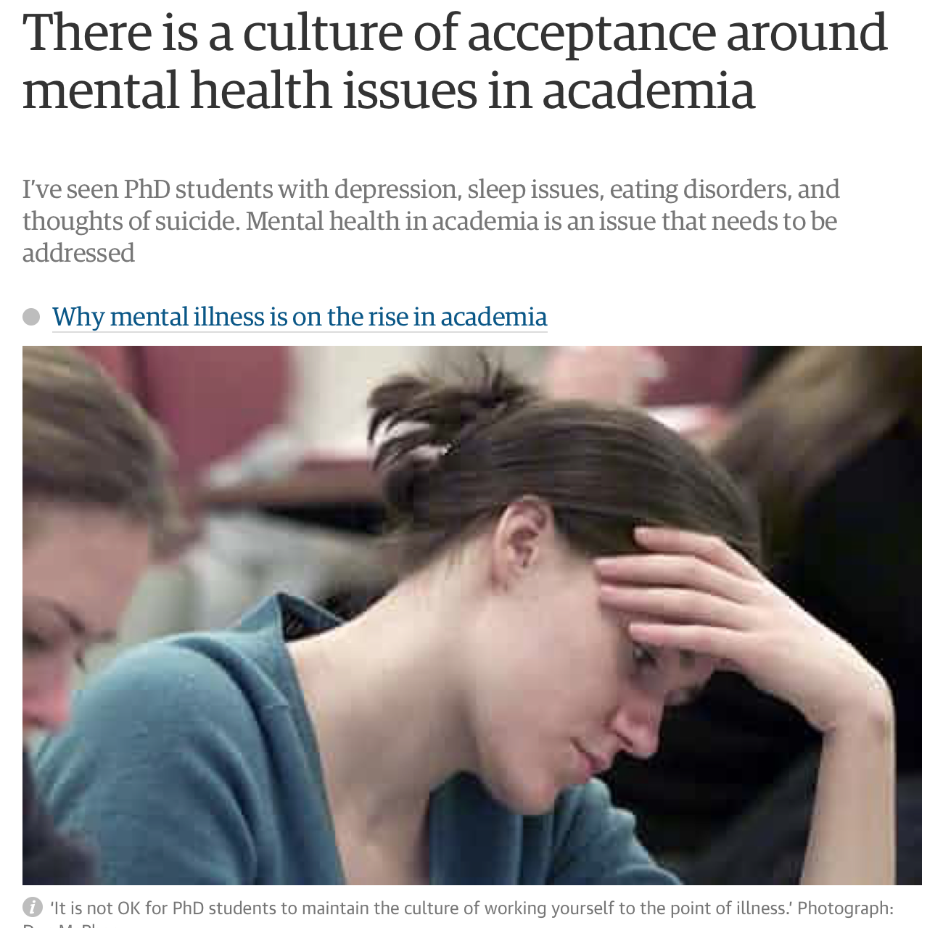


Slide 12
Questioning the Role of Coaching
The association between the changing nature of higher education and the growing use of coaching in the sector (Iordanou, Lech and Barnes, 2015) .
The danger of introducing coaching as:
yet another ‘intervention’ to help people ‘cope’
a space for individuals to “confess” shortcomings and set new targets for themselves to increase productivity (Ball, 2012, p. 19).

Slide 13
Questioning the Role of Coaching
Auditing allows little room for dissent, maverick attitudes, or unconventional thinking, being designed above all to promote conformity of behaviour across sectors. This raises the spectre of coaching within the educational system degenerating into an exercise in helping individuals meet management-set performance targets rather than in developing their inner talents and abilities.
(du Toit & Sim 2010, p. 166)

Slide 14
Ways Forward..
‘Critical’ coaching in higher education
Challenges established state of affairs and contributes to revealing institutional realities
Encourages a wider sense of moral and social responsibility
Reduces focus on short-term gains and help see “the wider picture”
Helps higher education professionals foster a stronger public role (du Toit & Sim, 2010)
Perceives academics as Subjects capable of transforming their world (Freire, 1970).
).
‘

Slide 15

Coaching is often linked to enhancing ‘performance’
-> Calls for more focus on nourishing ‘well-being’
(Oades, 2016; van Nieuwerburgh, 2016)
Ways Forward..

Slide 16

Example
http://www.stevegreerphotography.com/2011/03/09/monarch-butterfly-metamorphosis/
Notes:
Senior lecturer at a large university in the UK
7 sessions, a total of 8.5 hours over 7 months
Purpose: Establishing work-life balance, and looking for goals that motivates him as his role has changed recently mostly against his will.
Wanted to work with an ‘outsider’
Read segments from my coaching notes that encourage criticality and action

Slide 17
Thank you
m.attia@sussex.ac.uk

