Slide 1
From protest to peacebuilding? Higher education and social justice in Burma/Myanmar
University of Sussex
CHEER/Asia Centre
21 January, 2016
Lynne Heslop
Director Education
British Council, Burma

Slide 2
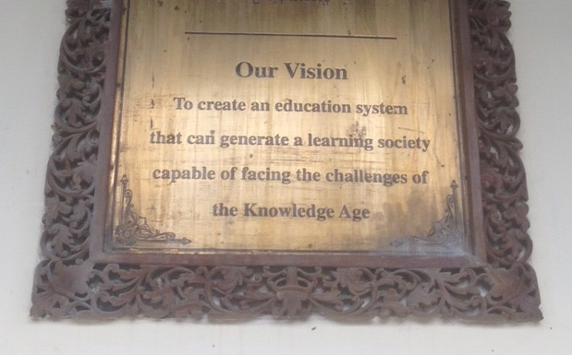
Plaque at the University of Yangon

Slide 3
Overview
The role of universities in peacebuilding, development and social justice
Conflict, protest and repression: what has happened to Burma’s universities?
Inequalities in higher education in Burma
Policies and reforms – a new era?
Opportunities, challenges and dangers

Slide 4
Are universities relevant institutions in building long-term peace and contributing towards social justice?
Universities have been absent in the peacebuilding discourse
Universities have powerful potential in perpetuating or addressing social injustice and inequality: the ‘two faces’ of education
They have a role in building long term ‘positive’ peace
Evidence that universities are greatly impacted by conflict, but there are substantial research gaps

Slide 5
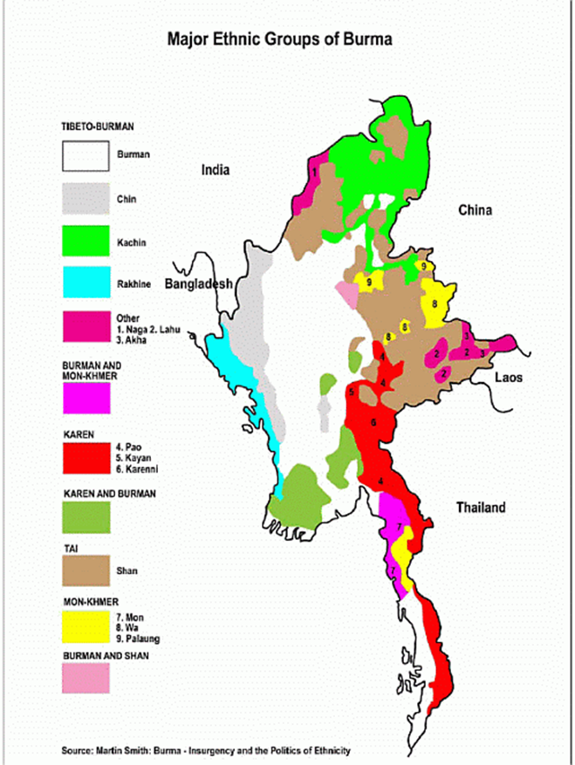
Burma/Myanmar

Slide 6
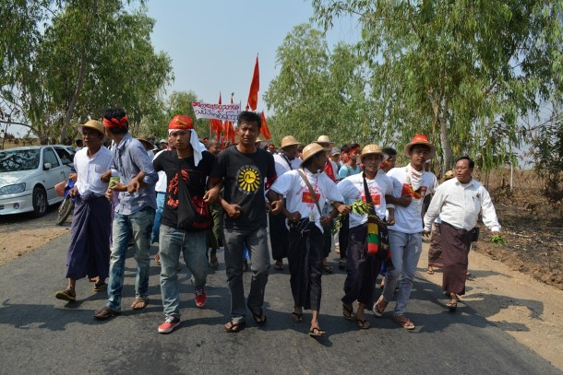
Burma’s universities at the centre of political protest and pro-democracy movements
(Photo: Kaung Myat Min / The Irrawaddy, 13 Feb 2015)

Slide 7
11 demands of protesting students (2015)
Inclusion of teachers and students in legislation process of education policies and laws
The right to freely establish and operate student and teacher unions
Establishment of National Ed Commission and University Coordination Committee
Self-determination on educational affairs of individual state/regions and schools
Modifying current examination and university matriculation system
Modifying teaching methods to ensure freedom for thinking and self-studying of students
Ensure freedom for the practice of ethnic languages and mother tongue based multi-lingual education for ethnic populations and tribes
Inclusive education for all children including children with disabilities
Resumption of enrollment for students previously expelled due to the student uprisings
Allocation of 20 percent of national budget for education
Free compulsory education up to middle school level rather than primary level

Slide 8
Impact of conflict on higher education
Undergraduates disbursed to rural campuses
No UGs on Yangon campus for 25 years
Highly centralised control across multiple ministries
Rote learning, minimal research, suppression of critical thinking
Very low levels of funding (with exceptions)
Erosion of value of higher education
Fear
Notes:
Leading to distortions in the system:
Distance education
More women than men at all levels of study
But not all subjects
Unequal
Women at least 60%, but underrepresented in some technical subjects
Women make up XX% of lecturers, professors, etc.
No disagregation for leadership roles
Nor for ethnicity.

Slide 9
A new era? Context of reforms in higher education
Comprehensive Education Sector Review:
3 year project on data gathering and analysis, but gaps remain
National Education Sector Plan (NESP): 5 years
Political change: project finalised at the juncture between new governments. What next?

Slide 10
An elitist system with significant inequalities
GER for higher education is 11%
Considerable barriers to people from poorer backgrounds
Missing data on ethnicity and language
Females outnumber males 2:1 at UG level, but DE roughly even
82.5% faculty are female
Missing data on female leadership

Slide 11
Inequalities in education start downstream
Nearly half drop out before secondary school
Net primary completion rates: 79% for the wealthiest, 31% for poorest
Secondary: 85% for richest quintile, 28% for poorest
Curriculum bias
Disparities in resources between government, ethnic and religious education systems

Slide 12
Gender: “the problem is that the problem is not seen as a problem”
(GEN: Raising the Curtain 2015)
Approaching parity of participation, but…
National averages mask significant disparities (poverty, urban/rural, regional, etc)
Women outnumber men in HE, but fewer women in the workforce and senior decision-making roles
Limited female participation in politics and the peace process
(Government presentation on analysis of Integrated Household Living Conditions Assessment 2010 (WB, ADB), GEN workshop Gender and Education, Yangon Dec 2015)

Slide 13
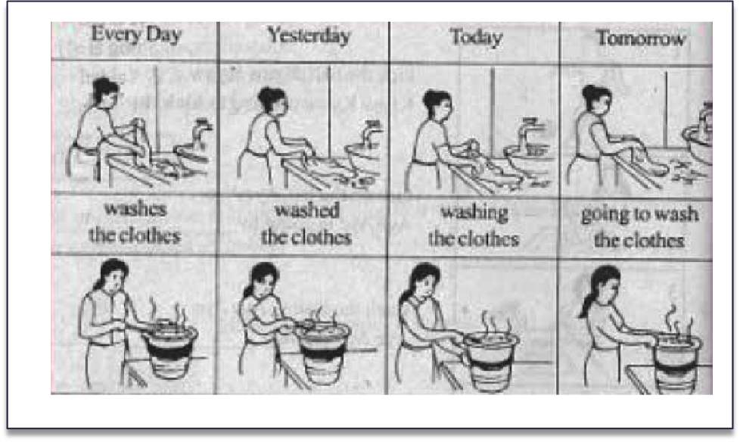
“Curriculum has been a battlefield” (Thein Lwin 2007)
Grade 4 English textbook, cited in GEN report 2015

Slide 14
HE reforms: collision or co-existence?
Marked absence of peacebuilding language
Marginalisation of higher education?
Dominance of global, neoliberal drivers

Slide 15
The future: opportunities, risks and the international community

Slide 16
Thank you.
lynne.heslop@britishcouncil.org

