Slide 1
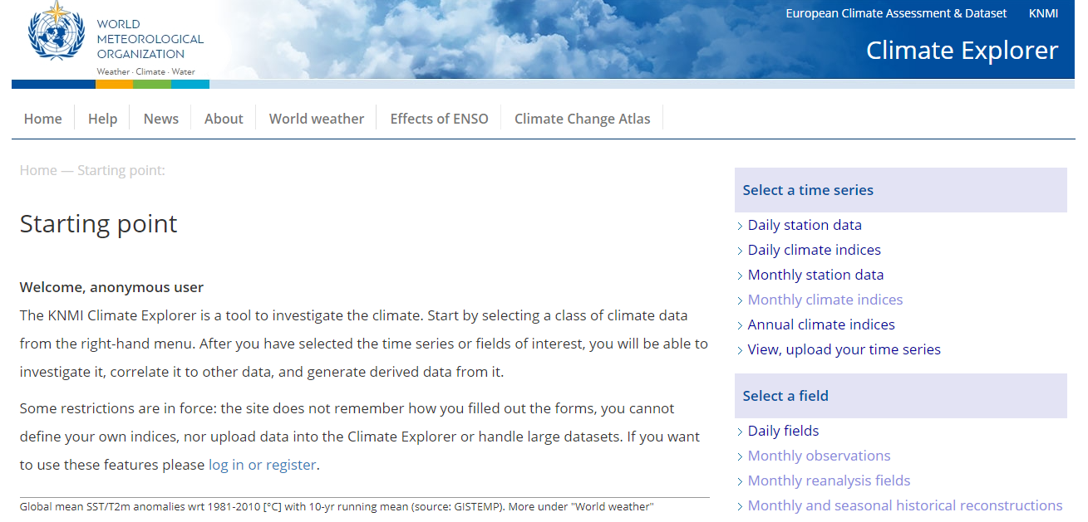
Summer School KNMI CLIMATE WORKSHOP: Case Study 3

Slide 2
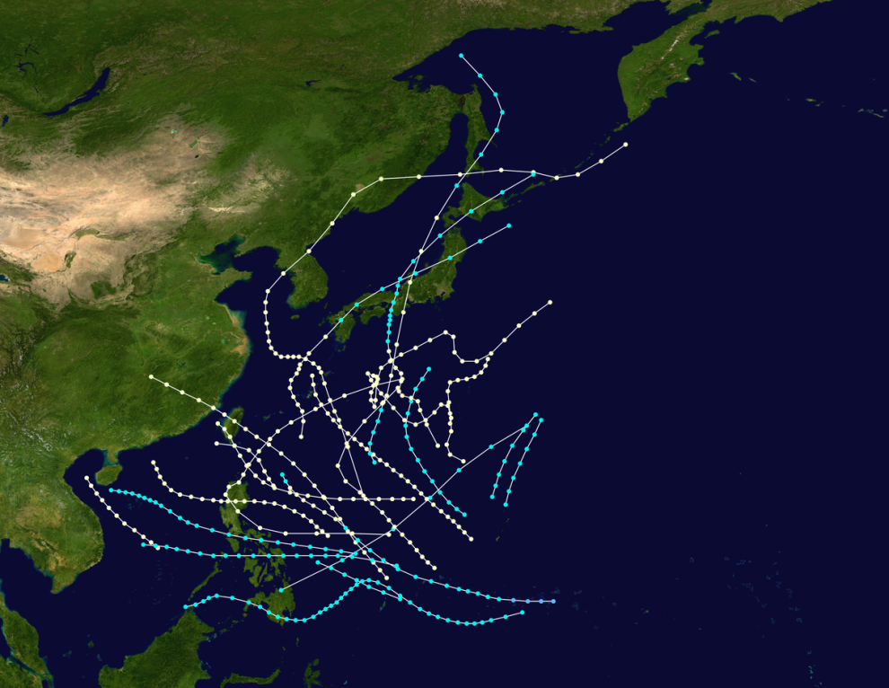
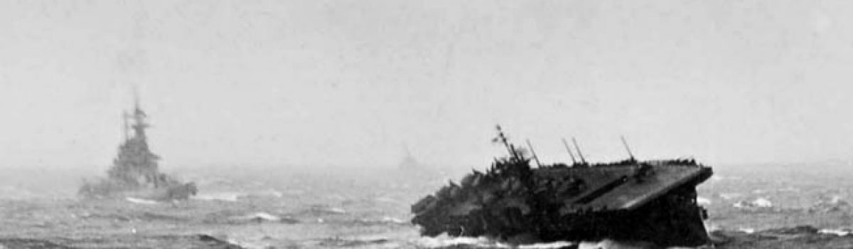
CASE STUDY 3: 1944-1945 Typhoons
Dates: Jun-Dec 1944 & 1945
Domain for this case study:
0 to 50N
100E to 180E
Typhoon Season typically from Jun-Dec
Caused sinking ships and loss of lives in the Pacific Ocean due to Tropical cyclone/Typhoon activity

Slide 3
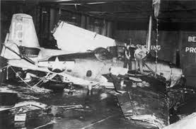
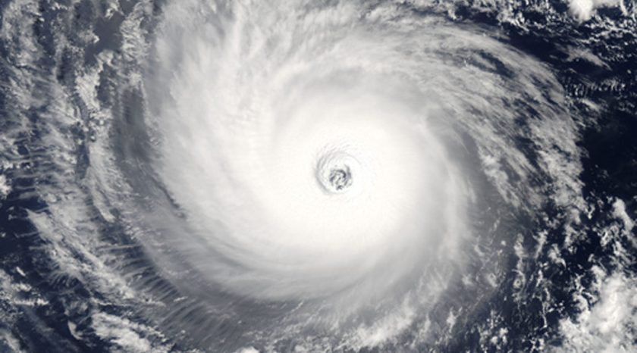
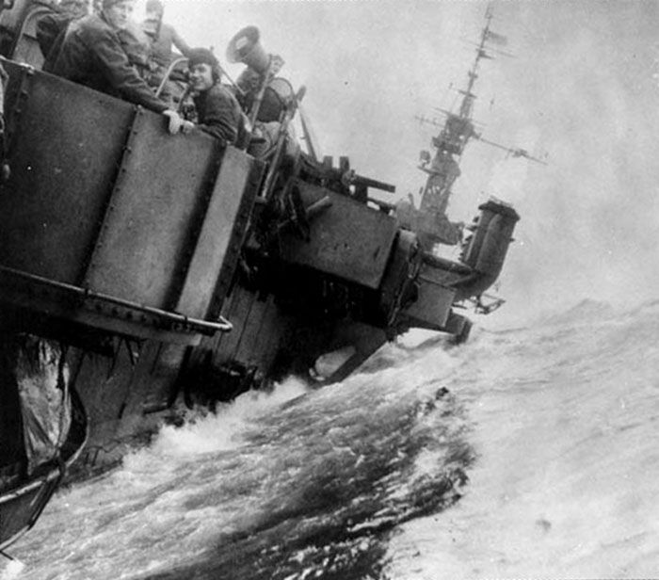
CASE STUDY 3: 1944-1945 Typhoons
Date: Specific Event on the 18th of Dec 1944
Known as Typhoon Cobra
Domain for this case study:
0 to 50N
100E to 180E
790 Americans lost their lives in Typhoon Cobra, killed outright or washed overboard and drowned
https://todayinhistory.blog/2017/12/18/december-18-1944-typhoon-cobra/

Slide 4
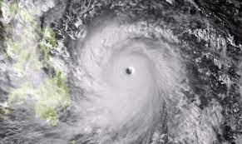
CASE STUDY 3: 1944-1945 Typhoons
What is a Typhoon Event?
A typhoon is another name for a tropical cyclone that develops in the NW Pacific Basin between 100° and 180°E in the Northern Hemisphere and move westwards
This basin is the most active tropical cyclone basin globally, accounting for almost 1/3rd of the world's annual tropical cyclones
These events are associated with heavy rain and damaging winds and low pressure centres

Slide 5

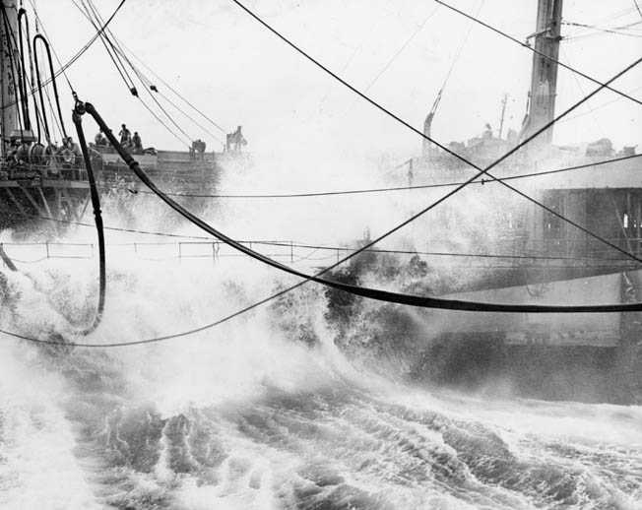
CASE STUDY 3: 1944-1945 Typhoons
How did the Typhoons of 1944 and 1945 affect shipping fleets from the US to Japan and the Philippines?
Many of them sank due to the extreme weather conditions as well as affecting planes too and many people were killed.

Slide 6
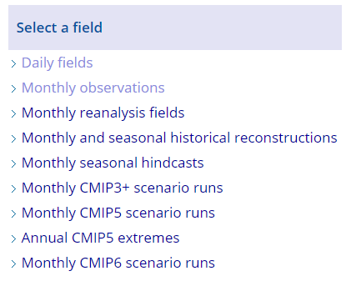
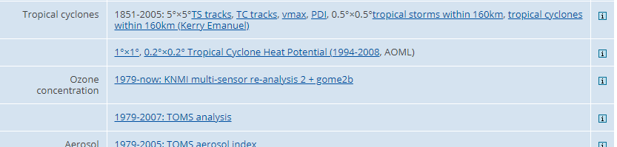
CASE STUDY 3: 1944-1945 Typhoons
Let’s start off selecting Monthly Observations and
Choose Tropical Cyclones
Choose TC Tracks
Please note that data only begins from Jan 1945 therefore you cannot analyse events prior to this date.

Slide 7
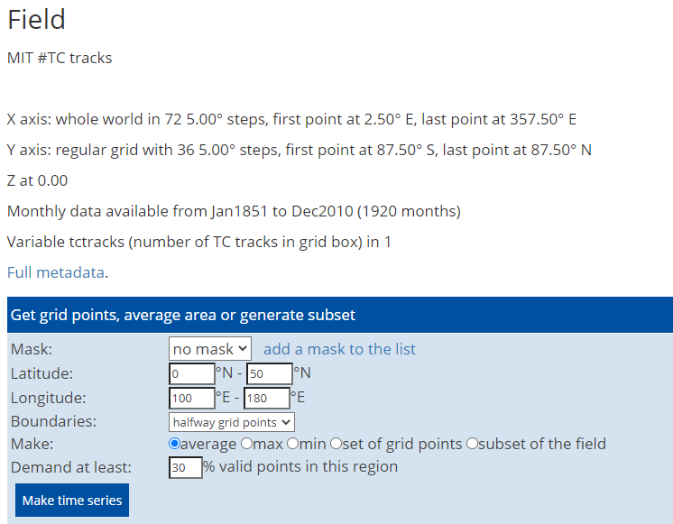
CASE STUDY 3: 1944-1945 Typhoons
Let’s make a time series to see how the number of TC tracks have changed over the NW Pacific Ocean region
Input domain of
0-50N and 100E to 180E and click Make time series

Slide 8
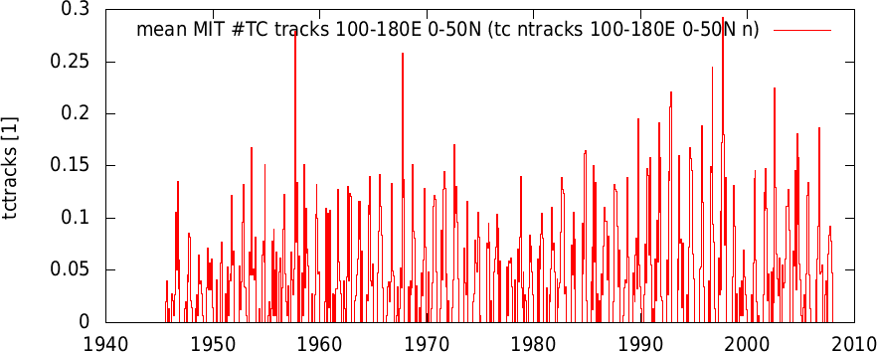
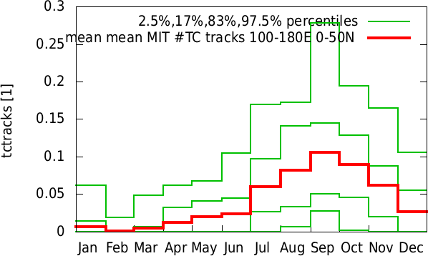
CASE STUDY 3: 1944-1945 Typhoons
You can see clearly from the top plot that number of TC tracks has increased with some peaks at 1958 and 1997.
There were a few tracks recorded in 1945
The bottom graph shows the seasonal cycle of these tracks in the Pacific and can clearly see they peak from June to December with the largest peak in Sept.

Slide 9
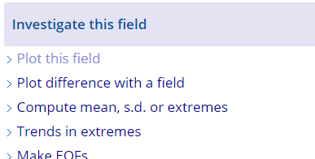
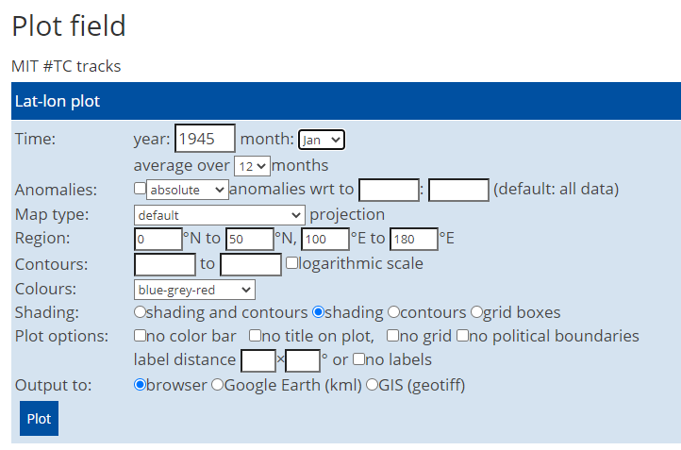
CASE STUDY 3: 1944-1945 Typhoons
Let’s plot these TC tracks spatially over the Pacific Region just for 1945 to see where the TCs occurred and if they match with the literature from the case study
Click on Monthly Observations again and choose TC tracks but this time go to Investigate this field and Plot this field.
Then choose the entire year of 1945 – start from Jan and average over 12 months and put in the domain
0-50N and 100-180E

Slide 10
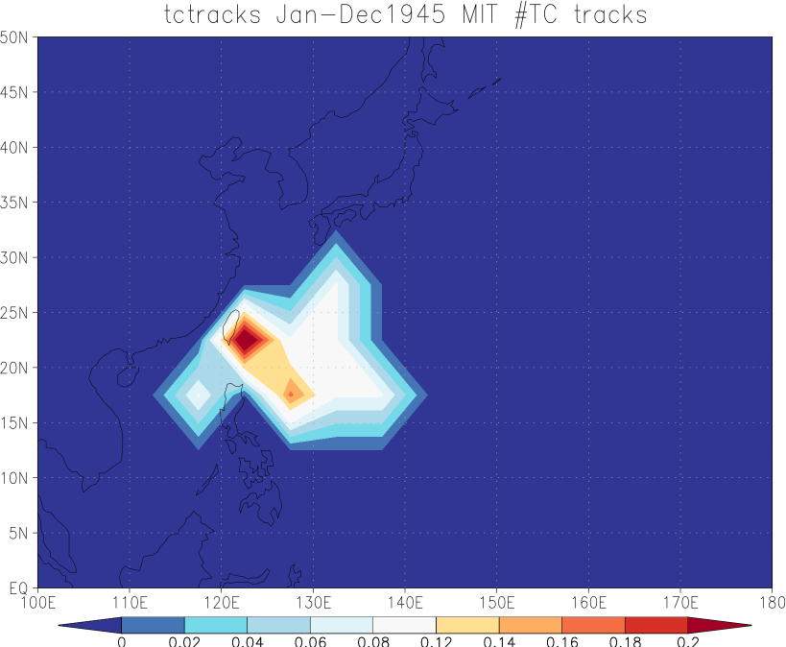
CASE STUDY 3: 1944-1945 Typhoons
Can see that there was a cluster of TC tracks over the region that was likely responsible for much damage and sinking of ships during this time. Many around Taiwan specifically.
Let’s do the same plot but now for tropical cyclones within 160km (Kerry Emanuel)

Slide 11
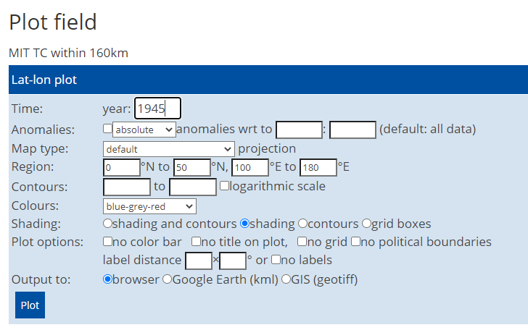
CASE STUDY 3: 1944-1945 Typhoons
Repeat slide 9 but for Tropical Cyclones within 160km
Do it for the year 1945

Slide 12
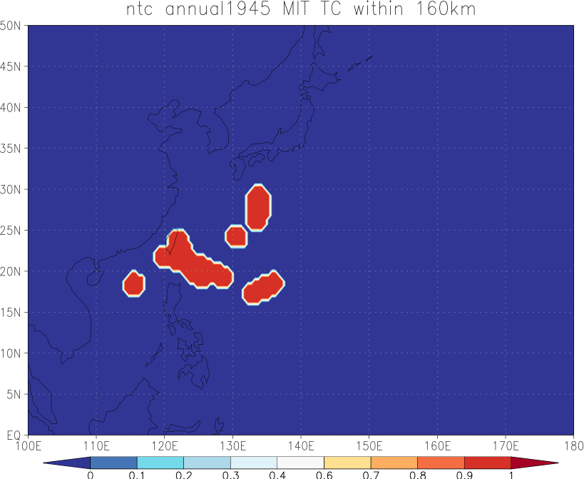
CASE STUDY 3: 1944-1945 Typhoons
Can see that there were a number of Typhoons that occurred in 1945 over the region which would have an effect on any ships passing through at the time.
It is a shame there is no data available for 1944 but we can look at some of that data in other observations and reanalysis in the next few slides.

Slide 13
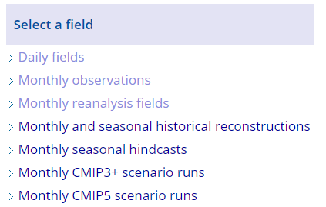
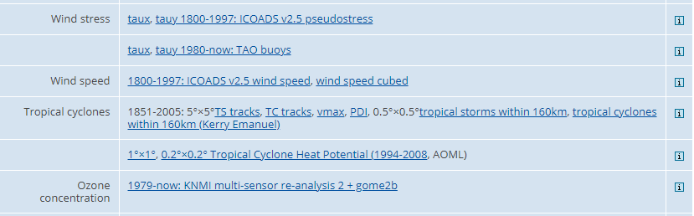
CASE STUDY 3: 1944-1945 Typhoons
Lets look at Monthly Observations to see some more evidence of these Typhoons during 1944-1945.
Let’s take a look at the wind speeds which appeared to have cause much damage during that time.

Slide 14
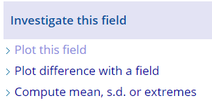
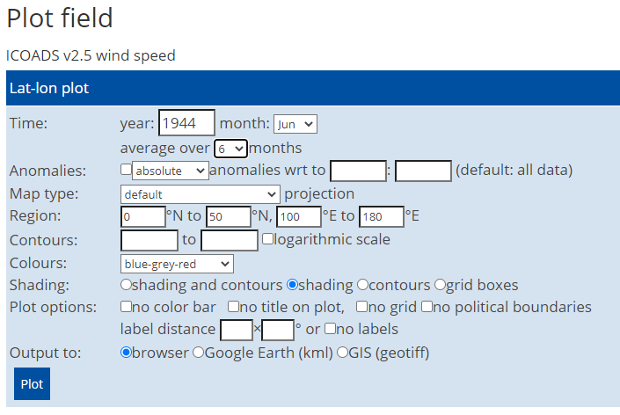
CASE STUDY 3: 1944-1945 Typhoons
Choose Plot this field
Choose year 1944 starting month June and average over 6 months.
Choose the domain
0-50N and 100E to 180E

Slide 15
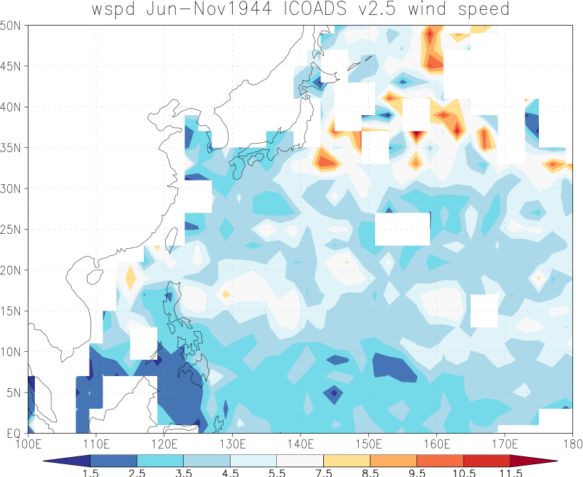
CASE STUDY 3: 1944-1945 Typhoons
Can clearly see much higher wind speeds to the east of Japan for this period which makes physical sense due to many typhoons moving through the area causing ship fleets to sink

Slide 16
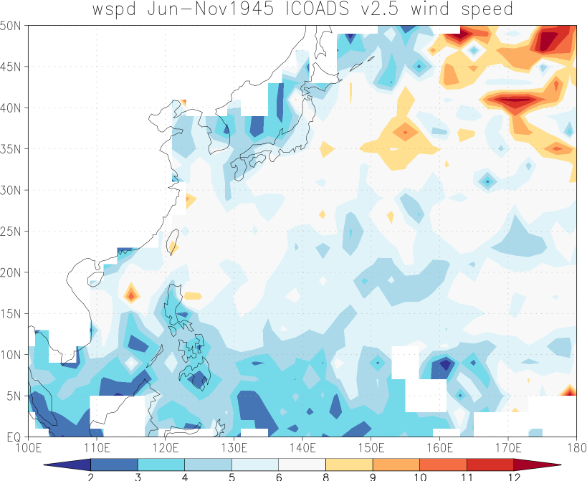
CASE STUDY 3: 1944-1945 Typhoons
If you do the same plot for 1945 from June averaged for 6 months you can also see that this year also experienced high wind speeds from typhoons in the Pacific Basin
Now lets have a look at the rainfall from these events

Slide 17
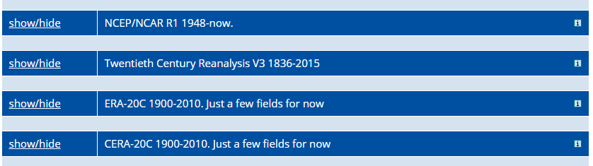
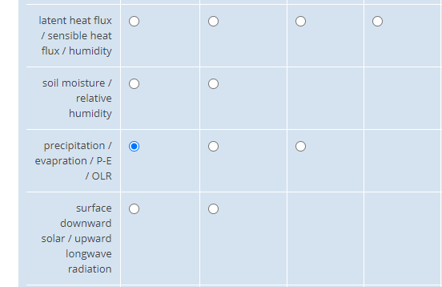
CASE STUDY 3: 1944-1945 Typhoons
Select Monthly Reanalysis Fields and
Choose 20 Century Reanalysis Data V3 and
Choose precipitation

Slide 18
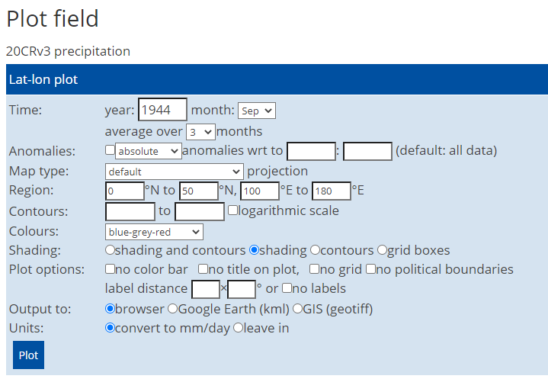
CASE STUDY 3: 1944-1945 Typhoons
Lets look at Monthly Reanalysis Fields to see what the precipitation was like for the 1944-1945 period from the typhoons.
Choose 1944 and start from Sept and average over 3 months

Slide 19
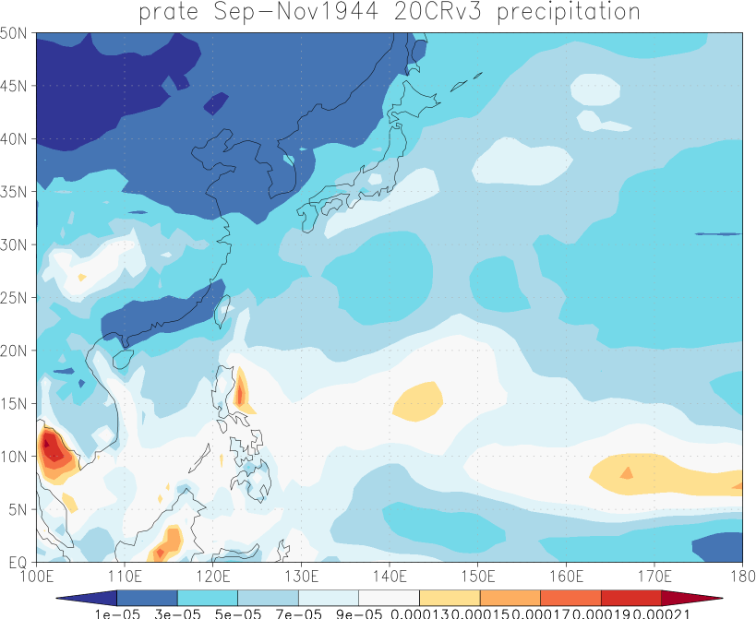
CASE STUDY 3: 1944-1945 Typhoons
Clear evidence of higher precipitation rates where the typhoons would have passed through towards Japan and the Philippines.
This would have caused difficult weather conditions for the ships which the articles and grey literature point out.
Let’s now look at the rainfall for the specific event of 18 Dec 1944 which was Typhoon Cobra

Slide 20
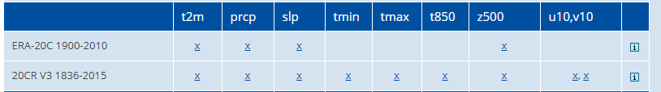
CASE STUDY 3: 1944-1945 Typhoons
Select Daily Fields and
Choose 20 Century Reanalysis Data V3 1836-2015 and
Choose prcp

Slide 21
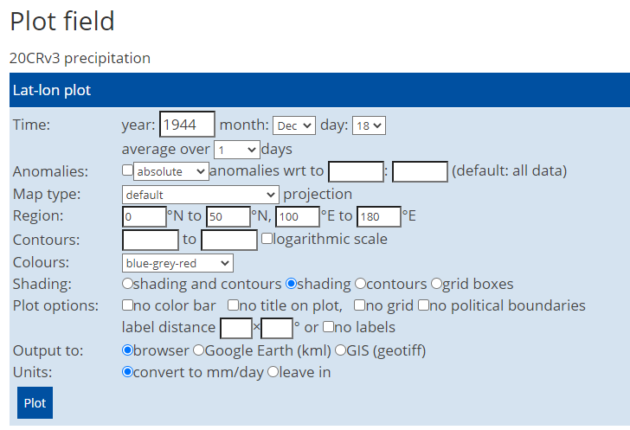
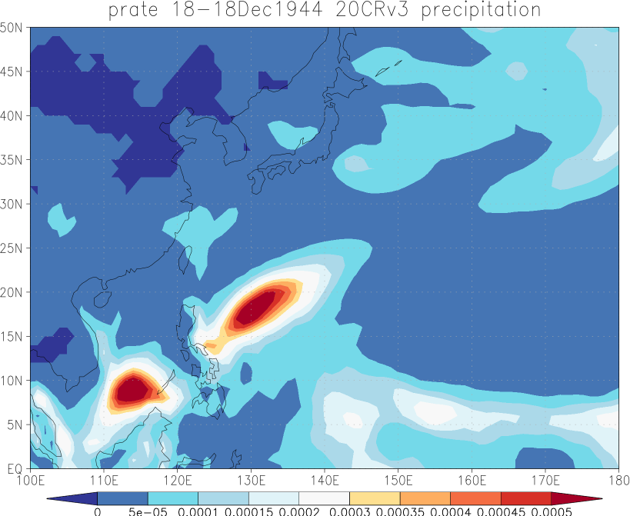
CASE STUDY 3: 1944-1945 Typhoons
Select 1944 and just the 18th of Dec and average over 1 day for the region 0-50N and 100-180E
Can see from the image that there was very high rainfall rates near the Philippines which were a result of Typhoon Cobra

Slide 22
Can you try and analyse other variables to see evidence of the typhoons in the Pacific during 1944-1945 using KNMI?
☺

