Slide 1
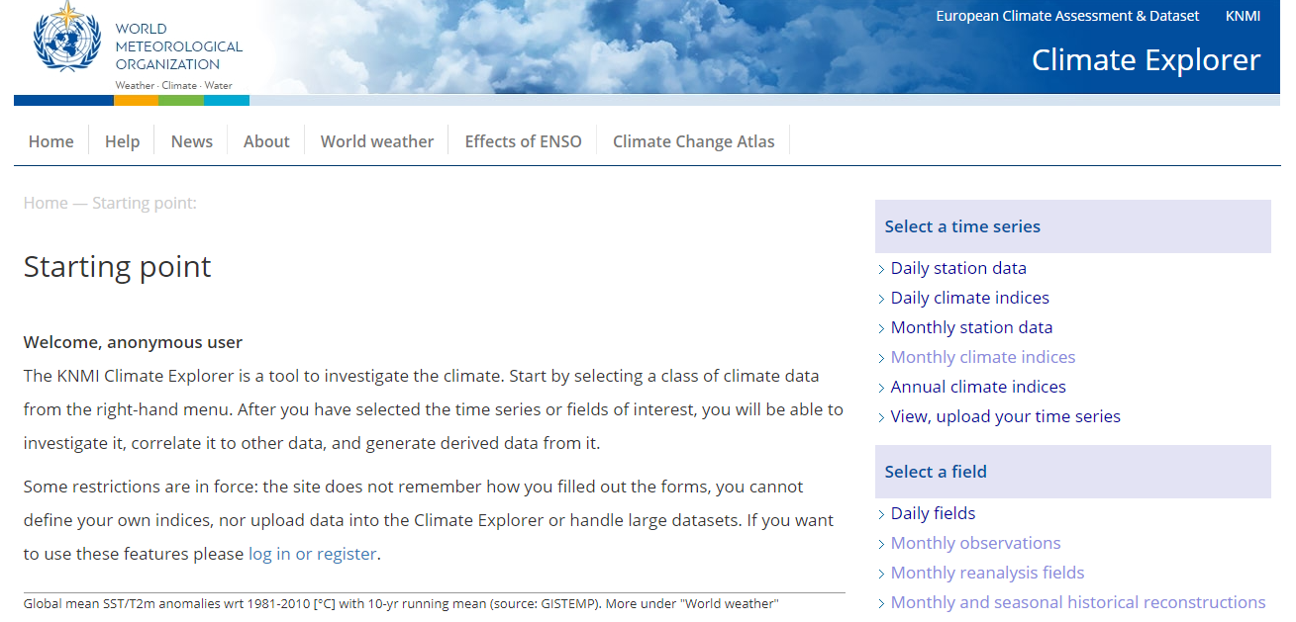
Summer School KNMI CLIMATE WORKSHOP: Case Study 2

Slide 2
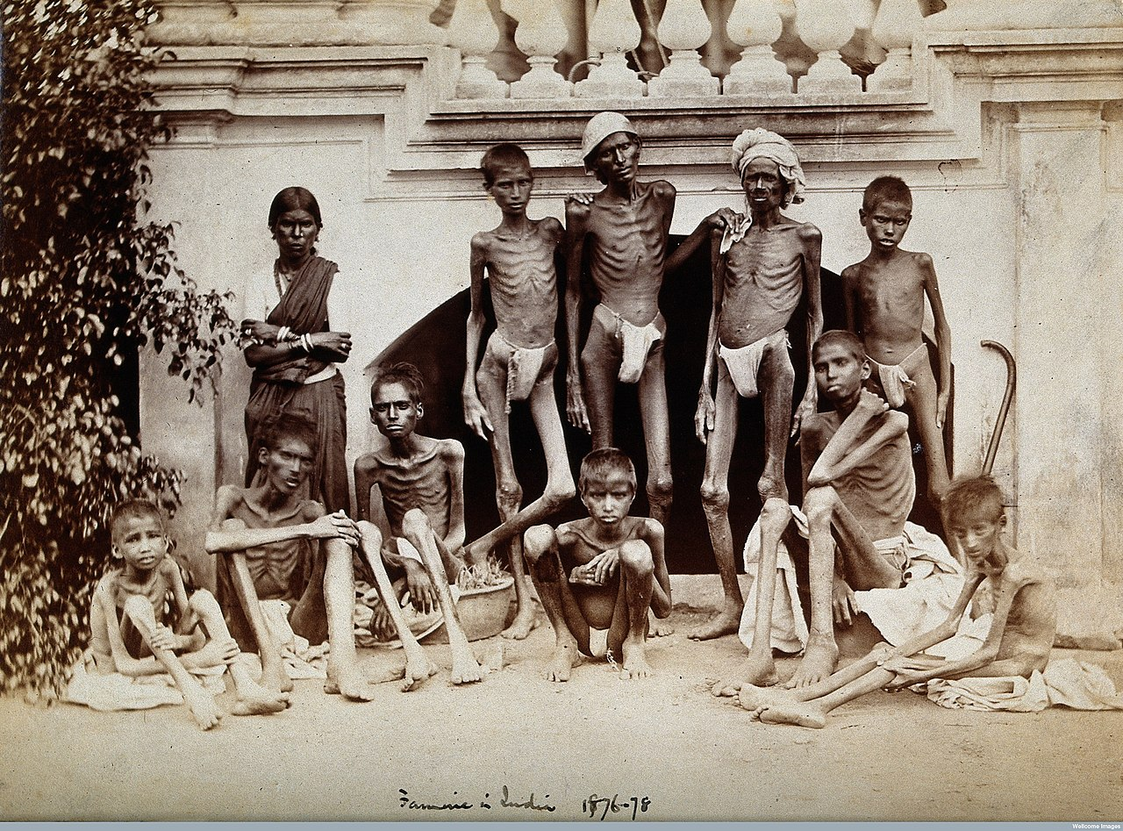
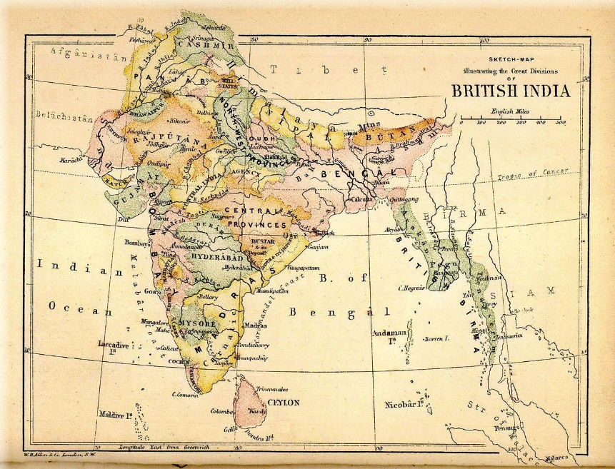
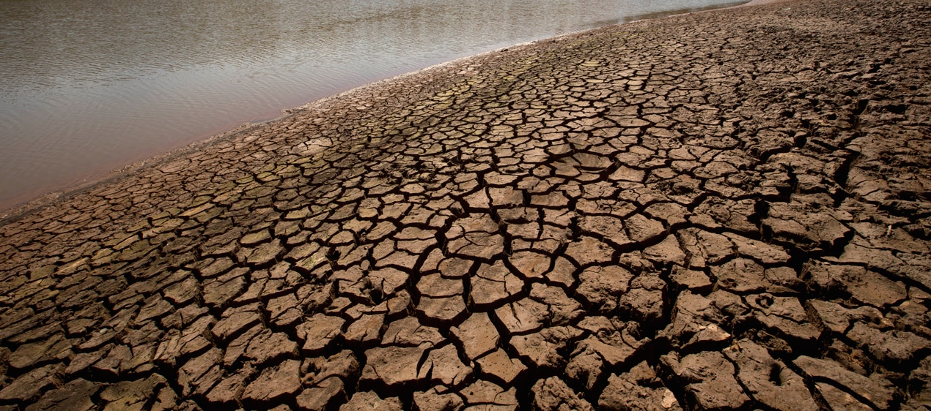
CASE STUDY 2: 1877-1878 El Niño
Date: 1877-1878
Domain for this case study:
0 to 35N
70E to 110E
Caused Drought and Great Famine for the Indian Ocean World especially India

Slide 3
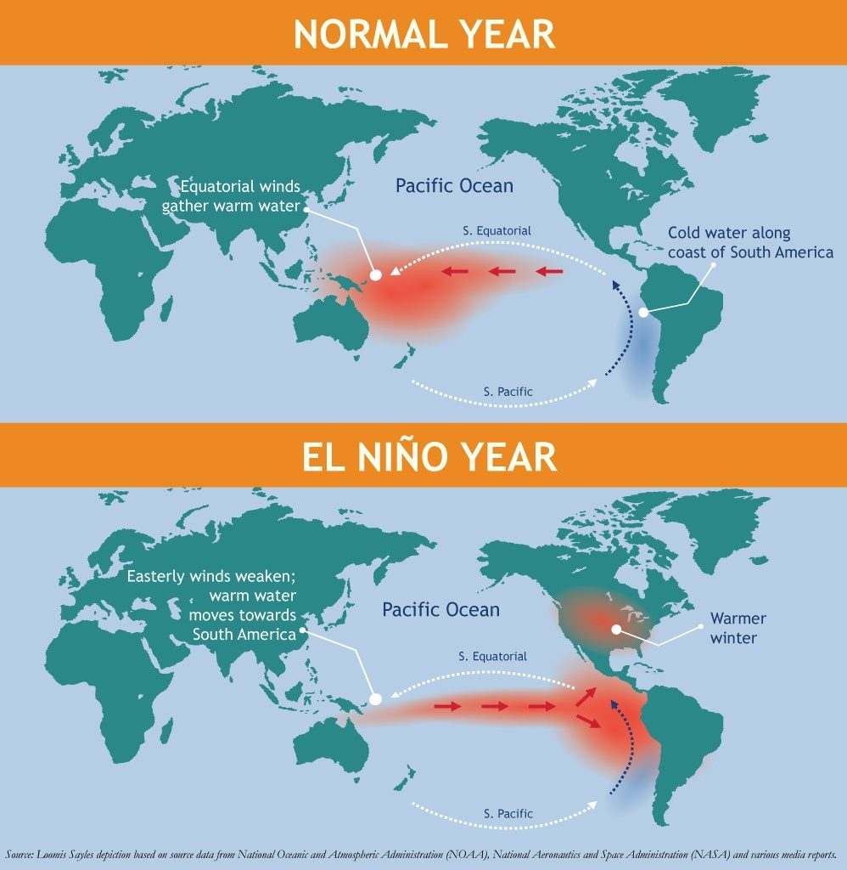
CASE STUDY 2: 1877-1878 El Niño
What is an El Nino Event?
When the trade winds change direction and warm water is pushed towards the central and eastern Pacific Ocean.
i.e. There are anomalously warm SSTs in the Pacific
This has knock on effects around the globe called teleconnections
These events normally peak in Dec-Jan-Feb

Slide 4
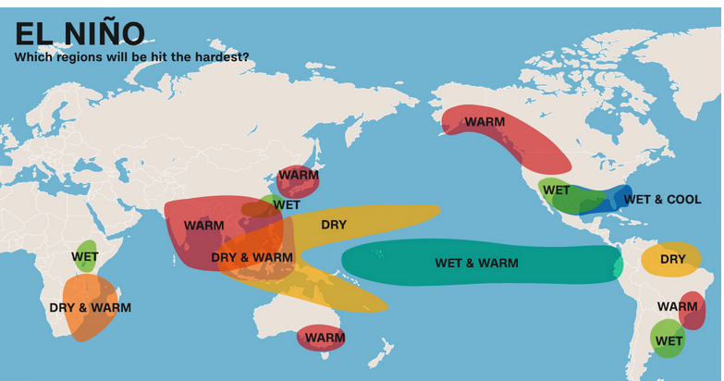
CASE STUDY 2: 1877-1878 El Niño
How do El Nino events affect the Indian Ocean World??
I.e. What are their teleconnections
Mainly by making it warmer and drier => drought events and potential famine.

Slide 5
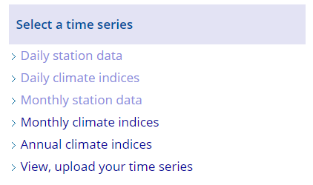
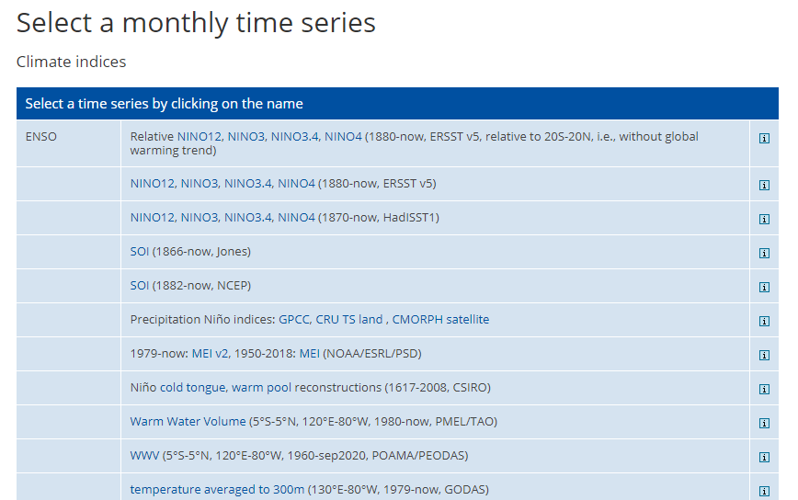
CASE STUDY 2: 1877-1878 El Niño
Let’s start off selecting Monthly Climate Indices and
Choose ENSO NINO3.4
This is the Index used to identify an El Nino (+) or La Nina (-) Event

Slide 6
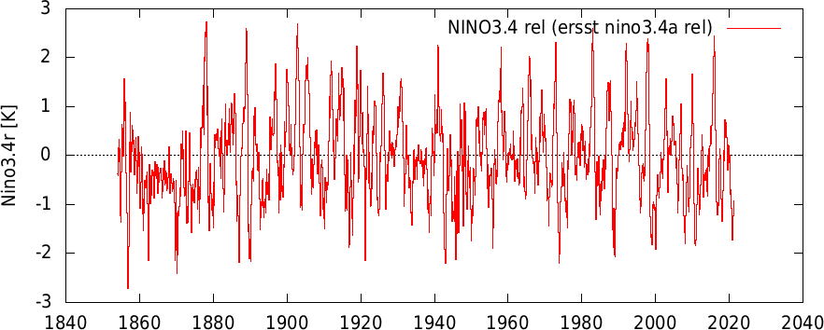
CASE STUDY 2: 1877-1878 El Niño
You can see that in 1877 there was the highest ever recorded El Nino event on record!!
This value means that the Pacific Ocean SSTs were anomalously ~2.5 degrees warmer than normal – any value over +0.5 on this index means there is an El Nino Event and the higher the value the stronger the event.
Negative values of below -0.5 are indicative of La Nina Events.

Slide 7
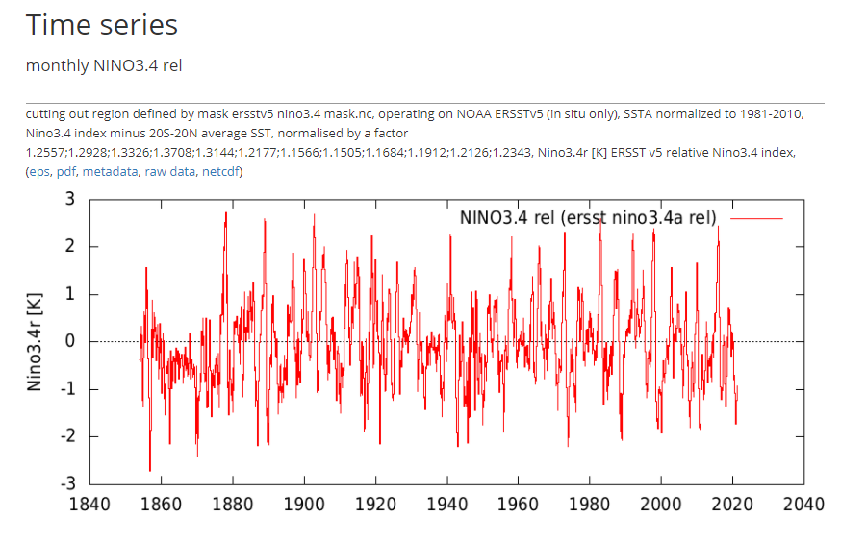
CASE STUDY 2: 1877-1878 El Niño
You can click on the raw data option (see below: to look up 1877 to see the exact value of the NINO3.4 Index). Scroll down to find 1877. (Note it’s monthly data)
It should be: 2.52505 was the highest index value ever recorded reached in Nov 1877!
1876.5834 0.206979
1876.6666 0.169132
1876.7500 0.574442
1876.8334 0.560364
1876.9166 0.753798
1877.0000 1.01665
1877.0834 0.918327
1877.1666 1.42988
1877.2500 1.02421
1877.3334 0.571600
1877.4166 0.435997
1877.5000 1.04833
1877.5834 2.00895
1877.6666 1.93867
1877.7500 2.07151
1877.8334 2.52505
1877.9166 2.42863
1878.0000 2.44527
1878.0834 2.72497
1878.1666 0.823289
1878.2500 1.52950
1878.3334 1.41186
1878.4166 -0.167337
1878.5000 -0.95379

Slide 8
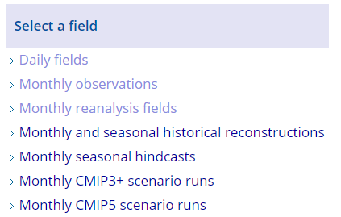
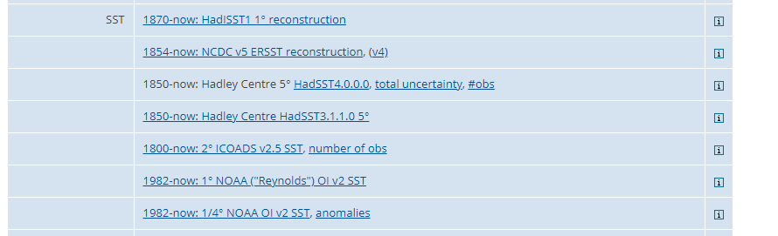
CASE STUDY 2: 1877-1878 El Niño
Let’s look at Monthly Observations to see what the SST anomalies were spatially over the globe
Choose 1850-now: Hadley Centre

Slide 9
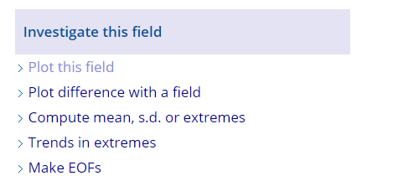
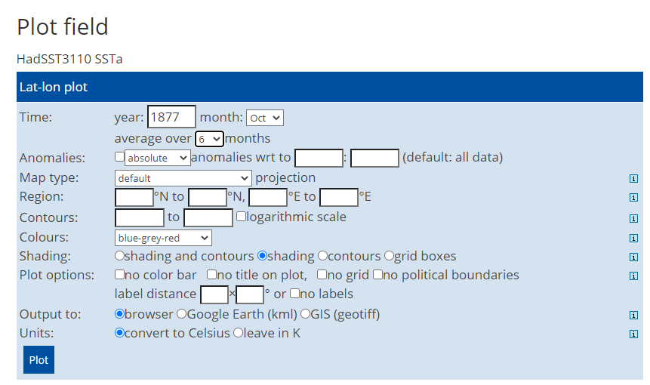
CASE STUDY 2: 1877-1878 El Niño
Now Investigate this field by using the plot this field function and choose 1877 from Oct averaging over 6 months and leave region blank to ensure the entire globe is plotted

Slide 10
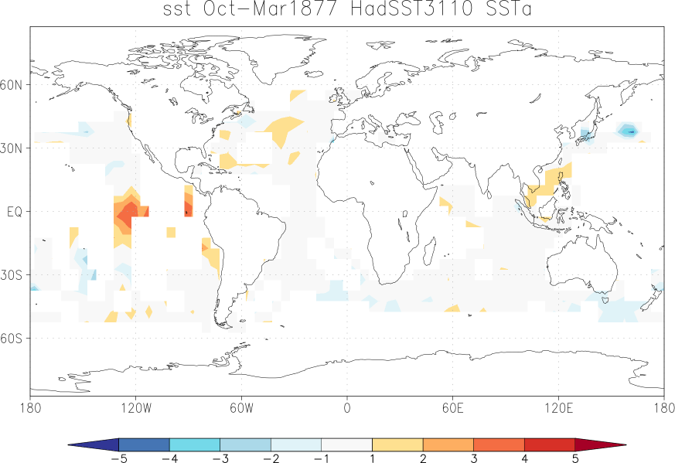
CASE STUDY 2: 1877-1878 El Niño
Can see there is quite a lot of missing data (white blocks) but the event was a long time ago when there were less observations available (only a few from ships)
But you can see warmer SST anomalies for the Pacific Ocean over that 1877-1878 El Nino Event
These El Nino events last several months and sometimes even years.

Slide 11
CASE STUDY 2: 1877-1878 El Niño
Now go back to select Monthly Climate Indices and
Choose ENSO Nino3.4 again
This is the Index used to identify an El Nino (+) or La Nina (-) Event

Slide 12
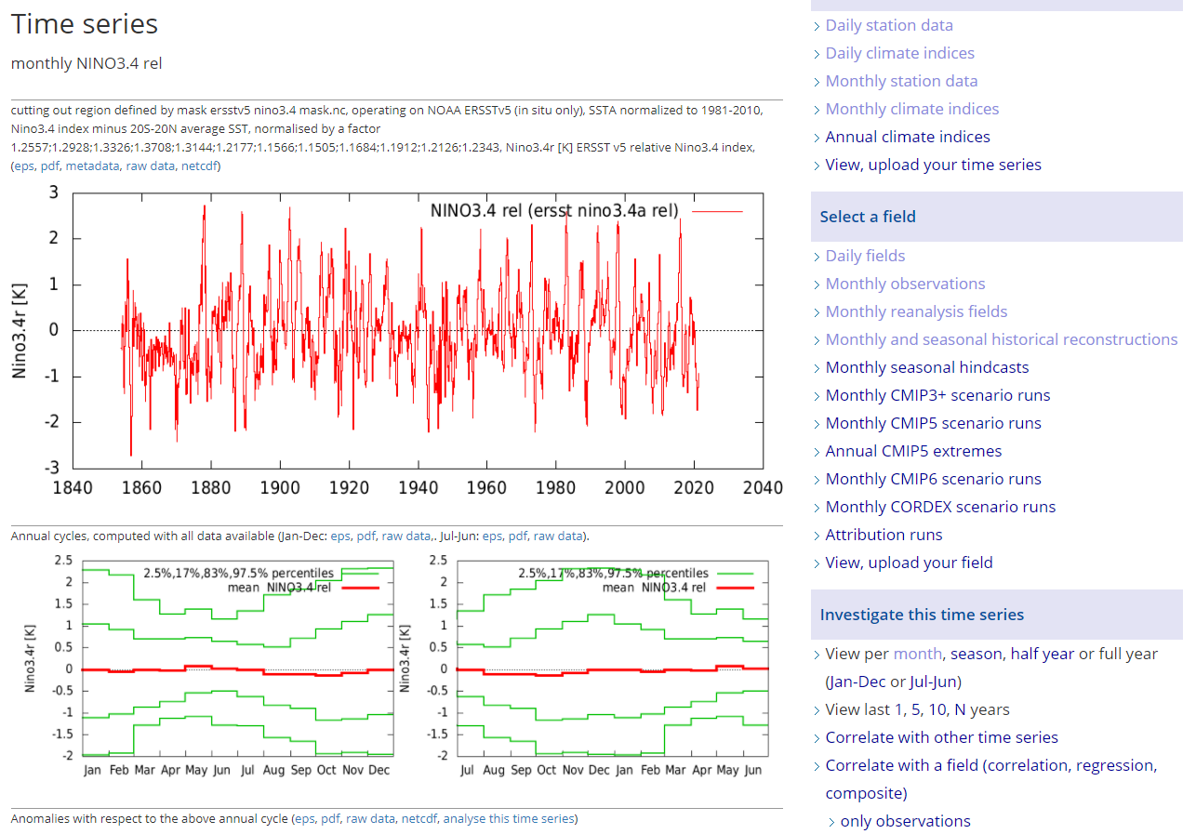
CASE STUDY 2: 1877-1878 El Niño
We are now going to correlate this index with rainfall and temperature over the Indian Ocean region to determine how the El Nino events affect rainfall and temperature
Now go to Investigate this Time Series and click on Correlate with a field

Slide 13
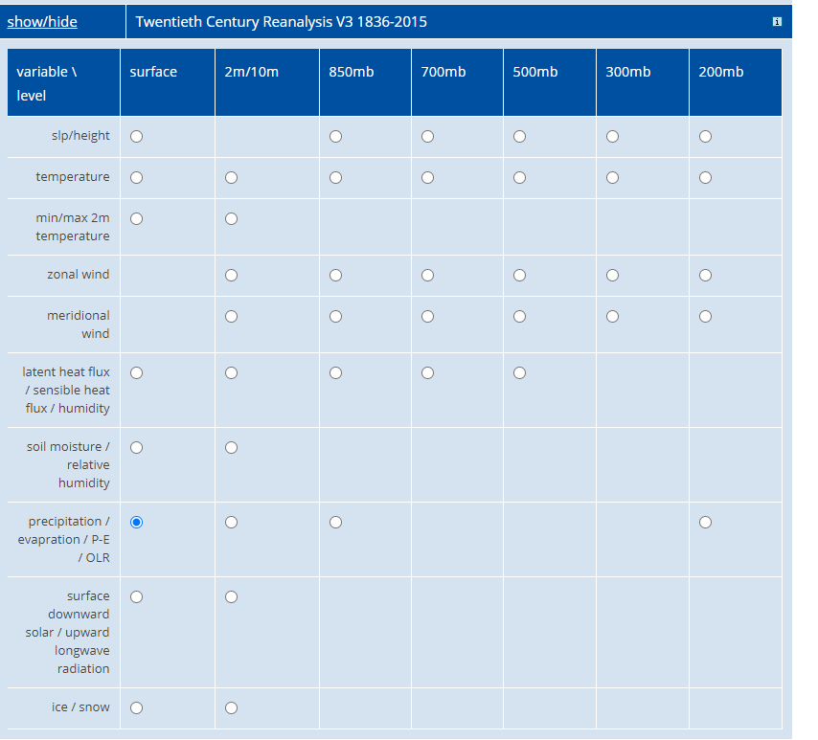
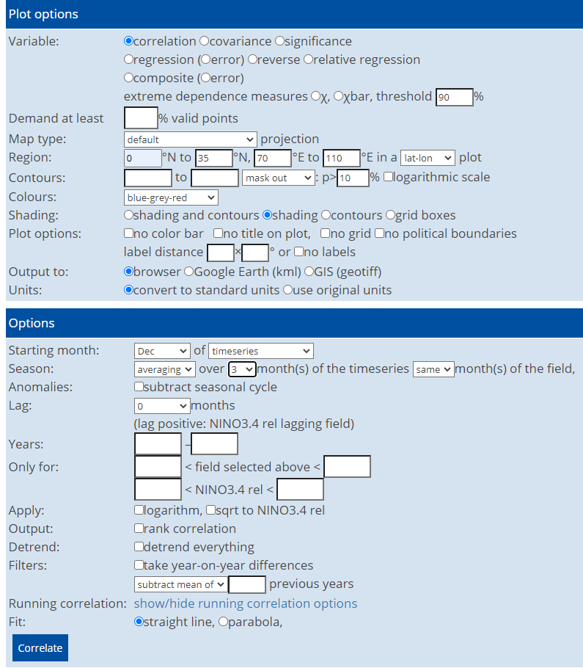
CASE STUDY 2: 1877-1878 El Niño
Choose Twentieth Century precipitation data and scroll down for plotting options
Choose correlation and domain of 0 to 35N and 70 to 110E
Starting Month Dec and average over 3 months (this is when El Nino’s are the strongest) and click Correlate

Slide 14
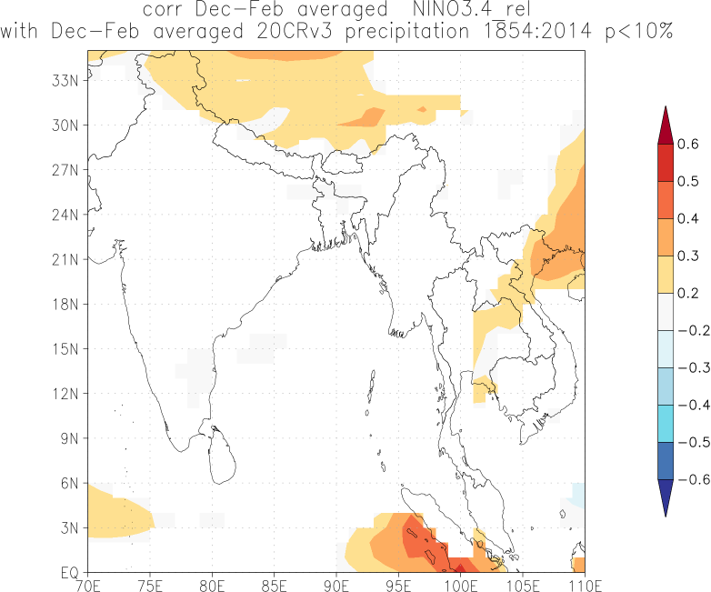
CASE STUDY 2: 1877-1878 El Niño
The plot shows the relationship with ENSO events and rainfall over the Indian Ocean Basin
Can see that when you have a + event (which means an El Nino event you have more rainfall where it is orange and red.
It looks like there is less rainfall over most of the Indian Ocean basin or no change based on this relationship
Now go back one step and choose temperature and correlate

Slide 15
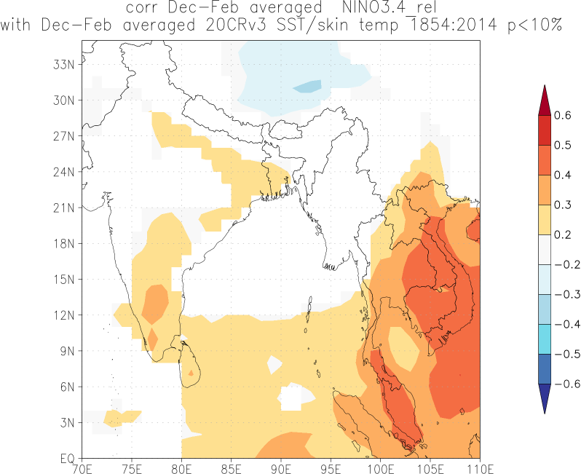
CASE STUDY 2: 1877-1878 El Niño
Can see that when you have an El Nino event you expect much warmer conditions over much of the Indian Ocean Basin region in particular India.
These warmer temperatures may have been an important factor affecting the drought and famine of 1877.

Slide 16
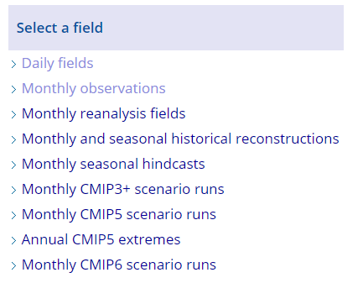
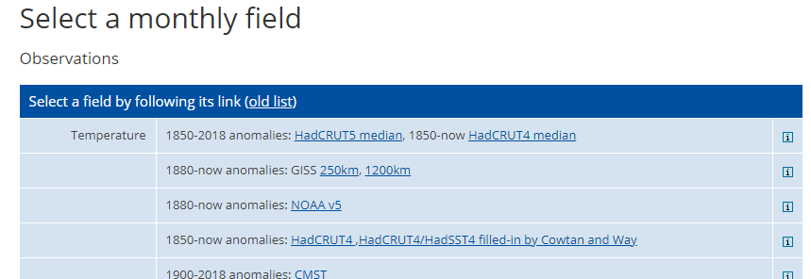
CASE STUDY 2: 1877-1878 El Niño
Select Monthly Observations and
Choose Temperature 1850-2018 anomalies HadCRUT5 median

Slide 17
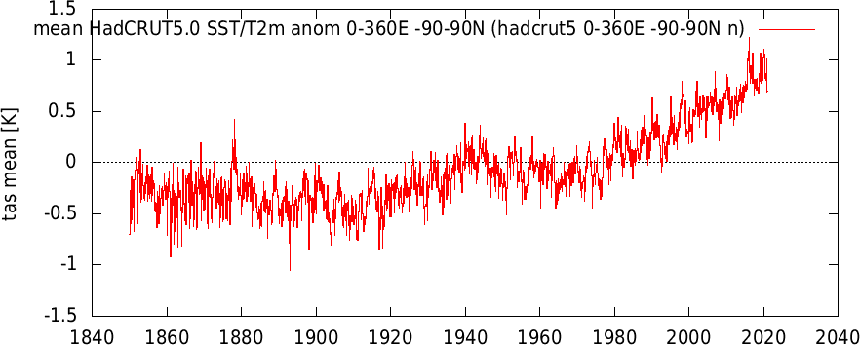
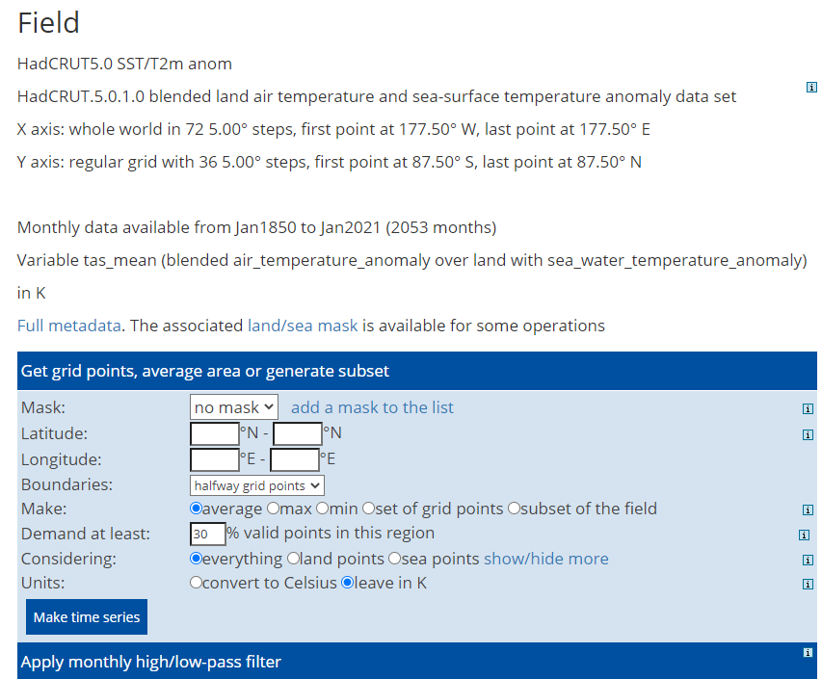
CASE STUDY 2: 1877-1878 El Niño
If you make time series and leave the lat and lon out it will make a time series for the entire globe – see image on right
You can see globally 1877 was an anomalous hot year which was mainly due to the El Nino event but now the climate is warmer much more due to climate change

Slide 18
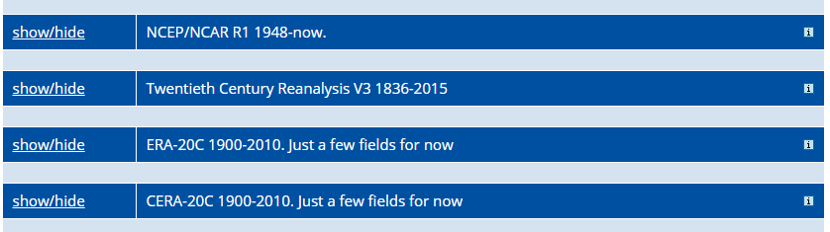
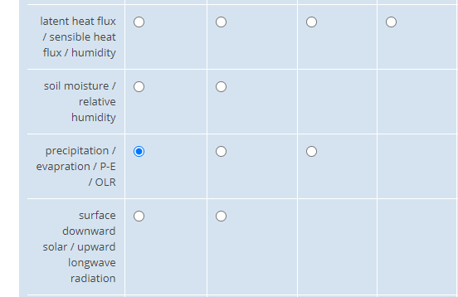
CASE STUDY 2: 1877-1878 El Niño
Select Monthly Reanalysis Fields and
Choose 20 Century Reanalysis Data V3 and
Choose precipitation

Slide 19
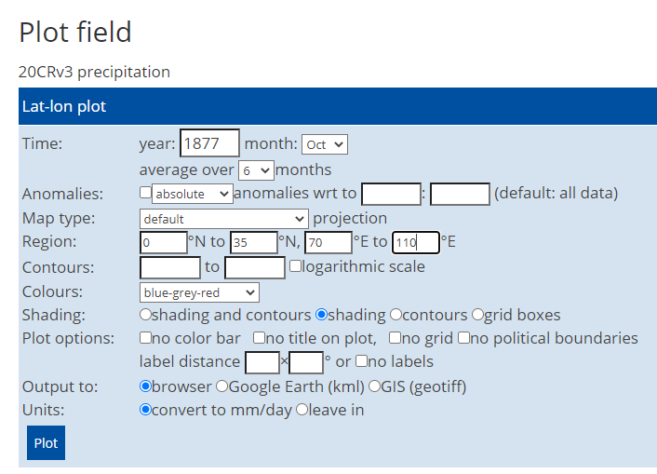
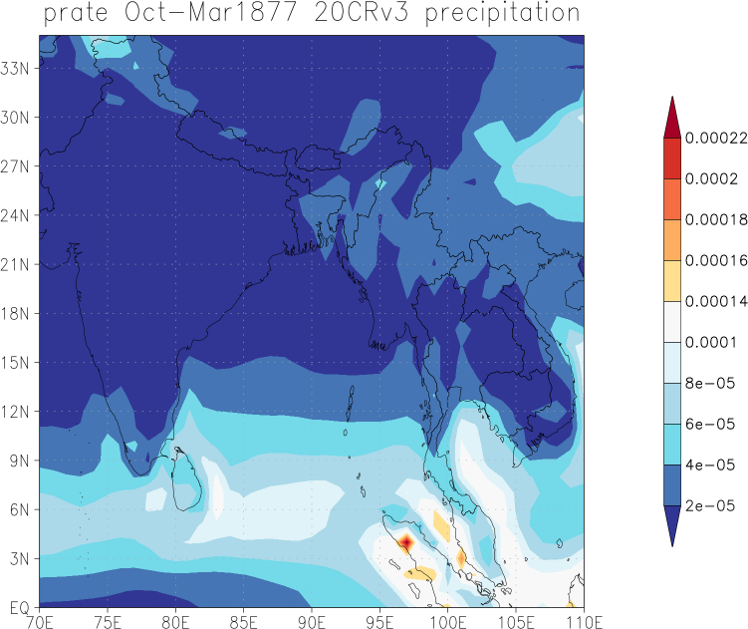
CASE STUDY 2: 1877-1878 El Niño
Choose 1877 from Oct to Mar so average over 6 months to see the precipitation data over the Indian Ocean domain
0-35N and 70E to 110E
Can see that the precipitation rate is not very high over most of India (dark blue) for those 6 months which would have contributed to the Great Famine of 1877 as many crop yields would have failed with insufficient water and the effect of warmer temperatures we have seen in previous slides

Slide 20
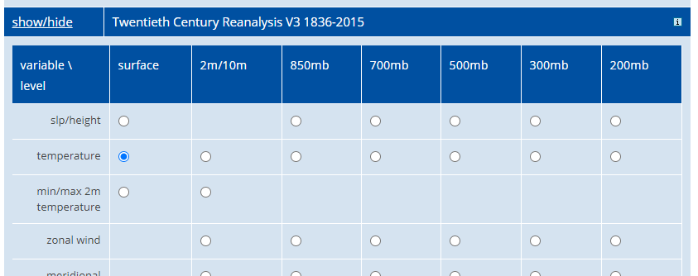
CASE STUDY 2: 1877-1878 El Niño
Select Monthly Reanalysis fields and
Choose 20 Century Reanalysis Data V3 and
Choose temperature

Slide 21
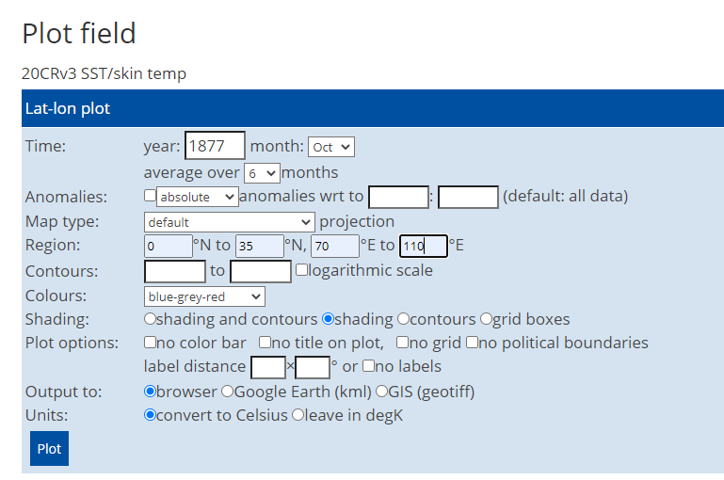
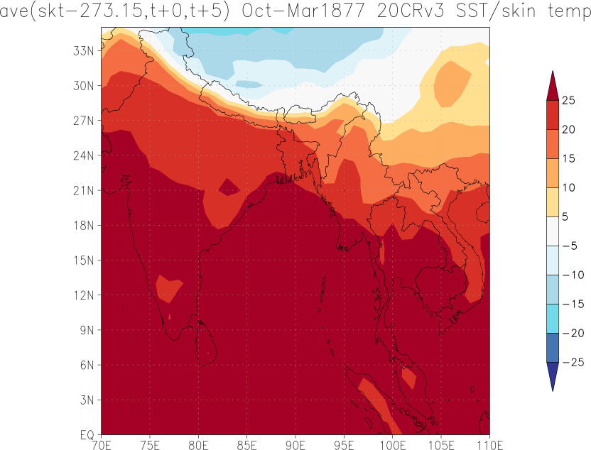
CASE STUDY 2: 1877-1878 El Niño
Choose 1877 from Oct to Mar so average over 6 months to see the temperature data over the Indian Ocean domain
0-35N and 70E to 110E
Can see that the average temperatures for that 6 month period during 1877/1878 were around 20-25 which means that some days would have been much warmer than that and caused much heat stress to crops.

Slide 22
Can you try and analyse other variables to see evidence of the strong 1877/78 El Nino event using KNMI?
☺

