Slide 1
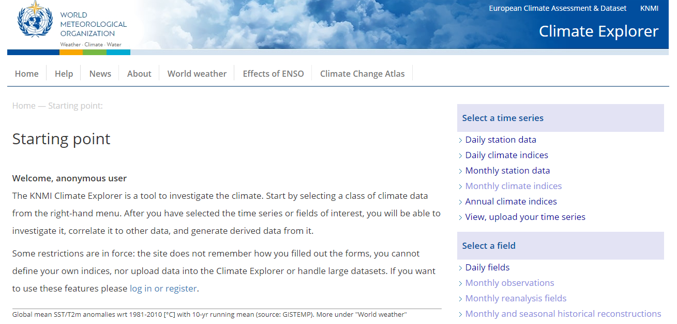
Summer School KNMI CLIMATE WORKSHOP: 27 May 2021

Slide 2
Workshop Outcomes:
An introduction to KNMI which allows you to access and analysis climate data
Demonstrate how to obtain and analyse climate data for 3 different case studies from Day 1 of the Summer School
1. CASE STUDY: 1864 Kolkata Cyclone (I will demo this case study)
2. CASE STUDY: 1877-1878 El Niño
3. CASE STUDY: 1944-1945 Typhoons

Slide 3
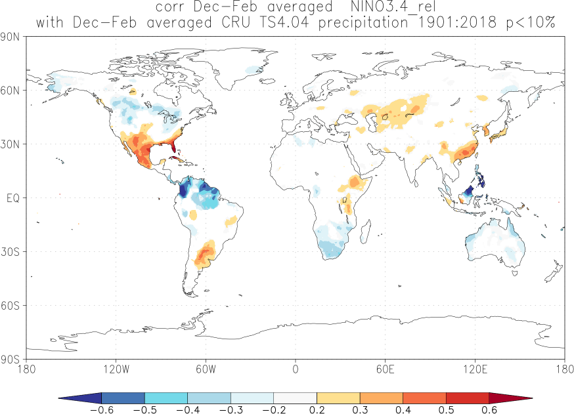
Site for doing research remotely
KNMI Climate Explorer (Geert Jan van Oldenborgh)
Site allows external users to produce temporal and spatial averages of climate variables such as rainfall from global, gridded data sets and relate these to global data sets such as SSTs.

Slide 4
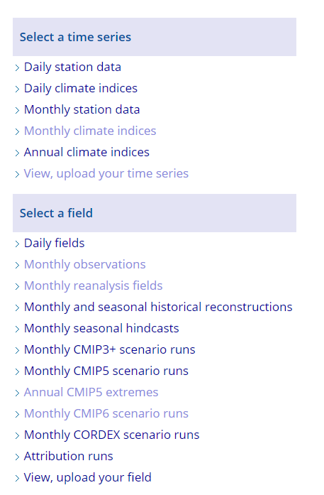
Types of data
We are dealing here with data which covers both
space (the world) and time
We will deal mainly with DAILY and
MONTHLY during this workshop

Slide 5
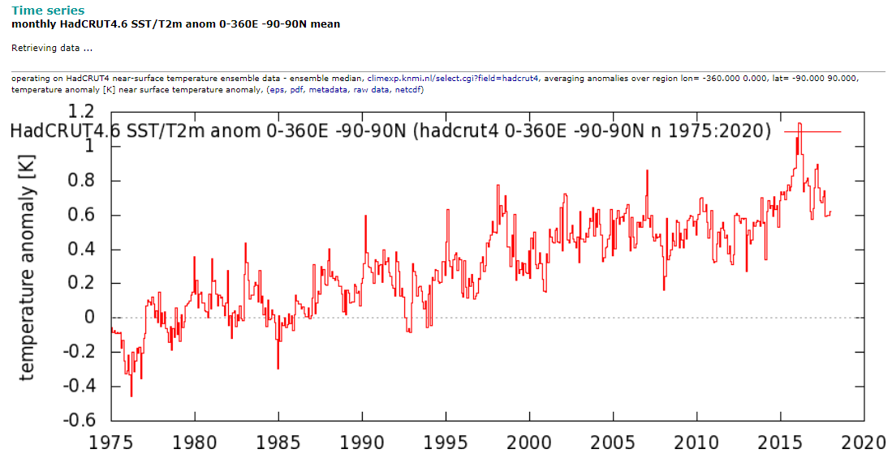
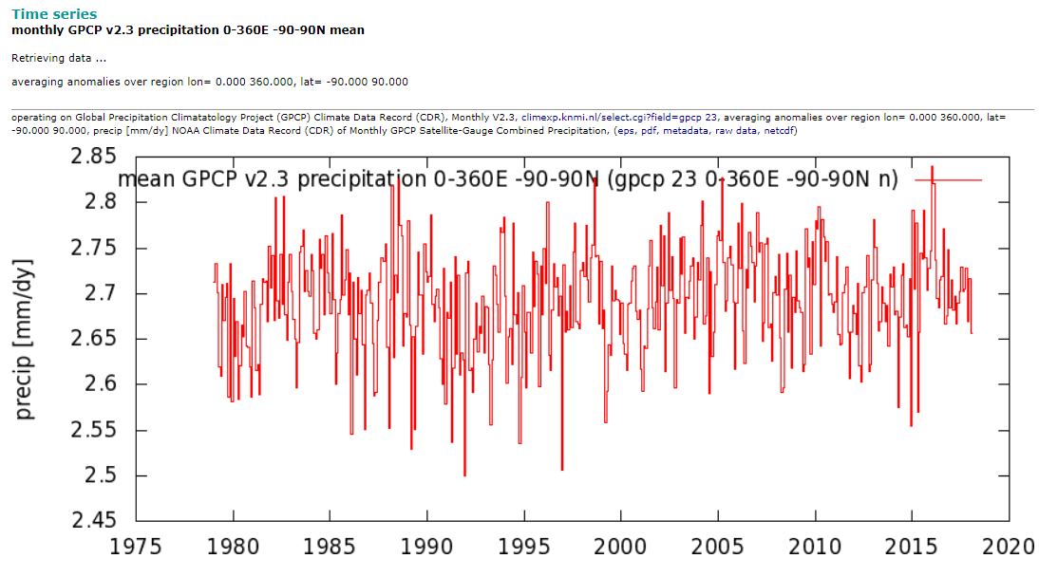
Types of data: TIMESERIES
Historical Trends of Precipitation versus Temperature (time series analysis)
Temperature has a much clearer historical trend (clearly increasing)
However pr is highly variable and more difficult to identify trends
Temperature Trend Globally
for 1975-present
Precipitation Trend Globally for 1979-present

Slide 6
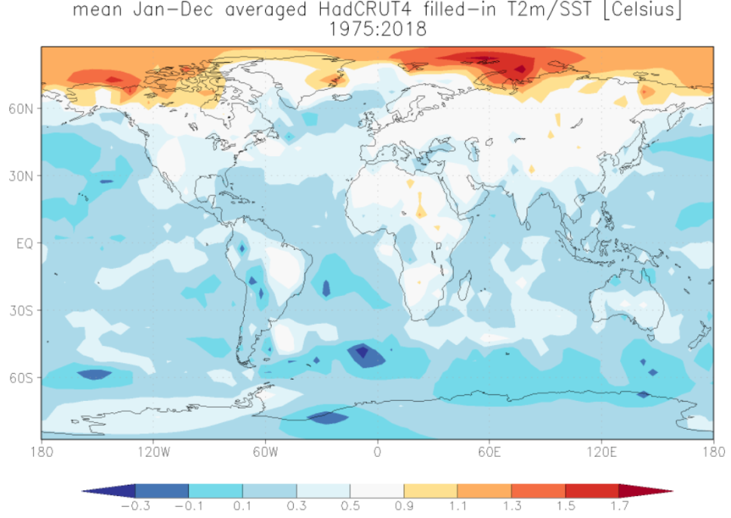
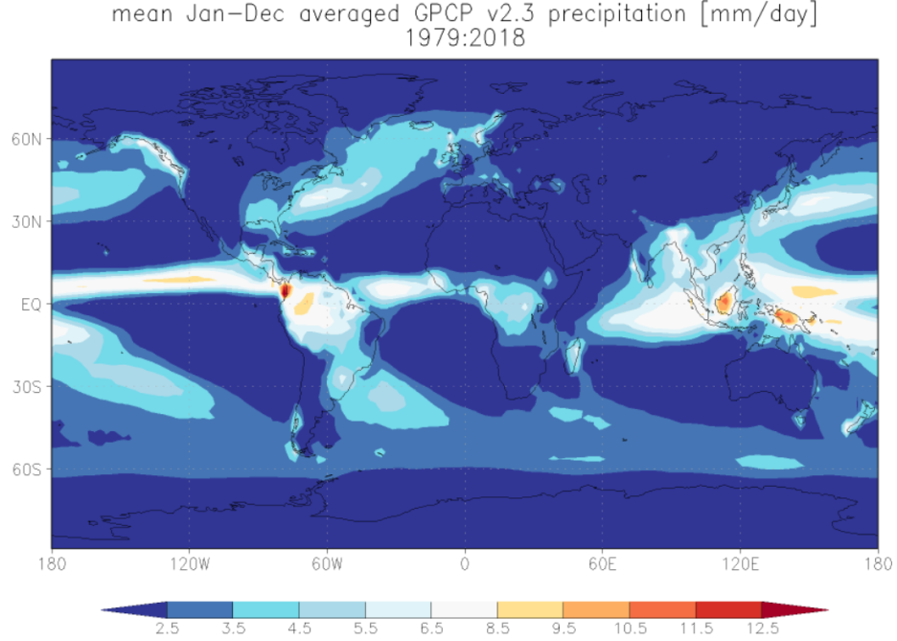
Types of data: SPATIAL
Historical Trends of Precipitation versus Temperature (spatial analysis)
Temperature spatially is warming much more rapidly in the NH than SH
Pr has spatially increased more along the equatorial regions (wet – get wetter?)
Temperature Trend Globally
for 1975-present
Precipitation Trend Globally for 1979-present

Slide 7
How to choose your region of interest
North +
Coordinates in KNMI are + for N and E
and – for S and W
West -
East +
South -

Slide 8
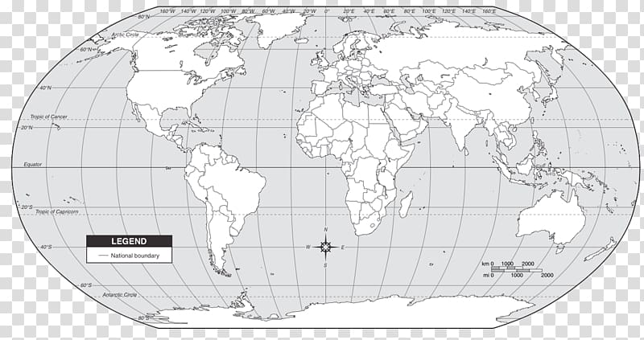
Choose your region of interest
Example southern Africa is
-40 to 0
0 to 50
Example UK is
50 to 60
-10 to 2
North +
West -
East +
South -

Slide 9
Choose your region of interest
Red Box: Indian Ocean World domain
-50 to 35
20 to 140
North +
West -
East +
South -

Slide 10
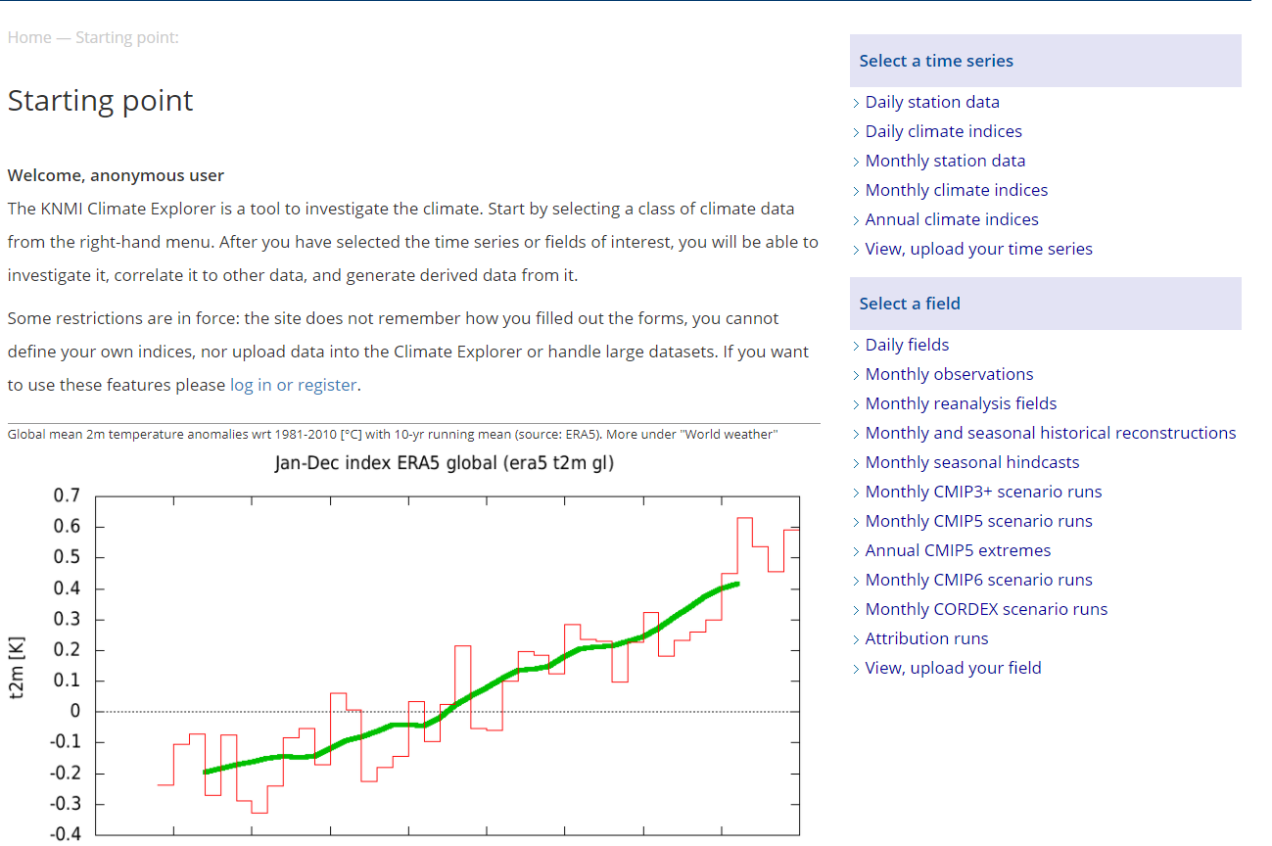
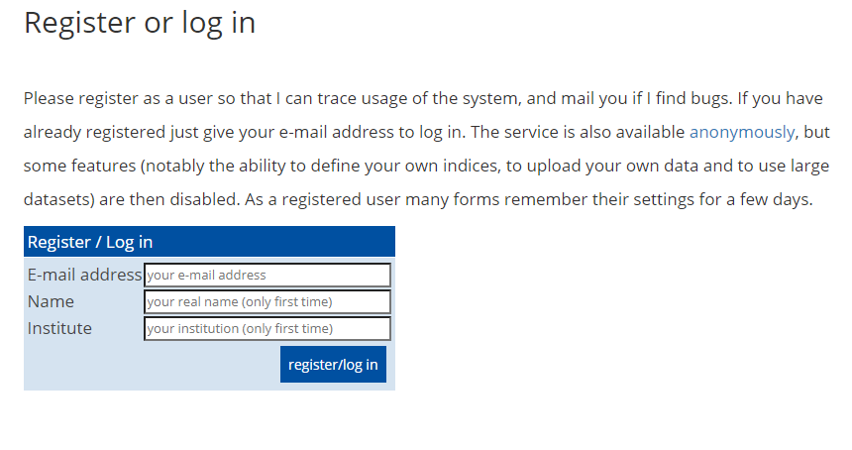
Getting started – go to KNMI Climate Explorer in Google Chrome and Login
Click here to login in with your email, name and institution
Insert you details here and click register/log in
https://climexp.knmi.nl/start.cgi

Slide 11
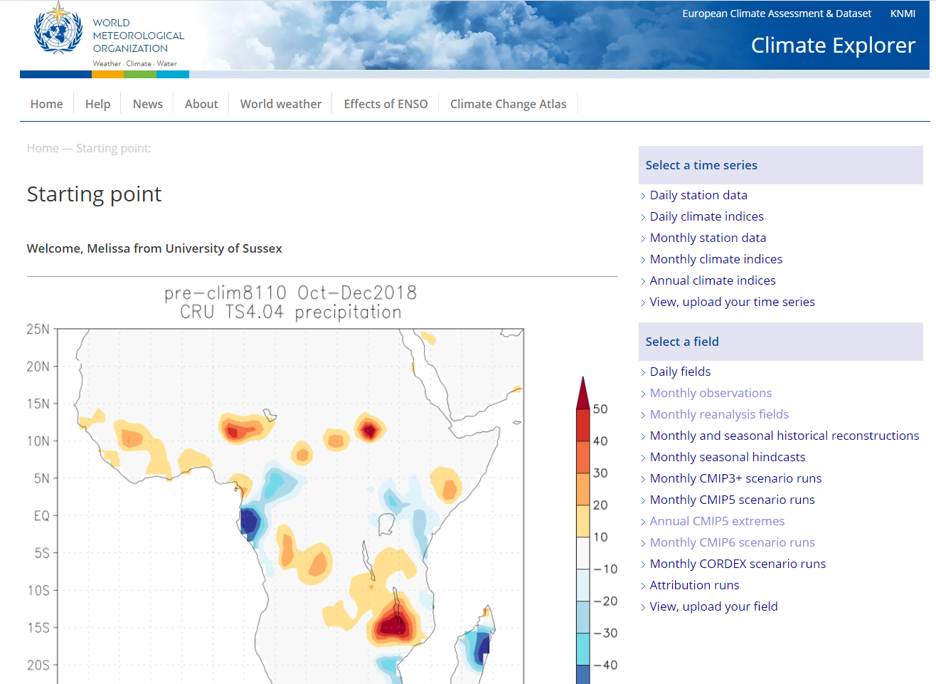
Access to data on KNMI
Single time series either (i) at one location e.g. rainfall in Brighton or (ii) some area-average index e.g. global mean temp, ENSO SSTs etc (iii) you can upload you own timeseries
Gridded/spatial (usually global) datasets) either (i) observed rainfall (ii) climate model projections (‘scenario run’ SSP585). Also provides access to (iii) seasonal and decadal predictions and reanalysis data (Historical observations interpolated using a model: very good source of fully global historical conditions)

Slide 12
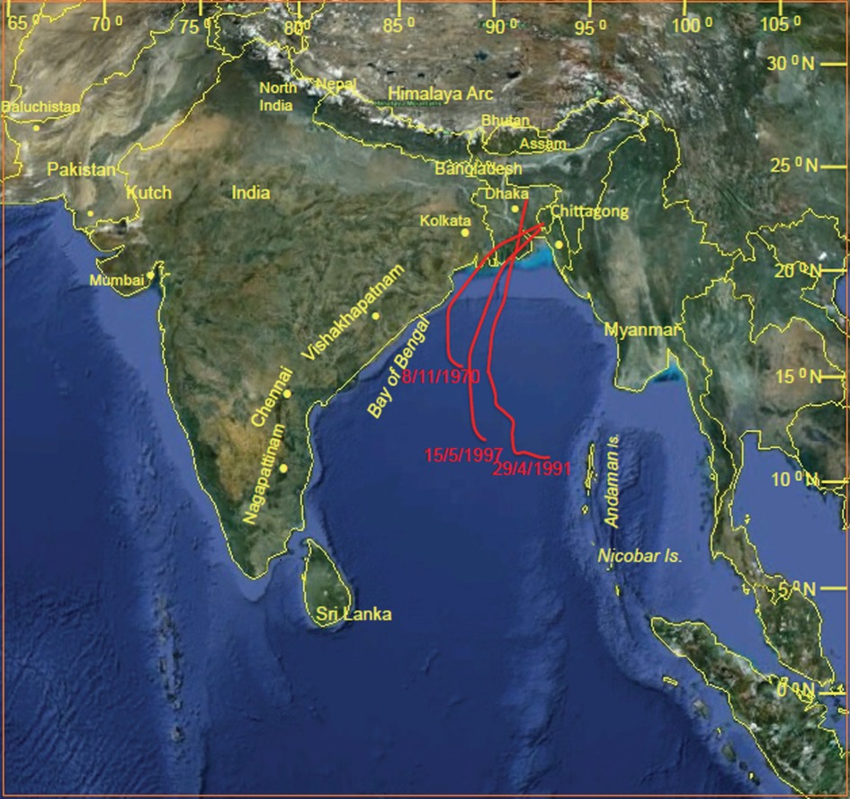
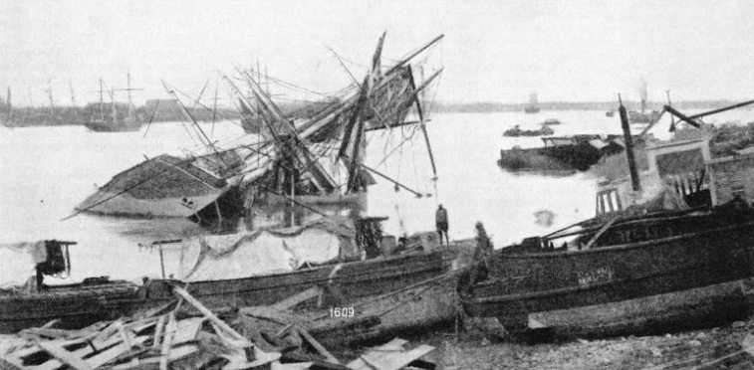
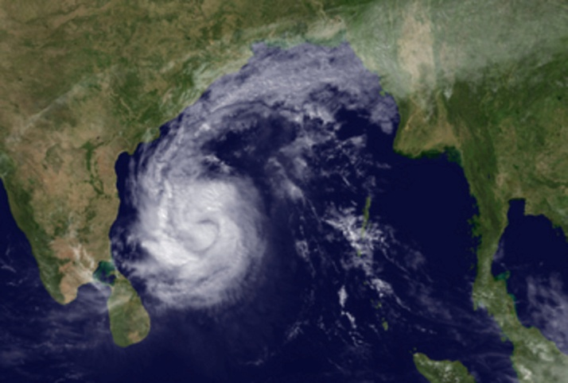
CASE STUDY 1 : 1864 Kolkata Cyclone
Date: 5 October 1864
Domain for this case study:
0 to 35N
70E to 110E
Low pressure
Warm SSTs >28 degrees C
Heavy winds and rainfall

Slide 13
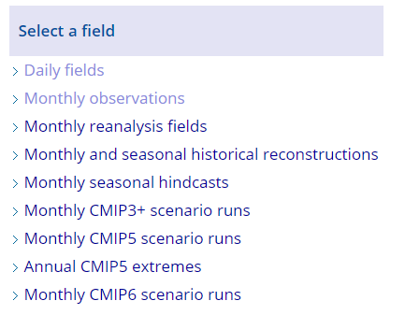
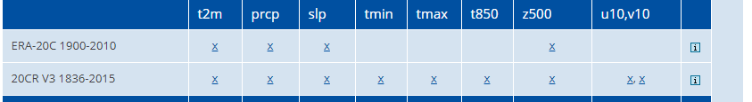
CASE STUDY 1 : 1864 Kolkata Cyclone
Let’s start off selecting Daily Fields and
Choose 20 Century Reanalysis Data and
Choose slp which is sea level pressure

Slide 14
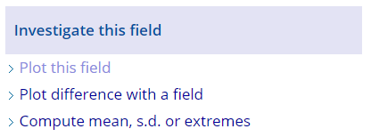
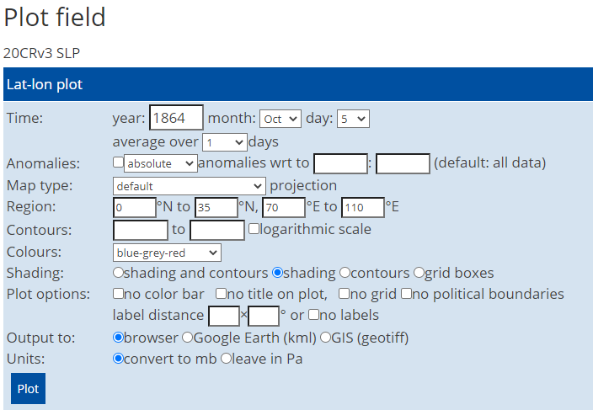
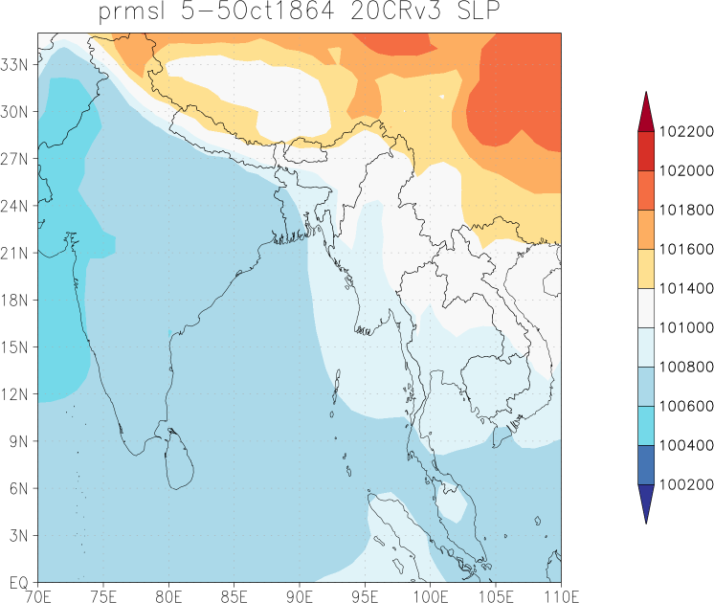
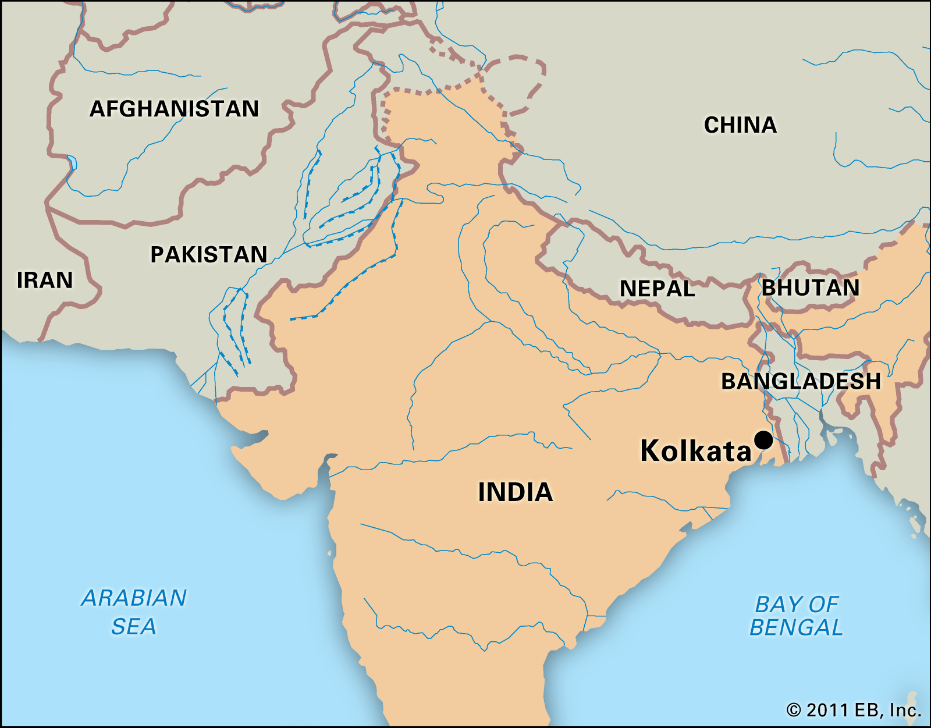
CASE STUDY1 : 1864 Kolkata Cyclone
Select plot this field SLP and plot for the exact day the event occurred 5 October 1864
Notes:
Not high enough resolution to see the detail of the lower pressure of the tropical cyclone

Slide 15
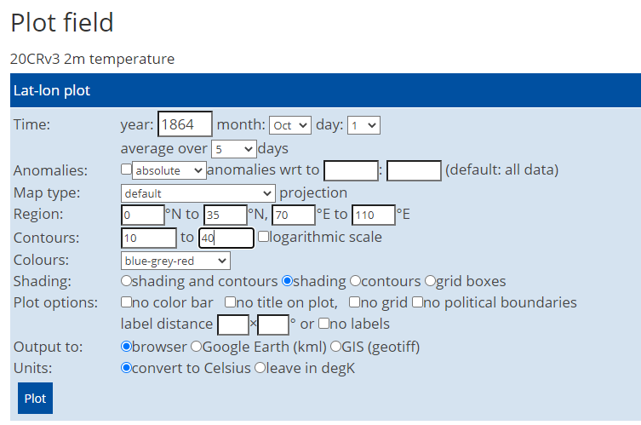
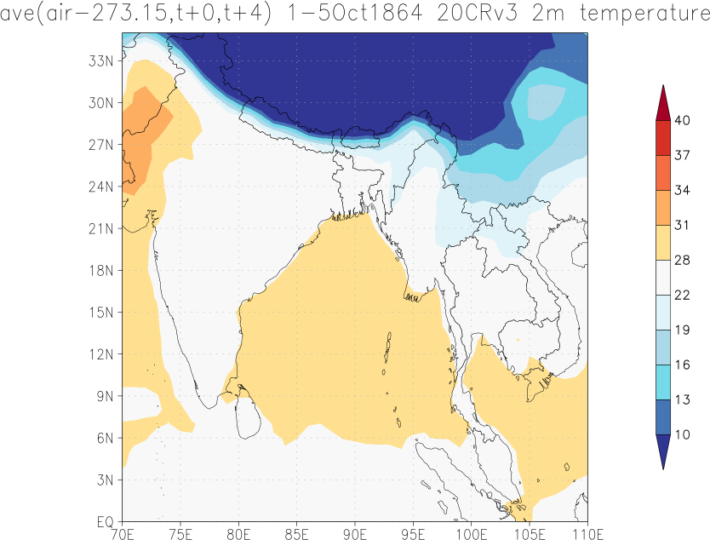
CASE STUDY1 : 1864 Kolkata Cyclone
Select plot this field – Temp 2m temperature for 5 days before leading up to the 5th of October 1864
Change contours to 10-40 degrees Celsius
SSTs 28 degrees and above in the Indian Ocean basin for the formation and maintenance of this tropical cyclone for the 5 days leading up to the event

Slide 16
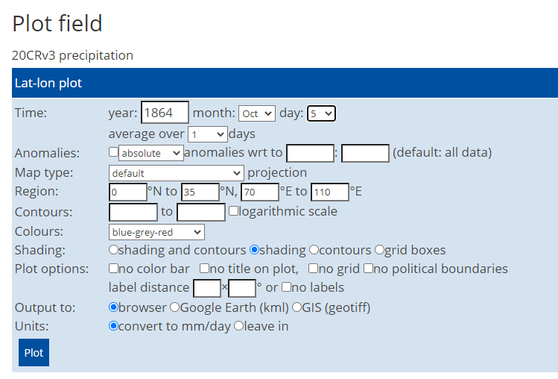
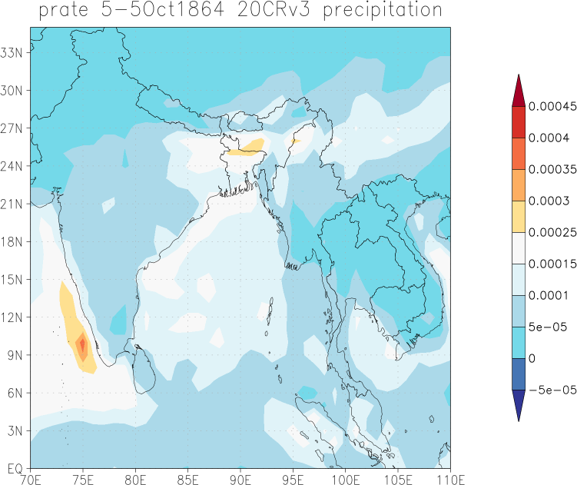
CASE STUDY1 : 1864 Kolkata Cyclone
Select plot this field – precipitation for the 5th of October 1864
On the 5th of Oct the precipitation rate was clearly high in the Indian Ocean Basin and over the Kolkata region which would be due to the tropical cyclone

Slide 17
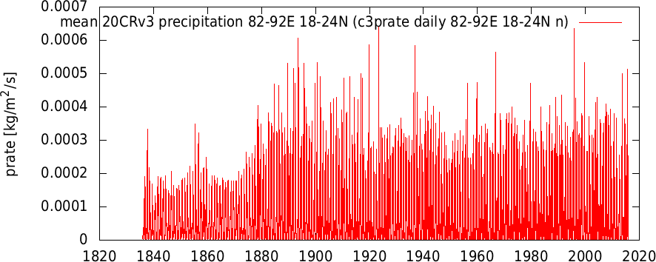

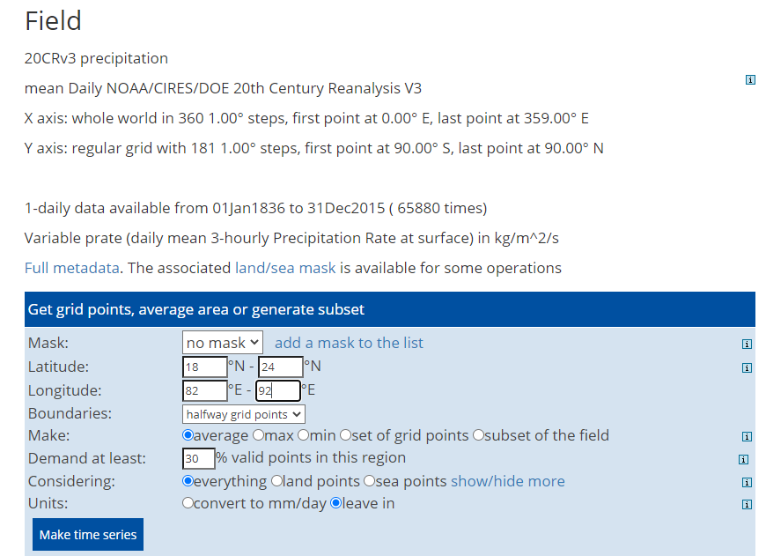
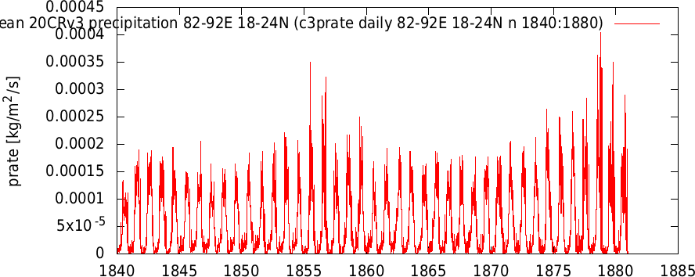
CASE STUDY1 : 1864 Kolkata Cyclone
Lets make a time series over a smaller domain over Kolkata to see how precip changed over time.
Domain 18N to 24N and 82E to 92E
Please note this takes some time to load as it is daily data.
In 1864 it does not appear to show very high precipitation in the dataset, this may be due to a category 1 cyclone which did not produce very high rainfall but the wind speed may have been more damaging factor

Slide 18
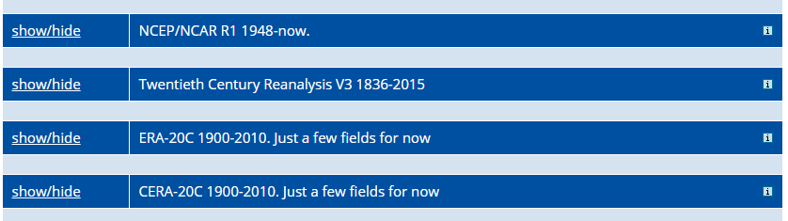
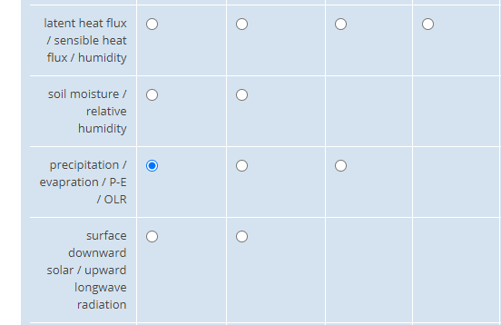
CASE STUDY1 : 1864 Kolkata Cyclone
Select Monthly Reanalysis Fields and
Choose 20 Century Reanalysis Data V3 and
Choose precipitation

Slide 19
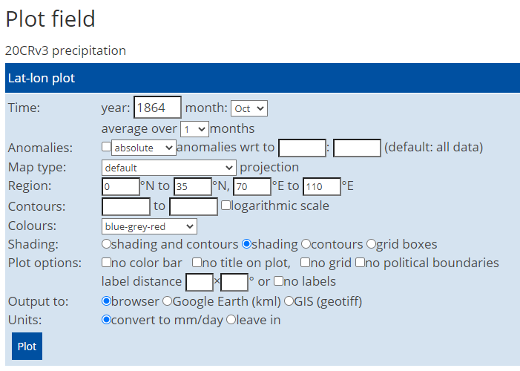
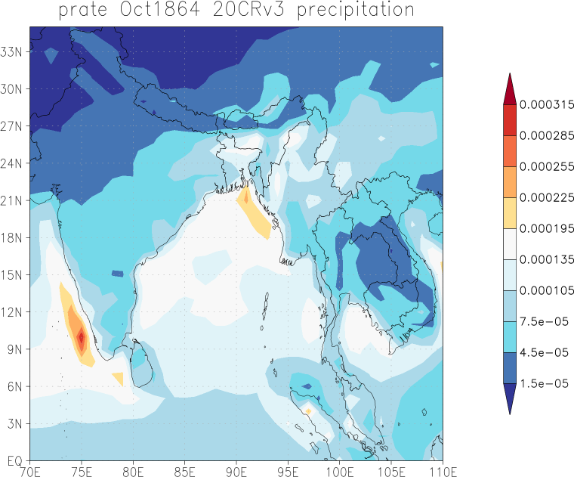
CASE STUDY1 : 1864 Kolkata Cyclone
Select plot this field
Do it for Precipitation and average over 1 month - October

Slide 20
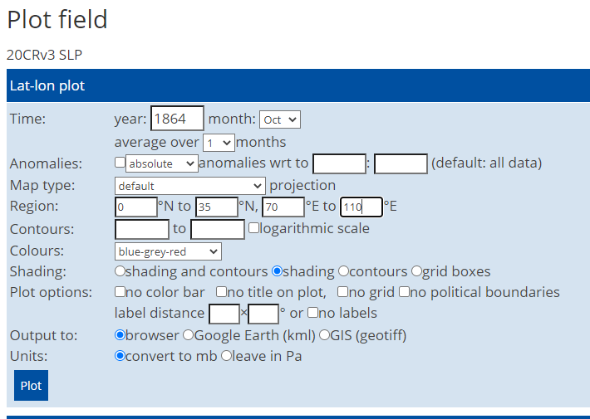
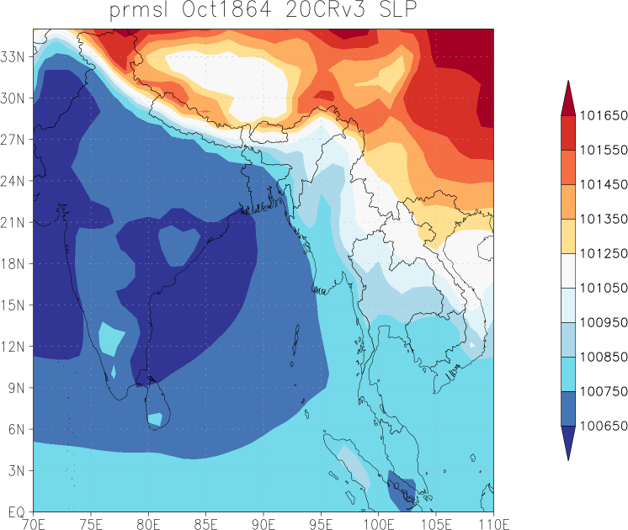
CASE STUDY1 : 1864 Kolkata Cyclone
Select plot this field
Do it for SLP – sea level pressure

Slide 21
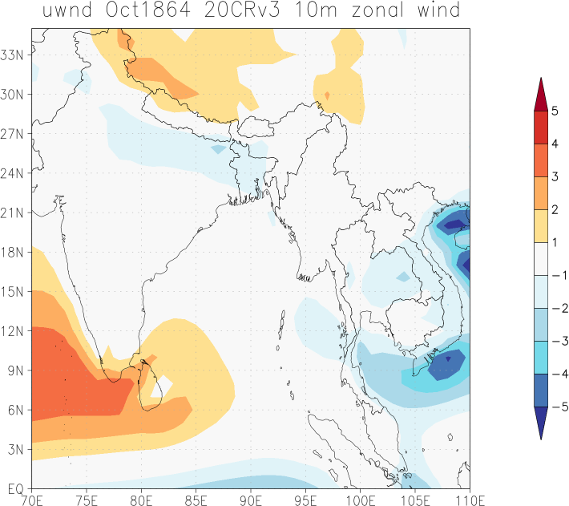
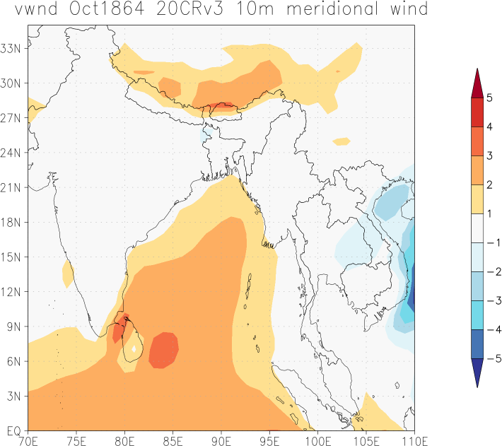
CASE STUDY1 : 1864 Kolkata Cyclone
Select plot this field
Do it for U and W winds – zonal (E/W) and meridonal (N/S) winds
Notes:
zonal wind is positive if it blows from the west and negative if from the east
positive meridional values indicate wind blowing from south to north

Slide 22
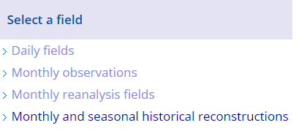
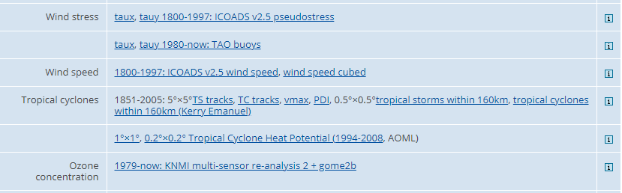
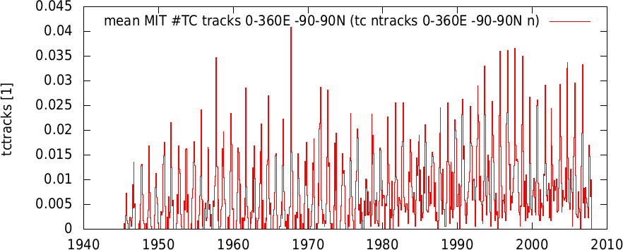
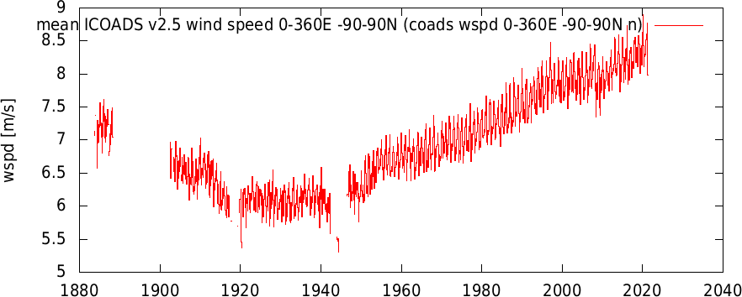
CASE STUDY1 : 1864 Kolkata Cyclone
Let’s have a look at what Monthly Observations KNMI has for Tropical Cyclones and Case Study 1:
Data only starts from 1945 for TC data fields
And wind speed data has missing values for our period of interest – will use them in the other 2 case studies

Slide 23
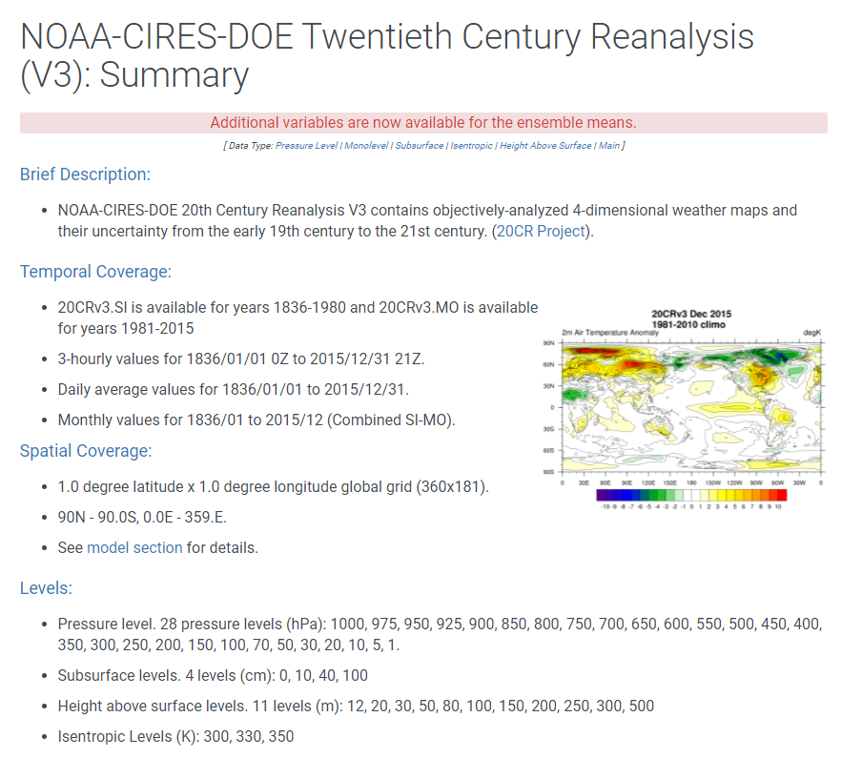
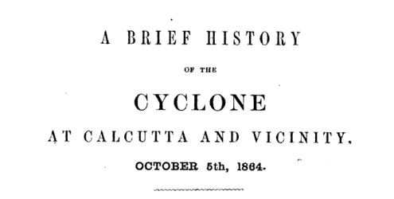
CASE STUDY1 : 1864 Kolkata Cyclone
Limitations to analysing climate data of this event:
Low resolution data 1 degree x 1 degree which = ~100km x 100km grid boxes and cyclones happen on smaller scales so not able to clearly see the event in the data.
This cyclone was only a Category 1 cyclone but produced much damage and killed many people.
This was the oldest case study out of the 3 when less observational data was collected therefore more uncertainty as we use models to fill the gaps and interpolate.

