Slide 1
Academics and Activism
CONNECT or DISCONNECT?
Prof Minoti Chakravarty-Kaul
Founder Rahat for Shamilat-deh
Formerly Dept of Economics Lady Shri Ram College

Slide 2

Academia and Activism
Connect or Disconnect?
In 1977 the Bisagama villagers protested against the renewed lease of 123 acres from the common lands of Kanjhawala
These acres were distributed by the Delhi Administration to harijans landless poor – poverty alleviation a 'public cause'.
Newspapers called it caste and class war;
It was neither;
Without understanding the history of land use and property rights, the analysis was blind.
The fault lay with academia.

Slide 3
Academic Blind Spots
My story is based on my own findings about academic blind spots which were exposed with this protest. Clearly policies like poverty alleviation served only to deprive the village cattle of the poor more than any other villager the grazing pasture they needed!!! There were serious environmental consequences too.
My findings also indicate the centrality of institutions (laws) - tampering with land records has far reaching consequences for the ecological relationships of those who share natural resources.
The evidence from historical records showed how land records minimised uncertainty in the Indian country-side and supported rules which took care of not only cheating and shirking rules of use, but also how to avoid a "tragedy of the commons".

Slide 4
Tragedy of the Commons?
Garrett Hardin's Essay 1968 and Population
Metaphor of Shepherd and Grazing Commons
Private Gain and Social Cost : Free Riding?
Absence/Breakdown in rules to govern the access, use and decision making in resources
Uncertainty : Information, Monitoring, Sanction.

Slide 5
History, Analysis
&
Activism
1.Sidney and Beatrice Webb - their 10 volume work on self-governance of communities, the cleansing of the Thames and designing of worker's houses in London and the most important founding LSE 1895, New Statesman 1913.
2. Lord Everseley's monumental work on “the Battle during the last Forty-five years for Public Rights over the Commons, Forests and the Footpaths of England and Wales,” published in 1910. This culminated into movements like that of the Open Spaces Society and Octavia Hill's National Trust which ultimately inspired the setting up of Garden cities in the UK.
3. Dr. Andrew Humphries (who has taught in Newton Rigg in Cumbria) founded The Foundation for Common Lands in Uk which has taken up the case of pastoral resources in the UK and has gained support from the Prince's Trust for young people in rural areas.

Slide 6
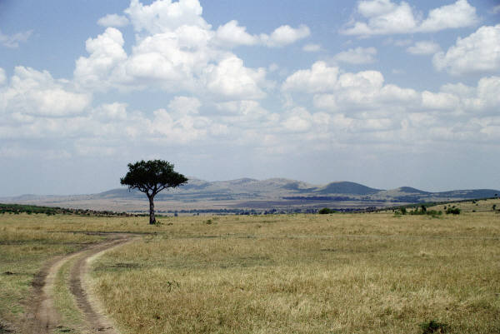
THE WASTE
The Waste in Village & in Region Who controls it?
The Waste in property The Waste in use
Access : Open, Limited & Closed Fallows : Banjar Kadim & Banjar Jadid
Notes:
The term waste signifies fallows even in the English language. Terms used for ‘waste’ were banjar jadid and banjar kadim and these were fallows within agrarian villages and outside them and the grazing in these were designed to complement the resources in the open steppes, grasslands in the khadir and bangur areas and pasture in the forests.

Slide 7
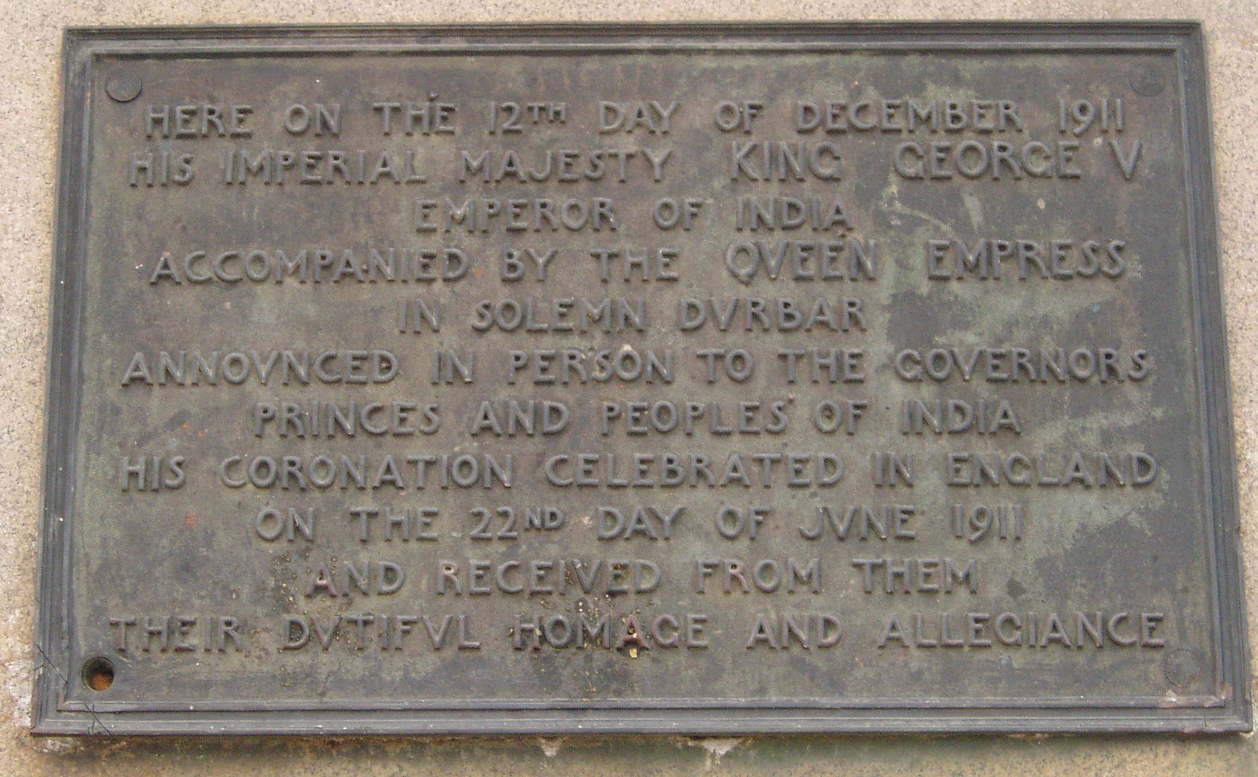
1911
The Imperial Durbar
Land Acquisition

Slide 8


Compulsory Acquisition of Land
& 'Public Purpose'
NEW DELHI
Land Acquisition Act 1894
Imperial
1911-1947
Enclosure and Clearance
Delhi Land Reforms Act 1954
Republic
1947-2011
Open access
& Free Riding

Slide 9
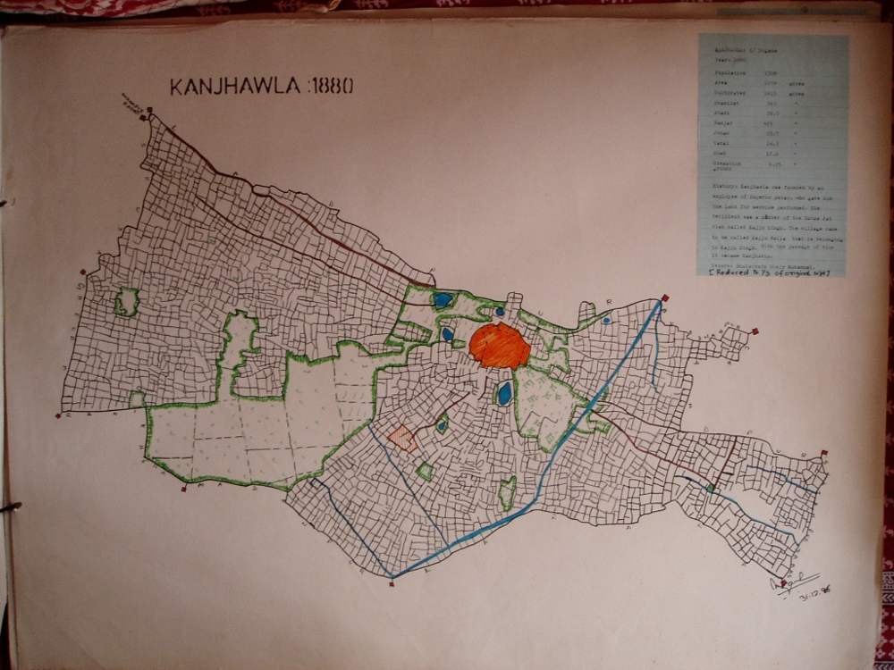
Open Field Village
Risk Aversion & Risk Dispersal
Notes:
Complementariy in land use
Risk Aversion & Risk Dispersal
In Village
I use Kanjhawala as a representation of complementarity of arable and pastoral land-use and the logic of the open field system with scattering and compact holdings : Risk averse and Risk dispersal strategy of land-use and property rights.

Slide 10
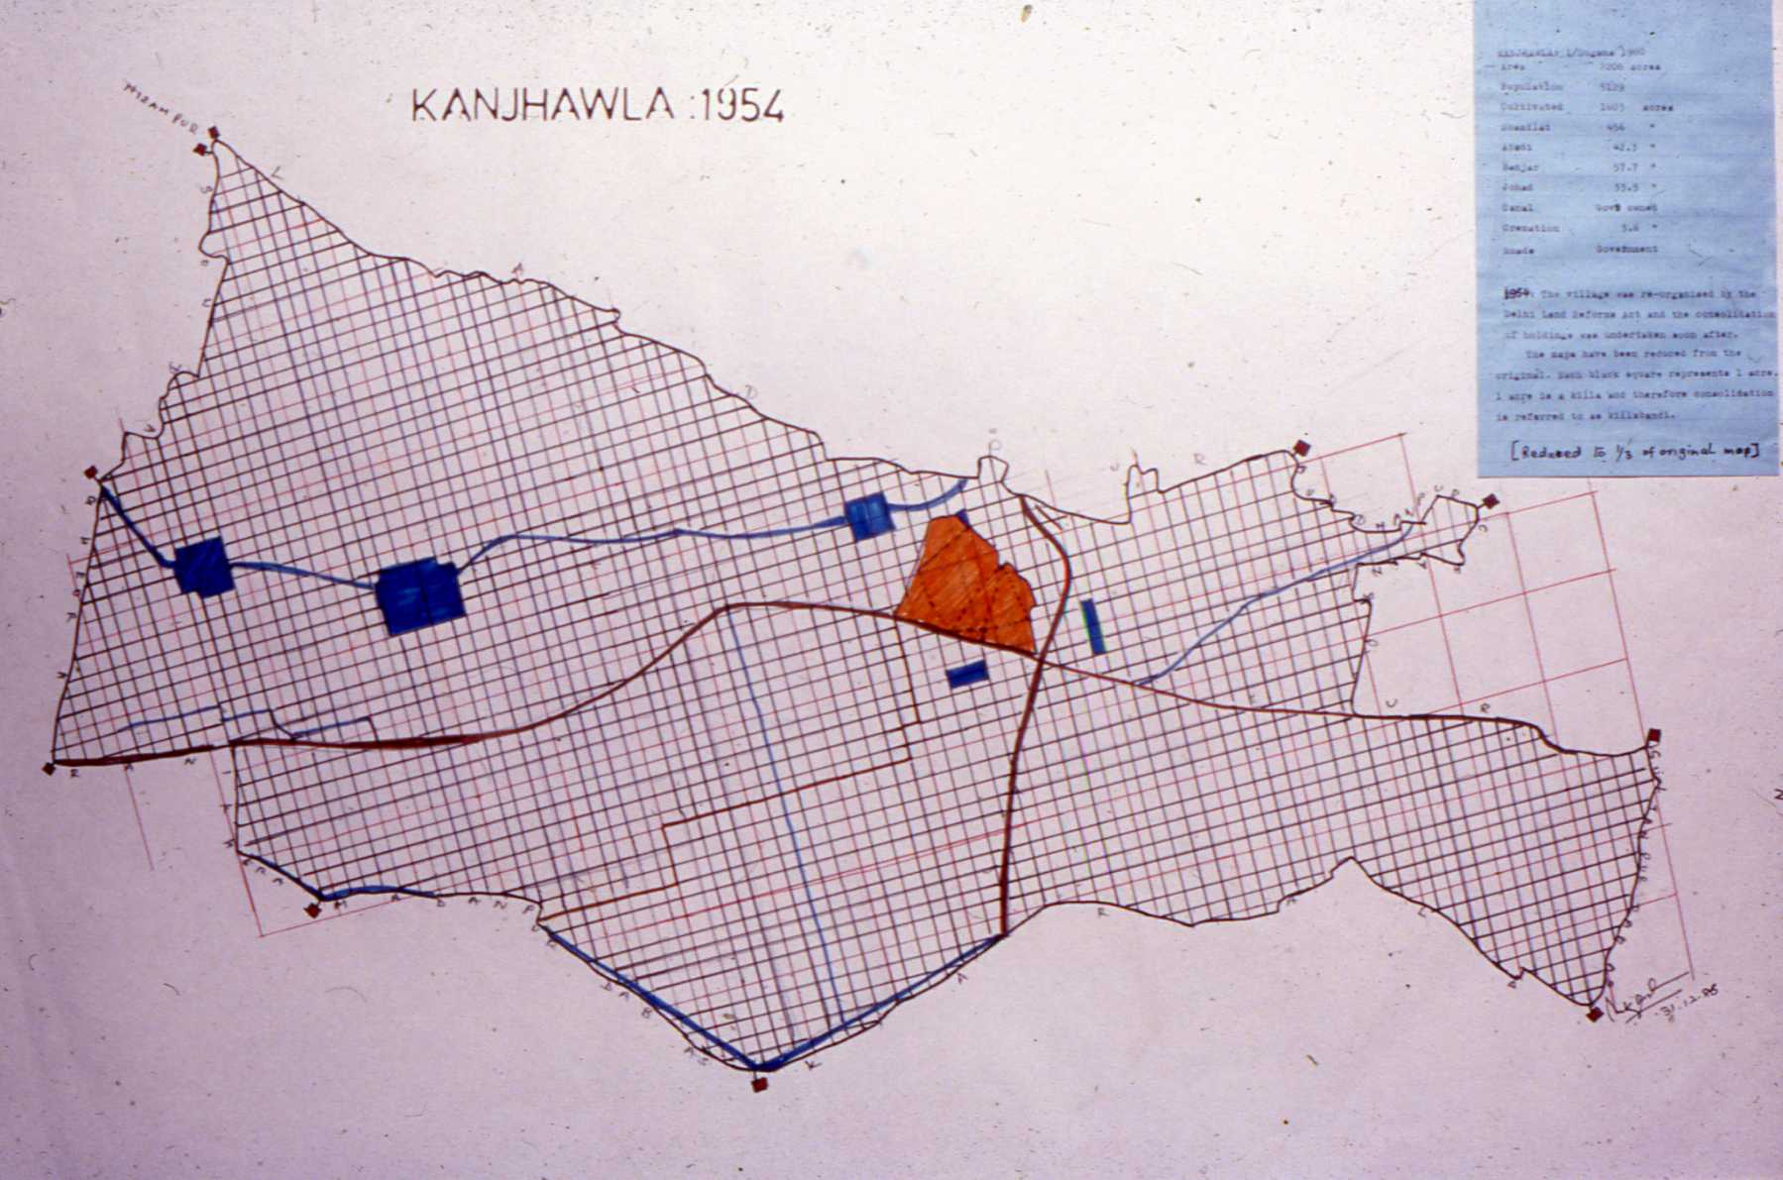
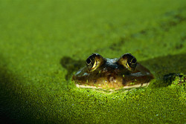
Kanjhawala 1954
Consolidation & Land Reforms

Slide 11
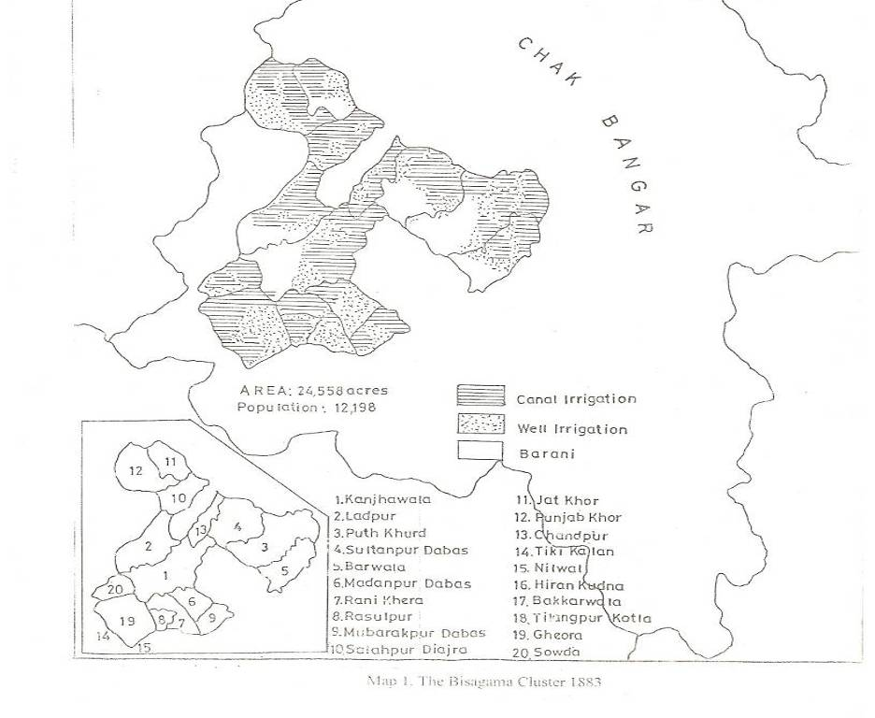
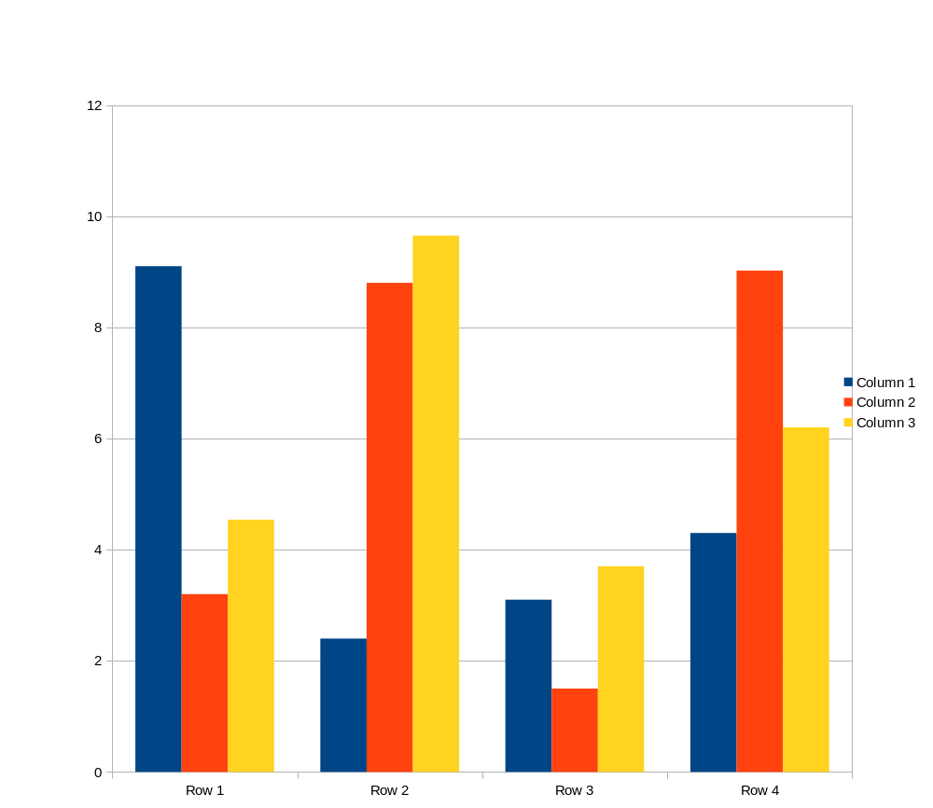

Slide 12
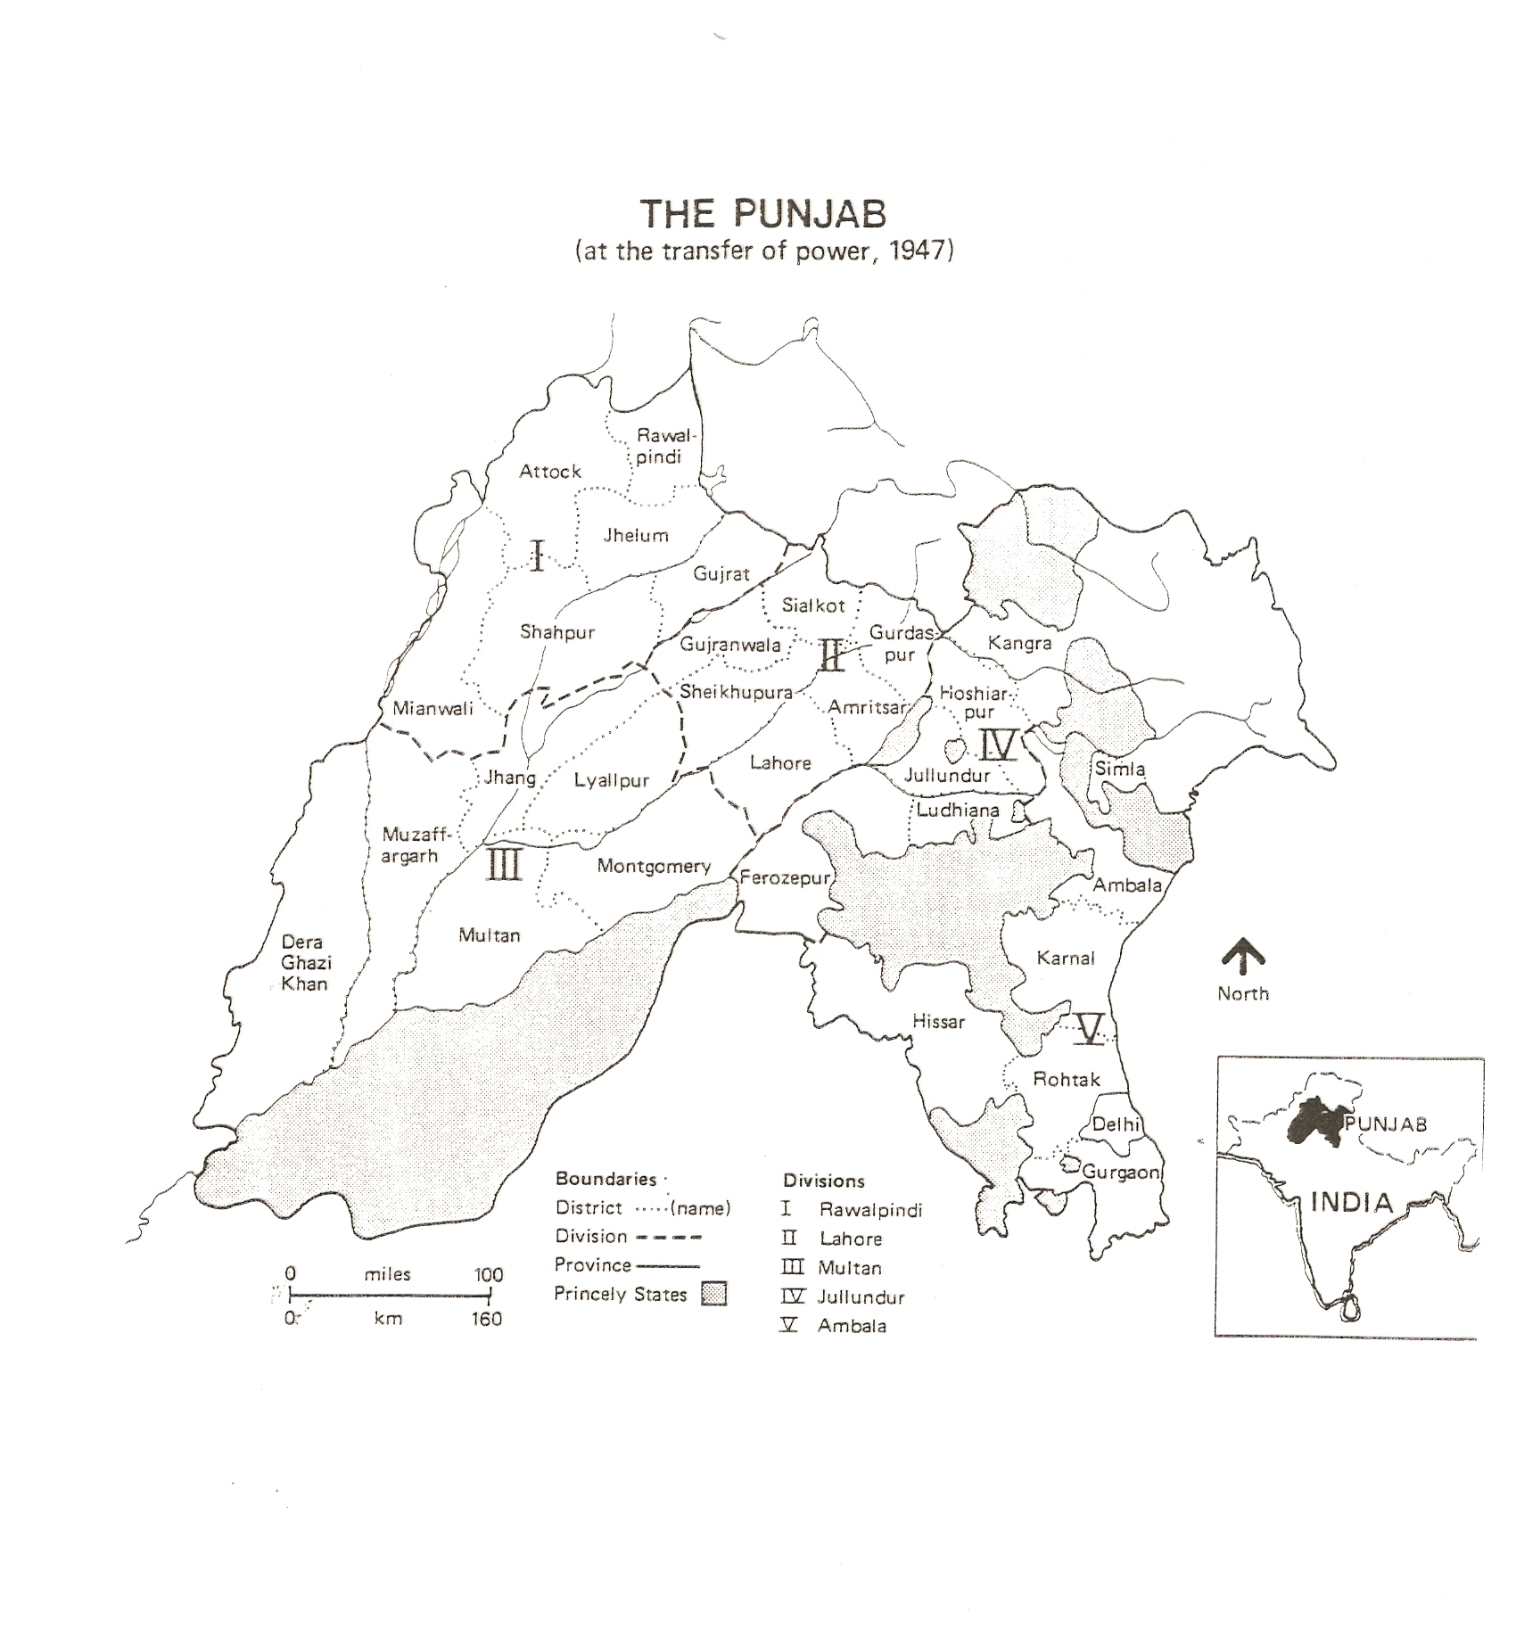
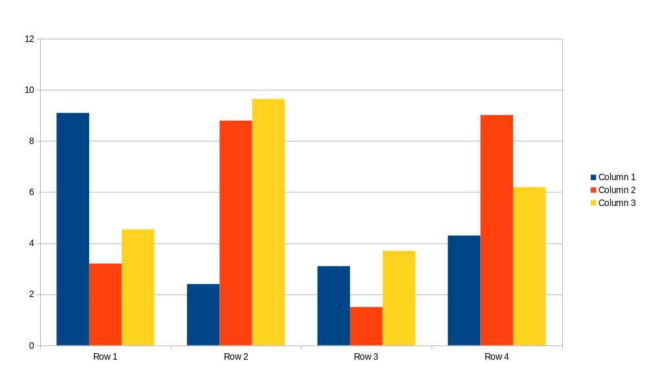
THE PUNJAB
At transfer of Power 1947

Slide 13
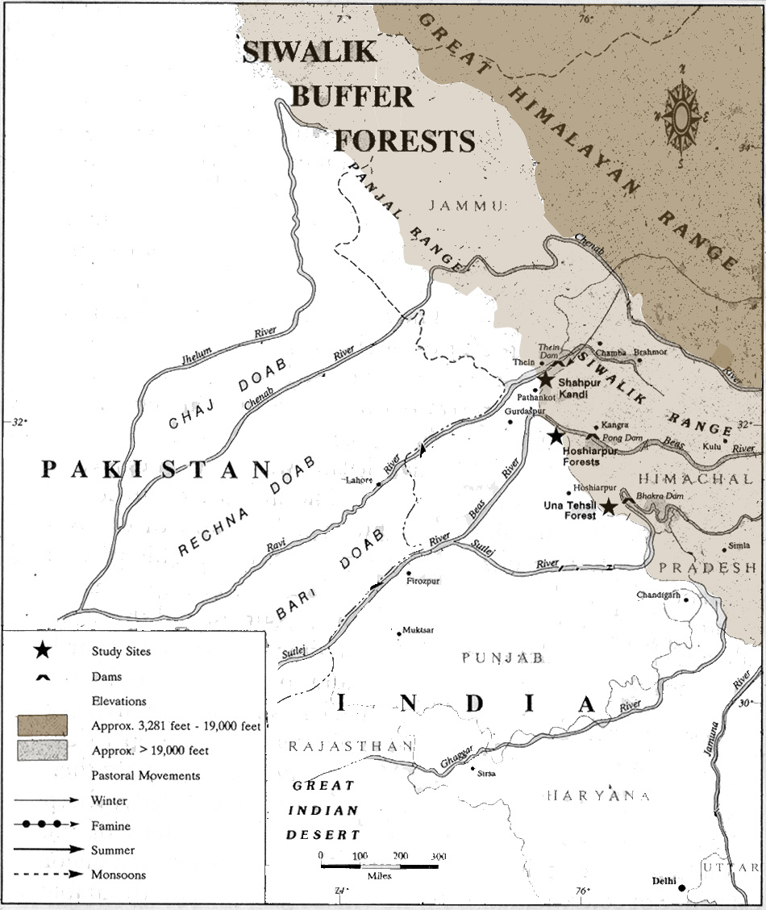
THE PUNJAB: Physical Map

Slide 14
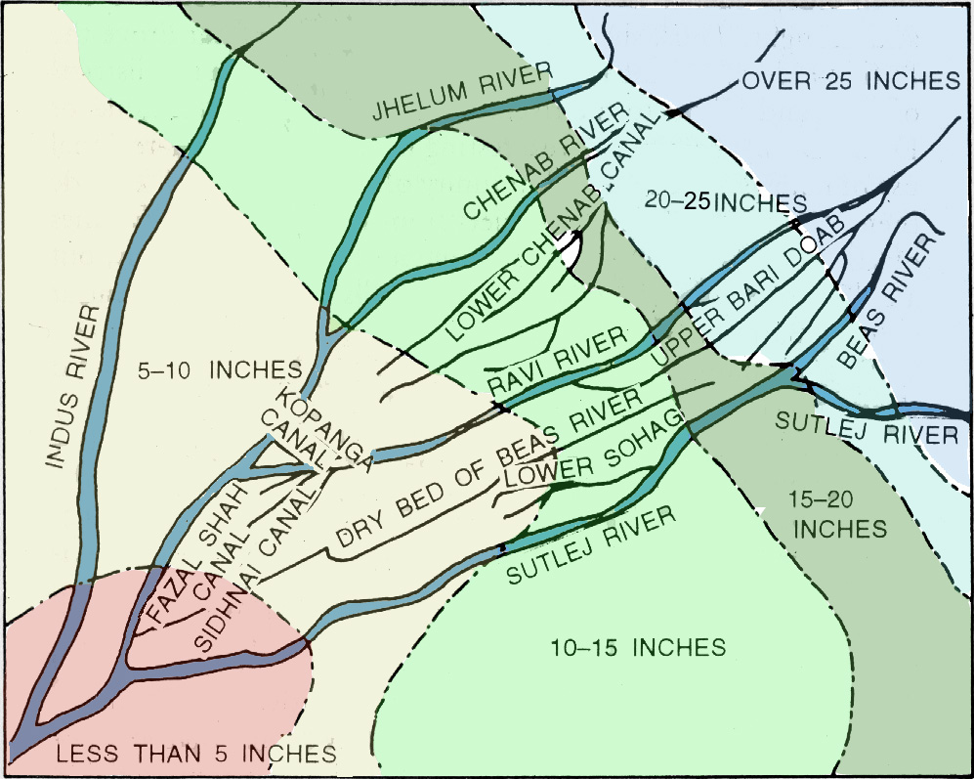
Regional Complementarity

Slide 15
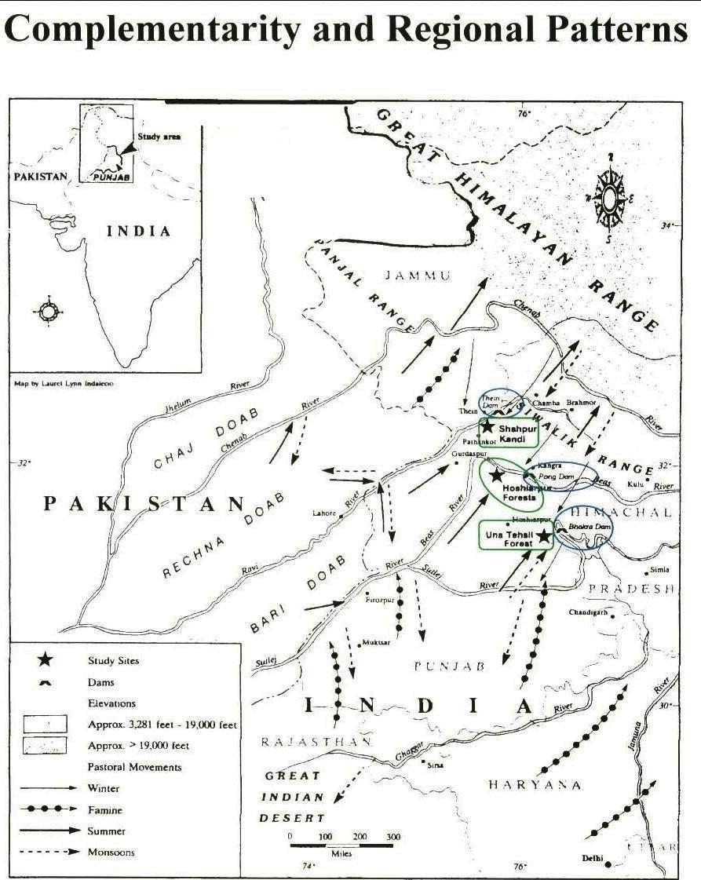
Complementarity and Regional Commons

Slide 16
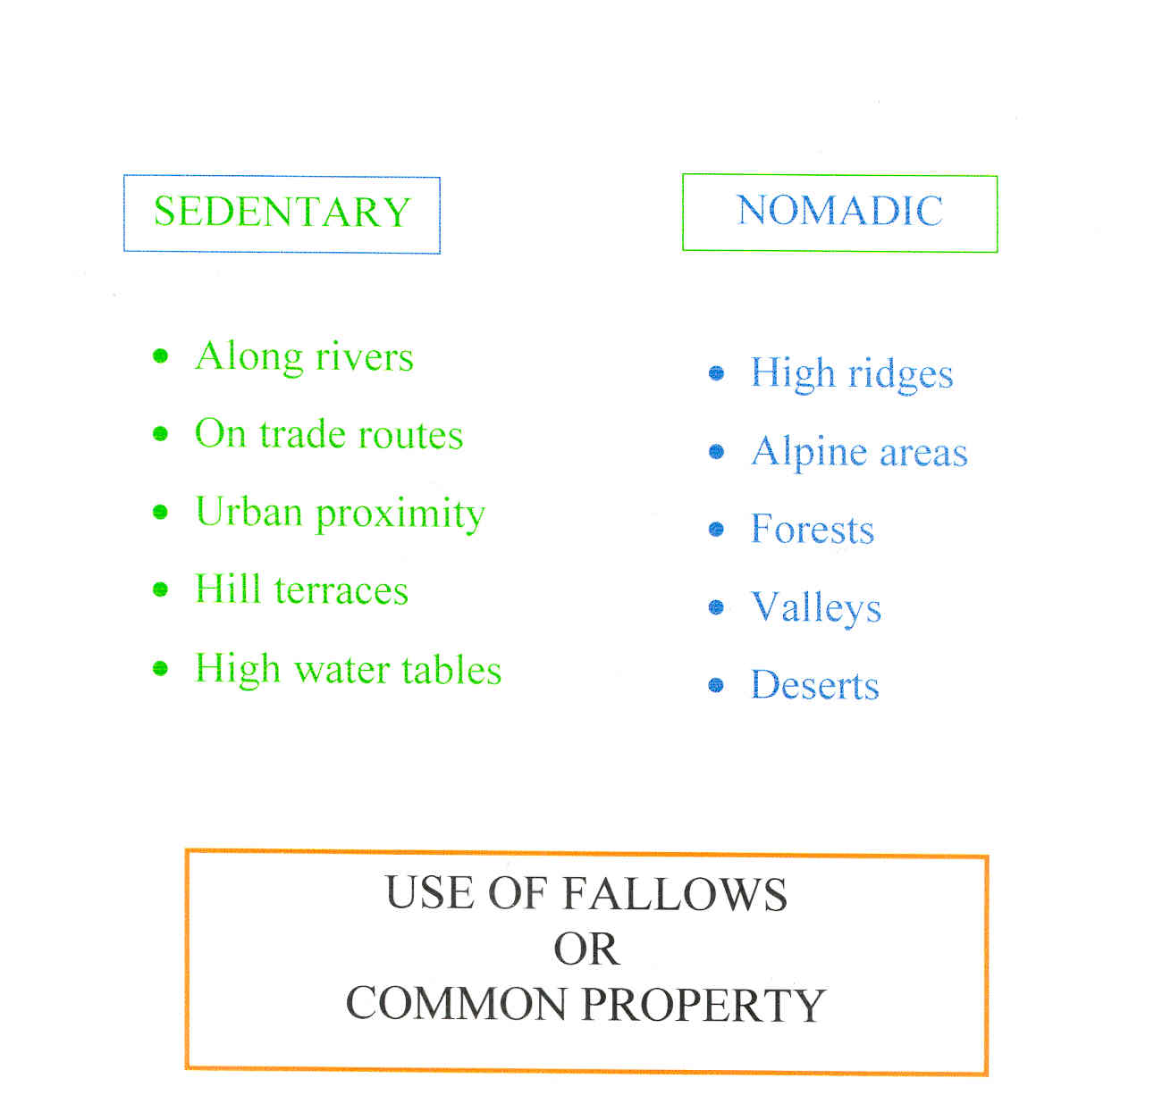
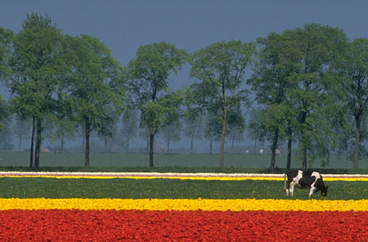
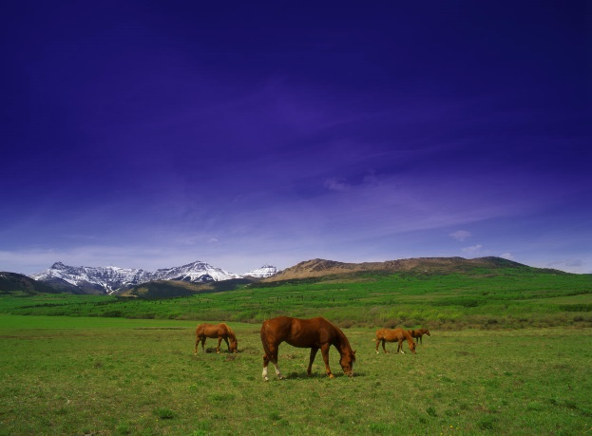
Pattern of Human Ecology
Notes:
Sedentary as in the case of Kanjhawala & mobile as in the case of transhumance and the relationship is maintained through complementary use of the fallows as common property.

Slide 17
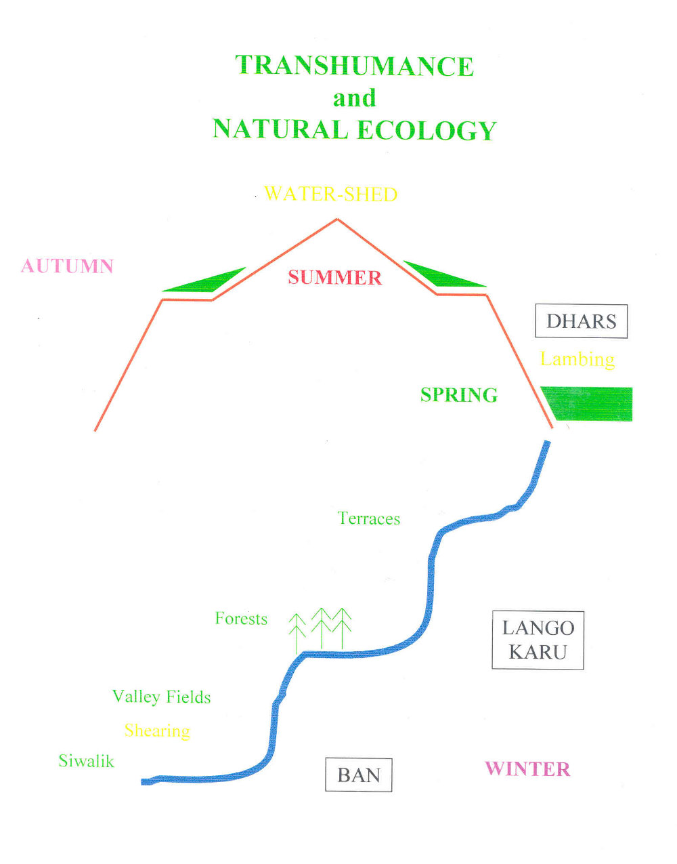
Notes:
Sedentary is represented in the case of Kanjhawala & the cluster & for pastoral people transhumance

Slide 18
Ecological Complementarity
Institutions of Reciprocity
Based on Trust
Sedentary
Common of Shack
Stubble
Food
Leaves
Employment
Winter Camping
Nomadic
Manure
Surrogate pasture
Distress relief
Wool
Labour
Summer relief
Notes:
Institutions of Reciprocity to maintain ecological complementarity.

Slide 19
The Delhi Tract: Grazing Wastes
Districts | Grazing Wastes | Season
LUDHIANA | Common lands in villages Birs in Samrala, Ludhiana and Jagraon | Monsoon Winter & Summer
KARNAL | Common lands in villages Birs or reserved grass lots in Nardak Dhak & Jhao jungle in Nardak Riverain Jhao jungles in Saraswati and Ghaggar region | Monsoon Post‑harvest Winter Summer
DELHI | Common lands in villages Rakhiyas/woodlots in 46 villages Khadir lands of Kohi tract in Ballabhgarh tehsil. Hill pasturage near Tughlakabad | Monsoon Monsoon Winter Summer
GURGAON | Common lands in villages Hill pasturage | Monsoon Winter
Notes:
Sources: a. Delhi SR,1872‑80 : 81.
b. Delhi Gaz.1912 : 121.
c. Delhi Gaz.1881‑84 : 2.

Slide 20
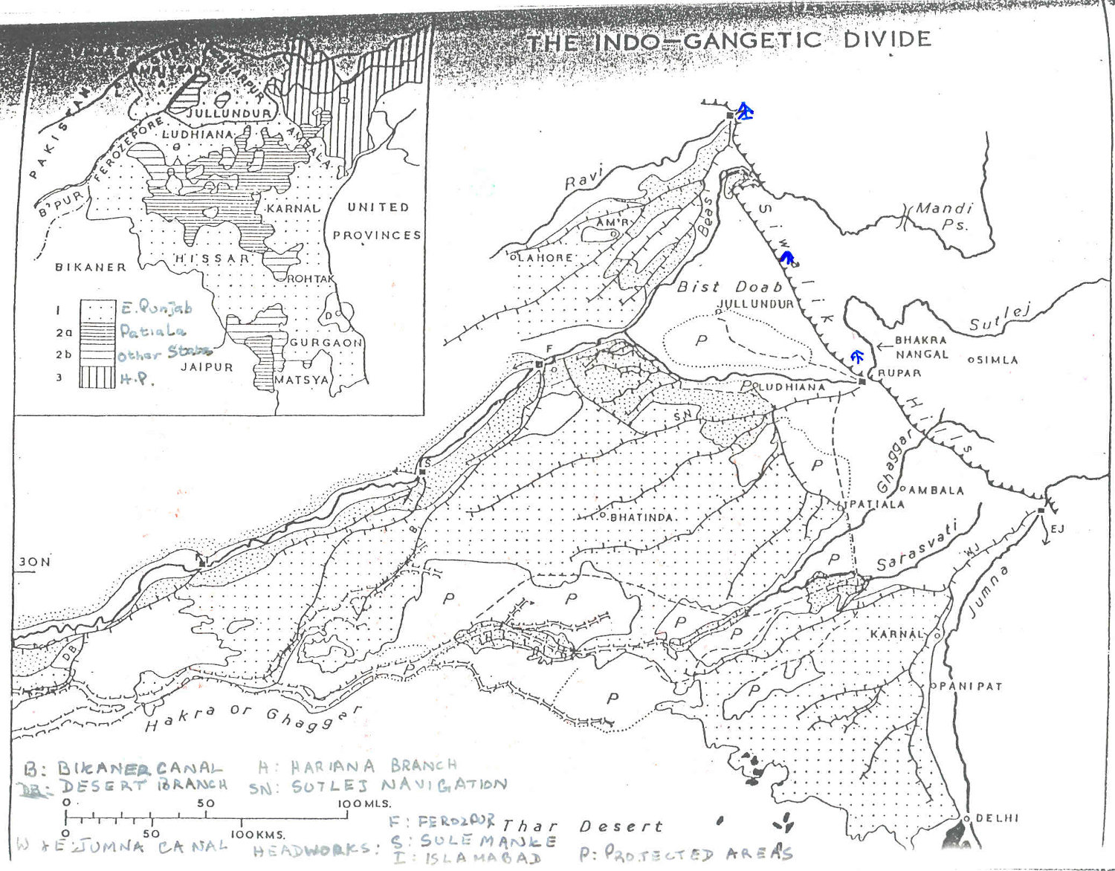

Slide 21
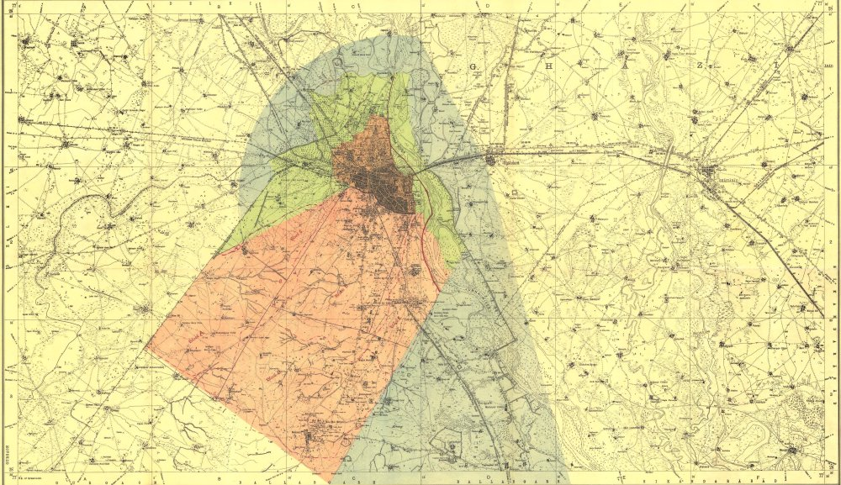
Orange : Area for purchase for City & Cantonments
Green : Area for extension of present city
Blue : Purchase for firm control
Red : Developed area excluded

Slide 22
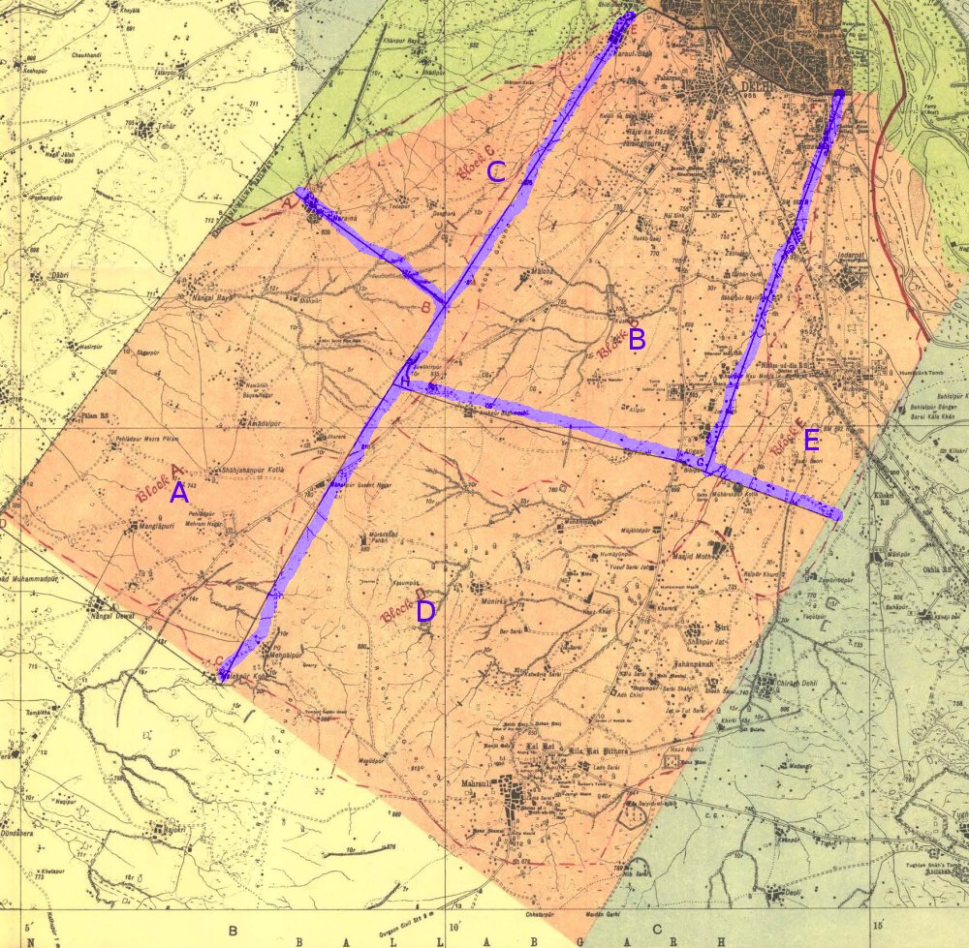
A Cantonment
B Imperial City
C Expansion for new City
D
Growth in future
E Expansion
Notes:
Block : Designated Area By scale Adjusting boundaries acres of Villages
A Cantonment : 10,022 9,495
B Imperial City : 10,916 13,428
C Expansion for new
City 2,886 2,542
D Growth in future 16, 960 13,184
E Expansion 4,416 4,628
TOTAL IMPERIAL TRACT 45,100 43,157

Slide 23
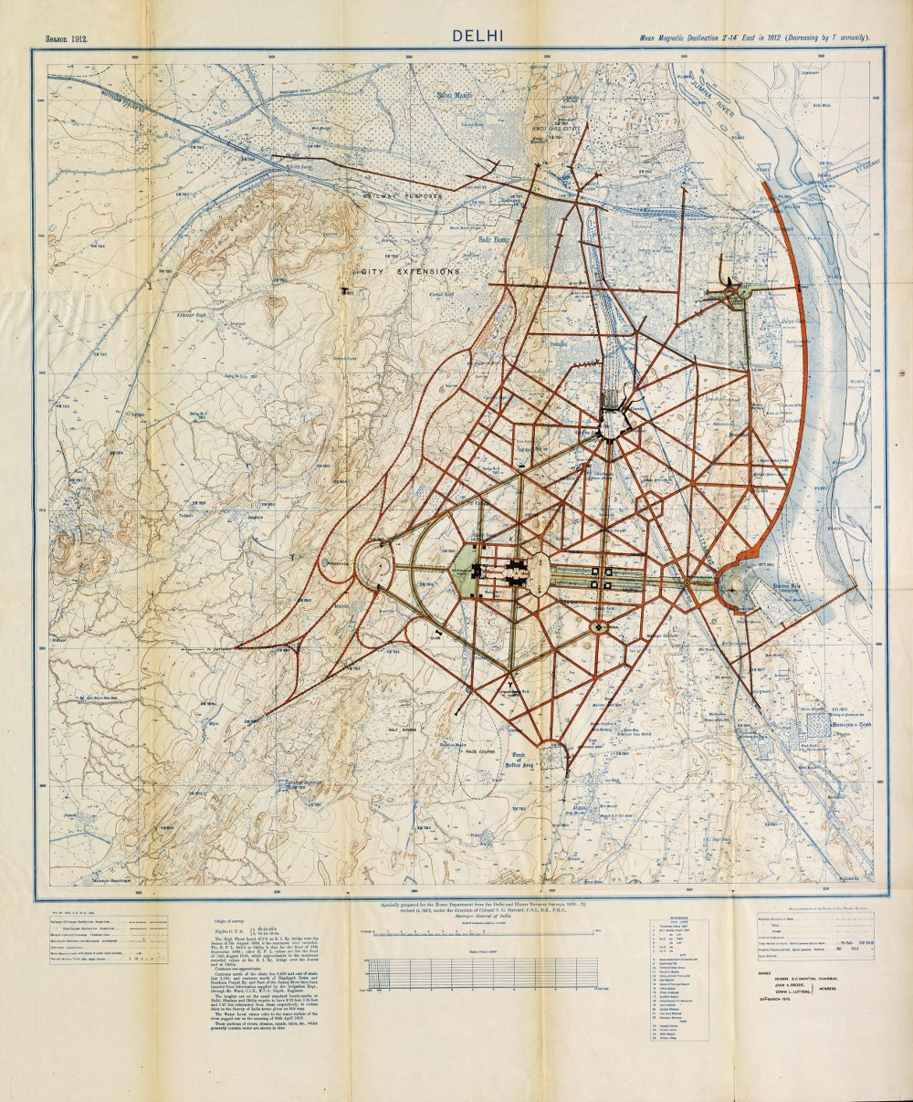
Delhi Plan - 1912

Slide 24
Impact on Grazing Land
Land | A | B | C | D | E | Total
Waste acres | 1,814 | 4,999 | 1,421 | 5,312 | 902 | 15,110
Abadi/Waste | 116 | 166 | 13 | 152 | 28 | 475
No. Villages | 15 | 18 | 4 | 21 | 8 | 66
Price Per acre | Rs 61/- | Rs 75/- | Rs 41/- | Rs 92/- | Rs 181/-
Area sq. miles | 14.75 | 21 | 45 | 20.50 | 6.50 | 107.75
Notes:
The impact of acquisition of these areas then led to the decrease of 11,713 acres in cultivation in 1913-14 which was then made up by breaking of new lands by those whose lands had been acquired and so cultivation increased in 1914-15 by 9,563 acres. This further added to shortfall of grazing lands hence it led to acquisition of land on the left bank of the Jumna.

Slide 25
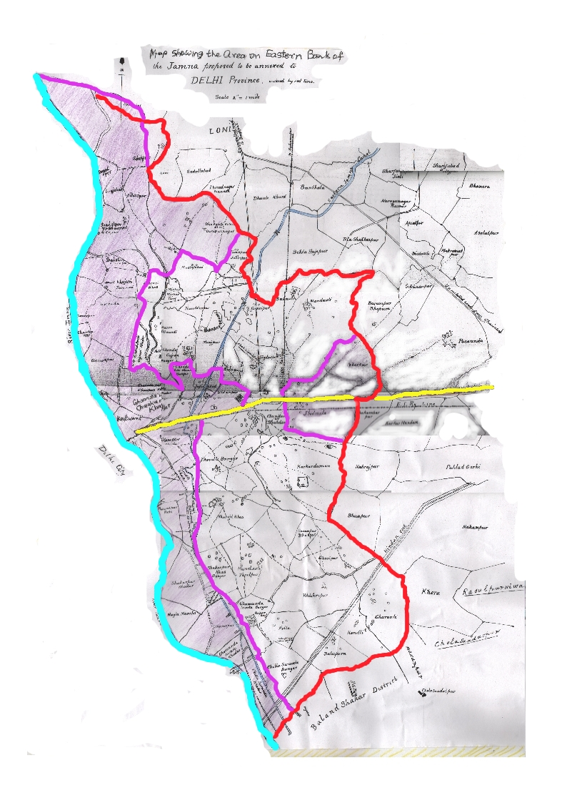
Acquisition of Land on East Bank of Jumna
Patparganj

Slide 26
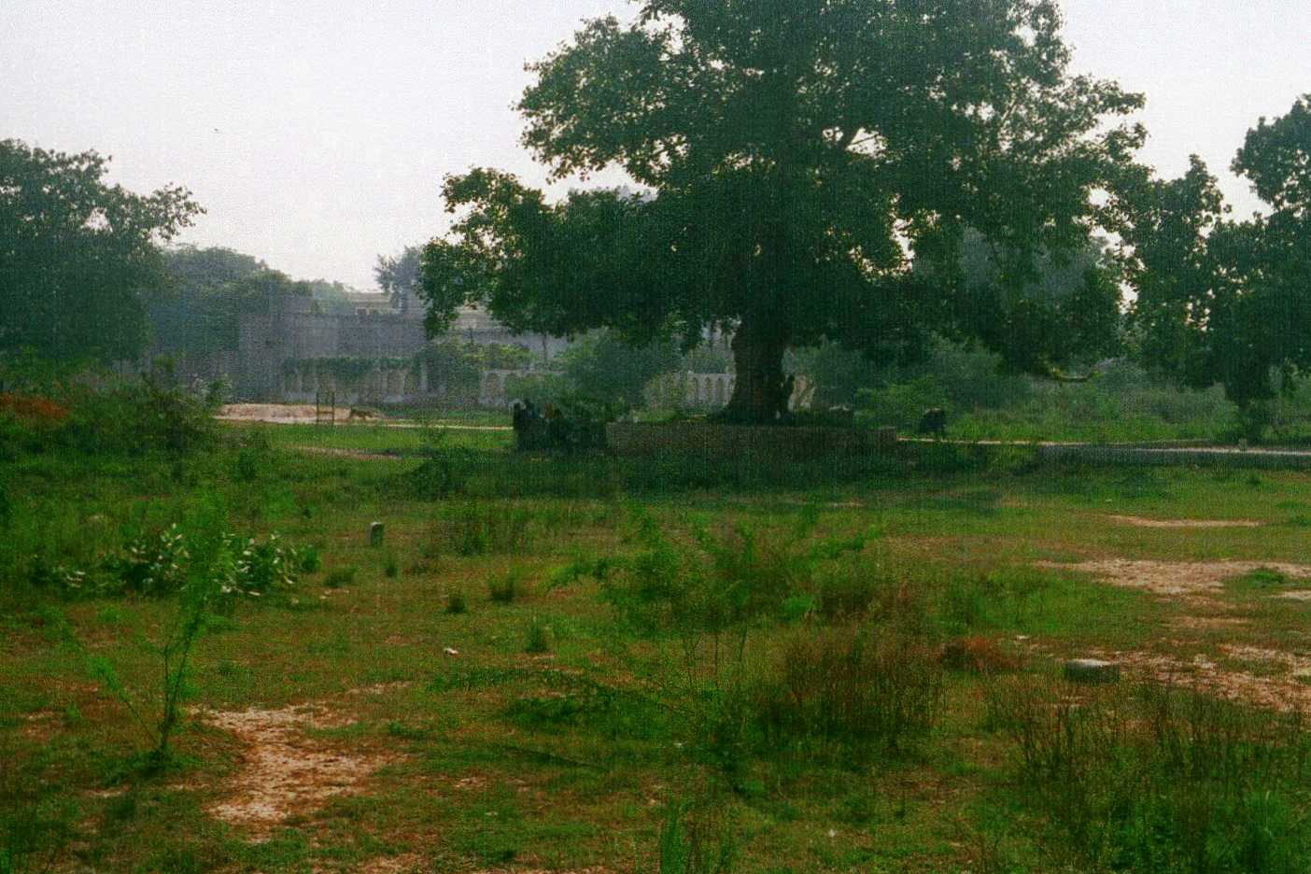
Kanjhawala’s degraded Commons
2004

Slide 27
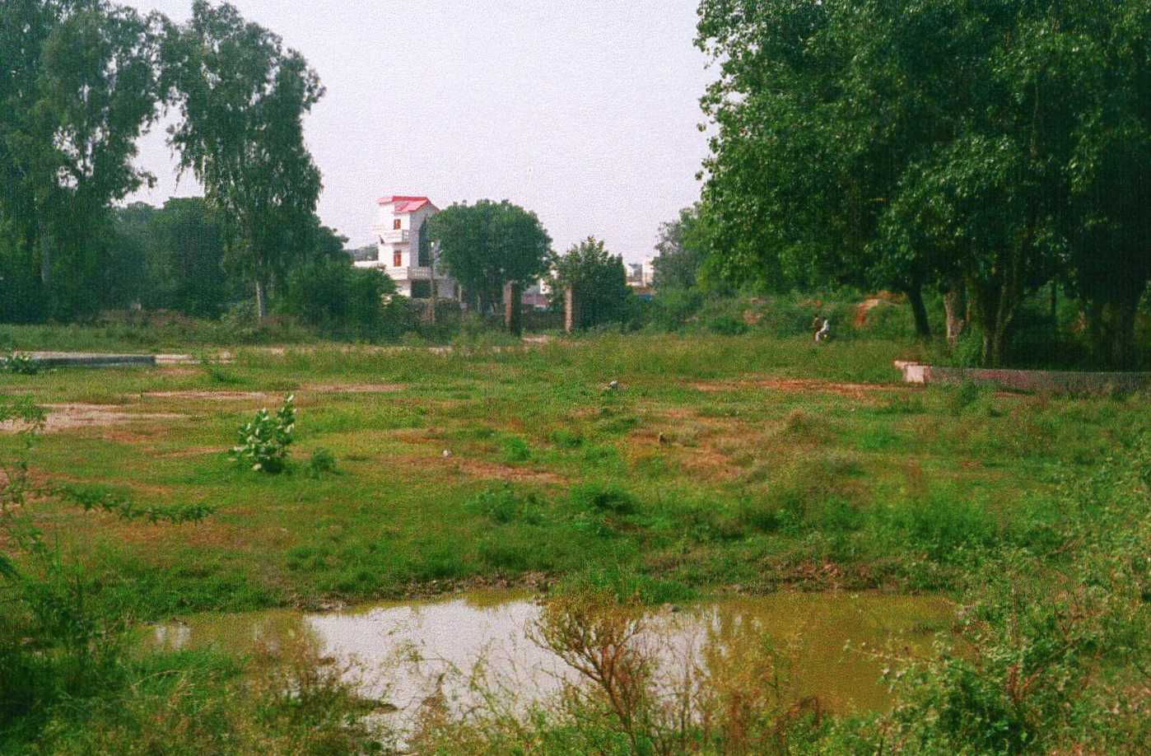
Kanjhawala’s Silted Johad

Slide 28
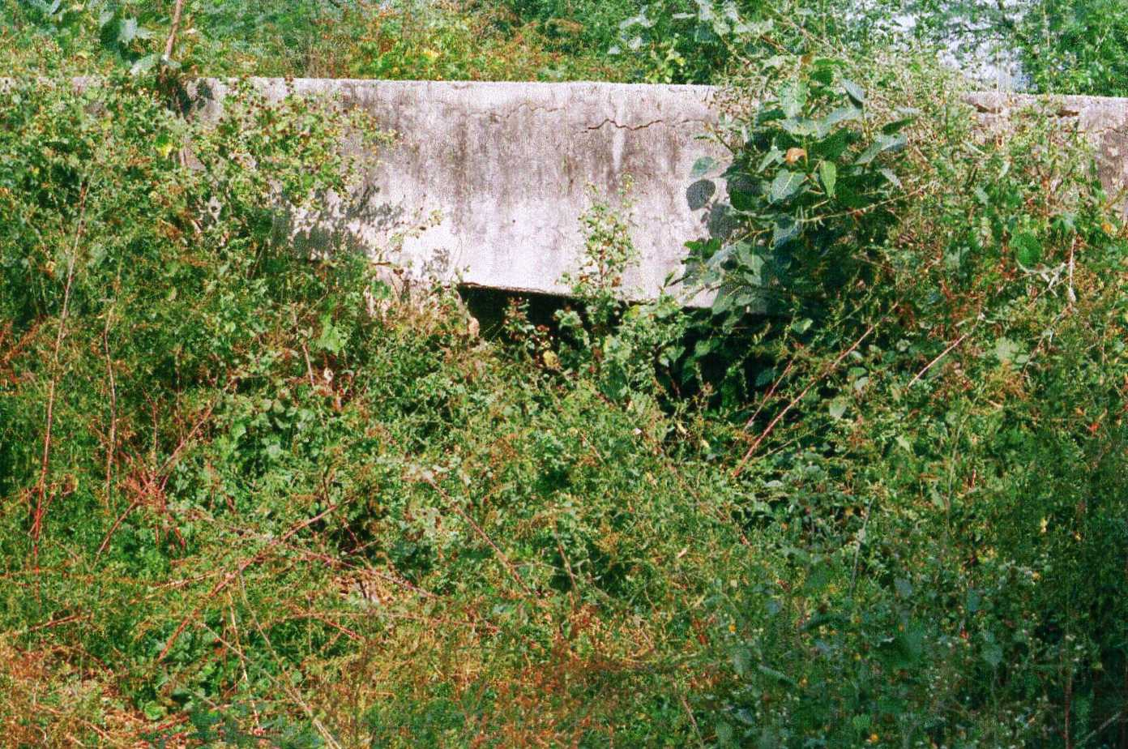
Kanjhawala’s choked dhana

Slide 29
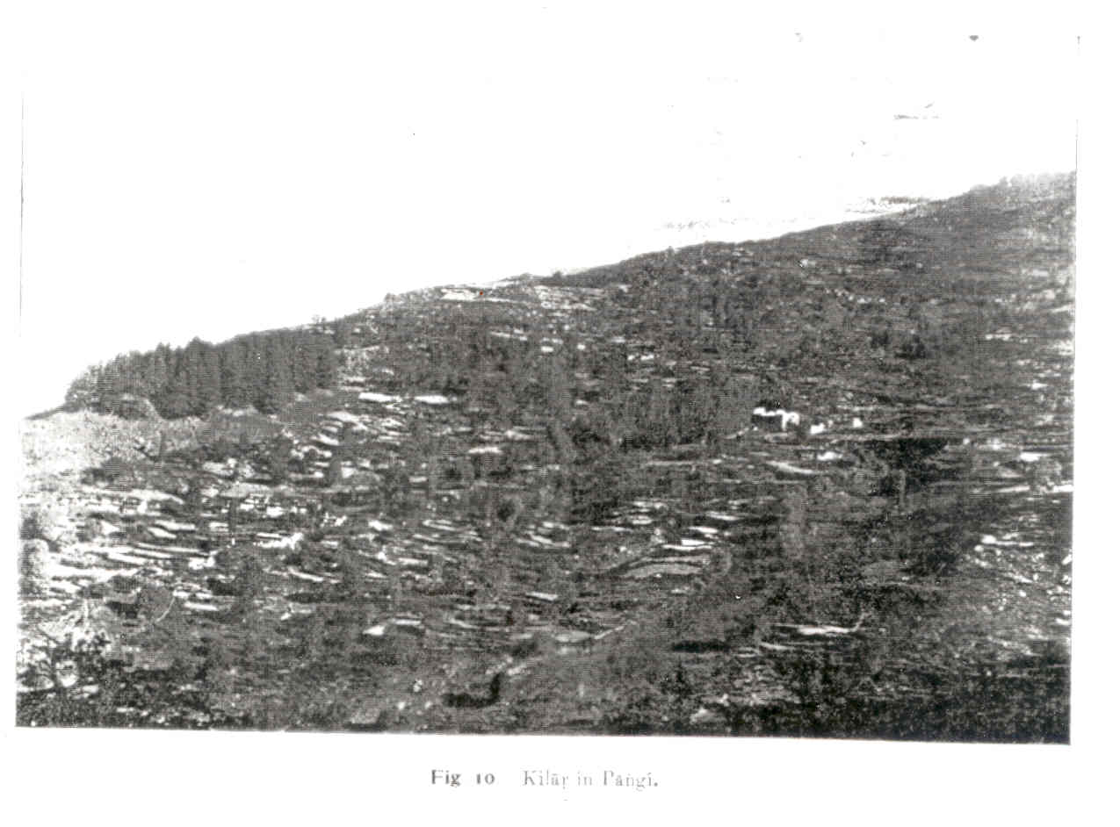
Kilar 1908

Slide 30
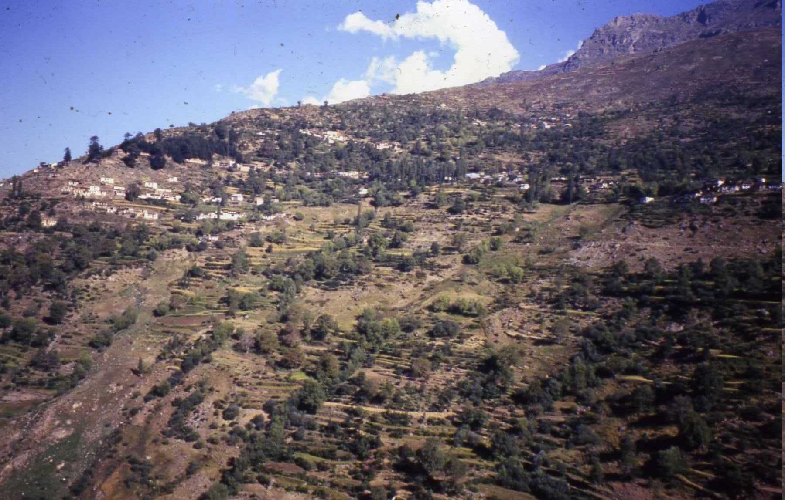
Kilar 1994

