Slide 1


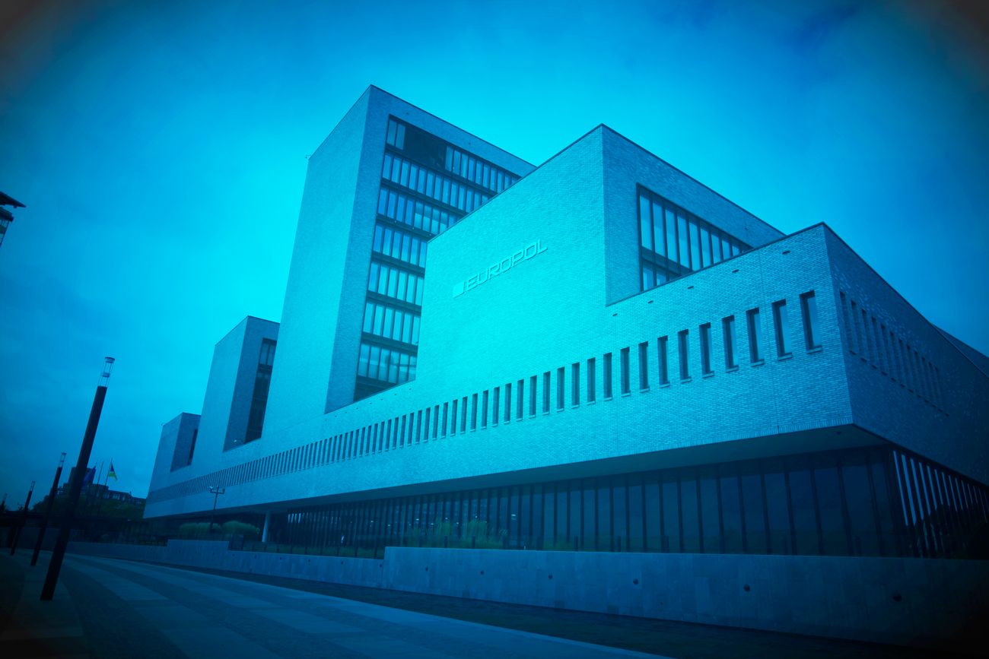
University of Sussex
3 May 2017
“The role of Europol in Countering Organised Crime and Terrorism”
Rob Wainwright
Executive Director

Slide 2
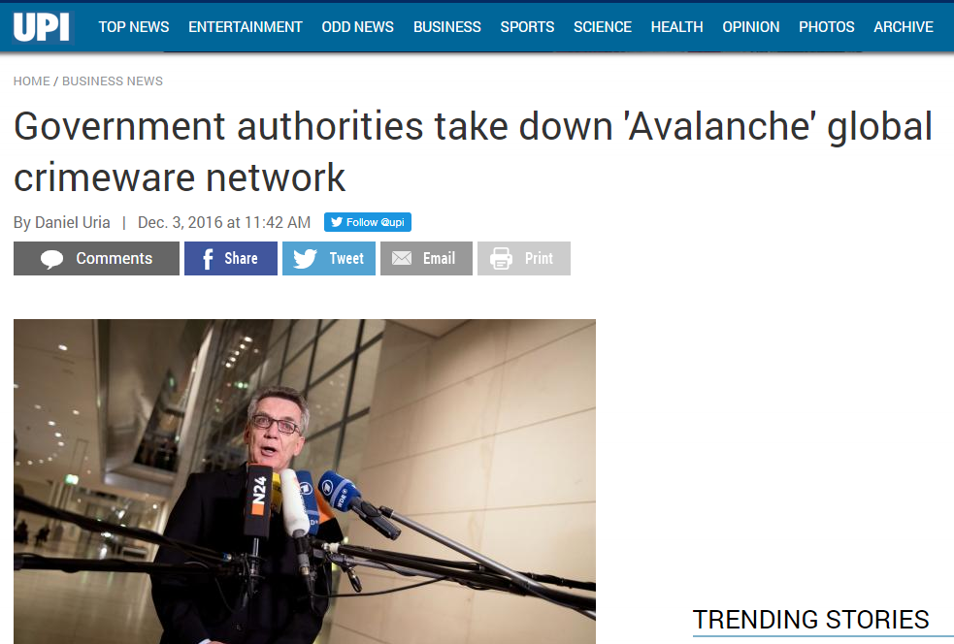
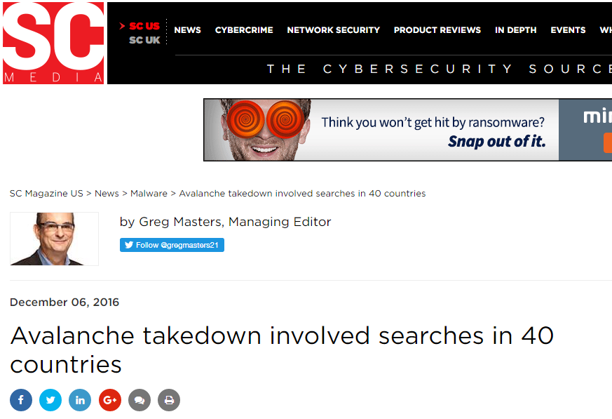
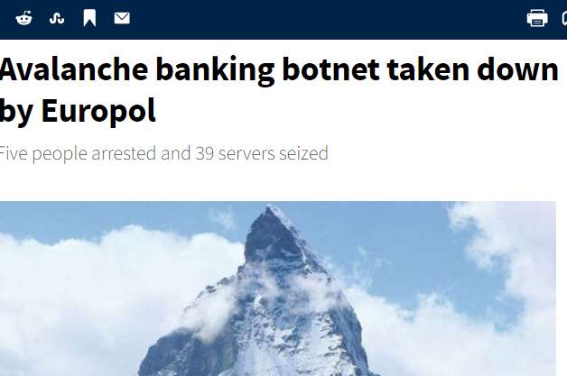


Slide 3

Notes:
Director’ speech

Slide 4
ORGANISED CRIME GROUPS
Notes:
Tamara

Slide 5
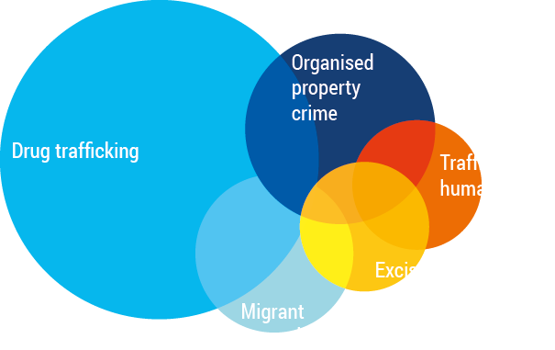
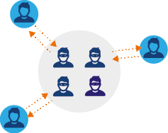
ORGANISED CRIME GROUPS
Poly-criminality
  Of the OCGs reported for the SOCTA 2017 are involved in more than one criminal activity
45%
Sharing economy
An increasing number of individual criminal entrepreneurs come together on an ad hoc basis for specific criminal ventures or deliver crime-as-a-service
= Increasing

Slide 6
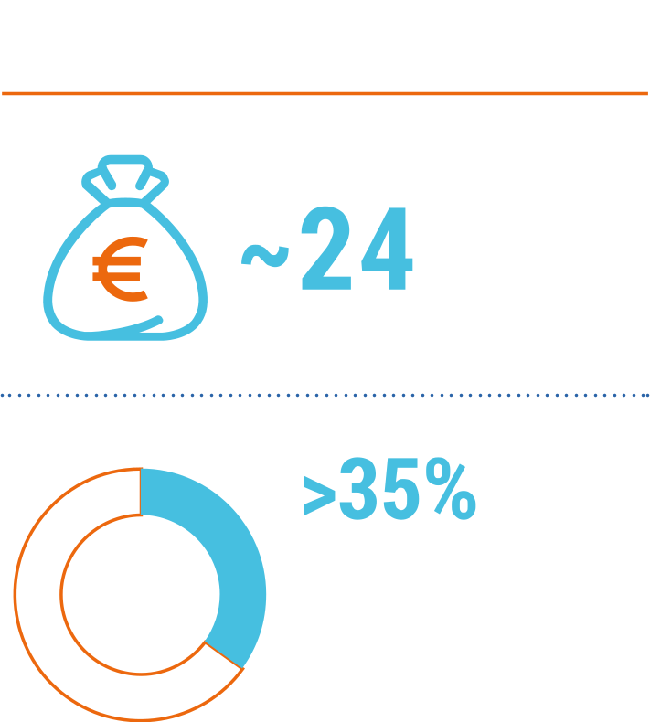
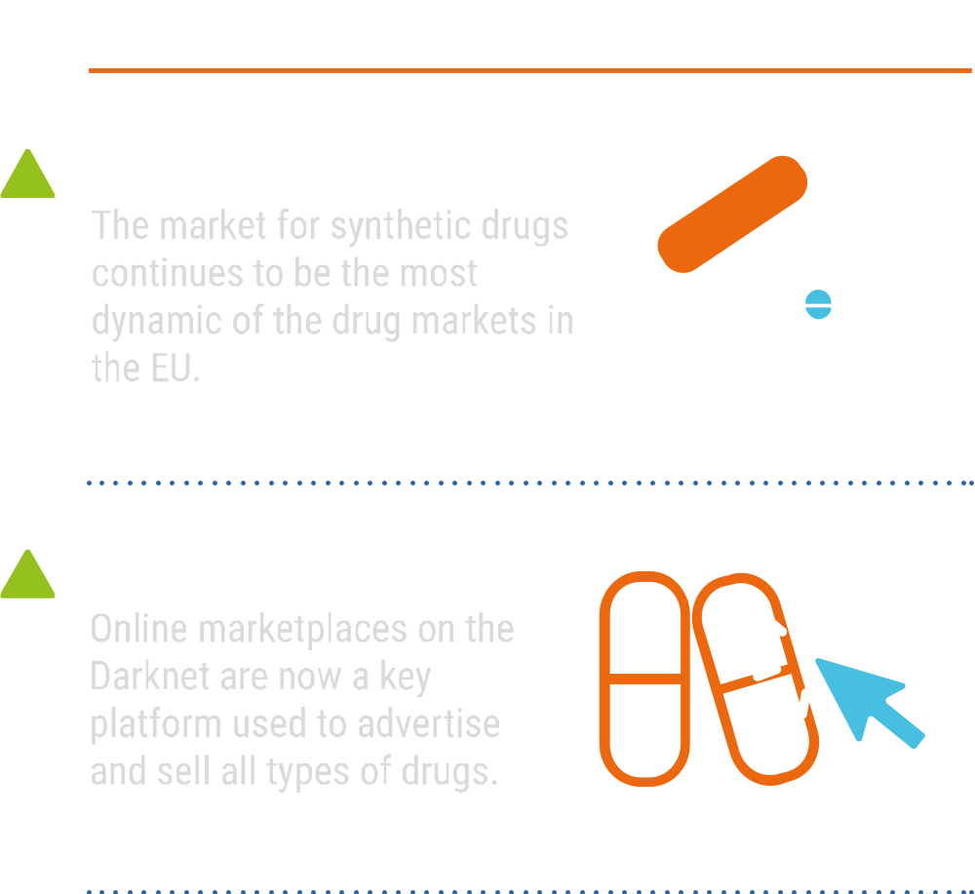
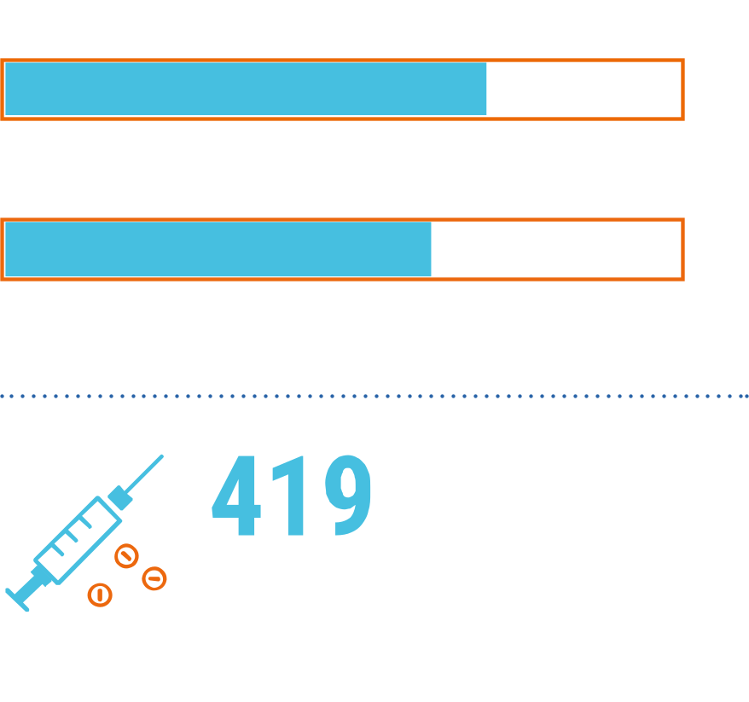
DRUG TRAFFICKING
Notes:
Sascha

Slide 7
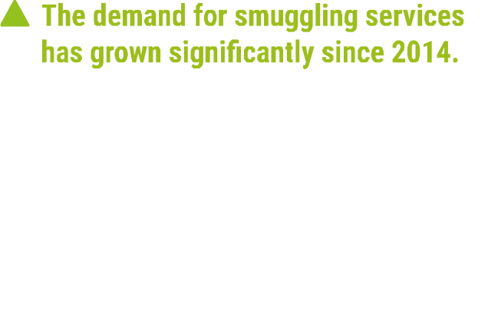



MIGRANT SMUGGLING
Trafficking in Human Beings
Notes:
Robert

Slide 8



TRAFFICKING IN HUMAN BEINGS
The migration crisis has resulted in an increase in the number of potential victims of THB.
A growing number of vulnerable adults and unaccompanied minors in the EU are likely to be targeted by traffickers.
LABOUR EXPLOITATION
THB for labour exploitation is increasing in the EU.
Traffickers continue to target less regulated industries as well as those featuring seasonal demand for workers.
SEXUAL EXPLOITATION
OCGs have further increased the use of legal businesses that can conceal exploitations such as hotels, nightclubs and massage parlours.
CHILD TRAFFICKING
Traffickers often specifically target underage victims, both male and female, to sexually exploit them.
In some cases, underage victims are trafficked for the purpose of producing Child Sexual Exploitation Material (CSEM), which is traded on online platforms.
= Increasing

Slide 9
ORGANISED PROPERTY CRIME
Online marketplaces have made it easier to sell stolen goods, particularly phones, tablets and other electronic equipment.
Notes:
David

Slide 10
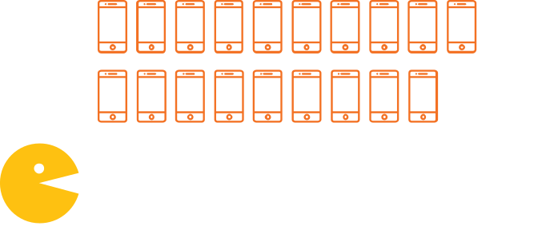
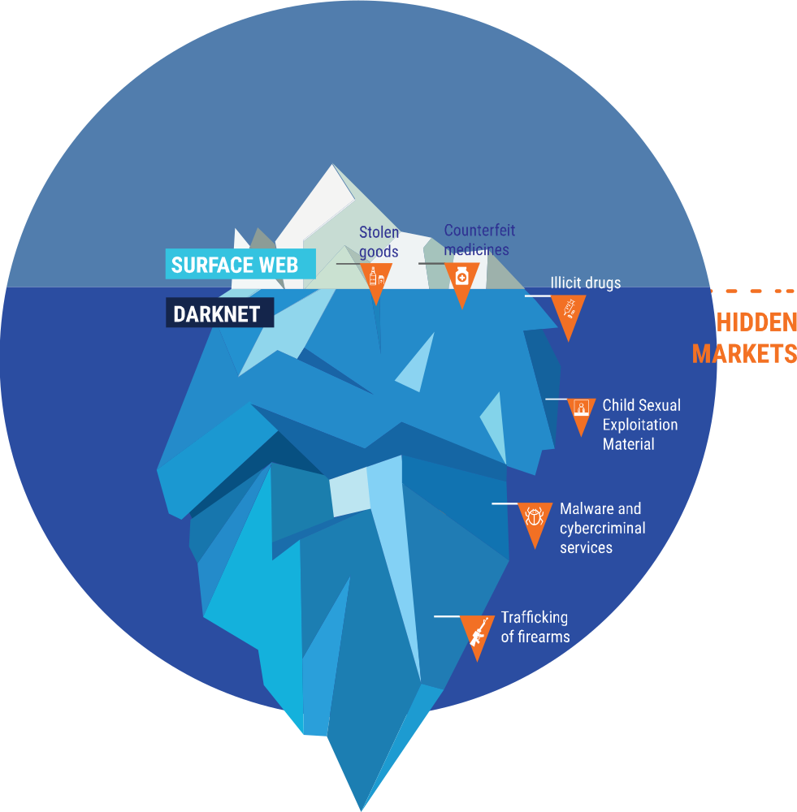

Online trade in illicit goods and services
Notes:
Steve

Slide 11
CYBERCRIME
Cybercrime continues to grow as society becomes
increasingly more digitised.
Notes:
Steve

Slide 12
8 RECOMMENDED PRIORITIES
THE ENGINES
OF CRIME
Notes:
Director

Slide 13

TERRORISM

Slide 14
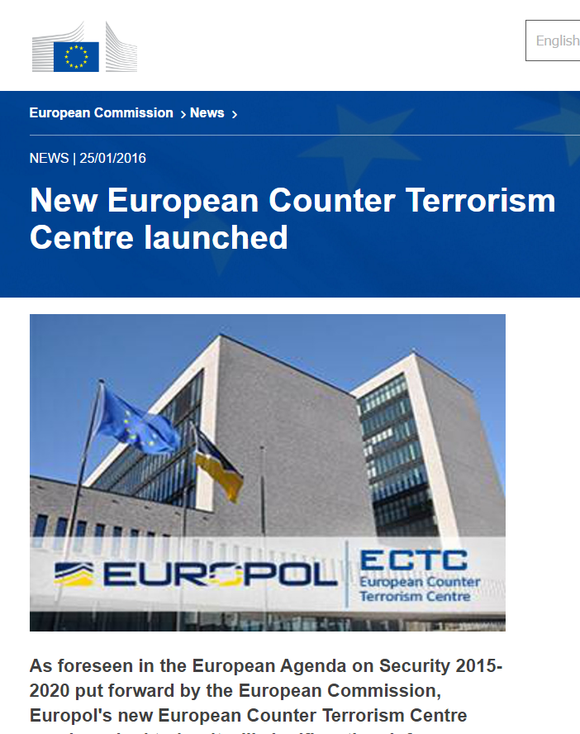

Slide 15
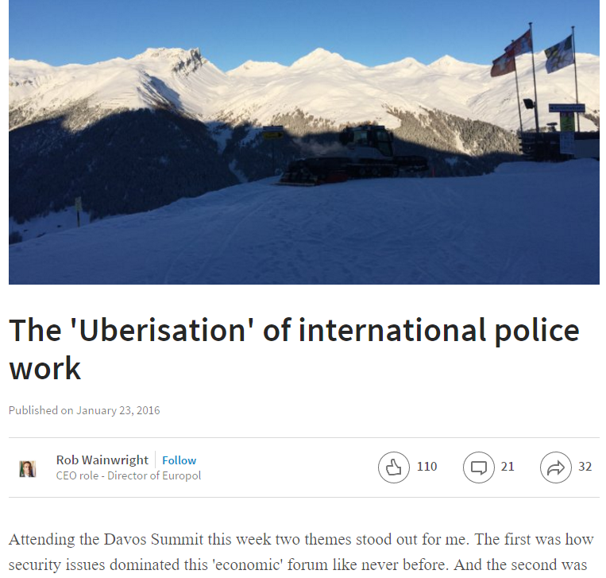


Slide 16
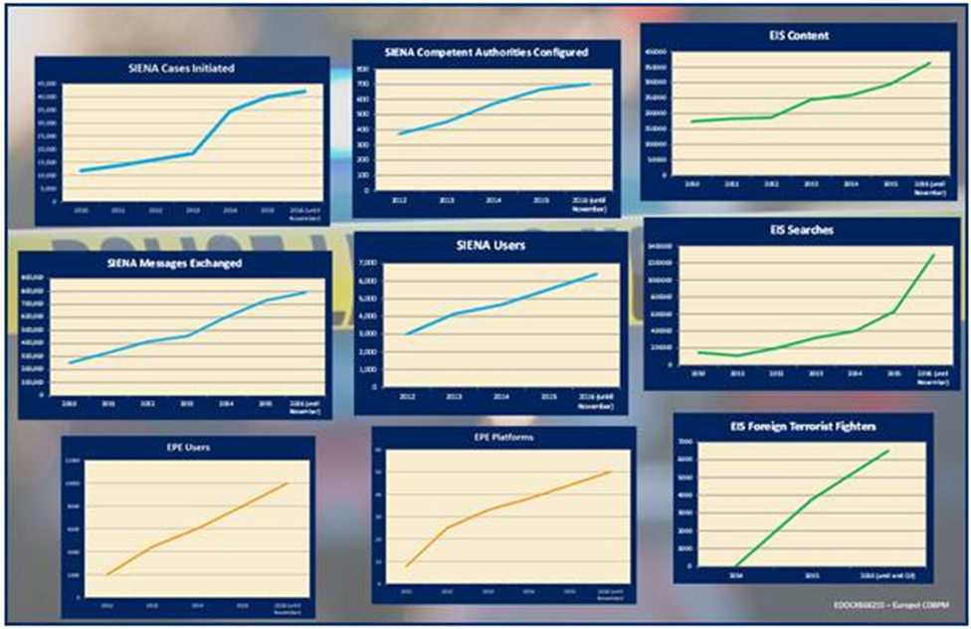
INCREASE IN CORE INFORMATION MANAGEMENT FLOWS IN 2016
EIS
1.3 million searches
all time record,
over 105% increase
SIENA
820.000 messages
all time record, 75% increase
43.000 cases
all time record,
almost 8% increase
Users
EIS 50% increase
Over 10.000 EPE users
Similar developments in SIENA

Slide 17
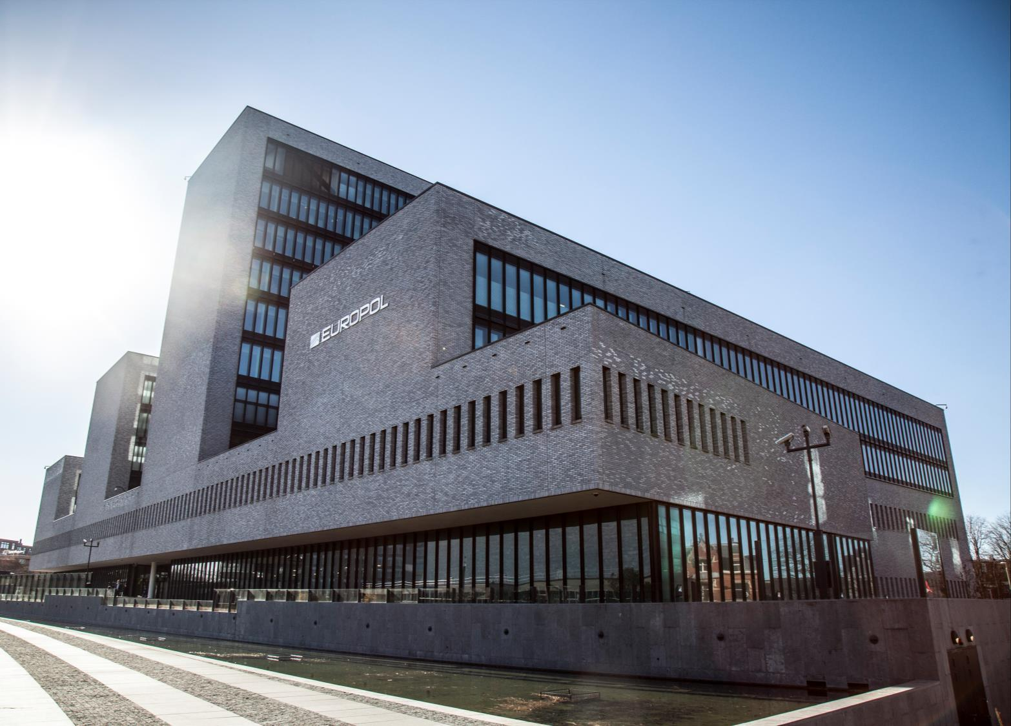

Slide 18
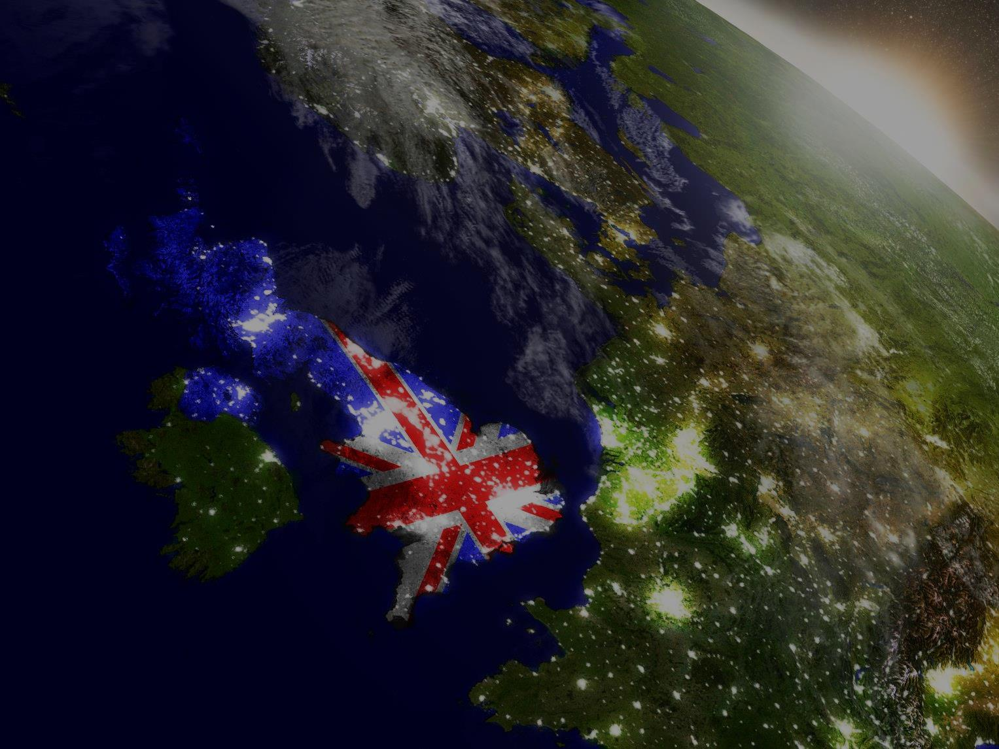

Slide 19





For more information
follow us on:
www.europol.europa.eu
@Europol
@EC3Europol
www.facebook.com/Europol
www.youtube.com/EuropolTube

