Slide 1
The Rational(?) Status of the Decision Fallacies
Emmanuel Pothos
Funding:
ONRG grant N62909-19-1-2000

Slide 2
Focus of study
How people develop intuitions for why certain events are more or less likely.
Note, maybe there are no regular patterns across individuals for higher cognition (maybe this depends on the person’s knowledge, expert relevant knowledge etc. – Fodor).
However, this seems unlikely.

Slide 3
Predominant framework for probabilistic inference
Classical probability (CP) theory (Oaksford & Chater, 2009).
Three main reasons:
  Formal a priori motivation (notably, the Dutch Book theorem).
  Excellent descriptive coverage.
  Intuition: “probability theory is nothing but common sense reduced to calculation (Laplace, 1816).

Slide 4
What exactly is the claim
Behavior is the emergent outcome of the interaction of ~Bs of neurons.
What is the best way to characterize this behavior?
Some researchers employ individual principles (e.g., heuristics).
CPT principles are an extremely influential approach (for the reason just noted).

Slide 5
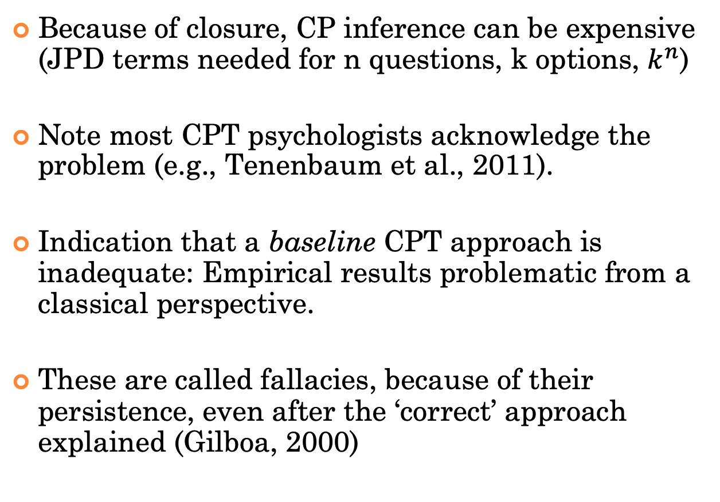
Problems
Because of closure, CP inference can be expensive (JPD terms needed for n questions, k options, $k^{n}$)
Note most CPT psychologists acknowledge the problem (e.g., Tenenbaum et al., 2011).
Indication that a baseline CPT approach is inadequate: Empirical results problematic from a classical perspective.
These are called fallacies, because of their persistence, even after the ‘correct’ approach explained (Gilboa, 2000)

Slide 6
Several approaches
1) sampling or other approximations in CPT (e.g., Bayesian nets).
2) abandon CP to favour heuristics/ biases.
3) dual route models (analytic/ heuristic).
4) alternative probabilistic frameworks.
Note, relevant concept common to all the above: bounded rationality (Simon, 1955; NB: Nobel price 1978).

Slide 7
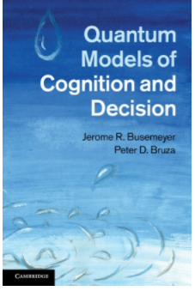
Approach (4)
We call quantum probability theory (QPT) in psychological modelling.
QPT: the rules for how to compute probabilities from quantum theory, without any of the physics.
Pothos, E.M. & Busemeyer, J.R. (2013). Behavioral & Brain Sciences, 36, 255-327.
Yearsley, J. M. & Pothos, E. M. (2014). Proceedings of the Royal Society B, 281, 1471-1479.

Slide 8
What exactly is quantum?
No ‘fundamental’ quantum effects – QPT is used as a framework for probabilistic inference.
Problem: how to understand regularity in human probabilistic inference.
A priori, any formal framework for assigning probabilities is a likely candidate.
Most researchers employ CPT; we ask whether QPT could provide a better descriptive framework in some cases.
In fact, we need not be restricted to a choice between CPT (work with James).

Slide 9
What exactly is quantum?
But QPT requires incompatibility. Where does it come from in human inference?
Actually we do not know.
Possibilities (none of which equivalent to incompatibility in the physical sense).
  Genuine contextuality (Pothos et al., 2017).
  Unfamiliarity (Trueblood et al., 2017).
  Savings in probabilistic inference/ representation (Khrennikov, Basieva).

Slide 10
Incompatibility
What can incompatibility mean in the study of behavior?
Operational (and approximate) approach:
  Are there order effects in a sequence of questions?
  Is there evidence of contextual dependence when one question asked together with others?

Slide 11
What exactly is quantum?
What about the brain?
We assume a fully classical brain.
There are often mimicries between a QPT description of a psychological finding and a CPT description (e.g., with conditionalization).
But, where we are advocating a QPT description, we argue that it provides a ‘better’ explanation for the data.
Note: in psychology it is common to have mimicries between formal explanations.
Yearsley, J. M. & Pothos, E. M. (2014). Challenging the classical notion of time in cognition: a quantum perspective. Proceedings of the Royal Society B, 281, 1471-1479.

Slide 12
Tversky and Kahneman (1983; note Nobel 2002 )
Linda is 31 years old, single, outspoken, and very bright. She majored in philosophy. As a student, she was deeply concerned with issues of discrimination and social justice, and also participated in anti-nuclear demonstrations.
Which is more probable?
Linda is a bank teller.
Linda is a bank teller and is active in the feminist movement.
More participants choose
the second option.
This CONJUNCTION FALLACY has been
extensively replicated with other types of stimuli.
Moreover, even after discounting conversational implicatures, there
is a residual CF (Moro, 2009, Synthese).

Slide 13
Conjunction fallacy puzzle
Conjunction fallacy emerges even when the problem makes the set-theoretic structure of probabilities obvious (Tentori et al., 2004).
“It is common in the Scandinavian peninsula to come across people with both blue hair and blue eyes.”
Imagine such a person chosen at random.
Choose ‘the most probable’ between the following three statements:
  the individual has blond hair
  the individual has blond hair and blue eyes
  the individual has blond hair and does not have blue eyes.
74%

Slide 14
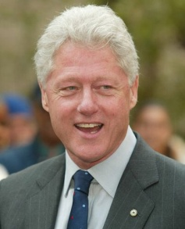
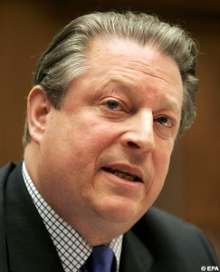
How common are such fallacies?
Gallup poll result (Moore et al., 2002, Public Opinion Quarterly):
Is Clinton honest? (50%) Is Gore honest? (68%)
Is Gore honest? (60%) Is Clinton honest? (57%)
Classically we would expect: Prob ‘yes’ to question A and then ‘yes’ to question B = Prob(B|A) Prob(A) = Prob(A&B)
=Prob(B&A) = Prob(A|B) Prob(B)

Slide 15
Medical diagnosis (Bergus et al., 1998)
Prob (Infection| Lab test & Physical Exam) = .59 ≠
Prob (Infection| Physical Exam & Lab Test ) = .51
Participants: 315 active members of the Iowa Academy of Family Practice

Slide 16
Jury decision making
McKenzie et al. (2002) jury decision making task.
Prob (Guilt| Defence & Prosecution) ≠
Prob (Guilt| Prosecution & Defence)
Participants were asked to imagine that they were jurors involved in a criminal trial.
Several other effects: disjunction fallacies, disjunction effects, unpacking effects etc.

Slide 17
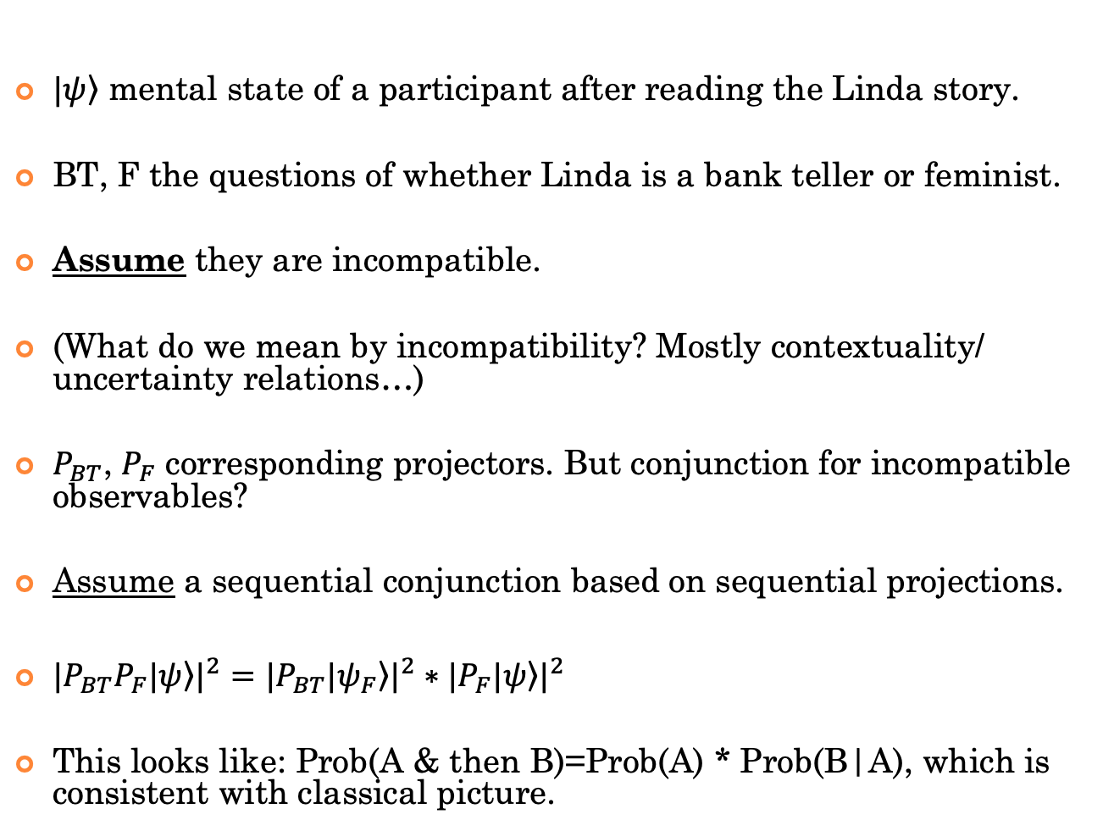
CF
$\left.|ψ\right\rangle$ mental state of a participant after reading the Linda story.
BT, F the questions of whether Linda is a bank teller or feminist.
Assume they are incompatible.
(What do we mean by incompatibility? Mostly contextuality/ uncertainty relations…)
$P_{BT}$, $P_{F}$ corresponding projectors. But conjunction for incompatible observables?
Assume a sequential conjunction based on sequential projections.
${|P_{BT}P_{F}\left.|ψ\right\rangle |}^{2}={|P_{BT}\left.|ψ_{F}\right\rangle |}^{2}∗{|P_{F}\left.|ψ\right\rangle |}^{2}$
This looks like: Prob(A & then B)=Prob(A) * Prob(B|A), which is consistent with classical picture.

Slide 18
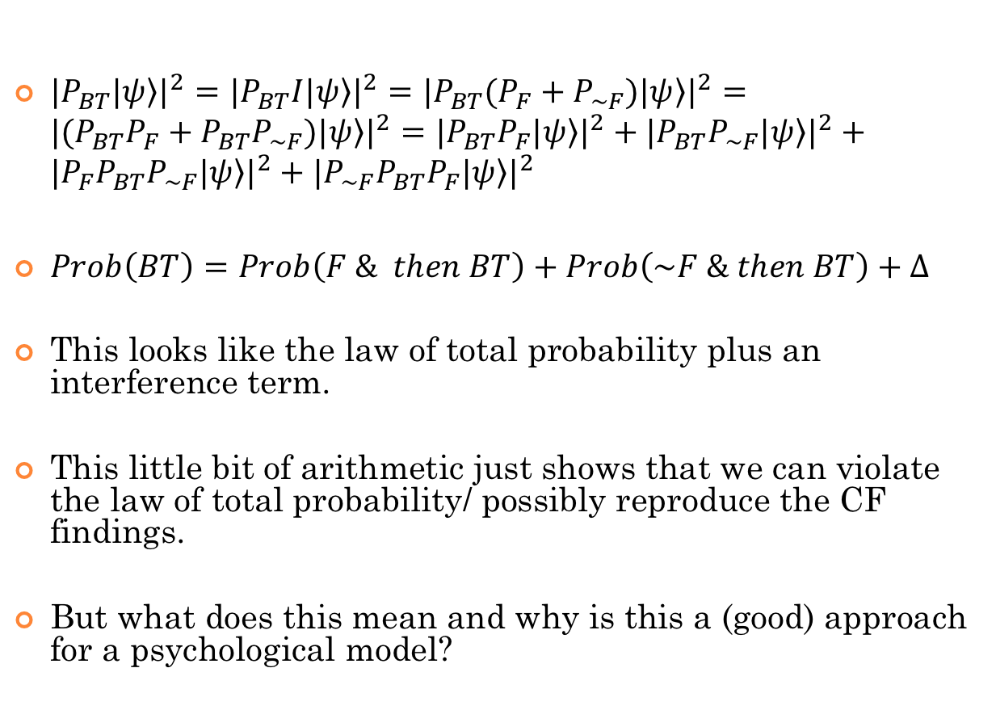
CF
${|P_{BT}\left.|ψ\right\rangle |}^{2}={|P_{BT}I\left.|ψ\right\rangle |}^{2}={|P_{BT}(P_{F}+P_{\sim F})\left.|ψ\right\rangle |}^{2}={|(P_{BT}P_{F}+P_{BT}P_{\sim F})\left.|ψ\right\rangle |}^{2}={|P_{BT}P_{F}\left.|ψ\right\rangle |}^{2}+{|P_{BT}P_{\sim F}\left.|ψ\right\rangle |}^{2}+{|P_{F}P_{BT}P_{\sim F}\left.|ψ\right\rangle |}^{2}+{|P_{\sim F}P_{BT}P_{F}\left.|ψ\right\rangle |}^{2}$
$Prob\left(BT\right)=Prob\left(F \& then BT\right)+Prob\left(\sim F \& then BT\right)+Δ$
This looks like the law of total probability plus an interference term.
This little bit of arithmetic just shows that we can violate the law of total probability/ possibly reproduce the CF findings.
But what does this mean and why is this a (good) approach for a psychological model?

Slide 19
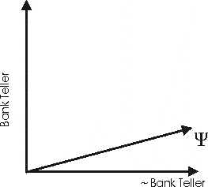
Build a simple model for the conjunction fallacy
For illustration assume relevant
subspaces are 1D.
State vector corresponds to the
impression a P would have about
Linda, after reading the story.

Slide 20
Build a simple model for the conjunction fallacy
Notice that we placed Psi near
the not BT subspace.
This reflects our prior assumption that, after
reading the story, Linda is very unlikely to be
a BT.

Slide 21
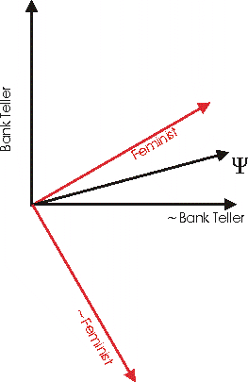
Build a simple model for the conjunction fallacy
The F subspace is a bit closer to the
not BT one.
That is, we assume that being a BT is
not the most likely profession for a F,
but it’s not entirely unlikely either!
Note also that Psi is very close
to the F subspace.
By assumption, the story makes Ps think
of Linda as a very likely feminist.

Slide 22
then project to the BT
subspace
first project to the F
subspace
the squared length
of the projection is prob(F & then BT)

Slide 23
this squared length
is prob(F & then BT)
this squared length
is prob (BT)
Recall, the direct projection
of Psi onto the BT subspace
is prob(BT)
Thus, the quantum model can
allow prob(F & then BT)>prob(BT)

Slide 24
Quantum account for the conjunction fallacy
It (the general version) works well for the CF and several related fallacies (disjunction fallacy, event dependencies, order effects, and unpacking effects).
Two key assumptions:
a) Incompatibility
b) Order for projection
Busemeyer, J.R., Pothos, E. & Franco, R., Trueblood, J. S. (2011). Psychological Review, 118, 193-218.
Busemeyer, J. R., Wang, J., Pothos, E. M., & Trueblood, J. S. (2015). Journal of Experimental Psychology: General, 144, 236-243.

Slide 25
Psychology?
From the perspective of the initial description, Linda is extremely unlikely to be a BT.
But, once a P has accepted Linda as a F, then she can imagine all sorts of professions a F can have, including that of a BT.
Accepting the F property for Linda is a kind of abstraction process:
Some of the initial information about Linda is lost. This lost information made it impossible to initially think of Linda as a BT.

Slide 26
Rationality
The conjunction fallacy is not a fallacy according to QPT.
But is it rational?
And if yes, how do we resolve a possible conundrum of having the conjunction fallacy rational according to one framework (QPT) and irrational according to another (CPT)?

Slide 27
Dutch Book Theorem
Consistency with the principles of CPT protects reasoners from:
assigning probabilities to gambles in a way that leaves them vulnerable to a sure loss (de Finetti et al., 1993).
What properties does a probability measure need to have, before it is consistent with the Dutch Book requirements?

Slide 28
Conditions for consistency with the Dutch Book criterion
Consider a probability measure p.
1) p has to be in the real numbers range [0,1], with 0 for impossible events and 1 for certain events.
2) The p for the union of two mutually exclusive events is the sum of the p’s for each individual event (additivity).
3) p(A|B) = p(B and then A) / p(B)
(e.g., Howson & Urbach, 1993)

Slide 29
Conditions for consistency with the Dutch Book criterion
CPT clearly satisfies these criteria.
Interestingly, QPT satisfies these criteria too (Pothos, Busemeyer, Shiffrin, & Yearsley, 2017).
That is, both CPT and QPT can be said to be rational, on the basis of exactly the same criterion – the Dutch Book criterion.
Do we have a conundrum? Did we just argue that the conjunction fallacy is both rational (consistent with the rational framework of QPT) and irrational (inconsistent with the rational framework of CPT)?

Slide 30
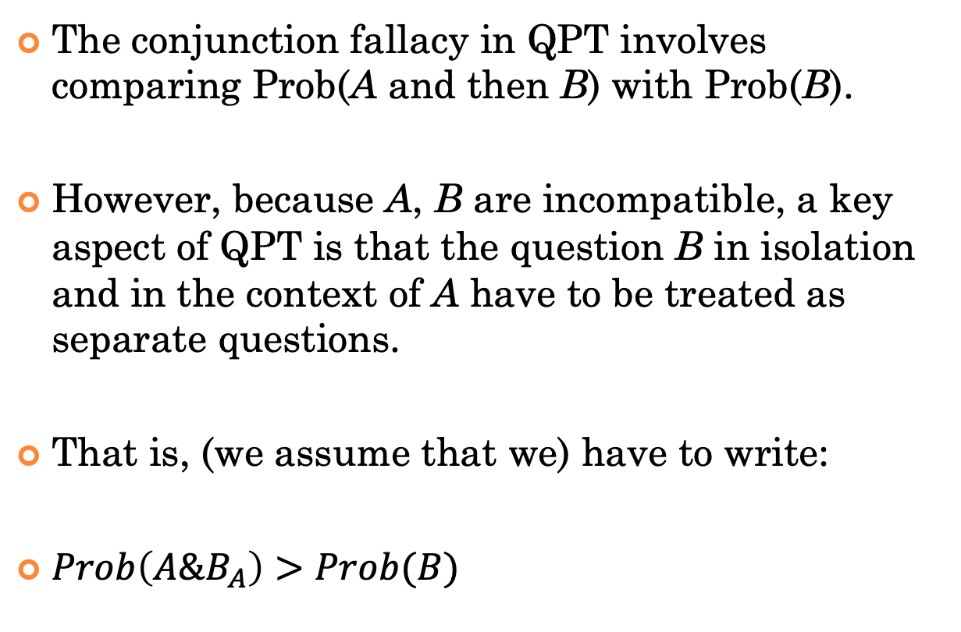
Contextuality
The conjunction fallacy in QPT involves comparing Prob(A and then B) with Prob(B).
However, because A, B are incompatible, a key aspect of QPT is that the question B in isolation and in the context of A have to be treated as separate questions.
That is, (we assume that we) have to write:
$Prob\left(A\&B_{A}\right)>Prob(B)$

Slide 31
Contextuality
Once we write $Prob\left(A\&B_{A}\right)>Prob(B)$ then this judgment is clearly allowed in CPT too,
since $B≠B_{A}$
That is, QPT reveals a perspective for the rationality of the conjunction fallacy which is the same as for CTP.
Contextuality can be captured in CPT too (e.g., through conditionalization), but QPT is more technically suited for dealing with contextuality.
Classical vs.
Quantum contextuality:
Former still requires a BA, the latter entails a PBA.

Slide 32
The Rationality of the CF
However, is it really rational? Is there a sense in which BT, F are contextual in the real world?
Probably not and we have to conclude that the CF is still a mental error (of representing as incompatible questions that are compatible.

Slide 33
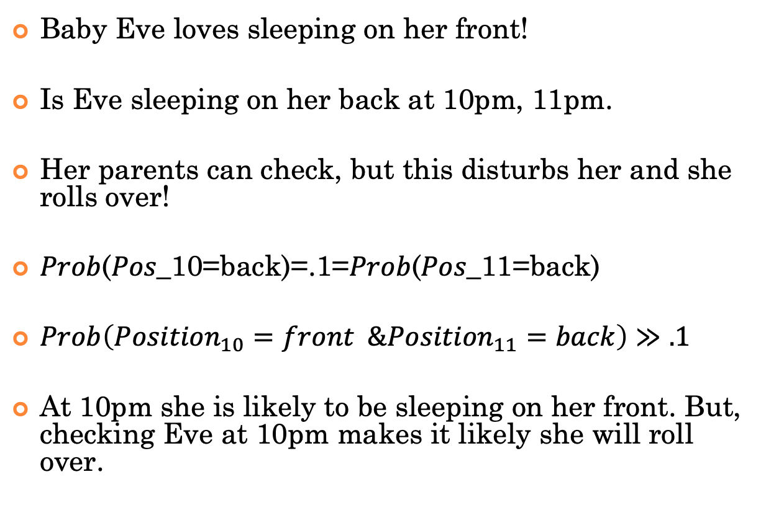
Baby Eve
Baby Eve loves sleeping on her front!
Is Eve sleeping on her back at 10pm, 11pm.
Her parents can check, but this disturbs her and she rolls over!
𝑃𝑟𝑜𝑏(𝑃𝑜𝑠_10=back)=.1=𝑃𝑟𝑜𝑏(𝑃𝑜𝑠_11=back)
$Prob\left({Position}_{10}=front \&{Position}_{11}=back\right)≫.1$
At 10pm she is likely to be sleeping on her front. But, checking Eve at 10pm makes it likely she will roll over.

Slide 34
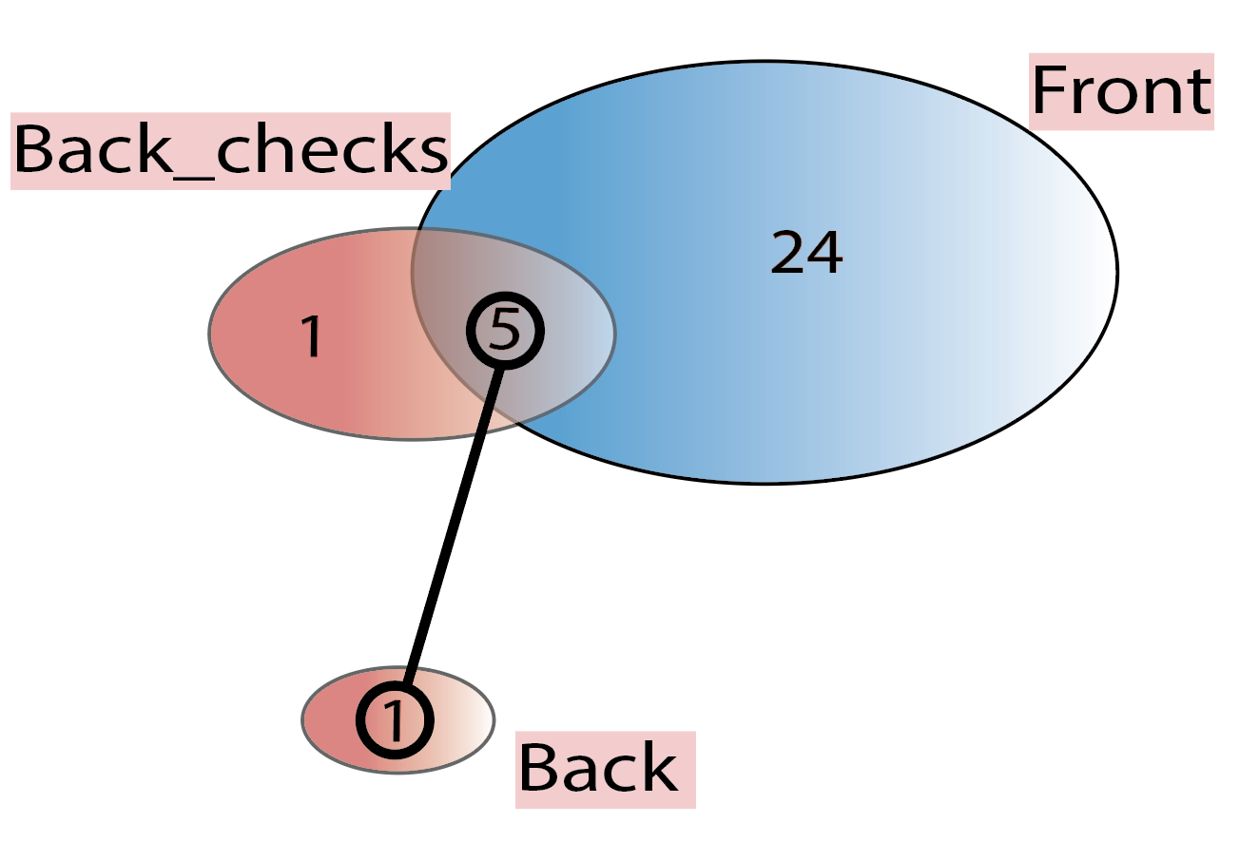
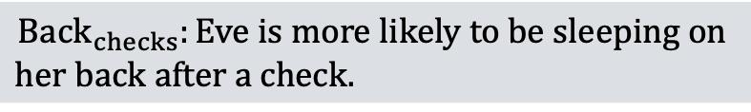
There are two sample spaces for the Back question.
When Eve has been checked previously.
When Eve has not been checked.
$${Back}_{checks}:Eve is more likely to be sleeping on$$
$$her back after a check.$$
Back: Eve is not likely at all to be sleeping
on her back.
Organising both events in a single sample
space misses structure.

Slide 35
Do we need QPT for contextuality?
No.
We can keep track of different question versions with conditionalization (though recall there is an issue of representation).
Also, the idea that prior questions can ‘activate thoughts’ which alter the meaning of subsequent ones is not new (e.g., Schwarz, 2007).
What does QPT offer?
(We argue) a more principled framework for modelling contextuality.

Slide 36
Qualifications
There are other ways to absolve the CE of fallacy.
Prob(BT&F | FM1)>Prob(BT | FM2)
Inductive confirmation (Tentori et al., 2013).
But, the price is to postulate a function other than a CPT conjunction, when faced with a conjunction.
CPT plus noise (Costello & Watts, 2013). More noise for more complex events leads to the CF.
But: a few notable problems

Slide 37
Example employing dynamics
Consider a binary ‘complex’ decision making task.
That is, a task such that the alternatives have poorly matched attributes and it is not possible to resolve in a systematic way (e.g., max expected utility).

Slide 38
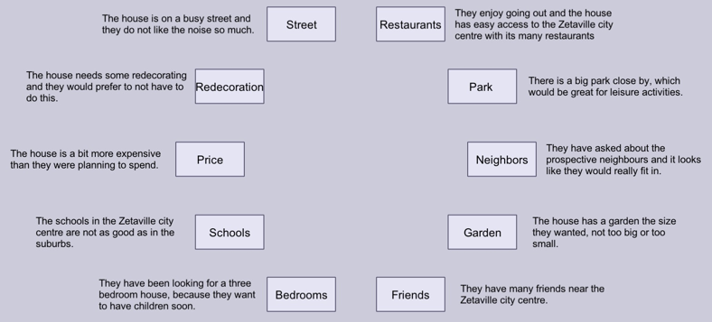

Slide 39
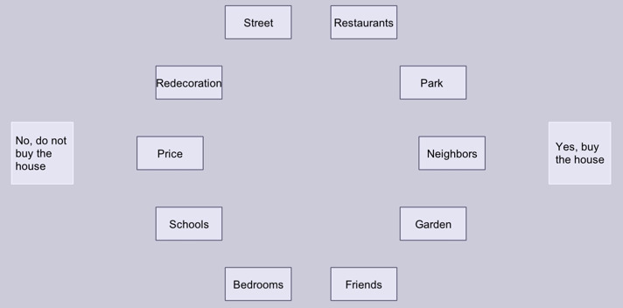

Slide 40
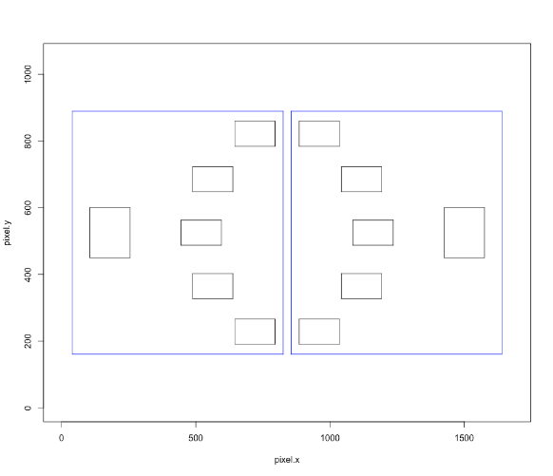
Measurement
Eye tracking variable:
Fixation durations in pros/yes Area of Interest (AOI) vs. cons/no AOI, in 200ms time bins. There is a ‘neither’ category too.

Slide 41
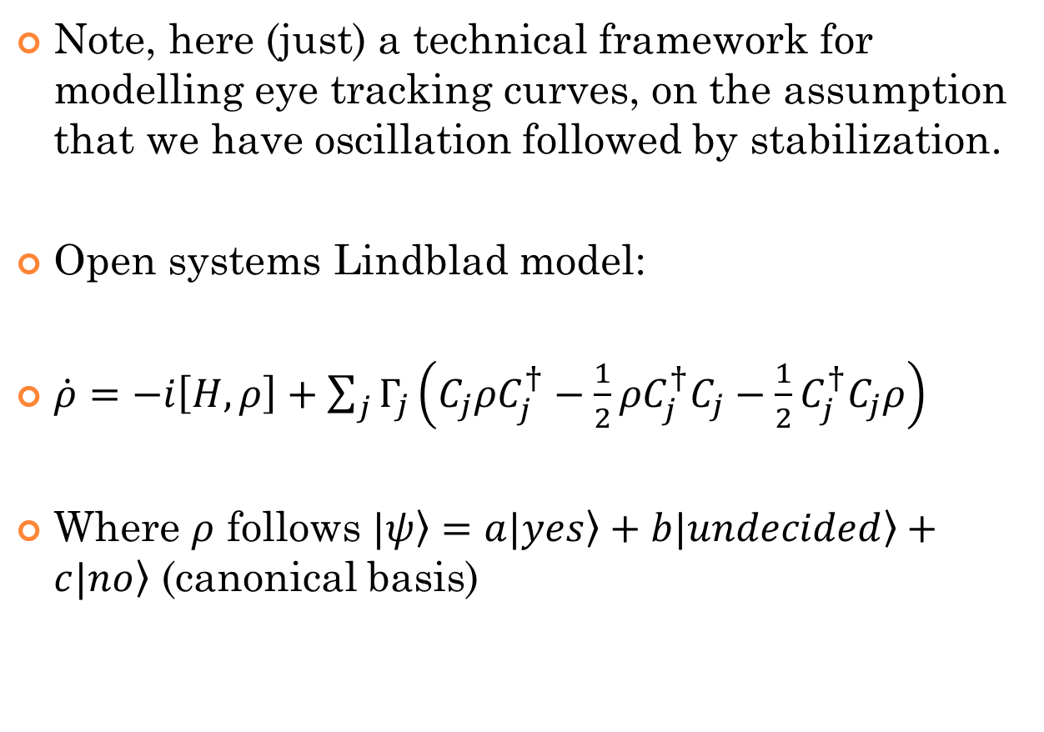
Quantum approach
Note, here (just) a technical framework for modelling eye tracking curves, on the assumption that we have oscillation followed by stabilization.
Open systems Lindblad model:
$\dot{ρ}=−i\left[H,ρ\right]+\sum_{j}{Γ_{j}}\left(C_{j}ρC_{j}^{†}−\frac{1}{2}ρC_{j}^{†}C_{j}−\frac{1}{2}C_{j}^{†}C_{j}ρ\right)$
Where $ρ$ follows $\left.|ψ\right\rangle =a\left.|yes\right\rangle +b\left.|undecided\right\rangle +c\left.|no\right\rangle$ (canonical basis)

Slide 42
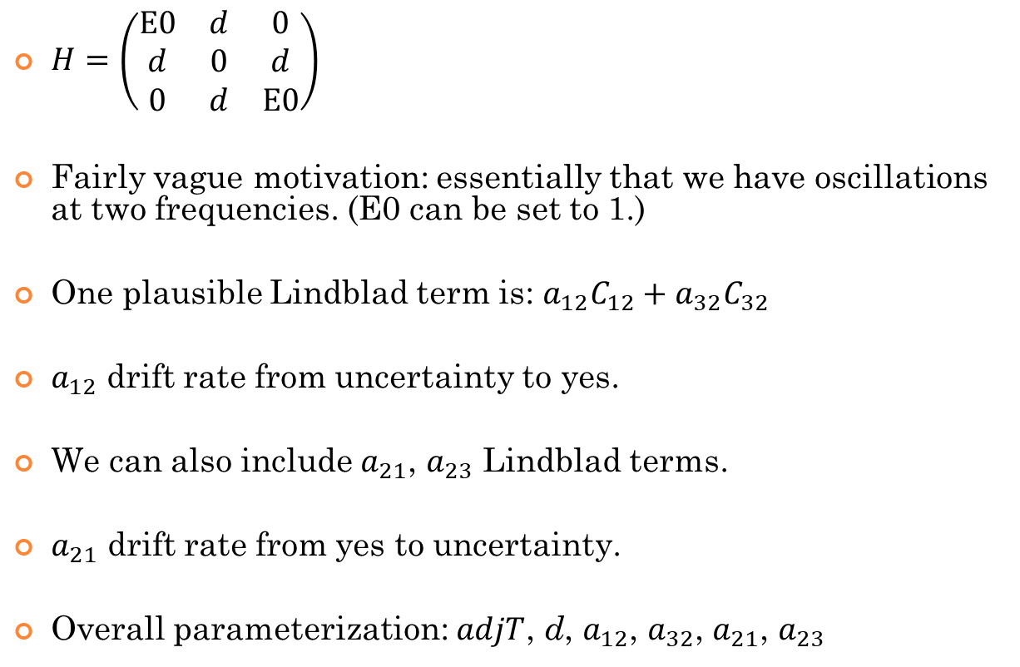
Quantum approach
$H=\left(\begin{matrix}E0 & d & 0 \\ d & 0 & d \\ 0 & d & E0\end{matrix}\right)$
Fairly vague motivation: essentially that we have oscillations at two frequencies. (E0 can be set to 1.)
One plausible Lindblad term is: $a_{12}C_{12}+a_{32}C_{32}$
$a_{12}$ drift rate from uncertainty to yes.
We can also include $a_{21}$, $a_{23}$ Lindblad terms.
$a_{21}$ drift rate from yes to uncertainty.
Overall parameterization: $adjT$, d, $a_{12}$, $a_{32}$, $a_{21}$, $a_{23}$

Slide 43
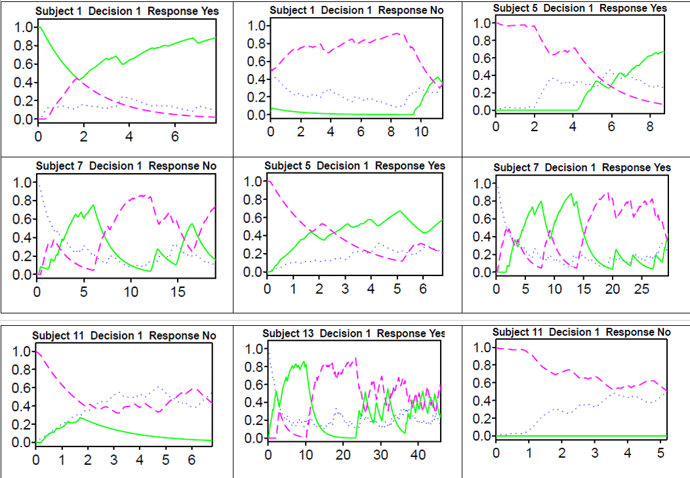
Modelling
Three different decision scenarios across
left, middle, right
Green curve: pros/ yes AOI
Purple dashed line: cons/ no AOI
Blue dotted line: neither (includes eye blinks)
Impression for both oscillation and stabilization,
but hardly a consistent pattern of gradually
diminishing oscillation.

Slide 44
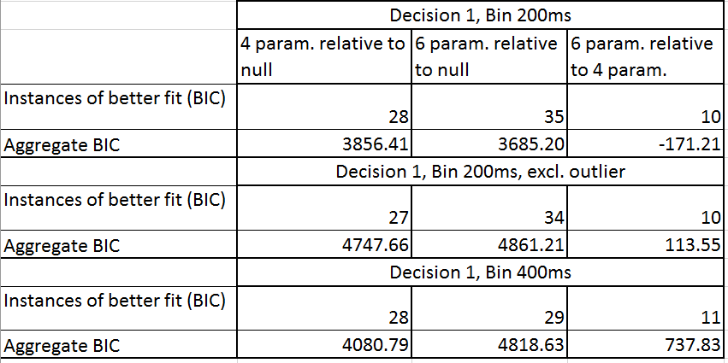
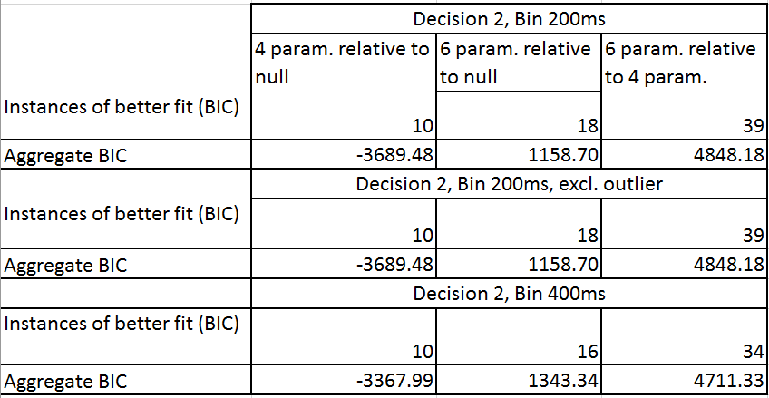
Decision 1: somewhat unclear picture
regarding relative merits of 4 param
OS-QDDM and 6 param one.
(both models better than null)
Decision 2: 6 param OS-QDDM clearly
better.

Slide 45
Possible uses of the model
Can the model reveal structure that is less obvious in the raw data?
For example, can the model parameters be related to important psychological parameters (e.g., actual decisions)?
Note: gaze cascade effect that this is the case, but maybe the model can provide added value.

Slide 46
New Predictions?
What is the generative value of this research programme?
One major area of application concerns so-called constructive influences in decision making:
Plenty of evidence that choices can influence our preference (Ariely & Norton, 2008; Sharot et al., 2010).
Plenty of suggestions for possible mechanisms: e.g., perhaps constructive influences reflect memory or attention mechanisms.
Unique contribution of quantum theory: there is a fundamental requirement for constructive influences, whenever a ‘measurement’ is made.

Slide 47
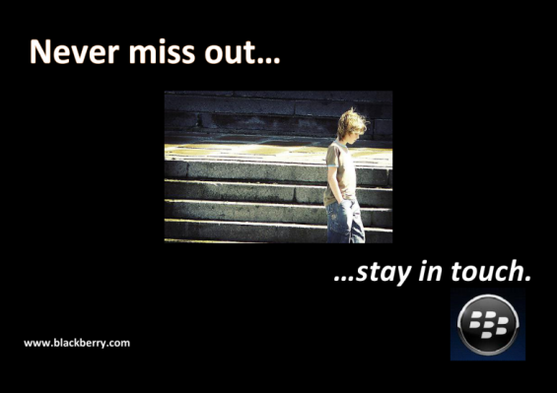
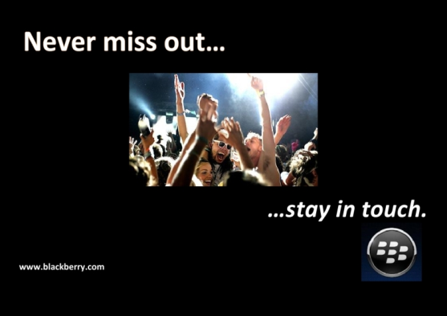


Basic paradigm
Pairs of images of
opposite affect.
Single rating
How does this advert make you feel?
You have rated this advert
Double rating
How does this advert make you feel?
You have rated this advert
How does this advert make you feel?
You have rated this advert

Slide 48
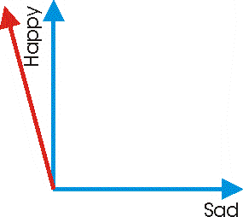

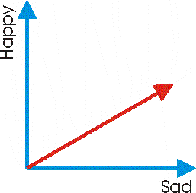
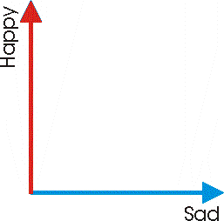
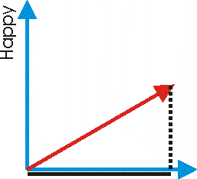
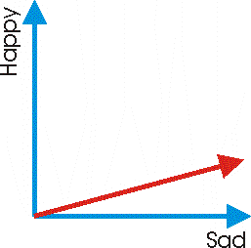
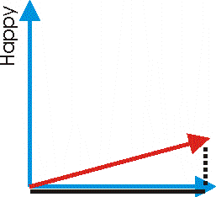
Quantum prediction
Single rating, PN condition
Double rating, PN condition
The state after seeing the
first image is close to the
Happy ray.
Same starting point.
The state after seeing the
second image rotates
towards the Sad ray.
But after the first rating
the state changes.
This projection indicates
how negatively the second
image will be judged.
But the projection
is longer.
Same rotation
as before.

Slide 49
Quantum prediction
(In the PN direction) the intermediate response forces the mental state to the Happy state.
So when the second, N image is presented...
...its negative affective content generates a more contrasting impression.
This in turn translates to a more negative rating.

Slide 50
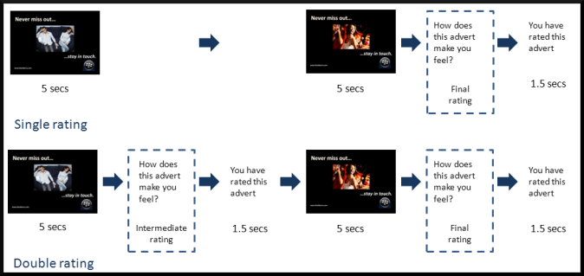
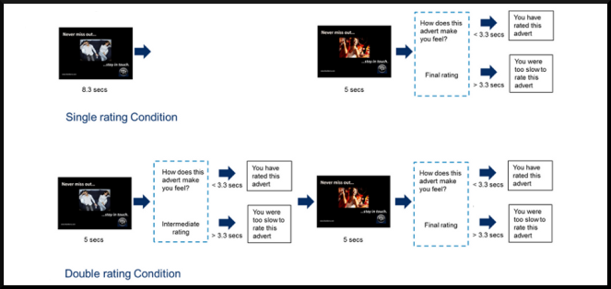
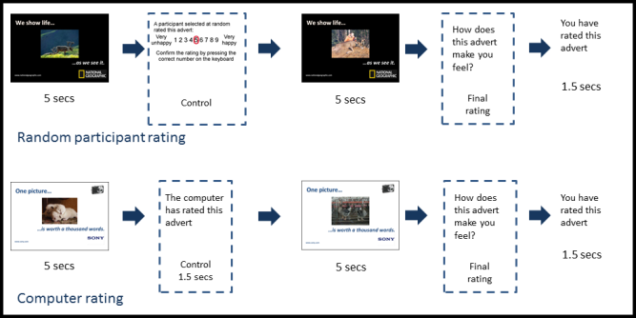
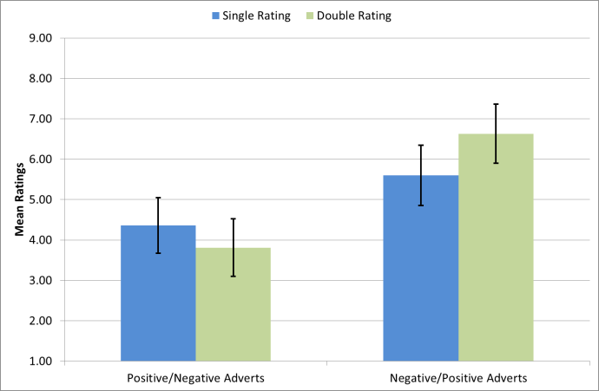
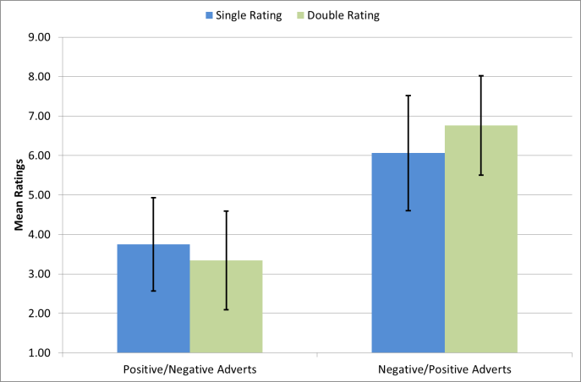
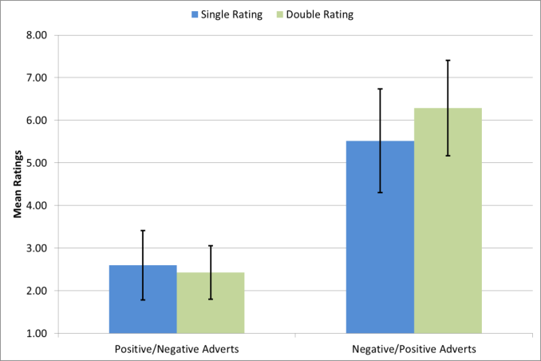
Study 1 (N=20) single image
Study 2 (N=23) time control
Study 3 (N=41) anchoring
An intermediate rating leads to a stronger affective contrast between the images
Time control: does the effect arise because the intermediate rating leads to greater processing?
Anchoring: does the effect arise because of the availability of *a* rating prior to the second rating?
Double rated P->N adverts rated significantly lower than single rated adverts (t(19)=-4.58, p<.001; d=1.03).
Double rated N->P adverts were rated significantly higher than single rated adverts (t(19)=4.78, p<.001; d=1.06).
Double rated P->N adverts rated significantly lower than single rated adverts (t(22)=2.53, p=.019; d=0.53).
Double rated N->P adverts were rated significantly higher than single rated adverts (t(22)=-3.88, p=.001; d=0.81).
Control type: no effect.
Anchoring: no evidence (no correlation between the anchor and the 2nd rating: PN: r=-.31, p=.04; NP: r=-.34, p=.02).
Main effect: as before (t(40)=-1.92, p<.05, d=.37; t(40)=4.51, p<.001, d=.67).

Slide 51
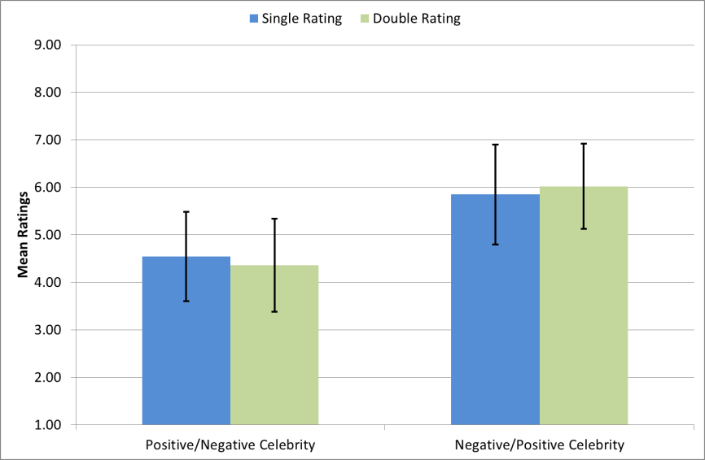
Judgments of trustworthiness
Design similar to that for affective judgments.
Pick celebrity pairs such that one would be considered trustworthy and the other untrustworthy.
Aim for recognizable celebrity pairs.
All other aspects of the design, identical to before.
Effect replicates, both directions, t(51)=-2.23, p=.029 and t(51)=2.23, p=.029.

Slide 52
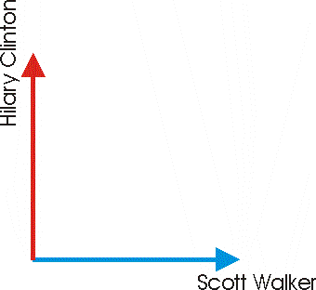
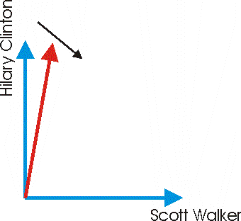
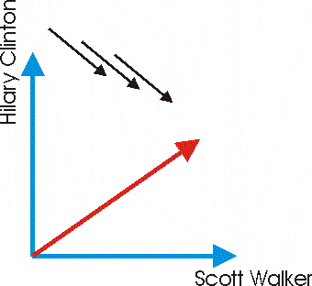
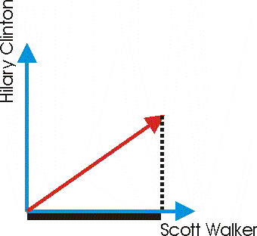
Quantum Zeno effect
A more ambitious application of these ideas concerns the quantum Zeno effect.
If an initial state is close to a ray, then continuous measurement can slow down or even freeze change.
Person initially
supports Clinton.
New evidence about Walker
has the same impact as before.
Asking *now* about
Walker, projects
back to Clinton.
Present some
evidence for Walker.
Asking about Walker now has
given a ‘chance’ to the state to
move towards the Walker ray.
Present lots of evidence about
Walker, *without* forcing a
decision.

Slide 53
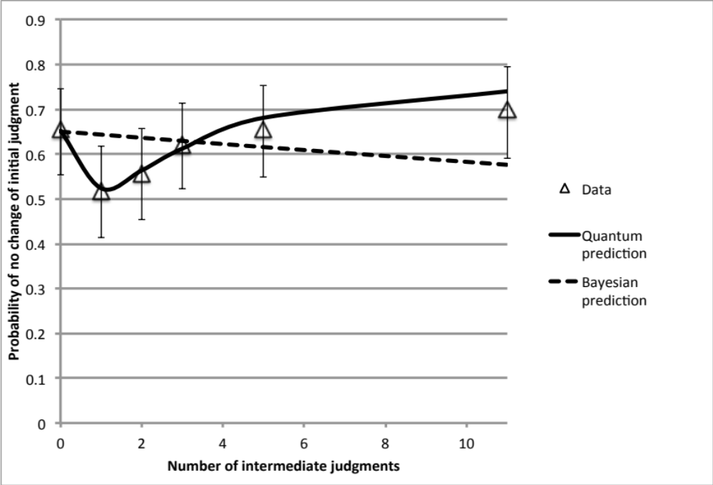
Quantum Zeno effect
Yearsley & Pothos, 2016, PROCB

Slide 54
Work in Progress
Understanding the impact of information overflow in modern political debate.
Briefly: complex questions → a transition from a Boolean algebra to a partial Boolean algebra.
This reduces the complexity of the required probability distributions, but at a price of incompatibility which may not exist in the real world.
This incompatibility could be one origin for the problems in modern political debate.
These ideas align well with ‘knowledge partitions’.
Technical challenge: If I have a set of questions A {A1,A2…} and a set of questions B {B1,B2...}; A, B are incompatible; I have only a broad idea of how A, B relate to each other. How can I economically construct the unitary for A to B.

Slide 55
Thanks to my collaborators
Irina Basieva
Pawel Blasiak
Jerome Busemeyer
Andrei Khrennikov
James Yearsley
Rich Shiffrin
Jennifer Trueblood
Bartosz Wojciechowski

