Slide 1

Governance approaches to residential heat decarbonisation:
A comparative analysis of the UK and the Netherlands
International Conference on Energy Research and Social Science
University of Manchester, 20-23 June 2022
Anna Devenish¹, Niall Kerr², Matthew Lockwood¹
¹ University of Sussex, Brighton, UK ² University of Edinburgh, Edinburgh, UK

Slide 2
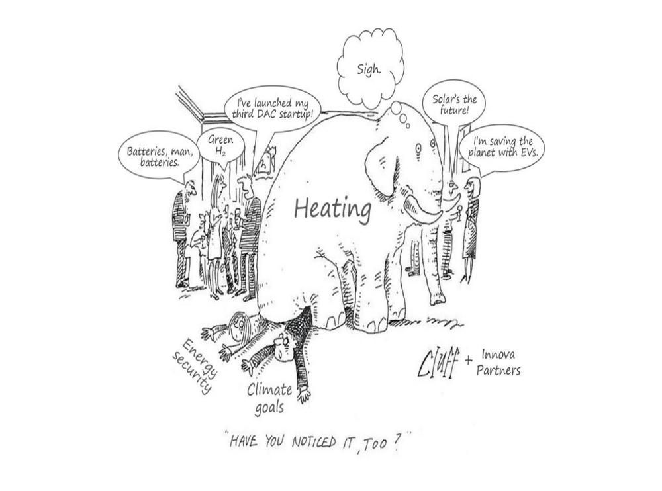

Slide 3
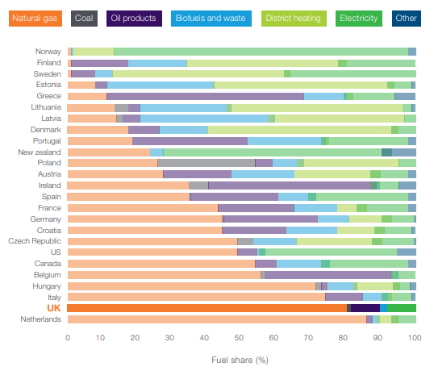
Going Dutch? project
18-month research project, led by Dr Matthew Lockwood (University of Sussex), funded by the UK Energy Research Centre, more at https://www.going-dutch.org/
Comparing governance arrangements for heat decarbonisation and natural gas phase-out in the UK and the Netherlands
Looking at possibilities of lesson-learning
Fuel share for heating demand (residential and commercial)
Source: BEIS 2018

Slide 4
Rationale for case selection
Similarities between the UK and the Netherlands
High dependence on natural gas for heating, but domestic gas production has been declining
Liberalised gas and electricity markets
Strong climate frameworks
  2008 UK Climate Change Act and 2009 Climate Change (Scotland) Act were amended in 2019 to adopt net zero targets by 2050 and 2045, respectively
  2019 Climate Act set a goal of a 95% greenhouse gas reduction by 2030 compared to 1990 levels
BUT
Different governance approaches for heat decarbonisation and natural gas phase-out

Slide 5
Key questions for this study
Institutional contexts shape governance choices for energy system changes (Kuzemko et al. 2016)
How has the wider system of institutions shaped the governance of heat transitions?
  Economic institutions (coordinated market economies vs liberal market economies)
  Political institutions (majoritarian democracy vs consensus democracy)
  Degree of government decentralisation
What are the possibilities for successful policy learning, given the institutional differences?

Slide 6
Methodology and data sources
Comparative case study approach
Sources of evidence will include:
  grey literature, policy documentation and legislation;
  secondary research;
  semi-structured interviews with participants in and close observers of governance of heat transition and gas phase out at national, regional and local levels;
  tracking activities of local authorities in 5 locations in both NL and UK

Slide 7



Heat and natural gas phase-out targets in the UK and the Netherlands
Heat transition targets | 2021 Heat and Buildings Strategy (UK): economy-wide 68% emission reduction target by 2030 from 1990 levels 2021 Heat in Buildings Strategy (Scotland): move 1 million homes (50% of all homes) currently using mains gas, and the majority of off-gas homes to zero-emission heating by 2030 (Scotland) | 2019 Climate Agreement, Built Environment sector: 7 million homes should be natural gas-free by 2050, with 1.5 million homes should be made ‘more sustainable’ by 2030 (about 20% of residential dwellings)
Standards for new buildings | No gas boilers in new buildings from 2025 2024 zero emission heat standard (Scotland) | 2018: new buildings are no longer allowed to connect to the gas grid 2021 standard for a net heating demand
Standards for existing buildings | “Confirmed ambition" to end sale of fossil fuel boilers by 2035 (Scotland by 2030) | From 2026, requirement to adopt low-carbon heating solutions when the gas boiler is to be replaced

Slide 8

Political institutions
Differences in political institutions (Lijphart 1999)
Majoritarian (Westminster) democracy model Winner-takes-all electoral system Single-party cabinets Pluralist interest group system | Consensus democracy model Proportional representation Multi-party coalition cabinets Corporatist interest group system
Impact on the governance of heat transitions
Climate targets were recommended by a technocratic body – Climate Change Committee Heat transition targets were set by the central government Citizens Climate Assemblies, limited impact Less support for measures requiring large amounts of government spending (energy efficiency) in the UK | Climate and heat transitions targets were negotiated through a consultative Polder-style process Greater societal support for heat decarbonisation? Consultative process takes time Greater focus on energy efficiency supported by government funds (National Insulation Programme, €4 billion)

Slide 9
Degree of decentralisation
Differences in administrative decentralisation
Centralised unitary state | Decentralised unitary state
Impact on the governance of heat transitions
Centralised high-level heat strategy to date at the UK level – lots of experiments in local energy planning/pilots Some role for local stakeholders signalled in 2021 Heat and Buildings Strategy, but still unclear how systematic this will be Scotland, devolved powers – Local Heat and Energy Efficiency Strategies (LHEES) were piloted by local authorities and became statutory to be delivered by the end of 2023 | Strong decentralisation: all Dutch municipalities were required to develop a plan for how to go gas-free at the neighbourhood level by 2021 30 ‘regions’ developed Regional Energy Strategies The Climate Agreement specifies in detail the roles of different actors and governance levels Open-source modelling tool (MAIS) Heating Expertise Centre

Slide 10
Economic institutions
'Varieties of capitalism' (Hall and Soskice 2001, p. 8 )
Liberal market economy (LME) Market institutions shape firms' activities: 'the arms-length exchange of goods and services in a context of competition and formal contracting' | Coordinated market economy (CME) Non-market coordination: 'exchange of private information inside networks, and more reliance on collaborative, as opposed to competitive, relationships’ The neoliberal shift in the 1980s did not go as far as it did in the UK
Impact on the governance of heat transitions
Reliance on market mechanisms (proposal for mandating the manufacturers of fossil fuel boilers to have a certain share of heat pump sales) ‘Wait-and-see’ approach on costs of low-carbon technologies | Learning by doing: Natural Gas-Free Neighbourhoods Programme provides grants to municipalities to establish testbeds Public R&D funding through Multi-year Mission-driven Innovation Programmes Construction and Technology Innovation Centre (BTIC) Demand-pooling to standardise supply packages

Slide 11
Potential lesson learning
Lessons for local heat transition planning in the UK from the Dutch experience
Developing policy interventions and regulatory frameworks in the UK: allow proper deliberation and incorporation of different priorities (to avoid policy failure similar to the Green Deal 2013-2015 collapse)
In the NL, legitimacy issues even with the consultative process – the need for broader public participation in the heat transition (e.g., Citizen Assemblies)

Slide 12
References
BEIS. (2018). Clean growth—Transforming heating: Overview of current evidence.
Hall PA and Soskice D (2001) An introduction to varieties of capitalism. In: Hall PA and Soskice D (eds) Varieties of Capitalism: The Institutional Foundations of Comparative Advantage. Oxford: Oxford University Press, pp. 1–68.
Kuzemko, C., Lockwood, M., Mitchell, C., & Hoggett, R. (2016). Governing for sustainable energy system change: Politics, contexts and contingency. Energy Research & Social Science, 12, 96-105.
Lijphart, A. (1999). Patterns of Democracy: Government Forms and Performance in Thirty-six Countries. Yale University Press.

Slide 13
Thanks!
Questions?
Dr Anna Devenish, Research Fellow
Science Policy Research Unit
University of Sussex
A.Devenish@sussex.ac.uk https://www.going-dutch.org/

