Slide 1
The Presentation
A title

Slide 2
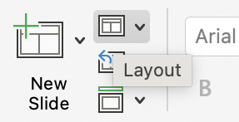
Instructions
See ‘Layout’ for more slide options.

