Slide 1
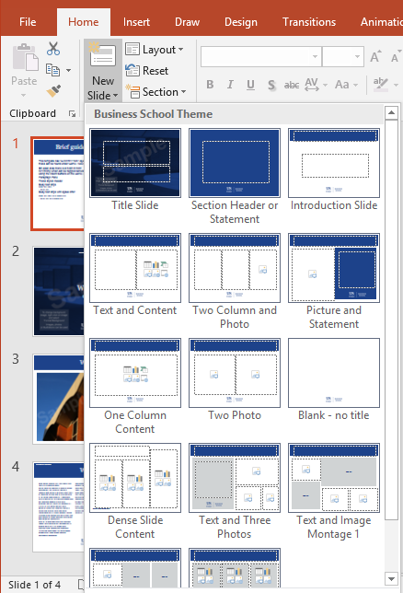
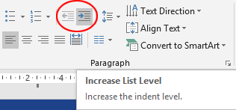
Brief guide to this template
        Slides and titles
        This template has 17 master slide
        layouts in 5 colour options. These can
        be found under Home / New Slide.
        To get started, make sure you ‘Enable
        Content’ if you see a security warning
        banner, or if not, ignore this step. Click
        ‘Home / New slide’ to begin creating
        your presentation. Choose your slide
        formats and follow these instructions
        to customise. When you are at a stage where you no longer need the instructions, you can delete this slide.
        The department name title box can be added to every slide by going to ‘Insert’ ‘Header & Footer’ and checking the box next to ‘Footer text’. The department name can be applied to the current slide by choosing ‘apply’ or ‘apply to all’ for the whole presentation.
        Save Theme (found on the Design tab) and apply to existing presentations. Alternatively, slides from old presentations can be added under ‘New Slide / Reuse slides’, Check the ‘Keep source formatting’ box. NB in both instances the old master slides will need deleting.
        Bullet points and line spacing
        To keep the correct line spacing and tab setting, please use the built-in font hierarchy which can be toggled between by using the List Level buttons on the Home / Paragraph Pane.
  Type your text onto the
  slide, then with the
  cursor placed within,
  click on the List Level
  button to choose from
  these styles:
Body text large
  Body text small
    Bullet text
      Body text large with space after
        Body text small with space after
          Bullet text with space after
  These styles are set using the correct line spacing and tab settings have been built in to keep alignment consistent.

