Slide 1





Entrepreneurial Finance in a Changing Landscape:
New Research Directions
Mike Wright
Mike.wright@imperial.ac.uk

Slide 2
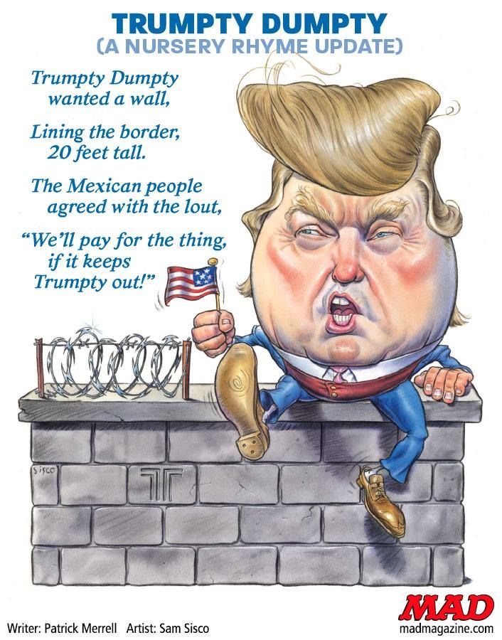
Entrepreneurial Finance –
Paying for new Ideas

Slide 3
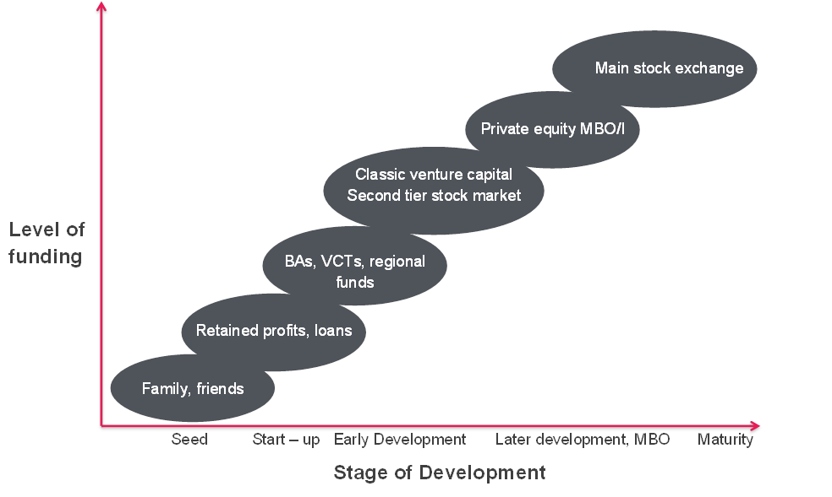
Changing Funding Landscape
Coinvesting
SMBO
Crowd-funding
Accelerator

Slide 4
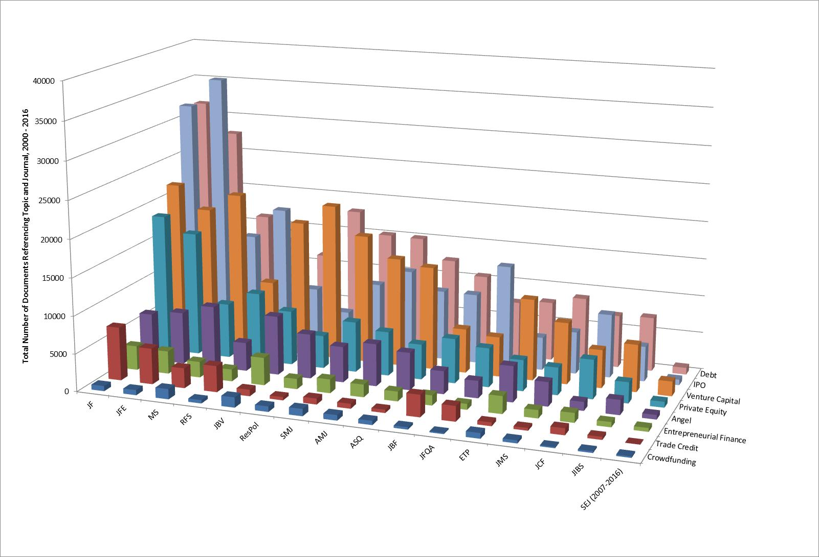
The Landscape according to Google Scholar
Source: Cumming and Johan (2017 SEJ)

Slide 5
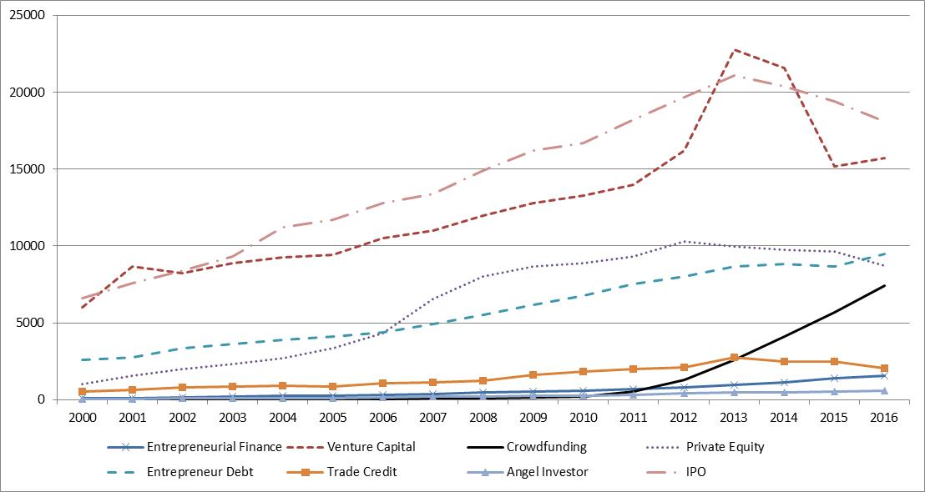
Time Series Patterns

Slide 6
Cross-Citations: Asymmetric Interdisciplinary
 |  | Private Equity Papers with at Least One Reference to a…
 | 2007-2016 | Finance Journal | Entrepreneurship Journal | Management Journal
Papers that also have a reference to a… | Finance Journal | 53.50% | 33.25% | 39.95%
 | Entrepre-neurship Journal | 18.30% | 21.60% | 23.78%
 | Management Journal | 28.21% | 45.15% | 36.27%
 |  | 100.00% | 100.00% | 100.00%
Bias!

Slide 7
Entrepreneurial Finance a Segmented Discipline!
By field
  Management/entrepreneurship v. finance
  Publishing outside your home dept viewed negatively
  Citing outside your home field even viewed negatively by finance scholars
By journal
  Different folks control different outlets; you are dead if you write a paper that upsets someone
By data
  Datasets not integrated with more than one form of finance
By competing interests
  “My dataset with 200 observations is more representative than your dataset with thousands of observations because the company that recorded the observations is systematically biased or are not reliable”
By country
  “My country’s data are better than your country’s data”
  “Who cares about UK/Canada/France?”

Slide 8
[segmented!] Sources of Data
Topic | Main Source | Other Sources
Venture Capital | Thompson SDC | Preqin, Pitchbook, Venture Source, VentureOne, CapitalIQ, Zephyr
Private Equity | CMBOR | Pitchbook, CapitalIQ, Private Research Capital Research Institute, Zephyr
Crowdfunding | Specific crowdfunding platforms (donations, rewards, debt, equity) | Various data vendors that charge for scraped data
Boards | Crunchbase | Hand collected
Angels | Pitchbook | Kaufmann, Angel Networks, Hand Collected
IPOs | SDC New Issues; Compustat | Stock Exchanges
Trade Credit | Company House | Surveys
Venture Debt | DealScan | Private Investment Memorandum
Accelerators | Nesta (UK) | Crunchbase

Slide 9
New landscape means escalator approach too simplistic
Angels are early stage and VC later stage and PE even later stage, right?
No! Massive amount of style drift among VC investors.
  Cumming, Fleming and Schwienbacher (2009 JBFA) show style drift to different stages is extremely frequent (next slide)

Slide 10
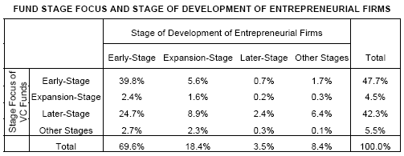
VC Style Drift is Common!
Up drifts: 14.9 %
No drifts: 41.3 %
Down drifts: 43.9 %
10

Slide 11
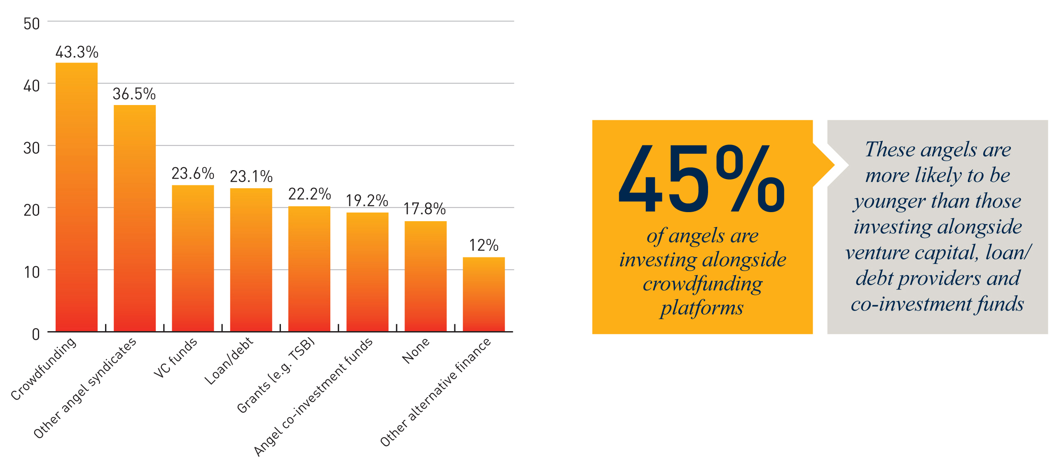
Important role of co-investing
Angels, VC and crowdfunding
Source: Wright, Hart and Fu, 2015

Slide 12
Angels and VC Coinvesting Some Issues
Sometimes Angels invest
  on their own or in angel groups,
  with VC funds
  with PE funds
Are Angel deals more sensitive to environment
  Cultural
  Legal
  Economic?
Do Angel deals do better or worse than VC (and mixed)?
  Propensity score match for deal characteristics

Slide 13
Angels Co-investing with Crowdfunding expect fewer high growth …but also fewer negative
Source: Wright, Hart and Fu, 2015

Slide 14
Angels Co-investing with VC expect more high growth …but also more negative

Slide 15
Crowdfunding and Coinvesting
Crowdfunding – More or Less Sensitive to Economic, Cultural, Legal Conditions?
Coinvesting – works better or worse between
  Angels and VCs?
  Angels and crowdfunding?
  Crowdfunding and VC?
  Etc.
Selection versus Treatment issues
  Differences across each form of entrepreneurial finance

Slide 16
Crowdfunding and coinvesting
Crowdfunding mixed with other forms of finance
  Does it depend on the platform characteristics?
    Due Diligence, fees, value-added services
    Type of platform (donations, rewards, debt, equity)
  Most [single-platform datasets] papers assume that the platforms are all homogenous
Which form of finance gives rise to the best real outcomes
  Employment, patents / new products / R&D, sales, income, exports, government grants, strategic alliances, new investment capital, IPO / acquisitions, other

Slide 17
Coinvesting future research
Investor level
Heterogeneity of crowdfunders
  Even among equity:
    Nominee (Seedrs) vs individual (Crowdcube) vs syndicated shareholdings (Syndicateroom) vs fund structure (Ourcrowd)
    Combining datasets from different platforms?
  How does investment process vary?
    ’Sophisticated’ vs other investors
    Aggressive dilution, pre-emption, etc.
How does post-investment interaction operate?
  Responsiveness of entrepreneurs
  Involvement of which investors

Slide 18
Coinvesting future research
Venture level
Heterogeneity of entrepreneurs
  Which entrepreneurs select which type? Why?
  What other funding sources have they approached and why rejected?
    Discouraged or rejected borrowers?
What post-investment interaction is sought?
What constraints on information provision and availability?
  Soft vs hard information?

Slide 19


Slide 20
Accelerators
Provide funding and structured support, for typically very early stage ventures or venture ideas
Accelerator program
  “a fixed-term, cohort-based program, including mentorship and educational components, that culminates in a public pitch event or demo-day”

Slide 21
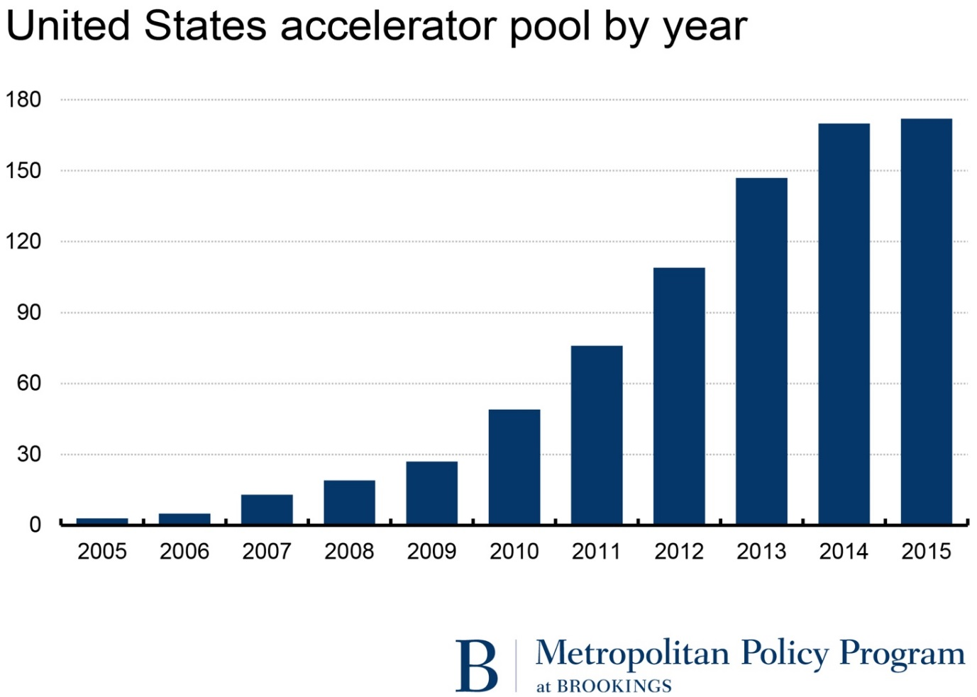
Accelerator Programs Rapid Growth
Source: Hathaway, I. 2016.

Slide 22
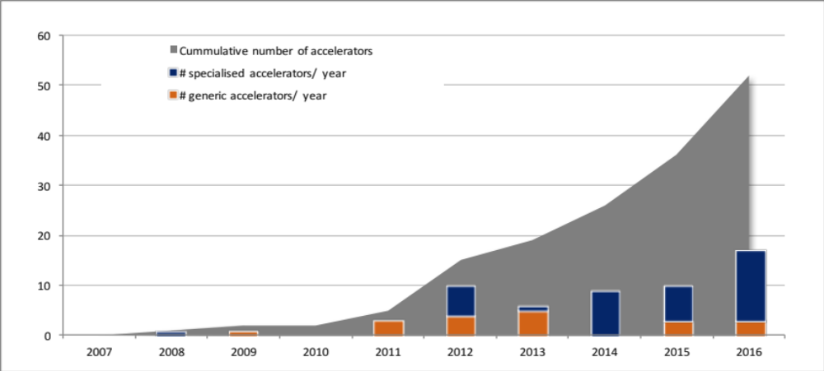
……and similar for London
Source: Clarysse, Wright, van Hove (2015)
Notes:
Worldwide we have noticed the past few years an increasing number of programs designed specifically for startups in the hardware and device space, as well as the emergence of programs equipped with wet labs to handle startups in the life sciences. Corporate-initiated programs are also on the rise, exhibiting a variety of forms and approaches. Universities, like many local governments, have also glommed onto the accelerator trends, opening summer programs to help facilitate their students’ entrepreneurial aspirations. Networks and franchising have become common. A number of marquee programs to transition away from the accelerator label and evolve into other models

Slide 23
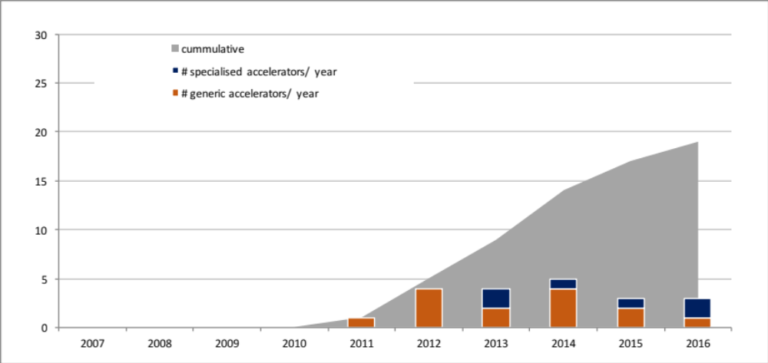
……and Paris, though different emphasis
Source: Clarysse, Wright, van Hove (2015)
Notes:
Worldwide we have noticed the past few years an increasing number of programs designed specifically for startups in the hardware and device space, as well as the emergence of programs equipped with wet labs to handle startups in the life sciences. Corporate-initiated programs are also on the rise, exhibiting a variety of forms and approaches. Universities, like many local governments, have also glommed onto the accelerator trends, opening summer programs to help facilitate their students’ entrepreneurial aspirations. Networks and franchising have become common. A number of marquee programs to transition away from the accelerator label and evolve into other models

Slide 24
Accelerator Process Life-cycle
Accelerator Context
Life-cycle –
Ownership Type, Goals and Governance
– Sector - Location - Policy
Candidate Sourcing
Cohort Selection Process
Accelerator Program
Demo Days
Exit to Next Stage
Assessment of Performance
Source: Wright & Drori (2017)

Slide 25
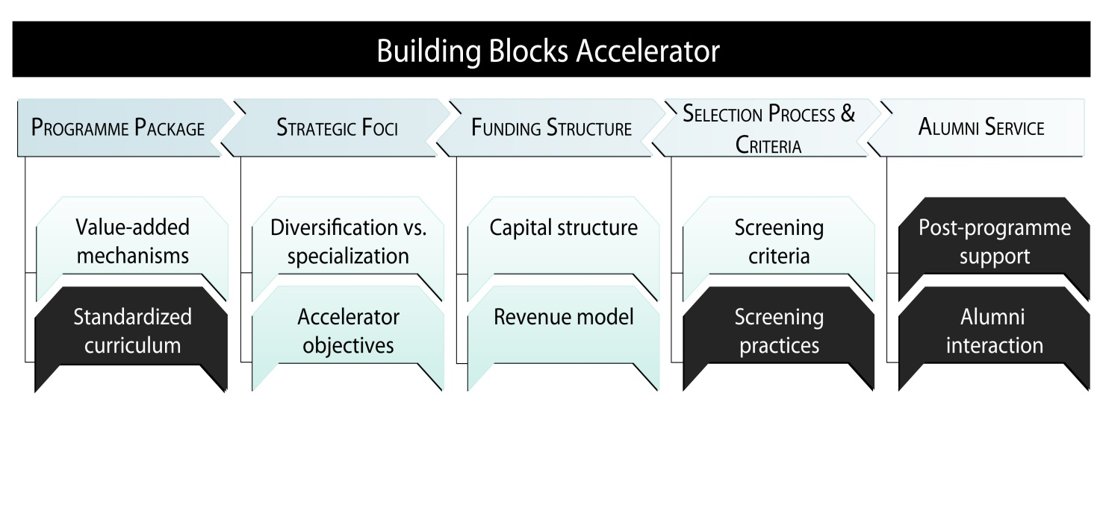
Accelerator Program Offerings Vary
Challenge of effectiveness of ‘Demo Days’ for identifying good deals for VCs
Clarysse, Wright, & Van Hove, 2015

Slide 26
Accelerators Have Different Objectives
 | Berlin | London | Paris
Welfare Stimulator [mainly generic] | Corporates Government Universities | Leading universities Government Charities | Government Public sector corporates
Deal-flow Makers [mainly generic] | Corporates | VCs, Angels | VCs, Angels
Ecosystem Builder [mainly specialized] | - | Corporates Government | Corporates Government
Evolving Trend | More specialist in Healthtech | More specialist in Fintech | Mainly generic
Font size indicates relative importance
Pauwels, Clarysse, Wright, Van Hove, 2016

Slide 27
Accelerator Impact
Accelerator backed start-ups exit faster than angel backed through
  Acquisitions
  Quitting
  Receive follow-on VC funding more quickly in short run but longer in long term [Winston Smith and Hannigan 2015]
More investor links during accelerator increases capital raising [Mejia and Gopal, 2015]
Accelerators aid and accelerate startups’ development
  effects neither due purely to selection nor credentialing
  participation in accelerators complements rather than substitutes for other forms of prior founders’ experience

Slide 28
Accelerator Future Research accelerator level
What is the additionality of accelerators?
  Fad, crowding out or gap filling?
How do accelerators contribute to and enter entrepreneurial ecosystems?
  Narratives used to distinguish from incubators?
What are KPIs for different types of accelerators with different goals?
  How relevant is financial performance of accelerated startups?
What is the particular impact of corporate accelerators?
  Relationship between corporate accelerators and CVC?

Slide 29
Accelerator future research accelerator program level
Selection
  How does accelerator cohort selection process differ from VC/BA?
  What is the contribution of prior experience of accelerator managers in selecting?
Accelerating
  How do accelerators select mentors? Their expertise and impact?
Exit
  How definitive is exit? What links are maintained?
  How successful is exit in terms of next stage finance?

Slide 30
Accelerator future research start up & entrepreneur level
Need evidence on:
  survivorship, financial and innovation performance, access to further finance, sale or IPO
  Influence of accelerator goals, ownership and types?
  Endogeneity and control samples
  Start-up characteristics
  Those who don’t apply or are rejected

Slide 31
Accelerator future research life cycle and time
Permanent or transitory? Drivers?
  Role of funding and goals
How do accelerators evolve?
  Selection, general to specific, etc
How do diverse goals, ownership types, programs, and funding regimes affect sustainability?
What will the diffusion curve look like?
  Entry and exit

Slide 32
Secondary Buyouts
SMBO = primary buyout acquired by a new set of PE investors
Refinancing of primary buyout rather than IPO or trade sale

Slide 33

Secondary Buyouts
Mixed evidence on S(M)BO performance (Achleitner and Figge, 2012; Bonini, 2015; Wang, 2011; Jenkinson and Sousa, 2015; Jelic, Zhou & Wright, 2018).
Changes to syndicate compositions?
  Types of PE; expertise; international?
Changes to board expertise and processes?
  International? Entrepreneurial?
Exits from S(M)BOs?
  3rd or 4th time around?

Slide 34
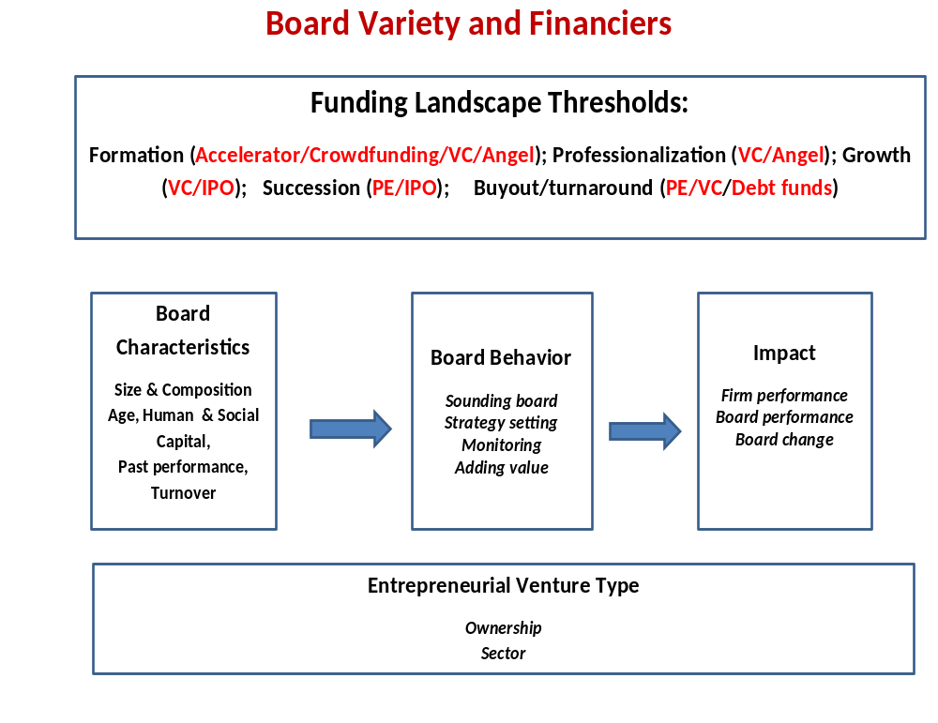

Slide 35
Boards and ENTFIN
ENTFIN is about involvement not just finance
  Complementarity and substitutability of director’s expertise?
  What configurations of expertise are more effective and when?
  How does effective board configuration vary with firm goals variety?
  How do boards change [or not] over life-cycle?
Data
  Investor firm level data vs deal level board data

Slide 36

Predicting the Future of Entrepreneurial Finance

Slide 37


Thank You!
Questions?

