Slide 1
Part 3: Shadow Banking and Other Emerging Themes
Based on some work with
Armin Schwienbacher
SKEMA Business School
Lars Hornuf
University of Trier

Slide 2
Learning Objectives
Part I: Understand VC Investment in Fintech
  Topics:
    Structure of VC funds, and investment strategies
    Exit outcomes
    Influence of financial regulation and enforcement
  Methods:
    Difference-in-Differences Analyses
Part II: Understand Lending Crowdfunding
  Topics:
    Structure of crowdfunding platforms
    How do lending platforms work?
    Performance of lending crowdfunding
  Methods:
    Panel Datasets / Hazard Models
    Endogeneity

Slide 3
Part I
Fintech Venture Capital
Fintech vs. shadow banking
Not all Fintech is shadow banking, and not all shadow banking is Fintech
A shadow banking system refers to the financial intermediaries involved in facilitating the creation of credit across the global financial system, but whose members are not subject to regulatory oversight.
The shadow banking system also refers to unregulated activities by regulated institutions.

Slide 4
The Rise of Fintech VC
“A new fintech-only VC fund just launched [by Spanish Bank BBVA] with over $150 million [changed to $250 million] to play with”
  Business Insider Feb 11, 2016
“UK fintech VC investment booms to almost $1bn”
  Computer Business Review Feb 25, 2016
“4 reasons you should believe the fintech hype”
  Venturebeat, Feb 20, 2016
“Fintech’s Wakeup Call”
  Bloomberg, Feb 22, 2016
  “without the financial crisis and the popular anger it spawned against the whole banking system, there would be no fintech”

Slide 5
Forbes, Feb 27, 2016… “An Inside Look At Fintech Marketplace Lenders”
Regulatory Matters
“Despite the notion that startups have it easier, marketplace lenders are held to many of the same rules as other lenders. Catheryn Robinson, Head of Business Development for Peerform, a personal loan marketplace, explained that, “Marketplace platforms are already complying with all the consumer lending rules and regulations in order to market, underwrite, and service the loans. These rules include the Truth in Lending Act, the Fair Credit Reporting Act, the Equal Credit Opportunity Act, and the Fair Debt Collection Practices Act, to name just a few. In addition to regulations on the borrower side, there are regulations for the investors who act as the lenders. Platforms accepting Accredited Investors must adhere to proper due diligence through KYC, OFAC rules and AML compliance.”
Compliance with these rules is no easy feat when you are a startup operating with a lean budget and small staff “The 2008 financial crisis produced a thicket of new regulations which apply equally to a small fintech startup with no compliance officer to a big bank with over 100 compliance employees,” explained Jobe Danganan, General Counsel and Chief Compliance Officer for Sindeo, a fintech startup in the mortgage marketplace lending space. Even setting up business is a complicated set of steps. “In the U.S., most of these fintech companies are non-banks, meaning they don’t have federal charter, so they have to apply for licenses at the individual state level,” added Danganan. The regulatory burdens don’t stop there as annual audits are done to ensure compliance with the relevant rules.
And regulators may impose even further requirements. Luan Cox, President & CEO of Crowdnetic, a company which provides data, technology and infrastructure to marketplace lenders, highlighted that “Last July, the U.S. Treasury Department sought public comment and input through its Request For Information on the marketplace lending industry, and over 100 responses were submitted through September 30th, the end of the comment period. It remains to be seen what the regulatory response might be from this process, but the industry may be facing additional regulation to help support the safe and continued growth of this constantly-expanding sector.”
While the level of regulation and complexity might seem overblown to the average business person, the financial sector has always been a highly regulated arena, going back to the 1930s.
After the 2008 crisis, banks faced additional capital adequacy requirements and also came under fire for non-compliance on existing rules. So while fintech startups are still subject to many of the same rules as their traditional counterparts, they don’t have the added burdens that come with litigation, fines and other penalties that several large institutions have had to deal with in recent years.

Slide 6
Implications of Differential Enforcement of Banking Rules… Fintech and Shadow Banking
Expect more fintech VC post financial crisis than pre-financial crisis relative to other types of VC, but only among certain types of VCs and in certain countries
Hypothesis 1: Fintech VC investment is more pronounced in countries without a major financial center.
Hypothesis 2: Fintech VC investment is more pronounced among less experienced VCs, particularly since the global financial crisis.
Hypothesis 3: Fintech VC investments are less likely to result in successful exit outcomes, particularly since the global financial crisis.

Slide 7
Difference-in-Differences (DD) Analyses
One way to test these propositions is to create a panel dataset
  Typical context in which to study differential impact of a regime change
DD is a quasi-experimental technique
  Can be used to study
    Regime change
    Change in government policy
    Change in economic environment
Natural experiment
  The change in the economic environment brought about a regime change
  Exogenous source of variation

Slide 8
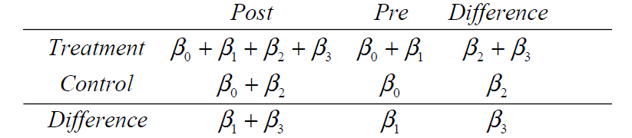
Difference-in-Differences Estimator
Cross-sectional estimator avoids omitted common trends
Time-series estimator avoids cross-sectional differences
Can see what the parameters estimate in this matrix:

Slide 9
Natural Experiment: Financial Crisis
After the financial crisis, enforcement of banking rules for fintech start-ups were more stringent in countries with a major financial center than without a major financial center
y_{it} : round amounts in fintech ventures per country per year
“Treat”: non-major financial centers
“Post”: after the financial crisis
“Treat*Post”: the key variable of interest

Slide 10

Key Assumption of DD Estimator
In the absence of the differential enforcement of financial regulation in non-financial centers, the average change in round amounts in fintech would have been the same for the countries with and without a financial center
Can’t observe ε so this is not testable
How to check this assumption (you should do it in your papers!):
  look at graphs for levels in the pre-era and compare the treat group with the non-treat group
  Do a t-test of levels during the pre-treatment period

Slide 11
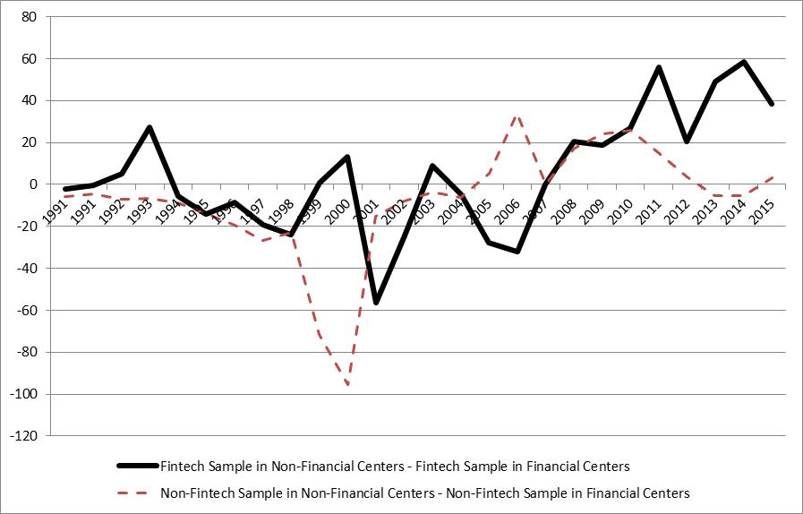
Figure 1. Total Size of All VC Rounds, Scaled 2007=0

Slide 12
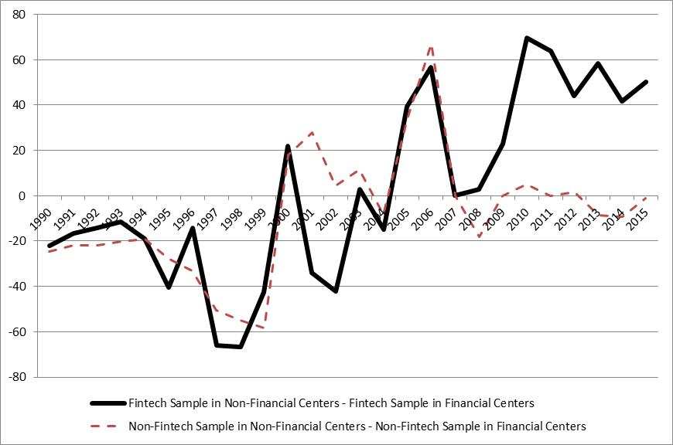
Figure 2. Number of VC Rounds, Scaled 2007=0

Slide 13
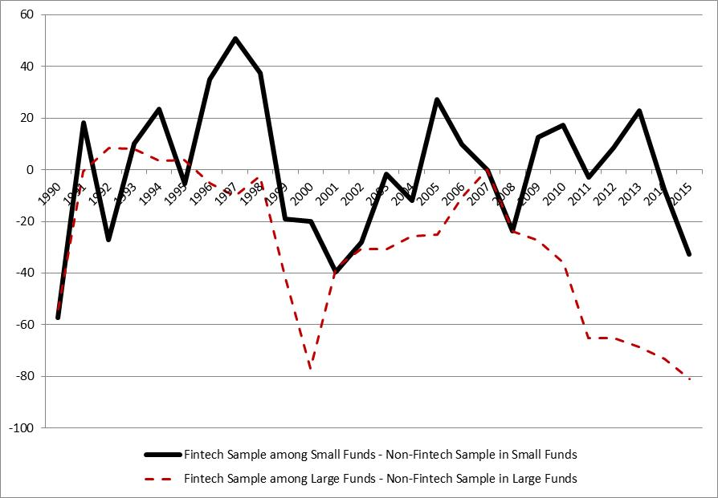
Figure 3. Number of Investment Rounds, Scaled 2007=0

Slide 14
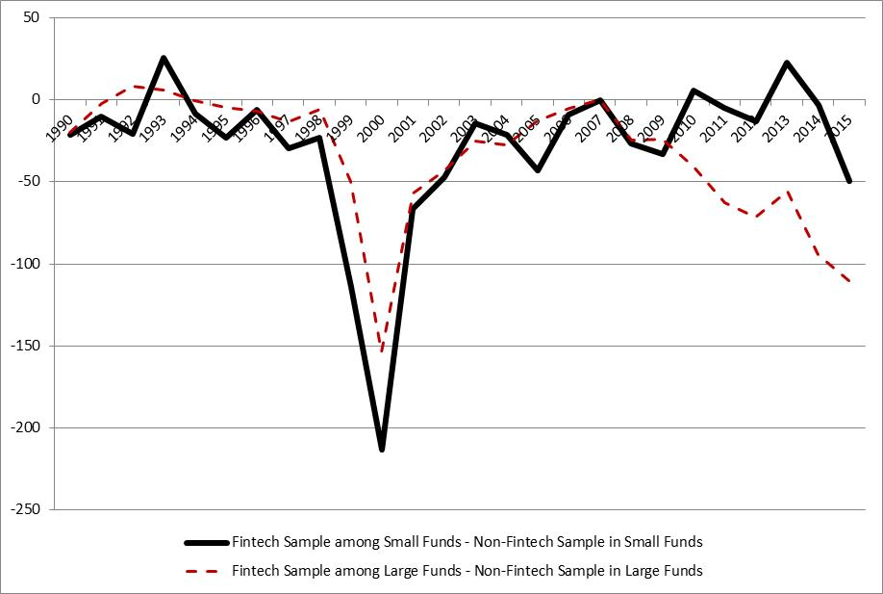
Figure 4. Annual Volume of Round Investments, Scaled 2007=0

Slide 15
Data
We collect all VC investments from the VentureXpert database from 1/1/1990 to 12/31/2015.
3,704 investment rounds in 1,805 distinct fintech ventures.
329,131 round investments in non-fintech ventures that comprises all remaining industry sectors.

Slide 16
Differential Enforcement of Banking Regulation
To assess whether a venture is located in a country with a major financial center, we rely on the 2015 Global Financial Centres Index 18 (GFCI 18) that is computed by the Z/Yen Group Limited on an annual basis.
We consider the following list of countries to have a major financial center: United Kingdom (London), United States (New York, San Francisco, Washington DC, Chicago, Boston), China (Hong Kong), Singapore (Singapore), Japan (Tokyo), South Korea (Seoul), Switzerland (Zurich, Geneva), Canada (Toronto), Germany (Frankfurt), and Australia (Sydney).

Slide 17
Difference-in-Differences: Number of Rounds
Difference-in-differences analysis for fintech in non-financial versus financial centers.
y_{it} : number of round sin fintech ventures per country per year
“Treat”: non-major financial centers
“Post”: after the financial crisis
“Treat*Post”: the key variable of interest
Estimates:
β₁ = -15.7497 (-1.41)
β₂ = -16.0194 (-1.13)
β₃ = 59.90831 (2.98)***
β₀ = 60.19417 (7.63)***
Observations = 52
Fraction Treatment = 50%
Adjusted R² = 0.1848
Average value of dependent variable: 56.6
Inference: number of fintech rounds went up by 105.8% after the financial crisis for fintech in countries without a financial center relative to countries with financial center

Slide 18
Robustness Checks with Differences-in-Differences Estimators
Bertrand, Marianne, Esther Duflo, and Sendhil Mullainathan. 2004. “How much should we trust difference in difference estimates?” 119 Quarterly Journal of Economics 249-275.
  Suggestion: use an AR(1) model Lagged dependent variable as a robustness check
Another thing to do, if the data allow, is to look at transaction specific details… more below next number of slides

Slide 19
Looking into More Detail in the Data
Always start with some summary statistics
Always include comparison tests

Slide 20
 |  | Full Sample |  |  |  | Fintech Sample Only | Non-Fintech Sample Only | Diff. Mean Test
Variable |  | Mean | Median | Std. Dev. |  | Mean | Mean | p-value
Startup Characteristics:
Post-Crisis (dummy) |  | 0.3412 | 0.0000 | 0.4741 |  | 0.3170 | 0.3414 | 0.008
Fintech Startup (dummy) |  | 0.0096 | 0.0000 | 0.0977 |  | 1.0000 | 0.0000 | - -
Round Amount (x1000 USD) |  | 13,323.8 | 6,000.0 | 39,161.4 |  | 17,937.2 | 13,279.0 | 0.000
ln(Round Amount) |  | 8.5001 | 8.6995 | 1.6260 |  | 8.5672 | 8.4995 | 0.032
Syndicate Size (No. Investors) |  | 4.5392 | 4.0000 | 3.2081 |  | 3.1538 | 4.5527 | 0.000
Startup Age (in years) |  | 5.1569 | 4.0000 | 8.7989 |  | 7.5358 | 5.1338 | 0.000
Seed-Stage Dev. (dummy) |  | 0.0759 | 0.0000 | 0.2648 |  | 0.0586 | 0.0760 | 0.001
Early-Stage Dev. (dummy) |  | 0.2726 | 0.0000 | 0.4453 |  | 0.2296 | 0.2730 | 0.000
Expansion-Stage Dev. (dummy) |  | 0.4096 | 0.0000 | 0.4918 |  | 0.4955 | 0.4087 | 0.000
Later-Stage Dev. (dummy) |  | 0.2419 | 0.0000 | 0.4283 |  | 0.2162 | 0.2422 | 0.002
IPO Exit (dummy) |  | 0.2216 | 0.0000 | 0.4153 |  | 0.3000 | 0.2209 | 0.000
Trade Sale Exit (dummy) |  | 0.6129 | 1.0000 | 0.4871 |  | 0.5118 | 0.6137 | 0.000
Successful Exit (dummy) |  | 0.8345 | 1.0000 | 0.3717 |  | 0.8118 | 0.8347 | 0.029
Bankruptcy Exit (dummy) |  | 0.1453 | 0.0000 | 0.3524 |  | 0.1567 | 0.1452 | 0.249
Startup Country: USA (dummy) |  | 0.7527 | 1.0000 | 0.4314 |  | 0.6281 | 0.7539 | 0.000
Startup Country: Canada (dummy) |  | 0.0385 | 0.0000 | 0.1925 |  | 0.0183 | 0.0387 | 0.000
Startup Country: United Kingdom (dummy) |  | 0.0348 | 0.0000 | 0.1832 |  | 0.0616 | 0.0345 | 0.000
Startup Country: China (dummy) |  | 0.0286 | 0.0000 | 0.1667 |  | 0.0560 | 0.0284 | 0.000
Startup Country: France (dummy) |  | 0.0295 | 0.0000 | 0.1691 |  | 0.0176 | 0.0296 | 0.000

Slide 21
VC Fund Characteristics: | Full Sample |  |  |  | Fintech Sample Only | Non-Fintech Sample Only | Diff. Mean Test
Financial VC Fund (dummy) | 0.0665 | 0.0000 | 0.2491 |  | 0.1019 | 0.0661 | 0.000
Private VC Fund (dummy) | 0.6497 | 1.0000 | 0.4771 |  | 0.6355 | 0.6499 | 0.122
Corporate VC Fund (dummy) | 0.0772 | 0.0000 | 0.2668 |  | 0.0579 | 0.0773 | 0.000
VC Firm Age (in years) | 20.2090 | 15.0000 | 18.0797 |  | 21.8096 | 20.1935 | 0.000
Fund Size (million USD) | 293.01 | 106.60 | 945.00 |  | 395.26 | 292.00 | 0.000
Market Conditions:
GDP (in USD) | 9.6895 | 10.2848 | 5.3009 |  | 7.9656 | 9.7062 | 0.000
GDP per Capita (in USD) | 38.4823 | 38.1139 | 12.3711 |  | 31.4577 | 38.5506 | 0.000
GDP Growth | 2.8160 | 2.6660 | 2.2646 |  | 3.7273 | 2.8071 | 0.000
No. Obs. | 277,994 |  |  |  | 2,678 | 275,316

Slide 22
Deal Level Analyses: Round Amounts
We also performed deal level analyses
Our main variable of interest is similar to the standard difference-in-differences estimator above, but instead now we focus on this variable: Post-Crisis*Fintech
The data examined are very consistent with our expectations that fintech increased after the financial crisis.
Round investment amounts for fintech went up, relative to the average amounts for all investments in the sample,
  by 3.2% to 3.7% for the full sample (Models 3-4), relative to the average deal sizes in the sample.
  by 3.0% to 3.4% for the subset of early stage VC fintech deals (Models 5-6), and
  by 2.7% to 3.2% for the early/seed stage rounds excluded (Models 7-8).

Slide 23
 | Full Sample |  |  |  |  | Early/Seed-Stage Rounds Only |  | Early/Seed-Stage Rounds Excluded
Variable | [1] | [2] | [3] | [4] |  | [5] | [6] | [7] | [8]
Startup Characteristics:
Post-Crisis (dummy) | -0.1381 | -0.1015 | -0.1414 | -0.1045 |  | -0.1255 | -0.0853 | -0.1409 | -0.1026
Fintech Startup (dummy) | 0.0358 | 0.5288*** | -0.0615 | 0.4431*** |  | 0.1003 | 0.3659* | -0.1185 | 0.4551**
Post-Crisis * Fintech |  |  | 0.3127*** | 0.2728*** |  | 0.2931** | 0.2585* | 0.2759** | 0.2270**
Startup Age (in years) | -0.0111*** | -0.0088*** | -0.0111*** | -0.0088*** |  | -0.0066 | -0.0069 | -0.0114*** | -0.0087***
VC Fund Characteristics:
Financial VC Fund (dummy) | 0.6346*** | 0.6361*** | 0.6346*** | 0.6360*** |  | 0.7702*** | 0.7662*** | 0.5624*** | 0.5664***
Private VC Fund (dummy) | 0.4796*** | 0.4676*** | 0.4795*** | 0.4676*** |  | 0.6109*** | 0.5928*** | 0.3943*** | 0.3846***
Corporate VC Fund (dummy) | 0.8074*** | 0.7823*** | 0.8070*** | 0.7820*** |  | 0.8309*** | 0.8036*** | 0.7671*** | 0.7396***
VC Firm Age (in years) | 0.0048*** | 0.0046*** | 0.0048*** | 0.0046*** |  | 0.0068*** | 0.0066*** | 0.0038*** | 0.0036***
Market Conditions:
GDP (in USD) | 0.0157 | 0.0122 | 0.0157 | 0.0122 |  | 0.0079 | 0.0060 | 0.0195 | 0.0158
GDP per Capita (in USD) | 0.0207** | 0.0207** | 0.0207** | 0.0208** |  | 0.0148** | 0.0153** | 0.0244*** | 0.0240***
GDP Growth | 0.0795* | 0.0808* | 0.0795* | 0.0808* |  | 0.0548 | 0.0612* | 0.0933* | 0.0920*
Industry Dummies | No | Yes | No | Yes |  | No | Yes | No | Yes
Stage of Dev. Dummies | Yes | Yes | Yes | Yes |  | Partial | Partial | Partial | Partial
Startup Country Dummies | Yes | Yes | Yes | Yes |  | Yes | Yes | Yes | Yes
No. Obs. | 277994 | 277994 | 277994 | 277994 |  | 96874 | 96874 | 181120 | 181120

Slide 24
Deal Level Analysis: Round Amounts by Type of VC Fund and Regions with Financial Center
Round investment amounts went up for fintech post crisis by
  4.6% for independent VCs (Model 2),
  No change for corporate VCs (Model 3)
  No change for financial institution affiliated VCs (Model 1).
Round investment amounts for fintech post crisis went up by
  2.0% among large VC funds (Model 5),
  9.1% among small VC funds (Model 4),
  consistent with Hypothesis 2.
Round investment amounts for fintech post crisis went up by
  5.4% in countries without a large financial center (Model 7),
  unchanged in countries with a major financial center (Model 6),
  consistent with Hypothesis 1.

Slide 25
 | FIN. VCs | PRIVATE VCs | CORP. VCs |  | Small VC Funds | Large VC Funds |  | Large Financial Center | No Large Financial Center
Variable | [1] | [2] | [3] |  | [4] | [5] |  | [6] | [7]
Startup Characteristics:
Post-Crisis (dummy) | -0.0184 | -0.2303 | -0.0033 |  | -0.3250 | -0.0200 |  | -0.1583 | 0.2713
Fintech Startup (dummy) | 0.7206** | 0.3853** | -0.3057 |  | 0.1999 | 0.4811** |  | 0.3930** | 0.7011**
Post-Crisis * Fintech | -0.0015 | 0.3927*** | -0.4758 |  | 0.7759*** | 0.1734** |  | -0.0277 | 0.4610**
Startup Age (in years) | -0.0112*** | -0.0090** | -0.0143*** |  | -0.0152*** | -0.0075** |  | -0.0122*** | -0.0020*
VC Fund Characteristics:
Financial VC Fund (dummy) | - - | - - | - - |  | 0.4807*** | 0.7675*** |  | 0.6961*** | 0.4433***
Private VC Fund (dummy) | - - | - - | - - |  | 0.3650*** | 0.5321*** |  | 0.4709*** | 0.4512***
Corporate VC Fund (dummy) | - - | - - | - - |  | 0.7438*** | 0.7856*** |  | 0.7965*** | 0.6344***
VC Firm Age (in years) | 0.0053*** | 0.0053*** | 0.0005 |  | 0.0074*** | 0.0019*** |  | 0.0044*** | 0.0052***
Market Conditions:
GDP (in USD) | 0.1100*** | 0.0297* | -0.0137 |  | 0.0319 | -0.0085 |  | 0.0070 | 0.1738
GDP per Capita (in USD) | 0.0007 | 0.0235*** | 0.0155* |  | 0.0243*** | 0.0164* |  | 0.0264** | -0.0102
GDP Growth | 0.0939** | 0.0744 | 0.0928** |  | 0.0839* | 0.0705** |  | 0.0895* | 0.0370*
Industry Dummies | Yes | Yes | Yes |  | Yes | Yes |  | Yes | Yes
Stage of Dev. Dummies | Yes | Yes | Yes |  | Yes | Yes |  | Yes | Yes
Startup Country Dummies | Yes | Yes | Yes |  | Yes | Yes |  | Yes | Yes
No. Obs. | 18484 | 180621 | 21448 |  | 62973 | 215021 |  | 247642 | 30352

Slide 26
Round Amounts Excluding the US, only the US, and US State level
Fintech rounds investment amounts excluding the U.S. (Models 1 and 2)
  shows a pronounced increase in fintech after the financial crisis among countries without a financial center and not in countries with a financial center, consistent with Hypothesis 1.
Fintech rounds investment amounts within the U.S. only at the state level (Models 3 and 4)
  no material difference in state-level investments depending on whether or not the state had a financial center in Models 3 and 4.
Supports our analysis at the country-level where financial regulation and enforcement takes place.
  There are scant differences in enforcement of banking regulations within a country, but marked differences in enforcement of banking regulations across countries.

Slide 27
 | Non-US Ventures in Financial Centers Only | Non-US Ventures in Non-Financial Centers Only | US Ventures in Financial Centers Only (State Level) | US Ventures in Non-Financial Centers Only (State Level)
Variable | [1] | [2] | [3] | [4]
Startup Characteristics:
Post-Crisis (dummy) | 0.626*** | 0.212 | 0.176 | 0.281
Fintech Startup (dummy) | 1.071** | 0.626*** | 0.193 | 0.579**
Post-Crisis * Fintech | -1.336*** | 0.345** | 0.263 | -0.095
Startup Age (in years) | -0.003* | -0.002 | -0.024*** | -0.014***
VC Fund Characteristics:
Financial VC Fund (dummy) | 0.760*** | 0.462*** | 0.563*** | 0.775***
Private VC Fund (dummy) | 0.771*** | 0.428*** | 0.334*** | 0.482***
Corporate VC Fund (dummy) | 1.158*** | 0.590*** | 0.617*** | 0.824***
VC Firm Age (in years) | -0.001 | 0.007*** | 0.004*** | 0.007***
Market Conditions:
GDP (in USD) | -0.148 | 0.082*** | -0.883 | -1.738**
GDP per Capita (in USD) | 0.013* | -0.006 | 0.353 | 0.651**
GDP Growth | 0.102*** | 0.034* | 0.114* | 0.112*
Industry Dummies | No | Yes | Yes | Yes
Stage of Dev. Dummies | Yes | Yes | Yes | Yes
Startup Country Dummies | Yes | Yes | No | No
No. Obs. | 30751 | 37992 | 131853 | 77398

Slide 28
Deal Level Analysis of Syndicate Size
Round syndicate size went up, relative to the average syndicate size in the full sample by:
  23.9% for full sample (Model 1),
  18.4% for early stage rounds (Model 2),
  26.6% excluding early stage rounds (Model 3),
  31.8% for small VC funds (Model 4),
  22.9% for large VC funds (Model 5),
  29.8% in countries without a large financial center (Model 7),
  and unchanged in countries with a large financial center (Model 6), consistent with Hypothesis 1.

Slide 29
 | Full Sample | Early/Seed-Stage Rounds Only | Early/Seed-Stage Rounds Excluded | Small VC Funds | Large VC Funds | Large Financial Center | No Large Financial Center
Variable | [1] | [2] | [3] | [4] | [5] | [6] | [7]
Startup Characteristics:
Post-Crisis (dummy) | -0.2993 | 0.2832 | -0.6238*** | -0.5517*** | -0.2812 | -0.3498 | 0.2113
Fintech Startup (dummy) | 0.3349 | 0.3220 | 0.2431 | 0.2759 | 0.3600 | 0.3098 | 0.5191
Post-Crisis * Fintech | 1.0834*** | 0.8340** | 1.2094** | 1.4447*** | 1.0405** | 0.4249 | 1.3510***
Startup Age (in years) | -0.0611*** | -0.0217*** | -0.0627*** | -0.0594*** | -0.0617*** | -0.0660*** | -0.0288***
VC Fund Characteristics:
Financial VC Fund (dummy) | 0.8694*** | 0.6614*** | 0.9689*** | 0.5373*** | 0.9527*** | 1.0127*** | 0.1619
Private VC Fund (dummy) | 0.4699*** | 0.3916*** | 0.5240*** | 0.2629** | 0.4986*** | 0.5238*** | 0.0892
Corporate VC Fund (dummy) | 1.1633*** | 0.8448*** | 1.3232*** | 0.9130*** | 1.2003*** | 1.2491*** | 0.4891***
VC Firm Age (in years) | 0.0072*** | 0.0080*** | 0.0068*** | 0.0129*** | 0.0059*** | 0.0068*** | 0.0069***
Market Conditions:
GDP (in USD) | -0.0416** | 0.0189 | -0.0788*** | -0.0527** | -0.0312 | -0.0510** | -0.1362
GDP per Capita (in USD) | 0.0037 | -0.0105* | 0.0101 | 0.0124 | 0.0004 | 0.0096 | -0.0198**
GDP Growth | 0.0488 | 0.0423 | 0.0530 | 0.0460 | 0.0464 | 0.0519 | 0.0272
Industry Dummies | Yes | Yes | Yes | Yes | Yes | Yes | Yes
Stage of Dev. Dummies | Yes | Yes | Yes | Yes | Yes | Yes | Yes
Startup Country Dummies | Yes | Yes | Yes | Yes | Yes | Yes | Yes
No. Obs. | 277994 | 96874 | 181120 | 62973 | 215021 | 247642 | 30352

Slide 30
Fintech Exits
The data for the full sample indicate that controlling for other things being equal, fintech VC deals are
  6.4% more likely to be sold as write-offs if they originated after the financial crisis (Model 4),
  10.4% less likely to be a trade sale (Model 3), and
  8.3% less likely to be either an IPO or a trade sale (Model 2),
  Consistent with Hypothesis 3.
No significant difference in exit outcomes for fintech after the crisis amongst the countries with a major financial center (Models 5-8).
Focusing on the exits of ventures located in a country without a major financial center (Models 9-12),
  there is a material increase in liquidations post crisis for fintech by 9.3% (Model 12),
  and a reduction in successful exits (IPOs or trade sales) by 14.8% (Model 10).

Slide 31
 | Full Sample |  |  |  | Ventures Located in Country with a Major Financial Center |  |  |  | Ventures Not Located in Country with a Major Financial Center
 | IPO Exit | Successful Exit | TS Exit | Bankruptcy Exit | IPO Exit | Successful Exit | TS Exit | Bankruptcy Exit | IPO Exit | Successful Exit | TS Exit | Bankruptcy Exit
Variable | [1] | [2] | [3] | [4] | [5] | [6] | [7] | [8] | [9] | [10] | [11] | [12]
Startup Characteristics:
Post-Crisis (dummy) | 0.1105*** | 0.0931*** | -0.0600*** | -0.1010*** | 0.1173*** | 0.0989*** | -0.0660*** | -0.1032*** | 0.0372 | 0.0553*** | -0.0011 | -0.0422**
Fintech Startup (dummy) | -0.1282** | 0.0320 | 0.1991*** | -0.0375 | -0.1036 | 0.0259 | 0.1717** | -0.0366 | -0.2464 | 0.0343 | 0.2913 | 0.2494***
Post-Crisis * Fintech | 0.0223 | -0.0829** | -0.1039** | 0.0636* | 0.0536 | -0.0218 | -0.0988 | 0.0000 | 0.0171 | -0.1476** | -0.1932 | 0.0926***
Market Conditions:
GDP at Exit (in USD) | -0.0037*** | 0.0034*** | 0.0060*** | 0.0005 | -0.0016 | 0.0032*** | 0.0028 | -0.0007 | 0.0490** | 0.0023 | -0.0456*** | -0.0119*
GDP per Capita at Exit (in USD) | -0.0067*** | -0.0016*** | 0.0062*** | 0.0006 | -0.0083*** | -0.0015 | 0.0086*** | 0.0004 | -0.0063*** | -0.0019*** | 0.0041*** | 0.0008**
GDP Growth at Exit | 0.0159*** | 0.0056** | -0.0165*** | -0.0030 | 0.0111** | 0.0035 | -0.0133*** | -0.0025 | 0.0240*** | 0.0113*** | -0.0167** | -0.0042**
Industry Dummies | Yes | Yes | Yes | Yes | Yes | Yes | Yes | Yes | Yes | Yes | Yes | Yes
No. Obs. | 17072 | 17072 | 17072 | 17031 | 14637 | 14613 | 14637 | 14559 | 2435 | 2435 | 2435 | 2383

Slide 32
Summary
We document a notable change in the pattern of fintech VC investments around the world relative to other types of investments after the global financial crisis.
The spike in fintech VC in certain countries is attributable to differential enforcement of financial institution rules amongst start-ups versus large established financial institutions after the financial crisis.
The marked increase in fintech is more pronounced in countries without a major financial center.
The fintech boom is more pronounced for smaller private limited partnership VCs that likely have less experience with prior VC booms and busts.
These fintech VC deals are less likely to be successfully exited as IPOs and acquisitions, and substantially more likely to be liquidated, especially when located in countries without a major financial center.

Slide 33
Crowdfunding to SMEs

Slide 34
European Crowdlending Platform
Multinational company, operating a peer-to-peer lending platform, operating in a number of different countries (so far has requested annominity)
Using the crowdfunding model, the company creates a direct link between private lenders and small businesses seeking loans.
Small business loans from 10,000 to 250,000 euros.
Platform determines whether the borrower is creditworthy and assigns a credit grade that determines the payable interest rate and the fees.
Charges borrowers a 1% to 4.5% origination fee.
Loan can be repaid without an early repayment fee at any time

Slide 35
Data
March 2014 to November 2015
Over €9 million funded
414 companies
Median company asks for €60,000 and receives €29,450
Median company has €295,975 in assets, €44,100 income
1-61 days for time until funded
On average, a firm gets 57.5% of requested funding
Median success is 53.2%
Min 0.01% to Max 100%

Slide 36
Variable | Obs | Mean | Median | Std. Dev. | Min | Max
Dependent Variables
Success (% of Capital Raised) | 414 | 0.58 | 0.532 | 0.32 | 0.01 | 1
Investment Campaign | 414 | 84.70 | 77 | 47.28 | 4 | 302
Bid Amount | 414 | 33,680.68 | 29,450.00 | 22,297.93 | 400.00 | 124,800.00
Funded Dummy | 414 | 0.89 | 1 | 0.31 | 0 | 1
Time Listed to Funded | 403 | 20.12 | 20 | 11.85 | 0 | 61
Time Funded to Issued | 367 | 19.17 | 15 | 10.38 | 4 | 59
Investment Characteristics
Nominal Yield - Risk Free | 414 | 0.0685 | 0.0657 | 0.0190 | 0.0313 | 0.1502
Percent Female Investors | 414 | 0.07 | 0.0714 | 0.03 | 0 | 0.2363636
Principal Amount | 414 | 72,183.57 | 60,000.00 | 46,889.03 | 10,000.00 | 250,000.00
Loan Duration (Months) | 414 | 34.01 | 36 | 13.80 | 6 | 60
Firm Characteristics
Number of Employees | 414 | 17.55 | 10 | 28.51 | 1 | 300
Female Debtor | 414 | 0.16 | 0 | 0.37 | 0 | 1
Assets | 414 | 808,571.20 | 295,975.00 | 1,409,318.00 | 9,000.00 | 14,600,000.00
Current Assets/Current Liabilities | 412 | 2.87 | 1.297928 | 14.10 | 0 | 256.2
Liabilities | 414 | 808,609.80 | 295,975.00 | 1,409,146.00 | 9,000.00 | 14,600,000.00
Equity | 414 | 160,649.70 | 49,241.67 | 519,186.70 | -1,214,900.00 | 7,492,967.00
Net Income | 414 | 66,744.35 | 44,100.00 | 101,940.60 | -346,300.00 | 1,112,533.00
Legal Entity Status of Debtor
AG (PLC) | 414 | 0.02 | 0 | 0.13 | 0 | 1
Registered Cooperative (eG) | 414 | 0.00 | 0 | 0.07 | 0 | 1
Registered Merchant (eK) | 414 | 0.04 | 0 | 0.20 | 0 | 1
Freelancer | 414 | 0.03 | 0 | 0.17 | 0 | 1
LLC (GmbH) | 414 | 0.56 | 1 | 0.50 | 0 | 1
LP with LLC as GP (GmbH & Co KG) | 414 | 0.09 | 0 | 0.29 | 0 | 1
LP (KG) | 414 | 0.01 | 0 | 0.11 | 0 | 1
Non-Registered Merchant (neK) | 414 | 0.08 | 0 | 0.27 | 0 | 1
General Partnership (OHG) | 414 | 0.01 | 0 | 0.11 | 0 | 1
Other | 414 | 0.13 | 0 | 0.34 | 0 | 1
small LLC (UG) | 414 | 0.01 | 0 | 0.12 | 0 | 1

Slide 37
Variable | Obs | Mean | Median | Std. Dev. | Min | Max
Reason for Raising External Capital
Asset Purchase | 414 | 0.12 | 0 | 0.32 | 0 | 1
Expansion / Growth Capital | 414 | 0.46 | 0 | 0.50 | 0 | 1
Other | 414 | 0.08 | 0 | 0.27 | 0 | 1
Tax Liability | 414 | 0.02 | 0 | 0.14 | 0 | 1
Working Capital | 414 | 0.32 | 0 | 0.47 | 0 | 1
Risk Rating of Debtor
Risk A Plus | 414 | 0.05 | 0 | 0.22 | 0 | 1
Risk A | 414 | 0.21 | 0 | 0.41 | 0 | 1
Risk B | 414 | 0.47 | 0 | 0.50 | 0 | 1
Risk C | 414 | 0.23 | 0 | 0.42 | 0 | 1
Rick D | 414 | 0.00 | 0 | 0.00 | 0 | 0
Market Conditions
MSCI | 414 | -0.0002 | -0.0001 | 0.0045 | -0.0218 | 0.0182
Industry Dummy Variables
Accommodation and food service activities | 414 | 0.03 | 0 | 0.17 | 0 | 1
Agriculture, forestry and fishing | 414 | 0.02 | 0 | 0.13 | 0 | 1
Arts, entertainment and recreation | 414 | 0.00 | 0 | 0.05 | 0 | 1
Construction | 414 | 0.09 | 0 | 0.28 | 0 | 1
Electricity, gas, steam and air conditioning supply | 414 | 0.00 | 0 | 0.05 | 0 | 1
Financial and insurance activities | 414 | 0.03 | 0 | 0.17 | 0 | 1
Human health and social work activities | 414 | 0.06 | 0 | 0.24 | 0 | 1
Information and communication | 414 | 0.07 | 0 | 0.26 | 0 | 1
Manufacturing | 414 | 0.11 | 0 | 0.32 | 0 | 1
Other | 414 | 0.08 | 0 | 0.28 | 0 | 1
Other services activities | 414 | 0.19 | 0 | 0.39 | 0 | 1
Professional, scientific and technical activities | 414 | 0.04 | 0 | 0.19 | 0 | 1
Real estate activities | 414 | 0.00 | 0 | 0.00 | 0 | 0
Rental and leasing activities | 414 | 0.02 | 0 | 0.14 | 0 | 1
Transporting and storage | 414 | 0.04 | 0 | 0.19 | 0 | 1
Wholesale and retail trade, repair of motor vehicles and motorc | 414 | 0.21 | 0 | 0.41 | 0 | 1

Slide 38
2 Types of Analyses that can be Done
Unit of Analysis: Firm that applied for funding
  Probit analysis of whether or not funded
  Regression analysis of amount funded
  Regression analysis of time to funding
Unit of Analysis: Each Day on the Campaign
  Panel data of amounts offered each day
  Survival analysis of panel data – competing risks – of time to funding or time to cancelling of campaign

Slide 39
Fractional Response Models:
Dependent Variable Bounded between 0 and 1
https://www3.nd.edu/~rwilliam/stats3/FractionalResponseModels.pdf
  Procedure to use in Stata
http://www.stata-journal.com/sjpdf.html?articlenum=st0147
  Explanation of logistic transformations
Other reference material
  Cook, D. O., R. Kieschnick, and B. D. McCullough. 2008. Regression analysis of proportions in finance with self selection. Journal of Empirical Finance.

Slide 40
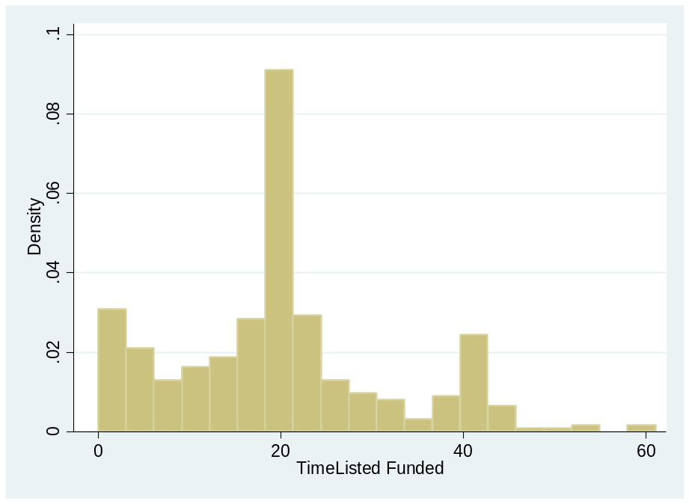
Worth Checking The Distribution of the Dependent Variable for Other Models
Here it is for Time Listed to Time Funded
Not necessarily the case that a Poisson or Negative Binomial Model is superior than OLS

Slide 41
 | Model 1a: Success (% of Capital Raised) OLS |  | Model 1b: Success (% of Capital Raised) Percentage Model |  | Model 2: Funded=1
 | Coefficient | t-statistic | Marginal Effect | t-statistic | Marginal Effect | t-statistic
Investment Characteristics
Nominal Yield - Risk Free | 5.6603 | 3.61*** | 7.4221 | 3.68*** | -3.0721 | -1.99**
Percent Female Investors | 0.6432 | 1.72* | 0.7332 | 1.58 | 0.0711 | 0.16
Number of Employees | 0.0012 | 2.40** | 0.0015 | 3.10*** | -0.0003 | -0.69
Principal Amount | -3.83E-06 | -11.80*** | -4.73E-06 | -10.76*** | -4.16E-07 | -1.15
Loan Duration (Months) | -0.0079 | -7.25*** | -0.0100 | -7.42*** | -0.0011 | -1.02
Firm Characteristics
Female Debtor | -0.0300 | -0.9 | -0.0438 | -1.02 | -0.0238 | -0.58
Assets | -1.46E-06 | -0.41 | -6.78E-06 | -2.47** | 2.01E-06 | 0.41
Current Assets/Current Liabilities | -0.0020 | -2.23** | -0.0023 | 3.82*** | 0.0008 | 0.28
Liabilities | 1.44E-06 | 0.4 | 6.76E-06 | 2.46** | -2.02E-06 | -0.41
Equity | 2.60E-08 | 0.75 | 3.34E-08 | 1.02 | -1.40E-08 | -0.28
Net Income | 3.04E-07 | 2.04** | 3.61E-07 | 2.37** | 2.23E-07 | 1.16
Industry Dummies? | Yes |  | Yes |  | Yes
Legal Status of Debtor
AG (PLC) | 0.2099 | 1.07 | -0.2206 | -1.16 | 0.0618 | 1.68*
Registered Merchant (eK) | 0.2640 | 1.45 | -0.4196 | -3.45*** | 0.0512 | 1.13
Freelancer | 0.3252 | 1.76* | -0.1553 | -0.9
LLC (GmbH) | 0.3051 | 1.75* | -0.1116 | -0.64 | 0.1329 | 1.15
LP with LLC as GP (GmbH & Co KG) | 0.3298 | 1.84* | -0.1103 | -0.7 | 0.0391 | 0.71
LP (KG) | 0.3394 | 1.65* | -0.0759 | -0.44
Non-Registered Merchant (neK) | 0.3010 | 1.68* | -0.0412 | -0.22 | 0.0103 | 0.13
General Partnership (OHG) | 0.3963 | 1.93* | -0.1272 | -0.72 | -0.0656 | -0.33
Other | 0.2087 | 1.18 | -0.0087 | -0.04 | 0.0516 | 1.04
small LLC (UG) | 0.4074 | 2.02** | -0.2329 | -1.42
Reason for Raising External Capital
Asset Purchase | -0.0256 | -0.25 | 0.0742 | 1.64 | 0.0063 | 0.15
Expansion / Growth Capital | -0.0919 | -0.96 | 0.0000 | 0 | 0.0397 | 1.28
Other | -0.0615 | -0.6 | 0.0434 | 0.74 | 0.0103 | 0.23
Tax Liability |  |  | 0.1224 | 1.11 | -0.1348 | -0.58
Working Capital | -0.0862 | -0.9
Risk Rating of Debtor
Risk A Plus | 0.5398 | 3.42*** | 0.3943 | 9.67*** | -0.2531 | -0.51
Risk A | 0.3818 | 2.78*** | 0.3794 | 3.80*** | -0.1925 | -0.62
Risk B | 0.1643 | 1.41 | 0.2028 | 1.43 | -0.0976 | -0.72
Risk C | 0.0847 | 0.93 | 0.0861 | 0.75 | -0.1310 | -0.82
Market Conditions
MSCI | -1.4299 | -0.52 | -1.9533 | -0.53 | 6.8692 | 2.10**
Constant | 0.3646 | 0.95 | 0.1546 | 0.13 | 6.0342 | 2.07**
Model Dianostics
Number of Observations | 414 |  | 414 |  | 414
F-Statistic (LR for Logit) | 8.43*** |  | 557.03*** |  | 39.26
Adjusted R2 (Pseudo R2 for Logit) | 0.4429 |  | 0.1673 |  | 0.1471

Slide 42
 | Model 3: Investment Campaign |  | Model 4: Bid Amount |  | Model 5: Time Listed to Funded |  | Model 6: Time Funded to Issued
 | Coefficient | t-statistic | Coefficient | t-statistic | Coefficient | t-statistic | Coefficient | t-statistic
Investment Characteristics
Nominal Yield - Risk Free | 940.4385 | 3.57*** | 410772.3000 | 3.37*** | -262.1899 | -4.13*** | 21.3612 | 0.28
Percent Female Investors | 114.8675 | 1.83* | 38671.0900 | 1.33 | 4.4051 | 0.3 | 21.2842 | 1.25
Number of Employees | 0.1328 | 1.64 | 131.1348 | 3.51*** | 0.0002 | 0.01 | -0.0185 | -0.75
Principal Amount | 4.68E-04 | 8.54*** | 1.90E-01 | 7.52*** | 1.55E-04 | 12.08*** | -3.38E-06 | -0.22
Loan Duration (Months) | -0.7068 | -3.85*** | -425.1061 | -5.01*** | 0.2636 | 5.99*** | -0.1483 | -2.81***
Firm Characteristics
Female Debtor | -8.0612 | -1.43 | -4681.3860 | -1.8 | -0.2339 | -0.18 | -0.0125 | -0.01
Assets | 7.50E-04 | 1.24 | 5.83E-02 | 0.21 | 2.21E-04 | 1.59 | -2.09E-04 | -1.33
Current Assets/Current Liabilities | -0.0916 | -0.61 | -50.9647 | -0.74 | 0.0097 | 0.28 | -0.0120 | -0.31
Liabilities | -7.55E-04 | -1.25 | -6.08E-02 | -0.22 | -2.21E-04 | -1.59 | 2.10E-04 | 1.34
Equity | 1.36E-06 | 0.23 | -5.13E-04 | -0.19 | -1.37E-06 | -0.98 | -1.70E-06 | -1.05
Net Income | -4.76E-06 | -0.19 | 6.18E-03 | 0.53 | -8.59E-06 | -1.48 | -2.32E-06 | -0.34
Industry Dummies? | Yes |  | Yes |  | Yes |  | Yes
Legal Status of Debtor
AG (PLC) | -5.1180 | -0.15 | 6222.0490 | 0.41 | 4.9335 | 0.64 | -18.7579 | -2.17**
Registered Merchant (eK) | 29.4862 | 0.96 | 11586.6100 | 0.82 | -6.0418 | -0.86 | -11.5568 | -1.45
Freelancer | 34.5153 | 1.11 | 13165.3300 | 0.91 | -1.6226 | -0.23 | -21.2559 | -2.64**
LLC (GmbH) | 18.9714 | 0.64 | 9623.1540 | 0.71 | -2.4024 | -0.36 | -17.9707 | -2.36**
LP with LLC as GP (GmbH & Co KG) | 26.1221 | 0.87 | 12013.8400 | 0.86 | -1.3986 | -0.2 | -15.2384 | -1.95*
LP (KG) | 44.4291 | 1.28 | 14105.9800 | 0.88 | -8.2017 | -1.03 | -21.7805 | -2.44**
Non-Registered Merchant (neK) | 30.8897 | 1.02 | 10263.0500 | 0.74 | -2.2407 | -0.32 | -16.0232 | -2.05**
General Partnership (OHG) | 3.2701 | 0.09 | 4610.9400 | 0.29 | 0.1943 | 0.02 | -21.8923 | -2.38**
Other | 2.9705 | 0.1 | -834.3967 | -0.06 | -3.6273 | -0.53 | -14.2656 | -1.85*
small LLC (UG) | 41.1958 | 1.21 | 16708.5100 | 1.06 | -5.8255 | -0.75 | -23.9162 | -2.56**
Reason for Raising External Capital
Asset Purchase | -5.6011 | -0.33 | 4049.5180 | 0.52 | -1.3919 | -0.36 | 5.2426 | 2.00**
Expansion / Growth Capital | -10.5568 | -0.66 | -1609.5210 | -0.22 | 0.1628 | 0.04 | 1.9886 | 0.91
Other | -7.4264 | -0.43 | 1970.4880 | 0.25 | 0.7421 | 0.19
Tax Liability |  |  |  |  |  |  | 5.9001 | 1.14
Working Capital | -11.8621 | -0.73 | -1432.8040 | -0.19 | 0.3735 | 0.1 | 1.2670 | 0.55
Risk Rating of Debtor
Risk A Plus | 100.9971 | 3.79*** | 51278.0700 | 4.17*** | -23.4732 | -3.71*** | -0.2993 | -0.04
Risk A | 76.9756 | 3.33*** | 41641.1700 | 3.90*** | -20.4184 | -3.69*** | 0.2856 | 0.04
Risk B | 55.4445 | 2.83*** | 25767.8500 | 2.85*** | -12.7037 | -2.71*** | -2.8187 | -0.5
Risk C | 43.6065 | 2.84*** | 19167.2200 | 2.70*** | -6.3541 | -1.72* | -4.0193 | -0.91
Market Conditions
MSCI | -606.8846 | -1.3 | -172787.6000 | -0.8 | -49.7878 | -0.46 | -225.5001 | -1.76*
Constant | -44.9276 | -0.7 | -31952.5000 | -1.08 | 27.0205 | 1.81 | 28.8086 | 1.73*
Model Dianostics
Number of Observations | 414 |  | 414 |  | 414 |  | 414
F-Statistic (LR for Logit) | 4.98*** |  | 5.56*** |  | 7.40*** |  | 1.36*
Adjusted R2 (Pseudo R2 for Logit) | 0.3737 |  | 0.3998 |  | 0.413 |  | 0.0413

Slide 43
Regression Results (1 of 2)
A 1-standard deviation change in Nominal yield – risk free causes
  18.7% increase in % funded
  6.53% reduction in likelihood of being fully funded
  21.1% increase in investment campaign
  23.2% increase in the amount bid
  24.8% reduction in the time from being listed to being funded
A 1-standard deviation change in Percent of Female Investors causes
  3.9% increase in the % funded
A 1-standard deviation change in number of employees causes
  5.71% increase in % funded
  26.5% increase in the investment campaign
  38.2% increase in the amount bid

Slide 44
Regression Results (1 of 2)
A 1-standard deviation increase in Net Income causes
  5.39% increase in the % funded
Risk Ratings of Debtor increase the percent funded by
  Risk A Plus raises by 54.0%
  Risk A raises by 38.2%
    Relative to Risk B, C, or D
Risk Rating of Debtor Increase bid amount by
  €51,278 for Risk A Plus
  €41,641 for Risk A
  €25,768 for Risk B
  €19,167 for Risk C
    Relative to Risk D
Risk Rating of Debtor Reduces time to Funded by
  23.5 days for Risk A Plus
  20.4 days for Risk A
  12.7 days for Risk B
  6.4 days for Risk C
    Relative to Risk D

Slide 45
Analysis of Daily Data
Panel Data
Don’t forget to set up your panel correctly!
  This takes time
  We converted our data from investment days (many observations for a single day) to one observation per day an indicated how many investments there were per day
Don’t forget to tell Stata that you are using a Panel!
  xtset company_id Day

Slide 46
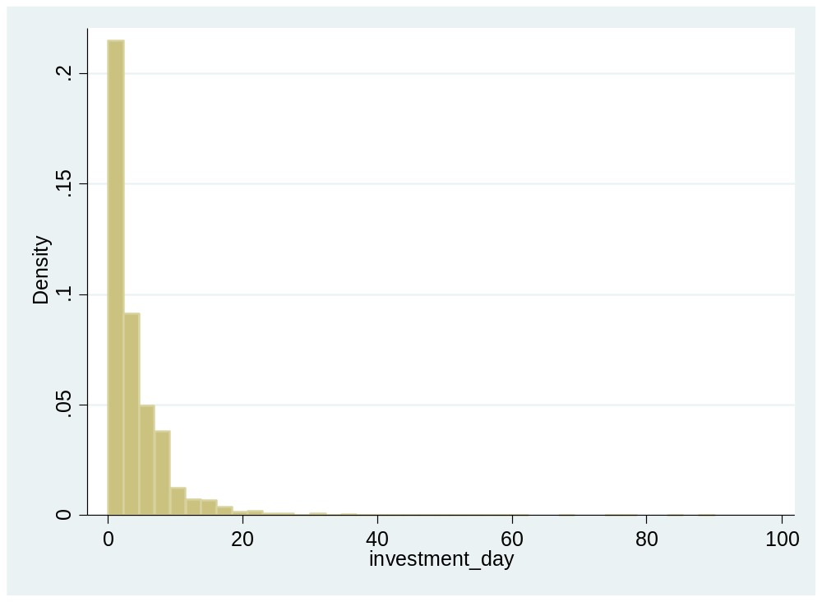
Dependent variable is highly skewed
Suggests a negative binomial panel model
Alternative could be a Poisson model

Slide 47
Investments Per Day or Amount Per Day
Function of
  Female participation (+)
  Newsletter (+)
  Use of mobile phones (+)
  MSCI returns (-)
  Nominal Yield (+?)
  Yield on public debt (-)
  Number of parallel investments (-)
  Number of prior investment in this project (+?)
  Dollar value of prior investments in this project (+?)

Slide 48
 | Model 7 (Panel, Random Effects): Number of Investment / Day |  | Model 8 (Panel, Fixed Effects): Number of Investment / Day |  | Model 9 (Negatve Binomial, Random Effects): Number of Investment / Day |  | Model 10 (Negatve Binomial, Fixed Effects): Number of Investment / Day |  | Model 11 (Random Effects): Amount Investment / Day |  | Model 12 (Fixed Effects): Amount Investment / Day |  | Model 13 (Negative Binomial, Random Effects): Amount Investment / Day |  | Model 14 (Negative Binomial, Fixed Effects): Amount Investment / Day
 | Coefficient | t-statistic | Coefficient | t-statistic | Coefficient | t-statistic | Coefficient | t-statistic | Coefficient | t-statistic | Coefficient | t-statistic | Coefficient | t-statistic | Coefficient | t-statistic
Female Percentage Day | 0.2312 | 1.04 | 0.2199 | 0.99 | 0.1654 | 3.43*** | 0.1634 | 3.37*** | 64.0866 | 0.45 | 49.0841 | 0.35 | 0.3974 | 7.83*** | 0.40203 | 7.84***
Newsletter Percentage Day | 1.1994 | 10.33*** | 1.1972 | 10.32*** | 0.4646 | 17.86*** | 0.4677 | 17.85*** | 590.8812 | 7.99*** | 588.4078 | 7.97*** | 1.0266 | 36.01*** | 1.0401 | 36.13***
Mobile Percentage Day | 0.8734 | 4.54*** | 0.8592 | 4.47*** | 0.2919 | 7.12*** | 0.2881 | 6.96*** | 271.1427 | 2.21** | 260.3751 | 2.13** | 0.5228 | 11.83*** | 0.52722 | 11.80***
MSCI Return | 1.3979 | 0.47 | 1.4489 | 0.49 | 0.1220 | 0.17 | 0.2291 | 0.32 | 34.9068 | 0.02 | 125.1385 | 0.07 | -0.3968 | -0.44 | -0.34794 | -0.39
Nominal Yield | 33.0645 | 1.74* |  |  | 0.9944 | 0.7 | 0.7819 | 0.4 | 89.8981 | 0.01 |  |  | -2.9322 | -3.43*** | -3.0878 | -3.30***
Yield on Public Debt | -2.8555 | -4.75*** | -2.6880 | -4.05*** | -0.4349 | -4.79*** | -0.2385 | -2.13** | -1058.589 | -2.83*** | -1512.298 | -3.58*** | -0.4737 | -8.04*** | -0.47804 | -7.63***
Number of Parrellel Investments | -0.1270 | -11.82*** | -0.1194 | -10.75*** | -0.0247 | -11.27*** | -0.0245 | -10.13*** | -54.9028 | -8.09*** | -47.81229 | -6.76*** | -0.0143 | -7.57*** | -0.01313 | -6.54***
Cumulative Lag Number of Investments | -0.0255 | -5.66*** | -0.0234 | -5.10*** | -0.0030 | -3.35*** | -0.0032 | -3.41*** | 28.5400 | 9.98*** | 33.38217 | 11.43*** | 0.0071 | 8.34*** | 0.008307 | 9.22***
Cumulative Lag Bid Amount | 4.71E-05 | 4.23** | 3.90E-05 | 3.43*** | 8.64E-06 | 4.13*** | 7.51E-06 | 3.36*** | -0.0574 | -8.12*** | -0.0711553 | -9.83*** | -1.18E-06 | -0.56 | -5.95E-06 | -2.70***
Constant | 7.2700 | 4.84** | 7.4946 | 18.19*** | 1.5429 | 11.68*** | 1.5014 | 8.99*** | 3568.858 | 4.20*** | 2664.616 | 10.16*** | -0.8321 | -9.22*** | -0.821765 | -8.52***
Number of observations | 8236 |  | 8236 |  | 8236 |  | 8236 |  | 8236 |  | 8236 |  | 8236 |  | 8236
Number of Groups | 414 |  | 414 |  | 414 |  | 414 |  | 414 |  | 414 |  | 414 |  | 414
Within R2 | 0.04 |  | 0.0402 |  |  |  |  |  | 0.0374 |  | 0.038
Between R2 | 0.0878 |  | 0.0797 |  |  |  |  |  | 0.0006 |  | 0.0017
Overall R2 | 0.031 |  | 0.0364 |  |  |  |  |  | 0.0256 |  | 0.0136

Slide 49
Investments Per Day or Amount Per Day
Number of investments per day increases by
  0.6% with a 1 std dev increase in Female participation
  9.3% with a 1-std dev increase in Newsletter
  4.1% with a 1-std dev increase in Use of mobile phones
  Unrelated to MSCI returns
  12.9% with a 1-std dev increase in Nominal Yield
  -18.3% with a 1-std dev increase in Yield on public debt
  -25.5% with a 1-std dev increase in the Number of parallel investments
  -22.3% with a 1-std dev increase in the Number of prior investment in this project
  17.4% with a 1-std dev increase in the Dollar value of prior investments in this project

Slide 50
Invariant Data over Time
Financial Data (Income, Revenue, Assets)
Age
Cannot include in a panel regression with firm fixed effects
Can segregate the data by levels of income, revenue, assets, age

Slide 51
 | Model 15 (Negatve Binomial, Fixed Effects): Number of Investment / Day, Net Income > 44,066 |  | Model 16 (Negatve Binomial, Fixed Effects): Number of Investment / Day, Net Income < 44,066 |  | Model 17 (Negatve Binomial, Fixed Effects): Number of Investment / Day, Found Year < 2002 |  | Model 18 (Negatve Binomial, Fixed Effects): Number of Investment / Day, Found Year > 2001 |  | Model 19 (Negatve Binomial, Fixed Effects): Number of Investment / Day, Revenue > 947,333 |  | Model 20 (Negatve Binomial, Fixed Effects): Number of Investment / Day, Revenue < 947,333 |  | Model 21 (Negatve Binomial, Fixed Effects): Number of Investment / Day, Assets > 888,777 |  | Model 22 (Negatve Binomial, Fixed Effects): Number of Investment / Day, Assets < 888,777
 | Coefficient | t-statistic | Coefficient | t-statistic | Coefficient | t-statistic | Coefficient | t-statistic | Coefficient | t-statistic | Coefficient | t-statistic | Coefficient | t-statistic | Coefficient | t-statistic
Female Percentage Day | 0.1841 | 2.65*** | 0.1237 | 1.83* | 0.1292 | 1.61 | 0.1829 | 3.01*** | 0.1510 | 2.23** | 0.1852 | 2.65*** | 0.0566 | 0.63 | 0.2141 | 3.71***
Newsletter Percentage Day | 0.4480 | 11.96*** | 0.4822 | 13.19*** | 0.5052 | 11.45*** | 0.4481 | 13.74*** | 0.4991 | 13.46*** | 0.4438 | 11.97*** | 0.4387 | 8.65*** | 0.4822 | 15.73***
Mobile Percentage Day | 0.3500 | 5.97*** | 0.2156 | 3.70*** | 0.3309 | 4.73*** | 0.2702 | 5.26*** | 0.3507 | 5.98*** | 0.2253 | 3.85*** | 0.3615 | 4.56*** | 0.2538 | 5.22***
MSCI Return | -0.4134 | -0.42 | 0.8696 | 0.85 | 1.0281 | 0.87 | -0.0529 | -0.06 | -1.6512 | -1.62 | 2.2521 | 2.26** | -1.5209 | -1.19 | 1.0567 | 1.23
Nominal Yield | -6.8652 | -2.26** | 7.9321 | 2.69*** | 0.5279 | 0.13 | 0.9348 | 0.42 | -0.7233 | -0.24 | 2.2229 | 0.86 | -2.4839 | -0.66 | 2.6158 | 1.12
Yield on Public Debt | -0.0235 | -0.14 | -0.5077 | -3.21*** | -0.0668 | -0.36 | -0.3317 | -2.32*** | 0.0025 | 0.02 | -0.6158 | -3.52*** | -0.0282 | -0.14 | -0.3261 | -2.42**
Number of Parrellel Investments | -0.0243 | -7.23*** | -0.0277 | -7.81*** | -0.0195 | -5.00*** | -0.0277 | -8.86*** | -0.0220 | -6.60*** | -0.0280 | -7.95*** | -0.0214 | -4.79*** | -0.0267 | -9.20***
Cumulative Lag Number of Investments | -0.0048 | -4.00*** | -0.0033 | -1.98** | -0.0068 | -4.52*** | -0.0012 | -1.01 | -0.0006 | -0.47 | -0.0077 | -5.15*** | -0.0044 | -2.48** | -0.0030 | -2.580***
Cumulative Lag Bid Amount | 8.45E-06 | 3.15*** | 1.33E-05 | 3.00*** | 1.65E-05 | 4.70*** | 2.16E-06 | 0.76 | 2.37E-06 | 0.83 | 1.62E-05 | 4.58*** | 8.88E-06 | 2.32** | 7.66E-06 | 2.66***
Constant | 2.0244 | 8.07*** | 1.0765 | 4.25*** | 1.3391 | 4.02*** | 1.6092 | 8.21*** | 1.3403 | 5.34*** | 1.7962 | 7.71*** | 1.5883 | 4.99*** | 1.4520 | 7.26***
Number of observations | 8236 |  | 8236 |  | 8236 |  | 8236 |  | 8236 |  | 8236 |  | 8236 |  | 8236
Number of Groups | 198 |  | 216 |  | 140 |  | 274 |  | 172 |  | 242 |  | 100 |  | 314

Slide 52
 | Model 23 (Negatve Binomial, Fixed Effects): Amount Investment / Day, Net Income > 44,066 |  | Model 24 (Negatve Binomial, Fixed Effects): Amount Investment / Day, Net Income < 44,066 |  | Model 25 (Negatve Binomial, Fixed Effects): Amount Investment / Day, Found Year < 2002 |  | Model 26 (Negatve Binomial, Fixed Effects): Amount Investment / Day, Found Year > 2001 |  | Model 27 (Negatve Binomial, Fixed Effects): Amount Investment / Day, Revenue > 947,333 |  | Model 28 (Negatve Binomial, Fixed Effects): Amount Investment / Day, Revenue < 947,333 |  | Model 29 (Negatve Binomial, Fixed Effects): Amount Investment / Day, Assets > 888,777 |  | Model 30 (Negatve Binomial, Fixed Effects): Amount Investment / Day, Assets < 888,777
 | Coefficient | t-statistic | Coefficient | t-statistic | Coefficient | t-statistic | Coefficient | t-statistic | Coefficient | t-statistic | Coefficient | t-statistic | Coefficient | t-statistic | Coefficient | t-statistic
Female Percentage Day | 0.4303 | 5.87*** | 0.3425 | 4.73*** | 0.4825 | 5.72*** | 0.1829 | 3.01*** | 0.4368 | 6.18*** | 0.3684 | 4.91*** | 0.2925 | 3.17*** | 0.4685 | 7.56***
Newsletter Percentage Day | 1.0556 | 25.66*** | 1.0194 | 25.31*** | 0.9992 | 20.65*** | 0.4481 | 13.74*** | 1.0952 | 26.97*** | 0.9855 | 24.03*** | 1.0097 | 18.47*** | 1.0471 | 30.81***
Mobile Percentage Day | 0.5775 | 9.04*** | 0.4767 | 7.63*** | 0.6092 | 7.96*** | 0.2702 | 5.26*** | 0.6037 | 9.55*** | 0.4540 | 7.14*** | 0.5618 | 6.66*** | 0.5106 | 9.63***
MSCI Return | -0.2631 | -0.21 | -0.5978 | -0.47 | -0.8096 | -0.53 | -0.0529 | -0.06 | -1.5034 | -1.19 | 1.0210 | 0.8 | -3.2734 | -2.05*** | 0.9204 | 0.85
Nominal Yield | -8.2969 | -5.33*** | -0.0392 | -0.03 | -6.5409 | -3.55*** | 0.9348 | 0.42 | -2.0003 | -1.42 | -4.3154 | -3.32*** | -1.4874 | -0.79 | -3.4704 | -3.15***
Yield on Public Debt | -0.3749 | -4.28*** | -0.6011 | -6.59*** | -0.7400 | -7.30*** | -0.3317 | -2.32** | -0.3645 | -4.19*** | -0.5864 | -6.41*** | -0.1795 | -1.55 | -0.6152 | -8.15***
Number of Parrellel Investments | -0.0115 | -4.06*** | -0.0165 | -5.69*** | -0.0153 | -4.69*** | -0.0277 | -8.86*** | -0.0084 | -2.97*** | -0.0182 | -6.28*** | -0.0013 | -0.34 | -0.0187 | -7.65***
Cumulative Lag Number of Investments | 0.0068 | 6.00*** | 0.0106 | 6.62*** | 0.0045 | 3.06*** | -0.0012 | -1.01 | 0.0089 | 8.13*** | 0.0068 | 4.15*** | 0.0079 | 5.30*** | 0.0087 | 7.30***
Cumulative Lag Bid Amount | -4.77E-06 | -1.80* | -8.35E-06 | -1.91* | 3.54E-06 | 1.04 | 2.16E-06 | 0.76 | -7.16E-06 | -2.67*** | -1.69E-06 | -0.42 | -2.34E-06 | -0.71 | -8.77E-06 | -2.86***
Constant | -0.4997 | -3.44*** | -0.9756 | -7.36*** | -0.3237 | -1.80* | 1.6092 | 8.21*** | -1.1255 | -8.06*** | -0.4928 | -3.59*** | -1.3527 | -7.43*** | -0.5951 | -5.15***
Number of observations | 8236 |  | 8236 |  | 8236 |  | 8236 |  | 8236 |  | 8236 |  | 8236 |  | 8236
Number of Groups | 198 |  | 216 |  | 140 |  | 274 |  | 172 |  | 242 |  | 100 |  | 314

Slide 53
Results of Segregating the Data by Income
For larger income projects, there is a greater impact on investments / day for:
  Female participation
  Mobile phones
  And Nominal Yield is negatively related to investments per day (unexpected)
For smaller income projects, there is a greater impact on investments / day for:
  Newsletters
  Yield on public debt
  Number of parallel investments
  Cumulative lagged investments and cumulative bid amount
  And Nominal Yield is positively related to investments per day

Slide 54
Results of Segregating the Data by Age
For young firms, there is a greater impact on investments / day for:
  Female participation
  Parallel investments
  Yield on pubic debt
For older firms, there is a greater impact on investments / day for:
  Newsletters
  Mobile phones
  Cumulative prior investments and cumulative prior investment amounts

Slide 55
Results of Segregating the Data by Revenue
For high revenue firms, there is a greater impact on investments / day for:
  Newsletters
  Mobile use
For low revenue firms, there is a greater impact on investments / day for:
  Female participation
  MSCI returns
  Yield on public debt
  Number of parallel investments
  Cumulative prior investments and cumulative prior investment amounts

Slide 56
Results of Segregating the Data by Assets
For high assets firms, there is a greater impact on investments / day for:
  Mobile use
  Cumulative prior investments and cumulative prior investment amounts
For low assets firms, there is a greater impact on investments / day for:
  Female participation
  Newsletters
  MSCI returns
  Yield on public debt
  Number of parallel investments

Slide 57
Unresolved Issue: Endogeneity
Female, newsletter, mobile
Possible that the number of investors per day affects these percentages for female, newsletter, mobile use?
  Picky referee may say so
  But we think it would be strange/annoying!
Possible solution: 2SLS
  Possible instrument: look at median levels in prior deals in same industry category
    We have used such an instrument in a crowdfunding paper comparing “all or nothing” to “keep it all”

Slide 58
 | (1) | (2) | (3) | (4) | (5) | (6)
 | Probit | Probit | First stage (Dep.Var.=ln(Goal)) | IV Probit (Second stage) | First Stage (Dep.Var.=ln(Goal)) | IV Probit (Second stage)
ln(Goal) | -0.157*** | -0.150*** |  | -0.483*** |  | -0.346***
Digital Output Dummy | 0.379*** |  | -0.0111 | 0.391***
Fixed Costs Dummy |  | -0.232*** |  |  | 0.0837*** | -0.209***
Reward Levels | -0.0288*** | -0.0226*** | 0.0429*** | -0.0151** | 0.0411*** | -0.0148**
Team Size | 0.0256*** | 0.0275*** | 0.0384*** | 0.0394*** | 0.0371*** | 0.0355***
Instrumental Variables
Med. Goal by Subcat. of Succ. Proj. in s-1 (log) |  |  | 0.0971*** |  | 0.0988***
Med. Completion Ratio by Subcat. in s-1 |  |  | -1.128*** |  | -1.100***
Category F.E. | Yes | Yes | Yes | Yes | Yes | Yes
Semester F.E. | Yes | Yes | Yes | Yes | Yes | Yes
Country F.E. | Yes | Yes | Yes | Yes | Yes | Yes
Observations | 22850 | 22850 | 22850 | 22850 | 22850 | 22850
R² / Pseudo R² | 0.108 | 0.103 | 0.111 |  | 0.112
 |  |  | Tests for weak instruments, over-identification, and exogeneity
Over Id. test |  |  |  | 0.073 |  | 0.309
Over Identif. p-val |  |  |  | 0.787 |  | 0.578
First stage F-stat |  |  |  | 38.4 |  | 38.95
Wald chi2 test of exog. |  |  |  | 9.886 |  | 3.348
Wald chi2 p-val |  |  |  | 0.002 |  | 0.067

Slide 59
Propensity Score Matching
Another possible complaint is that our categories are too heterogenous
Possible to restrict the subsamples further by propensity score matching
  accounting for the covariates that predict receiving the treatment
  For instance, a certain type of firm may be more likely to have a higher interest rate, or attract more female investors
We could create a matched subsample with a propensity score algorithm

Slide 60
Hazard (Survival) Analysis of Time to Cancelled
 | Hazard Ratio | t-statistic
females_day_perc | 0.6133752 | -0.74
newsletter_subscription_perc | 1.049508 | 0.16
mobile_perc | 0.6273528 | -0.84
MSCI_return | 15.16982 | 0.39
nominal_yield | 8.289388 | 0.42
YieldsPublicDebt | 7.078208 | 4.68***
para_investment_day | 1.045231 | 3.79***
investment_cumlag | 1.010051 | 1.24
bid_amount_day_cumlag | 0.9999704 | -1.52
1-Std Dev Increase in Public Debt Yield increases hazard rate to 1.8 (faster time)
1-Std Dev Increase in Parallel Investment increases hazard rate to 8.5

Slide 61
Summary / Takeaways from Part III
Part I: Understand VC Investment in Fintech
  Topics:
    Structure of VC funds, and investment strategies
    Exit outcomes
    Influence of financial regulation and enforcement
  Methods:
    Difference-in-Differences Analyses
Part II: Understand Lending Crowdfunding
  Topics:
    Structure of crowdfunding platforms
    How do lending platforms work?
    Performance of lending crowdfunding
  Methods:
    Panel Datasets, Hazard Models
    Endogeneity

