Slide 1
Debt
Prof. Douglas Cumming
3rd Young Finance Scholars’ Conference and
Corporate Debt Workshop

Slide 2
Outline / Schedule
Part 1: Debt Markets around the World
  11:00-12:30
Part 2: Private Debt: Methodological Issues
  13:30-15:00
Part 3: Shadow Banking and Other Emerging Themes
  15:30-17:00

Slide 3
Part 1: Debt Markets around the World
Based in part on some work with
Florencio Lopez de Silanes (EDHEC),
Joe McCahery (Tilburg), and
Armin Schwienbacher (SKEMA)

Slide 4
Learning Objectives for this Section
How are loans structured?
  Differences between securitization vs. tranching
  Syndicated loans
  Frequency of tranching
How to compare countries
  Ways to benchmark (/GDP, /Population, /Other)
  Legal variables
  Market characteristics, institutional investors, economic conditions
  Culture
Sources of loan data, and matching or combining datasets
Use of panel methods, clustering
Economic significance versus statistical significance
Robustness checks and selling papers to editors and referees

Slide 5
Introduction to Debt Finance
Debt financing is the main source of external capital for listed and unlisted firms worldwide.
In most countries, debt takes the form of bank loans since only a few nations have well-developed bond markets.
For this reason, it is essential to understand the factors that allow banks to extend loans and thereby support credit growth.
Banks manage risk exposure to large loans through
  Securitization (4 slides below)
  Syndication (1 slide below), and
  Loan tranching (our focus here).

Slide 6
Securitization (1 of 4)
Asset Securitization Process
  Seller: Originates assets and sells to issuer
  Issuer/Special Purpose Vehicle (SPV): Sells ABS securities; buys assets
  Investors: Buy securities; receive cash flows
  Servicer: Collects payments (often the seller)
Source: Kaplan

Slide 7
Securitization (2 of 4)
Example: Asset Securitization
Customers Buy Cars
$1 billion in car loans
Fred Motor Company
(Seller and Servicer)
$1 billion in car loans
$1 billion
Auto Owner
T
rust (SPV)
(Issuer/
Trust)
$1 billion in
ABS
$1 billion
Investors
Source: Kaplan

Slide 8
Securitization (3 of 4)
Asset Securitization Process
The SPV is bankruptcy remote from the seller
ABS issued by the SPV may have a higher credit rating than bonds issued by the seller
Lower cost of funds with securitization than by issuing corporate bonds
Source: Kaplan

Slide 9
Securitization (4 of 4)
Mortgage Pass-through Securities
Securitization: Pool mortgages to diversify risk
Investors receive a pro rata share of all cash flows
Mortgage 1
Investor 1
Mortgage 2
Investor 2
Pool
…
…
Investor N
Mortgage N
Pass-through securities backed by the pool are issued to investors
Source: Kaplan

Slide 10
Loan Syndication (1 of 1)
Multiple lenders for the same loan
Benefit to borrower: avoid hold-up, possible more value added
  (although value added more common with venture capital syndication)
Benefit to lender: mitigate risk, diversify

Slide 11
Loan Tranching (here on out in this lecture)
What is a loan tranche?
  A number of related securities offered as part of the same transaction.
  Tranche means slice, section, series, or portion
  Each tranche is a different slice of the deal's risk.
  Transaction documentation usually defines the tranches as different "classes" of notes, each identified by letter (e.g., the Class A, Class B, Class C securities) with different bond credit ratings (ratings).

Slide 12
Loan Tranching versus Securitization
The term tranching is also used in the literature of structured finance and securitized assets, but the context is quite different
  Securitization has the purpose of sharing risk by pooling loans from different borrowers.
  (De Marzo, 2005; Firla-Cuchra and Jenkinson, 2005; Coval et al., 2008; Keys et al., 2010; Brennan et al., 2009; Hamerle et al., 2009).
Tranching in loan syndication differs from securitization in several ways, which helps explain why these two types of deals are differently allocated and priced.
  The loans involved in syndication are typically larger than the mortgages and other financial assets underlying securitizations (Schwartz, 2009).
  Securitization involves selling securities linked to pools of loans from different borrowers with correlated underlying assets (Gorton and Metrick, 2012).
  By contrast, syndicated loans involve the tranching of a loan made to a single borrower, with different banks and institutional investors acting as direct creditors of the borrower.

Slide 13
Why loan tranching?
Tranching increases investor participation.
  Active investors or investors with private information will be more willing to participate in riskier tranches,
  Passive investors or investors facing information asymmetry problems will prefer to participate in safer, less-information-sensitive tranches
Tranching helps increase firm financing by matching borrowers’ needs with the risk and return profiles of a larger pool of investors
  May vary by country, depending on the development and efficiency of its financial markets.
Loans with multiple tranches typically include a revolving credit facility and a term loan, along with other institutional term loans.
  Therefore, credit lines may provide borrowers with an option to draw down credit, thus acting as an insurance cushion for firms
Loan tranching may be particularly important for riskier firms and unlisted borrowers with few other sources of external finance.

Slide 14
Research on Tranching / Debt Markets
Studies on tranching primarily related to securitization and structured finance (e..g, Brennan et al., 2009; Coval et al., 2008; Firla-Cuchra and Jenkinson, 2005)
Theoretical work on (corporate) tranching:
  In the presence of asymmetric info: Boot and Thakor (1993), Franke and Krahnen (2008), DeMarzo (2005)
Optimal structure of debt composition:
  Hege & Mella-Barral (2005), Hackbarth et al. (2007): public vs private debt
  Mansi et al. (2009): different levels of maturity
Impact of “Law & Finance” on lending (international studies):
  Djankov et al. (2007, 2008), Haselmann et al. (2009); various LLSV articles
  Coasian view (Bergman and Nicolaievsky, 2007)
  Bae and Goyal (2009) on legal protection (creditor and property rights)

Slide 15
How Common is Loan Tranching?
Tranched loans represent close to 38% of the total size of the syndicated loan market
Around 31% of all syndicated loan deals are tranched, with an average number of 2.641 tranches.
Loans with more than two tranches make up close to 40% of tranched loans.
Also, note that non-publicly-traded companies dominate the syndicated loan market. More than 72% of loans are made to unlisted firms.

Slide 16
The Unit of Analysis in Debt Market Studies
The few previous articles in this literature have taken each tranche as the unit of analysis
  Esty and Megginson, 2003 JFQA
  Bae and Goyal, 2009 JF
  Maskara, 2010 JBF
Alternate perspective: consolidate all tranches of the same loan in order to analyze tranching itself and to identify the differences among the tranches of each loan.

Slide 17
A Loan is a Sum of Tranches
Firm’s perspective: what matters most is the total amount that can be borrowed.
  The size of individual facilities is only part of the picture; one also needs to know how many tranches a borrower received and the spread and fee of each tranche.
  Larger facilities may simply mean fewer tranches, which, in turn, could mean that the overall loan amount remains the same.
Lender’s perspective: looking at the total size of the loan gives a more accurate picture of the risk taken vis-a-vis a specific borrower.
  Since lenders may participate in different tranches of the same loan, the overall risk that a lender takes can be assessed only by aggregating a lender’s holdings across different tranches of the loan.
Bank’s perspective: the loan-level approach also gives a better picture of banks’ "true" holdings.

Slide 18
What Affects Loan Tranching
Legal institutions and regulation;
The structure and characteristics of financial markets; and
  Note/Aside: there is an increasing tendency in multi-country finance studies to use Hofstede cultural indices
    More on this later
Borrower characteristics and contractual terms.

Slide 19
1. Legal Institutions and Regulation
The law and finance view hypothesizes that legal protection of investors facilitates financing, as it reduces agency costs (La Porta et al., 1997, 1998).
Differences in legal risk from country to country should influence the decision to tranche loans.
The legal system provides the means to enforce claims in the event of disputes between lenders and borrowers.
Differences in legal risk affect the capacity of debtholders to recover their loans in the event of default.
Thus, the legal environment can mitigate moral hazard and problems of information asymmetry through strong creditor protection and contractual enforcement.
3 Proxies: legal origin, creditor rights, enforcement (next 3 slides)

Slide 20
First proxy for differences in the legal risk of creditors across countries: Legal Origin
Conquest and colonization – Legal Origin is exogenous!
  Civil Law (French, German, Scandinavian, Socialist)
  Common Law (English)
    Better protection for minority shareholders
    Better contract enforcement with less legal formalism and greater judicial independence
    More flexible legal systems that can accommodate and facilitate more complex financial transactions
      Common-law countries enjoy larger credit markets and a lower cost of debt, as greater creditor protection and more transparent disclosure rules mitigate moral hazard and asymmetric information costs
Countries based on common law and with better creditor protection should have larger syndicated loan markets since banks tend to be better protected in these nations.
Tranching should be more common in countries with common-law origins than in those with civil-law origins.
To the extent that lower expected costs are associated with common-law systems, this should also reduce the price of risk and the disparity between the interest rate in one tranche and that in another.

Slide 21
Second proxy for differences in the legal risk of creditors across countries: Creditor Rights
Creditor Rights (Djankov et al., 2008; http://www.doingbusiness.org)
  Specific rules embedded in bankruptcy and reorganization laws, which specify the legal rights of lenders to seize secured assets in the event of default.
    Existence of a creditor’s prerogative to restrict reorganization,
    Whether or not there is an automatic stay on assets,
    Secured creditor priority, and
    The possibility to fire management during reorganization proceedings
Stronger creditor rights:
  Reduce loans’ interest rate spreads
    The greater liquidation value induced by better creditor rights should lead to a narrower range of interest rate spreads, as creditors from the riskier tranches, who may typically be impaired, have a larger probability of recovery.
  Boost the expected benefits to higher-risk lenders (higher liquidation value of the firm) and, thus, facilitate the creation of riskier tranches.

Slide 22
Third proxy for differences in the legal risk of creditors across countries: Enforcement
Countries with more efficient debt markets have lower risks and costs associated with bankruptcy, and creditors find it easier to lend more and at lower cost
  An efficient debt market reduces the cost of maintaining a company as a going concern, increasing claim enforceability and reducing monitoring costs.
    Enforcement leads to more tranching, a narrower range of interest rate spreads across tranches of the same loan
The law and finance literature argues that a key component of the contractual environment is the degree of corruptibility of the country’s institutions.
  If borrowers are able to influence legal decisions, creditors will find it difficult to successfully exercise their claims, regardless of their legal rights.
    The increased security provided by an orderly legal system should also entail less variable enforcement risk, leading to smaller differences in the tranches of the same loan.

Slide 23
2. The Structure and Characteristics of Financial Markets
Demand side:
  Greater economic development should boost the demand for tranched loans, and more developed debt and equity markets should provide better institutional conditions for structured products to grow.
Credit side:
  From the credit side, there are three main groups of participants in this market: commercial banks, investment banks, and institutional investors.
    Institutional investors such as hedge funds, which can collect specific information on borrowers, typically purchase risky tranches.
    Some institutional investors, such as pension funds, face legislative constraints on holding risky investments.
    Insurance companies must invest in less risky assets and tend to participate in tranched loans
  In countries in which institutional investors are relatively more prevalent, loan tranching would be more frequent, not only because structured products are typically sold to such investors, but also because tranching makes it easier to match their risk preferences and constraints.

Slide 24
Aside – Hofstede Cultural Conditions
Another way to characterize countries
individualism-collectivism;
uncertainty avoidance;
power distance (strength of social hierarchy);
masculinity-femininity (task orientation versus person-orientation);
long-term orientation; and
indulgence versus self-restraint.
Critiques:
  inaccurate / overly generalized
  highly correlated
  little time series variation

Slide 25
3. Borrower characteristics and contractual terms
Riskier borrowers → more tranches
  Borrower risk can be proxied by heterogenous assets on balance sheets, size, whether or not they are publicly listed, and investment grade rating
Differences in maturities and collateral:
  The use of revolving facilities often leads to tranching (Maskara, 2010).
    Revolving loans, which are more flexible than term loans and bonds, are generally awarded to low-risk borrowers.
    Thus, the use of such a facility may indicate that the loan is more likely to be made up of a larger variety of tranches.
Transaction costs:
  Tranching is costly, and many of these costs are fixed since they involve legal, regulatory, rating agency, and servicing costs (Brennan et al., 2009)—not to mention the setting up of a bank syndicate.
  Smaller loans would be less likely to be tranched since the resulting tranches would be too small to be cost effective.
  Transaction costs theory provides no clear prediction of the heterogeneity of tranches of any one loan.

Slide 26
Where do you find Loan Data?

Slide 27
Where do you find Loan Data?
Loan Pricing Corporation (LPC) DealScan database
  Details on syndicated loans and borrower characteristics
  For publicly traded firms (28% of the sample), you can match to stock market data
  72% of loans in the data are to private firms – can’t be matched with other databases
Initial sample: 115 countries, 130,537 loans, 209,099 tranches, 1995-2009
LPC data are best after 1995
  (scant coverage outside the US prior to 1995)

Slide 28
Matching Data
Morgan Stanley Capital International (MSCI) indices from Compustat.
The information on legal conditions that pertain to debt markets in different countries comes from Djankov et al. (2007, 2008a) and legal-origin variables from La Porta et al. (1999, 2008).
  Some of these legal variables vary over time, whereas others do not.
  Time-varying measures of "law and order" from the International Country Risk Guide (ICRG), which captures two complementary components: the strength and impartiality of the legal system; and the assessment of popular observance of the law.
  Time-varying Transparency International’s corruption perceptions index. This index measures the degree to which corruption is perceived to exist among public officials and politicians in the country.
World Bank dataset on the structure of domestic financial markets (Beck et al., 2010).
Final sample for the baseline econometric specification is made up of 93,315 loans with a total of 135,236 tranches.

Slide 29
APPENDIX 1: Sample selection statistics
This table presents the number of observations remaining in the sample after each filter is imposed on the data in order to obtain the full sample of loans used in the paper.
 |  | Number of tranches | Number of loans
Number of observations in the initial sample (i.e., all loans from 1995–2009 found in LPC’s DealScan database) |  | 209,099 | 130,537
Number of observations left after excluding deals for which no information is available about the dependent variables (number of tranches, spread ratio, and spread range) and after excluding deals within the upper 3% of the dependent variables in order to filter out outliers |  | 153,248 | 105,751
Number of observations left after excluding deals with missing information on key explanatory variables in the baseline specification |  | 135,236 | 93,315

Slide 30
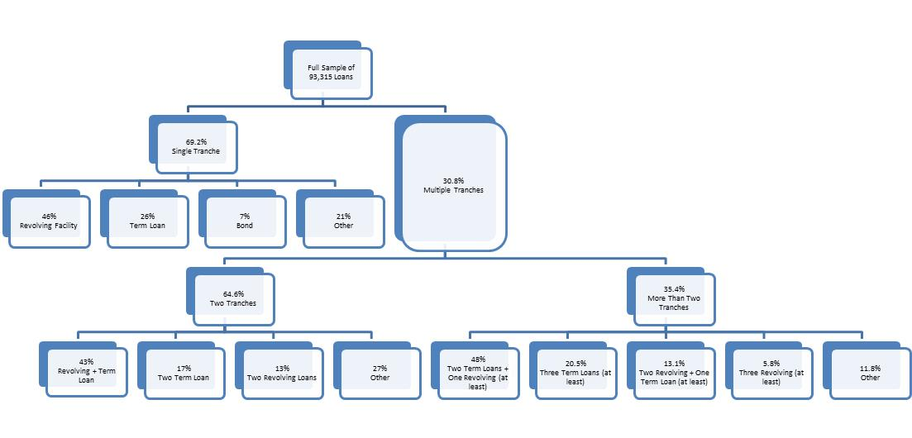
FIGURE 1: Combinations of tranches (or facilities) in the syndicated loan market
The figure presents the distribution of the total number of loans in our sample according to the number of tranches and the type of facility. The numbers in percentage in each node show the proportion of loans in each node above.

Slide 31
Variables | Full sample |  |  | Deals that are not tranched |  |  | Deals that are tranched |  | Tranched vs. non-tranched
 | Mean | Std. Dev. |  | Mean | Std. Dev. |  | Mean | Std. Dev. | p-value
Loan is tranched | 0.308 | 0.462 |  | 0 | 0 |  | 1 | 0 | - -
Number of tranches | 1.449 | 0.770 |  | 1 | 0 |  | 2.457 | 0.675 | 0.000
Deal amount | 310.2 | 881.6 |  | 247.4 | 663.5 |  | 451.0 | 1226.8 | 0.000
Average tranche amount | 229.6 | 616.4 |  | 247.4 | 663.5 |  | 189.7 | 492.1 | 0.000
Spread range | 6.968 | 23.781 |  | 0 | 0 |  | 20.702 | 37.362 | - -
Spread ratio | 1.040 | 0.132 |  | - - | - - |  | 1.119 | 0.207 | - -
Average maturity | 48.833 | 41.875 |  | 44.290 | 39.040 |  | 59.027 | 46.024 | 0.000
Range of maturities | 4.739 | 17.754 |  | 0 | 0 |  | 15.374 | 29.310 | - -
Standard deviation of maturities | 2.975 | 10.959 |  | 0 | 0 |  | 9.652 | 18.034 | - -
Standard deviation of maturities = 0 | 0.851 | 0.356 |  | 1 | 0 |  | 0.517 | 0.500 | - -
Revolving facility | 0.532 | 0.499 |  | 0.461 | 0.498 |  | 0.690 | 0.462 | 0.000
Borrower has public listing | 0.296 | 0.456 |  | 0.308 | 0.461 |  | 0.270 | 0.444 | 0.000
Borrower is a corporation | 0.666 | 0.472 |  | 0.642 | 0.479 |  | 0.718 | 0.450 | 0.000
Investment grade | 0.104 | 0.305 |  | 0.116 | 0.320 |  | 0.078 | 0.268 | 0.000
Borrower’s rating is not available | 0.097 | 0.296 |  | 0.082 | 0.274 |  | 0.131 | 0.337 | 0.000
Common-law origin | 0.741 | 0.438 |  | 0.713 | 0.452 |  | 0.805 | 0.396 | 0.000
Creditor rights | 1.540 | 0.916 |  | 1.532 | 0.888 |  | 1.558 | 0.975 | 0.000
Efficiency of debt collection | 83.107 | 16.175 |  | 83.811 | 15.745 |  | 81.523 | 16.997 | 0.000
Law & order | 5.289 | 0.775 |  | 5.298 | 0.758 |  | 5.271 | 0.811 | 0.000

Slide 32
Transaction purpose |  | Percentage of loan sample | Fraction of loans tranched | Mean number of tranches | Average spread range | Average spread ratio | Borrower has public listing | Borrower’s rating not available | Investment grade | Average maturity | Range of maturities | Revolving facility
General corporate purpose |  | 43.00% | 0.246 | 1.330 | 16.819 | 1.107 | 0.266 | 0.137 | 0.100 | 47.370 | 2.960 | 0.478
Debt repayment |  | 13.87% | 0.341 | 1.490 | 17.963 | 1.110 | 0.364 | 0.082 | 0.094 | 49.821 | 4.911 | 0.661
Working capital |  | 12.29% | 0.205 | 1.271 | 20.144 | 1.100 | 0.375 | 0.057 | 0.074 | 38.338 | 2.445 | 0.666
Merger and acquisition |  | 8.91% | 0.524 | 1.803 | 23.028 | 1.117 | 0.388 | 0.024 | 0.100 | 52.039 | 7.928 | 0.721
LBO |  | 2.97% | 0.828 | 2.511 | 40.703 | 1.171 | 0.134 | 0.008 | 0.007 | 71.607 | 12.435 | 0.833
Real estate |  | 3.49% | 0.142 | 1.195 | 17.916 | 1.123 | 0.033 | 0.014 | 0.006 | 40.748 | 1.498 | 0.208
Project finance |  | 2.79% | 0.490 | 1.793 | 14.389 | 1.130 | 0.100 | 0.163 | 0.022 | 110.798 | 24.344 | 0.262
Any other purpose |  | 12.67% | 0.401 | 1.596 | 19.112 | 1.133 | 0.334 | 0.096 | 0.174 | 43.894 | 5.348 | 0.525
Full sample (93,315 loans) |  | 100.00% | 0.308 | 1.449 | 20.702 | 1.119 | 0.296 | 0.097 | 0.104 | 48.833 | 4.739 | 0.532

Slide 33
Country |  | (1) Number of Deals |  | (2) Volume of Syndicated Loans over GDP |  | (3) Volume of Tranched Loans over GDP |  | (4) Fraction of Tranched Loans (weighted) |  | (5) Fraction of Tranched Loans (un-weighted) |  | (6) Mean Number of Tranches |  | (7) Average Spread Ratio
Common-Law Legal Origin (Total) |  | 69185 |  | 0.063 |  | 0.033 |  | 0.451 |  | 0.367 |  | 1.489 |  | 1.115
United States |  | 50889 |  | 0.107 |  | 0.047 |  | 0.424 |  | 0.318 |  | 1.451 |  | 1.115
Australia |  | 4877 |  | 0.127 |  | 0.076 |  | 0.578 |  | 0.345 |  | 1.565 |  | 1.177
United Kingdom |  | 3736 |  | 0.081 |  | 0.041 |  | 0.491 |  | 0.322 |  | 1.525 |  | 1.137
Canada |  | 2687 |  | 0.073 |  | 0.030 |  | 0.420 |  | 0.357 |  | 1.518 |  | 1.118
Malaysia |  | 1266 |  | 0.162 |  | 0.090 |  | 0.578 |  | 0.520 |  | 1.883 |  | 1.033
Singapore |  | 1177 |  | 0.146 |  | 0.092 |  | 0.616 |  | 0.594 |  | 1.619 |  | 1.064
Thailand |  | 1039 |  | 0.061 |  | 0.042 |  | 0.583 |  | 0.540 |  | 1.896 |  | 1.027
India |  | 905 |  | 0.016 |  | 0.005 |  | 0.340 |  | 0.329 |  | 1.456 |  | 1.090
New Zealand |  | 493 |  | 0.072 |  | 0.044 |  | 0.605 |  | 0.537 |  | 1.829 |  | 1.143
Ireland |  | 364 |  | 0.036 |  | 0.014 |  | 0.375 |  | 0.164 |  | 1.299 |  | 1.110
Civil-Law Legal Origin (Total) |  | 24130 |  | 0.034 |  | 0.014 |  | 0.340 |  | 0.256 |  | 1.336 |  | 1.143
Japan |  | 11820 |  | 0.024 |  | 0.010 |  | 0.411 |  | 0.211 |  | 1.181 |  | 1.086
France |  | 1942 |  | 0.044 |  | 0.023 |  | 0.479 |  | 0.352 |  | 1.598 |  | 1.209
Indonesia |  | 1240 |  | 0.050 |  | 0.034 |  | 0.517 |  | 0.449 |  | 1.733 |  | 1.050
Spain |  | 1220 |  | 0.039 |  | 0.019 |  | 0.372 |  | 0.291 |  | 1.568 |  | 1.224
The Netherlands |  | 1005 |  | 0.071 |  | 0.034 |  | 0.399 |  | 0.282 |  | 1.556 |  | 1.165
Italy |  | 744 |  | 0.024 |  | 0.014 |  | 0.497 |  | 0.330 |  | 1.604 |  | 1.193
Sweden |  | 643 |  | 0.046 |  | 0.011 |  | 0.251 |  | 0.147 |  | 1.199 |  | 1.081
Norway |  | 638 |  | 0.041 |  | 0.011 |  | 0.257 |  | 0.169 |  | 1.214 |  | 1.091
Mexico |  | 605 |  | 0.025 |  | 0.009 |  | 0.367 |  | 0.297 |  | 1.391 |  | 1.202
Philippines |  | 585 |  | 0.082 |  | 0.048 |  | 0.602 |  | 0.529 |  | 1.823 |  | 1.042
Tests of Means (t-stat values):
Common Law versus Civil Law |  | - - |  | 7.571 |  | 7.571 |  | 4.928 |  | 6.062 |  | 26.598 |  | -6.850

Slide 34
Country Level Analysis
The size of the tranched-loan market as a proportion of GDP
Tobit panel regression, clustered standard errors by country
  (Petersen 2009 RFS) – go to Mitchel Petersen’s webpage at Northwestern to get the programming procedure for Stata
Panel A Results:
  The size of the tranched-loan market as a proportion of GDP is 2.01 percentage points higher in common-law countries than in civil-law nations.
  The difference between common-law and civil-law countries is only 1.21 percentage points higher in the non-tranched loan market.

Slide 35
Table 5 Panel A | [1] | [2] | [3] | [4] | [5]
 | Dep. Var. = Annual Volume of Tranched Syndicated Loans / GDP
Common-Law Origin | 0.0201***
Creditor Rights |  | 0.0064** |  | 0.0056*
Law & Order |  |  | 0.0036 | 0.003
Efficiency of Debt Collection |  |  |  |  | 0.0001
Ln(Real GDP per Capita) | 0.0201***
Year Dummies Included? | Yes | Yes | Yes | Yes | Yes
Number of Observations | 571 | 571 | 571 | 571 | 525
Overall R-squared | 0.1701 | 0.1159 | 0.0841 | 0.1228 | 0.0644
Wald-Chi2 | 89.44 | 88.96 | 79.52 | 82.07 | 84.14

Slide 36
Table 5 Panel A Continued | [6] | [7] | [8] | [9] | [10]
 | Dep. Var. = Annual Volume of Non-Tranched Syndicated Loans / GDP
Common-Law Origin | 0.0121**
Creditor Rights |  | 0.0022 |  | 0.0013
Law & Order |  |  | 0.0038*** | 0.0036***
Efficiency of Debt Collection |  |  |  |  | 0.0001
Ln(Real GDP per Capita) | 0.0058*** | 0.0054*** | 0.0032*** | 0.0033*** | 0.0044***
Year Dummies Included? | Yes | Yes | Yes | Yes | Yes
Number of Observations | 571 | 571 | 571 | 571 | 525
Overall R-squared | 0.1646 | 0.1192 | 0.1366 | 0.1391 | 0.0882
Wald-Chi2 | 101.79 | 92.72 | 96.72 | 98.46 | 90.81

Slide 37
Alternative Ways to Compare Countries
Panel B Regressions (1) to (5) use the volume-weighted measure as a dependent variable, while regressions (6) to (10) repeat the analysis for our second proxy of the extent of tranching.
Since the dependent variables in these specifications have a natural lower bound of zero, we report Tobit panel regressions. The table reports marginal effects.
Common-law countries have a substantially higher proportion of tranched syndicated loans.
  In an average year, the volume (number) of tranched loans is 13.84 (11.61) percentage points higher in a common-law than in a civil-law country.
  The table also suggests that most of the difference between common- and civil-law countries is explained by differences in creditor rights: strong creditor rights lead to a proportionately larger tranched-loan component in countries’ syndicated loan markets.
  The efficiency of debt collection procedures and law and order also increase the relative size of tranched loans, but their statistical significance is lower than that of the creditor rights measure.

Slide 38
Table 5 Panel B | [1] | [2] | [3] | [4] | [5]
 | Dep. Var. = Fraction of Tranched Loans
 | (volume, weighted)
Common-Law Origin | 0.1384***
Creditor Rights |  | 0.0501** |  | 0.0492**
Law & Order |  |  | 0.0112 | 0.0027
Efficiency of Debt Collection |  |  |  |  | 0.0018
Ln(Real GDP per Capita) | -0.0025 | -0.0103 | -0.014 | -0.0119 | -0.0199
Year Dummies Included? | Yes | Yes | Yes | Yes | Yes
Number of Observations | 490 | 490 | 490 | 490 | 467
Wald-Chi2 | 89.64 | 86.54 | 81.18 | 86.57 | 91.17

Slide 39
Table 5 Panel B Continued | [6] | [7] | [8] | [9] | [10]
 | Dep. Var. = Fraction of Tranched Loans
 | (number, un-weighted)
Common-Law Origin | 0.1161***
Creditor Rights |  | 0.0581*** |  | 0.0534***
Law & Order |  |  | 0.0189* | 0.0123
Efficiency of Debt Collection |  |  |  |  | 0.0022**
Ln(Real GDP per Capita) | -0.0234** | -0.0311*** | -0.0379*** | -0.0374*** | -0.0452***
Year Dummies Included? | Yes | Yes | Yes | Yes | Yes
Number of Observations | 490 | 490 | 490 | 490 | 467
Wald-Chi2 | 101.84 | 104.3 | 98.05 | 106.05 | 106.7

Slide 40
Aside –
Other work comparing countries
Not being careful can have horrible consequences
Next 4 slides are a Shocker!

Slide 41
Table 2: Innovation ratios, by country
 |  | High Tech |  | Early Stage
Country | Obs. | Mean | St.D. | Mean | St.D.
Austria | 16 | 0.48 | 0.33 | 0.33 | 0.27
Belgium | 13 | 0.42 | 0.19 | 0.25 | 0.13
Denmark | 14 | 0.45 | 0.24 | 0.30 | 0.18
Finland | 15 | 0.41 | 0.14 | 0.38 | 0.16
France | 16 | 0.28 | 0.11 | 0.17 | 0.12
Germany | 16 | 0.31 | 0.18 | 0.24 | 0.12
Greece | 8 | 0.27 | 0.19 | 0.26 | 0.10
Ireland | 16 | 0.41 | 0.30 | 0.22 | 0.19
Italy | 16 | 0.13 | 0.12 | 0.16 | 0.09
Netherlands | 16 | 0.30 | 0.09 | 0.19 | 0.06
Portugal | 16 | 0.15 | 0.13 | 0.18 | 0.09
Spain | 16 | 0.15 | 0.10 | 0.24 | 0.17
Sweden | 16 | 0.26 | 0.16 | 0.19 | 0.15
UK | 16 | 0.21 | 0.08 | 0.13 | 0.08
Note: High-tech ratio is the ratio of high-tech to total private equity investments. Early stage ratio is the ratio of early stage to total venture investments.
Table deleted (!!!) from Da Rin et al. (2006 J Pub Econ)

Slide 42
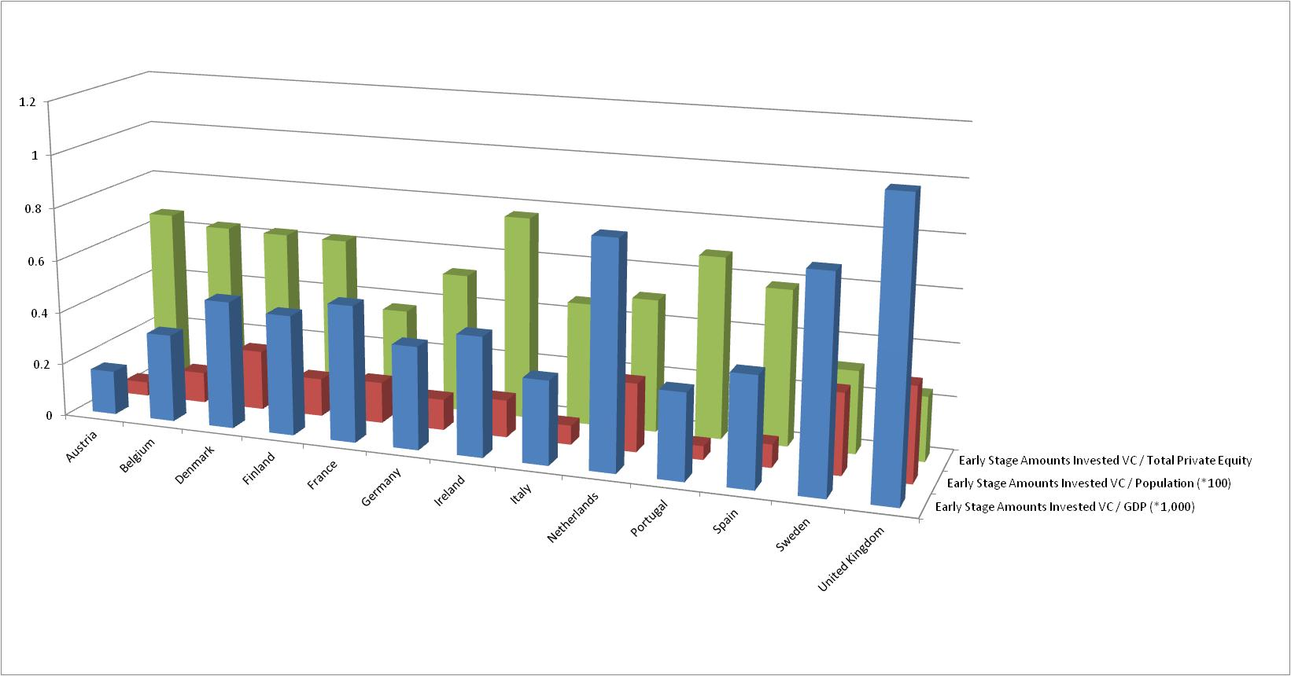
Figure 1. VC $

Slide 43
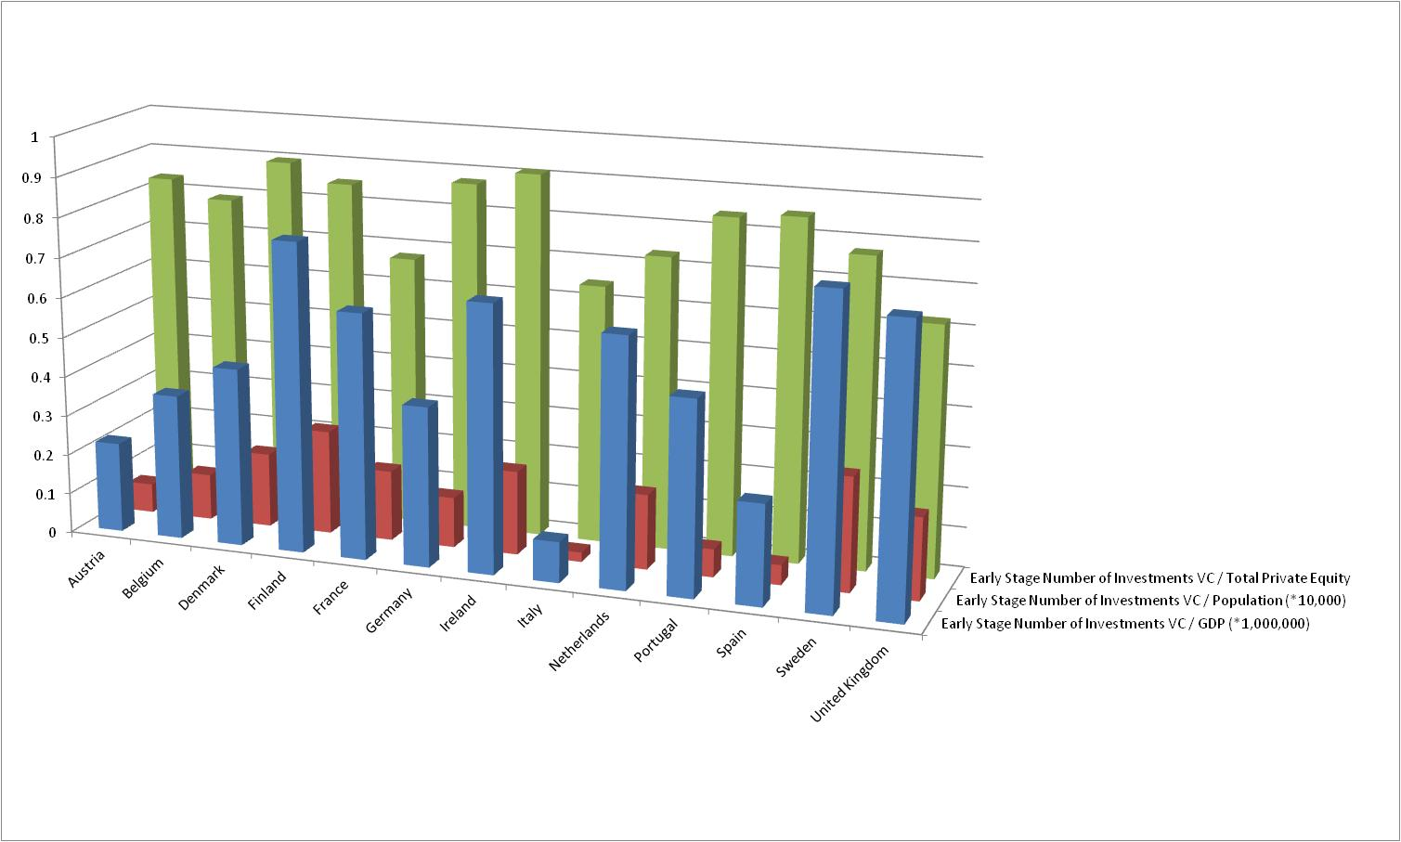
Figure 1. VC Numbers

Slide 44

Economist Magazine
January 2013
“IT IS always heartening to see
scholars loudly and publicly
disagreeing with each other.
When Douglas Cumming, a
professor at York University’s
Schulich School of Business,
examined a 2006 paper on
venture capital and government
investment in Europe he
concluded that the methods used
are “completely incorrect”
and the conclusions “completely
unsupported by the data”.
In academia, them’s fighting words.”

Slide 45
End of the Aside
Be Careful!

Slide 46
Loan Level Analysis
Table 6: Dummy =1 if loan tranched
Loans from borrowers in common-law countries are 7.6% more likely to be tranched than loans made to borrowers in civil-law countries.
  The coefficient is significant at the 1% level.
  The loans of borrowers from common-law countries outside of the United States are 10.46% more likely to be tranched when everything else is controlled for.
A two-standard-deviation increase in creditor rights is associated with a 3.7% increase in the probability of tranching.
  The coefficient is significant at the 1% level.
Listed companies are between 6.3% and 7.0% less likely to tranche, depending on the specification.
  This variable is statistically significant at the 1% level in every specification.
The dummy for investment-grade borrowers has a negative and significant effect on tranching: investment-grade companies issue loans that are 15.0% to 15.3% less likely to be tranched.

Slide 47
Dummy =1 if tranched | (1) | (2) | (3) | (4) | (5)
 | All Loans
Institutional Characteristics:
Common-Law Origin | 0.0763***
Creditor Rights |  | 0.0200*** |  | 0.0199***
Law & Order |  |  | 0.0046 | 0.0008
Efficiency of Debt Collection |  |  |  |  | 0.0003
Borrower and Deal Characteristics:
Borrower has Public Listing | -0.0698*** | -0.0635*** | -0.0652*** | -0.0636*** | -0.0646***
Borrower's Rating Not Available | 0.1957*** | 0.2002*** | 0.2091*** | 0.2000*** | 0.2135***
Ln(Deal Amount) | 0.0533*** | 0.0532*** | 0.0539*** | 0.0532*** | 0.0538***
Investment Grade | -0.1507*** | -0.1499*** | -0.1531*** | -0.1500*** | -0.1520***
Borrower is a Corporation | 0.0114 | 0.0097 | 0.0083 | 0.0097 | 0.0081
Revolving Facility | 0.1990*** | 0.2050*** | 0.2037*** | 0.2049*** | 0.2050***
Market Characteristics:
Private Bond Market Capitalization | 0.0197 | 0.0518*** | 0.0345*** | 0.0524*** | 0.0322**
Life Insurance Premium Volume | -0.7948*** | -1.2810*** | -1.0505*** | -1.2743*** | -1.0134***
Bank Concentration | 0.1710*** | 0.1221*** | 0.1362*** | 0.1229*** | 0.1249***
Stock Market Capitalization | 0.0384*** | 0.0688*** | 0.0749*** | 0.0685*** | 0.0793***
Ln(Real GDP per Capita) | -0.0347*** | -0.0354*** | -0.0392*** | -0.0359*** | -0.0465***
Market Return Prior to Deal Close Date | -0.0207 | -0.0044 | -0.0066 | -0.0048 | -0.0032
Major Industry Group dummies included? | Yes | Yes | Yes | Yes | Yes
Specific Purpose dummies included? | Yes | Yes | Yes | Yes | Yes
Number of Observations | 93315 | 93315 | 93315 | 93315 | 92268
Pseudo R-squared | 0.153 | 0.151 | 0.151 | 0.151 | 0.153

Slide 48
Number of Tranches | (1) | (2) | (3) | (4) | (5)
 | All Loans
Institutional Characteristics:
Common-Law Origin | 0.1378***
Creditor Rights |  | 0.0449*** |  | 0.0457***
Law & Order |  |  | 0.0033 | -0.0050
Efficiency of Debt Collection |  |  |  |  | -0.0000
Borrower and Deal Characteristics:
Borrower has Public Listing | -0.1322*** | -0.1194*** | -0.1222*** | -0.1187*** | -0.1208***
Borrower's Rating Not Available | 0.3341*** | 0.3396*** | 0.3632*** | 0.3412*** | 0.3671***
Ln(Deal Amount) | 0.0770*** | 0.0770*** | 0.0781*** | 0.0768*** | 0.0781***
Investment Grade | -0.2924*** | -0.2892*** | -0.2954*** | -0.2887*** | -0.2948***
Borrower is a Corporation | 0.0053 | 0.0020 | -0.0012 | 0.0019 | -0.0034
Spread of Maturities | 0.0084*** | 0.0084*** | 0.0084*** | 0.0084*** | 0.0085***
Revolving Facility | 0.2750*** | 0.2861*** | 0.2841*** | 0.2865*** | 0.2851***
Market Characteristics:
Private Bond Market Capitalization | 0.0372 | 0.1052*** | 0.0585*** | 0.1011*** | 0.0560**
Life Insurance Premium Volume | -1.1431*** | -2.0441*** | -1.5805*** | -2.0849*** | -1.4579***
Bank Concentration | 0.3012*** | 0.2038*** | 0.2300*** | 0.1993*** | 0.2122***
Stock Market Capitalization | 0.0620*** | 0.1117*** | 0.1286*** | 0.1135*** | 0.1354***
Ln(Real GDP per Capita) | -0.0531*** | -0.0543*** | -0.0572*** | -0.0508*** | -0.0675***
Market Return Prior to Deal Close Date | 0.0797 | 0.1089 | 0.1069 | 0.1114 | 0.1072
Major Industry Group dummies included? | Yes | Yes | Yes | Yes | Yes
Specific Purpose dummies included? | Yes | Yes | Yes | Yes | Yes
Number of Observations | 93315 | 93315 | 93315 | 93315 | 92268

Slide 49
Spread Range
Common law: 2 basis points lower
Creditor rights: each additional value to the index (1 to 4) lowers the spread by 1 basis point
Investment grade: 20 basis points lower
Revolving facilities – some evidence of lower spread by 5 basis points
  Revolving facilities may be granted more often to safer borrowers, or their existence reduces the risks for all the other tranches since they provide a constant source of cash that can be used over the life of the loan.
Spread of maturities – heterogeneity of spreads may increase with more tranches - loans with a longer range of maturities exhibit larger interest rate spread.
  This association can be explained by different maturities being related to different yield spreads or by the fact that shorter maturity tranches are less risky since they get repaid earlier.

Slide 50
Spread Range | (1) | (2) | (3) | (4) | (5)
 | All Loans
Institutional Characteristics:
Common-Law Origin | -2.672**
Creditor Rights |  | -1.199* |  | -1.069*
Efficiency of Debt Collection |  |  | -1.133 | -0.960
Law & Order |  |  |  |  | -0.093***
Borrower and Deal Characteristics:
Borrower has Public Listing | -2.040 | -2.167* | -1.984 | -2.070 | -2.121
Borrower's Rating Not Available | -10.351*** | -10.061*** | -10.322*** | -9.714*** | -11.356***
Ln(Deal Amount) | 0.367 | 0.428 | 0.333 | 0.378 | 0.364
Investment Grade | -21.113*** | -21.242*** | -20.925*** | -21.131*** | -21.173***
Borrower is a Corporation | 2.446** | 2.415** | 2.507*** | 2.380** | 2.648***
Spread of Maturities | 0.158*** | 0.158*** | 0.160*** | 0.160*** | 0.156***
Revolving Facility | -0.110 | -0.344 | -0.054 | -0.196 | -0.357
Market Characteristics:
Private Bond Market Capitalization | 2.274 | 0.757 | 0.668 | -0.411 | 1.864
Life Insurance Premium Volume | 26.680 | 39.155 | 21.774 | 34.104 | 36.176
Bank Concentration | -10.283*** | -8.028** | -9.972*** | -9.378*** | -9.055**
Stock Market Capitalization | -0.445 | -0.899 | -0.957 | -0.581 | -0.942
Ln(Real GDP per Capita) | 0.255 | 0.227 | 1.009 | 0.938 | 0.839
Market Return Prior to Deal Close Date | 10.275 | 10.060 | 10.375 | 10.331 | 10.823
Major Industry Group dummies included? | Yes | Yes | Yes | Yes | Yes
Specific Purpose dummies included? | Yes | Yes | Yes | Yes | Yes
Number of Observations | 20372 | 20372 | 20372 | 20372 | 20136
Adjusted R-squared | 0.070 | 0.070 | 0.070 | 0.070 | 0.068

Slide 51
Spread Range – Exactly 2 Tranches | (1) | (2) | (3) | (4) | (5)
 | All Loans
Institutional Characteristics:
Common-Law Origin | 0.0340
Creditor Rights |  | -1.0616*** |  | -0.6743**
Law & Order |  |  | -2.5860*** | -2.4668***
Efficiency of Debt Collection |  |  |  |  | -0.0566
Borrower and Deal Characteristics:
Borrower has Public Listing | 0.2493 | 0.2003 | 0.4753 | 0.4335 | 0.2160
Borrower's Rating Not Available | -8.7052*** | -8.0429*** | -7.5410*** | -7.1767*** | -8.9529***
Ln(Deal Amount) | -0.3565 | -0.3190 | -0.4791 | -0.4496 | -0.3797
Investment Grade | -12.9600*** | -13.1474*** | -12.6563*** | -12.7887*** | -12.9264***
Borrower is a Corporation | 2.4868*** | 2.3610*** | 2.3418*** | 2.2693*** | 2.5123***
Spread of Maturities | 0.1083*** | 0.1079*** | 0.1124*** | 0.1120*** | 0.1020***
Revolving Facility | -4.8583*** | -4.9626*** | -4.4834*** | -4.5680*** | -4.9389***
Market Characteristics:
Private Bond Market Capitalization | 6.9278*** | 5.6226** | 3.2992 | 2.6373 | 6.7032**
Life Insurance Premium Volume | -0.1036 | 11.1924 | -9.1411 | -1.5461 | 6.7636
Bank Concentration | -4.1277 | -3.8929 | -7.8324*** | -7.4981*** | -4.6868
Stock Market Capitalization | -2.6581* | -2.2020 | -1.6191 | -1.3846 | -2.4099*
Ln(Real GDP per Capita) | -0.2540 | -0.2149 | 1.6766** | 1.6119b | 0.1358
Market Return Prior to Deal Close Date | 4.7888 | 4.8428 | 5.4039 | 5.4085 | 5.3873
Major Industry Group dummies included? | Yes | Yes | Yes | Yes | Yes
Specific Purpose dummies included? | Yes | Yes | Yes | Yes | Yes
Number of Observations | 13541 | 13541 | 13541 | 13541 | 13387
Adjusted R-squared | 0.043 | 0.043 | 0.045 | 0.045 | 0.042

Slide 52
Robustness Checks
Sell your paper
Include “online Appendices”

Slide 53
Robustness Checks
Excluding countries
  Kick out US
  Developed versus developing
Different subsets of the data
  Exclude non-syndicated loans
Different dependent variables
  Spread ratio instead of spread level
Different independent variables
  Variety of different legal indices

Slide 54
Summary of “Takeaways” from Part I
How are loans structured?
  Differences between securitization vs. tranching
  Syndicated loans
  Frequency of tranching
How to compare countries
  Ways to benchmark (/GDP, /Population, /Other)
  Legal variables
  Market characteristics, institutional investors, economic conditions
  Culture
Sources of loan data, and matching or combining datasets
Use of panel methods, clustering
Economic significance versus statistical significance
Robustness checks and selling papers to editors and referees

