Slide 1


towards microwave entanglement generation for quantum simulation and computing
Seb Weidt
IQsim13, Brighton
IQT group, University of Sussex

Slide 2
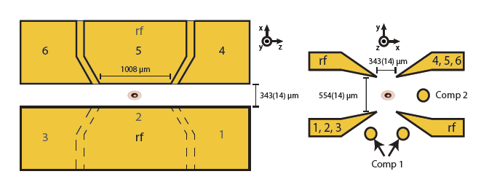
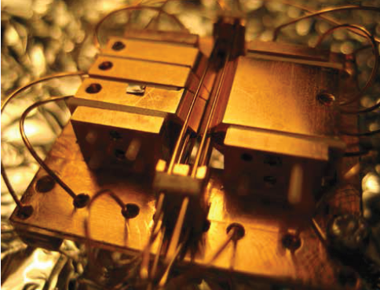
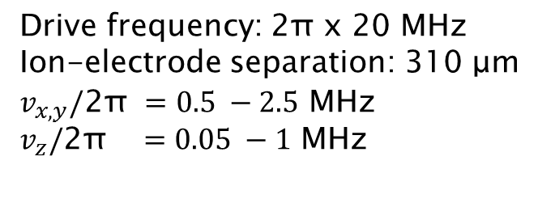
Experimental setup
Linear Paul trap
Drive frequency: 2π x 20 MHz
Ion-electrode separation: 310 μm
$v_{x, y}/\text{2}\text{π} =0.5 −2.5$ MHz
$v_{z}/\text{2}\text{π} =0.05 −1$ MHz

Slide 3
Experimental setup
Cooling ¹⁷¹Yb⁺
F=0
³D[3/2]_{1/2}
2 GHz
F=1
F=1
²P_{1/2}
F=0
935nm
F=2
²D_{3/2}
1 GHz
369nm
F=1
F=1
²S_{1/2}
12.6 GHz
F=0

Slide 4
Experimental setup
Cooling ¹⁷¹Yb⁺
F=0
³D[3/2]_{1/2}
2 GHz
F=1
F=1
²P_{1/2}
F=0
935nm
F=2
²D_{3/2}
1 GHz
369nm
F=1
F=1
²S_{1/2}
12.6 GHz
F=0

Slide 5
Experimental setup
State preparation
F=0
³D[3/2]_{1/2}
2 GHz
F=1
F=1
²P_{1/2}
2 GHz
F=0
935nm
F=2
²D_{3/2}
1 GHz
369nm
F=1
F=1
²S_{1/2}
F=0
Optical pumping to ²S_{1/2} F=0 in ~ 20 μs

Slide 6
Experimental setup
Coherent manipulation
F=0
³D[3/2]_{1/2}
F=1
F=1
²P_{1/2}
F=0
F=2
²D_{3/2}
F=1
F=1
²S_{1/2}
12.6 GHz
F=0

Slide 7
Experimental setup
State detection
F=0
³D[3/2]_{1/2}
2 GHz
F=1
F=1
²P_{1/2}
F=0
935nm
F=2
²D_{3/2}
1 GHz
369nm
F=1
F=1
²S_{1/2}
F=0

Slide 8
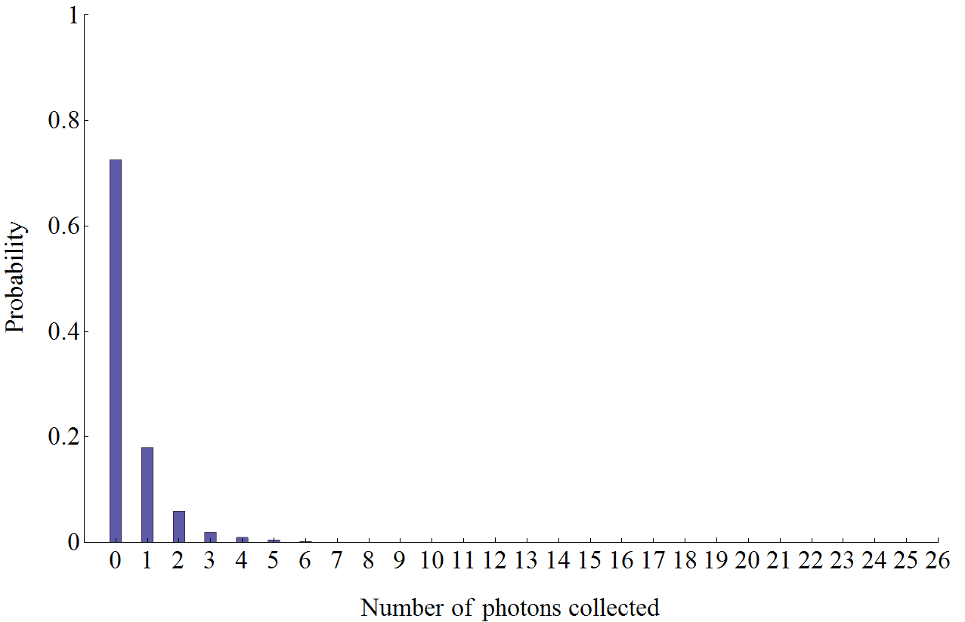
Experimental setup
State detection
F=0
³D[3/2]_{1/2}
2 GHz
F=1
F=1
²P_{1/2}
F=0
935nm
F=2
²D_{3/2}
1 GHz
369nm
F=1
F=1
²S_{1/2}
F=0

Slide 9
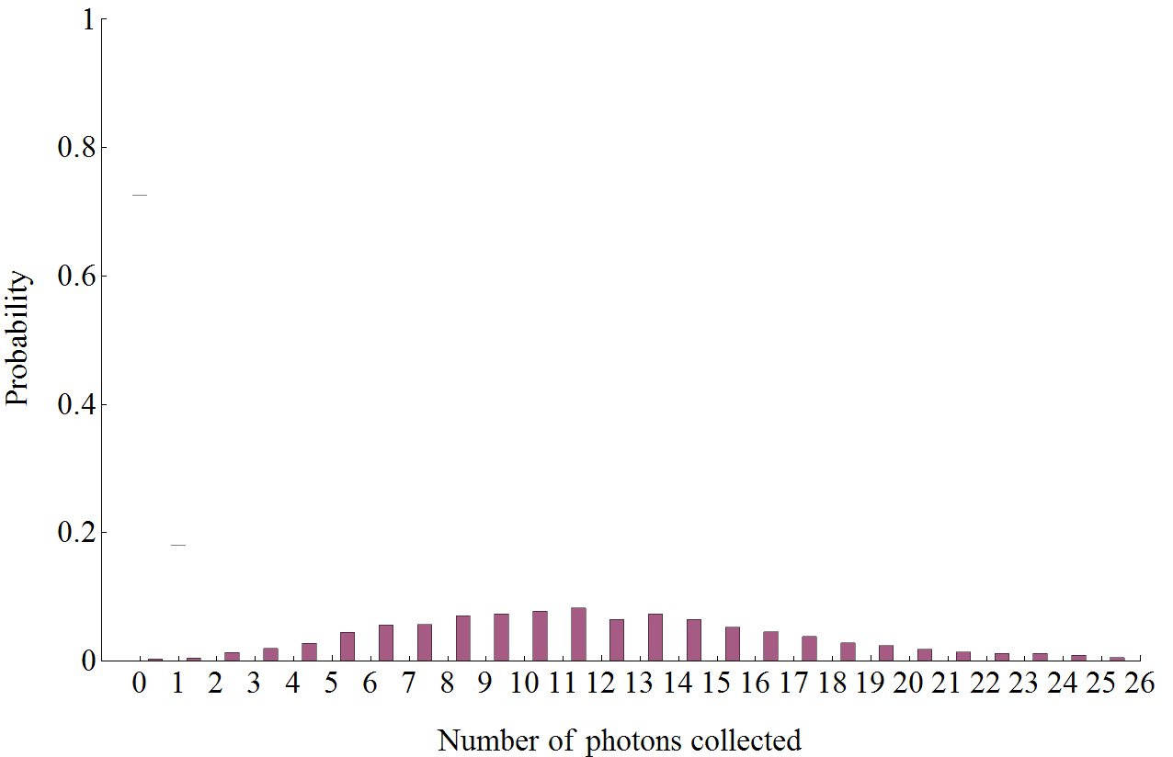
Experimental setup
State detection
F=0
³D[3/2]_{1/2}
2 GHz
F=1
F=1
²P_{1/2}
F=0
935nm
F=2
²D_{3/2}
1 GHz
369nm
F=1
F=1
²S_{1/2}
F=0

Slide 10
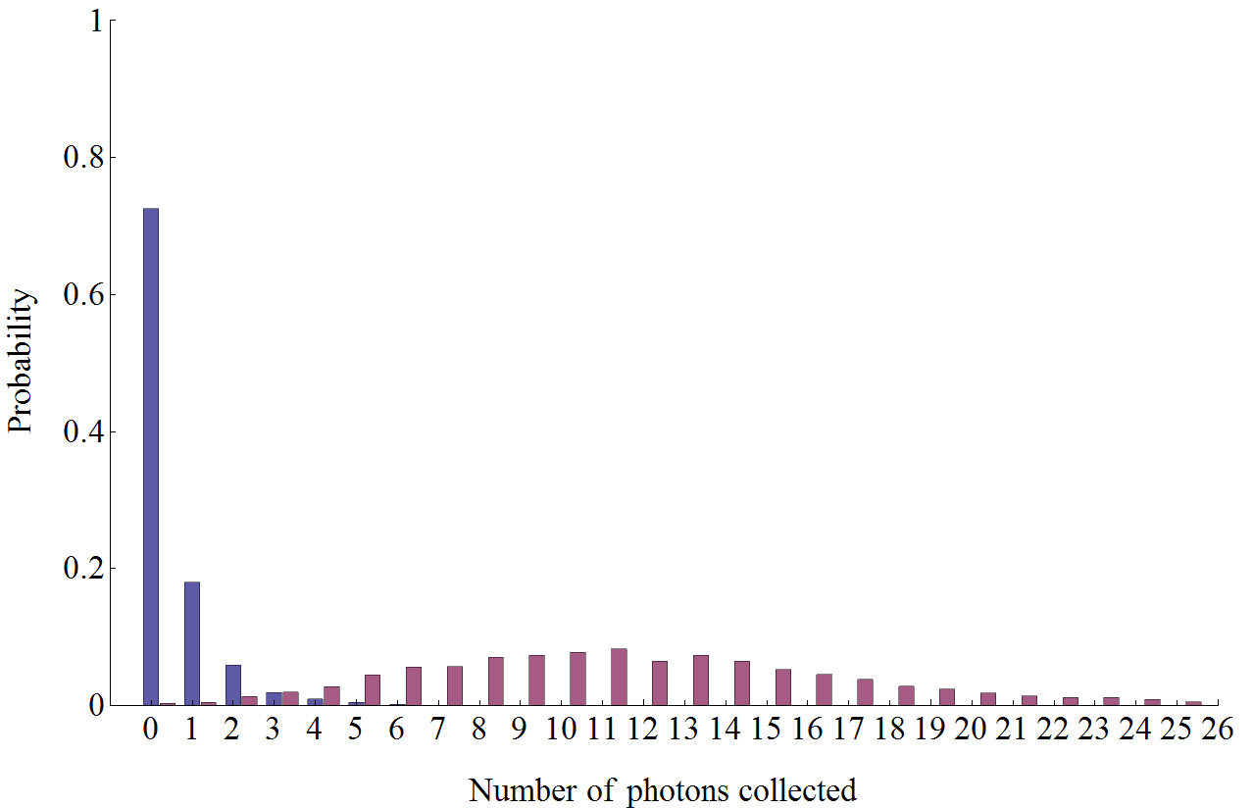
Experimental setup
State detection
Threshold technique
Detection fidelity ~ 0.93
Increase collection efficiency for improvement

Slide 11









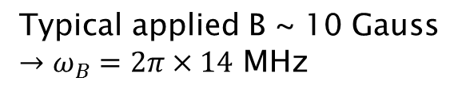
Experimental setup
Ground state
F=1, m_{F} = +1
$${ω_{B}}^{+}$$
F=1, m_{F} = 0
F=1, m_{F} = -1
$${ω_{B}}^{−}$$
$ω_{0}=2π ×12.6$ GHz
²S_{1/2}
$$ω_{0}$$
$${ω_{B}}^{±}=\frac{μ_{B}}{ℏ}B$$
F=0, m_{F} = 0
Typical applied B ~ 10 Gauss
$→ω_{B}=2π×14$ MHz

Slide 12
Experimental setup
Ground state
$${ω_{B}}^{+}$$
$${ω_{B}}^{−}$$
$ω_{0}=2π ×12.6$ GHz
²S_{1/2}
$$ω_{0}$$
$${ω_{B}}^{±}=\frac{μ_{B}}{ℏ}B$$
Typical applied B ~ 10 Gauss
$→ω_{B}=2π×14$ MHz

Slide 13
Experimental setup
Ground state
$${ω_{B}}^{+}$$
$${ω_{B}}^{−}$$
$ω_{0}=2π ×12.6$ GHz
²S_{1/2}
$$ω_{0}$$
$${ω_{B}}^{±}=\frac{μ_{B}}{ℏ}B$$
Typical applied B ~ 10 Gauss
$→ω_{B}=2π×14$ MHz

Slide 14
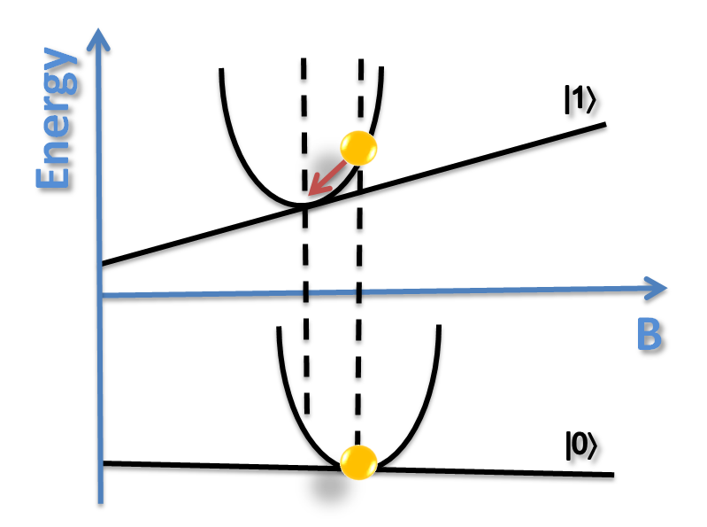
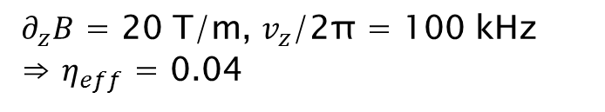
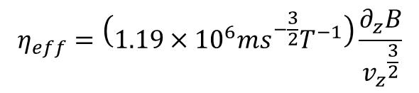
Experimental setup
Motional coupling with a magnetic field gradient
Add a magnetic field gradient
Gives a state dependent force
Effective Lamb-Dicke parameter
$$η_{eff}=\left(1.19×{10}^{6}{ms}^{−\frac{3}{2}}T^{−1}\right)\frac{∂_{z}B}{{v_{z}}^{\frac{3}{2}}}$$
$∂_{z}B$ = 20 T/m, $v_{z}$/2π = 100 kHz ⇒ $η_{eff}$ = 0.04
Requires the use of magnetic field sensitive states
F. Mintert and C. Wunderlich, Phys. Rev. Lett. 87, 257904 (2001)
A. Kromova et al., Phys. Rev. Lett. 108, 220502

Slide 15



Experimental setup
$${ω_{B}}^{+}$$
Fluctuations in the magnetic field causes dephasing
$${ω_{B}}^{−}$$
Gives rise to short coherence times
$$ω_{0}$$

Slide 16
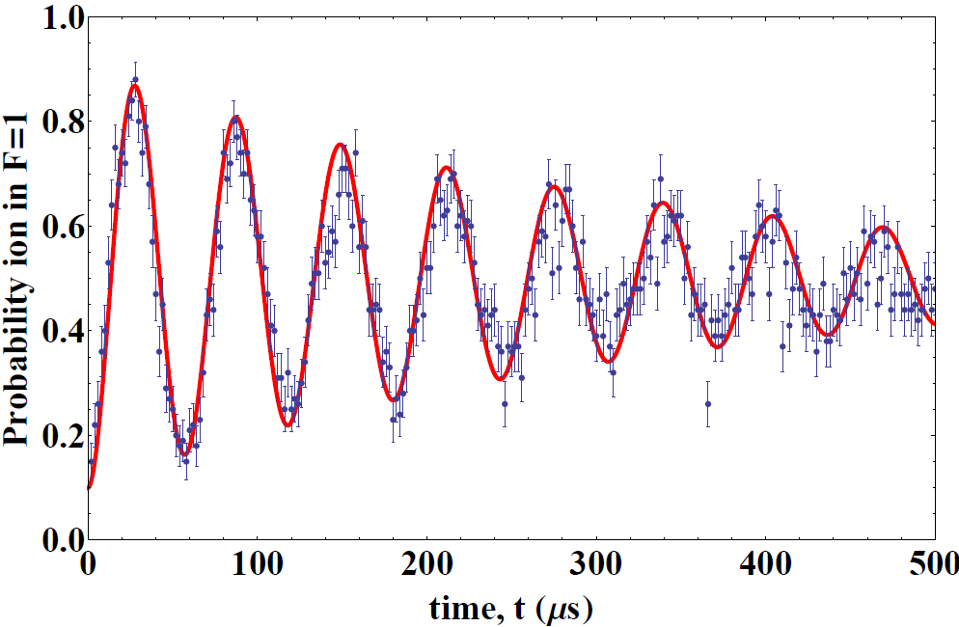
Experimental setup
Rabi oscillations using magnetic field sensitive state
Fluctuations in the magnetic field causes dephasing
coherence time of ~ 500 μs

Slide 17
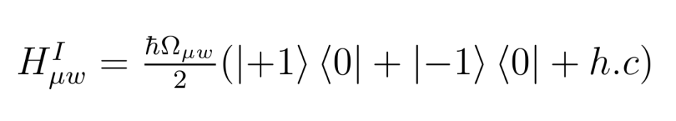
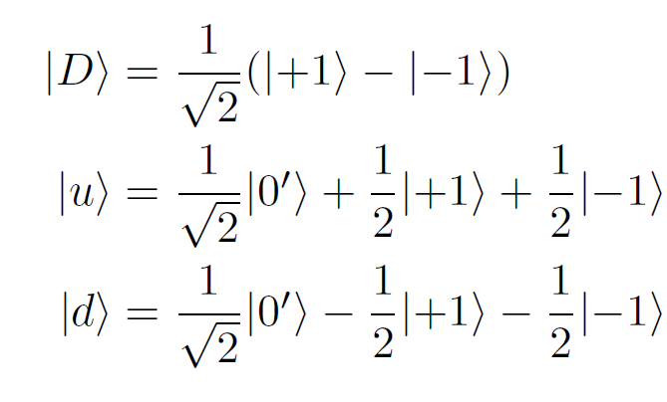

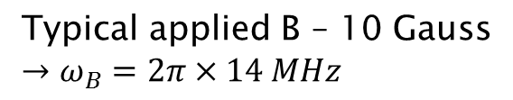



Microwave dressed-states
Dressed-states
Two microwave dressing fields
$${ω_{B}}^{+}$$
When ${Ω_{μw}^{}}^{+}$ = ${Ω_{μw}^{}}^{−}$ = $Ω_{μw}^{}$:
$${ω_{B}}^{−}$$
$${Ω_{μw}^{}}^{+}$$
$$ω_{0}$$
Three eigenstates:
$${Ω_{μw}^{}}^{−}$$
N. Timoney, I. Baumgart, M. Johanning, A. F. Varon, M. B. Plenio, A. Retzker, and C. Wunderlich, Nature 476, 185 (2011)

Slide 18

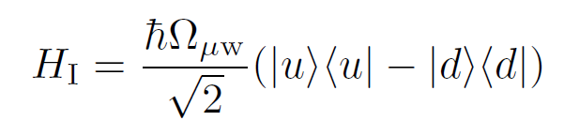




Microwave dressed-states
Dressed qubit
$${\sqrt{2} Ω}_{μw}^{}$$
Three eigenstates:
N. Timoney, I. Baumgart, M. Johanning, A. F. Varon, M. B. Plenio, A. Retzker, and C. Wunderlich, Nature 476, 185 (2011)

Slide 19
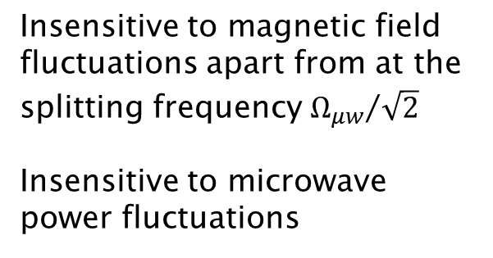
Microwave dressed-states
Dressed qubit
$${\sqrt{2} Ω}_{μw}^{}$$
Form a qubit using and
Insensitive to magnetic field fluctuations apart from at the splitting frequency ${Ω_{μw}^{}}/{\sqrt{2}}$
Insensitive to microwave power fluctuations
N. Timoney, I. Baumgart, M. Johanning, A. F. Varon, M. B. Plenio, A. Retzker, and C. Wunderlich, Nature 476, 185 (2011)

Slide 20
Microwave dressed-states
Preparation
Prep
Optical pumping to prepare
S. C. Webster, S. Weidt, K. Lake, J. J. McLoughlin and W. K. Hensinger, Phys. Rev. Lett. 111, 140501 (2013)

Slide 21
Microwave dressed-states
Preparation
Prep
π to
Microwave π-pulse to
S. C. Webster, S. Weidt, K. Lake, J. J. McLoughlin and W. K. Hensinger, Phys. Rev. Lett. 111, 140501 (2013)

Slide 22
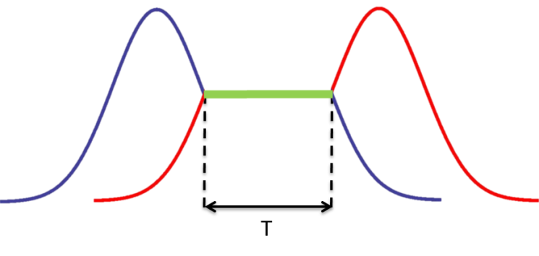
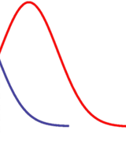




Microwave dressed-states
Preparation
Prep
π to
STIRAP
Partial STIRAP - Bare states mapped to dressed-states
$${Ω_{μw}^{}}^{+}$$
$$Ω_{μw}^{}$$
$${Ω_{μw}^{}}^{−}$$
$$t$$
t_{h}
S. C. Webster, S. Weidt, K. Lake, J. J. McLoughlin and W. K. Hensinger, Phys. Rev. Lett. 111, 140501 (2013)

Slide 23
Microwave dressed-states
Preparation
Prep
π to
STIRAP
Partial STIRAP - Bare states mapped to dressed-states
$${Ω_{μw}^{}}^{+}$$
$$Ω_{μw}^{}$$
$${Ω_{μw}^{}}^{−}$$
$$t$$
t_{h}
S. C. Webster, S. Weidt, K. Lake, J. J. McLoughlin and W. K. Hensinger, Phys. Rev. Lett. 111, 140501 (2013)

Slide 24
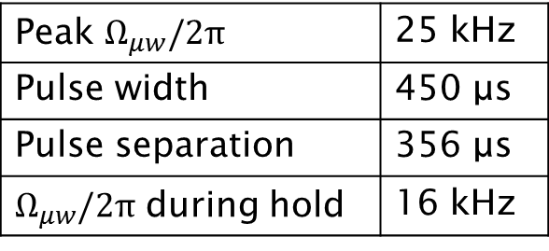
Microwave dressed-states
Preparation
Prep
π to
STIRAP
Partial STIRAP - Bare states mapped to dressed-states
$${Ω_{μw}^{}}^{+}$$
$$Ω_{μw}^{}$$
$${Ω_{μw}^{}}^{−}$$
$$t$$
t_{h}
Peak $Ω_{μw}^{}/2π$ | 25 kHz
Pulse width | 450 μs
Pulse separation | 356 μs
$Ω_{μw}^{}/2π$ during hold | 16 kHz
S. C. Webster, S. Weidt, K. Lake, J. J. McLoughlin and W. K. Hensinger, Phys. Rev. Lett. 111, 140501 (2013)

Slide 25
Microwave dressed-states
Detection
Prep
π to
STIRAP
Partial STIRAP - Bare states mapped to dressed-states
$${Ω_{μw}^{}}^{+}$$
$$Ω_{μw}^{}$$
$${Ω_{μw}^{}}^{−}$$
$$t$$
t_{h}
S. C. Webster, S. Weidt, K. Lake, J. J. McLoughlin and W. K. Hensinger, Phys. Rev. Lett. 111, 140501 (2013)

Slide 26
Microwave dressed-states
π to
Detection
Prep
π to
STIRAP
Microwave π-pulse to
followed by state detection
S. C. Webster, S. Weidt, K. Lake, J. J. McLoughlin and W. K. Hensinger, Phys. Rev. Lett. 111, 140501 (2013)

Slide 27
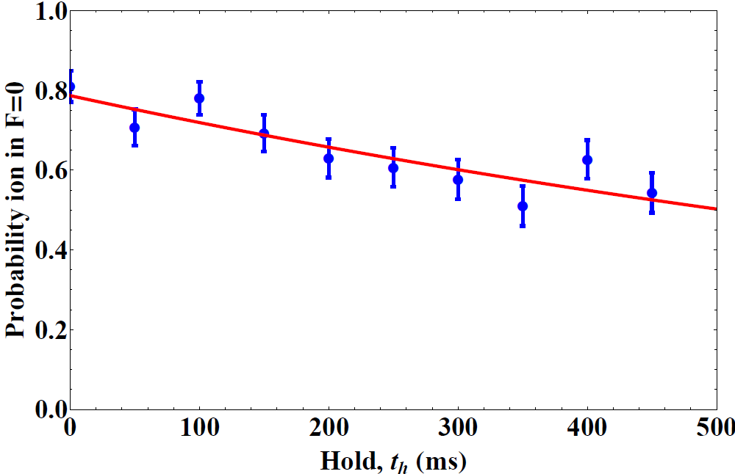

Microwave dressed-states
Lifetime measurement
$$Ω_{μw}^{}$$
$$t$$
t_{h}
$${Ω_{μw}^{}}^{+}$$
$${Ω_{μw}^{}}^{−}$$
Lifetime of = 550 ms
S. C. Webster, S. Weidt, K. Lake, J. J. McLoughlin and W. K. Hensinger, Phys. Rev. Lett. 111, 140501 (2013)

Slide 28

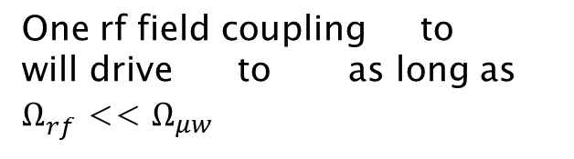
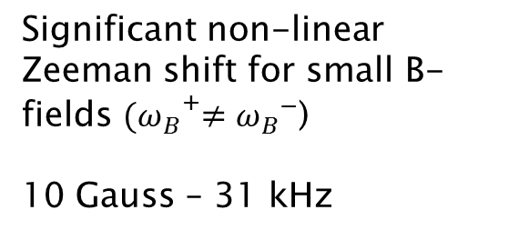



Microwave dressed-states
Qubit manipulation
Second order
Zeeman shift
$$Ω_{rf}^{}$$
$${ω_{B}}^{+}$$
Significant non-linear Zeeman shift for small B-fields ${(ω_{B}}^{+}≠{ω_{B}}^{−}$)
10 Gauss – 31 kHz
$${ω_{B}}^{−}$$
$${Ω_{μw}^{}}^{+}$$
$$ω_{0}$$
One rf field coupling to will drive to as long as $Ω_{rf}^{}$ << $Ω_{μw}^{}$
$${Ω_{μw}^{}}^{−}$$
S. C. Webster, S. Weidt, K. Lake, J. J. McLoughlin and W. K. Hensinger, Phys. Rev. Lett. 111, 140501 (2013)

Slide 29
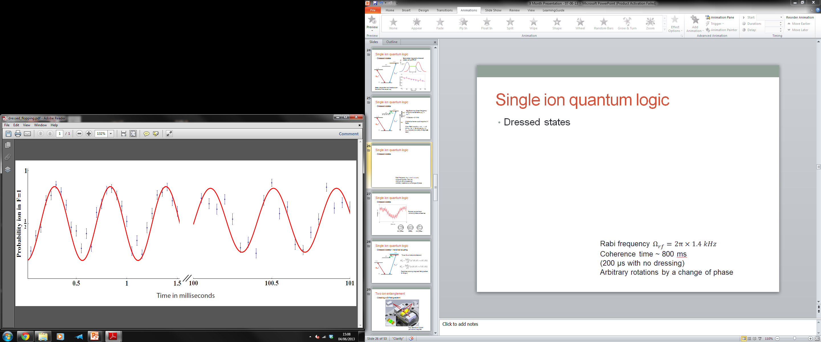
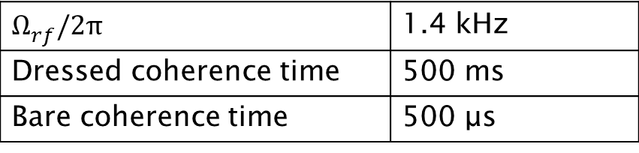
Microwave dressed-states
Rabi oscillations
$$Ω_{rf}^{}/2π$$ | 1.4 kHz
Dressed coherence time | 500 ms
Bare coherence time | 500 μs
S. C. Webster, S. Weidt, K. Lake, J. J. McLoughlin and W. K. Hensinger, Phys. Rev. Lett. 111, 140501 (2013)

Slide 30
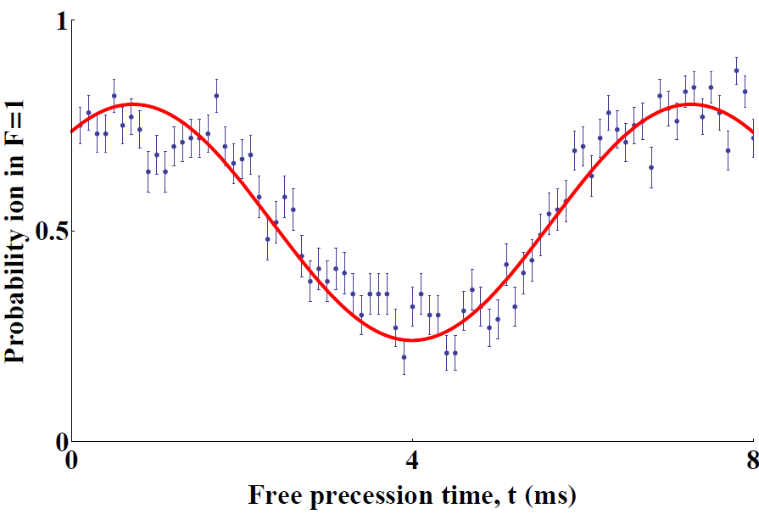
Microwave dressed-states
Ramsey experiment
Arbitrary qubit rotations are
possible
Detuned π/2 pulse
Free
precession
Detuned π/2 pulse
S. C. Webster, S. Weidt, K. Lake, J. J. McLoughlin and W. K. Hensinger, Phys. Rev. Lett. 111, 140501 (2013)

Slide 31
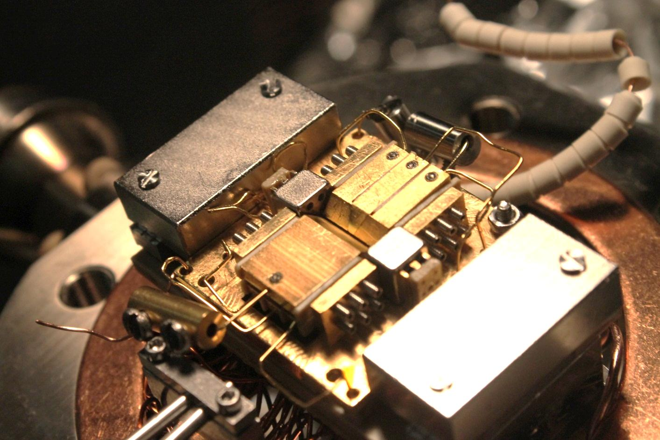
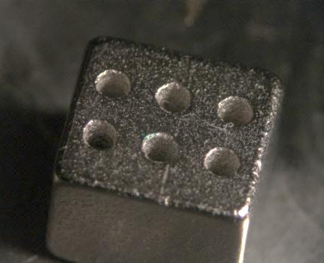
Microwave entanglement
Creating a magnetic field gradient
6 mm
Four Samarium Cobalt permanent magnets

Slide 32











Microwave entanglement
Individual addressing in frequency space
Magnetic field strength
$$∆ω$$
$$∆ω$$
$$ω_{0}$$

Slide 33
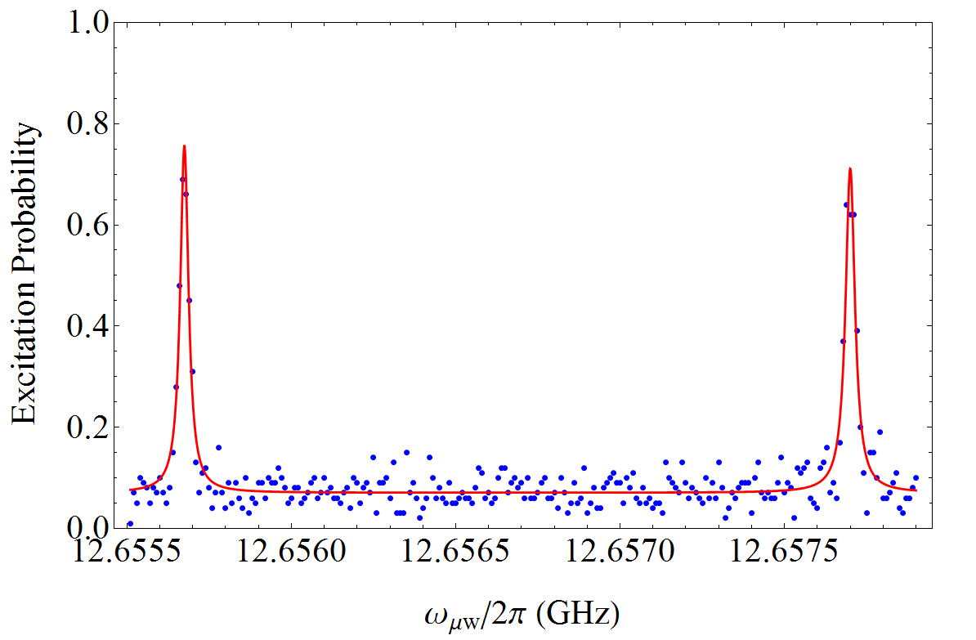









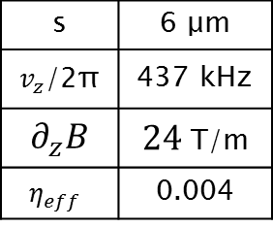


Microwave entanglement
Individual addressing in frequency space
$∆ω=$2.03 MHz
Ion 1
Ion 2
s | 6 μm
$v_{z}$/2π | 437 kHz
$∂_{z}B$ | $24$ T/m
$$η_{eff}$$ | 0.004
$$∆ω$$
$$∆ω$$

Slide 34
Microwave entanglement
Individual addressing in frequency space
$∆ω=$2.03 MHz
Ion 1
Ion 2
s | 6 μm
$v_{z}$/2π | 437 kHz
$∂_{z}B$ | $24$ T/m
$$η_{eff}$$ | 0.004
$$∆ω$$
$$∆ω$$

Slide 35
Microwave entanglement
Individual addressing in frequency space
$∆ω=$2.03 MHz
Ion 1
Ion 2
s | 6 μm
$v_{z}$/2π | 437 kHz
$∂_{z}B$ | $24$ T/m
$$η_{eff}$$ | 0.004
$$∆ω$$
$$∆ω$$

Slide 36
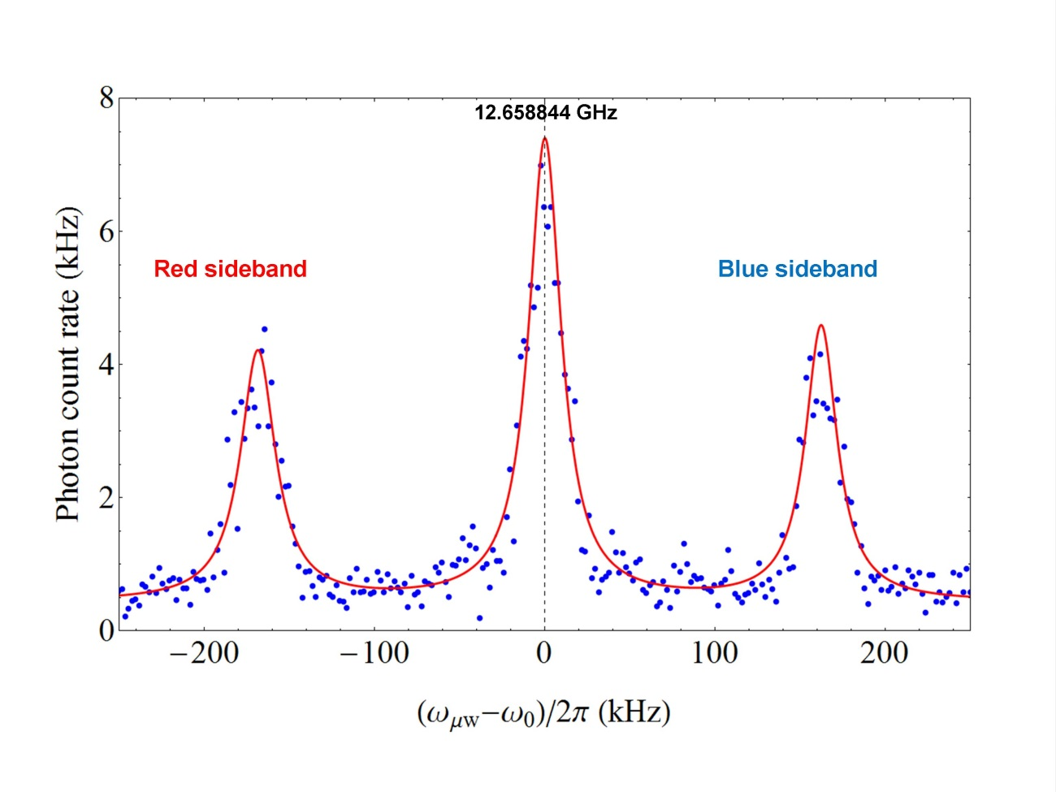
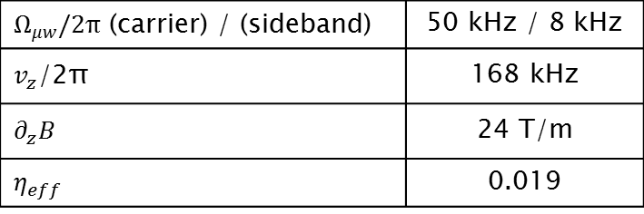

Microwave entanglement
Resolving motional sidebands
$$v$$
$Ω_{μw}^{}/2π$ (carrier) / (sideband) | 50 kHz / 8 kHz
$v_{z}$/2π | 168 kHz
$$∂_{z}B$$ | 24 T/m
$$η_{eff}$$ | 0.019

Slide 37

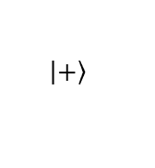
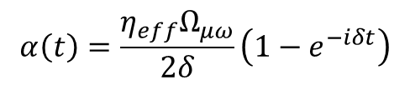
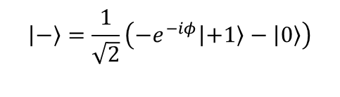

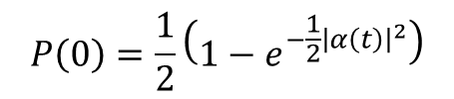

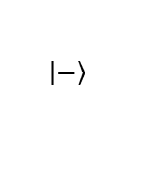
Microwave entanglement
Creation of Schrödinger cat state
Apply Mølmer-Sørensen type spin operator
$$\left|\left.+\right\rangle \right.=\frac{1}{\sqrt{2}}\left(\left|\left.+1\right\rangle +e^{iφ}\left|\left.0\right\rangle \right.\right.\right),$$
$$\left|\left.−\right\rangle \right.=\frac{1}{\sqrt{2}}\left({−e}^{−iφ}\left|\left.+1\right\rangle \right.−\left|\left.0\right\rangle \right.\right)$$
$$δ$$
Driving detuned red and blue sideband
-$δ$
Coherent states will be displaced in phase space
Im(α)
$$α\left(t\right)=\frac{η_{eff}Ω_{μω}}{2δ}\left(1−e^{−iδt}\right)$$
$$\left|\left.+\right\rangle \right.$$
$$P\left(0\right)=\frac{1}{2}\left(1−e^{{−\frac{1}{2}\left|α\left(t\right)\right|}^{2}}\right)$$
Re(α)
$$\left|\left.−\right\rangle \right.$$
First demonstrated by Monroe et al. Science 272, 1131
K. Mølmer and A. Sørensen, Phys. Rev. Lett, 82:1835-1838, 1999

Slide 38
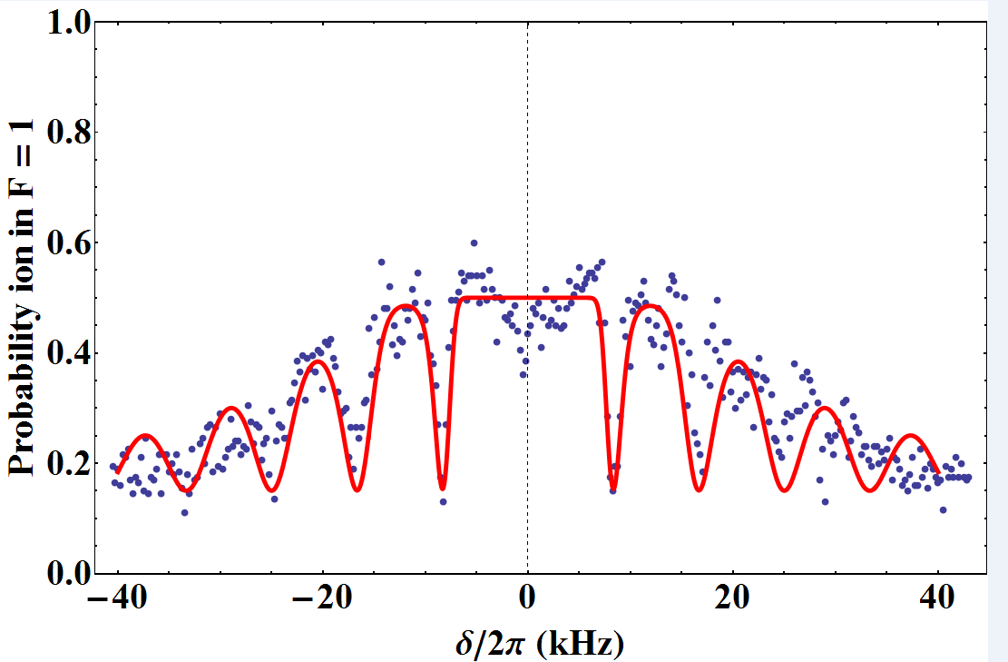
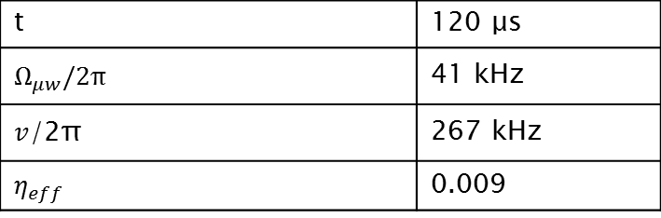
Microwave entanglement
Creation of Schrödinger cat state
$$δ$$
-$δ$
t | 120 μs
$$Ω_{μw}^{}/2π$$ | 41 kHz
$v$/2π | 267 kHz
$$η_{eff}$$ | 0.009

Slide 39
Microwave entanglement
Creation of Schrödinger cat state
No interference between
wave packets
Im(α)
Re(α)
t | 120 μs
$$Ω_{μw}^{}/2π$$ | 41 kHz
$v$/2π | 267 kHz
$$η_{eff}$$ | 0.009

Slide 40
Microwave entanglement
Creation of Schrödinger cat state
Interference between
wave packets
Im(α)
Re(α)
t | 120 μs
$$Ω_{μw}^{}/2π$$ | 41 kHz
$v$/2π | 267 kHz
$$η_{eff}$$ | 0.009

Slide 41
Microwave entanglement
Creation of Schrödinger cat state
Two-ion gate time ~ 15 ms
Coherence time ~ 500 μs
Combine magnetic field gradient
with dressed-state setup
t | 120 μs
$$Ω_{μw}^{}/2π$$ | 41 kHz
$v$/2π | 267 kHz
$$η_{eff}$$ | 0.009

Slide 42
Microwave entanglement
Dressed-state motional coupling
$$Ω_{rf}^{}$$
$${ω_{B}}^{+}$$
$${ω_{B}}^{−}$$
Use rf field to drive motional sidebands in dressed-state qubit
$${Ω_{μw}^{}}^{+}$$
$$ω_{0}$$
$${Ω_{μw}^{}}^{−}$$

Slide 43
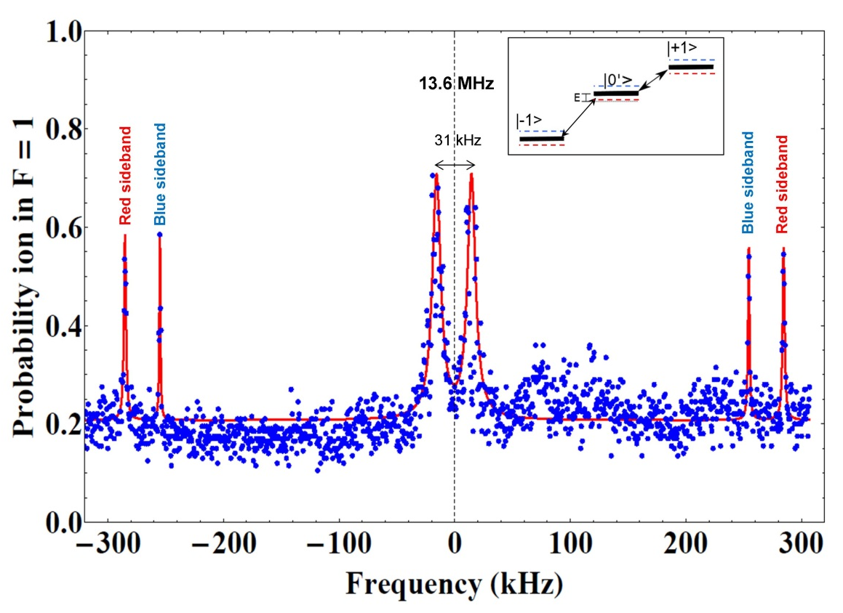
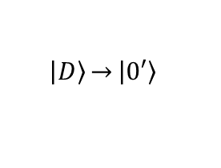
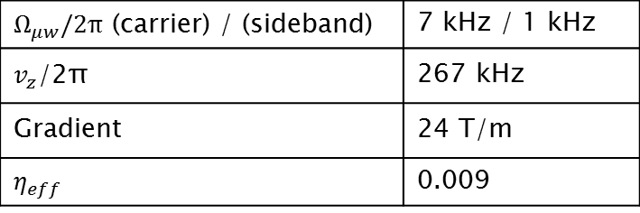
Microwave entanglement
Dressed-state motional coupling
$$\left|\left.D\right\rangle \right.\overset{→}{}\left|\left.0′\right\rangle \right.$$
$$Ω_{rf}^{}$$
$${Ω_{μw}^{}}^{+}$$
$${Ω_{μw}^{}}^{−}$$
$Ω_{μw}^{}/2π$ (carrier) / (sideband) | 7 kHz / 1 kHz
$v_{z}$/2π | 267 kHz
Gradient | 24 T/m
$$η_{eff}$$ | 0.009

Slide 44
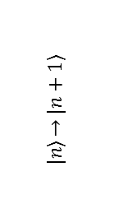

Microwave entanglement
Dressed-state motional coupling
$$\left|\left.D\right\rangle \right.\overset{→}{}\left|\left.0′\right\rangle \right.$$
$$\left|\left.n\right\rangle \right.\overset{→}{}\left|\left.n+1\right\rangle \right.$$
$$Ω_{rf}^{}$$
$${Ω_{μw}^{}}^{+}$$
$${Ω_{μw}^{}}^{−}$$
$Ω_{μw}^{}/2π$ (carrier) / (sideband) | 7 kHz / 1 kHz
$v_{z}$/2π | 267 kHz
Gradient | 24 T/m
$$η_{eff}$$ | 0.009

Slide 45
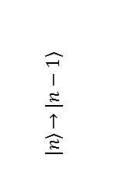

Microwave entanglement
Dressed-state motional coupling
$$\left|\left.D\right\rangle \right.\overset{→}{}\left|\left.0′\right\rangle \right.$$
$$\left|\left.n\right\rangle \right.\overset{→}{}\left|\left.n−1\right\rangle \right.$$
$$Ω_{rf}^{}$$
$$\left|\left.n\right\rangle \right.\overset{→}{}\left|\left.n+1\right\rangle \right.$$
$${Ω_{μw}^{}}^{+}$$
$${Ω_{μw}^{}}^{−}$$
$Ω_{μw}^{}/2π$ (carrier) / (sideband) | 7 kHz / 1 kHz
$v_{z}$/2π | 267 kHz
Gradient | 24 T/m
$$η_{eff}$$ | 0.009

Slide 46
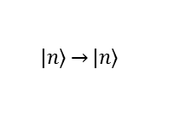
Microwave entanglement
Dressed-state motional coupling
$$\left|\left.D\right\rangle \right.\overset{→}{}\left|\left.0′\right\rangle \right.$$
$$\left|\left.n\right\rangle \right.\overset{→}{}\left|\left.n\right\rangle \right.$$
$$\left|\left.n\right\rangle \right.\overset{→}{}\left|\left.n−1\right\rangle \right.$$
$$Ω_{rf}^{}$$
$$\left|\left.n\right\rangle \right.\overset{→}{}\left|\left.n+1\right\rangle \right.$$
$${Ω_{μw}^{}}^{+}$$
$${Ω_{μw}^{}}^{−}$$
$Ω_{μw}^{}/2π$ (carrier) / (sideband) | 7 kHz / 1 kHz
$v_{z}$/2π | 267 kHz
Gradient | 24 T/m
$$η_{eff}$$ | 0.009

Slide 47
Microwave entanglement
Dressed-state motional coupling
$$\left|\left.D\right\rangle \right.\overset{→}{}\left|\left.0′\right\rangle \right.$$
$$\left|\left.n\right\rangle \right.\overset{→}{}\left|\left.n\right\rangle \right.$$
$$\left|\left.n\right\rangle \right.\overset{→}{}\left|\left.n−1\right\rangle \right.$$
$$\left|\left.n\right\rangle \right.\overset{→}{}\left|\left.n+1\right\rangle \right.$$
$$Ω_{rf}^{}$$
$${Ω_{μw}^{}}^{+}$$
$${Ω_{μw}^{}}^{−}$$
$Ω_{μw}^{}/2π$ (carrier) / (sideband) | 7 kHz / 1 kHz
$v_{z}$/2π | 267 kHz
Gradient | 24 T/m
$$η_{eff}$$ | 0.009

Slide 48
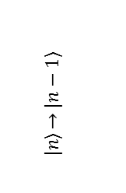

Microwave entanglement
Dressed-state motional coupling
$$\left|\left.D\right\rangle \right.\overset{→}{}\left|\left.0′\right\rangle \right.$$
$$\left|\left.n\right\rangle \right.\overset{→}{}\left|\left.n\right\rangle \right.$$
$$\left|\left.n\right\rangle \right.\overset{→}{}\left|\left.n−1\right\rangle \right.$$
$$\left|\left.n\right\rangle \right.\overset{→}{}\left|\left.n+1\right\rangle \right.$$
$$\left|\left.n\right\rangle \right.\overset{→}{}\left|\left.n−1\right\rangle \right.$$
$$Ω_{rf}^{}$$
$${Ω_{μw}^{}}^{+}$$
$${Ω_{μw}^{}}^{−}$$
$Ω_{μw}^{}/2π$ (carrier) / (sideband) | 7 kHz / 1 kHz
$v_{z}$/2π | 267 kHz
Gradient | 24 T/m
$$η_{eff}$$ | 0.009

Slide 49
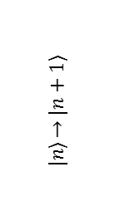

Microwave entanglement
Dressed-state motional coupling
$$\left|\left.D\right\rangle \right.\overset{→}{}\left|\left.0′\right\rangle \right.$$
$$\left|\left.n\right\rangle \right.\overset{→}{}\left|\left.n\right\rangle \right.$$
$$\left|\left.n\right\rangle \right.\overset{→}{}\left|\left.n−1\right\rangle \right.$$
$$\left|\left.n\right\rangle \right.\overset{→}{}\left|\left.n+1\right\rangle \right.$$
$$Ω_{rf}^{}$$
$$\left|\left.n\right\rangle \right.\overset{→}{}\left|\left.n+1\right\rangle \right.$$
$$\left|\left.n\right\rangle \right.\overset{→}{}\left|\left.n−1\right\rangle \right.$$
$${Ω_{μw}^{}}^{+}$$
$${Ω_{μw}^{}}^{−}$$
$Ω_{μw}^{}/2π$ (carrier) / (sideband) | 7 kHz / 1 kHz
$v_{z}$/2π | 267 kHz
Gradient | 24 T/m
$$η_{eff}$$ | 0.009

Slide 50
Microwave entanglement
Dressed-state motional coupling
$$\left|\left.D\right\rangle \right.\overset{→}{}\left|\left.0′\right\rangle \right.$$
$$\left|\left.n\right\rangle \right.\overset{→}{}\left|\left.n\right\rangle \right.$$
$$\left|\left.n\right\rangle \right.\overset{→}{}\left|\left.n−1\right\rangle \right.$$
$$\left|\left.n\right\rangle \right.\overset{→}{}\left|\left.n+1\right\rangle \right.$$
$$Ω_{rf}^{}$$
$$\left|\left.n\right\rangle \right.\overset{→}{}\left|\left.n+1\right\rangle \right.$$
$$\left|\left.n\right\rangle \right.\overset{→}{}\left|\left.n−1\right\rangle \right.$$
$${Ω_{μw}^{}}^{+}$$
$${Ω_{μw}^{}}^{−}$$
Resilient to magnetic field fluctuations
BUT sensitive to magnetic field gradient

Slide 51
Conclusion
Arbitrary manipulation of magnetic field noise resilient dressed-state qubit
Creation of a strong magnetic field gradient
Individual addressing and motional coupling using bare states
Creation of Schrödinger cat state
Motional coupling using dressed-state qubit

Slide 52
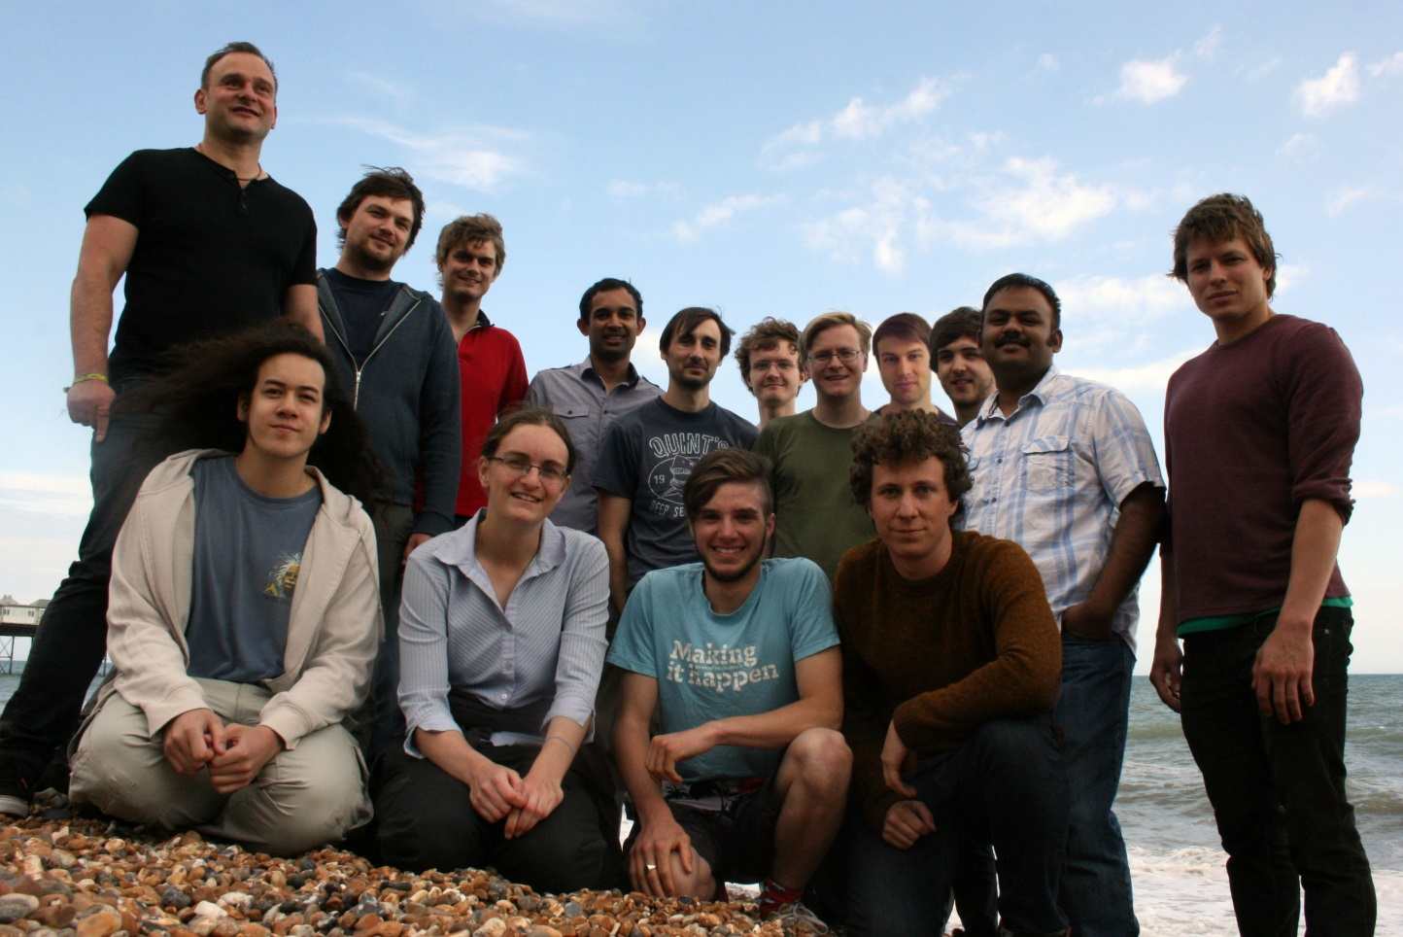





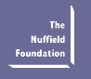
The IQT Group
Head of Group:
Dr. Winfried Hensinger
Postdocs:
Dr. Simon Webster
Dr. Gouri Giri
Research Assistants:
Dr. Marcus Hughes
Dr. James Siverns
PhD Students:
Seb Weidt
Bjo Lekitsch
Kim Lake
Darren De Motte
Joe Randall
Eamon Standing
David Murgia
Tomas Navickas
We gratefully acknowledge funding from:

Slide 54

Experimental setup
Ground state
$${ω_{B}}^{+}$$
$${ω_{B}}^{−}$$
Magnetic field insensitive
qubit
$$Ω_{μw}^{}$$
$$ω_{0}$$

Slide 55
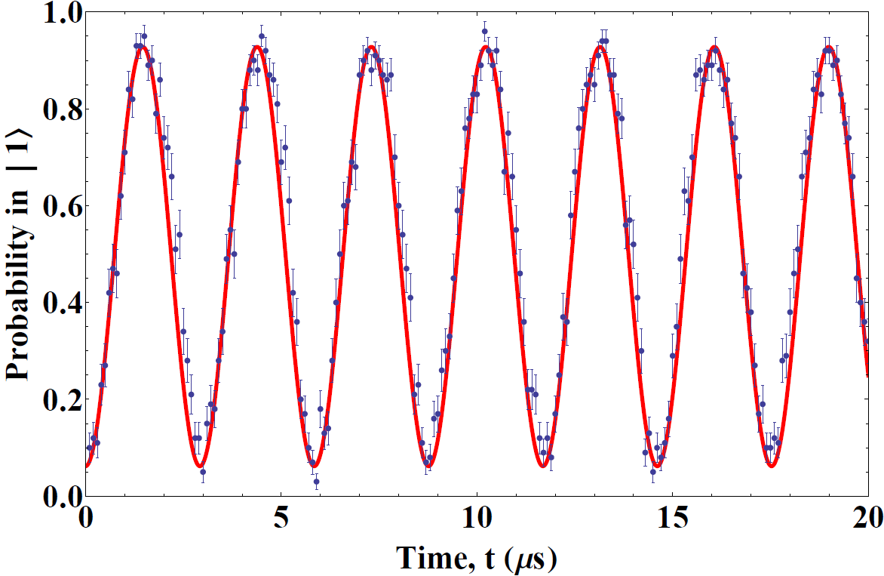
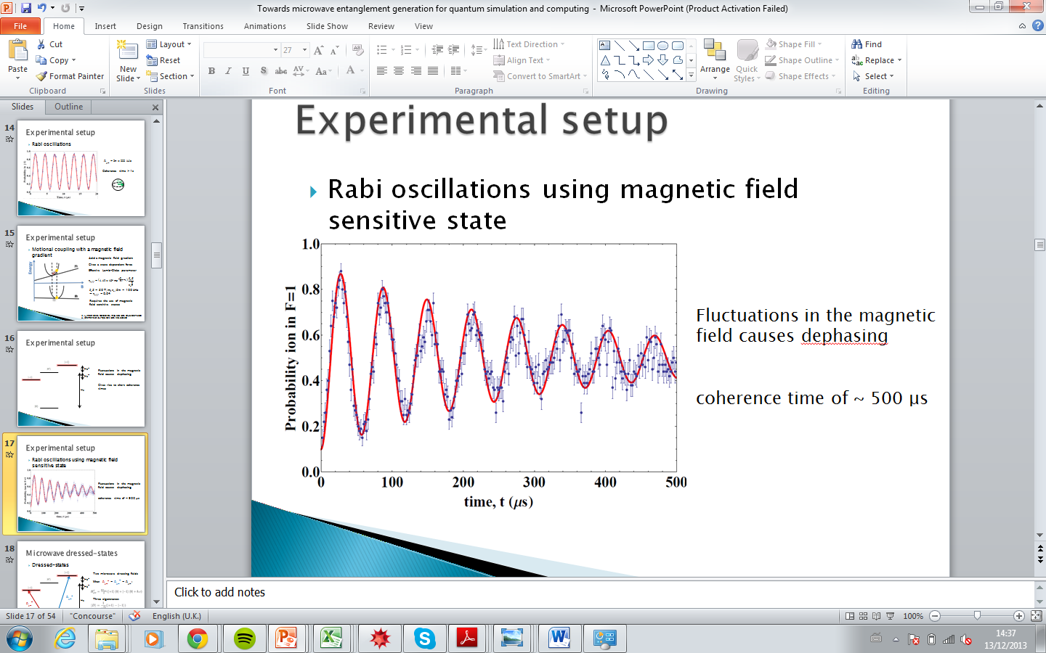

Experimental setup
Rabi oscillations
$$Ω_{μw}^{}=2π×333 kHz$$
Coherence time > 1s

Slide 56



Microwave entanglement
Creating a magnetic field gradient
10 mm
Four Samarium Cobalt permanent magnets

