Slide 1
Coulomb Crystals and Ground State Cooling of Single Ca⁺ Ions in a Penning Trap
Danny Segal

Slide 2
People involved in the work
Richard Thompson (Alex Retzker, Martin Plenio)
Dan Crick
Shailen Bharadia
Sean Donnellan
Sandeep Mavadia
Stephen Rardin
Joe Goodwin Poster
Graham Stutter
Shamim Patel
Stefan Zeeman
Sarah Woodrow
Juvid Aryaman
Support: EPSRC, PICC (EU STREP)

Slide 3
Talk Outline
Penning Trap and Laser Cooling
Motivation – Quantum dynamics of small ion Coulomb crystals
Recent Trap Modifications
Coulomb Crystals
Motional Sideband Spectroscopy of a Single Ion In a Penning Trap
Ground state cooling
Heating rate measurement

Slide 4
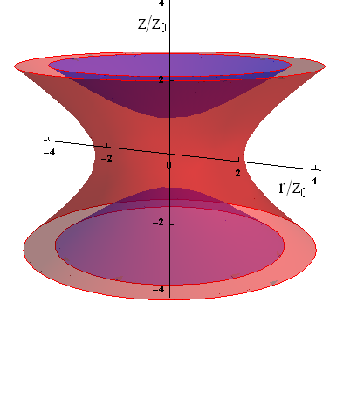
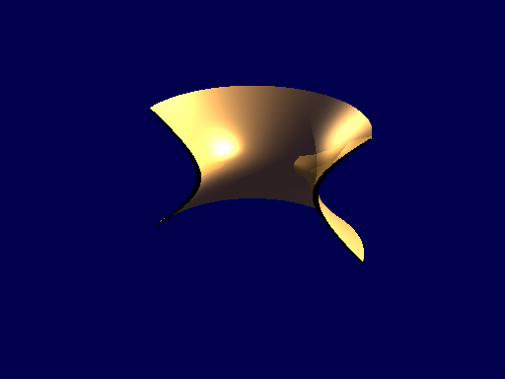
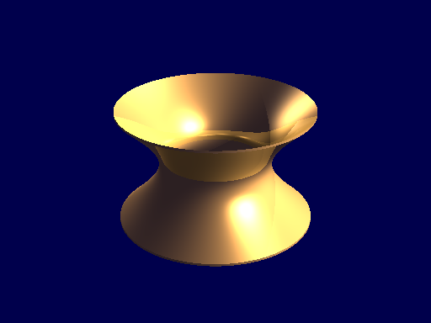
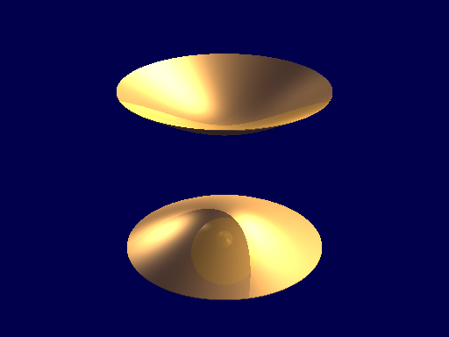
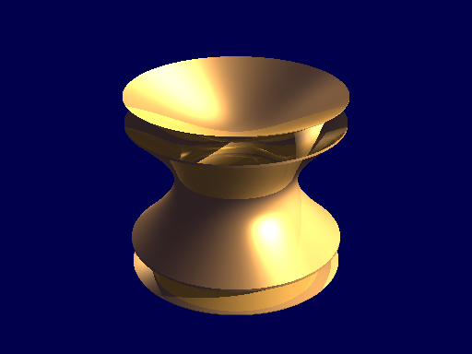
Ideal Trap Electrode Structure
Penning Trap: DC Potential +
Axial B-Field
Joe Goodwin

Slide 5
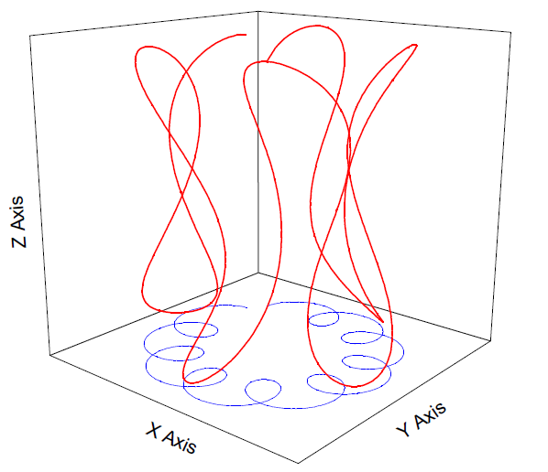
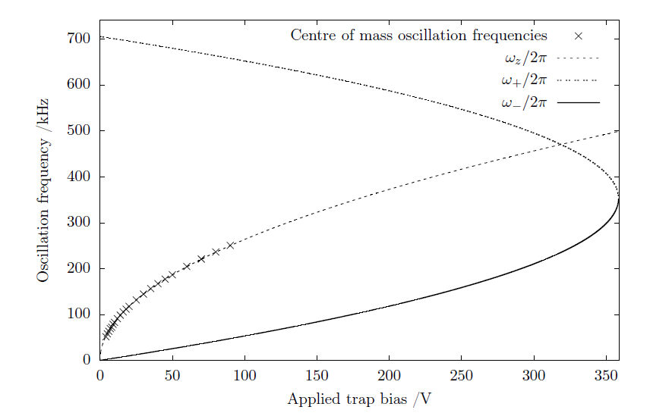




Motion in a Penning Trap
Axial
Mod. Cyclotron
Magnetron

Slide 6
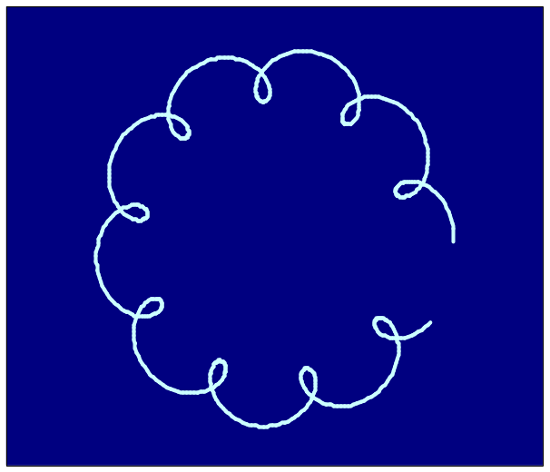
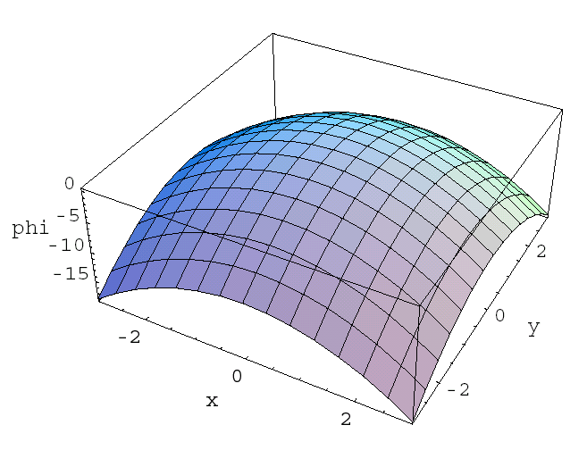
Laser cooling in the Penning trap
In the Penning trap the ions are in an orbit around the trap centre
  Magnetron motion has negative total energy
  To cool both cyclotron and magnetron motions the laser must be offset from trap centre
    To the side where the ions go away from the laser
  Magnetron motion is always cooled less effectively than cyclotron
Tight localisation is difficult – Axialisation, Rotating Wall – require segmented ring electrode
Radial potential

Slide 7
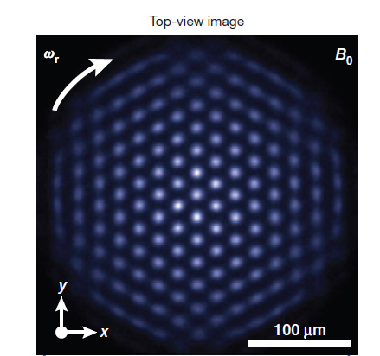
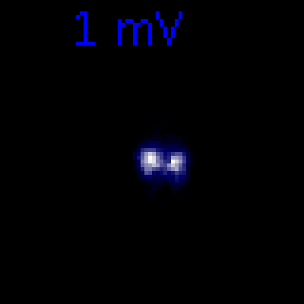
ICCs in Penning Traps
NIST group (Bollinger, Biercuk)
Imperial Group

Slide 8
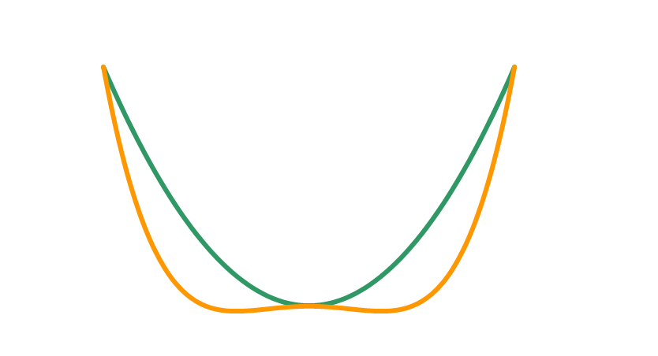
Motivation : Degeneracy of zig-zag states
If we keep ω_{y}>ω_{x} there are two degenerate states
  Mirror images of each other
  Described by double-well potential
  Depth and width of well adjustable
  Intrinsic well (no extra electrodes)
  Would like to look for evidence of tunneling
Penning Trap Advantage
  Ion-ion separations not affected by micromotion
  Big trap so heating rate should be very low
Double Well Potentials and Quantum Phase Transitions in Ion Traps, A. Retzker, R.C. Thompson, D.M.S and M.B. Plenio, PRL 101, 260504 (2008)

Slide 9
Quantum Information and Simulation
QS - Exploit naturally occurring triangular lattice to study Hamiltonians of relevance to condensed matter systems (frustration) – Biercuk, Bollinger
We concentrate on small to moderate sized ion Coulomb crystals
QI - Potential to use dipole force beams to generate exotic quantum states efficiently and/or demonstrate protocols of wider interest making use of natural geometry.

Slide 10
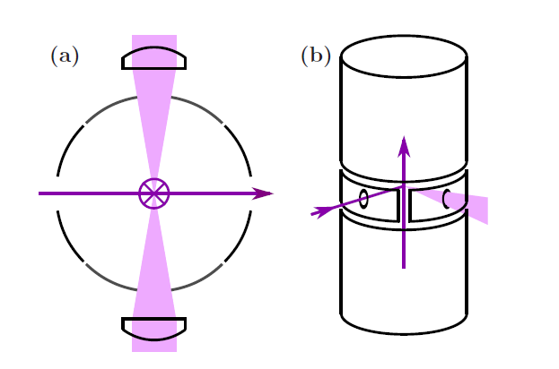
Trap Modified to include vertical laser beams
In principle 1 skew laser beam would cool all motions
In practice optical access means two beams are needed, axial and radial

Slide 11
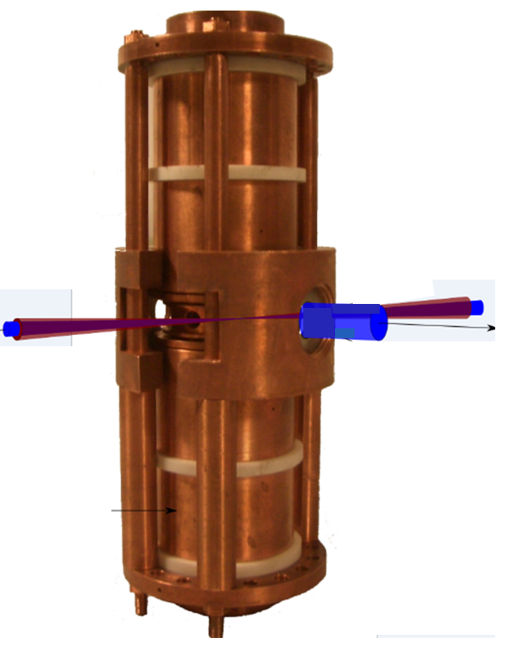
Superconducting Magnet PT
Originally designed for use at GSI Darmstadt in an experiment with highly charged ions
21.2mm
B = 1.8T (up to 2.5T)
Typical trap frequencies
~200 kHz
~700 kHz
~50kHz

Slide 12
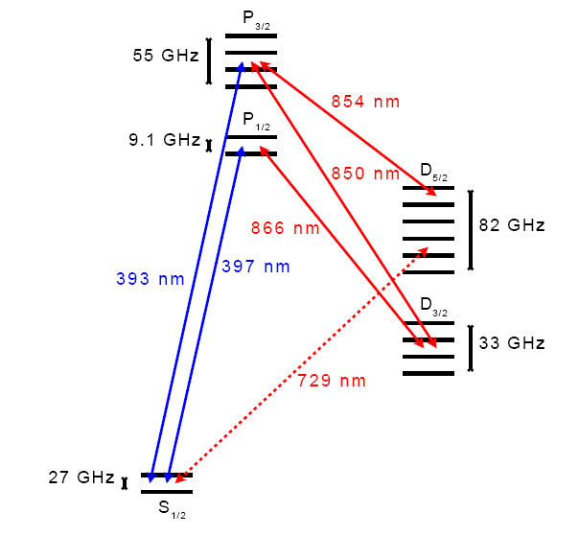
Lasers
2 x Violet Diode Lasers, Doppler Cooling
1 x 866nm diode laser for repumping (with rf sidebands)
1 x 854nm laser diode for quenching/repumping (J-state mixing)
1 x ultra-stable 729nm diode laser for spectroscopy, sideband cooling, manipulation

Slide 13
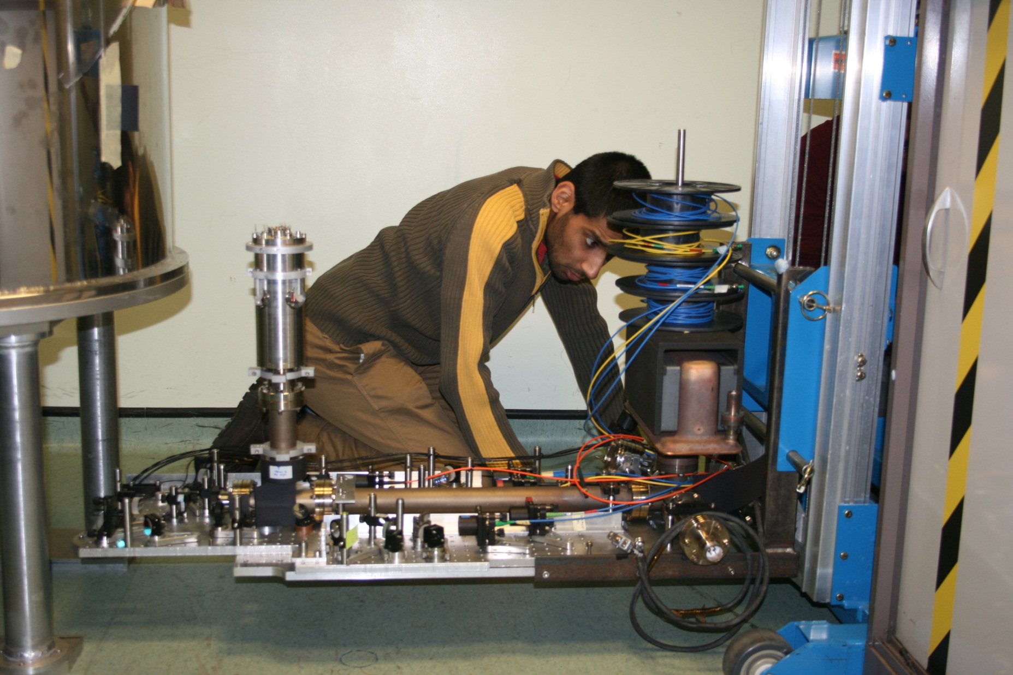
Trap Modification

Slide 14
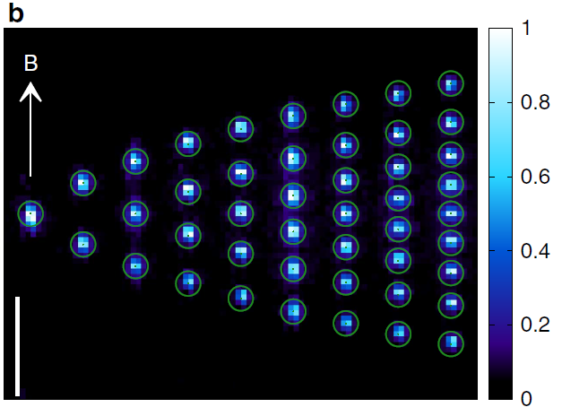
Linear Chains
50µm

Slide 15
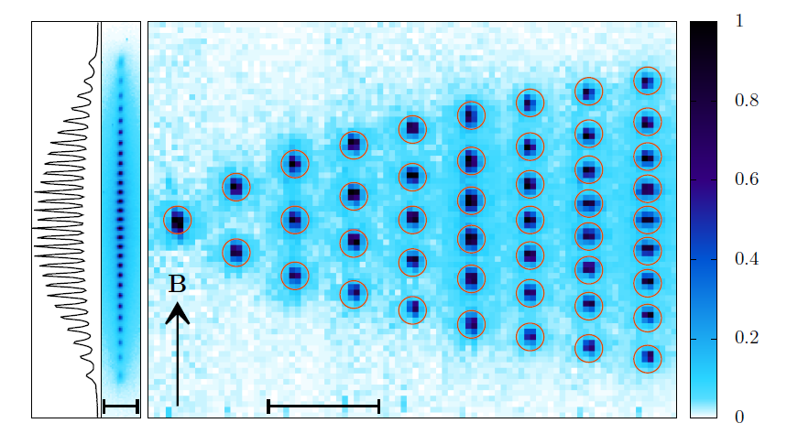
29 Ion Chain
B
50µm

Slide 16
Simulations
Matlab code
Choose a set of trap parameters
Initialise ions in random positions
Calculate forces on each ion
Move each ion in direction of force
Iterate
Keep going until a stable configuration is reached
Rotate around magnetic field, convolve with a point spread function and project into a plane.

Slide 17

Increase Trap Potential
Experiment
Simulation
15 Ion Chain

Slide 18

Increase Trap Potential
Experiment
Simulation
15 Ion Chain

Slide 19

Increase Trap Potential
Experiment
Simulation
Simulation gives zig-zag
Projected image looks blurred
15 Ion Chain

Slide 20
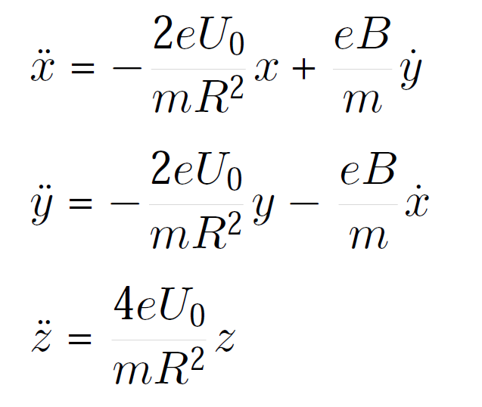
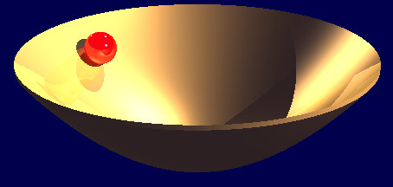
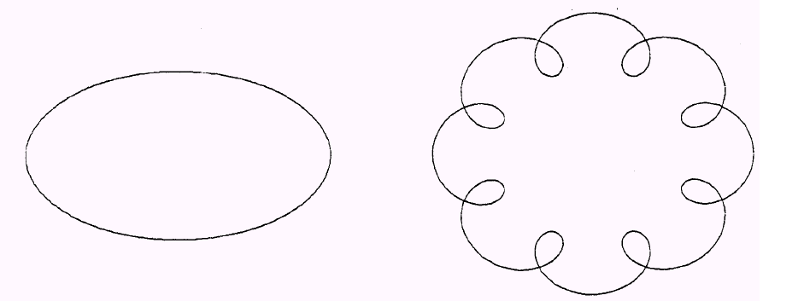
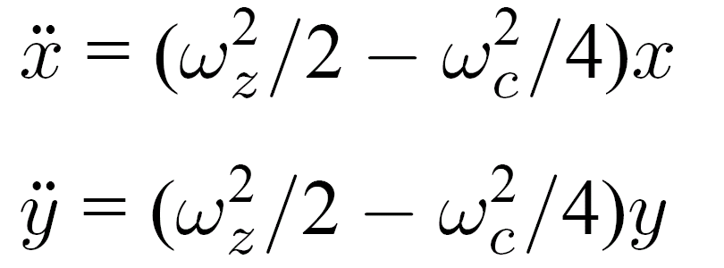

Motion in a rotating frame
In lab frame x and y motions are coupled by vxB
Axial motion harmonic
Radial motion appears simpler in a frame rotating at ω_{c}/2
In this frame the magnetic force is cancelled by the Coriolis force
Radial co-ordinates decouple
The ion appears to move in a 2D harmonic well in the radial plane
Curvature of well is the same in both dimensions
Typical motion
Rotating frame
Lab frame
At ω_{z}=ω_{c} /√6 trap is ‘spherical’

Slide 21


Larger Ion Coulomb Crystals
ω’_{r} is the rotation frequency of the crystal in the lab frame.
ω_{r} is the rotation frequency in the rotating frame
The number density of ions in the trap is given by
This has a maximum value when ω’_{r} = ω_{c}/2
i.e. when the crystal is stationary in the rotating frame (ω_{r}=0)
This can be achieved by using a ‘rotating wall’ - but you can get close with good Doppler cooling

Slide 22

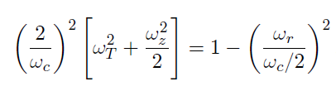
Rotation frequency of Coulomb crystals
The stiffness of the effective potential in the radial plane is affected by the rotation of the ion crystal in that frame
The effective radial potential in the rotating frame is characterised by ω_{T}
We can measure the radial size of a crystal and use this to infer the rotation frequency
ω_{T} and ω_{r} are related through
( )

Slide 23
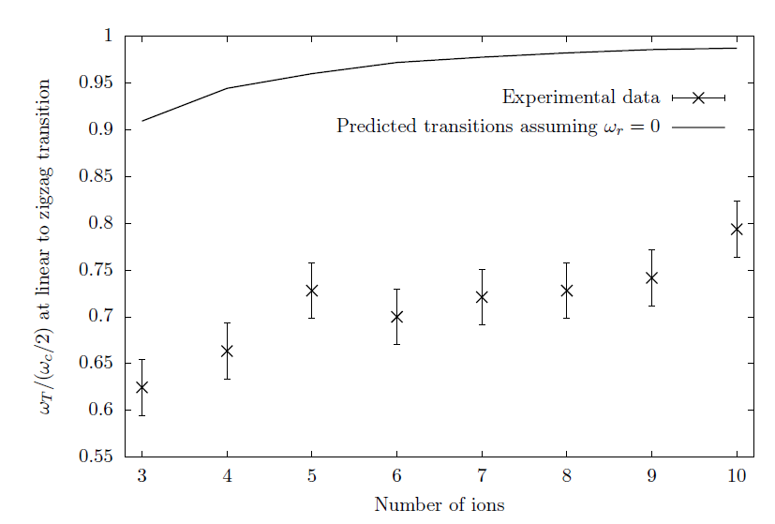
Linear – zig-zag transitions
We measure the axial voltage at which the linear to zig zag transition occurs
Comparison to the predicted transitions assuming ω_{r}=0 shows that the density is not maximal for zig-zag chains

Slide 24
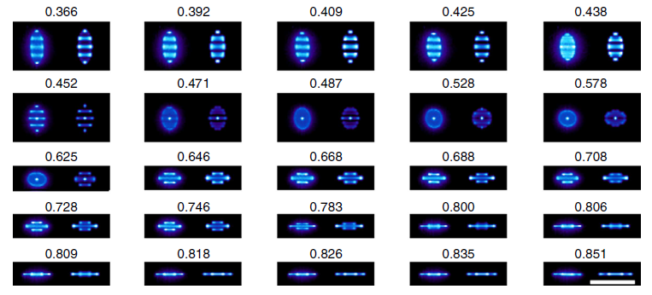
Zoo of crystal shapes
100 µm

Slide 25
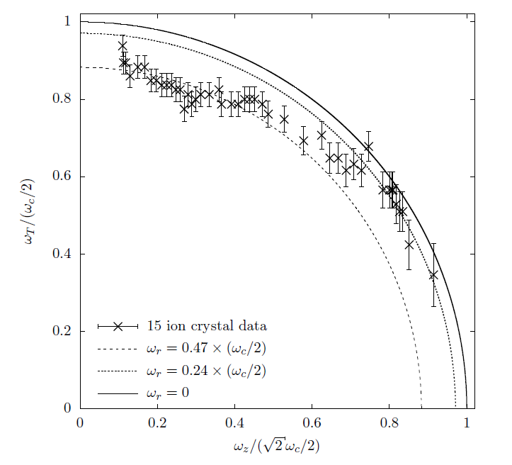
Flatter crystals cool better
Compare crystal shape to simulation
Infer a value of ω_{T}
Plot ω_{T} against ω_{z}
Circles of different diameter correspond to different values of ω_{r}
Tight axial confinement gives flat crystals that nearly rotate at ω_{c}/2
Weak axial confinement gives strings that don’t rotate so fast

Slide 26
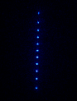
Controlling the shape of the Ion Coulomb Crystal

Slide 27
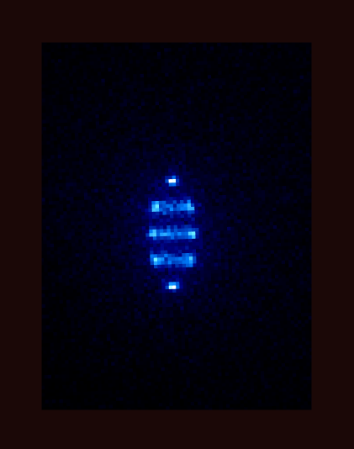

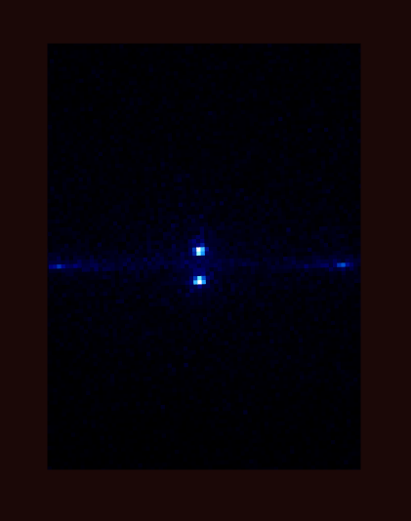
Stills from movie

Slide 28
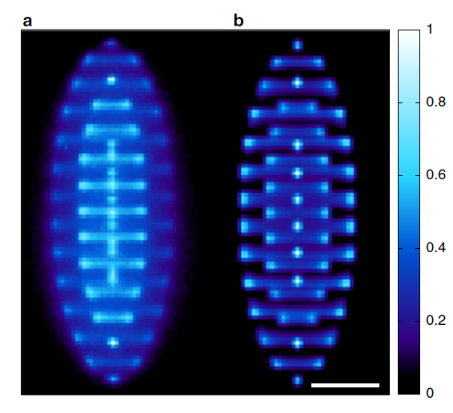
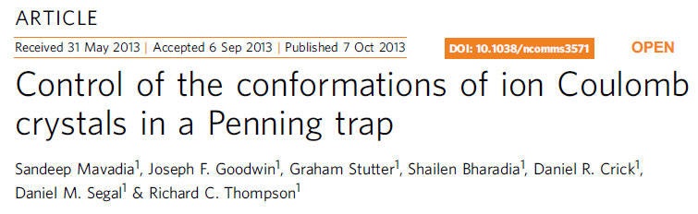
Larger crystals
Best match is for 174 ions at
50 µm
Experiment
Simulation

Slide 29
Spectroscopy on the 729nm transtion
Allows good measurement of temperature and heating rate
Provides a starting point for sub-Doppler ‘sideband cooling’
Sideband cooling to motional ground state in turn allows coherent manipulation of S-D qubit
Cooling 3D Ion Coulomb Crystal to motional GS would be a starting point for study of macroscopic quantum effects

Slide 30
Spectroscopy on the 729nm transition
Load single ion
Wait for a start pulse triggered by mains cycle
Doppler cool
Prepare ion in one S_{1/2} sublevel
Interrogate with 729nm pulse
Look to see if ion is dark or bright
Repeat 100 times
Step to new frequency

Slide 31
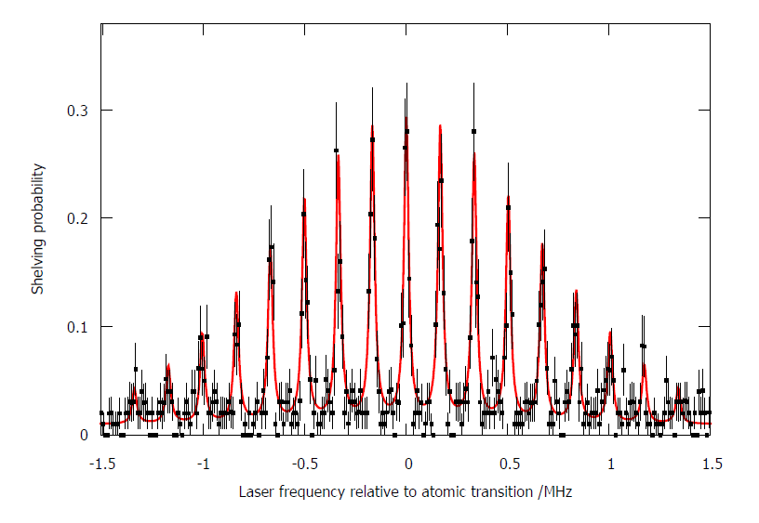
Axial Spectrum
Trap frequencies quite low so not in the Lamb-Dicke regime
Background due to J-mixing
-
Temperature = 1.1 mK, n=130 near Doppler limit

Slide 32
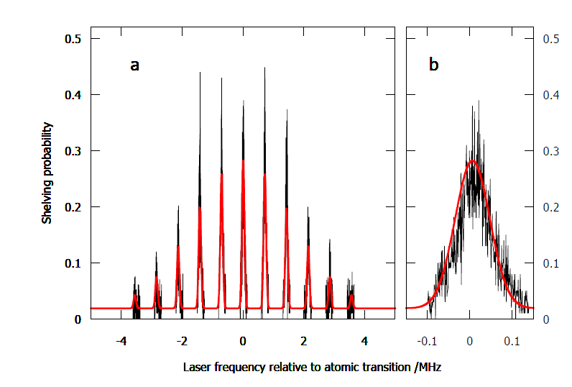
Radial Spectrum (Trap voltage 5 V)
-
Temperature = 7±3 mK, n=200

Slide 33
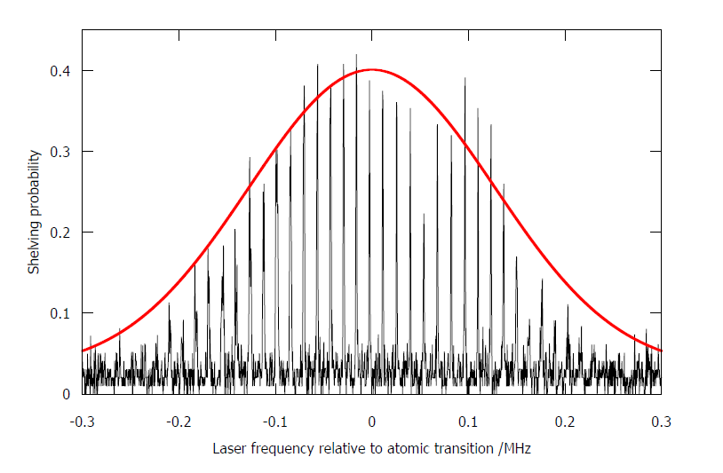
Zoom of one Cyclotron sideband at higher trap voltage (25V)
-
Temperature = 42±6 µK, n=3000

Slide 34
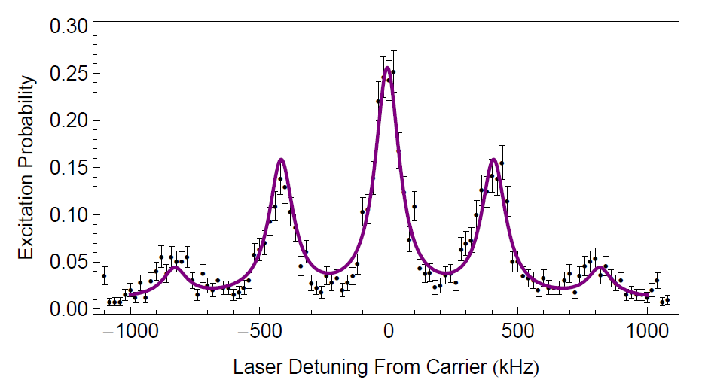

Axial Spectrum with Axialisation and High Trap Voltage

Slide 35
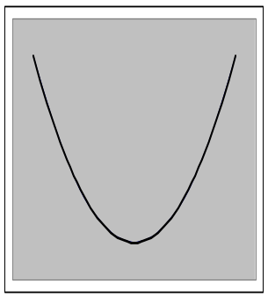
Sideband Cooling
Park laser on red sideband and pump ion down the ladder until it is in the ground motional state
|e>
z
|g>
z

Slide 36
Sideband Cooling
Park laser on red sideband and pump ion down the ladder until it is in the ground motional state
|e>
z
|g>
When the ion gets to the ground state the interaction switches off
z

Slide 37
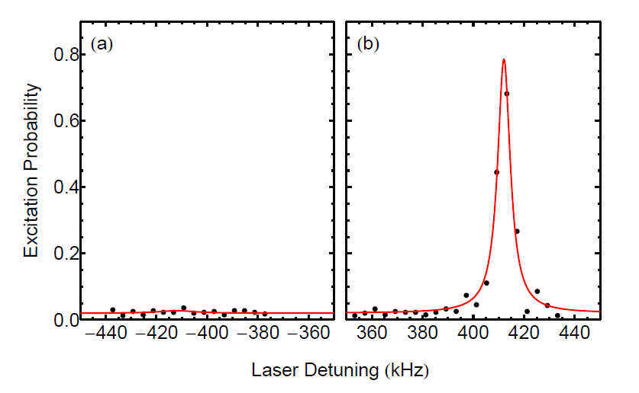
Sideband cooling
Motional ground state >99%

Slide 38
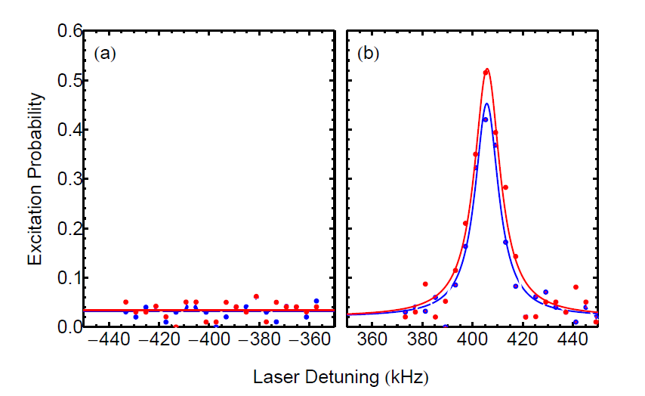
Heating Rate
Heating rate < 0.3 phonon/s – very low as expected (hoped!)
Not surprising since ion-electrode distance is large

Slide 39
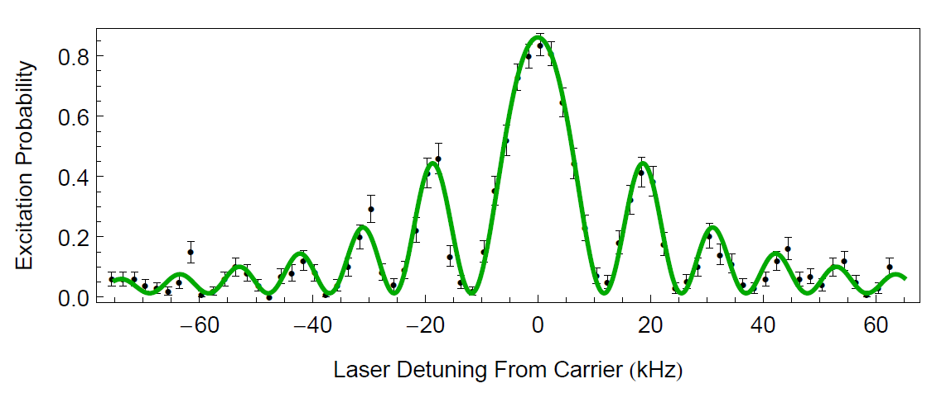

Scan of Carrier

Slide 40
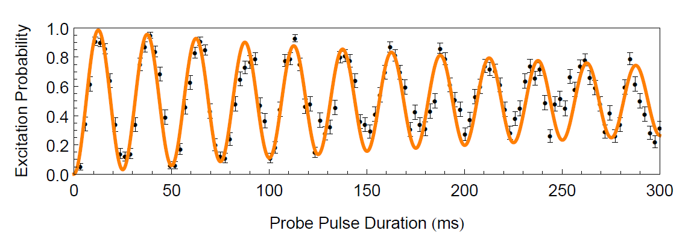
Rabi Oscillations
(µs)

Slide 41
What next ?
Sideband cool radial motion
Attempt sideband cooling for a small planar Ion Coulomb Crystal (ICC) - challenging for larger crystals
Control rotation of our ICCs – new trap, rotating wall, stroboscopic imaging, single ion addressing
Multi-species crystals
Quantum crossovers/ Quantum information protocols

Slide 42

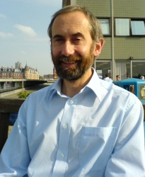
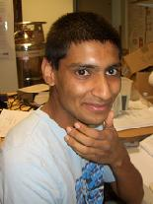
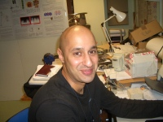



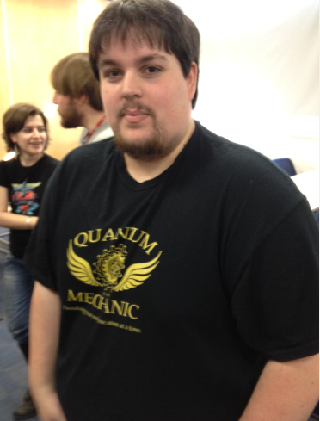
The team…

Slide 47
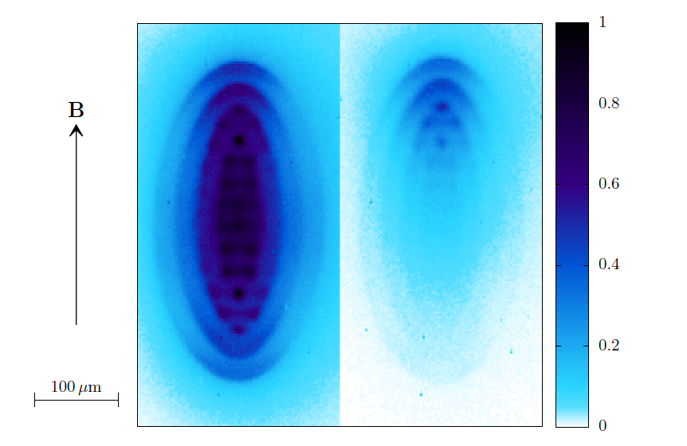
Effect of J-state Mixing
Switch off the 854 repumper
Some ions get shelved in the D_{5/2} state by magnetic field J-mixing
These ions are not pushed by the laser beam.
Bright ions accumulate at one end of the trap

Slide 48
Trap Frequencies
B=1.85T
Trap frequencies measured by applying weak rf drive and seeing image of 3 ion crystal blur at COM freq.

Slide 49
Spectroscopy on the 729nm transtion
Allows good measurement of temperature and heating rate
Provides a starting point for sub-Doppler ‘sideband cooling’
Sideband cooling to motional ground state in turn allows coherent manipulation of S-D qubit
Cooling 3D Ion Coulomb Crystal to motional GS would be a starting point for study of macroscopic quantum effects

Slide 50
Spectroscopy on the 729nm transtion
Load single ion
Wait for a start pulse triggered by mains cycle
Doppler cool
Prepare ion in one S_{1/2} sublevel
Interrogate with 729nm pulse
Look to see if ion is dark or bright
Repeat 100 times
Step to new frequency

Slide 51
Laser cooling in the Penning trap
In the Penning trap the ions are in an orbit around the trap centre
  Magnetron motion has negative total energy
  To cool both cyclotron and magnetron motions the laser must be offset from trap centre
    To the side where the ions go away from the laser
  Magnetron motion is always cooled less effectively than cyclotron
Tight localisation is difficult – Axialisation, Rotating Wall
Radial potential

Slide 52
Increase Trap Potential
Experiment
Simulation

Slide 53
Increase Trap Potential
Experiment
Simulation

Slide 54
Increase Trap Potential
Experiment
Simulation

Slide 55

Increase Trap Potential
Experiment
Simulation

Slide 56

Increase Trap Potential
Experiment
Simulation

Slide 57

Increase Trap Potential
Experiment
Simulation

Slide 58

Increase Trap Potential
Experiment
Simulation

Slide 59
Single Ions - Quantum Jumps
|2>
Ion cycles between states 1 and 2 high fluorescence rate
Occasionally ion makes ‘quantum jump’ into state 3 (metastable state). Fluorescence switches off.
The absence of a large number of 1-2 photons accompanies the absorption of a single 1-3 photon
Use to ‘read-out’ state of a single atom
.
|3>
Strong transition
Weak transition
|1>

Slide 60
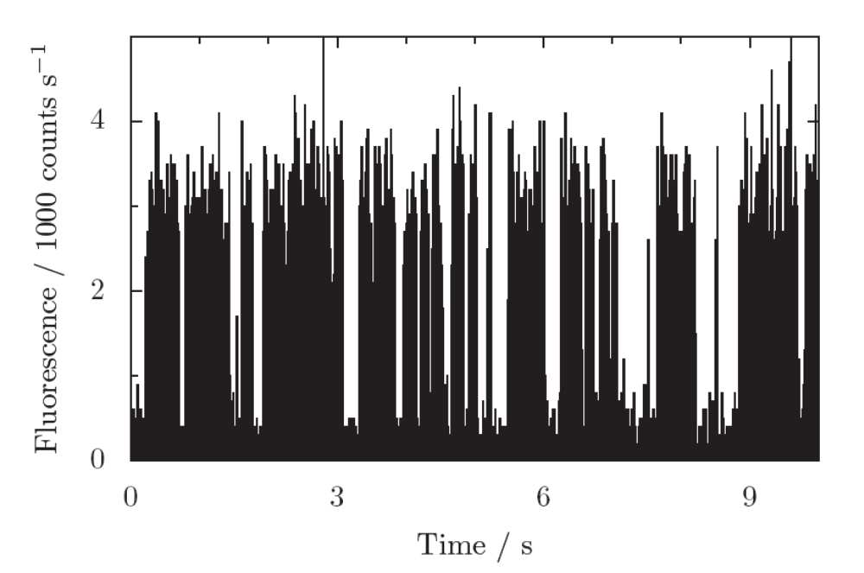
Quantum Jumps in a single Ca⁺ ion
|2>
|3>
|1>
Quantum jumps really happen, they are truly random, and they act as a measurement of the state of a single atom.

Slide 61
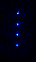
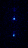
Quantum Jumps

Slide 62
Driving Carrier and Sideband Transitions
Carrier
Blue Sideband
Red Sideband
|e>
z
What if the ion is already in the motional ground state?
|g>
If ion is in the motional ground state excitation on the red sideband does nothing!
z

Slide 63
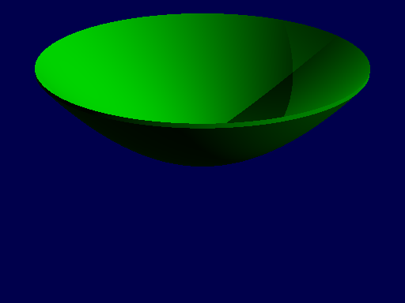

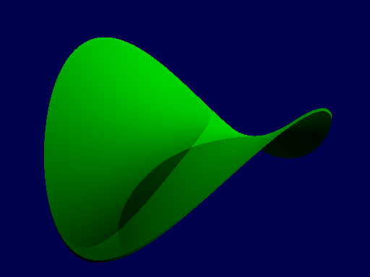

Ion Traps
Ion trap – set of electrodes, apply electric potentials, attempt to trap an ion in 3D
This would be the equivalent of making a 3D potential bowl (a 2D one is shown)
Impossible – Earnshaw’s theorem
Laplace Eq.
Best you can do is make a 3D quadrupole
This is a 3D saddle point, (2D one shown ). Traps along z but not x and y

Slide 64

Trap Loading
Photoionisation using pulsed 532nm YAG laser
Ions can continue to join the party for ~10 minutes. Most irritating
Wait for required number of ions to come in then turn trap voltage off for 20µs
Or selectively eject ions one at a time

