Slide 1



Quantum Simulations: From Ground to Excited States
AFM
Phil Richerme
Monroe Group
University of Maryland and NIST
iQsim Workshop
Brighton, UK
December 18, 2013
AFM
AFM
?
?
AFM
AFM
AFM
Notes:
I’d like to share with you some of the recent work we’ve been doing in the Monroe group in simulating many-body physics using trapped ions. The idea is that if you have some complicated many-body system whose behavior you’d like to investigate, you can map that system onto another system over which you have good control, and then use the well-controlled quantum system to study the physics you’re interested in.
Now it might seem like an obvious statement in the title that you need many trapped ions to simulate a many-body spin system, but this 1-to-1 correspondence is a powerful feature of quantum simulation. If you have some 30-spin many-body system, you only need 30 ions to simulate the system. Compare that to classical systems, where N=30 is already unsolvable since you need 2^30 numbers, or about 8 GB of memory, just to write down the wavefunction, and if you then want to build a 2^30 by 2^30 Hamiltonian and evolve the Schrodinger equation, you’ll likely end up with a result that looks something like

Slide 2
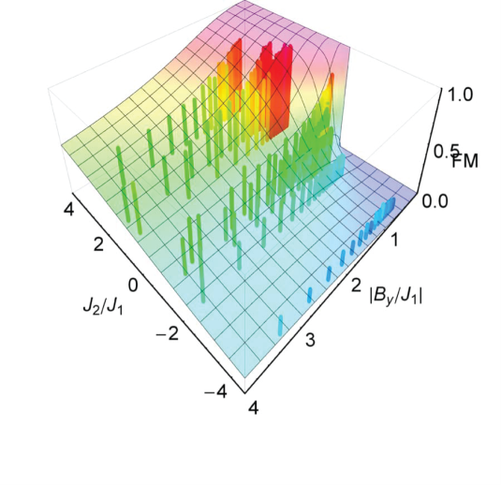
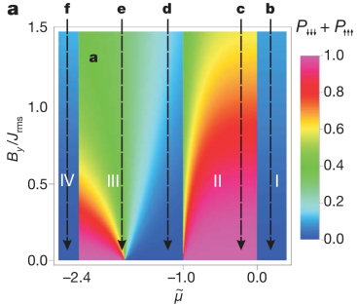
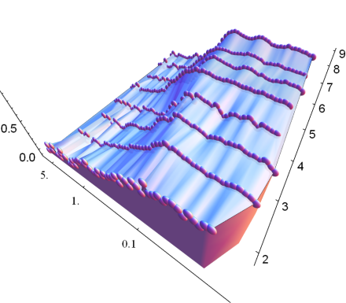
From Ground to Excited States
Current System: Fully-connected Ising model with d20 spins, for study of:
Ground-state phase diagrams [1]
Quantum phase transitions [2]
Studies of frustration [3,4]
[1] E. E. Edwards et. al., PRB 82, 060412 (2010)
[2] R. Islam et. al., Nat. Comm. 2, 377 (2011)
[3] K. Kim et. al., Nature 465, 590 (2010)
[4] R. Islam et. al., Science 340, 583 (2013)
Notes:
quantum simulations with trapped ions for several years, and have mapped out ground-state phase diagrams of Ising-like systems, observing the onset of a quantum phase transition as the number of ions was increased from 2 to 9, and performed early studies of frustration with 3 spins.

Slide 3
From Ground to Excited States
Current System: Fully-connected Ising model with d20 spins, for study of:
Ground-state phase diagrams [1]
Quantum phase transitions [2]
Studies of frustration [3,4]
Quantum fluctuations in a classical system [5]
Many-body Hamiltonian spectroscopy
Correlation propagation after global quenches
This Talk
[1] E. E. Edwards et. al., PRB 82, 060412 (2010)
[2] R. Islam et. al., Nat. Comm. 2, 377 (2011)
[3] K. Kim et. al., Nature 465, 590 (2010)
[4] R. Islam et. al., Science 340, 583 (2013)
[5] P. Richerme et. al., PRL 111, 100506 (2013)
Notes:
This talk will mainly focus on two aspects of our recent work, both of which start with an antiferromagnetic Ising chain. First, I'll show how we tune the range of interactions in our system and observe signatures of the changing amounts of frustration that result. Second, I'll show that if we start with an AFM spin chain and add a longitudinal magnetic field along the direction of the spin-spin couplings, we can drive the system through a number of first-order phase transitions.
:29

Slide 4
From Ground to Excited States
Current System: Fully-connected Ising model with d20 spins, for study of:
Ground-state phase diagrams [1]
Quantum phase transitions [2]
Studies of frustration [3,4]
Quantum fluctuations in a classical system [5]
Many-body Hamiltonian spectroscopy
Correlation propagation after global quenches
Scaling up the number of interacting spins
Non-equilibrium phase transitions
Studies of dynamics and thermalization
Future Work
[1] E. E. Edwards et. al., PRB 82, 060412 (2010)
[2] R. Islam et. al., Nat. Comm. 2, 377 (2011)
[3] K. Kim et. al., Nature 465, 590 (2010)
[4] R. Islam et. al., Science 340, 583 (2013)
[5] P. Richerme et. al., PRL 111, 100506 (2013)
Notes:
This talk will mainly focus on two aspects of our recent work, both of which start with an antiferromagnetic Ising chain. First, I'll show how we tune the range of interactions in our system and observe signatures of the changing amounts of frustration that result. Second, I'll show that if we start with an AFM spin chain and add a longitudinal magnetic field along the direction of the spin-spin couplings, we can drive the system through a number of first-order phase transitions.
:29

Slide 5
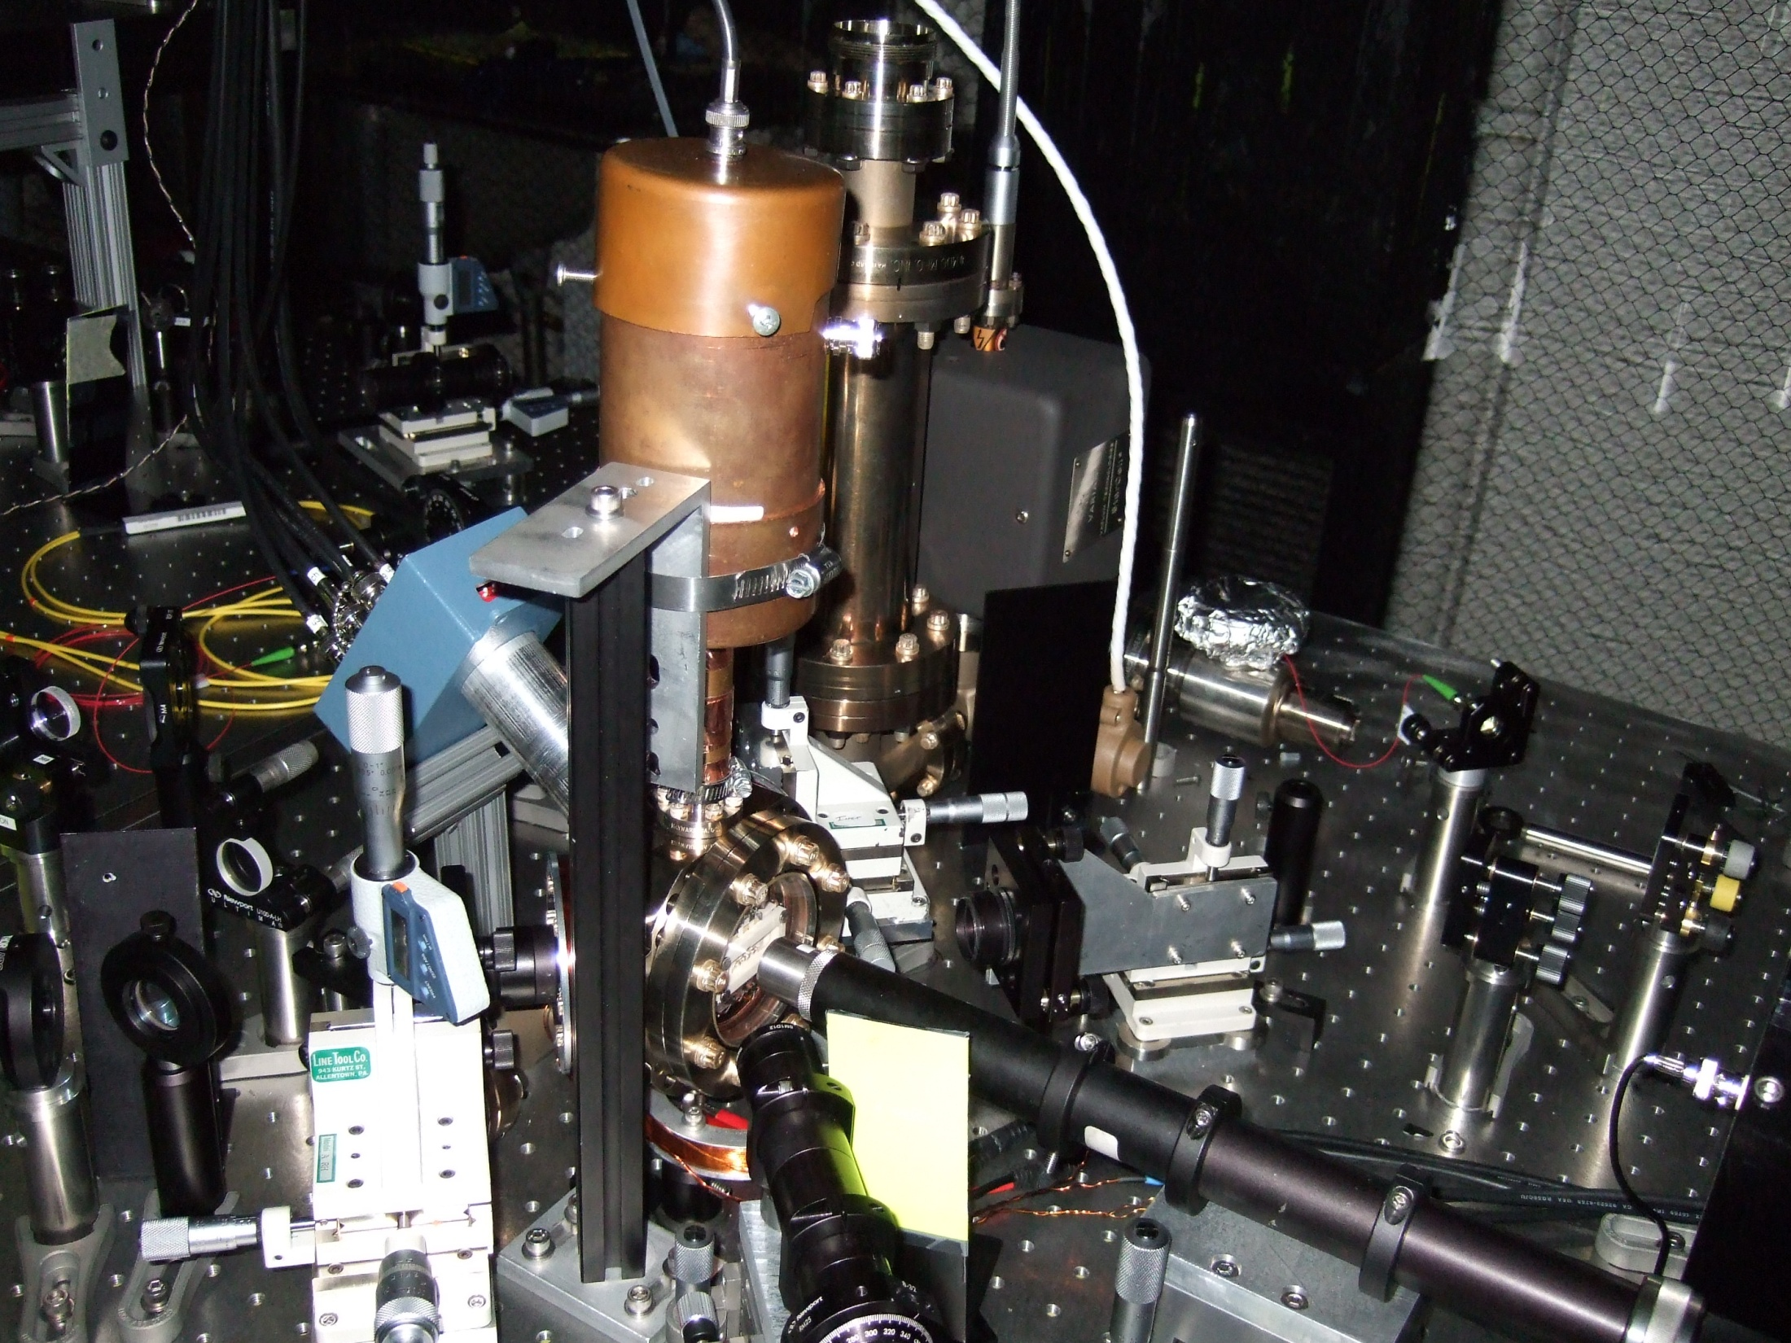
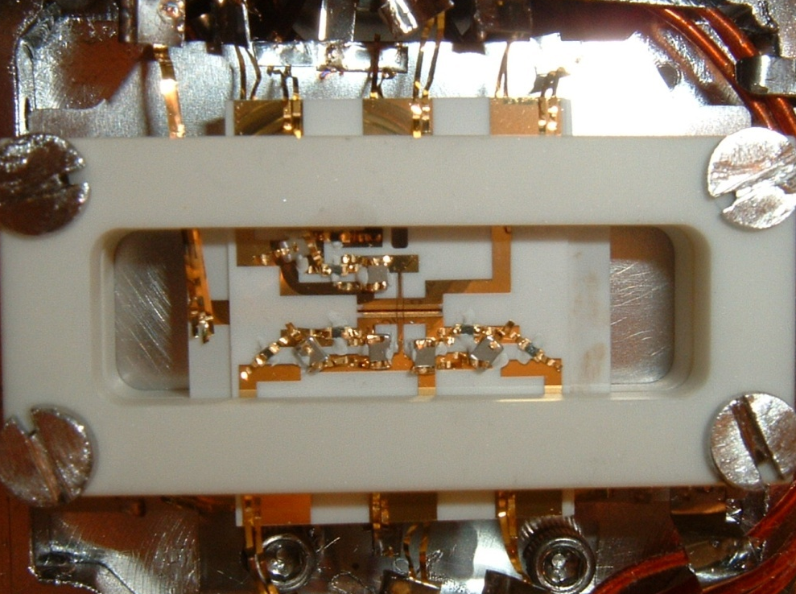
¹⁷¹Yb⁺
|↑_{z}⟩ = |1,0⟩
|1,1⟩
|1,-1⟩
ν_{HF} = 12 642 812 118 Hz
+ 311B² Hz/G²
²S_{1/2}
2 μm
|↓_{z}⟩ = |0,0⟩
γ/2π = 20 MHz
F=1
²P_{1/2}
2.1 GHz
F=0
370 nm
200μm
F=1
²S_{1/2}
|↑_{z}⟩
12.6 GHz
F=0
|↓_{z} ⟩
Notes:
These experiments are performed in a 3-layer RF Paul trap, housed in a UHV chamber with a pressure better than 10^-12 Torr.
We load into the trap Ytterbium 171 ions, and we adjust the trap voltages to ensure that they line up along the central axis of the trap.
This also means that the axial trap frequency along the chain is much lower than the transverse frequency perpendicular to the chain, which we’ll see later is important for the types of spin-spin couplings we wish to engineer.
The effective spin-1/2 system is represented by the mF=0 sublevels in the S ½ manifold. These so-called hyperfine clock states, which we label up and down in the z basis, are separated by about 12.6 GHz, and are relatively insensitive to external magnetic fields, giving a coherence time of better than a second without any magnetic shielding or other tricks.
1:00 – 3:30

Slide 6
¹⁷¹Yb⁺
|↑_{z}⟩ = |1,0⟩
|1,1⟩
|1,-1⟩
ν_{HF} = 12 642 812 118 Hz
+ 311B² Hz/G²
²S_{1/2}
2 μm
|↓_{z}⟩ = |0,0⟩
γ/2π = 20 MHz
F=1
²P_{1/2}
2.1 GHz
F=0
370 nm
200μm
F=1
²S_{1/2}
|↑_{z}⟩
12.6 GHz
F=0
|↓_{z} ⟩
Notes:
These experiments are performed in a 3-layer RF Paul trap, housed in a UHV chamber with a pressure better than 10^-12 Torr.
We load into the trap Ytterbium 171 ions, and we adjust the trap voltages to ensure that they line up along the central axis of the trap.
This also means that the axial trap frequency along the chain is much lower than the transverse frequency perpendicular to the chain, which we’ll see later is important for the types of spin-spin couplings we wish to engineer.
The effective spin-1/2 system is represented by the mF=0 sublevels in the S ½ manifold. These so-called hyperfine clock states, which we label up and down in the z basis, are separated by about 12.6 GHz, and are relatively insensitive to external magnetic fields, giving a coherence time of better than a second without any magnetic shielding or other tricks.
1:00 – 3:30

Slide 7

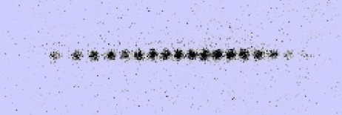

Generating Spin-Spin Couplings
Carrier
ω
Transverse
modes
Axial
modes
Axial
modes
Transverse
modes
ω+ω_{HF}±μ
μ
μ
ω+ω_{HF}
Beatnote frequency
33 THz
²P_{1/2}
ω
ω+ω_{HF}
²S_{1/2}
|↑_{z}⟩
12.6 GHz
|↓_{z} ⟩
K. Mølmer and A. Sørensen, PRL 82, 1835 (1999)

Slide 8
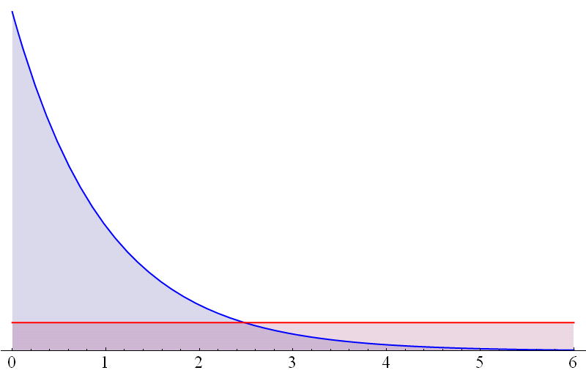
Studying Frustrated Ground States
x
>0
Step 1: Initialize all spins along y
y
Step 2: Turn on B_{y} and J_{x}^{i,j} and adiabatically lower B_{y}
B_{y}
amplitude
J_{x}^{i,j}
time
Step 3: Measure all spins along x
Notes:
To perform all of our simulations, we implement a simple 3-step protocol.
First, we initialize all spins along the y direction by optically pumping to the down-z state, then applying a pi/2 pulse.
Next, we turn on By and Jij. Note that we start with By much much larger than J, which means that our initialization of spins to point along y from step one starts the system in the ground state when we turn on B and J. We then adiabatically lower B until just the J part of the Hamiltonian remains, and if we were really adiabatic, then we remain in the ground state throughout the evolution.
Finally, we measure the spin state of each ion at the end of the simulation by directly imaging onto our CCD camera.
1:00 – 11:15

Slide 9
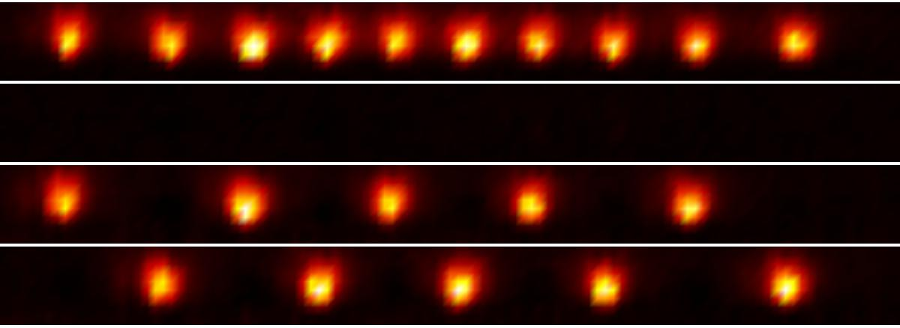
Antiferromagnetic Néel order of N=10 spins
2600 runs, α=1.12
All in state ↑
All in state ↓
AFM ground state order
222 events
219 events
441 events out of 2600 = 17%
Prob of any state at random =2 x (1/2¹⁰) = 0.2%
Notes:
Since we are able to image each ion individually using the camera, we can directly observe an increase in the number of excitations as we move to long-range afm interactions. For instance, with 10 spins, we can easily see the difference between when each of our spins is up and when each is down.
If we turn on our antiferromagnetic hamiltonian, we can then image our degenerate Neel ordered ground state. If we perform 2600 simulations of our AFM hamiltonian with a range of interaction parameterized by this alpha, we find
About 220 events for each of the ground states, or 17 percent probability of landing in the ground state. Compared to the probability of falling into these states at random, it’s clear that we’re still recovering some ground state character.
1:00 – 16:00

Slide 10
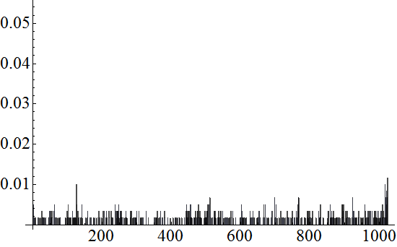

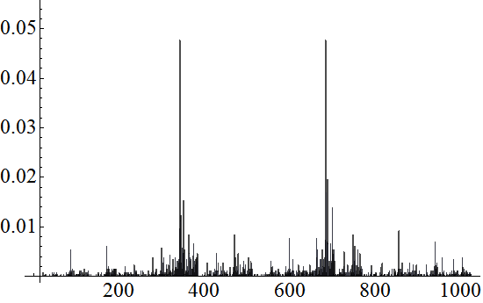
Distribution of all 2¹⁰ = 1024 states
Initial
paramagnetic
state
B >> J
Probability
0.10
0.08
0.06
0.04
0.02
0101010101
1010101010
Nominal
AFM
state
B = 0
Probability
0 341 682 1023
Notes:
In fact, using the camera we can look at the distribution of all 1024 possible states in the system. In the initial paramagnetic state, all possible spin configurations are roughly equally populated, save for a few detection errors.
When we ramp down the Hamiltonian, we see the two ground states popping out very clearly, each with about 9% probability, and the rest of the states suppressed.
:30 – 16:30

Slide 11
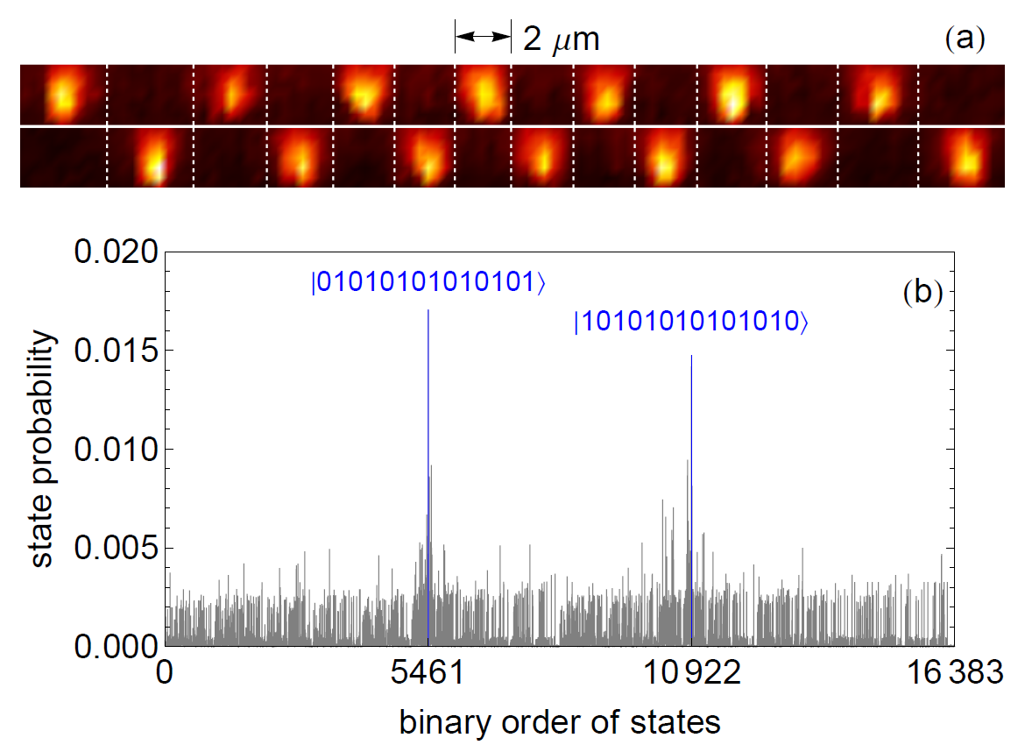
Distribution of all 2¹⁴ = 16383 states
Most prevalent state should always be the ground state
Initial
paramagnetic
state
B >> J
Probability
14 ions
0.10
0.08
0.06
0.04
0.02
0101010101
1010101010
Nominal
AFM
state
B = 0
Probability
P. Richerme et. al., PRA 88, 012334 (2013)
0 341 682 1023
Notes:
In fact, using the camera we can look at the distribution of all 1024 possible states in the system. In the initial paramagnetic state, all possible spin configurations are roughly equally populated, save for a few detection errors.
When we ramp down the Hamiltonian, we see the two ground states popping out very clearly, each with about 9% probability, and the rest of the states suppressed.
:30 – 16:30

Slide 12
AFM Ising Model with a Longitudinal Field
So far:
Now:
ramp adiabatically
    Study frustrated ground states of AFM Ising Model
vary strength of B_{x}
    N/2 classical phase transitions as B_{x} is increased
P. Richerme et. al., PRL 111, 100506 (2013)
Notes:
As we'll see in just a minute, doing so gives rise to a number of first-order phase transitions that we cross as we increase the strength of Bx.
0:30

Slide 13
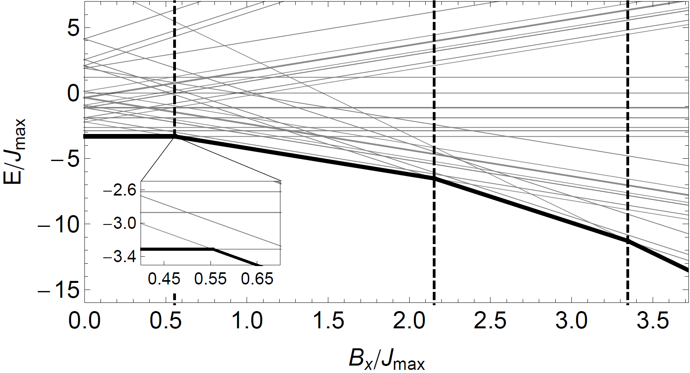
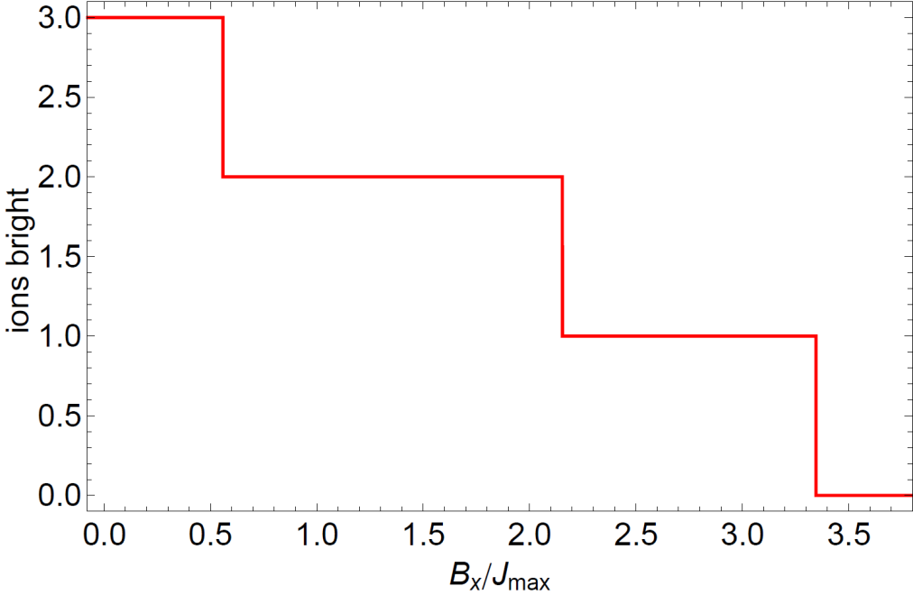
AFM Ising Model with a Longitudinal Field
=
=
P. Richerme et. al., PRL 111, 100506 (2013)
Notes:
Let's consider the ground state of this Hamiltonian when we set the transverse field part equal to zero.
For N=6, we can plot the energy eigenvalues as we vary the strength of Bx. We find that at three points, the ground state energy has abrupt kinks in it.
We can look at the ground state spin-configurations in each of these regions. Near Bx=0, we have our AFM states, as expected. However in this region, it becomes energetically favorable for one of the spins to flip from up to down to align along the longitudinal field. Likewise, past the next phase transition, another spin goes dark, and finally at large Bx, all of the spins are polarized along the longitudinal field.
If we plot an order parameter like the number of ions bright as a function of Bx, we see a staircase with abrupt jumps at the phase transitions.

Slide 14
AFM Ising Model with a Longitudinal Field
    Steps are only present for AFM Ising models with
    long-range interactions
=
=
P. Richerme et. al., PRL 111, 100506 (2013)
Notes:
FM is trivial – small longitudinal field breaks the up-down symmetry, so the system will always be in an FM state aligned with the external field. One step.
With nearest neighbor interactions, massive degeneracy gives only 2 phase transitions independent of the number of ions.

Slide 15
AFM Ising Model with a Longitudinal Field
    T = 0
    No thermal fluctuations to drive phase transitions
    System remains in the same phase
=
=
P. Richerme et. al., PRL 111, 100506 (2013)
Notes:
Let's consider the ground state of this Hamiltonian when we set the transverse field part equal to zero.
For N=6, we can plot the energy eigenvalues as we vary the strength of Bx. We find that at three points, the ground state energy has abrupt kinks in it.
We can look at the ground state spin-configurations in each of these regions. Near Bx=0, we have our AFM states, as expected. However in this region, it becomes energetically favorable for one of the spins to flip from up to down to align along the longitudinal field. Likewise, past the next phase transition, another spin goes dark, and finally at large Bx, all of the spins are polarized along the longitudinal field.
If we plot an order parameter like the number of ions bright as a function of Bx, we see a staircase with abrupt jumps at the phase transitions.

Slide 16
AFM Ising Model with a Longitudinal Field
    T = 0
    No thermal fluctuations to drive phase transitions
    Add quantum fluctuations to drive the phase transitions
    System remains in the same phase
=
=
P. Richerme et. al., PRL 111, 100506 (2013)
Notes:
Let's consider the ground state of this Hamiltonian when we set the transverse field part equal to zero.
For N=6, we can plot the energy eigenvalues as we vary the strength of Bx. We find that at three points, the ground state energy has abrupt kinks in it.
We can look at the ground state spin-configurations in each of these regions. Near Bx=0, we have our AFM states, as expected. However in this region, it becomes energetically favorable for one of the spins to flip from up to down to align along the longitudinal field. Likewise, past the next phase transition, another spin goes dark, and finally at large Bx, all of the spins are polarized along the longitudinal field.
If we plot an order parameter like the number of ions bright as a function of Bx, we see a staircase with abrupt jumps at the phase transitions.

Slide 17
Experimental Protocol
B_{x}
B
Step 1: Initialize all spins along B
B_{y}
Step 2: Turn on B_{y} , B_{x} , and J_{x}^{i,j} and adiabatically lower B_{y}
B_{y}
amplitude
B_{x}
J_{x}^{i,j}
time
Step 3: Measure all spins along x
P. Richerme et. al., PRL 111, 100506 (2013)
Notes:
Our experimental protocol with an axial field is similar to the one used before.
The main difference occurs in the initialization of our spins, which is along the direction of the total magnetic field By plus Bx.
This ensures that once again the spins start in the ground state when we turn on By, Bx, and J, and should remain in the ground state if we lower By adiabatically. As before, we can then directly measure the resulting spin states on our camera.
1:00 – 22:00

Slide 18
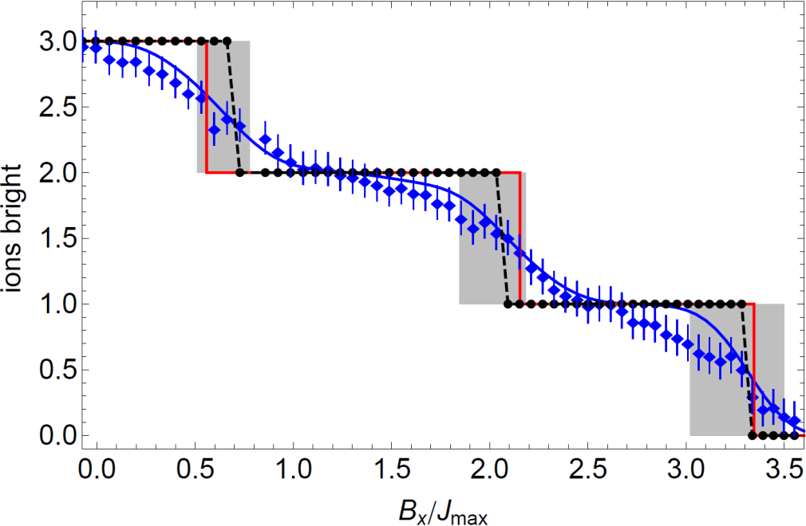
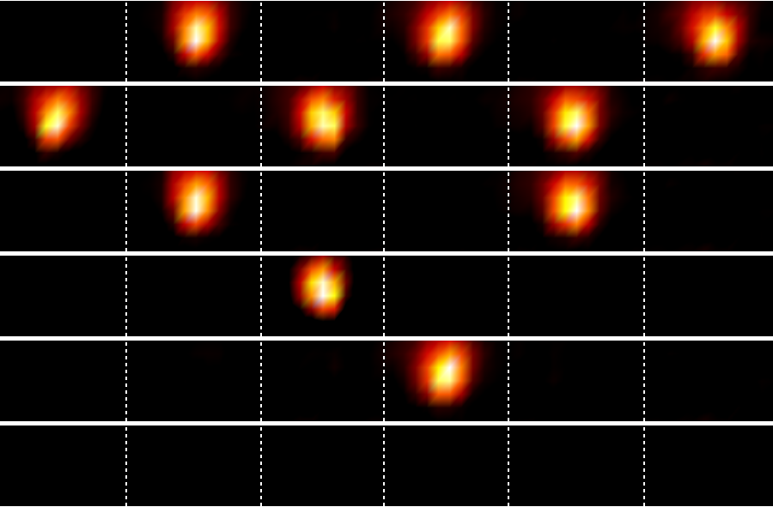
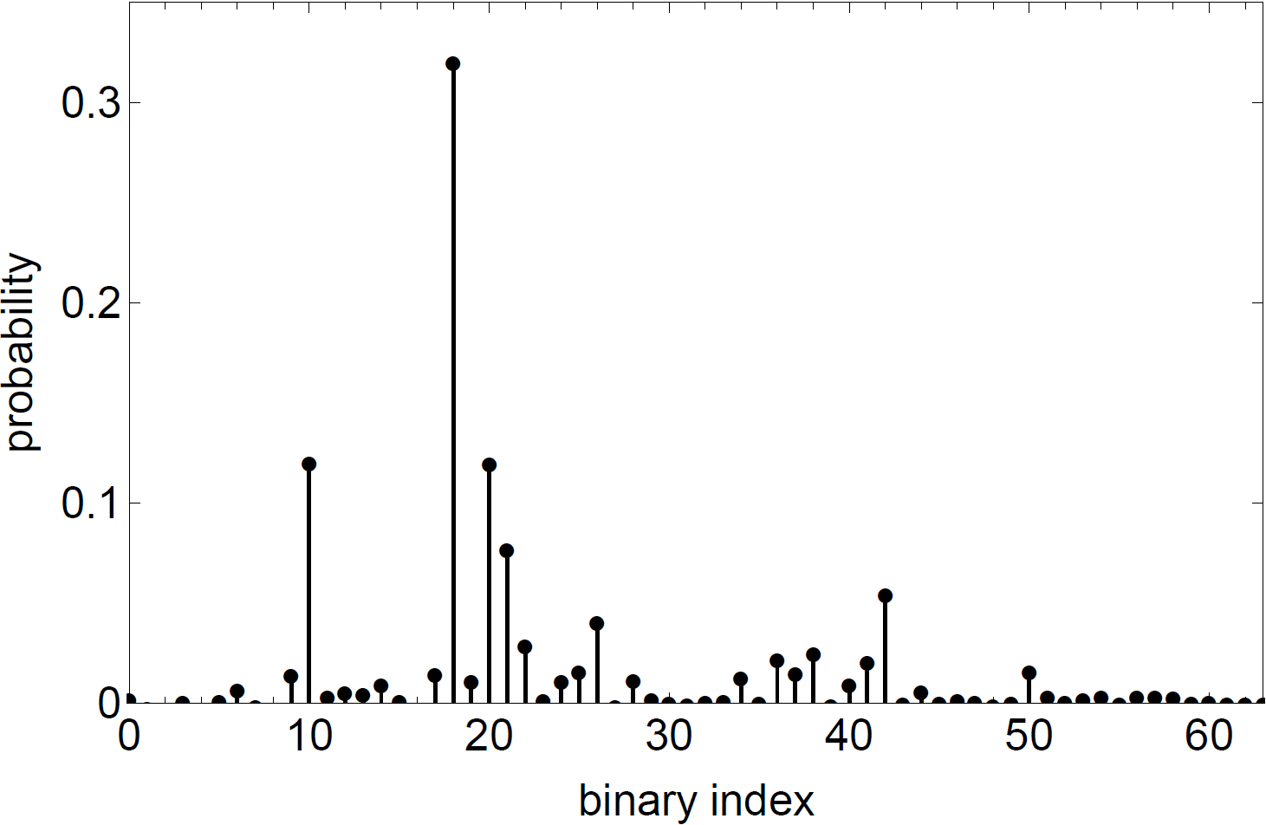
AFM Ising Model with a Longitudinal Field: 6 ions
AFM Ground States
2-Bright Ground State
1-Bright Ground States
010010
0-Bright Ground State
P. Richerme et. al., PRL 111, 100506 (2013)
Notes:
I have already showed you the theory prediction for the number of ions bright as the strength of Bx is increased.

Slide 19
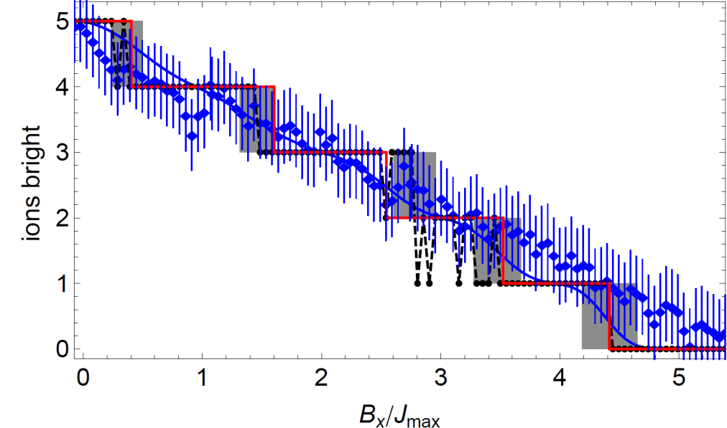
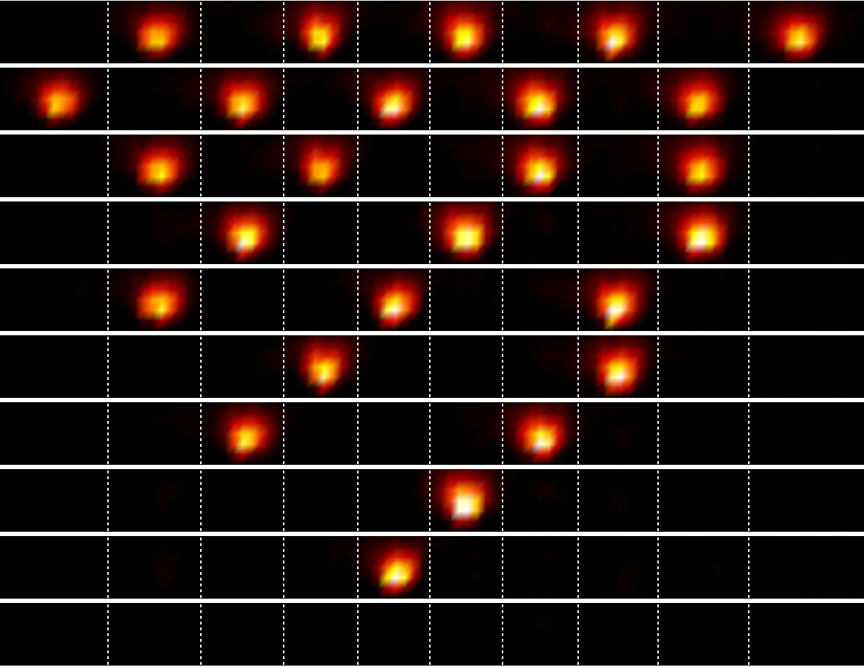
AFM Ising Model with a Longitudinal Field: 10 ions
5-Bright (AFM) Ground States
4-Bright Ground States
3-Bright Ground States
2-Bright Ground States
System exhibits a complete
devil's staircase for N → ∞
1-Bright Ground States
0-Bright Ground State
P. Bak and R. Bruinsma, PRL 49, 249 (1982)
P. Richerme et. al., PRL 111, 100506 (2013)
Notes:
1:30 – 25:00

Slide 20
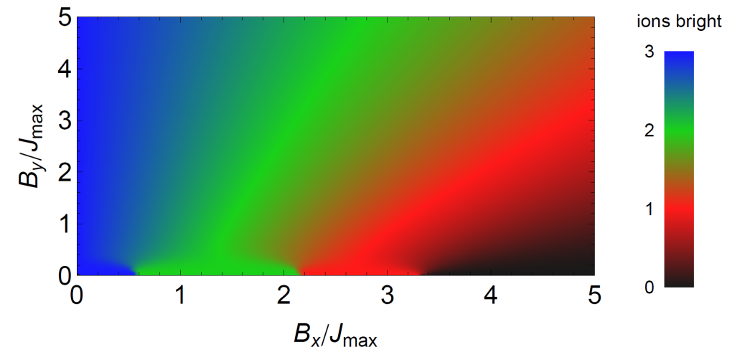
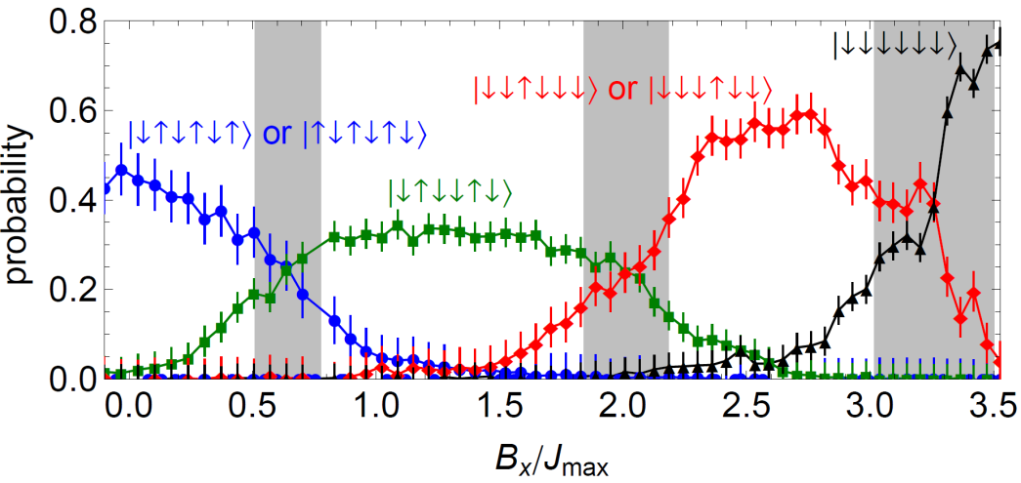
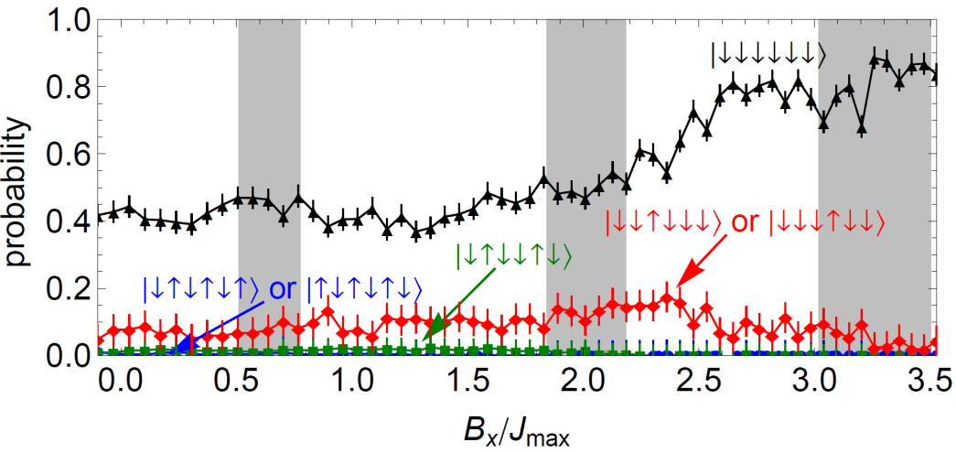
Quantum Fluctuations Drive Phase Transitions
Ramp B_{y}
No Thermal Fluctuations
Quantum Fluctuations
Ramp B_{x}
No Thermal Fluctuations
No Quantum Fluctuations
P. Richerme et. al., PRL 111, 100506 (2013)

Slide 21
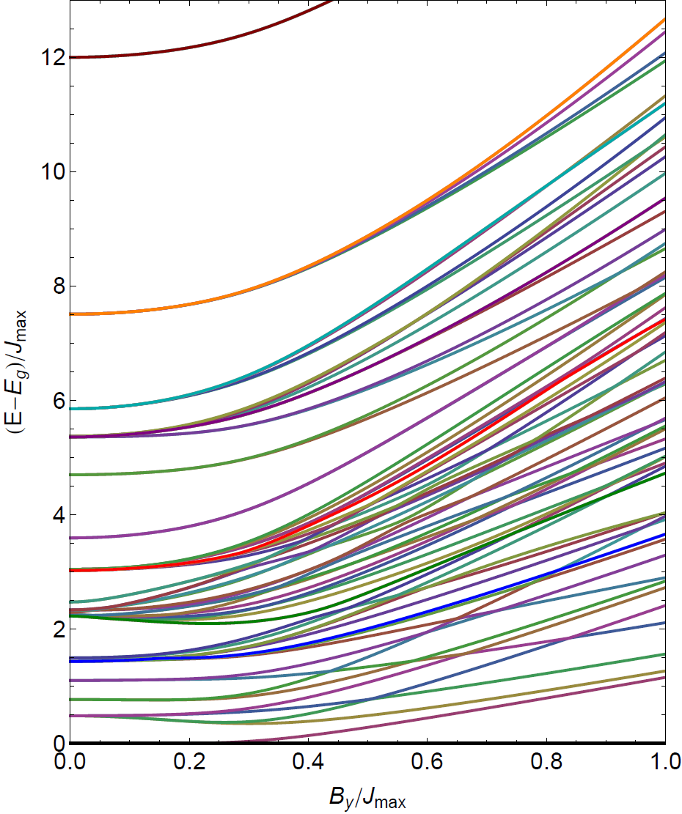
From ground to excited states
    Begin studying excited states of our system
Difficult (impossible?) to calculate excited state behavior for N > 20-30
Excited states are interesting:
  Hamiltonian spectroscopy
  Propagation of quantum correlations
  Non-equilibrium phase transitions
  Thermalization
Notes:
:45

Slide 22
From ground to excited states
small perturbation
Can drive transitions between states if:
Matrix element couples the states
Drive frequency ω matches energy
splitting
Experimental Protocol:
Step 1: Initialize in FM or AFM state
C. Senko et. al., in preparation
Notes:
:45

Slide 23
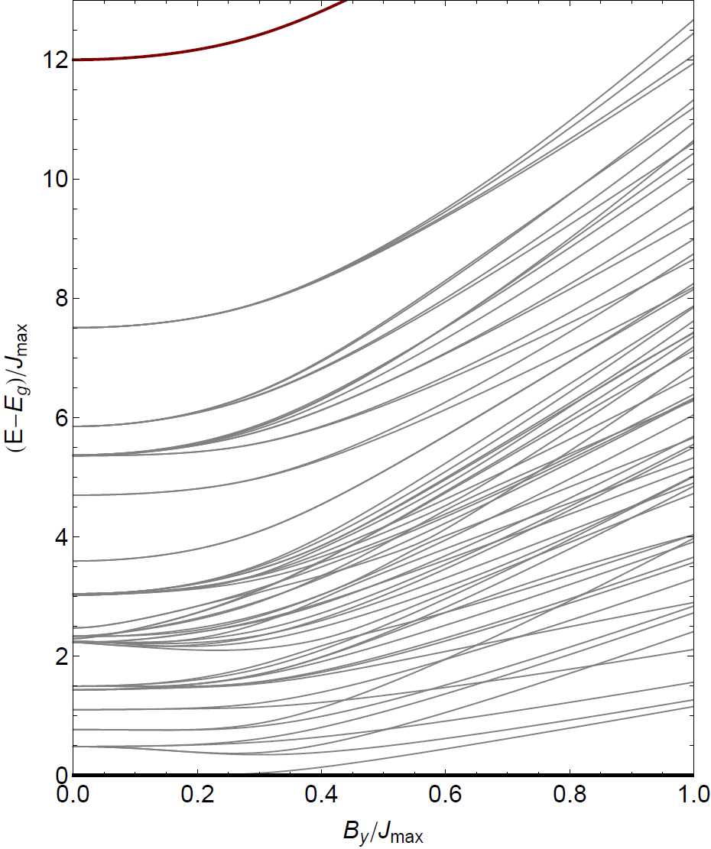
From ground to excited states
small perturbation
FM
Can drive transitions between states if:
Matrix element couples the states
Drive frequency ω matches energy
splitting
Experimental Protocol:
Step 1: Initialize in FM or AFM state
AFM
C. Senko et. al., in preparation
Notes:
:45

Slide 24
From ground to excited states
small perturbation
FM
Can drive transitions between states if:
Matrix element couples the states
Drive frequency ω matches energy
splitting
Experimental Protocol:
Step 1: Initialize in FM or AFM state
Step 2: Apply driving field for 3 ms
AFM
C. Senko et. al., in preparation
Notes:
:45

Slide 25
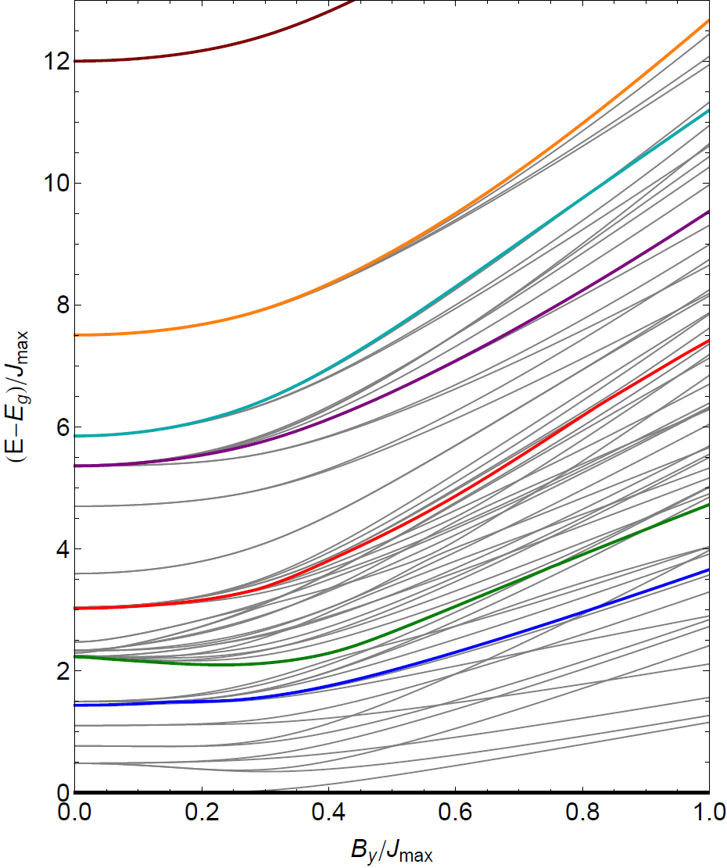
From ground to excited states
small perturbation
FM
Can drive transitions between states if:
Matrix element couples the states
Drive frequency ω matches energy
splitting
Experimental Protocol:
Step 1: Initialize in FM or AFM state
Step 2: Apply driving field for 3 ms
AFM
C. Senko et. al., in preparation
Notes:
:45

Slide 26
From ground to excited states
small perturbation
FM
Can drive transitions between states if:
Matrix element couples the states
Drive frequency ω matches energy
splitting
Experimental Protocol:
Step 1: Initialize in FM or AFM state
Step 2: Apply driving field for 3 ms
Step 3: Scan ω to find resonances
AFM
C. Senko et. al., in preparation
Notes:
:45

Slide 27
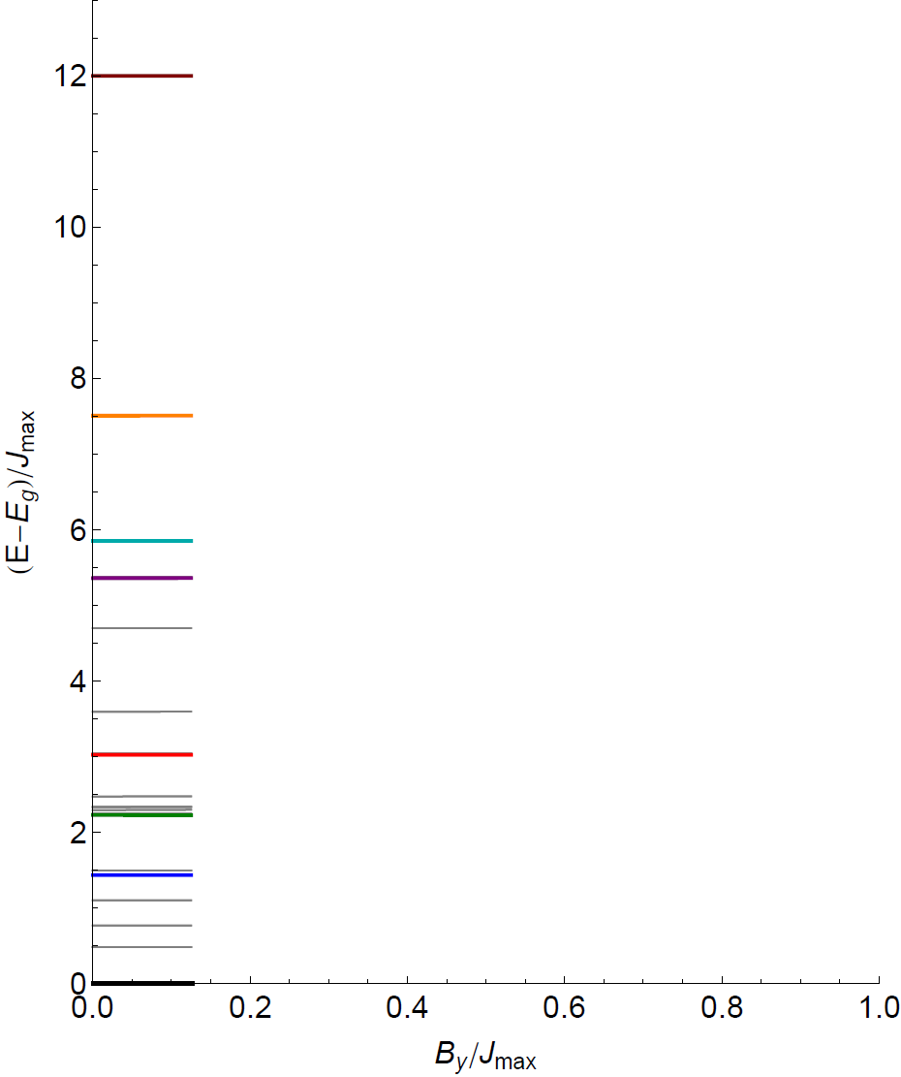
From ground to excited states
small perturbation
Can drive transitions between states if:
Matrix element couples the states
Drive frequency ω matches energy
splitting
Experimental Protocol:
Step 1: Initialize in FM or AFM state
Step 2: Apply driving field for 3 ms
Step 3: Scan ω to find resonances
C. Senko et. al., in preparation
Notes:
:45

Slide 28







From ground to excited states
small perturbation
Can drive transitions between states if:
Matrix element couples the states
Drive frequency ω matches energy
splitting
Experimental Protocol:
Step 1: Initialize in FM or AFM state
Step 2: Apply driving field for 3 ms
Step 3: Scan ω to find resonances
C. Senko et. al., in preparation
Notes:
:45

Slide 29
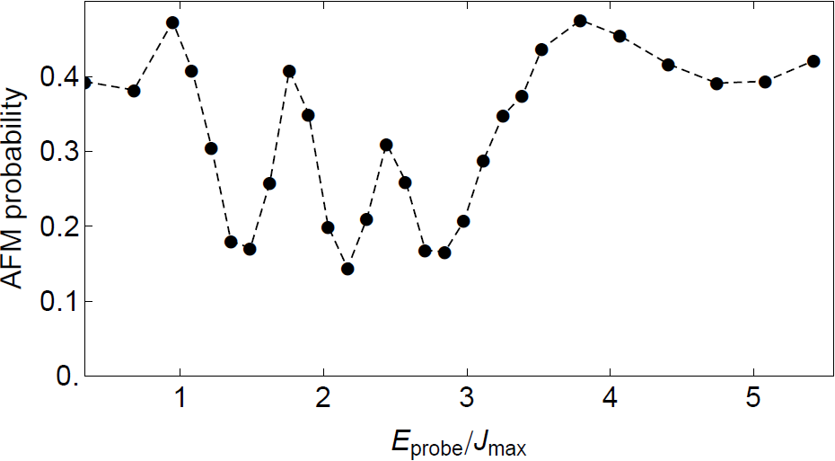
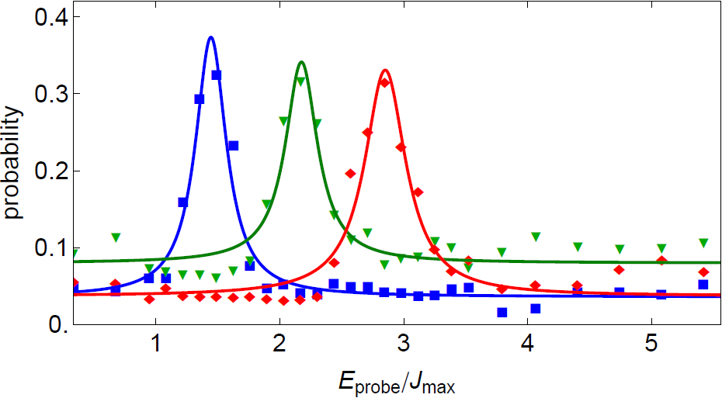
From ground to excited states
small perturbation
Start from AFM states:
Notes:
:45

Slide 30

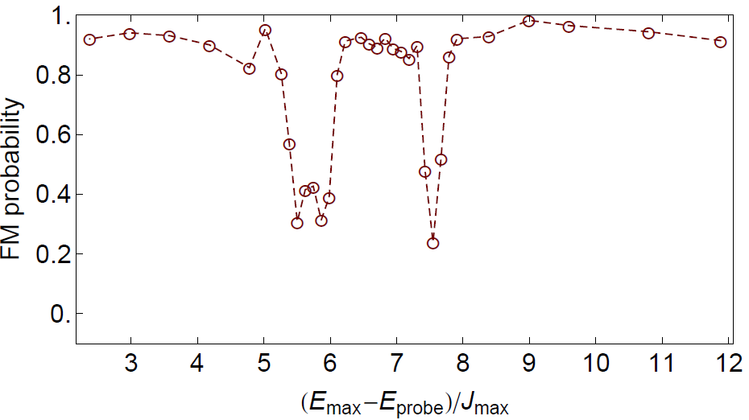






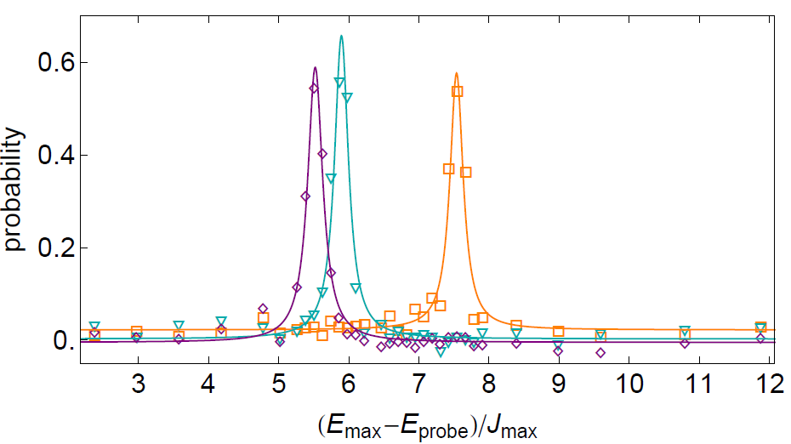
From ground to excited states
small perturbation
Start from FM states:
Notes:
:45

Slide 31
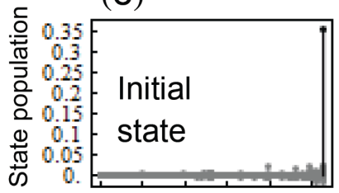
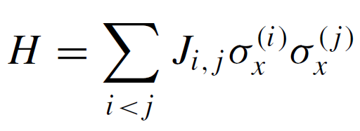
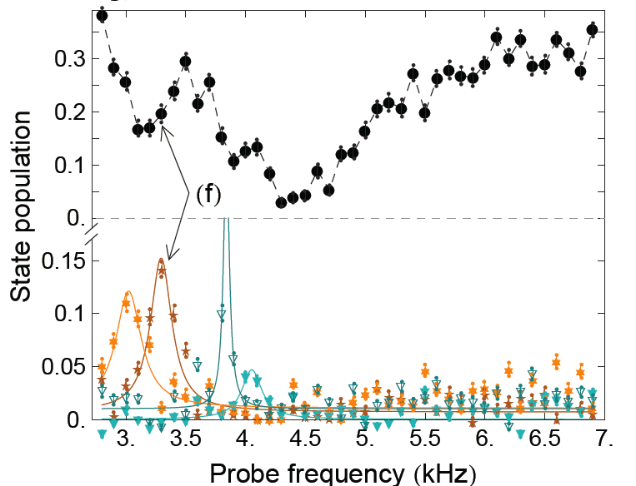
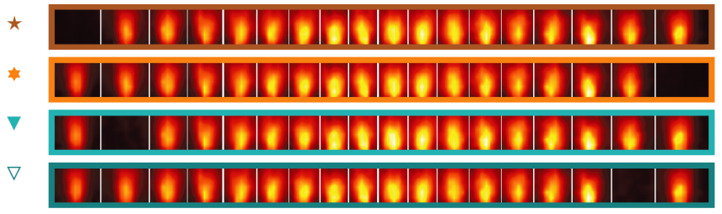
From ground to excited states – 18 ions
0
131071
262143
111111111111111111

Slide 32
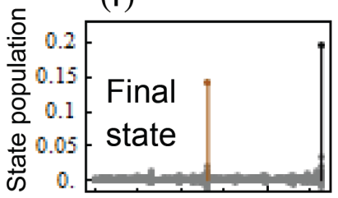
From ground to excited states – 18 ions
0
131071
262143
0
131071
262143
011111111111111111

Slide 33
From ground to excited states – 18 ions
0
131071
262143
0
131071
262143
011111111111111111
Notes:
Depends on all Jij couplings – good proxy for what the Hamiltonian is doing throughout the chain.

Slide 34
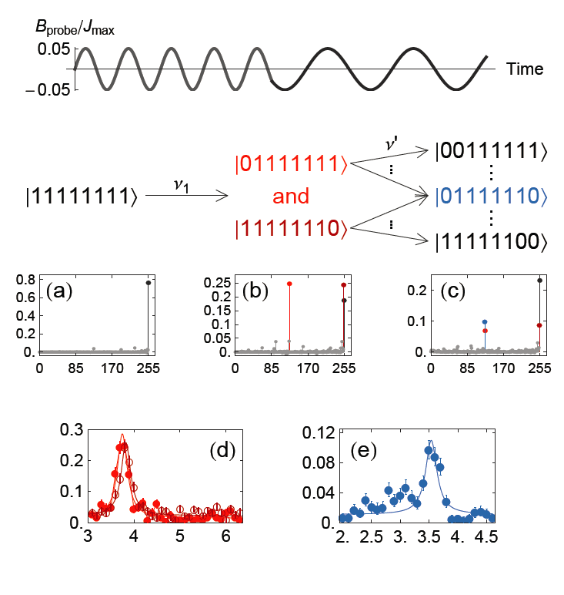
Direct Measurement of Spin-Spin Couplings
~N² terms in J_{ij} matrix, need
~N² measurements of ΔE
Spectroscopy Method:
~N levels for single scan
~N² levels for ~N scans
Probe frequency (kHz)
Probe frequency (kHz)
Notes:
:45

Slide 35
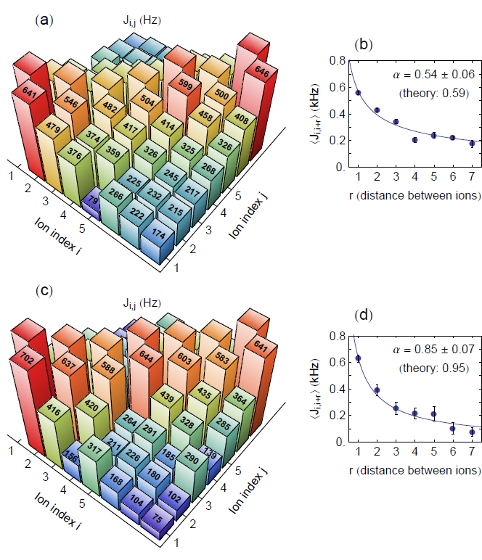
Direct Measurement of Spin-Spin Couplings
~N² terms in J_{ij} matrix, need
~N² measurements of ΔE
Spectroscopy Method:
~N levels for single scan
~N² levels for ~N scans
Notes:
:45

Slide 36
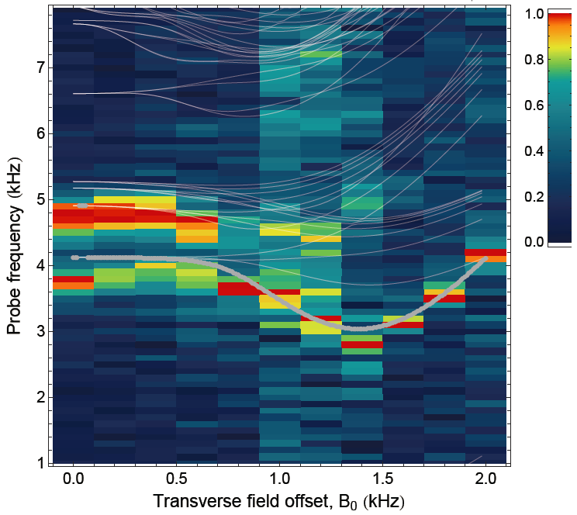
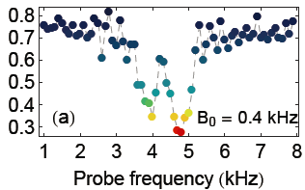
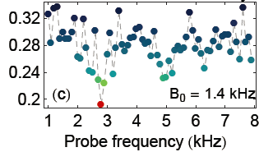
Spectroscopy at non-zero transverse field
Notes:
:45

Slide 37
Spectroscopy at non-zero transverse field
    Spectroscopy can measure (or constrain) critical gap
Notes:
:45

Slide 38
From ground to excited states
    Begin studying excited states of our system
Difficult (impossible?) to calculate excited state behavior for N > 20-30
Excited states are interesting:
  Hamiltonian spectroscopy
  Propagation of quantum correlations
  Non-equilibrium phase transitions
  Thermalization
Notes:
:45

Slide 39
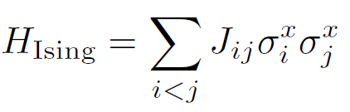
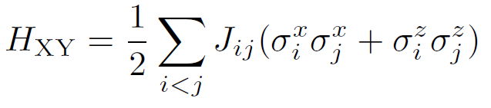
Correlation Propagation with 11 ions
Step 1: Initialize all spins along z
Step 2: Quench to Ising or XY model at t = 0 and let system evolve
Step 3: Measure all spins along z
Step 4: Calculate correlation function
P. Richerme et. al., in preparation
Notes:
To perform all of our simulations, we implement a simple 3-step protocol.
First, we initialize all spins along the y direction by optically pumping to the down-z state, then applying a pi/2 pulse.
Next, we turn on By and Jij. Note that we start with By much much larger than J, which means that our initialization of spins to point along y from step one starts the system in the ground state when we turn on B and J. We then adiabatically lower B until just the J part of the Hamiltonian remains, and if we were really adiabatic, then we remain in the ground state throughout the evolution.
Finally, we measure the spin state of each ion at the end of the simulation by directly imaging onto our CCD camera.
1:00 – 11:15

Slide 40
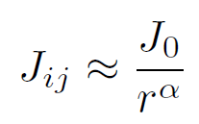
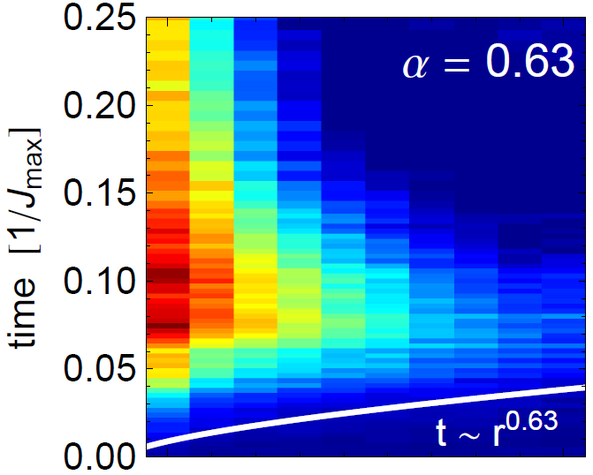
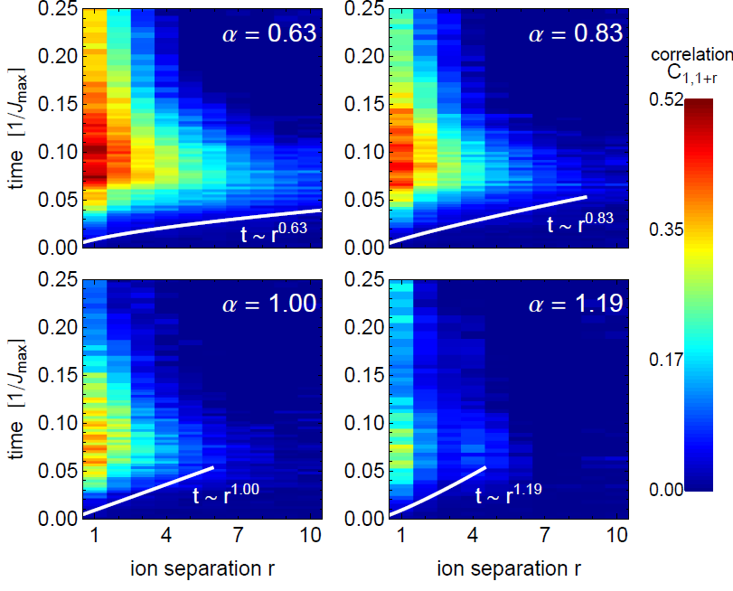
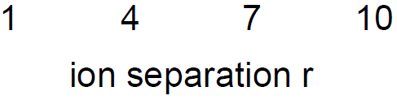
Global Quench: Ising Model
P. Richerme et. al., in preparation

Slide 41
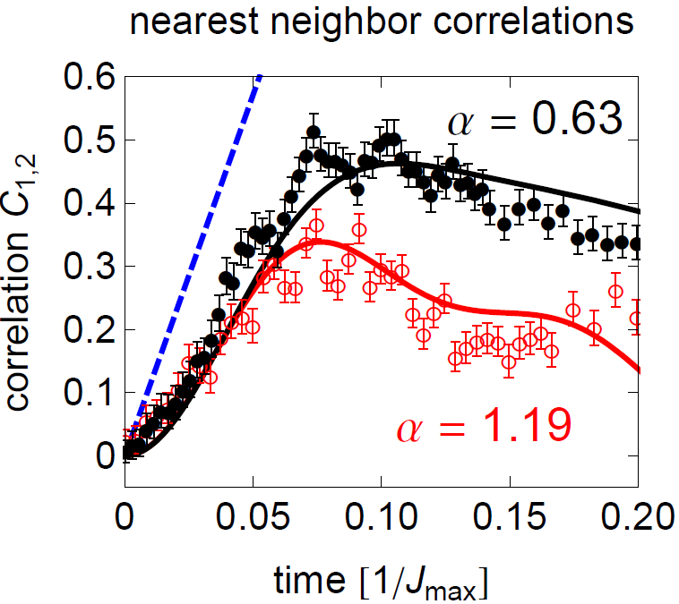
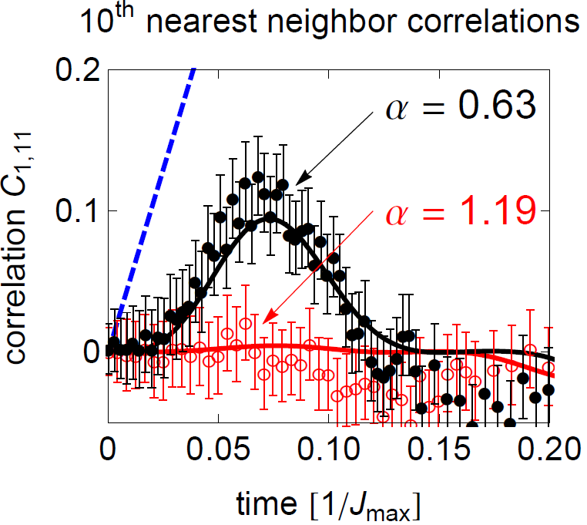
Global Quench: Ising Model
bound
bound
P. Richerme et. al., in preparation

Slide 42
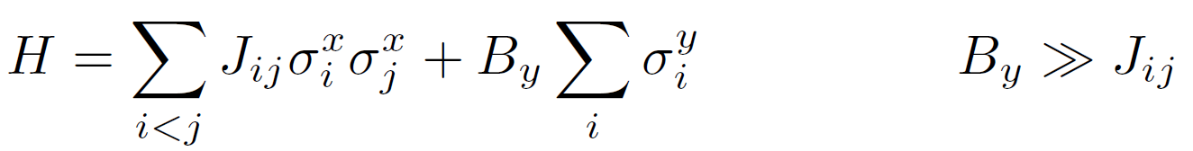
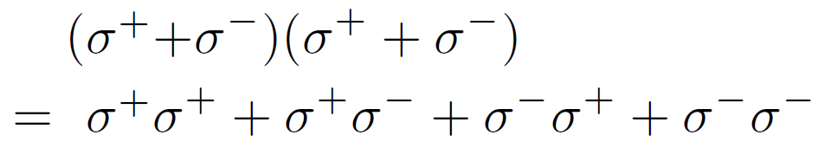
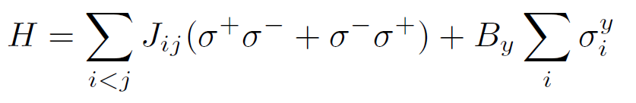
Global Quench: XY Model

Slide 43



Global Quench: XY Model

Slide 44

Scaling Up
4 K Shield
Ion trap
40 K Shield
300 K
To camera

Slide 45
Conclusion
Recent Results:
Quantum fluctuations to drive classical phase transitions
Spectroscopic method for Hamiltonian verification
Propagation of correlations after a global quench
Current Pursuits:
Non-equilibrium phase transitions
Thermalization
Larger numbers of ions with a cryogenic trap

Slide 46










www.iontrap.umd.edu
JOINT
QUANTUM
INSTITUTE
P.I.
Prof. Chris Monroe
Postdocs
Chenglin Cao
Taeyoung Choi
Brian Neyenhuis
Phil Richerme
Graduate Students
Aaron Lee
Andrew Manning
Crystal Senko
Jacob Smith
David Wong
Ken Wright
Recent Alumni
Wes Campbell
Susan Clark
Charles Conover
Emily Edwards
David Hayes
Rajibul Islam
Kihwan Kim
Simcha Korenblit
Jonathan Mizrahi
Theory Collaborators
Jim Freericks
Bryce Yoshimura
Zhe-Xuan Gong
Michael Foss-Feig
Alexey Gorshkov
Clayton Crocker
Shantanu Debnath
Caroline Figgatt
David Hucul
Volkan Inlek
Kale Johnson
Undergraduate Students
Daniel Brennan
Katie Hergenreder
Geoffrey Ji
Notes:
The Monroe Group at the Joint Quantum Institute at the University of Maryland, with the people in red here contributing most directly to these experiments.

