Slide 1
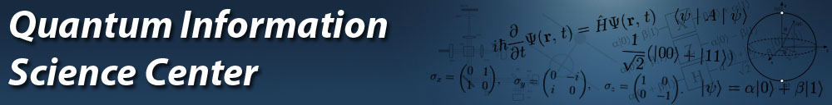
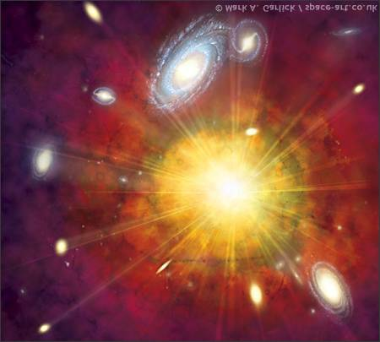
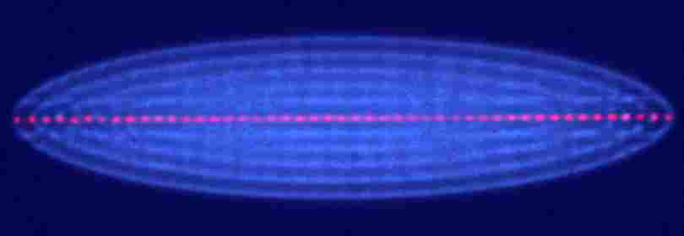

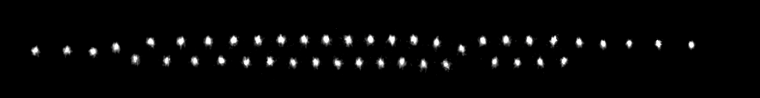
Quantum Simulation of the Haldane Phase
19.12.2013
HUJI
Alex Retzker
Sussex
Quantum Simulations with Trapped Ions, 2013
Itsik Cohen
Accepted to PRL

Slide 2



MAGIC - Magnetic Gradient Induced Coupling
V
z
F. Mintert and C Wunderlich,
PRL 87, 257904 (2001);
Notes:
In this slide I will describe the basic idea of error correction

Slide 3
MAGIC - Magnetic Gradient Induced Coupling
MAGIC
F. Mintert and C Wunderlich,
PRL 87, 257904 (2001);
δ z
|1>
Use microwave instead of laser light
|0>
Notes:
In this slide I will describe the basic idea of error correction

Slide 4
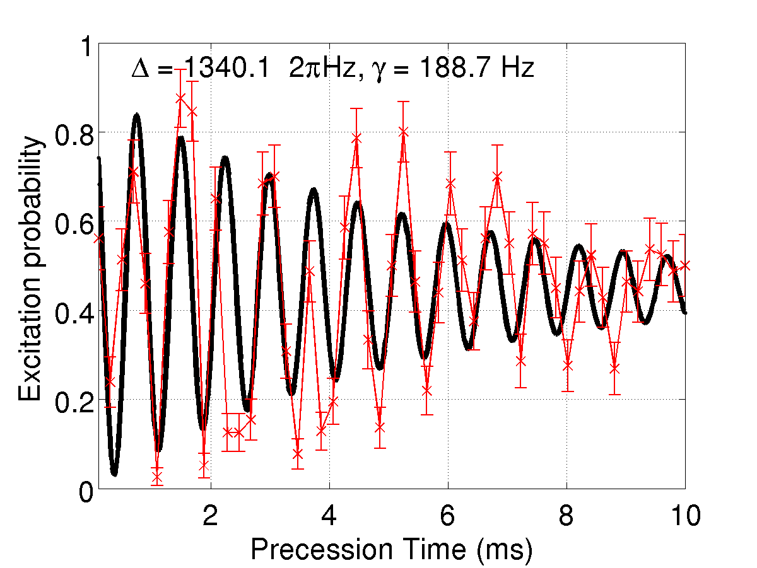
Short Qubit coherence time
Ramsey experiment
T ≈ 5 ms
m_{F}=0
m_{F}=+1
F=1
m_{F}=-1
F=0
m_{F}=0
Notes:
In this slide I will describe the basic idea of error correction

Slide 5
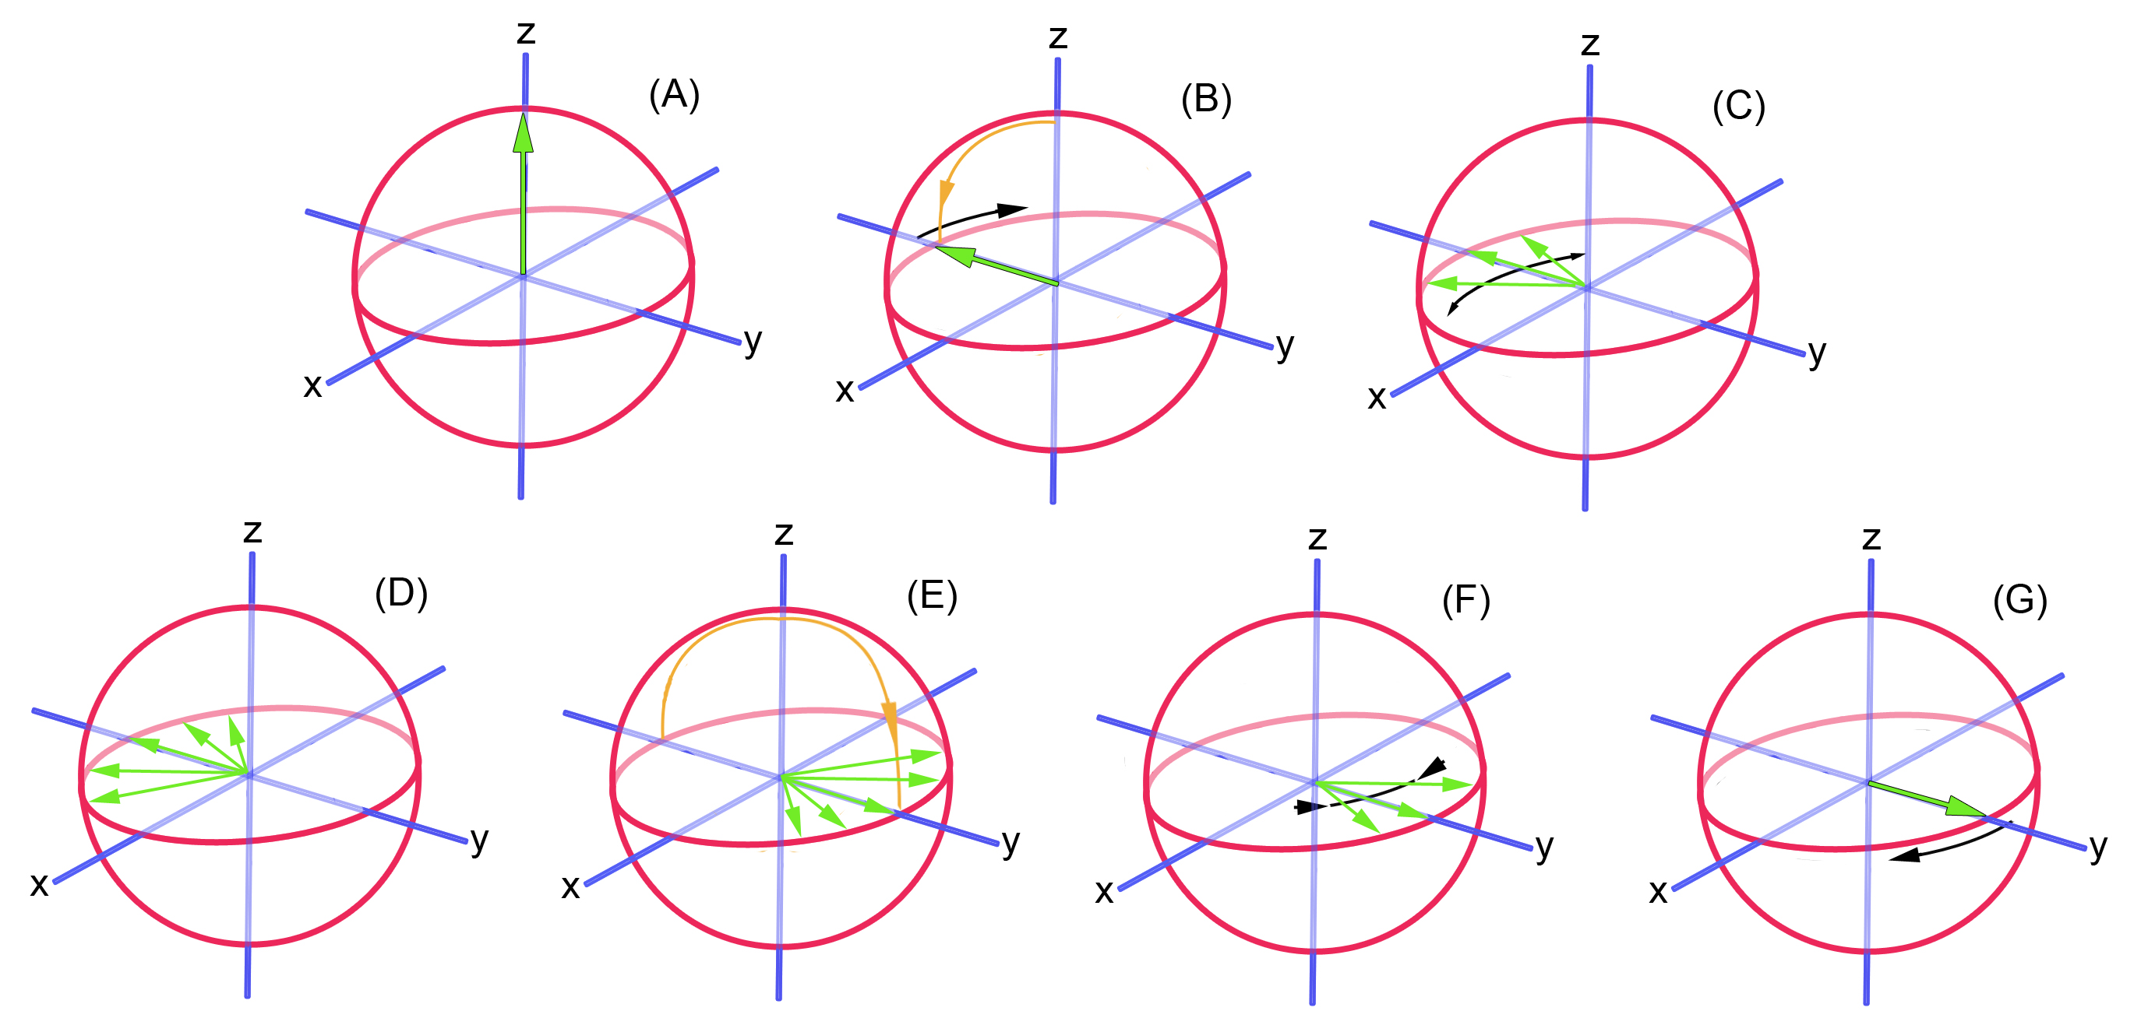
Hahn Echo:

Slide 6
Background
Carr Purcell – CP
Spin echo decay
A sequence of echos, i.e., of π pulses focuses the polarization for a long time
z
y
x
Sussex I 19.12.2013 I Folie: 6
Notes:
Hahn echo

Slide 7
Carr Purcell – CP:
Spin echo decay
A sequence of echos, i.e., of π pulses focuses the polarization for a long time
z
z
y
y
2 δΦ
π+δΦ
x
x
Sussex I 19.12.2013 I Folie: 7
Notes:
Hahn echo

Slide 8
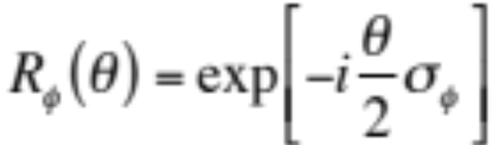
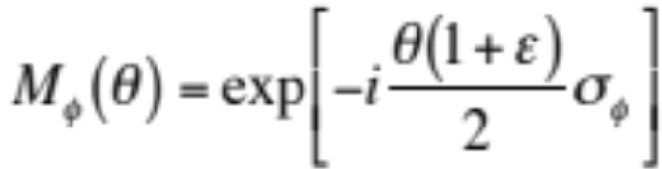

Composite pulses
z
Goal:
Real pulse:
y
x
but:
And now we can use the Suzuki Trotter decomposition
Torosov & Vitanov, PRA 87, 043418 (2013). Kyoseva & Vitanov arxiv:1310.7145.
Wang et al., arxiv: 1312.4523
The optimization is on operations not on memory but theoretically the difference is very small.
Kenneth R. Brown, Aram W. Harrow, and Isaac L. Chuang, PRA 70, 052318 (2004)
Sussex I 19.12.2013 I Folie: 8
Notes:
Hahn echo

Slide 9
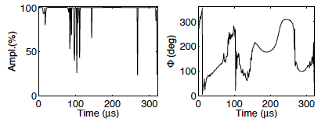
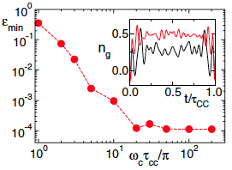
Coherent control
Timoney et, al., 2007
Montangero et,. Al. PRL 99, 170501 (2007)
Sussex I 19.12.2013 I Folie: 9
Notes:
Hahn echo

Slide 10
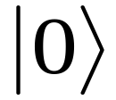
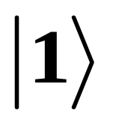
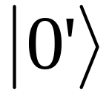
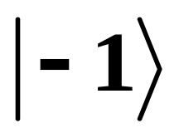
Search for a stable qubit
No dephasing but no coupling
Can we somehow construct two ‘good’ qubit levels?
Coupled but strongly dephased
Sussex I 19.12.2013 I Folie: 10
Notes:
Hahn echo

Slide 11







Dynamical Decoupling: take I
Flipping(T1) Rate:
Dephasing(T2) Rate:
Dephasing(T2) Rate:
+second order B effects
Sussex I 19.12.2013 I Folie: 11
Notes:
Hahn echo

Slide 12












Dynamical Decoupling: take II
Flipping(T1) Rate:
+ Relative phase fluctuations
Dephasing(T2) Rate:
+second order B effects
Sussex I 19.12.2013 I Folie: 12
Notes:
Hahn echo

Slide 13
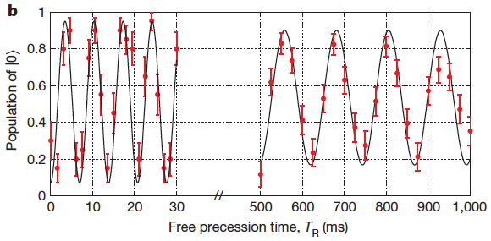
Ramsey measurement results
N. Timoney, I. Baumgart, M. Johanning, A. F. Varon, M. B. Plenio, A. Retzker & Ch. Wunderlich. Nature 476 (2011)

Slide 14
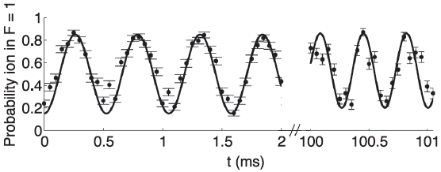
Rabi Oscillation of the Sussex group
S. C. Webster, S. Weidt, K. Lake, J. J. McLoughlin, and W. K. Hensinger. PRL 111, 140501 (2013)

Slide 15
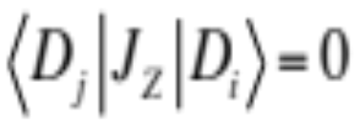
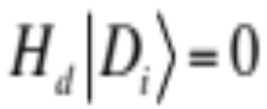
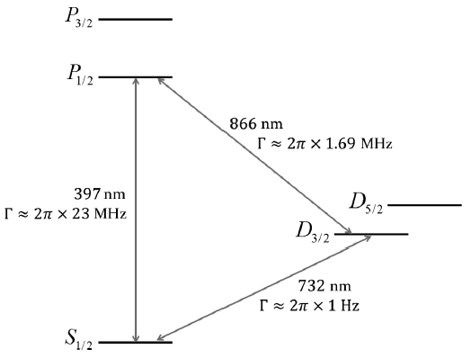
Generalisation to N levels
Robustness to external noise
General conditions:
for each i,j
Robustness to control noise
for each i
Level structure of the calcium ion.
N. Aharon, M. Drewsen, and A. Retzker, PRL 111, 230507 (2013)

Slide 16
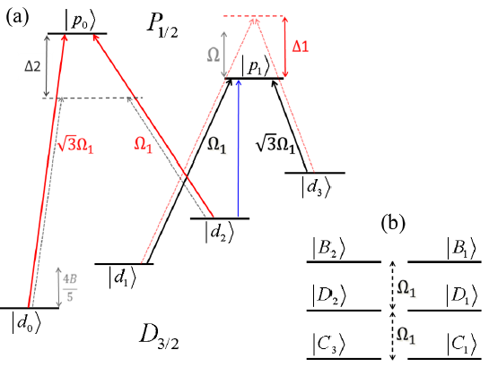
Generalisation to N levels
N. Aharon, M. Drewsen, and A. Retzker, PRL 111, 230507 (2013)

Slide 17
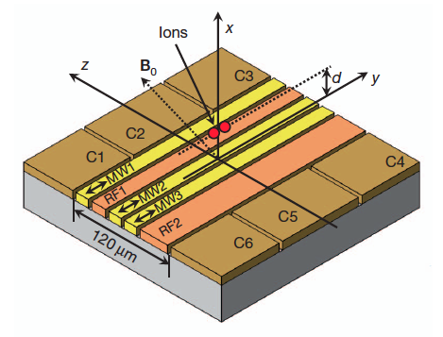
The Boulder Scheme
C. Ospelkaus, et. al., PRL 101, 090502 (2008)
C. Ospelkaus, et. al., Nature 476, 181 (2011)
Notes:
In this slide I will describe the basic idea of error correction

Slide 18
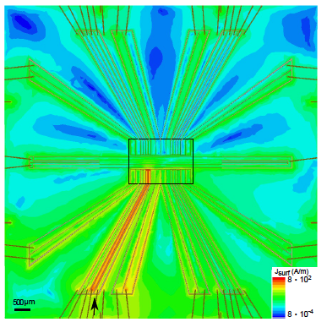
Oxford group
D.P.L Aude Craik, et al., arxiv: 1308.2078
Notes:
In this slide I will describe the basic idea of error correction

Slide 19
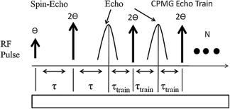
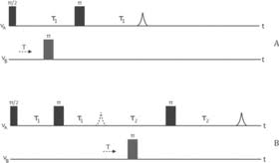
Magnetometry
locking the signal to the frequency of the pulses(Rabi frequency)
Kotler et al., Nature, 473 (2011)
Notes:
In this slide I will describe the basic idea of error correction

Slide 20
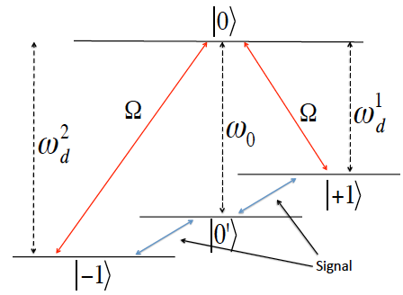
Magnetometry
locking to the frequency and not the Rabi frequency
I. Baumgart, J.-M. Cai, A. Retzker, M. Plenio, and Ch. Wunderlich, In preparation
Notes:
In this slide I will describe the basic idea of error correction

Slide 21
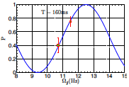
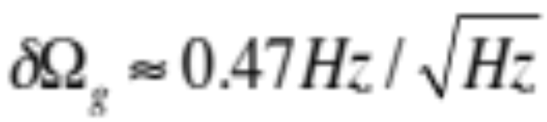
Magnetometry
I. Baumgart, J.-M. Cai, A. Retzker, M. Plenio, and Ch. Wunderlich, In preparation
Notes:
In this slide I will describe the basic idea of error correction

Slide 22
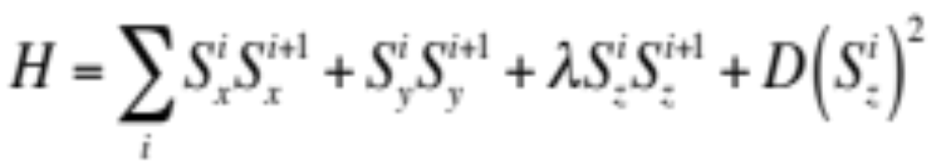

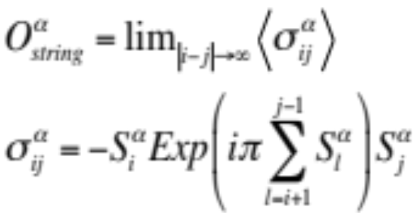
The Haldane Phase in the S=1 XXZ Antiferromagnetic chain
Flip flops
Neel Order
Invariant under global rotations around z and global spin flips

Slide 23
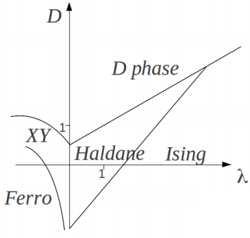
The Haldane Phase in the S=1 XXZ Antiferromagnetic chain
Finite energy gap, short range correlations. (Haldane, 1983)
Nonlocal string order parameter (Tasaki and Kennedy, 1987)
Symmetry protected double-degeneracy of the entanglement spectrum (Pollmann et at., 2010)

Slide 24
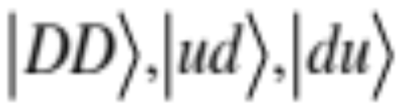
Spin degrees of freedom
This setup only kills external magnetic noise, but is not robust to power fluctuations
We have to work in a decoherence free subspace
The decoherence free subspace:

Slide 25
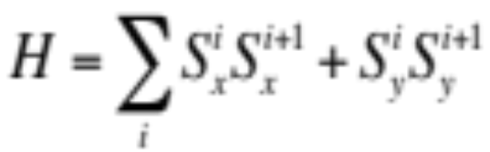

The
term
Analogous to a red/blue sidband interaction
Flip flops will happend automatically if we start in the DFS

Slide 26

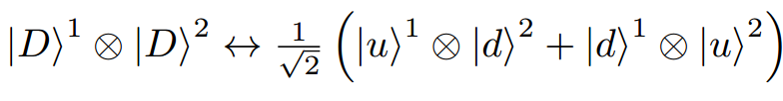
Two-qubit gate
almost:
Gets into a fully entangled state in the middle; Schmidt number 3

Slide 27
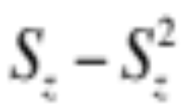
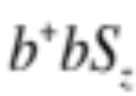
The effective Hamiltonian – single qubit
For zero temperature
Has no effect
For a thermal state
Has no effect

Slide 28


The effective Hamiltonian – two qubit
Virtual phonon

Slide 29
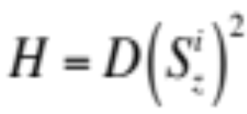
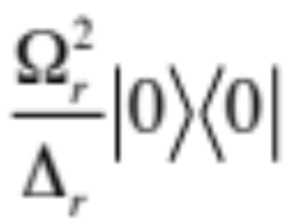


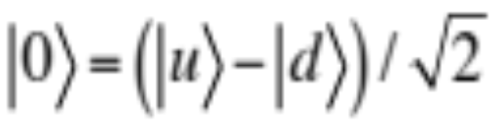
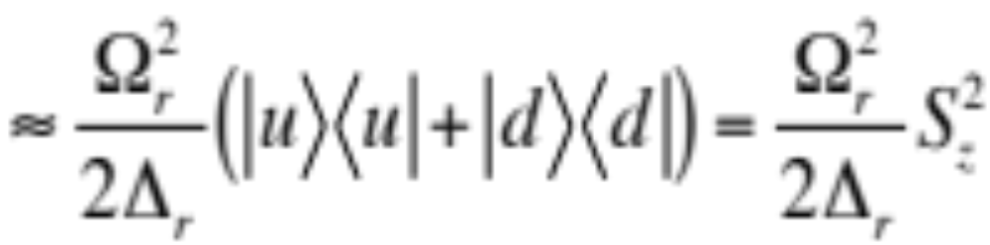
The effective Hamiltonian – the D term
Notes:
In this slide I will describe the basic idea of error correction

Slide 30
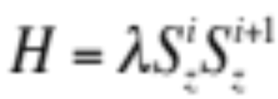
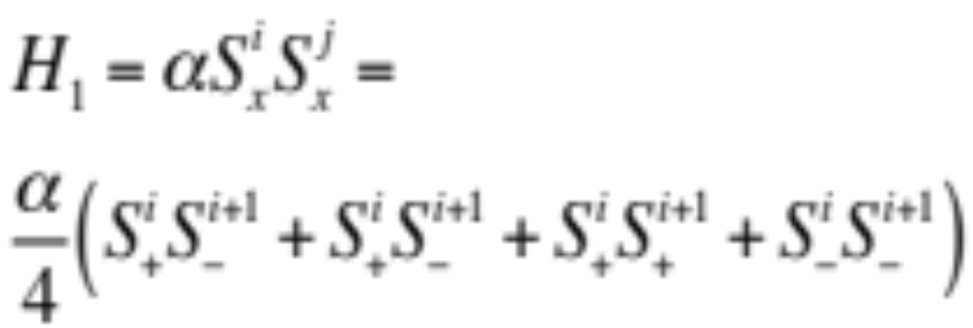
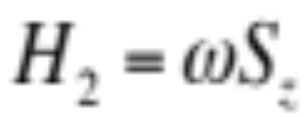
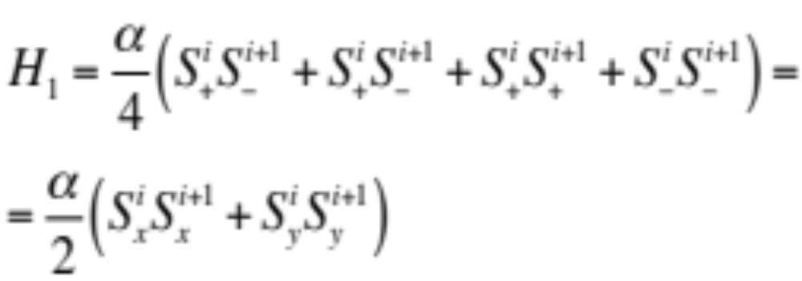
The effective Hamiltonian – the λ term
By adding a term of the form:
Notes:
In this slide I will describe the basic idea of error correction

Slide 31
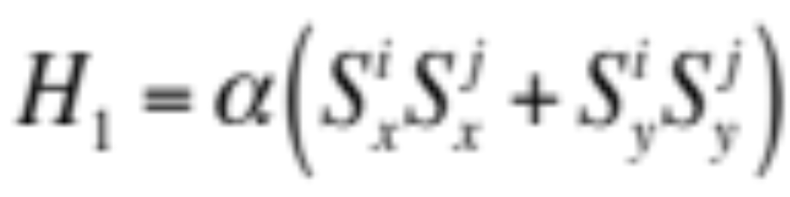
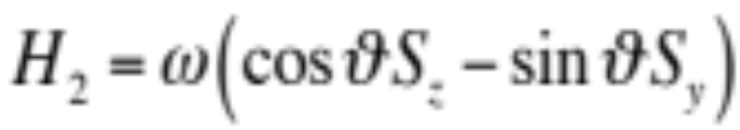
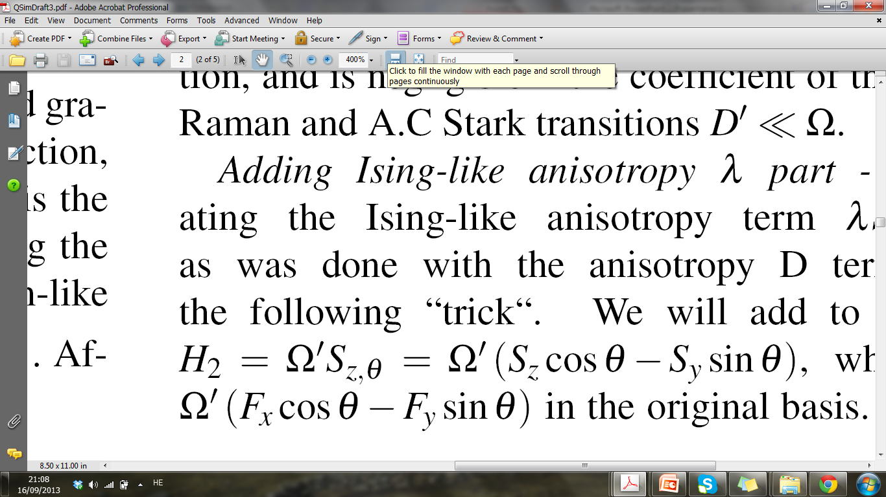

The effective Hamiltonian – the λ term
By adding a term of the form:
z
y
x
Notes:
In this slide I will describe the basic idea of error correction

Slide 32

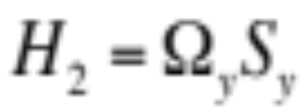


The effective Hamiltonian – the λ term
In the interaction picture
Notes:
In this slide I will describe the basic idea of error correction

Slide 33
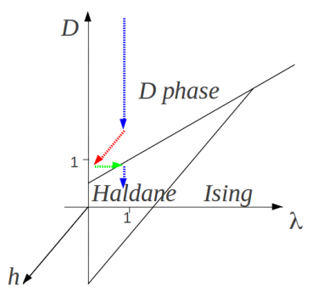
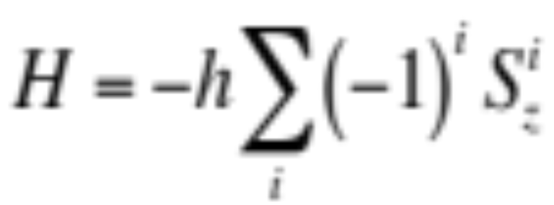
Reaching the Haldane phase
All the transitions are second order and thus hard to cross
To break the symmetries we add the term:
Notes:
In this slide I will describe the basic idea of error correction

Slide 34

Detecting the Haldane phase
1) String order:
2) Double degenrate entanglement spectrum
3) Gap and exponentialy decaying correlation function
Notes:
In this slide I will describe the basic idea of error correction

Slide 35
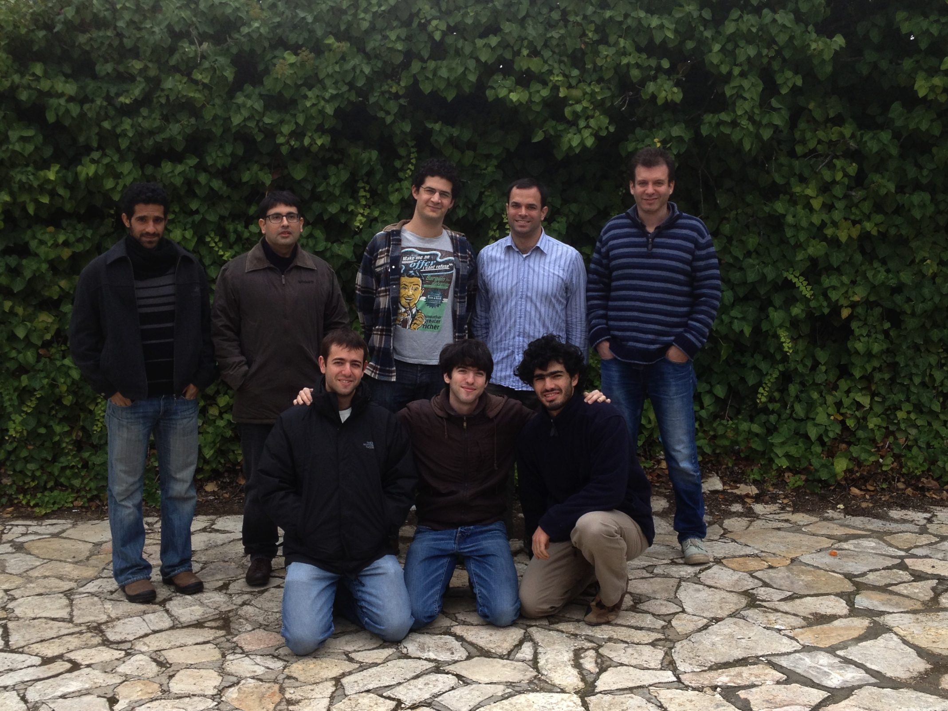

Thanks a lot for your attention!
Open postdoc and PhD positions
ISF
CIG
Career integration grant

