Slide 1
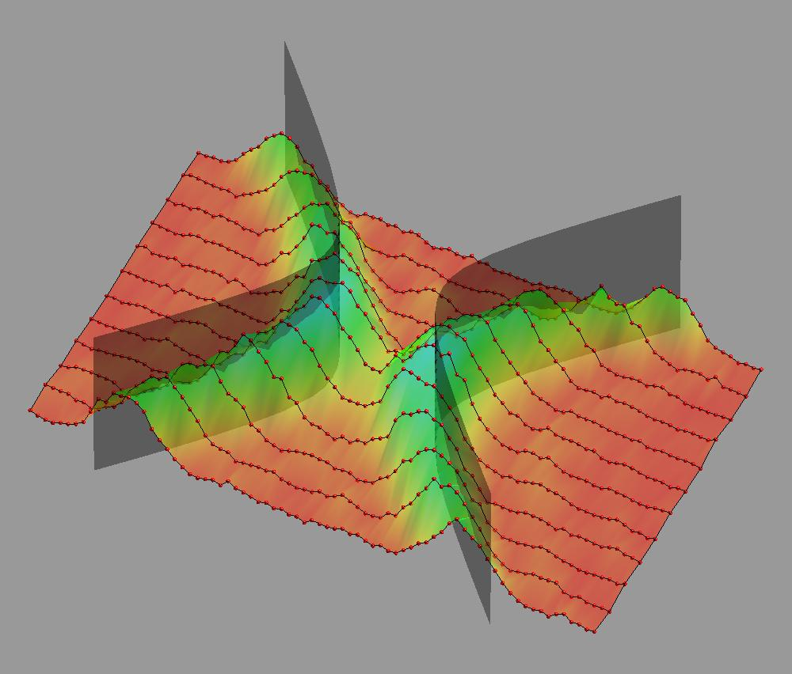



Quantum simulation with trapped ions at NIST
Dietrich Leibfried
NIST Ion Storage Group

Slide 2
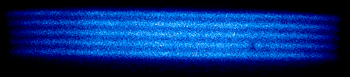
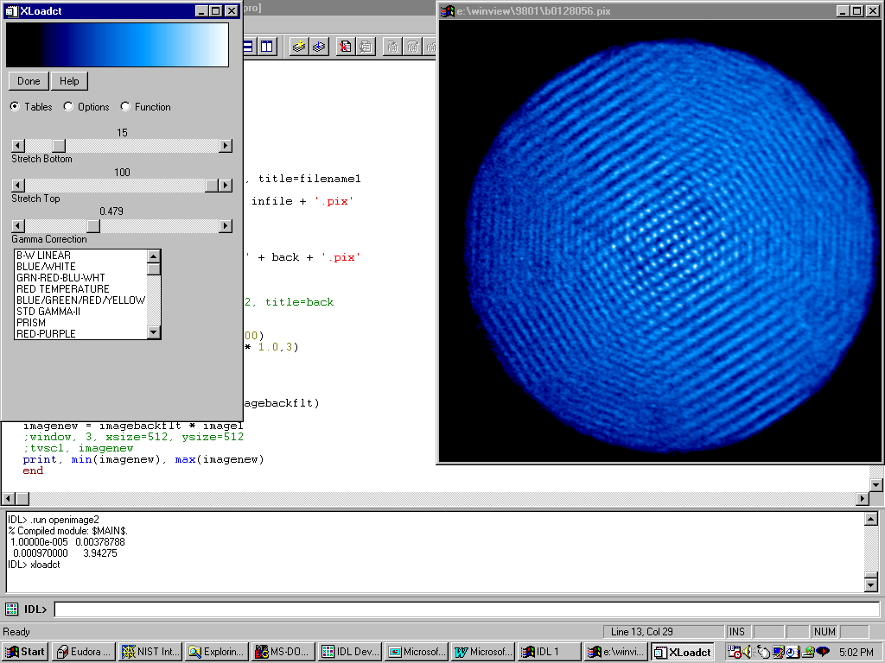
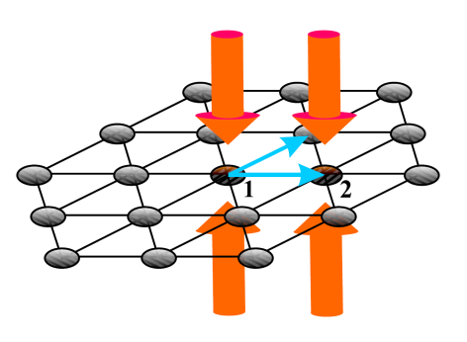
NIST Penning trap
(J. Bollinger, B. Saywer, J. Britton)
side view
CCD camera
side view
see Mike Biercuk’s talk
vacuum enclosure
B
top view
top view
CCD camera
ca. 4500 trapped and laser cooled ions:
electronic wave-function 0.1 nm
motional wave-function 80 nm
ABAB plane stacking
in-plane spacing ca. 20 μm
Porras&Cirac, PRL 96, 250501 (2006)
radial
cooling beam
axial cooling beam

Slide 3
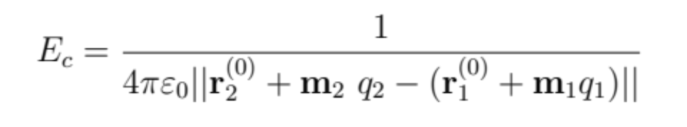
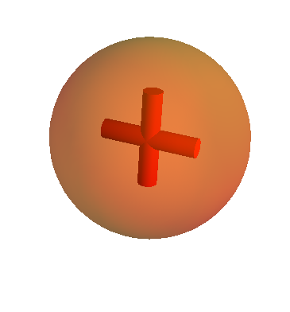
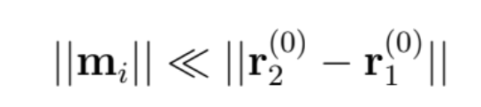
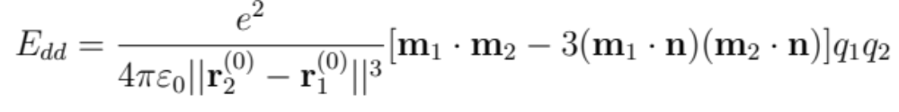
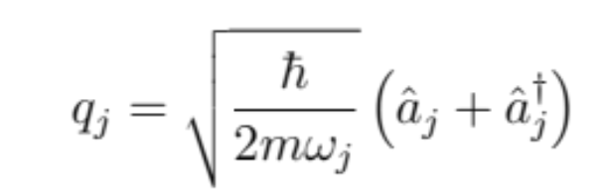
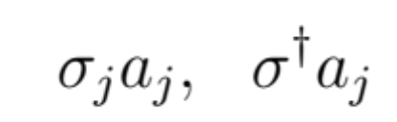
spin-spin interactions from Coulomb-coupling
Coulomb interaction:
m₁
m₂
n
r₁
r₂
for oscillating charges constitute two dipoles
quantum mechanically:
sidebands couple internal states to dipole:
BSB RSB

Slide 4
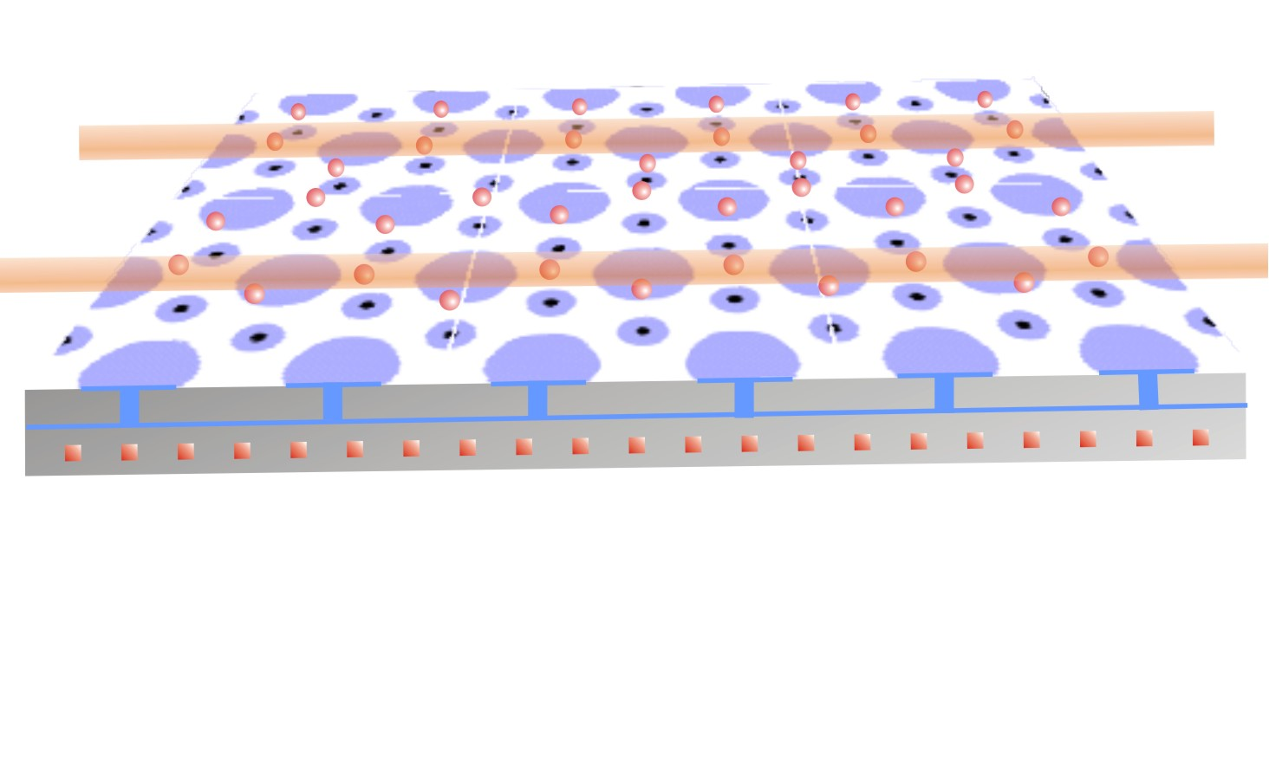
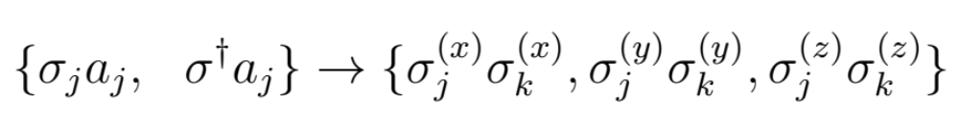
arbitrary 2D “spin”-lattice: bottom-up
2D lattice of ions, cooled and optically pumped by lasers
optimized surface electrode trap array
lasers/microwaves implement interactions (Sørensen Mølmer type+phase gates)
sidebands
gate interactions

Slide 5
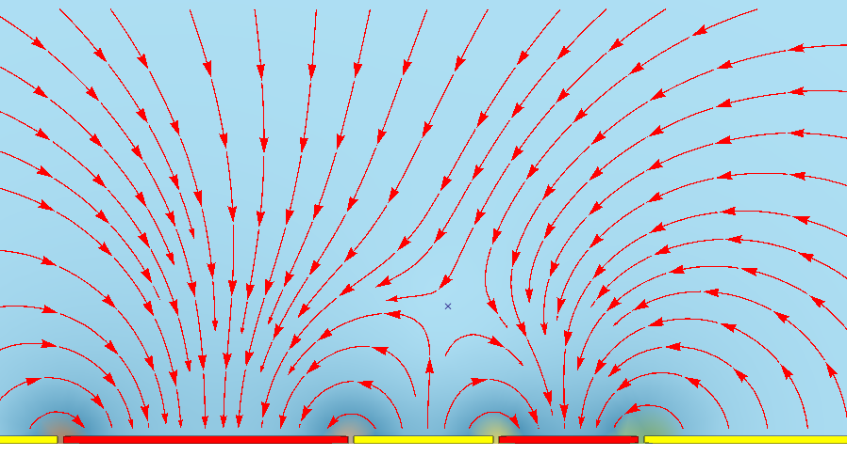
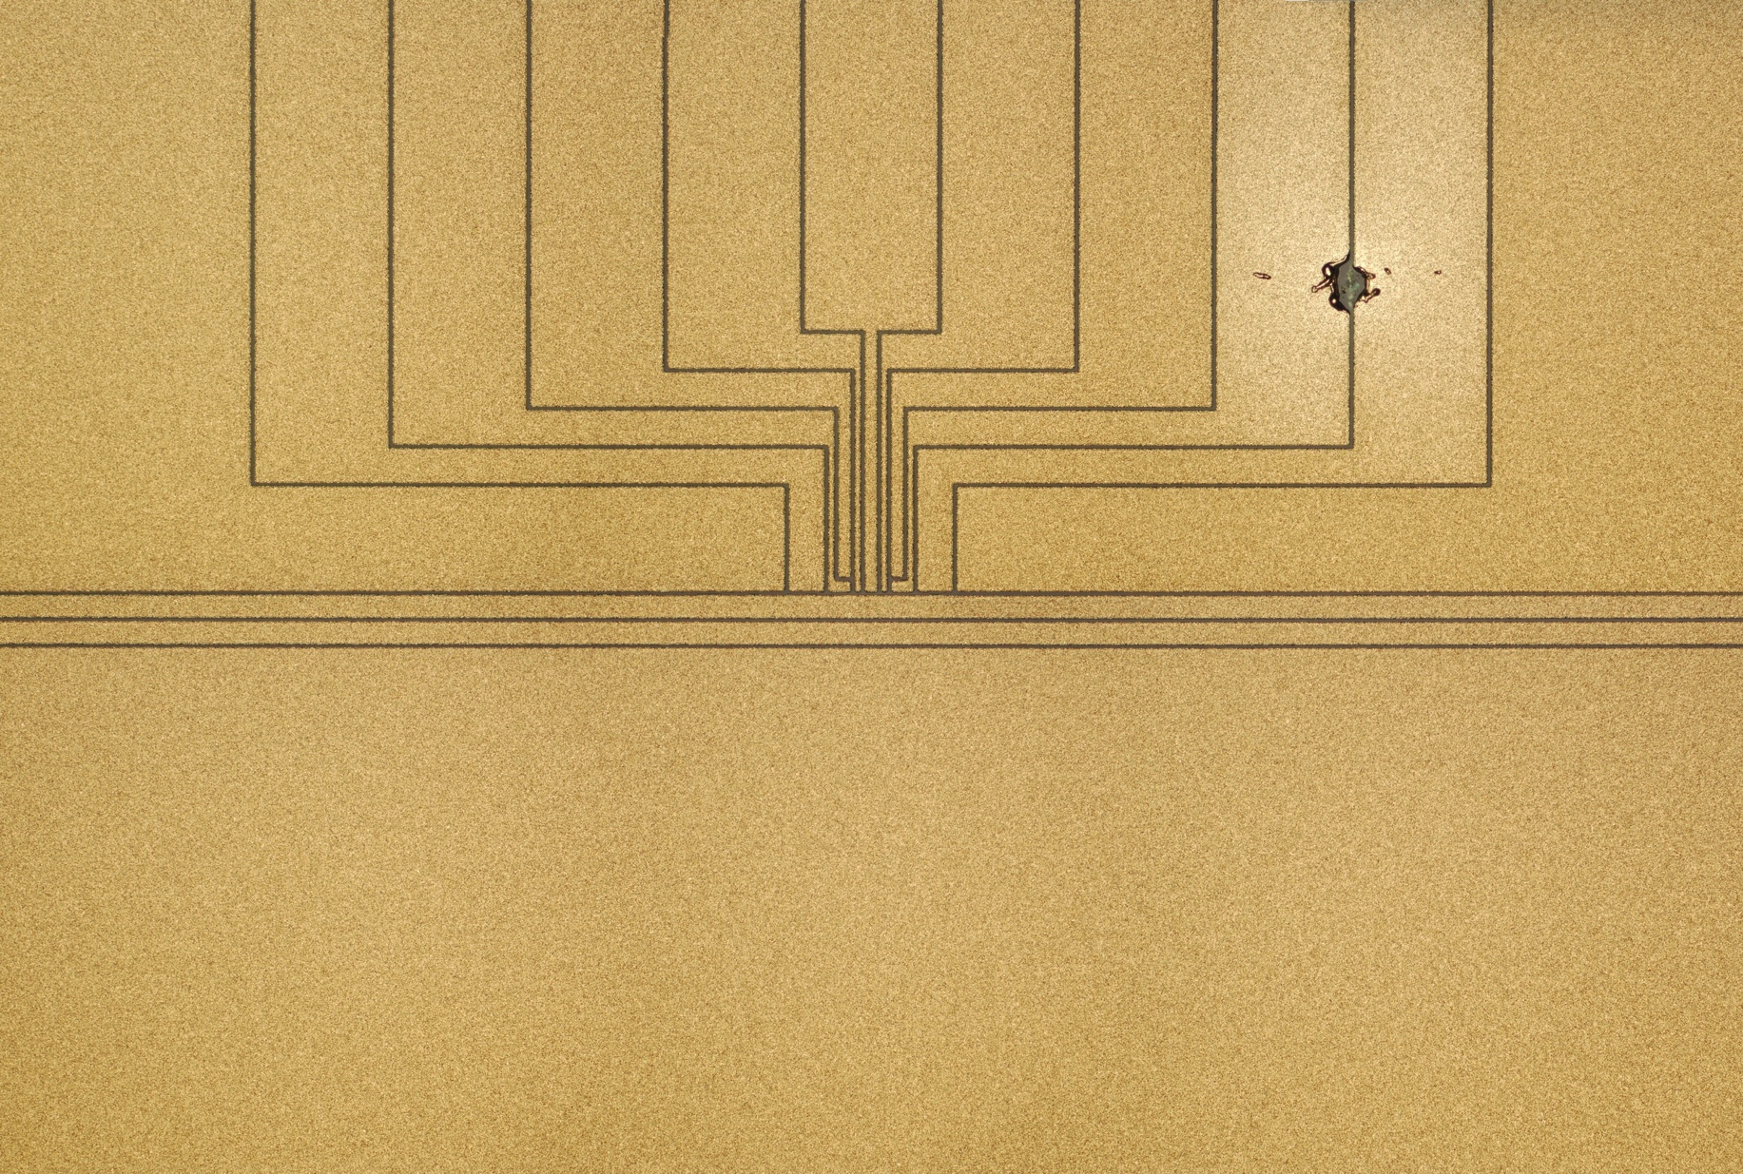
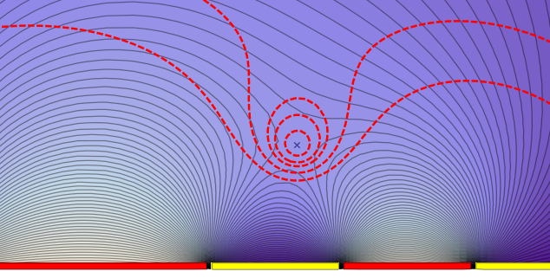
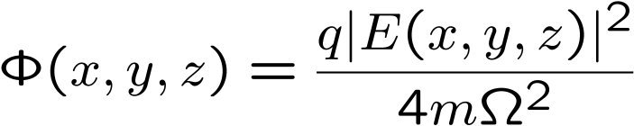
surface electrode trap basics
asymmetric 5 wire trap
radial confinement:
axial confinement:
electric field
electric potential
pseudo-potential
J. Chiaverini et al.,
Quant. Inform. Comp. 5, 419439 (2005)

Slide 6
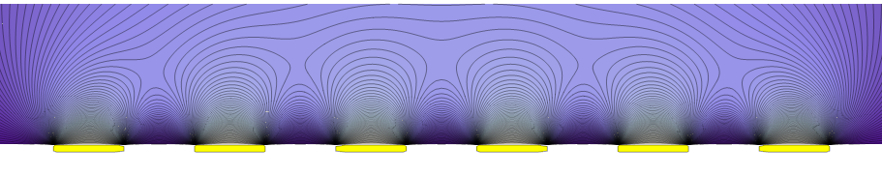
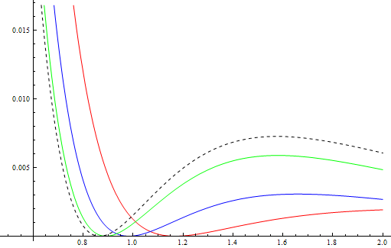
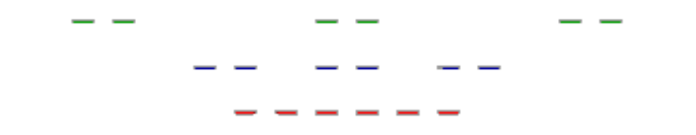
toy model array
3 infinitely long “5-wire” traps
add then square!
(dashed line: single 5 wire trap)
wire pairs move together
⇒
traps pushed up, depth vanishes
⇒
naïve approach will only work if
ion height << site distance
potential depth/ideal quadrupole
ion to surface distance

Slide 7
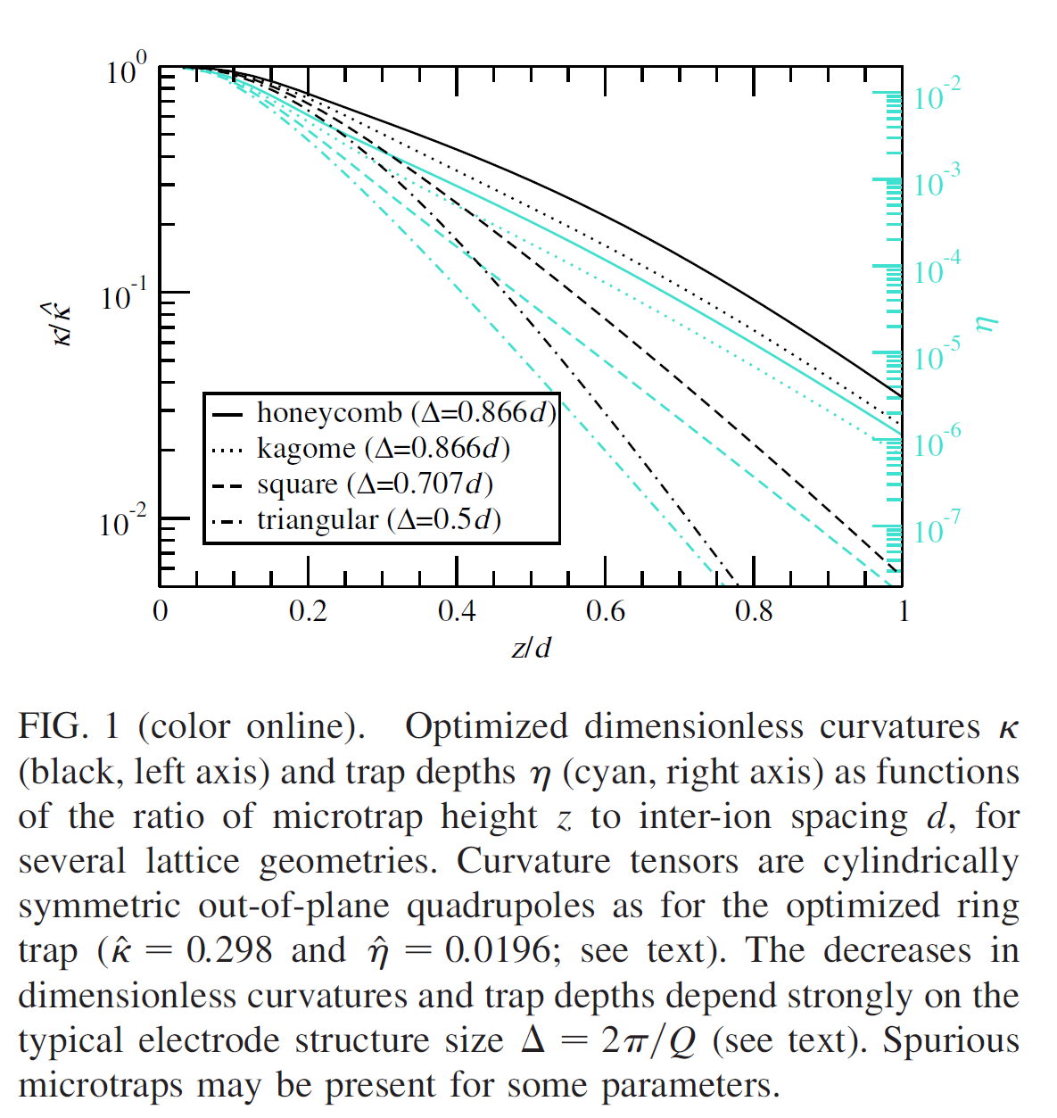
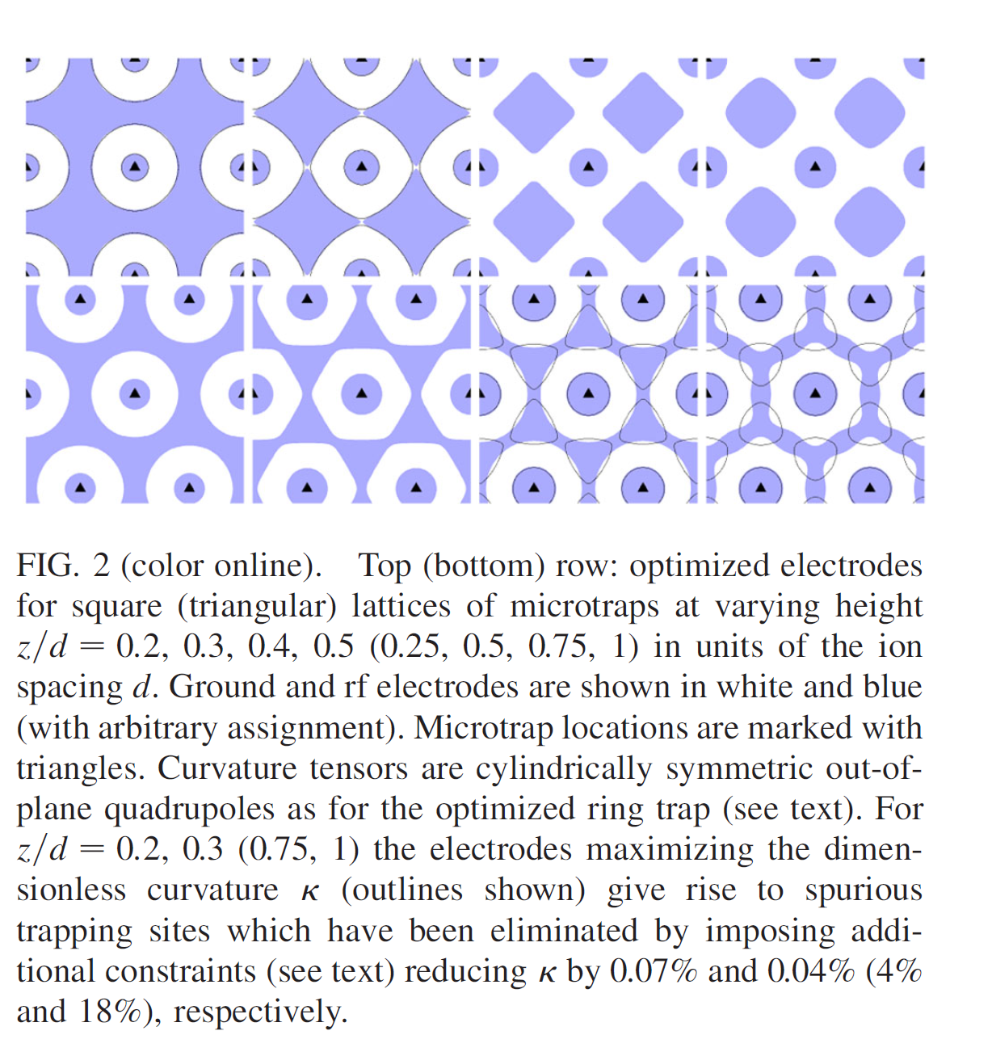
optimized array electrodes
(Schmied, Wesenberg, Leibfried, Phys. Rev. Lett. 102, 233002 (2009)
normalized to depth of ideal 3D-Paul trap and curvature of an optimal ring trap
J. H. Wesenberg, Phys. Rev. A 78, 063410 (2008)

Slide 8
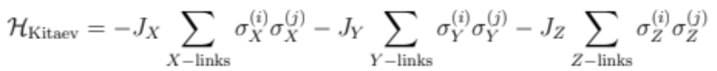
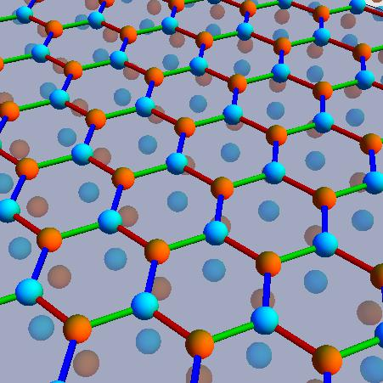
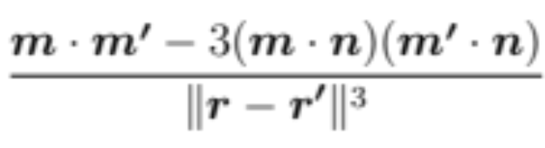
example model: hexagonal Kitaev
A. Kitaev, Anyons in an exactly solvable model and beyond, Annals of Physics 321, 2 (2006)
1 ion per site
dipole-dipole interaction
finite along blue
vanish along green/red
2 sub-lattices (cyan/orange)
electrode boundary conditions
σ^{x}σ^{x} (blue)
σ^{y}σ^{y} (green)
σ^{z}σ^{z} (red)

Slide 9
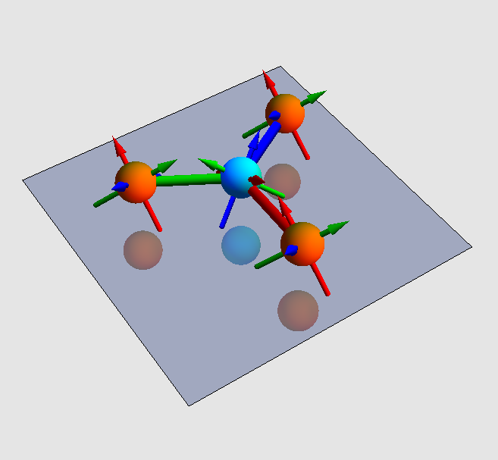
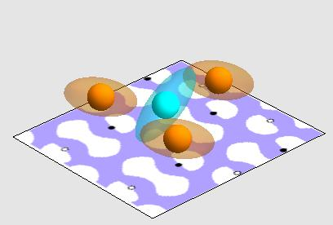
Kitaev implementation
1 ion per site
dipole-dipole interaction
along blue ≈ 1
along green/red ≈ 0.0025
2 sub-lattices (cyan/orange)
electrode shapes optimized
σ^{x}σ^{x} (blue)
σ^{y}σ^{y} (green)
σ^{z}σ^{z} (red)
rf
gnd
Schmied, Wesenberg, Leibfried, New J. Phys. 13, 115011 (2011)

Slide 10
towards implementation
experiments- the places theories go to die.
unknown physicist

Slide 11
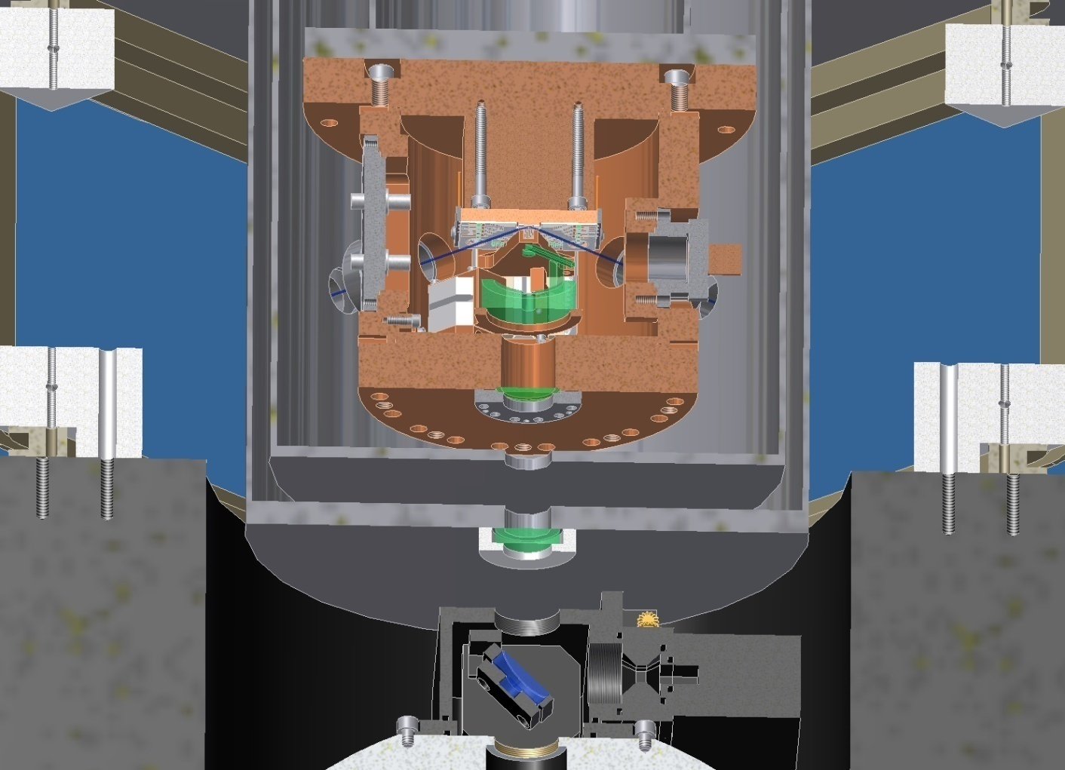
4K cryogenic ion trap apparatus
(built by K. Brown, C. Ospelkaus, M. Biercuk, A. Wilson)
LHe reservoir
radiation shield
ion trap
imaging optics
bakeable “pillbox” (internal vacuum system)
optical table with central hole
CCD and PMT
(outside vacuum)

Slide 12
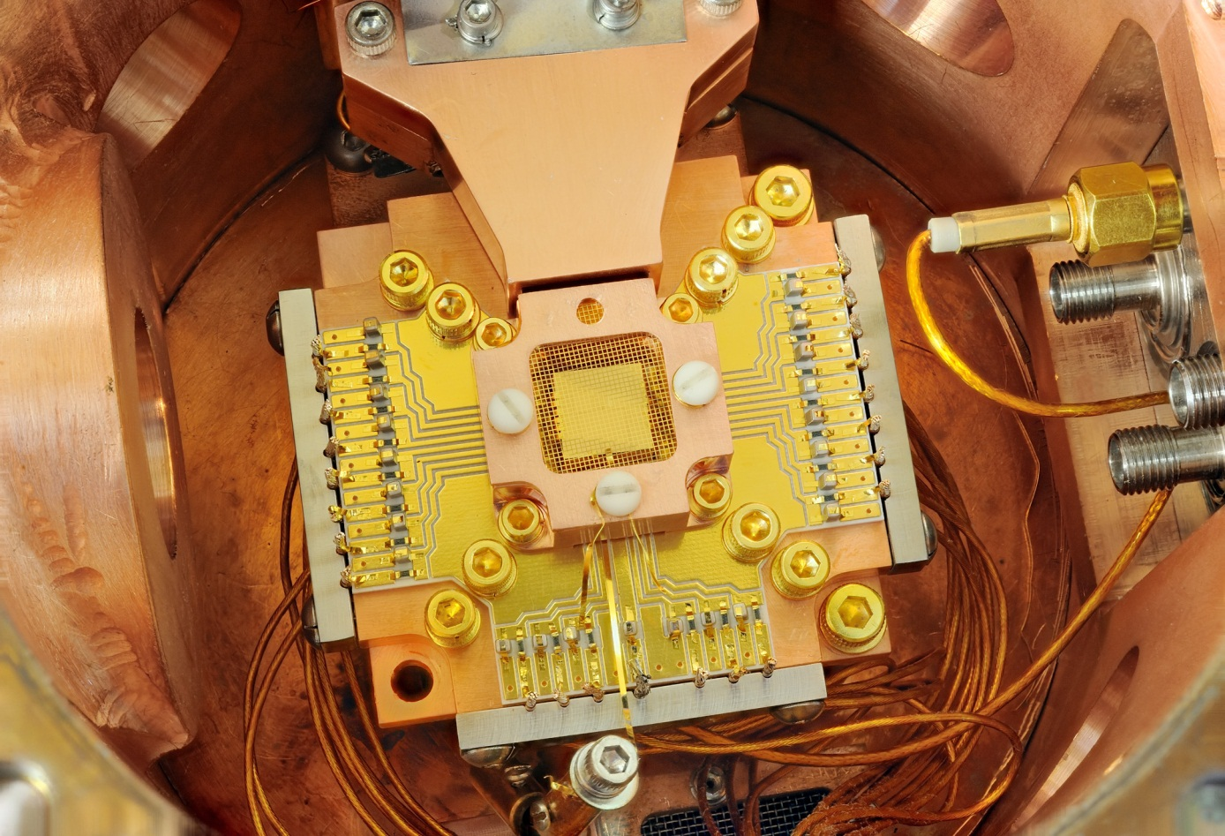
inside the copper pillbox
oven shield
filter board with low-passes
rf/microwave feedthroughs
90% transparent gold mesh
view from imaging direction, Schwarzschild objective removed
Notes:
12

Slide 13
multi-zone surface electrode trap
(K. Brown, Yves Colombe)
trap axis
center section of trap chip
≈ 10 μm gold on crystalline quartz
4.5 μm gap-width
Notes:
13

Slide 14
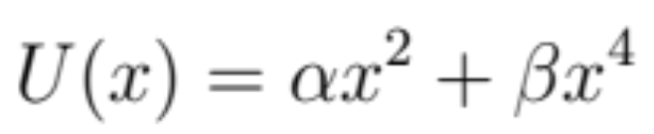
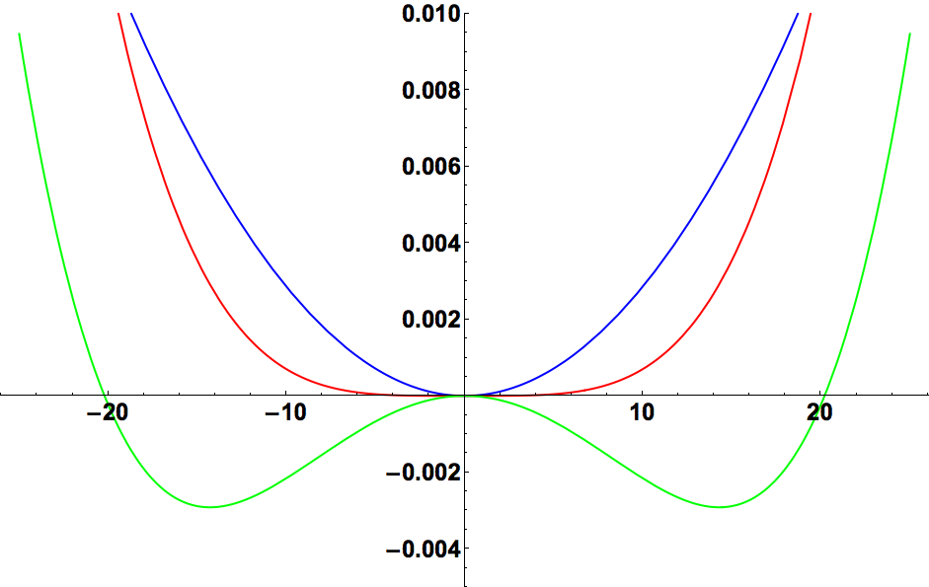
axial potentials
good approximation for all experiments:
a
α>0, β=0
α=0, β>0
α<0, β>0
potential/eV
distance from symmetry center/μm
Notes:
14

Slide 15
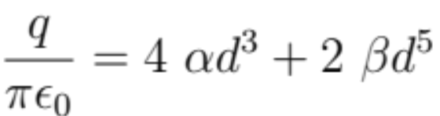
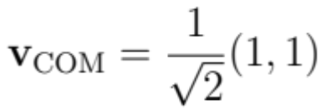
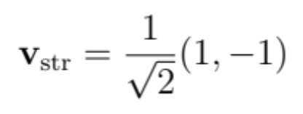
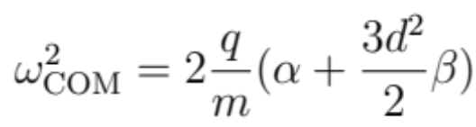
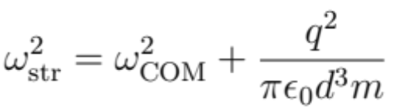
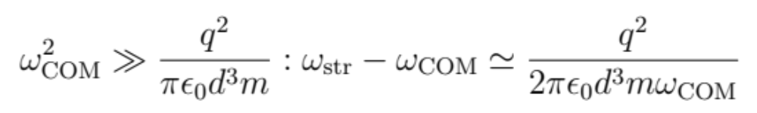

generalized normal modes
good approximation for all experiments:
generalized equilibrium condition:
(ion distance d)
generalized normal modes:
(small oscillations << d)
special cases:
α and β determine equilibrium distance and normal mode splitting
normal mode splitting given by (dipole-dipole) Coulomb-energy at distance d
fundamental character of oscillations independent of α and β
entangling gates can be implemented in the same way for all α and β
Notes:
15

Slide 16
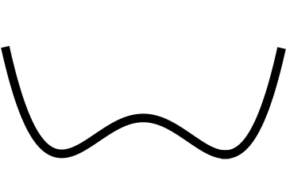
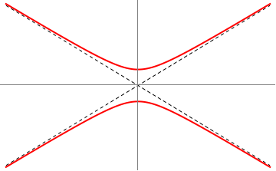
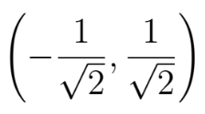




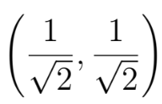
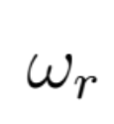
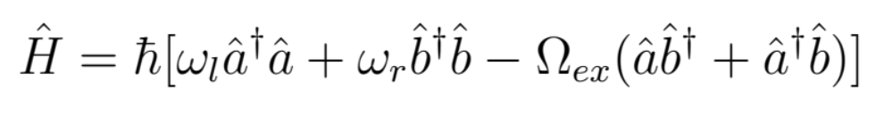
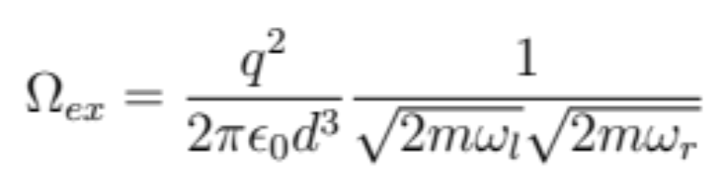
perturbed separate wells, avoided crossing of normal modes
example: homogenous electric field displaces ions in symmetric potential
exchange frequency

Slide 17
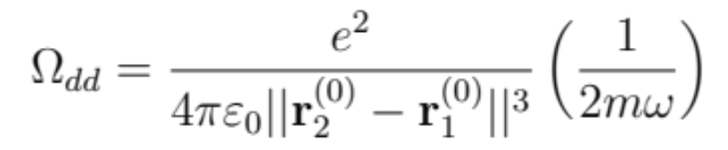
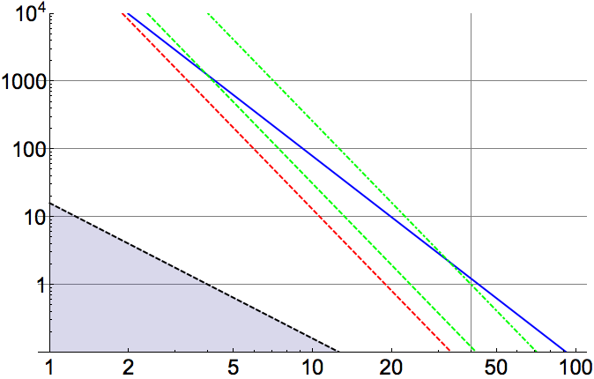
reality check: Coulomb vs. heating
array design rule:
ion-ion distance ≈ ion-surface distance
Ω_{dd} (Be⁺, 5 MHz ,40 μm dist.)
heating rate old trap chip
heating rate new trap chip
heating rate 300 K sputter-trap
Johnson noise slope (1/d²)
interaction or heating rate/kHz
Johnson noise varies widely with
filtering, electrode resistance
etc., line just to guide the eye
K. R. Brown et al.,
Nature 471, 196 (2011).
ion-ion or ion-surface distance/μm

Slide 18
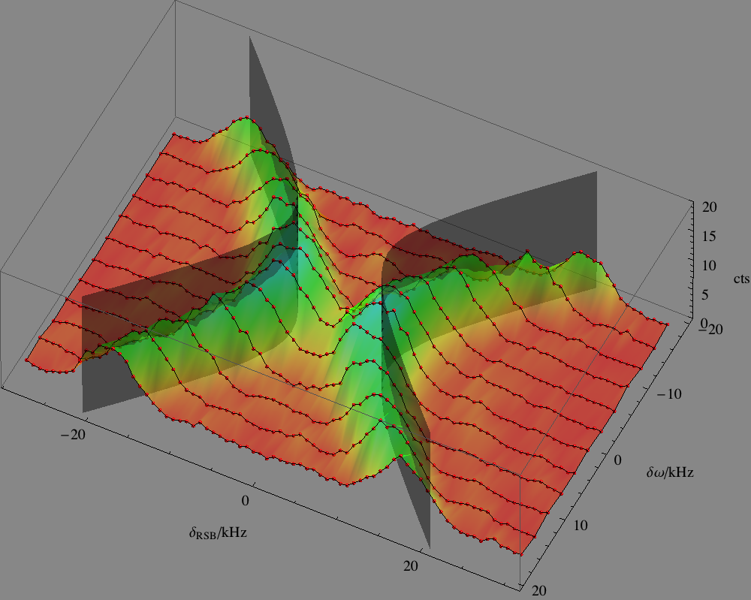
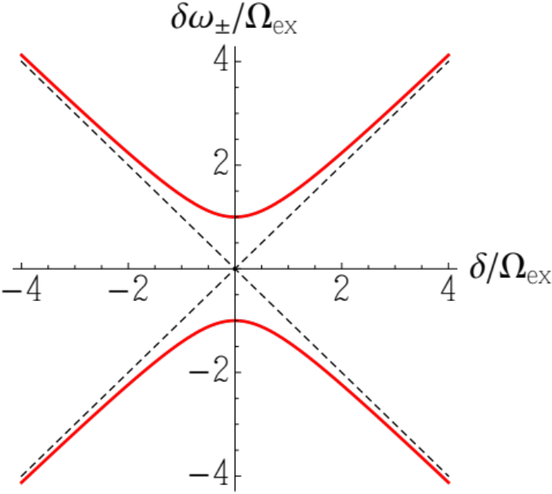

mapping the avoided crossing
experiment:
cool both ions to ground state
probe red sideband (RSB) spectrum for different well detuning
tune wells through resonance by changing potential curvatures (sub-mV tweaks)
8 kHz

Slide 19
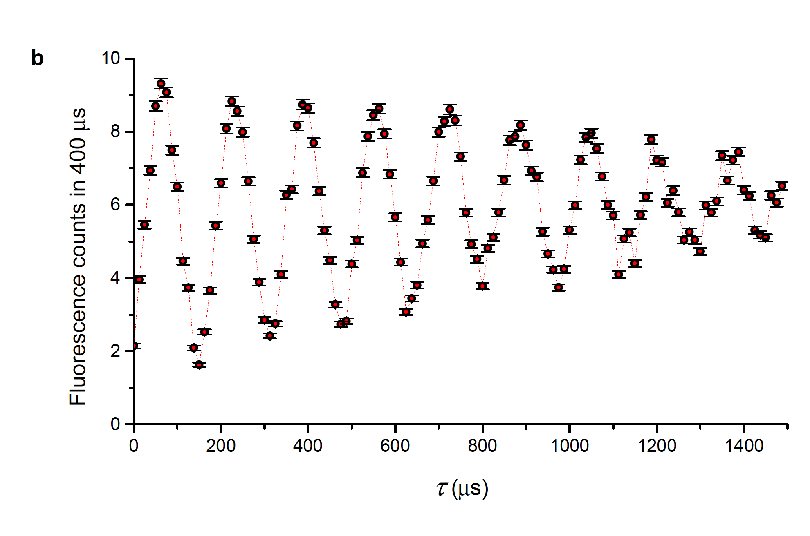
coupling on resonance
experiment:
cool both ions to ground state
insert one quantum of motion with BSB on right ion
attempt to extract quantum of motion after time on resonance
18+ quantum exchanges
T_{ex} = 80 μs
30 μm well separation
see also:
M. Harlander et al., Nature 471, 200 (2011)
K. R. Brown et al., Nature, 471, 196 (2011)

Slide 20



single sideband gate
α > 0, β=0: “conventional” two-ion gate
in single well:
single sideband gate
strong Carrier
(laser or microwave)
single Sideband
detuning close to one mode
δ
α<0, β>0: “double well” two-ion gate:
Bermudez et al., Phys. Rev. A 85, 040302 (2012)
analogous proposals for cavity QED
E. Solano et al., PRL 90, 027903 (2003)
S. B. Zheng, PRA 66, 060302R (2002)
carrier and motional frequency fluctuations suppressed
carrier phase not relevant (if constant over gate duration)
full microwave implementation possible
detuning between modes
adds phase space areas
δ
δ
arbitrary confining α, β analogously

Slide 21
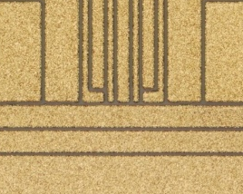

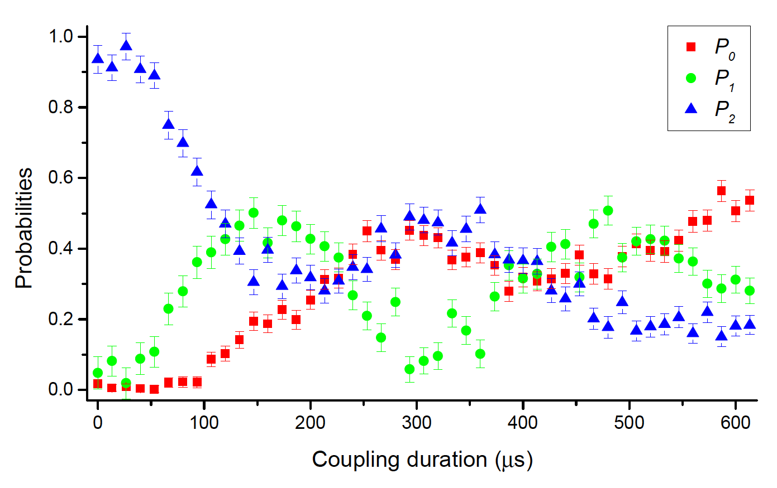

gate over coupled wells
(A. Wilson, Y. Colombe et al.)
two ⁹Be⁺ ions in separate wells
cryogenic surface trap at 4 K
ν_{COM}=4.13 MHz; mode splitting 8 kHz
COM heating: dn/dt= 200 quanta/s
Str heating: dn/dt = 200 quanta/s
single sideband gate on both modes
entangled state fidelity: 81%
30 μm
populations: 91%
parity visibility: 73%
leading sources of imperfection:
double well stability: ≈ 6%
beam pointing/power fluct. ≈3%
state preparation/detection: ≈3%
spontaneous emission: ≈2%

Slide 22

NIST ion storage group
(March 2013)
David Allcock (postdoc, Oxford)
Jim Bergquist
John Bollinger
Ryan Bowler (grad student, CU)
Sam Brewer (postdoc, NIST)
Joe Britton (postdoc, CU)
Kenton Brown (postdoc, now GTech)
Jwo-Sy Chen (grad student CU)
Yves Colombe (postdoc, ENS Paris)
Shon Cook (postdoc, CSU)
John Gaebler (postdoc, JILA)
Robert Jördens (postdoc, ETH Zuerich)
John Jost (postdoc, now ETH Lausanne)
Manny Knill (NIST, computer science)
Dietrich Leibfried
David Leibrandt
Yiheng Lin (grad student, CU)
Katy McCormick (grad student, CU)
Christian Ospelkaus (postdoc, now Hannover)
Till Rosenband
Brian Sawyer (postdoc, JILA)
Daniel Slichter (postdoc, Berkeley)
Ting Rei Tan (grad student, CU)
Ulrich Warring (post-doc, U Heidelberg)
Andrew Wilson (post-postdoc, U Otago)
David Wineland

