Slide 1
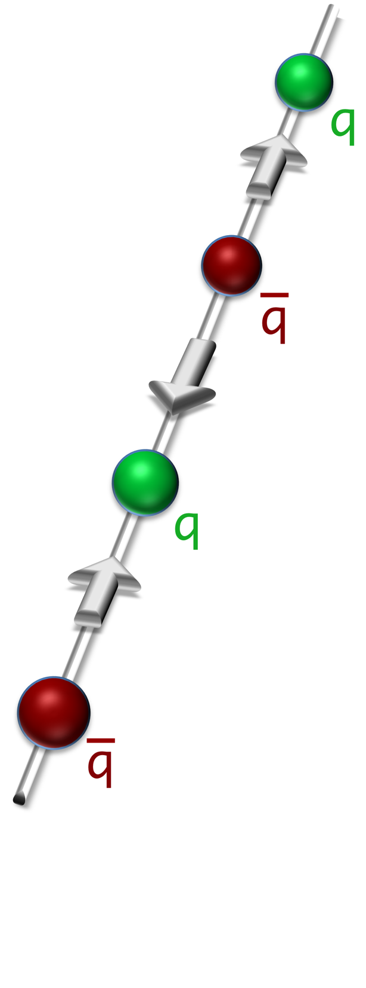
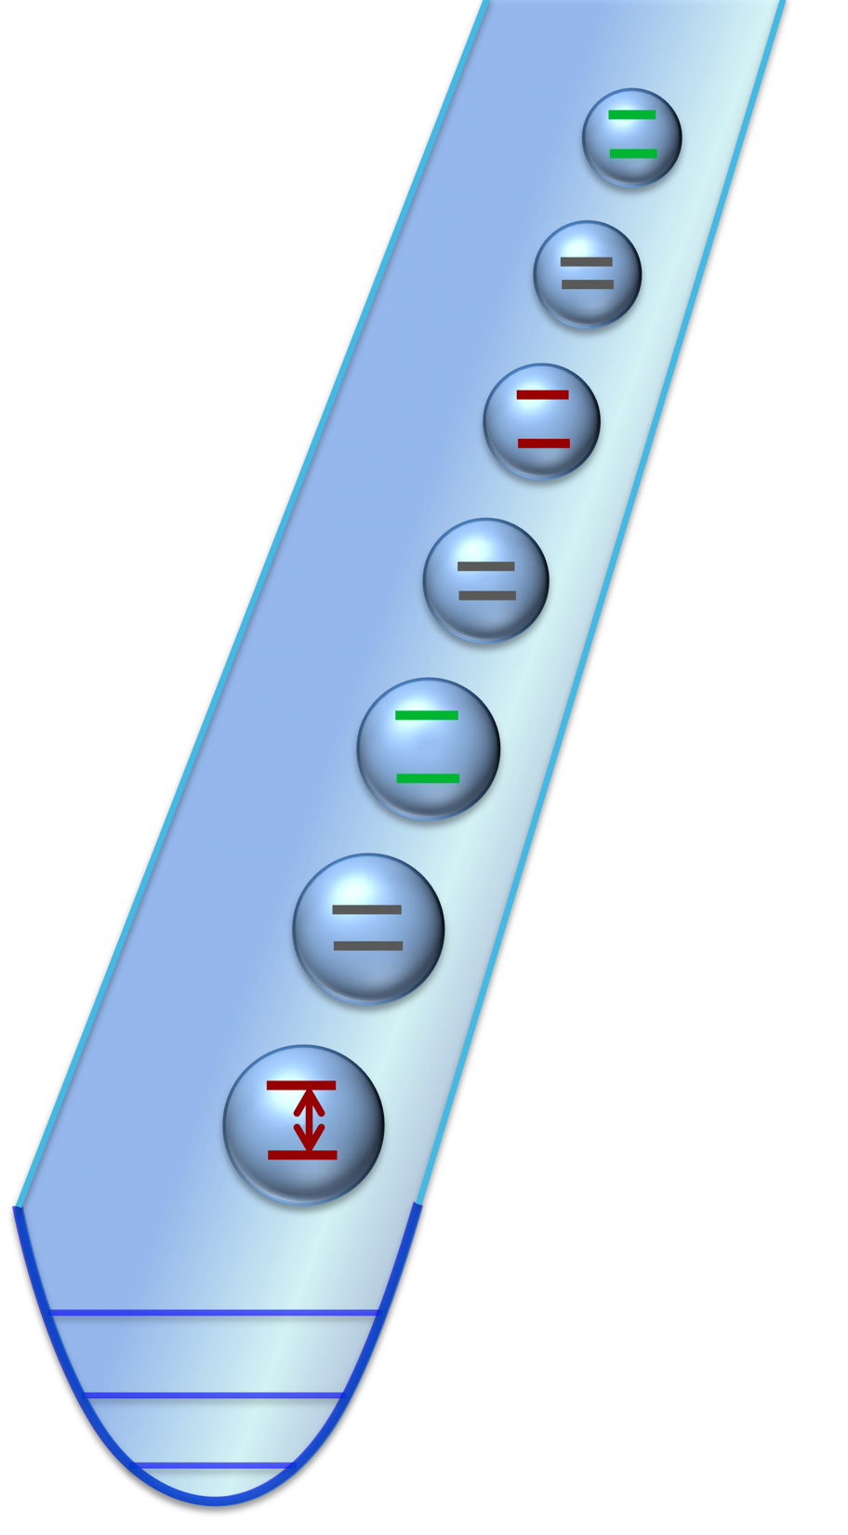
of a 1D lattice gauge theory
Quantum simulation
with
trapped
ions
Philipp Hauke, David Marcos,
Marcello Dalmonte, Peter Zoller
(IQOQI, Innsbruck)
Phys. Rev. X 3, 041018 (2013)
Experimental input:
Christian Roos, Ben Lanyon, Christian Hempel, René Gerritsma, Rainer Blatt
Brighton, 18.12.2013

Slide 2
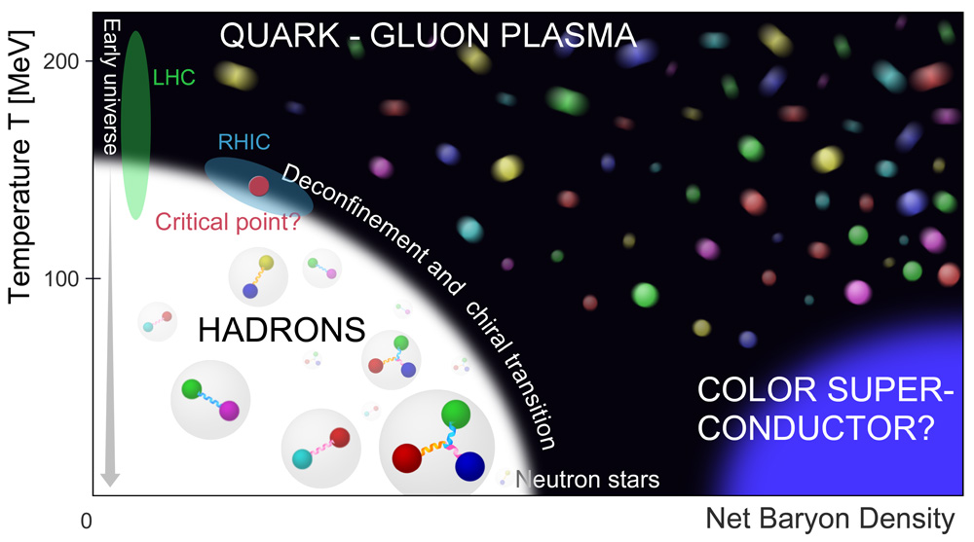
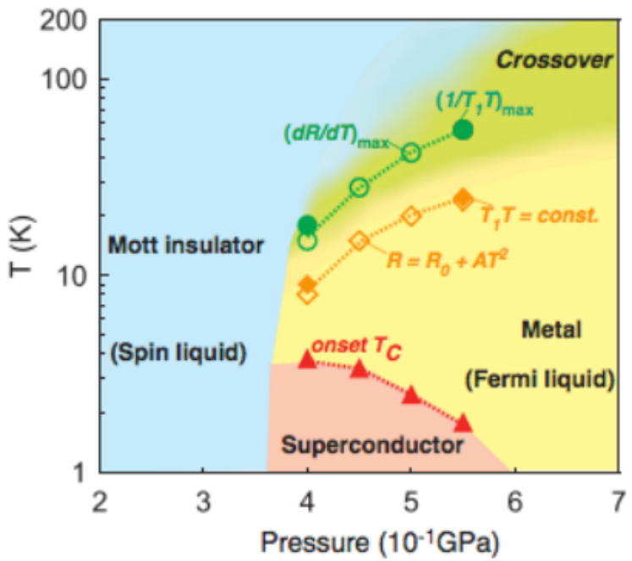
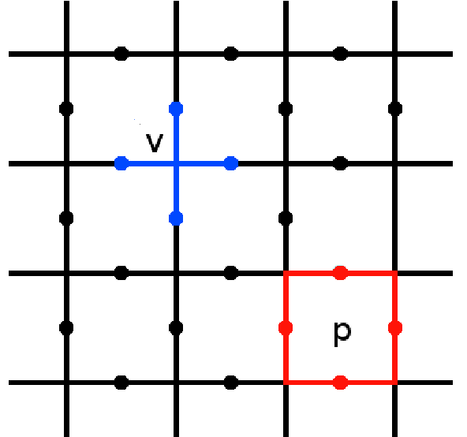

Gauge theories describe fundamental aspects of Nature
QCD
Spin liquids
Kitaev’s toric code
is a gauge theory

Slide 3
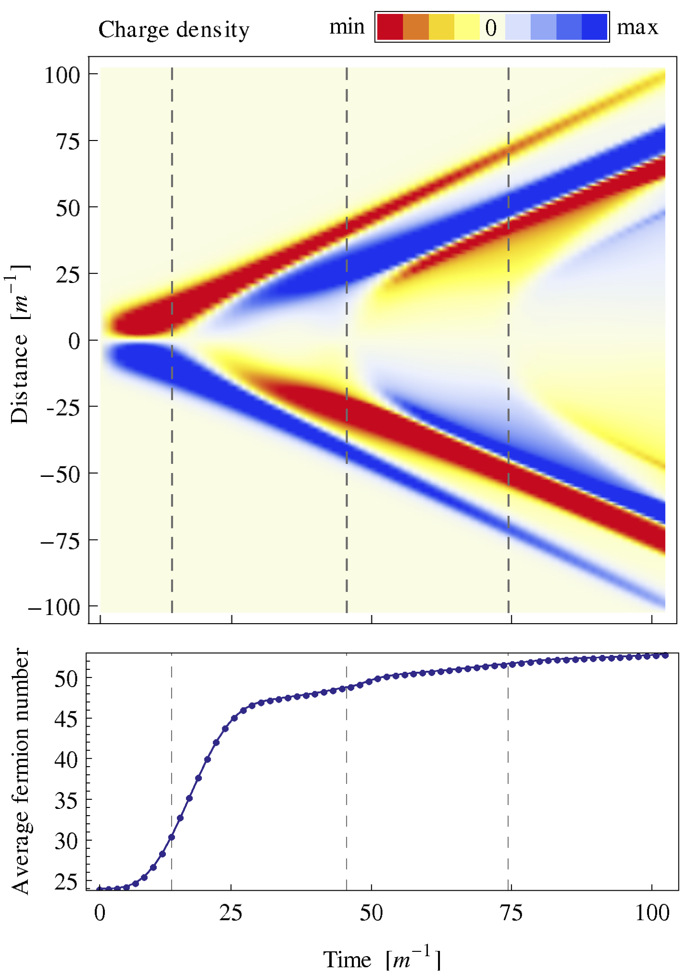
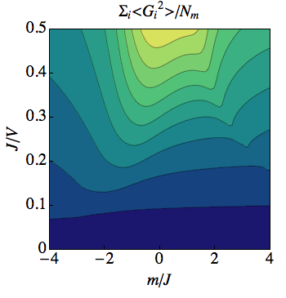
Outline
One dimensional quantum electrodynamics
Trapped-ion implementation
  Proposed scheme
  Numerical results
Protection of quantum gauge theory by classical noise
Conclusions

Slide 4
Outline
One dimensional quantum electrodynamics
Trapped-ion implementation
  Proposed scheme
  Numerical results
Protection of quantum gauge theory by classical noise
Conclusions

Slide 5
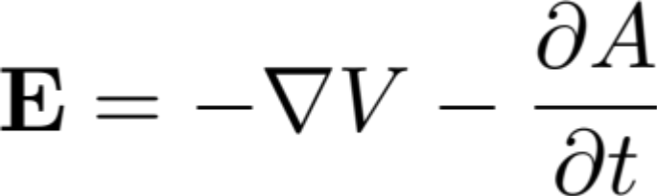


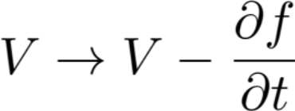

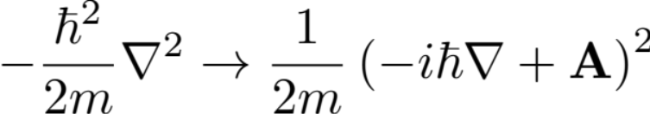
Gauge theory
Physical states obey a local symmetry.
E.g.: Gauss’ law
In quantum mechanics, the gauge field
acquires its own dynamics.
This symmetry couples kinetic terms to field

Slide 6






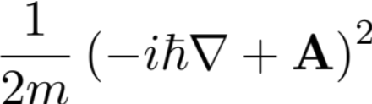
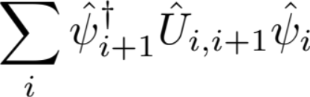


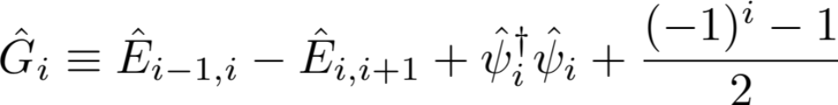
To make amenable to computation gauge theory lattice gauge theory
K. Wilson, Phys. Rev. D 1974
Bermudez, Schaetz,
Porras, 2011,2012
Shi, Cirac 2012
static gauge field
Gauss’ law

Slide 7




To make it simpler, discretize also gauge field (quantum link model).
Kogut 1979,Horn 1981,
Orland, Rohrlich 1990,
Chandrasekharand, Wiese 1997,
Recent Review:
U.-J. Wiese 2013
| >
3²D_{5/2}
| >
4²S_{1/2}
Notes:
%\nabla\cdot \mathbf{E} = \rho
%\mathbf{E}
%-\frac {\hbar^2}{2m}\nabla^2 \rightarrow \frac {1}{2m}\left(- i \hbar\nabla+\mathbf{A}\right)^2
%\rightarrow
%\hat G_i\equiv \hat E_{i-1,i}-\hat E_{i,i+1}+\hat \psi_i^\dagger \hat\psi_i + \frac{(-1)^i-1}{2}
%\hat G_i\left|\psi\right\rangle = 0
%\frac {1}{2m}\left(- i \hbar\nabla+\mathbf{A}\right)^2
%\sum_i \hat\psi_{i+1}^\dagger \hat{U}_{i,i+1} \hat\psi_i

Slide 8
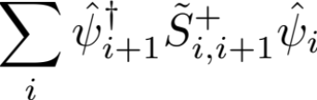
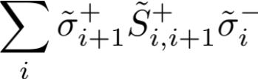

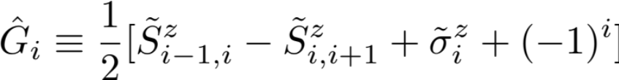
For trapped-ion implementation: transform to spins (Jordan-Wigner)
Dynamics
Gauss’ law
Spins can be represented by internal states.
| >
3²D_{5/2}
| >
4²S_{1/2}
Notes:
[Nicer animation]
Explain what terms mean.
%\nabla\cdot \mathbf{E} = \rho
%\mathbf{E}
%-\frac {\hbar^2}{2m}\nabla^2 \rightarrow \frac {1}{2m}\left(- i \hbar\nabla+\mathbf{A}\right)^2
%\rightarrow
%\hat G_i\equiv \hat E_{i-1,i}-\hat E_{i,i+1}+\hat \psi_i^\dagger \hat\psi_i + \frac{(-1)^i-1}{2}
%\hat G_i\left|\psi\right\rangle = 0
%\frac {1}{2m}\left(- i \hbar\nabla+\mathbf{A}\right)^2
%\sum_i \hat\psi_{i+1}^\dagger \hat{U}_{i,i+1} \hat\psi_i

Slide 9
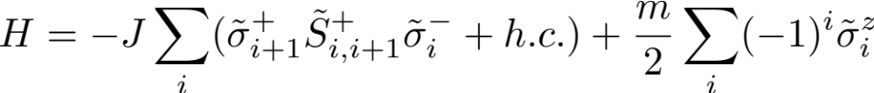
Want to implement
Dynamics
Conservation law (Gauss’ law)
Notes:
I will come in a moment to the meaning of the terms.
%\nabla\cdot \mathbf{E} = \rho
%\mathbf{E}
%-\frac {\hbar^2}{2m}\nabla^2 \rightarrow \frac {1}{2m}\left(- i \hbar\nabla+\mathbf{A}\right)^2
%\rightarrow
%\hat G_i\equiv \hat E_{i-1,i}-\hat E_{i,i+1}+\hat \psi_i^\dagger \hat\psi_i + \frac{(-1)^i-1}{2}
%\hat G_i\left|\psi\right\rangle = 0
%\frac {1}{2m}\left(- i \hbar\nabla+\mathbf{A}\right)^2
%\sum_i \hat\psi_{i+1}^\dagger \hat{U}_{i,i+1} \hat\psi_i

Slide 10
Interesting phenomena in 1D QED
string breaking
Charge density
distance
time
Hebenstreit et al.,
PRL 111, 201601 (2013)

Slide 11
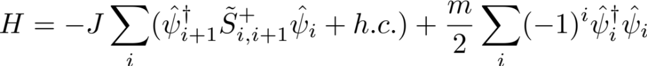
False-vacuum decay
quark picture
m/J→–∞
m/J→+∞
–
q
–
q
q
q
spontaneously breaks
charge and parity symmetry

Slide 12
Outline
One dimensional quantum electrodynamics
Trapped-ion implementation
  Proposed scheme
  Numerical results
Protection of quantum gauge theory by classical noise
Conclusions

Slide 13
Outline
One dimensional quantum electrodynamics
Trapped-ion implementation
  Proposed scheme
  Numerical results
Protection of quantum gauge theory by classical noise
Conclusions

Slide 14
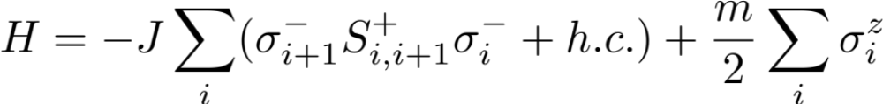
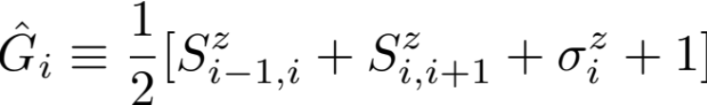




Want to implement
Dynamics
Conservation law (Gauss’ law)
Rotate
coordinate system

Slide 15

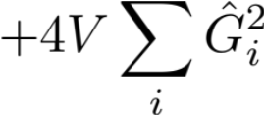



Energy penalty protects Gauss’ law
gauge
violating
total Hilbert
space
gauge invariant

Slide 16
Energy penalty protects Gauss’ law
spin-spin
interactions
longitudinal field

Slide 17
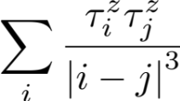

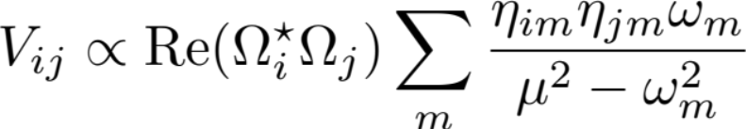
Need spin-spin interactions with equal strength between nearest- and next-nearest neighbors
Want
Know how to do
Various experiments
Schaetz, Monroe, Bollinger,
Blatt, Schmidt-Kaler, Wunderlich
Theory
Porras and Cirac, 2004
Sørensen and Mølmer, 1999
See also
Hayes et al., 2013
Korenblit et al., 2012

Slide 18
A closer look at the internal level structure
| >
ΔE_{Zee,D}
S
3²D_{5/2}
| >
σ
Ω_{S}
Ω_{σ}
| >
σ
4²S_{1/2}
ΔE_{Zee,S}
| >
S

Slide 19
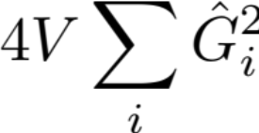
Need spin-spin interactions with equal strength between nearest- and next-nearest neighbors
Want
Know how to do
Solution:
Use two different qubits to
reinforce NNN interactions
+ dipolar tails

Slide 20
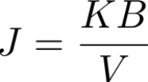
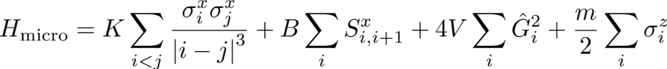
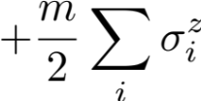


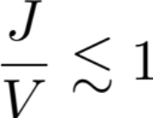


Interactions protect gauge invariance.
And allow to generate the dynamics!
gauge
violating
2nd order
perturbation
theory
gauge invariant

Slide 21
Outline
One dimensional quantum electrodynamics
Trapped-ion implementation
  Proposed scheme
  Numerical results
Protection of quantum gauge theory by classical noise
Conclusions

Slide 22
Outline
One dimensional quantum electrodynamics
Trapped-ion implementation
  Proposed scheme
  Numerical results
Protection of quantum gauge theory by classical noise
Conclusions

Slide 23
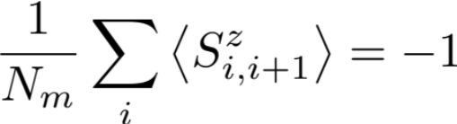
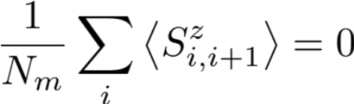
False vacuum decay
m/J→–∞
m/J→+∞
quark picture
–
q
–
q
q
q
breaks charge and parity symmetry
spin picture

Slide 24
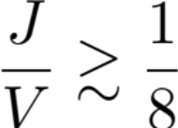
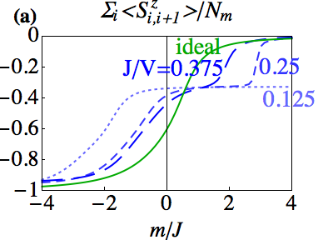
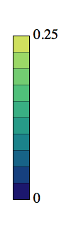
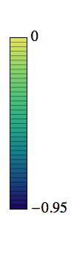
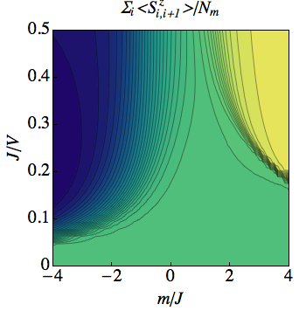
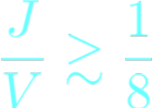
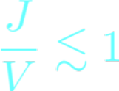
A numerical test validates the microscopic equations
Correct phase
P. Hauke, D. Marcos,
M. Dalmonte, P. Zoller
PRX (2013)
Dipolar tails
negligible
Perturbation
theory valid
Gauge invariance

Slide 25
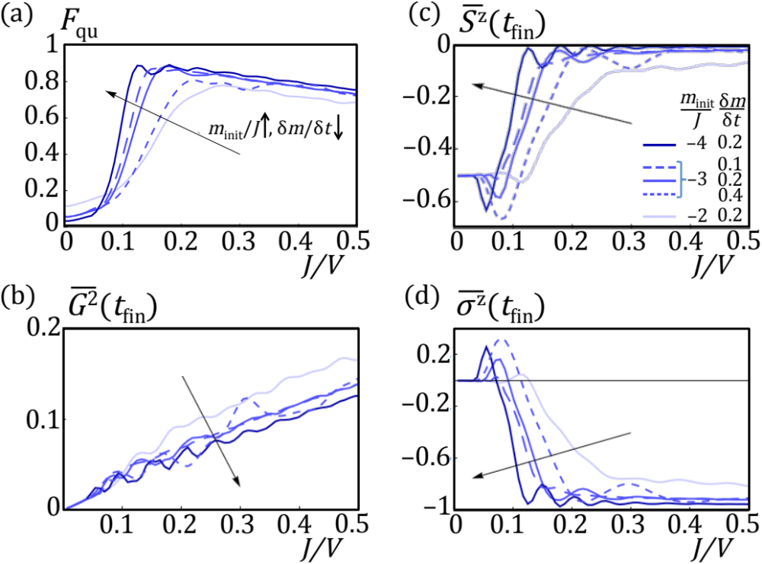
Sweeps in O(1ms) reproduce the dynamics of the LGT
fidelity after
quench

Slide 26
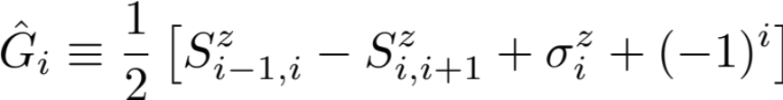
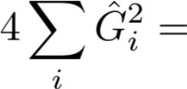





A simpler proof-of-principle experiment with four ions
Avoids the need for fast-decaying interactions
Enforcing of Gauss law
+
–2
–
+
–
σ₁
S₁₂
σ₂
S₂₁

Slide 27

A simpler proof-of-principle experiment with four ions
Avoids the need for fast-decaying interactions
+
Remember interactions
–2
–
+
–
σ₁
S₁₂
σ₂
S₂₁
Use mode with amplitudes
–1/2

Slide 28
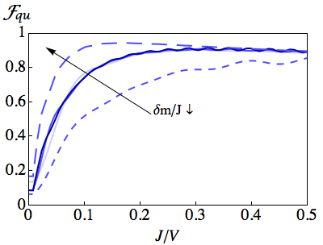
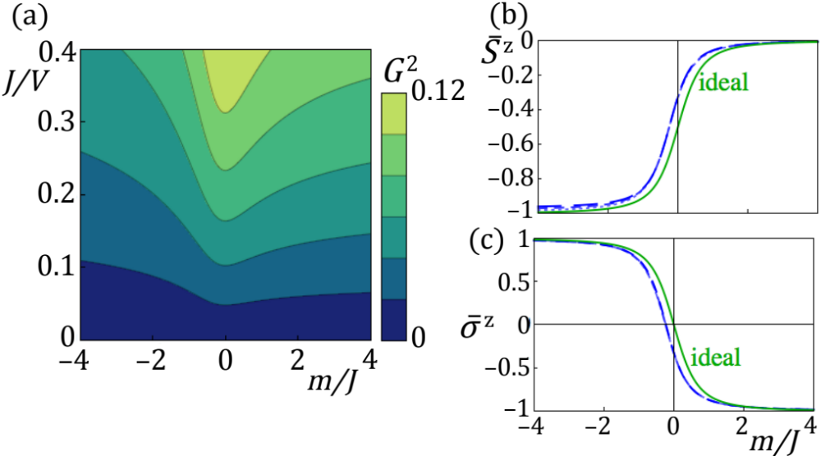
A simpler proof-of-principle experiment with four ions
+
–2
Avoids the need for fast-decaying interactions
And does not suffer from dipolar errors
–
+
–
σ₁
S₁₂
σ₂
S₂₁
–1/2
Compare scalable setup
–4
–2
0
2
4
–4
–2
0
2
4
m/J
m/J

Slide 29
Outline
One dimensional quantum electrodynamics
Trapped-ion implementation
  Proposed scheme
  Numerical results
Protection of quantum gauge theory by classical noise
Conclusions

Slide 30
Outline
One dimensional quantum electrodynamics
Trapped-ion implementation
  Proposed scheme
  Numerical results
Protection of quantum gauge theory by classical noise
Conclusions

Slide 31
Until now:
Energetic protection.
gauge
violating
total Hilbert
space
gauge invariant

Slide 32
Until now:
Energetic protection.
gauge #
theory generators
U(1) 1
U(2) 4
…
For more complicated models,
may require complicated
and fine-tuned interactions
If we could do this with single-particle terms,
that would be much easier!

Slide 33
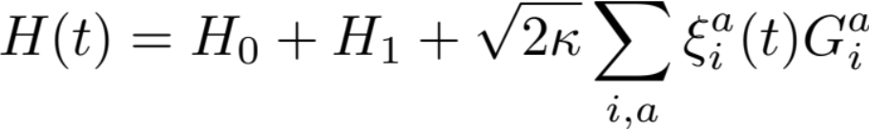


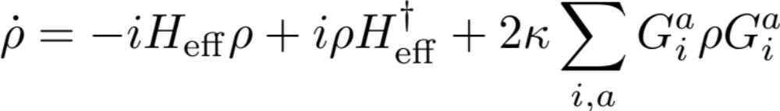
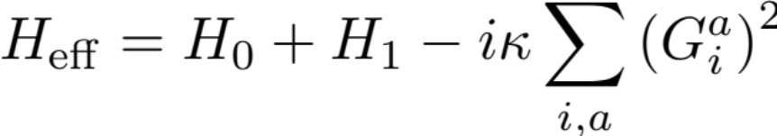
Dissipative protection
U(1) :
Gauge-invariant states
are not disturbed
single-particle terms !
white noise
→ Master equation
before
Stannigel et al.,
arXiv:1308.0528 (2013)

Slide 34
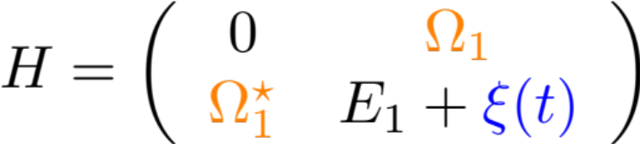




Analogy:
driven two-level system + dephasing noise remains in ground state forever.

Slide 35
Problem: Cannot obtain dynamics
as second-order perturbation
gauge
violating
In neutral atoms, we found
a way using intrinsic collisions.
Stannigel et al.,
arXiv:1308.0528 (2013)
gauge invariant

Slide 36
Conclusions
Phys. Rev. X 3, 041018 (2013)
arXiv:1308.0528 (2013)
Proposal for a simple lattice gauge theory.
Ingredients:
  Two different qubits (matter and gauge fields)
  Two perpendicular interactions
  (one stronger than the other and fast decaying with distance)
  Single-particle terms
Numerics validate the microscopic Hamiltonian.
  Statics
  Dynamics (adiabatic sweep requires reasonable times)
A simpler proof-of-principle is possible with four ions.
| >
| >
| >
| >
S₂₁

Slide 37
Outlook
Implementations with higher spins or several “flavors.”
“Pure gauge” models in 2D.
Gauge invariance protected by the classical Zeno effect?
Thank you !
arXiv:1308.0528
Optical lattices
Banerjee et al., 2012, 2013
Tagliacozzo et al., 2012, 2013
Zohar, Cirac, Reznik, 2012, 2013
Kasamatsu et al., 2013
Superconducting qubits
Marcos et al., 2013
Static gauge fields
Bermudez, Schaetz, Porras, 2011, 2012
Shi, Cirac, 2012
High-energy physics in ions
Gerritsma et al, 2010 (Dirac equation)
Casanova et al., 2011 (coupled quantum fields)
Casanova et al., 2012 (Majorana equation)

