Slide 1
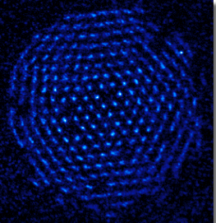








Towards programmable quantum simulation at computationally relevant scales
IQsim13
Michael J. Biercuk
Quantum Control Laboratory
Centre for Engineered Quantum Systems
School of Physics, The University of Sydney
Formerly, NIST Ion Storage Group
www.physics.usyd.edu.au/~mbiercuk

Slide 2
Outline
Aim: Build a useful quantum simulator where a user may program in a desired interaction to be simulated.
Motivation
9Be+ crystals in Penning Ion Traps
Engineering tunable coupling in ion crystals
A path to programmable simulation by coherent control

Slide 3
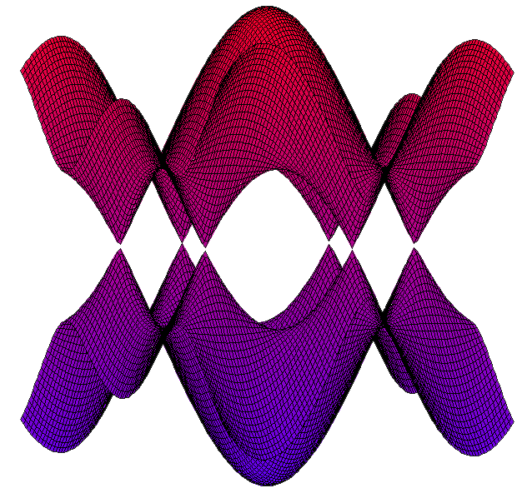
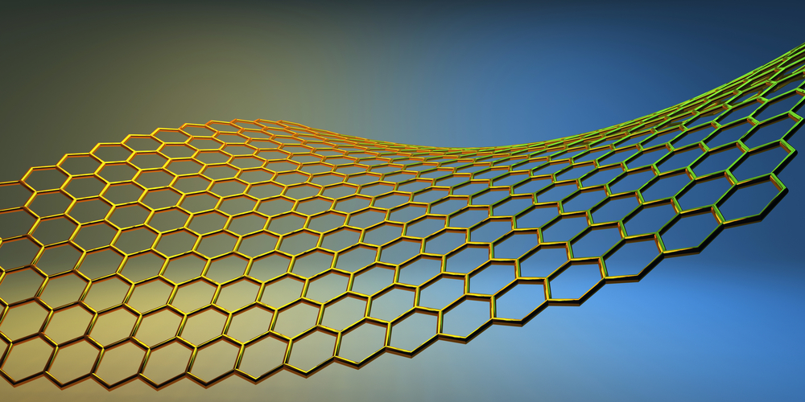
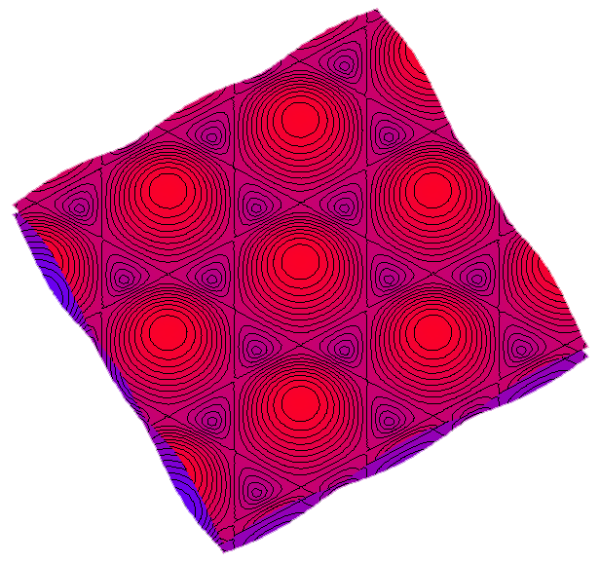
Problems in condensed matter
All of this physics comes from noninteracting models

Slide 4
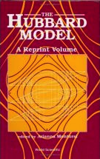
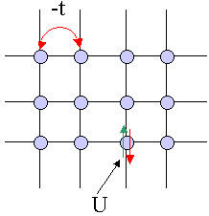
Lattice models of interacting electrons
Frustration: Antiferromagnetic interaction
?
http://large.stanford.edu/courses/2008/ph373/hughes2/images/f1.gif

Slide 5
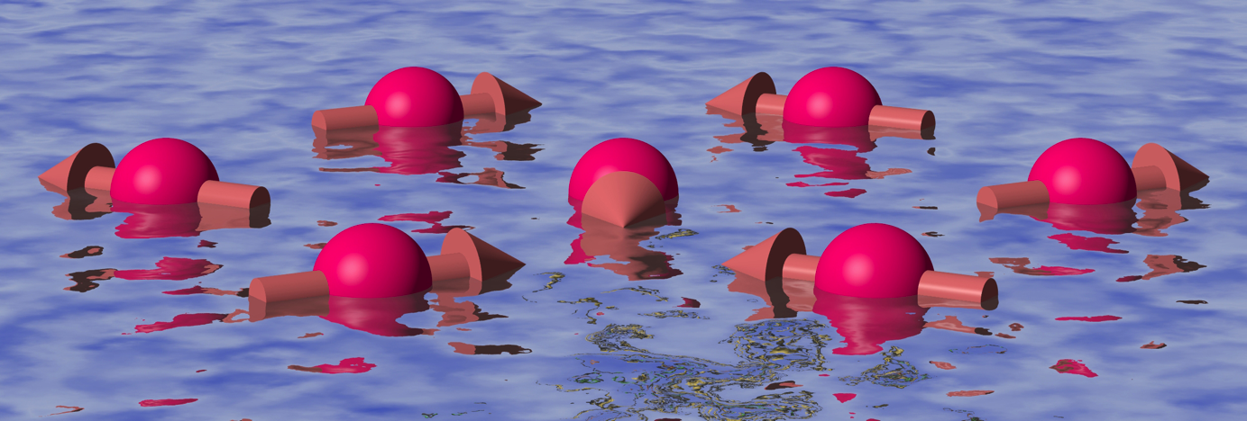
Exotic quantum states
Gapless fermi/bose spin liquids
Gapped spin liquids
Potential explanation for High-Tc superconductivity
Nature 471, 612 (2011), Francis Pratt /ISIS/ SFTC

Slide 6
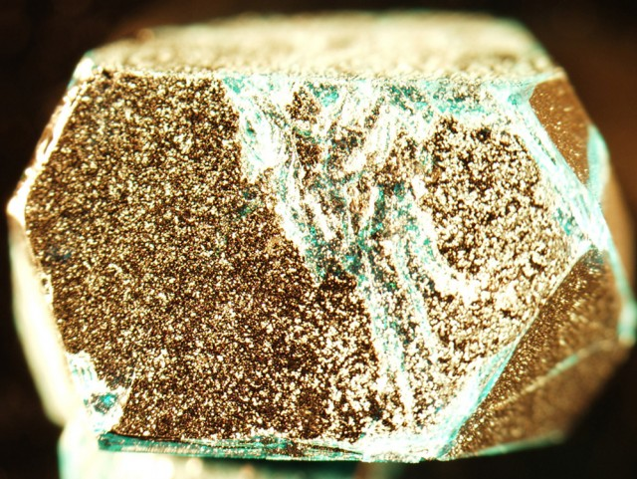
Candidate materials
Herbertsmithite
Nature 492, 406 (2012)

Slide 7
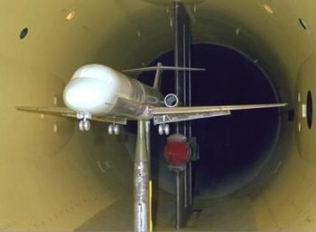
Quantum simulation
Lattice models from the bottom up.
It’s like this…but quantum

Slide 8
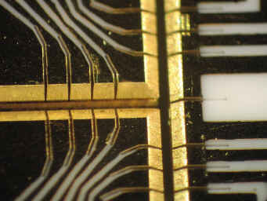
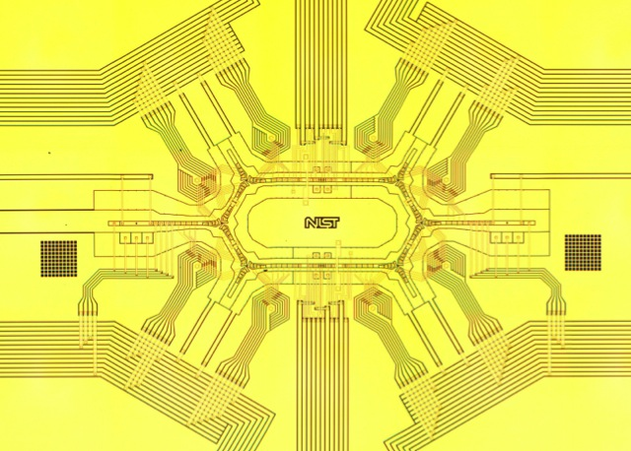
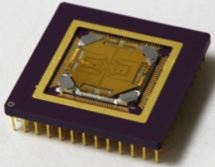
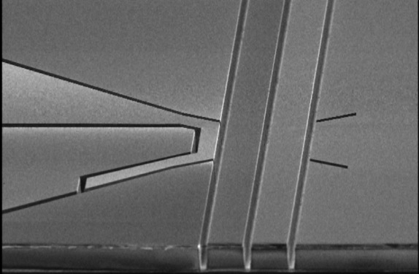
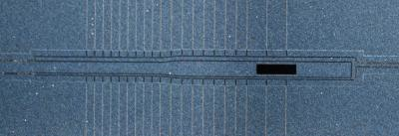
Scaling up Ion-trap Quantum Simulation
2.5 mm
Courtesy C. Monroe (UMD), M.G. Blain (Sandia); Amini et al., NJP 12, 033031 (2010).

Slide 9
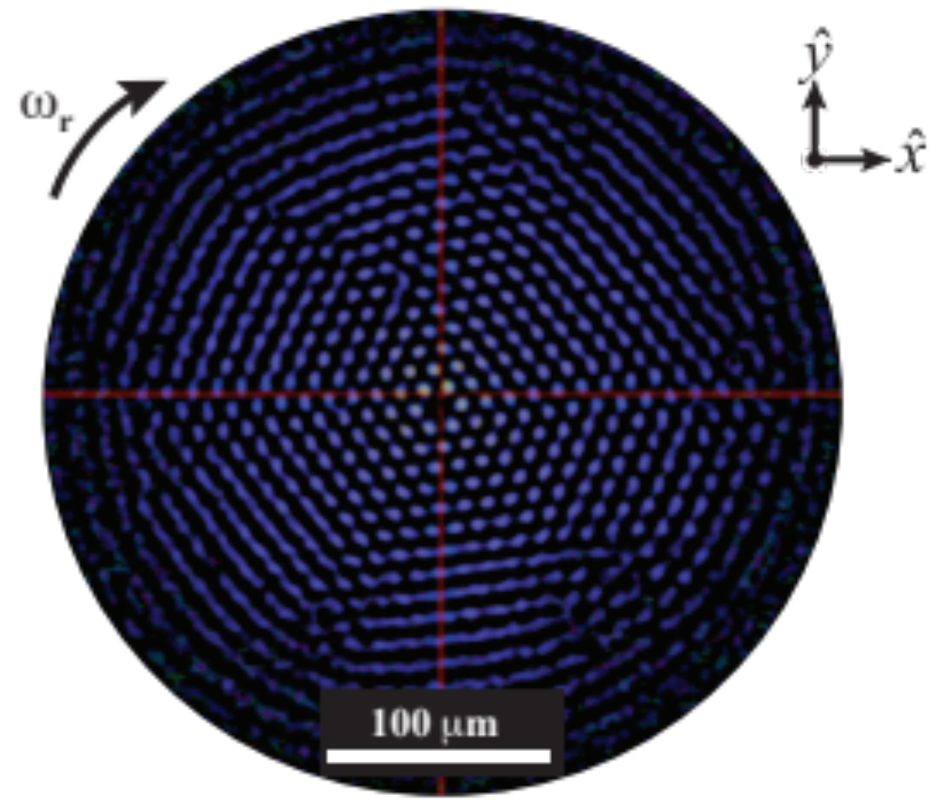
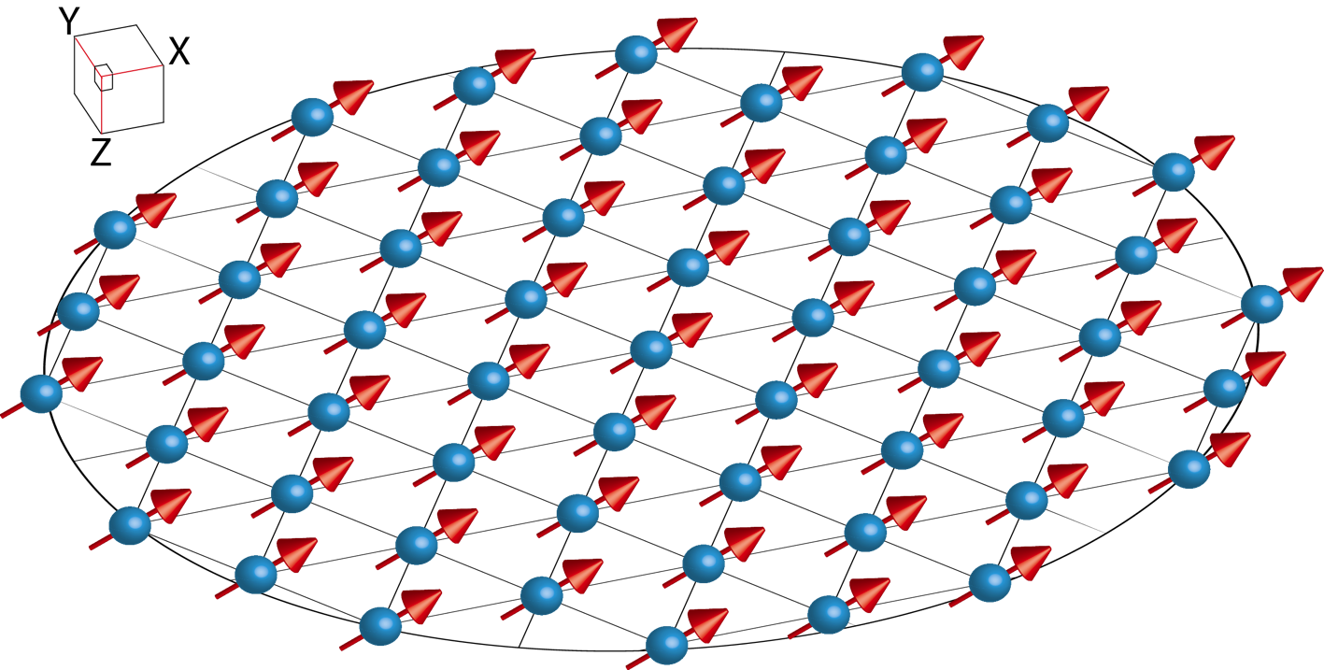
Simulation at computationally relevant scales
N>300

Slide 10
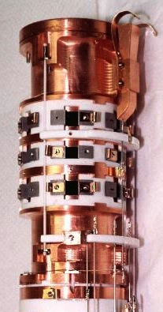
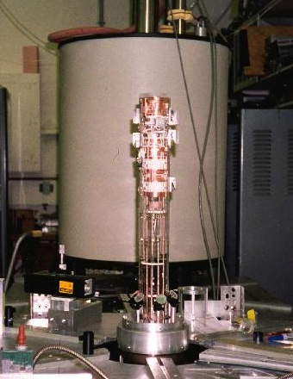
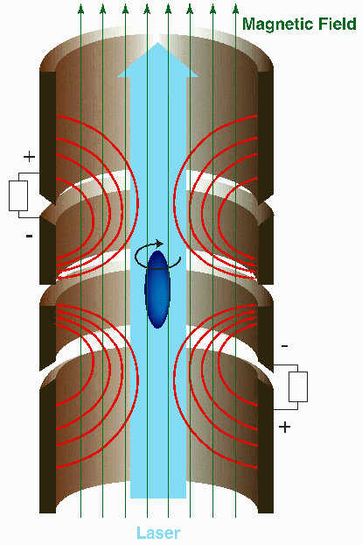



The NIST Penning Trap
B=4.5 T
⁹Be⁺
ν_{c} ~ 7.6 MHz, ν_{m} ~ 20-50 kHz
ν_{z} ~ 600-800 kHz

Slide 11
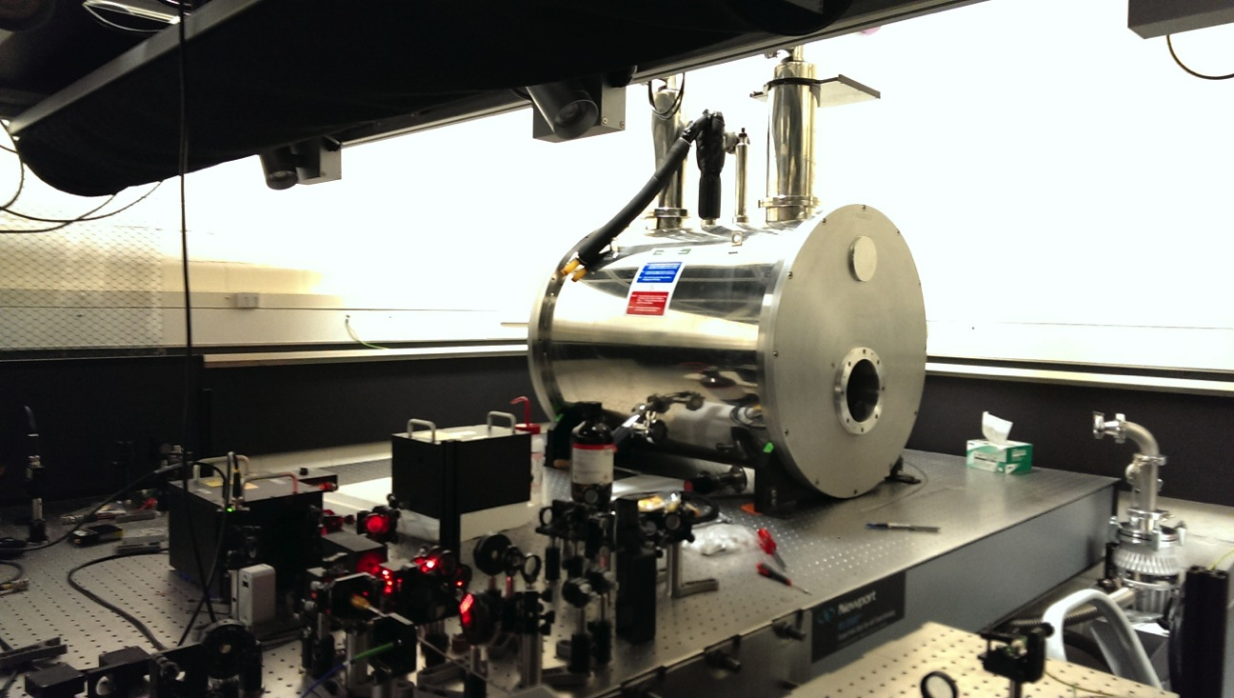
Forthcoming…the Sydney Penning Trap

Slide 12




Toy Ising-type Hamiltonian
Spin-spin interactions
Spin rotations
?

Slide 13






Beryllium Ion Qubit
⁹Be⁺ at 4.5T
Fluorescence
Cooling
Repump
F=1
124 GHz
Field Sensitive
F=2
MJB et al,. Nature 458, 996 (2009). MJB et al., Quant. Info. Comp. 9, 920 (2009).

Slide 14
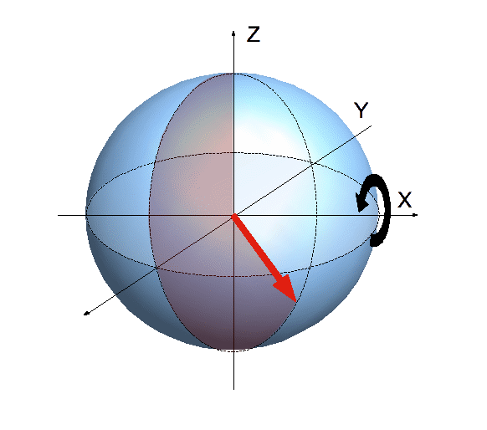
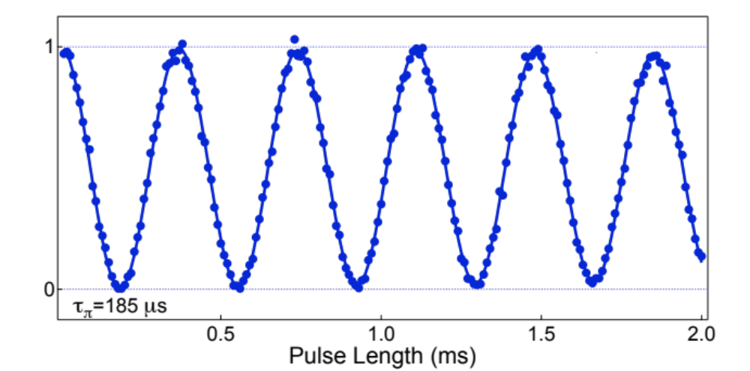


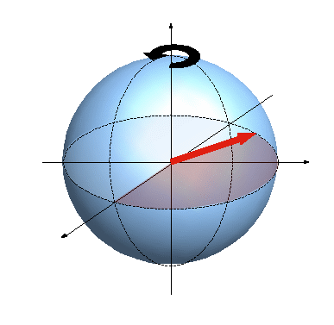
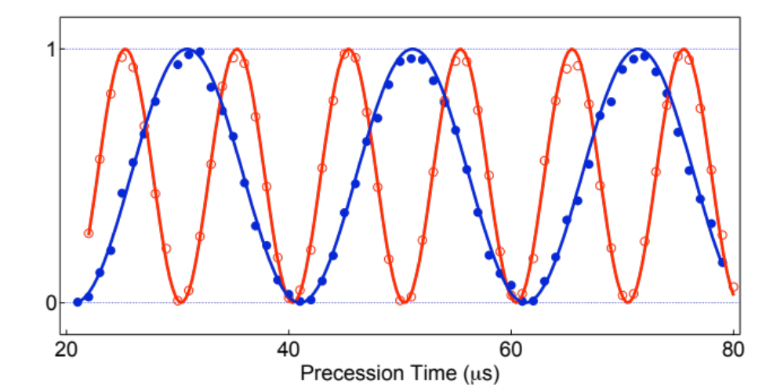
Hi-Fi μWave (124 GHz) Coherent Control
Rabi Oscillations
Average Error: 8 ± 1×10⁻⁴
(99.92% Fidelity/Gate)
Larmor Precession
MJB et al,. Nature 458, 996 (2009). MJB et al., Quant. Info. Comp. 9, 920 (2009).

Slide 15
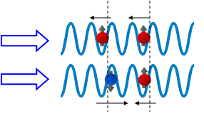
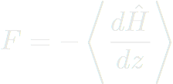
Motional bus for coupling spins
Spatially varying light field
Harmonic confinement
State-dependent ac stark shift
Nature 422, 412 (2003). Nature 438, 639 (2005).

Slide 16
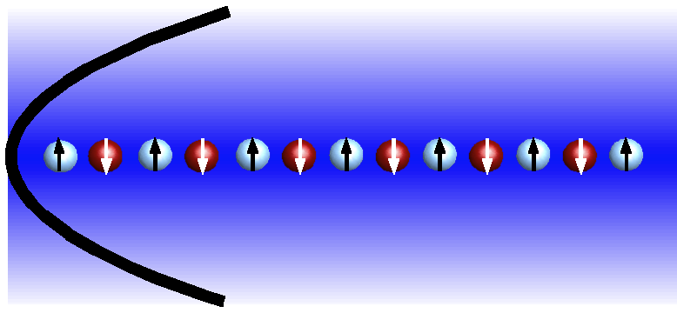
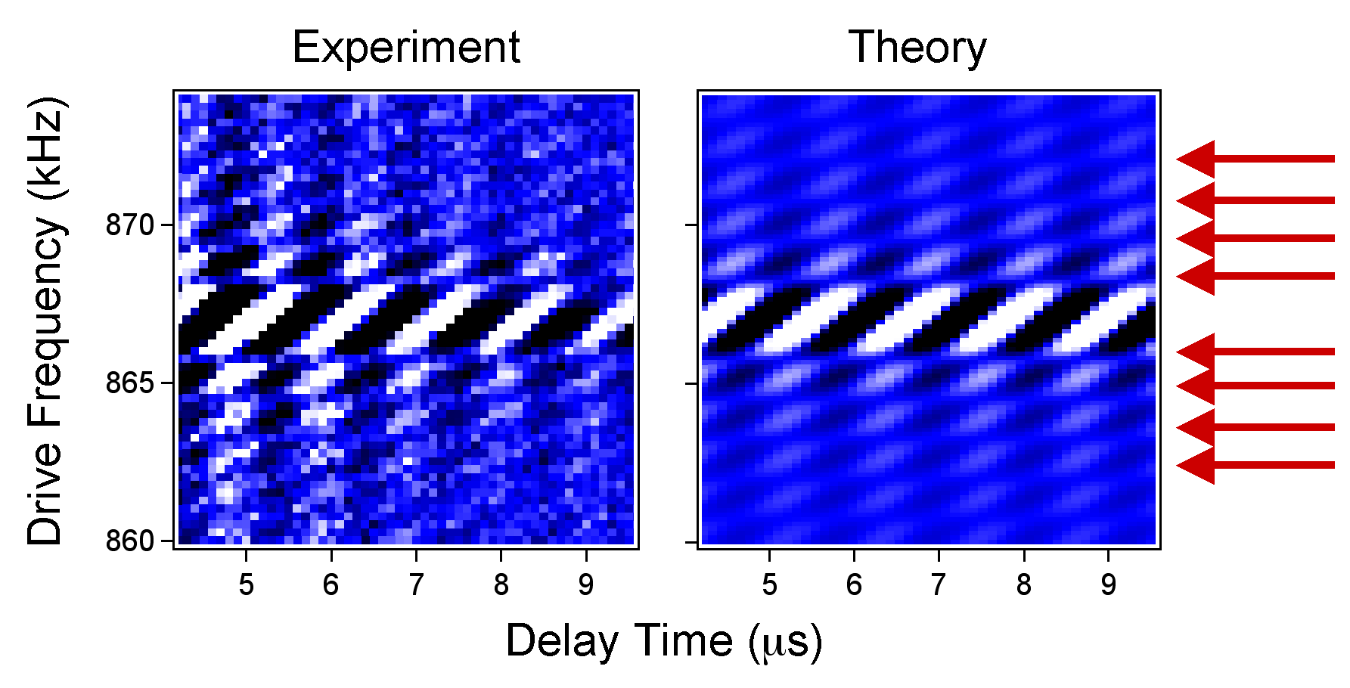
Transverse COM-Mode
Trap Axis
Phase-coherent Doppler velocimetry via RF tickle
MJB et al., Nature Nanotechnology 9, 646 (2010); MJB et al., Op. Ex. 19, 10304 (2011)

Slide 17
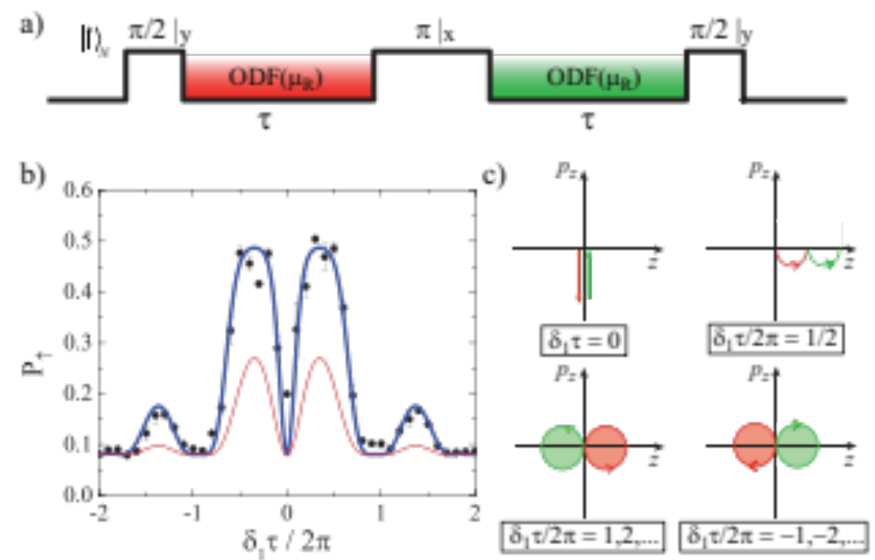


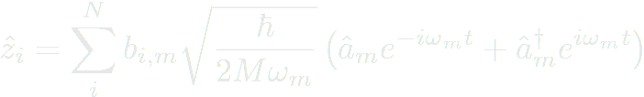
Spin-Motional Entanglement with COM
Sawyer et al., PRL 108, 213003 (2012)

Slide 18
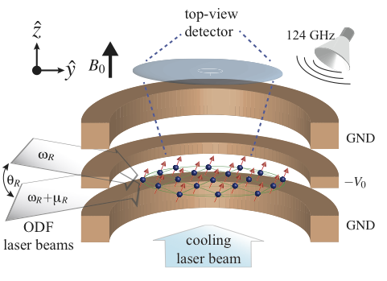

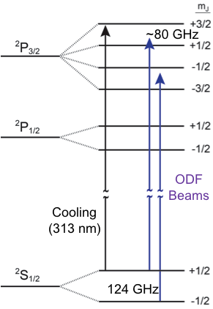
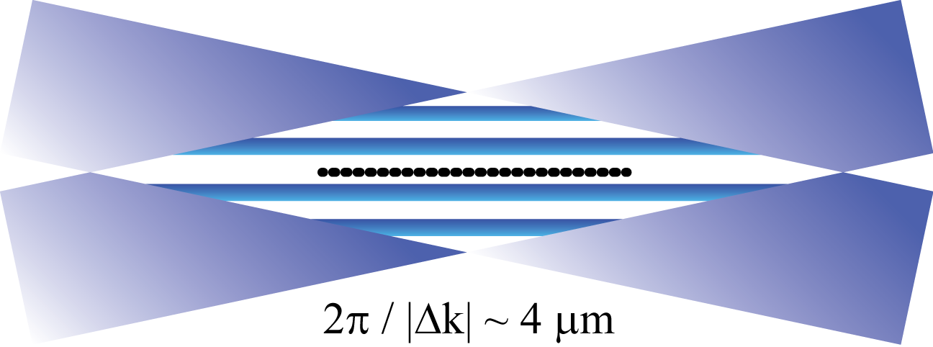

Implementation in the Penning trap
MJB et al., Op. Ex. 19, 10304 (2011), Sawyer et al., PRL 108, 213003 (2012), Britton et al, Nature 484, 489 (2012)

Slide 19
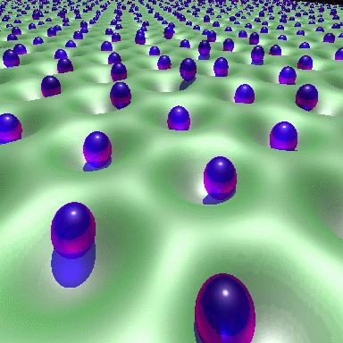



The mean-field limit
http://www.southampton.ac.uk/~fangohr/research/vortex1/subs/subs.html

Slide 20
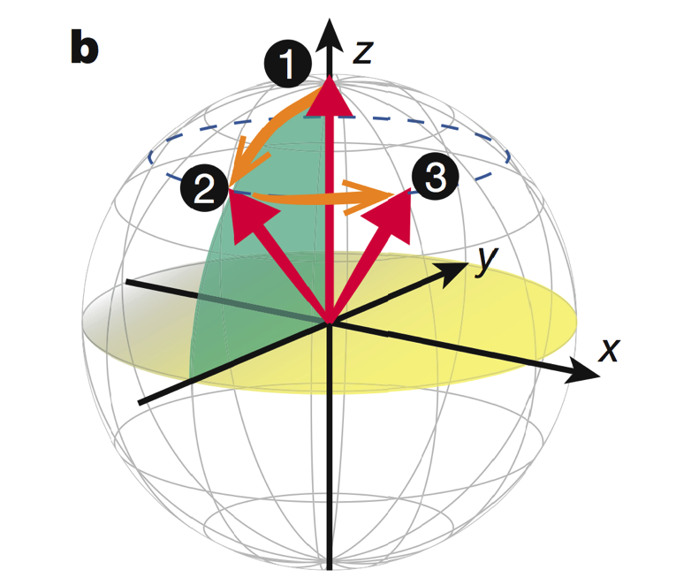
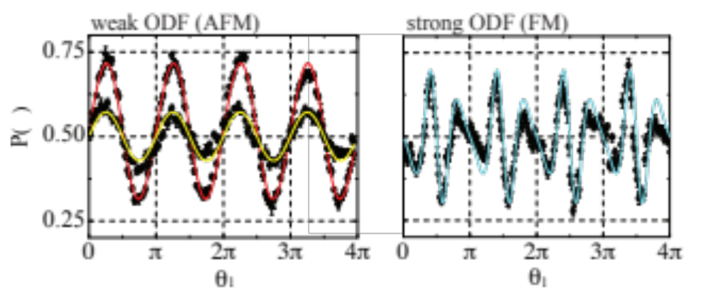


Measurement: B-induced precession
“Tipping angle”, θ
Nature 484, 489 (2012)

Slide 21
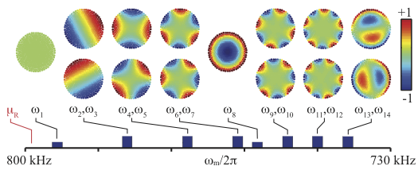

Tune coupling by spatial asymmetry
Tunable coupling to asymmetric modes gives control over interaction range
Nature 484, 489 (2012)

Slide 22
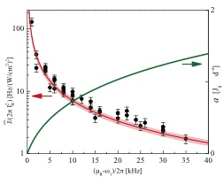


Mean-field benchmarking of tunable interaction
No Free Parameters
Ion-dipole
N~300
Coulomb
Extracted Mean Field
Infinite
Laser Detuning
Nature 484, 489 (2012)

Slide 23
Moving beyond the mean field
Increase interaction strength
Predictability breaks down

Slide 24

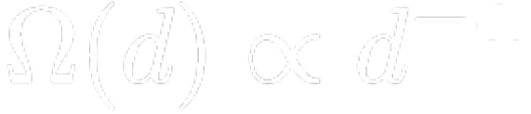
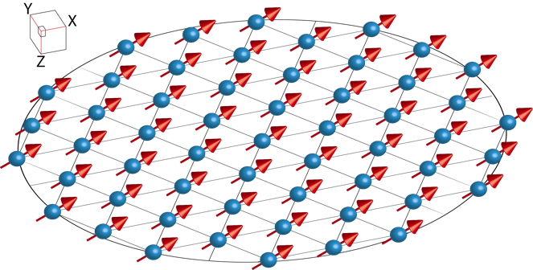
What have we accomplished so far…
Hilbert space ~ 2³⁰⁰
Tunable Engineered Spin-Spin Coupling
What if this functional form doesn’t give access to physics we care about?
Britton, Sawyer…MJB, Bollinger, Nature 484, 489 (2012).

Slide 25
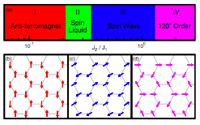
Richness of Physics
Increasing NNN-to-NN interaction strength
PRL 107, 077201 (2011)

Slide 26
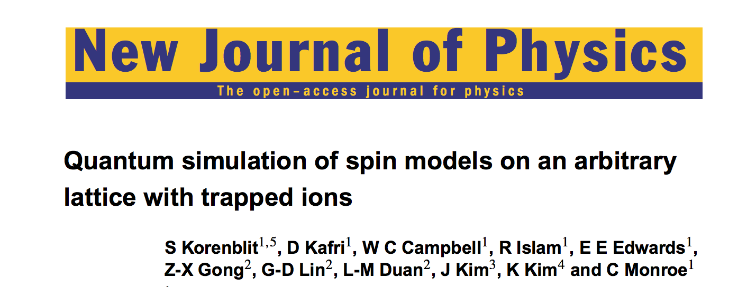
Background
Arbitrary simulation proven possible (a la universal QC)
Decoupling/Recoupling protocols in NMR
Recent ion-specific protocols
NJP 14, 095024 (2012).

Slide 27
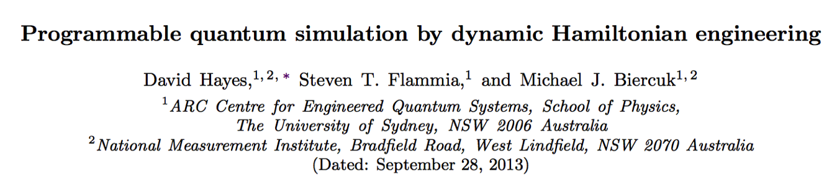
Towards programmable analog simulators
Only basic resources required
  Single-qubit Paulis with individual addressing
  Long-range coupling
Technology independent
Addresses the problem of “programming”
Hayes, Flammia, MJB, arXiv:1309.6736 (2013).

Slide 28
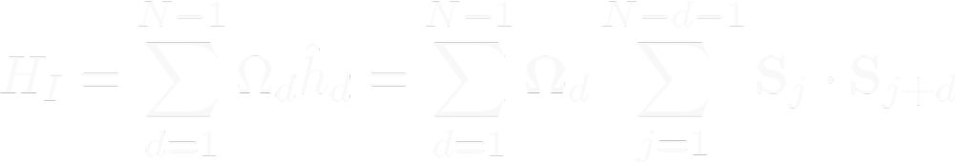
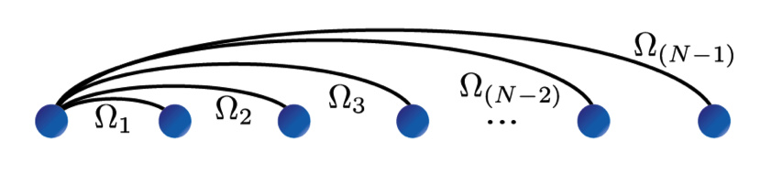




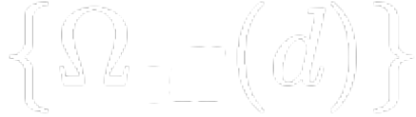
Programmable Quantum Simulation
CONTROL
Arbitrary
Apply control protocols to modify interactions
Quantum Simulation Program realized in form of control protocols, their scaling, and their sequencing
Hayes, Flammia, MJB, arXiv:1309.6736 (2013).

Slide 29
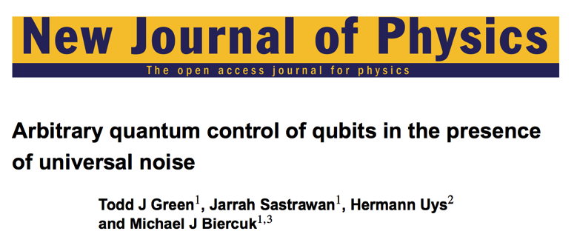
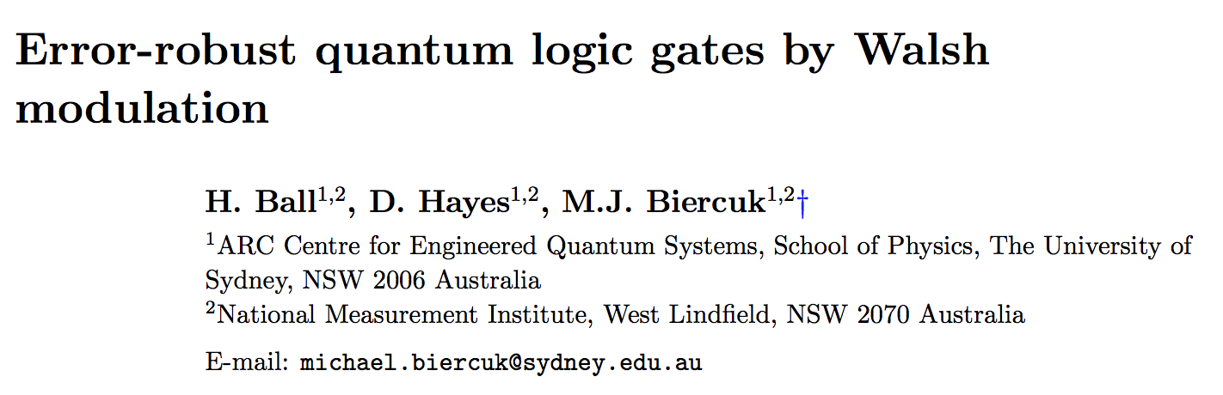
Error suppression & control…

Slide 30
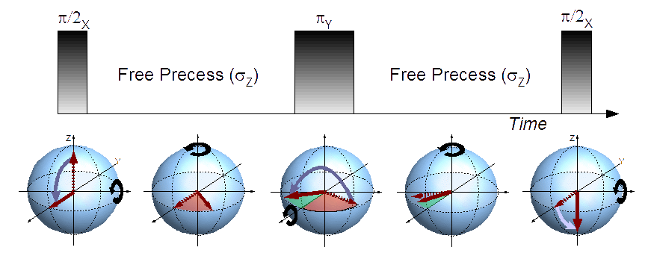



Spin Echo:
Engineering in the time domain
+1
y(t)
-1
Hahn 1950, NMR

Slide 31




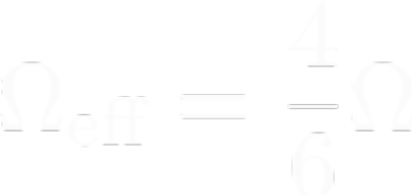


SU(2) ops can modify effective coupling
time
Sum on timesteps
Stroboscopically engineer a new effective spin coupling
Hayes, Flammia, MJB, arXiv:1309.6736 (2013).

Slide 32






Distance dependence revealed by symmetry of control propagator
NN
NNN
NNNN
t
For multiqubit system, H (P) is periodic in number of timesteps
Hayes, Flammia, MJB, arXiv:1309.6736 (2013).

Slide 33
Pulsed control filters interaction strength
Break evolution into more timesteps…
Filter Weight: H(P)
d
Coupling changes sign!
AFM
d
FM
Hayes, Flammia, MJB, arXiv:1309.6736 (2013).

Slide 34



Build program by combining filters
CONTROL
Arbitrary
Combine by sequential application and concatenation
Tuning knobs:
  Specific pulse sequence applied
  Filter duration (sets “Fourier” coefficient)
  Number of timesteps (sets triangle periodicity)
  Addition of free-evolution (can “decouple” terms)
  Addition of π/2 pulses to shift basis (X, Y, Z)
Notes:
Penalty: Rescaling of universal filter space – reduction in runtime.

Slide 35

Universal couplings achievable
Non-native adiabatic evolutions can also be engineered
“Universal” filter space
Hayes, Flammia, MJB, arXiv:1309.6736 (2013).
Notes:
Penalty: Rescaling of universal filter space – reduction in runtime.

Slide 36



Adiabatic evolutions
Hayes, Flammia, MJB, arXiv:1309.6736 (2013).

Slide 37




Approach is resource efficient
Concatenation scaling (Universal filter)
Runtime scaling
Calculating control is a problem in linear programming
Worst-case coupling strength
Interqubit distance
Arbitrary
Hayes, Flammia, MJB, arXiv:1309.6736 (2013).

Slide 38



Testing in a 1D Paul trap

Slide 39




Yb⁺ Ion strings for Quantum Simulation

Slide 40

Outlook...programming ion-based quantum simulators

Slide 41



Acknowledgements
Ion Storage Group
Quantum Control Lab
http://tf.nist.gov/ion
Joe Britton, Brian Sawyer,
Hermann Uys, Aaron VanDevender
Christian Ospelkaus, John Bollinger,
David Wineland
David Hayes, Steve Flammia,
Alex Soare, MC Jarratt,
Kale Johnson, James McLoughlin, Karsten Pyka

Slide 42







Acknowledgements & Collaborators
Lorenza Viola
Kaveh Khodjasteh
Chingiz Kabytaev
Ken Brown
Hendrik Bluhm
Amir Yacoby

Slide 43


PhD opportunities and postdoctoral fellowships available at Sydney
michael.biercuk@sydney.edu.au

