Slide 1
Inclusive Teaching, Learning and Assessment:
Sussex Teaching and Learning Conference 2017
Creating a (more) human-scale university in the context of massification and diversification
Dr Louise Gazeley, Dr Tamsin Hinton-Smith
and Dr Jacqui Shepherd
Notes:
Who to introduce?

Slide 2
Overview of workshop, focus, structure and aims
Knowing our students: taking account of change and diversity
Insights from two recently completed research projects
Blue skies thinking around a human-scale university
Looking beyond the workshop
Notes:
The connection to make explicit is that both projects allowed us to have a clearer sense of what some of the issues might be in terms of thinking about who the students are that we teach and what they might need.
Emphasis is on their participation in the activities – and chance to think about what a university needs to do, for whom and whether human-scale is something we should aspire to/are achieving already…

Slide 3
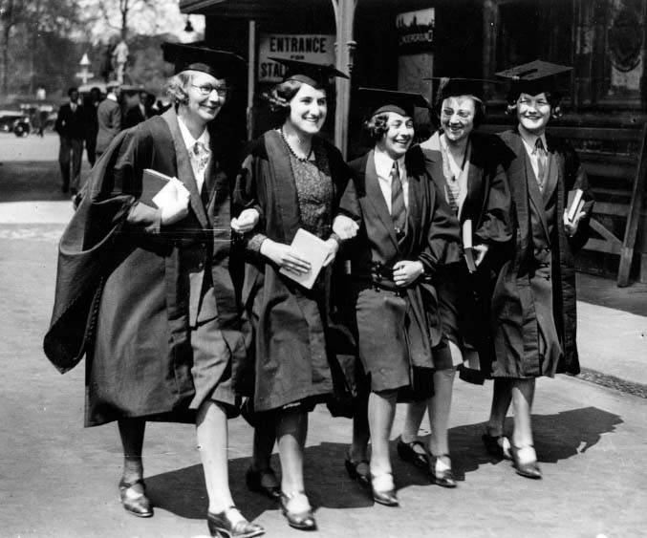
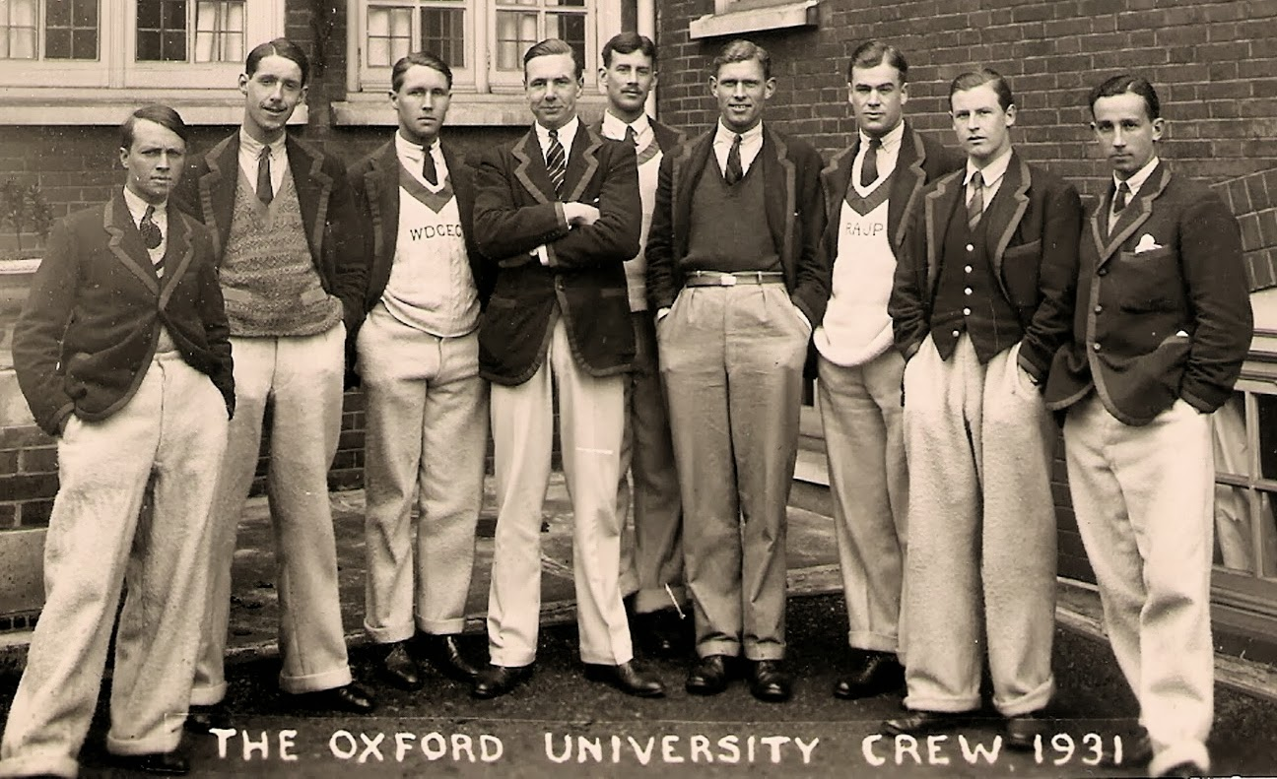
Notes:
Idea here is just to think about how students changed over time – who they mkight be etc.
Jacqui

Slide 4


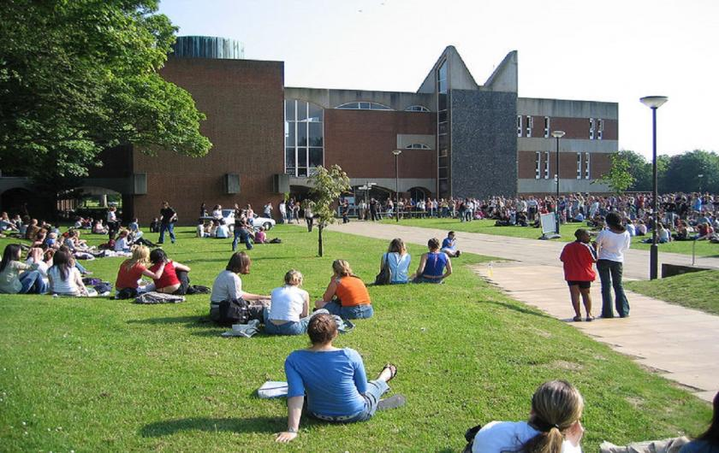

Slide 5
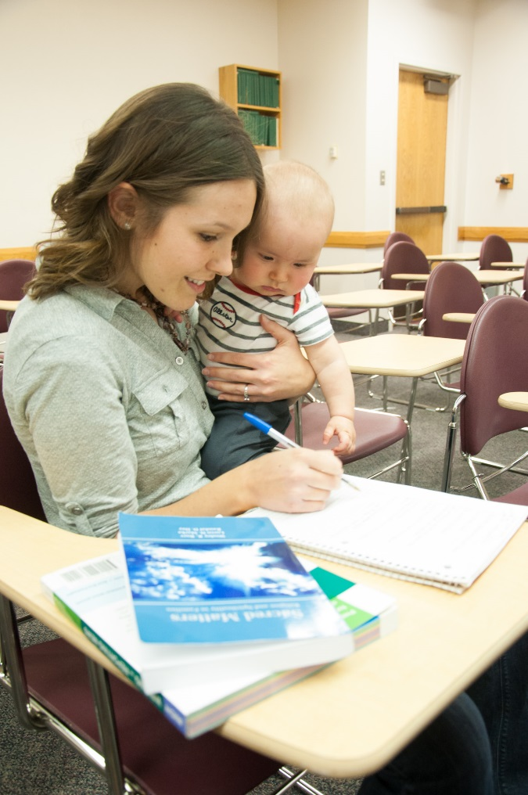
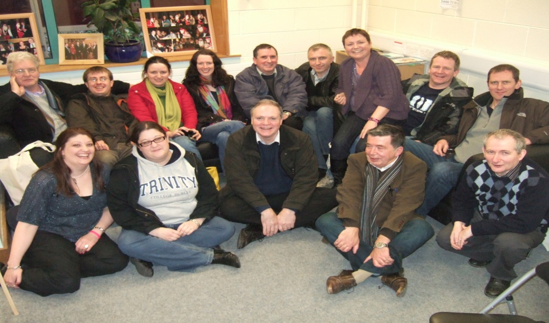

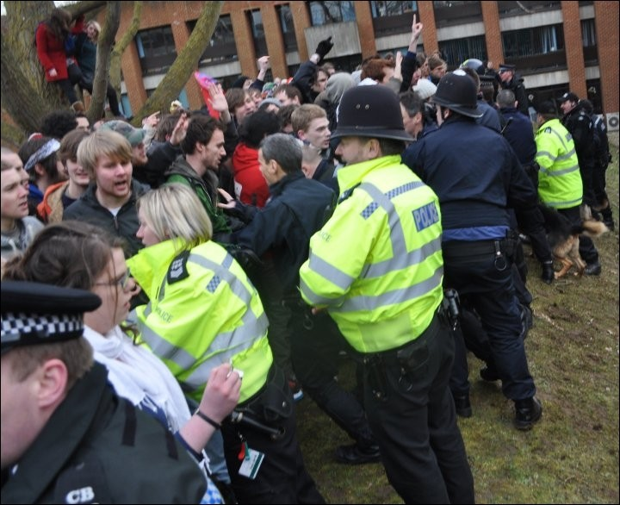

Slide 6

Using the flip chart and pens provided, work in groups to provide an annotated portrait of the Sussex students you typically work with, showing what they typically [need to] bring to this encounter.
Notes:
This may need to have some examples – perhaps drawn from BACY cohort.
If they feel need to narrow down, suggest we focus on UG – and their disciplinary area
Jacqui to lead

Slide 7

Insights from recent research:
Evaluation of the pilot phase of the HE Champions Coaching Programme for Looked After Children
Gazeley & Hinton-Smith 2016
“People need to know not just about the young person’s history in care, but about where they can go in life.” (Coach)
Funded by
Notes:
Tamsin’s notes:
This research, funded my Aimhigher London South, evaluated a pilot peer-to peer mentoring programme, for Looked after children, who have been in local authority care, as they negotiate the process of embarking on university.
We can share the report is anyone wants to get in touch with us for this.
As well as questionnaires, interviews and focus groups with the young people involved and key adults involved in their care, we also carried out focus group discussion with university widening participation staff. What they told us is that these vulnerable young people, often without informal networks to draw on, are negotiating a mine field of provision, whereby they are not only choosing between universities with different courses, facilities and academic reputations like other students, but also very differing levels of support and resources specifically aimed at supporting them. This is really important because for example they often don’t have any home to return to in university vacations, or any bedding or kitchen equipment to bring with them to university. And while some universities support them with these things and more, others don’t. And there is very little way for them to find out and compare what different universities offer.
As universities determine the focus for their own widening participation interventions, comparison becomes elusive and vulnerable groups can slip between the cracks of focus.
We identified ‘a need for more effective communication between the different stakeholders involved in the lives of young care-leavers embarking on university in order to prevent care-leaving university entrants from slipping through the net of care.’
This is just one example of how a particular vulnerable group may or may not receive support from particular universities’ widening participation work, but that there is no universal requirement to do so.
Key point is LAC as very under-represented group in HE and really a very small proportion go on to HE at the moment
Tamsin to introduce???

Slide 8
Aimed to:
Understand the strengths and limitations of a coaching intervention for Looked After Children at the point of considering entry to HE
Understand the value of employing care experienced near peer coaches
Initial questionnaire completed by all attending launch event
Two rounds of telephone Interviews with key adults
Final focus group with coachees
Focus groups and questionnaires completed by coaches
Notes:
Tamsin?

Slide 9
“Well for me it was the approach, the way they presented themselves, cos I wasn’t really sure about how, you know, about the steps about going to university and…It wasn’t just that, it was also the way that …they were talking about personal things that they had to go through and I don’t know; on that day I was really inspired, cos I just felt really uplifted and I felt like I wanted to participate in this.” (Coachee, Focus Group)
I left school at [before school leaving age] and didn’t go back properly until [early adulthood] – so was particularly drawn to this programme, as I’ve been in a similar situation. Now applying for a PhD!
(Supervisory coach, Stage 2 focus group, written feedback)
Notes:
Tamsin’s notes – study showed the importance of personalised (humanised) connections:
Generated empathy and engagement
‘Lots of responses are you don’t know me or what I’ve been through. Having a young person who has, has far more impact. Young people really take that on board, others who have been in same situation as them they can relate better.’
(Stage 1 interview, Key adult)
These quotes illustrate the reason that coaches and coaches got involved in the study – there is a personal connection and motivation – and for the coach the idea of giving back but also own difficult route through.
Worth saying is highly successful in educational terms as so much around LAC is about educational ‘failure’

Slide 10
‘Our children don’t have parents and teachers preparing them for [university admissions processes] like some others… Professionals working with young people need to have more sense of this.’ (Stage 1 interview, Key adult)
“I go and visit them. I try to keep involved… but it’s hard. … it’s definitely on a very one by one ad hoc basis.” (Stage 1 interview, Key adult)
Notes:
Tamsin’s notes:
The period immediately prior to entry to university has become a particular focus for WP interventions generally and typically there is a strong emphasis on providing access to the knowledge and guidance needed to support informed decision-making; but there is also a need for robust ongoing support from staff at university.
What they don’t have that other students do is continuing support – for professionals it is so hard to follow them through – yet Anglia Ruskinn study showed how vital family support is for students in difficulty in their 1st year
Who to present?

Slide 11
“A lot of our kids fluff the first year. Many students find the first year difficult, but if you’ve had trauma it can be much more so. Many of ours have to repeat the first year or change courses. They are very vulnerable, because many don’t have a safe place, a family to go back to. The other issue is accommodation. There’s a whole load of things we need to sort out.” (Stage 1 interview, Key adult)
“If I didn’t go for this I wouldn’t have read through all the modules, I would have said ‘Yeah I want to go here and do [subject name]’…so it’s actually made us more knowledgeable in the sense of what we need to do to know what we’re doing.” (Coachee, focus group)
Notes:
Sense from professionals that this is not just about learning but holistic support
The coachee quote evidences a more informed decision – which might lead to easier transition
Who to present?

Slide 12
One of the conclusions reached…
‘While some care experienced young people will be able to navigate HE without particular difficulty, for some it would be useful to factor into their decision making some reflection on the nature of the institution (eg. size, diversity, support systems) and courses (cohort size, lecture or seminar based teaching etc) and whether there is evidence of a more ‘human-scale’ approach (eg: academic advisor with interest/time to support).’
Notes:
This is a conclusion we reached – really points to the idea of human-scale learning (to be expanded on later)
Tamsin’s notes:
Training /awareness raising for academic staff in universities.
Universities should as a matter of good practice appoint dedicated care leaver teams with responsibility across the range of support issues. This would help ensure a holistic institutional framework for care leaving young people that does not leave them vulnerable to slipping through the net once they arrive at university.
Importantly, support for LAC should be flagged as a priority issue for academic and not simply support staff.
Bespoke support within universities - Given the risk of social isolation for this group, it is recommended that universities consider whether they can provide opportunities to bring young people from care leaver backgrounds together – including across years – and provide meaningful opportunities for social networking and personal and professional development in skills and confidence. This may usefully include opportunities to undertake high-value part-time work, for example as student ambassadors, residential advisors or library assistants. It will also be important to think further about the arrangements made for vacation periods.
Who to present?

Slide 13

Insights from recent research
Overcoming the barriers to working class students’ participation in higher education
Gazeley, Hinton-Smith, Shepherd 2017
.
“Everyone is different and has different needs”
(Year 10/11 Rural school focus group)
Funded by the
Notes:
Intro to the 2nd research project – this one about working class students/first generation/those from low participation areas
Tamsin?

Slide 14
Aimed to:
Improve understandings of factors feeding into working class students’ participation in higher education, including how to identify them for pre-entry support
Feed into the development of more contextualised approaches to widening participation interventions locally
Contribute to policy level discussion around under-representation of working class students in HE.
Participatory focus groups with young people in four 11-18 schools
Interviews with key members of school staff
Stage 2 Consultative seminar for key stakeholders
Telephone interviews with small number of parents
Notes:
Background to the project
Tamsin’s additional notes:
Research involved data collection with three different participant groups in four purposively selected 11-18 schools. Young people researched in groups at age 13, 15, and 17, through participatory focus groups, and their teachers and parents who agreed to be, were interviewed individually.
This was followed by a second stage of a consultative seminar for invited key stakeholder eg: members of university teams charged with widening participation, school leaders, academics with this area of specialism and representatives of other organisations identified in consultation with the funders of the research. Opportunity for further data collection, dissemination, and knowledge-sharing and policy learning.

Slide 15
“There is a definite advantage to those whose parents have been to university and even more if they went to Oxford or Cambridge in terms of preparation for those young people. So you know that they’re doing the right reading and they’re having the discussions that are going to help them at interview and those kind of… the wider skills to feel confident I suppose going into the university environment.” (Rural, 3)
“I didn’t go until 23, because I didn’t think University was for me. I went into the world of work and although I had a good set of GCSEs and a good set of A Levels and could have gone to Uni, I got into Uni when I was 18, and then I decided I couldn’t go, I was too nervous, anxious, didn’t fancy moving away from home.” (Urban, 4)
Notes:
Tamsin’s notes:
One of our findings was that messages about the value of HE need to better reflect the non-linear pathways sometimes experienced by working class students, building on an understanding that some young people will take more time and require different forms of support but will nevertheless be successful.
There is a need to provide more positive support for young people making an informed decision to study close to home. Universities need to recognise that such students are increasingly common and ensure that induction events are developed in ways that facilitate their academic and social integration.

Slide 16
“We suffer with students doing way more than ten to fifteen hours of work a week - way more - and I understand when you speak to the children they need to pay towards rent or bills at home.” (Coastal 3)
“We do have as I say a number of children where they feel responsible for other family members and to move away and do something might be quite difficult.” (Coastal 2)
“
Notes:
This is more about background/economic factors – ideas around inter-dependency within the family
Tamsin’s notes:
There is a need to provide more positive support for young people making an informed decision to study close to home. Universities need to recognise that such students are increasingly common and ensure that induction events are developed in ways that facilitate their academic and social integration.
Across the study was a concern about people dropping out once there

Slide 17
“They’d gone for their sort of taster day and they felt that, ‘I don’t fit in in this culture, the other students are not from my background, not from my experience and I just feel out of my depth.’” (Teacher, Urban School).
“There’s a boy [X] who works at [name of supermarket] who went off to University and is back working at [name of supermarket]. He was working at [name of supermarket] before he went and then came back and I think he’d done the first year, and he just said it wasn’t for him.’”
(Teacher, Urban School)
“One Pupil Premium boy who was at Oxbridge said that he was getting quite a lot of, “Oh, haven’t you done well”, by his sort of peers… because he’d come from a comprehensive and it was all very, you know, “Oh, you’re very lucky to be here”, and this feeling of that it was luck rather than his ability or talent that had got him there… and he said that used to wind him up a lot, he used to challenge that…And he’d say, ‘I obviously stood out.’” (Teacher, Urban School)
Notes:
Tamsin’s notes:
Concerns around disadvantaged young people’s participation in HE extend beyond the point of securing entry and it was noted that young people from disadvantaged backgrounds were perhaps more likely to achieve the targeted success of commencing university, only to either subsequently drop-out, or struggle through while finding it a less pleasant and comfortable experience than they had been encouraged to anticipate.
Ensuring access to a diverse range of first hand experiences in university settings
Focus group discussions indicated how beneficially the young people in Year12/13 experienced opportunities to find out about university through engagement events such as open days via staff and student talks and questions.
As a participant in our consultative seminar said: ‘We need to present young people with a range of diverse faces in talking about university to show opportunities are for people like them. Getting WP teams to be more diverse in the lectures - but in a non-tokenistic way - so, so difficult.’
Concerns linked to taster events, once there – and others making them feel different/exceptional
Pupil Premium /low income/Free School Meals may need to be explained -also very small number at Oxbridge
STOP HERE PERHAPS AND ASK AUDIENCE IF THEY FEEL THERE ARE SOME COMMON THEMES/CONCERNS EMERGING FROM WHAT WE HAVE PRESENTED AND COLLECT THESE UP

Slide 18
The two studies raise awareness of…
Need for broader understandings of student diversity
Some students having longer and more difficult journeys to university
Normative assumptions eg: around living at home
Pre-entry experiences being valuable but not available to all - including some who have the ‘correct’ profile for support
A lack of ready access to the right kinds of age-appropriate information needed to make well informed decisions
The need for more joined up and long term approaches to support - social and academic - to bridge transition, encourage integration and facilitate retention
A wider questioning of the assumed benefits of a university experience
Notes:
Some common ideas across the 2 studies
Tamsin’s notes:
The focus groups with young people in the Overxcoming barriers project suggested the importance of embedding broader understandings of diversity as a means of better addressing individual need. This includes ensuring that there are clear messages around universities being sites where there is tolerance for LGBT and access to support for mental health needs or ‘when you are down.’
We suggest the importance of employing an intersectional approach that recognises that identities are complex and that inequalities relating to social class are better understood when also linked to other aspects of identity.
Ensuring access to age appropriate information and personalised careers guidance
The school focus group discussions conveyed a sense of young people, particularly those in earlier years, wanting to find out more about university but wrestling with a lack of access to age appropriate information sources and being left unable to find the information they needed. Good practice therefore entails communicating key information in a timely, accessible, jargon free and supported way, in order to facilitate young people’s on-going educational engagement and decision-making from an early age.
Developing more inclusive approaches to interventions
The adoption of wider approaches to intervention helps to ensure that young people in need of support do not slip through the net. While input from all constituent groups acknowledged the need to target limited resources to those most in need, there was also a strong thread of support for interventions that can draw in more students

Slide 19
Examples of explicit teaching to support integration and success
Paul Ashwin et al. (2015) in Reflective Teaching in higher education notes the importance of skills teaching to validating, assessing and developing the competences of university students from diverse backgrounds.
Notes:
Here move to examples from BACY.
Tamsin’s notes:
Sociology, Criminology. Childhood and youth studies, Foundation (transition).
Study skills and substantive content.
Action learning – smaller groups and space to address wider personal development alongside strictly substantive academic.
Fits with HSE model.
Jacqui?

Slide 20
Explicit teaching of Academic Study Skills
‘Having been out of education for several years I was nervous about the writing style expected of me at this level. I was therefore pleased and excited to have a module based around these skills.’
‘Each week we would partake in an action learning group which was important to talk about the readings and discuss any issues that arose from them. At first I found talking to people about the readings each week tough as it seemed a very independent activity as we all interpreted things differently which made answering the questions in our groups somewhat difficult. However, as the weeks went past we learnt each other’s thought processes, and used our different strengths to work together and complete the tasks that where set.’
Notes:
Tamsin
Relationship between academic and wider personal, social, well-being.
And how our pedagogic approach as teachers can contribute to the latter.

Slide 21
‘As much as I can work on my own which is very effective for me, sometimes I find it easier and better to work in groups which is why I like to go to the Action Group Learning. Even though most of the time we didn’t work in our selected groups the class found people who we work best with and that helped further our understanding of the texts we needed to read and helped build friendships. I found that us being put into groups was useful at the start because you built friendships with the people in your group.’
Notes:
Tamsin
Relationship between academic and wider personal, social, well-being.
And how our pedagogic approach as teachers can contribute to the latter.

Slide 22
‘Not only has getting familiar with the module been difficult, but of course, so has the move to university… Although I was excited for the move, I didn’t realise how far away it was from my home. Many of the people I met at university came from surrounding areas such as London and Kent which are quite near, however my home was not. I got very homesick at times as I missed my family, friends and my boyfriend who lived back at[…]. However, the most difficult aspect of it all was the fact that I was living independently and had to do everything myself, from cooking, cleaning, laundry, paying rent etc. It was only then that I started to realise how much I took advantage of living at home. I was also very nervous, when moving to university, at meeting new people. However, I have met a lot of new people and made a lot of new friends who make my time at university enjoyable and somewhere I feel happy.’
Notes:
Tamsin
Academic spaces used to reflect on personal transition.

Slide 23

Explicit teaching of Group Skills
Range of students arrive with own academic and social experiences and their own primary discourses (Gee, 2012)
Responsibility of university to explicitly teach secondary discourses
Explicit teaching of potential group roles (Sutherland, 2013)
Autonomy for each group in planning and co-ordinating their group
Negotiated roles and discourses
Assessed group presentations
Learning Outcome: Demonstrate skills in
collaboration and the ability to reflect on
collaborative experiences
Notes:
Jacqui

Slide 24
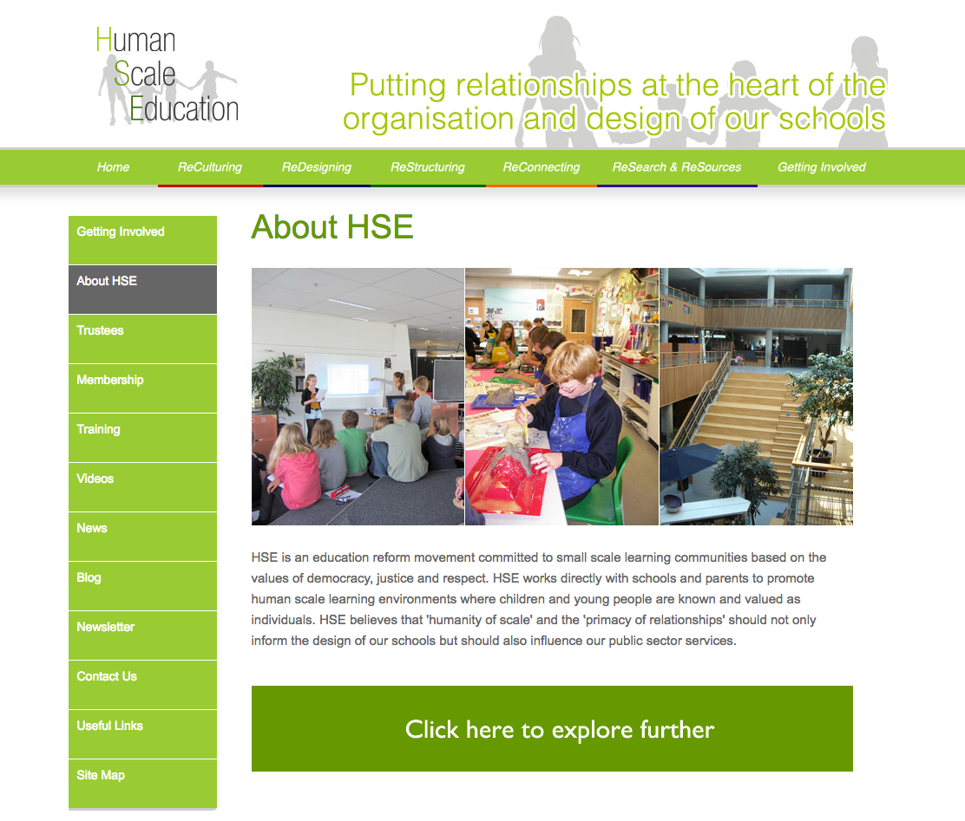
Human scale education
Schools within schools – the creation of learning communities that challenge pre-existing norms and structures, developed from a holistic and person-centred position
Identified benefits for both staff and students, including: improved transitions; reduced anonymity; improvements in sense of belonging; stronger learning relationships; more reflexive and inclusive pedagogies.
Notes:
Idea of human scale education outlined more explicitly – point is to think about how this relates to what we have presented and whether this is a useful concept to work with.
Louise?

Slide 25
“One cannot teach a student well if one does not know that student well.” (Davies p.104)
Designed: “To use time as appropriate to learning rather than as containers into which learning has to be levered.” (Davies p. 109)
Facilitated: “The development of a series of learning communities through the encouragement of a limited and coherent number of teachers to work alongside a dedicated cohort of students.” (Davies p. 109)
“Smaller scale structures were better able to facilitate ‘the appropriate dialogue, a continuous, prolonged, unhurried, activity-related conversation between teacher and student’ that would lead to greater challenge and rigour.” (Davies p.100)
Notes:
Some key ideas from the article that encourage us to think about how we organize, time, staffing, relationships

Slide 26
The school we’d like?
A beautiful school…
A comfortable school…
A safe school…
A flexible school…
A relevant school…
A respectful school…
A school without walls…
A school for everybody…
(Birkett 2001, cited in Davies, 2005, p. 107-8.)
Notes:
This is just he start of some lines from poem quoted in the article – full reference at end of presentation
The poem gave young people an opportunity to contribute what they felt a school should do/provide – what they wanted and why

Slide 27

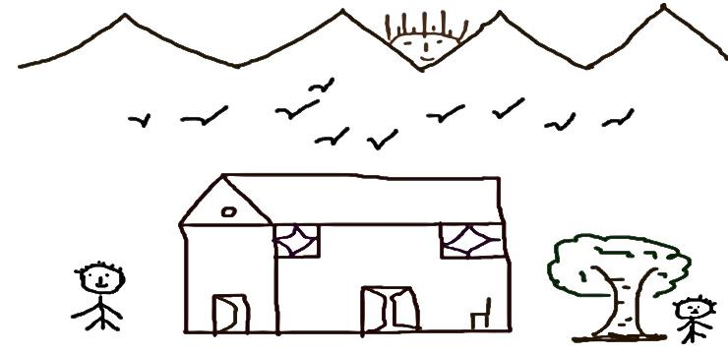
The university we’d like?
“At the heart of the College [university] are the students and the arrangements made to enhance their learning.” (p.110)
Please share ideas as a group before capturing your thoughts on the flip paper provided
Consider making a distinction between what might be within reach and more blue skies thinking
Notes:
Group to come up with their ideas for a human-scale university – and time needed to share these
Who to lead?

Slide 28

Beyond the workshop?
Do we see the need for a more human-scale approach to university – and if so why?
Can we identify anything that might be done differently – by us – by others - that could be taken forward from today?
Notes:
Gather ideas, final thoughts and ways forward
Who to lead?

Slide 29
References
Davies, M. 2005, Less is More: the move to person-centred, human scale education, FORUM, 47, 2, pp. 97- 118

