Slide 1
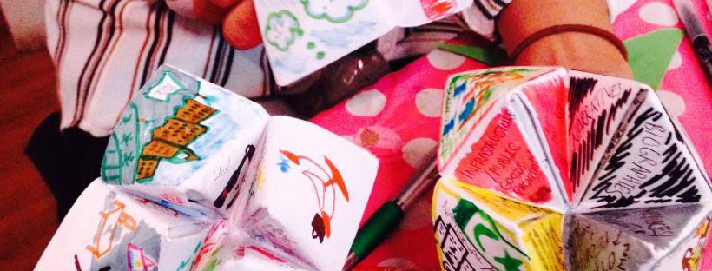

Writing into meaning together: Inclusive approaches to supporting doctoral students to write
Inclusive Teaching, Learning and Assessment: Sussex Teaching and Learning Conference 2017
Dr Emily Danvers, Dr Tamsin Hinton-Smith, and Dr Rebecca Webb

Slide 2
Writing into meaning? Today’s session:
What is this all about? Engaging in ‘writing into meaning’ practice
Why do things the way we did? Situating this group within pedagogical and theoretical literature.
What can I take from this? Engendering inclusive and productive spaces to support doctoral writing

Slide 3

Something to get us going…

Slide 4
What we did and why
‘Writing a doctoral thesis is well known for inducing anxiety. Given the scale of the task and the nature of writing itself, this is understandable and, perhaps to some extent at least, inevitable.’
(Barnacle & Dall’Alba 2013:1139)

Slide 5

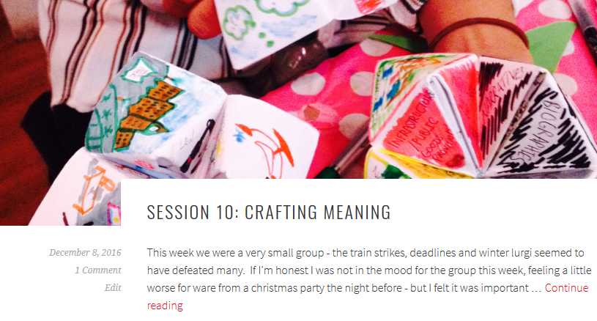
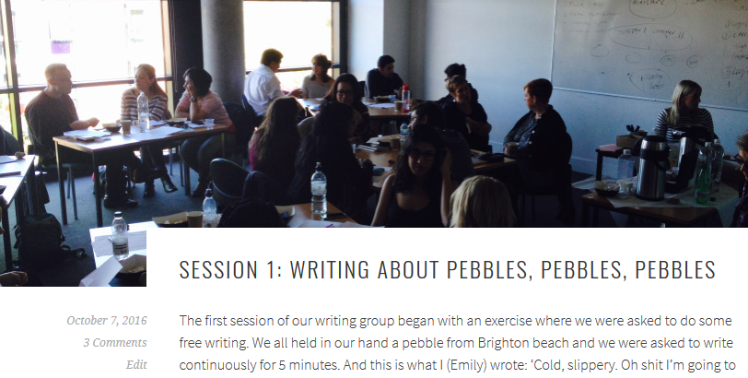
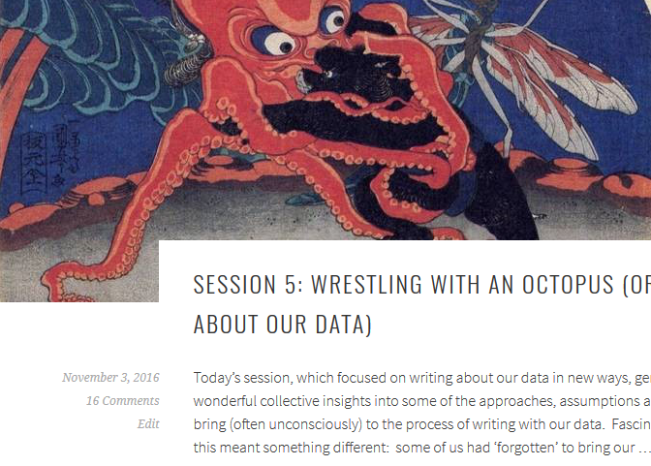
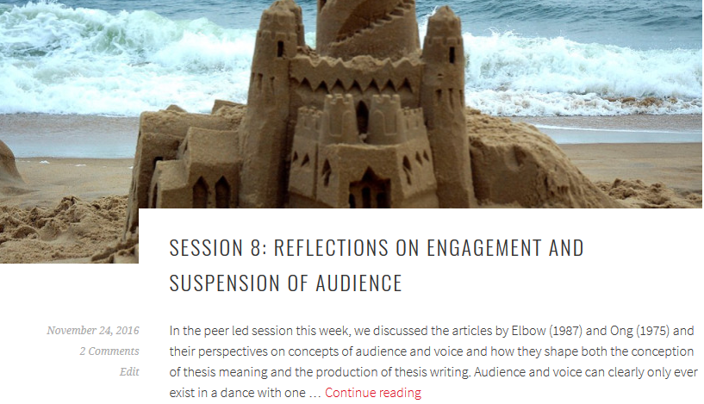
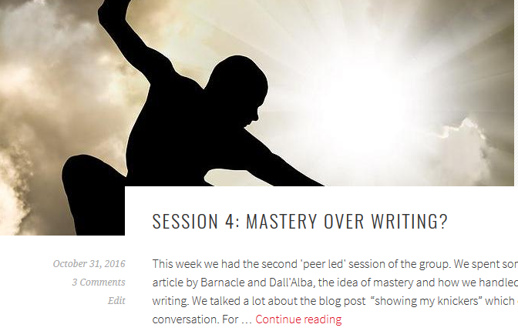

Slide 6
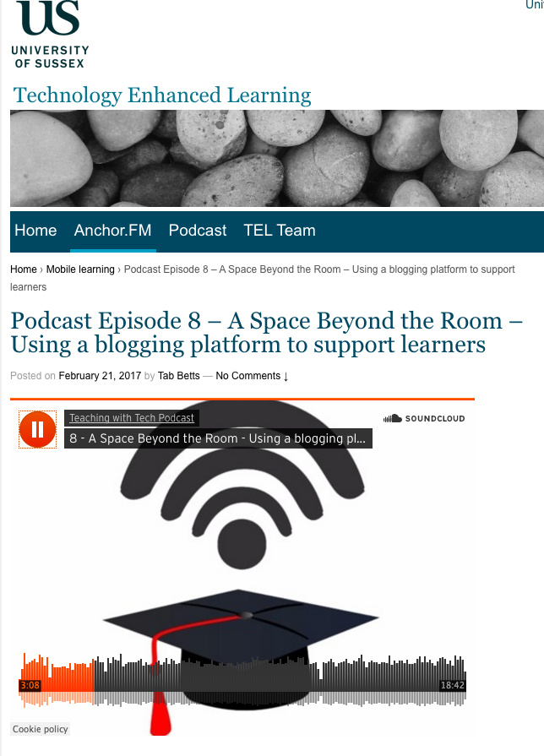

Slide 7
How we approached it
Developing advanced academic writing suggest pedagogical initiatives should go beyond discussions of technique and process and instead promote space to encourage a ‘sophisticated awareness of how to project oneself within a variety of social, cultural and linguistic settings.’
(Aitchison, 2009:906)

Slide 8
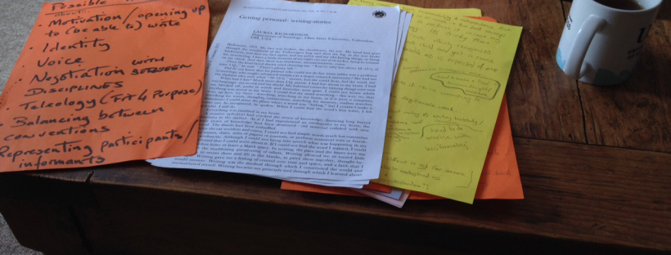
‘Double struggle’ in the mastery of research writing (Barnacle & Dall’Alba 2013)
‘Getting personal’ in academic writing (Richardson 2001)
Higher education as a collective rather than individual good (Reay 2013)

Slide 9
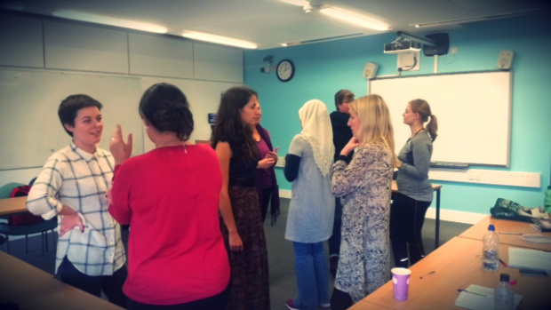
Experiences of the group
‘Thank you so much for putting together the concept and leading this group. Not only for the content but also the space you created which allowed people to talk freely about both issues and insights. It has been a very useful and timely experience and has forced me to confront some areas of my PhD I would have happily avoided for a while longer, for which I am very grateful.’

Slide 10
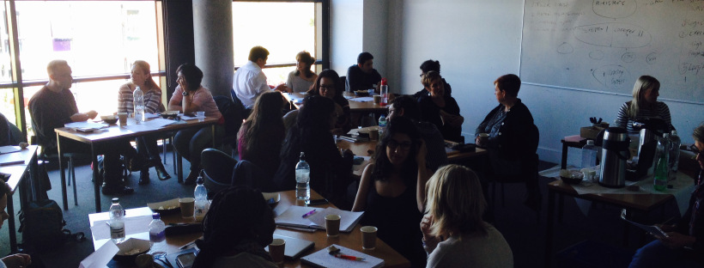
Taking Writing into meaning forward

Slide 11
References
Aitchison, C. (2009) Writing groups for doctoral education, Studies in Higher Education, 34:8, pp.905-916,
Barnacle, R. and Dall’Alba, G. (2013). Beyond Skills: Embodying Writerly Practices Through the Doctorate. Studies in Higher Education 39 (7). pp.1139-1149.
Elbow, P. (2000). Everyone can write: Essays toward a hopeful theory of writing and teaching writing. Oxford University Press on Demand.
Reay, D. (2013) Social Mobility, a Panacea for Austere Times: Tales of Emperors, Frogs, and Tadpoles. British Journal of Sociology of Education 34(5-6), pp.660-677.
Richardson, L. (2001). Getting personal: Writing-stories. International Journal of Qualitative Studies in Education, 14 (1) pp. 33-38.
Ong, W.J. (1975). The writer's audience is always a fiction. Publications of the Modern Language Association of America, pp.9-21.

