Slide 1
Overcoming Barriers to Inclusive Learning:
Is Team Based Learning (TBL) the Answer?
Buge Apampa, Geeta Hitch & Tara Hadley

Slide 2

Learning Outcomes
  Explain how and why team-based learning works
  Discuss the benefits and challenges of team-based learning at course level
  Describe solutions for overcoming these challenges
Adapted from Centre for Educational Development , The Flipped Classroom & Team-Based Learning

Slide 3
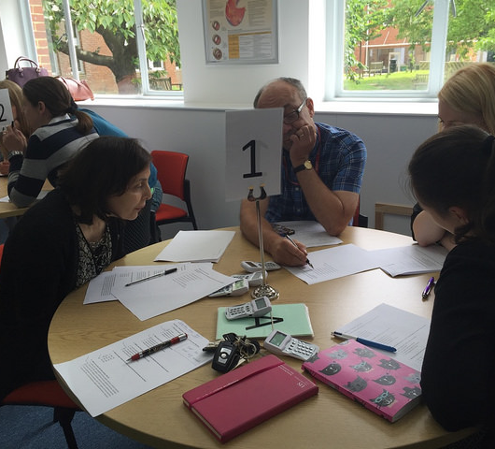
TBL Pedagogy
Why TBL?
What is TBL?
Team Formation
Readiness Assurance Process
Application exercises
Our Experiences of TBL
Discussion and Q&A
Adapted from Centre for Educational Development , The Flipped Classroom & Team-Based Learning

Slide 4
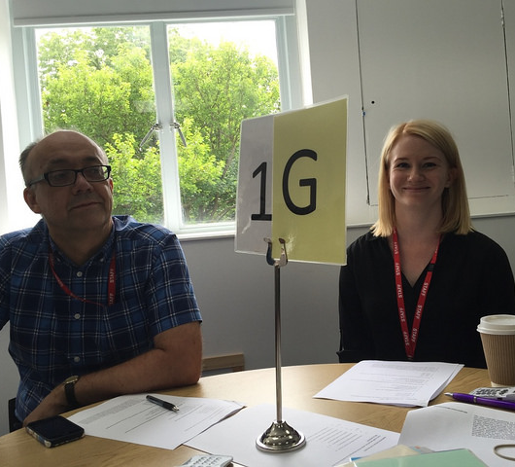
Sussex Pharmacy TBL Class
Teaching & Learning Strategy
Active Learning
Engaged learning & Teaching
Meaningful Learning versus Rote Learning
21st Century Learners
Peer to Peer Learning
Peer Evaluation
Attendance
Adapted from Centre for Educational Development , The Flipped Classroom & Team-Based Learning

Slide 5

Why TBL?
Benefits of small-group learning but scalable
Accountability to self and team
Removes passivity
Removes anonymity

Slide 6
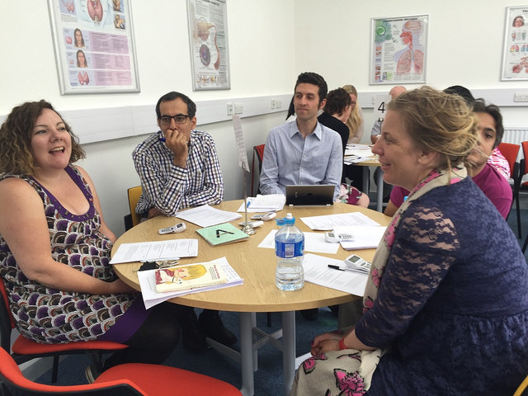
Expectation of Students
Prepare for class
Come to class
Participate and engage
Apply knowledge
Take a deep approach to their learning
Have Fun!

Slide 7
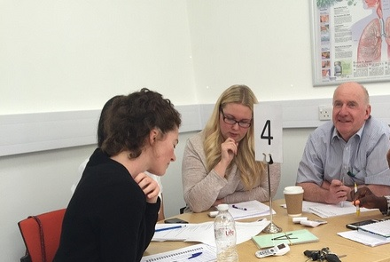
What is TBL?
“A special form of collaborative learning using a special sequence of individual work, group work and immediate feedback to create a motivational framework in which students increasingly hold each other accountable for coming to class prepared and contributing to discussion”

Slide 8
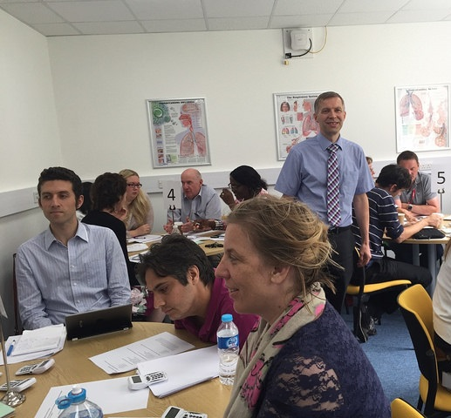
Four Key TBL Design Principles
Teams must be properly formed and managed
  Diverse & inclusive
  Permanent teams formed transparently
Students must be motivated to come to class prepared
Students must learn to use course concepts to solve problems
Students must be truly accountable
Adapted from Centre for Educational Development , The Flipped Classroom & Team-Based Learning

Slide 9
The TBL Class
Content
Pre-class
Readiness Assurance Process (RAP)
20-30% of class time
Application Exercises
70-80% of class time
  Individual Study
  Directed to Learning Resources
  4S criteria
    Significant
    Same
    Specific Choice
    Simultaneous
  iRAT
  tRAT
  Appeals
  Corrective Instruction
  Intra-team discussion
  Inter-team discussion, debate and justification
Adapted from Centre for Educational Development , The Flipped Classroom & Team-Based Learning

Slide 10
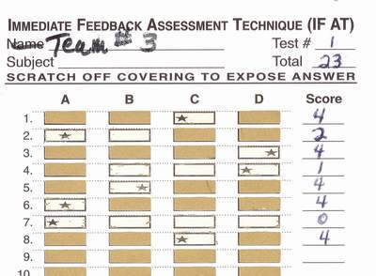
Readiness Assurance Process
Content
Pre-class
Readiness Assurance Process (RAP)
20-30% of class time
  Individual Study
  Directed to Learning Resources
  iRAT
  tRAT
    IF AT cards
    Same Test as a team

Slide 11
Sussex Pharmacy Adapted TBL Class
Content
Readiness Assurance Process (RAP)
20-30% of class time
Integration Sessions
70-80% of class time
  Individual Study
  Directed to Learning Resources
  iRAT
  tRAT
  Appeals
  Corrective Instruction
  4S criteria
    Significant
    Same
    Specific Choice
    Simultaneous
  Intra-team discussion
  Inter-team discussion, debate and justification
Adapted from Centre for Educational Development , The Flipped Classroom & Team-Based Learning

Slide 12
Let’s have a go!
Team Formation
Diverse Teams
Team formation
  Used TBL?
  Attended a TBL workshop?
  Watched a TBL session?
  Completed the Advanced Assignment
    Study Guide - An Introduction to TBL
  Rate your understanding of TBL 5 (excellent) to 1 (poor)
  Anyone else
Adapted from Centre for Educational Development , The Flipped Classroom & Team-Based Learning

Slide 13
Step 1 - Readiness Assurance Process
iRAT
  Complete the test
  Closed Book
  Individual
tRAT
  Closed book
  Team
  IF-ATs
Appeals
Corrective Instruction (Corrective Feedback)
Adapted from Centre for Educational Development , The Flipped Classroom & Team-Based Learning

Slide 14
Step 2 - Application Exercise 1
From a staff perspective, which of the following do you believe is the most important benefit of TBL to students? – 5 minutes
A Enhanced student attendance
B Enhanced student engagement
C Increased student attainment
D Enhanced student motivation
E Promotes deeper approaches to learning
Adapted from Centre for Educational Development , The Flipped Classroom & Team-Based Learning

Slide 15
Application Exercise 2
Which of the following is the most important reason that TBL works? – 5 minutes
Students receive immediate feedback in the tRATs
Students work on challenging and authentic applications
Students are held accountable to their teams
Students relate new knowledge to, and integrate it with, pre-existing knowledge (constructivist learning theory)
Students are actively applying knowledge to solve problems
Adapted from Centre for Educational Development , The Flipped Classroom & Team-Based Learning

Slide 16
Application Exercise 3
Which of the following aspects of TBL do you feel that you (as teachers) will find the most challenging skill? – 5 minutes
  A. Writing the RAT questions
  B. Writing application exercises
  C. Giving the corrective feedback after the RAP
  D. Managing the appeals process
  E. Managing the peer evaluation process
Adapted from Centre for Educational Development , The Flipped Classroom & Team-Based Learning

Slide 17
Application Exercise 4
Which of the following would you say is likely to be the most challenging when implementing TBL in a module? – 5 minutes
Students who don’t prepare for class
Freeloading student benefiting from the others in the team
Too much noise in the room
Increased staff contact time
Increased administration
Adapted from Centre for Educational Development , The Flipped Classroom & Team-Based Learning

Slide 18
Application Exercise 5
Where in the TBL cycle do you believe is the most effective at developing deep approaches to learning – 5 minutes
tRAT
Appeals
Corrective Instruction
Application Exercises
Discussion of application exercises

Slide 19
Experiences of TBL so far- a review
Benefits
Challenges
Quantitative data
Qualitative data
Employability skills

Slide 20
Outcomes – Benefits so far
“Good Team Work”
“Argumentative but overall great”
“Loud but mostly helpful”
Students
  Mostly very positive
  Enjoyable experience
  Peer-to-Peer Learning
Staff
  Students come prepared
  Students engaged in learning
  Students are more confident
  Supports inclusive learning
“Good to get to know new people and be taught by different professors”
“Improved my learning a lot”
“It is a great idea and it has really assisted my learning”
“I love my Team”
“Life Saving”
“Amazing”

Slide 21
Developing Readiness Assessment Tests
Staff Teamwork
Outcomes - Challenges
  Managing Expectations
    Faculty
    Students
Facilitation skills
Integration Cases
  Authentic, integrated and
  challenging
  Timings
Difficult concepts
  Student Support Sessions
Managing the readiness assurance process
Dealing with in-course retrievals
Developing authentic, challenging and integrated case studies
Effective facilitation
Additional workshops to support acquisition of more basic scientific concepts

Slide 22
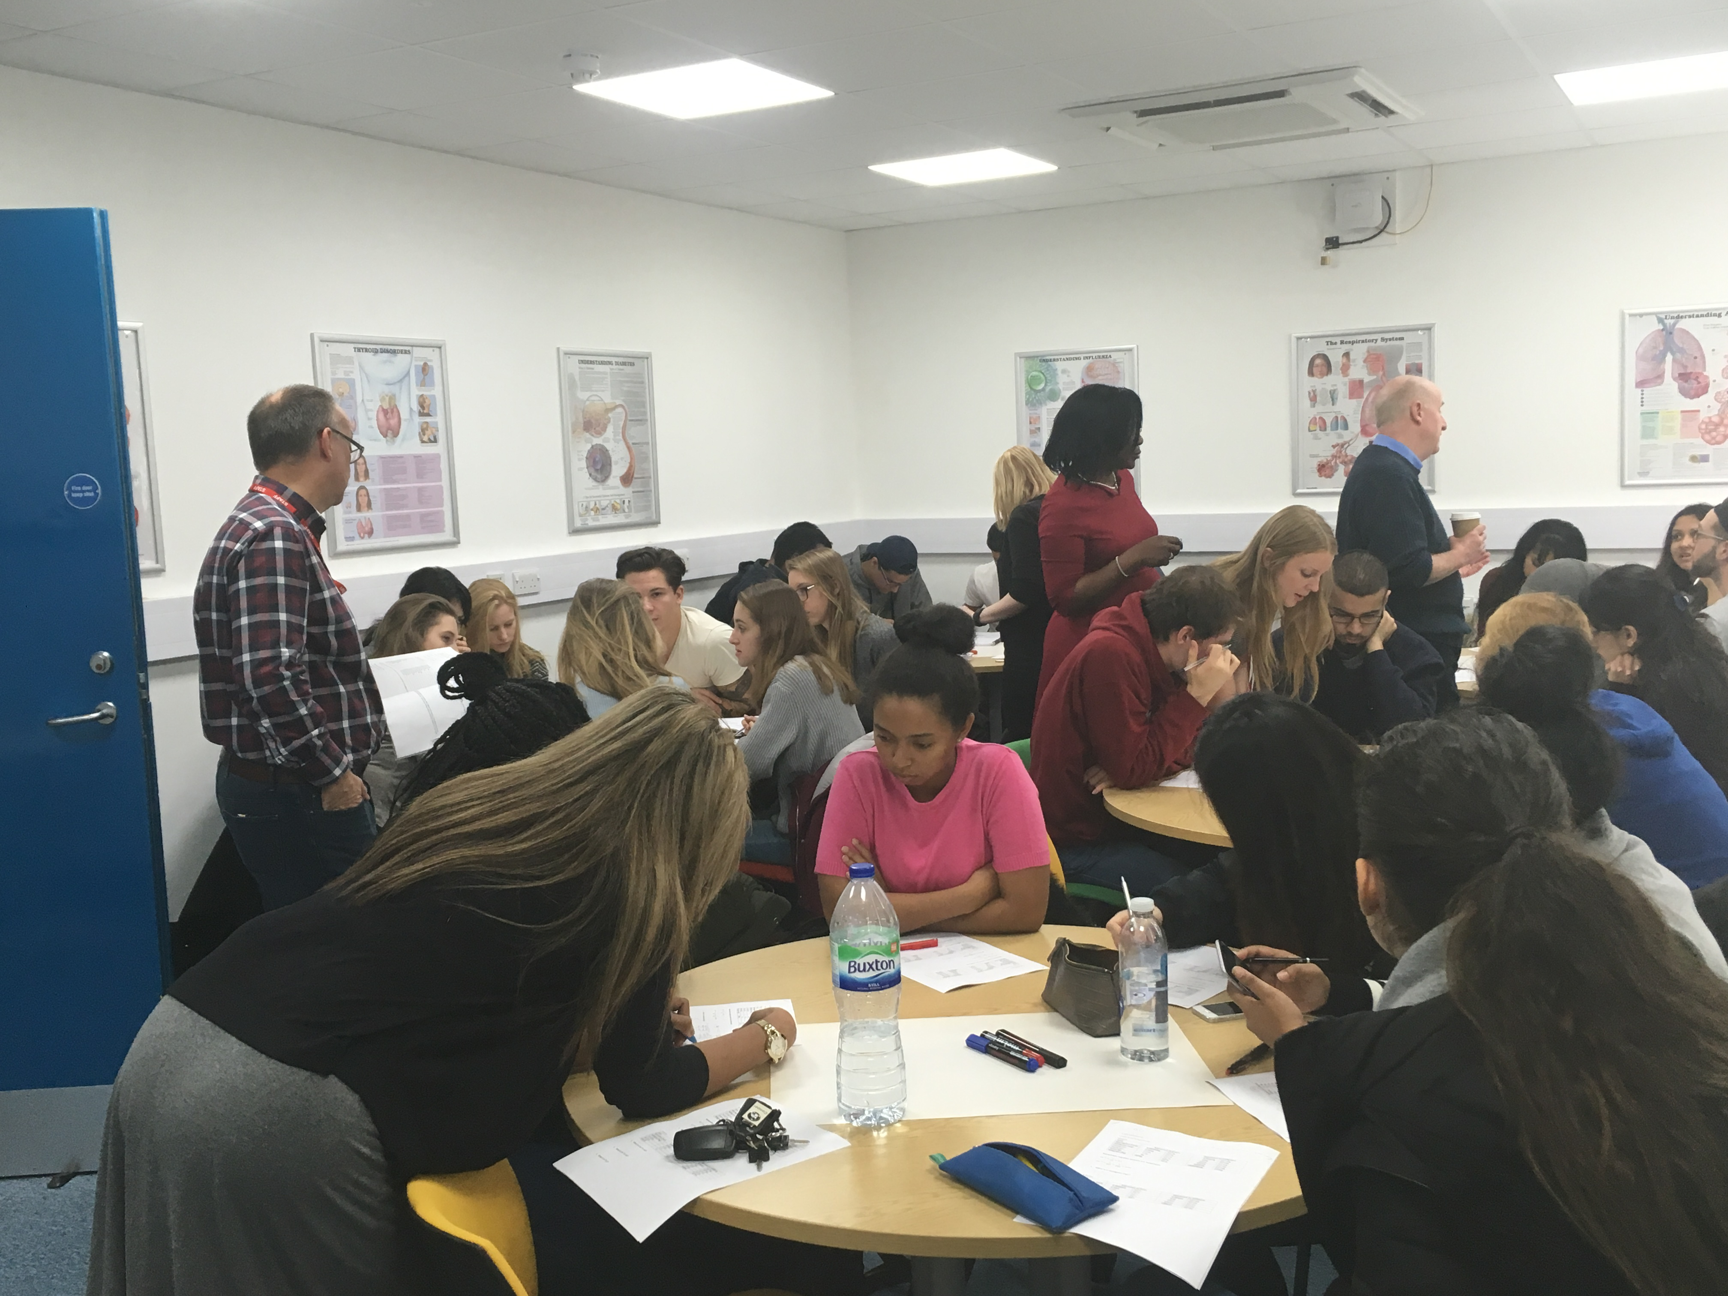
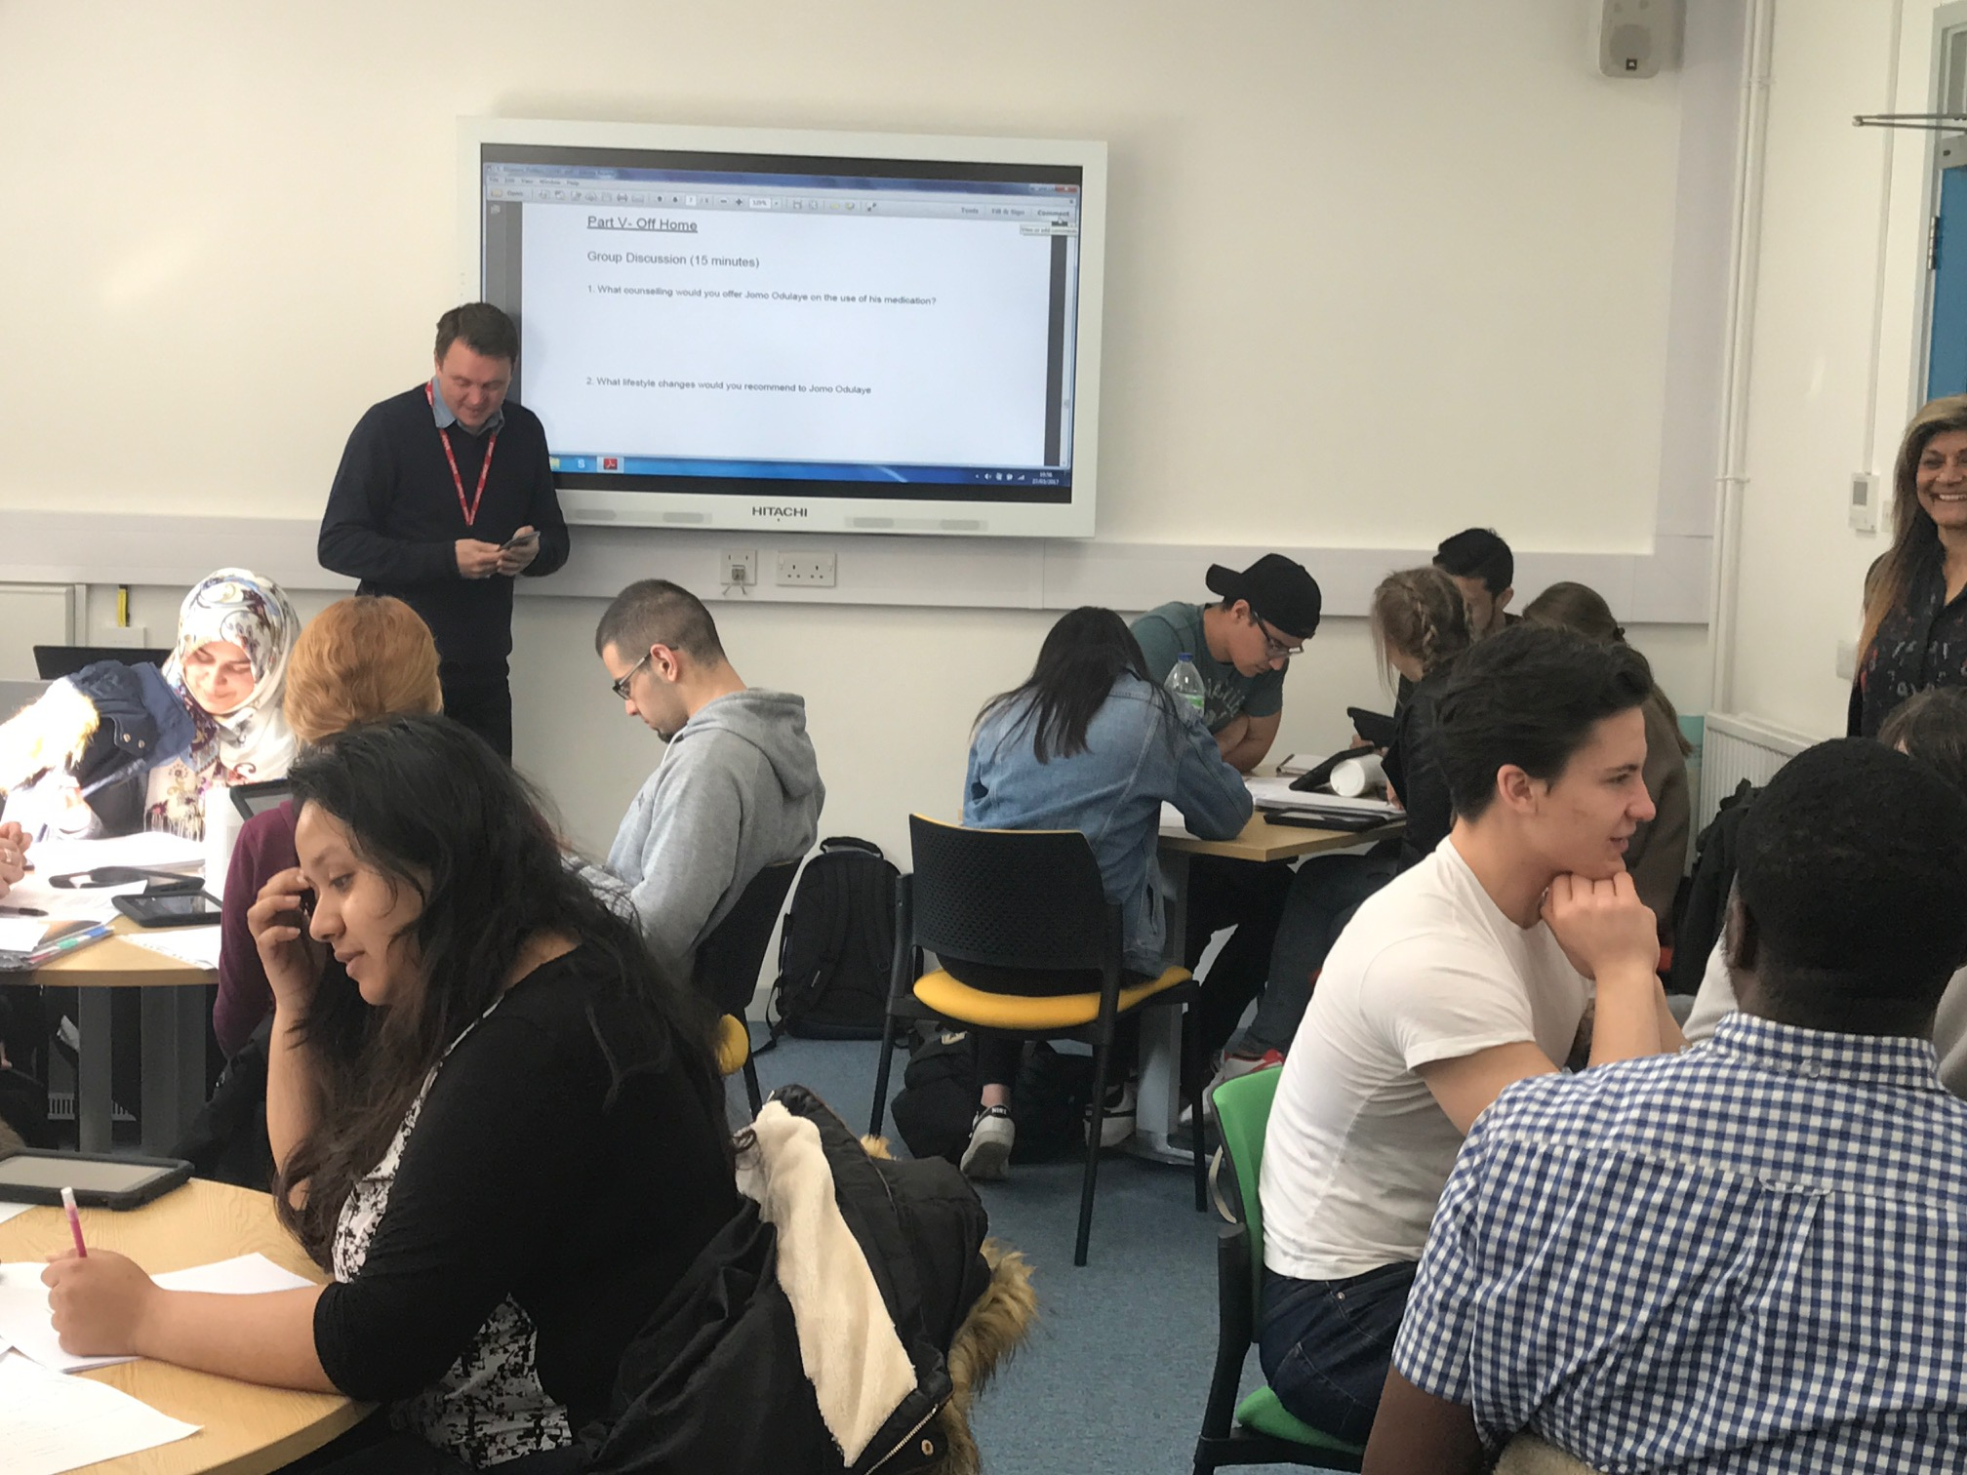
Sussex Pharmacy TBL Class
Benefits
  Attendance
  Engagement
  Peer Learning
  Peer Support
  Improved satisfaction
  Improved results
  Fun

Slide 23
PHA 101 TBL Results
 | iRATs | iRATs | tRATs | tRATs
 | Lowest Score % | Mean Score % | Lowest Score % | Mean Score %
1. | 29 | 66 | 82 | 91
2. | 43 | 71 | 86 | 92
3. | 29 | 62 | 89 | 96
4. | 33 | 63 | 75 | 84
5. | 14 | 48 | 54 | 71
6. | 14 | 68 | 79 | 91
7. | 14 | 58 | 79 | 94
Teams generally
outperformed
individuals
Lowest team scores substantially higher than mean of individual scores

Slide 24
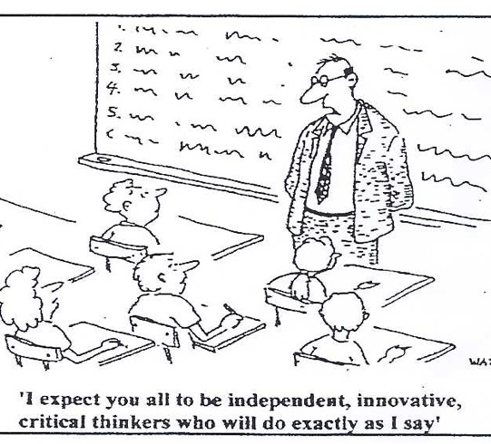
  TBL also Fosters Employability Skills
Collaborative
Communication
Critical thinkers
Independent learners
Confidence
Peer to Peer Teaching

Slide 25
References
Hrynchak, P. (2012). The educational theory basis of team-based learning. Medical Teacher, 34(10), 796–801. doi:10.3109/0142159X.2012.687120
Van der Vleuten, C. P. M., & Driessen, E. W. (2014). What would happen to education if we take education evidence seriously? Perspectives on Medical Education, 3(3), 222–232. doi:10.1007/s40037-014-0129-9

Slide 26
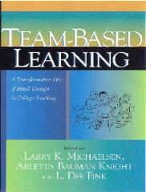


Further Resources
  Books (Michaelsen and Sibley)
  TBLC at www.teambasedlearning.org
  Email: s.j.tweddell@bradford.ac.uk

Slide 27

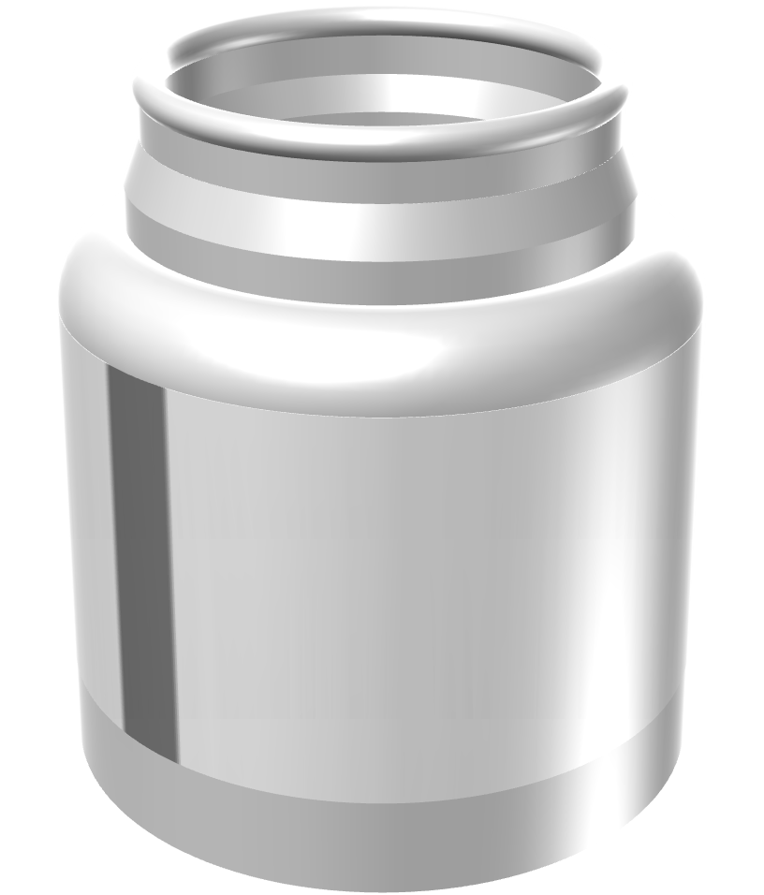
THANKS. ANY QUESTIONS

