Slide 1
How can technology make your teaching more inclusive?

Slide 2
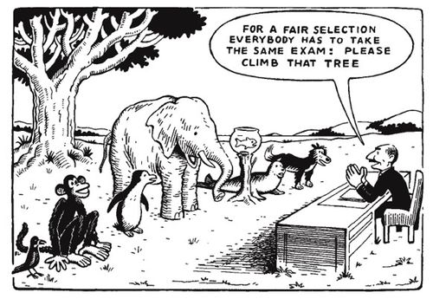
The social model of disability...
‘...emphasises that disability is caused by the way society is organised, rather than by a person’s impairment or difference... https://www.gov.uk/government/publications/inclusive-teaching-and-learning-in-higher-education
Found in 1242 places online, dating back to at least 2009, but no info on author.

Slide 3
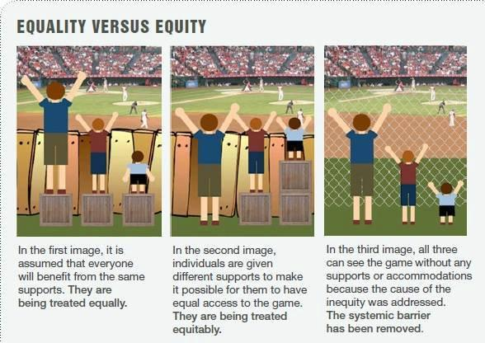
...and looks at ways of removing barriers ...
Found on Twitter at https://twitter.com/ajcorrigan/status/795610919967584256/photo/1
Source uncertain

Slide 4
Not just compliance with disability legislation
‘HE providers could embrace and adopt this approach as it supports and guides the ways in which pedagogy; curricula and assessment are designed and delivered to engage students in learning that is meaningful, relevant and accessible to all.’
https://www.gov.uk/government/publications/inclusive-teaching-and-learning-in-higher-education

Slide 5
‘learning that is meaningful, relevant and accessible to all’
Diverse students
Diversified teaching
Wider range of activities
Multimedia resources
Flipped learning

Slide 6
Universal Design for Learning
Provide multiple means of representation - present information to students in different ways
Provide multiple means of action and expression - allow students to approach learning tasks and demonstrate what they know in different ways
Provide multiple means of engagement - offer options that engage students, fuel their interests and provide autonomy

Slide 7

Task 1 - Match the cards
In front of you are two sets of cards:
Orange cards = learning tasks students have to do.
Blue cards = collections of different tools.
Match the learning tasks with set of tools which could be used to assist students in their learning.
If some activities aren’t covered add them to the
blank cards.

Slide 8
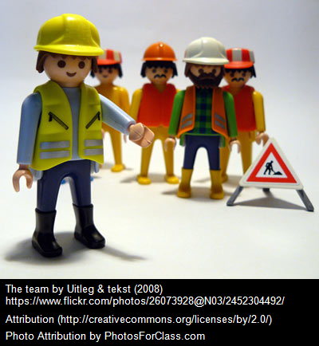
Get a learning technologist on your team!
LTs as consultants/guides
Tell us what you want to achieve
We’ll suggest tech to help (or not)
and support you using it
Email tel@sussex.ac.uk

Slide 9
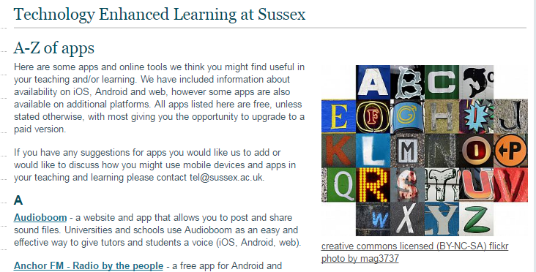
Where to find more ideas?
TEL’s A-Z of apps
http://blogs.sussex.ac.uk/tel/
Developing students’ discipline-specific vocabulary
Gamification using Poll Everywhere’s Segmented Responses
Portfolios, assessment and Mahara
Podcast Episode 8 – Using a blogging platform to support learners
Tech for active learning in large groups.

Slide 10

Task 2 - Creating an activity
Using the cards, choose an area that you would like to work on.
Plan a task or activity for class time - which uses one or more of the tools suggested.
Call on one of the learning technologists if you aren’t sure what tool(s) are most appropriate.
Your outputs will be captured and shared amongst
the group.

Slide 11
Department for Education, ‘Inclusive Teaching and Learning in Higher Education as a route to Excellence’, 27/1/2017 https://www.gov.uk/government/publications/inclusive-teaching-and-learning-in-higher-education
Jisc, ‘Supporting an inclusive learner experience in higher education’, 17/2/2016, https://www.jisc.ac.uk/guides/supporting-an-inclusive-learner-experience-in-higher-education

