Slide 1
Supporting student partnerships
in assessment and feedback
April 2017
Sarah Williams, Katharine Gilmore , Ali Hassan Hadadi

Slide 2
TEF Year Two: Assessment Criteria
Teaching Quality
Learning Environment
Student Outcomes and Learning Gain
Student Engagement
Resources
Employment and Further Study
Valuing Teaching
Scholarship, Research and Professional Practice
Employability and Transferrable Skills
Rigour and Stretch
Feedback
Personalised Learning
Positive Outcomes for All

Slide 3
Session Outcomes
By the end of the session you should be able to:
Choose feedback methods that provide learning opportunities for students.
Engage students in self and peer feedback to help students develop their skills of self-assessment.

Slide 4
Activity 1: Group discussion
What is feedback?
What makes effective feedback?

Slide 5
Activity 2
Watch this film clip with the students giving their perspectives on what makes effective feedback.
What strikes you about their views?

Slide 6
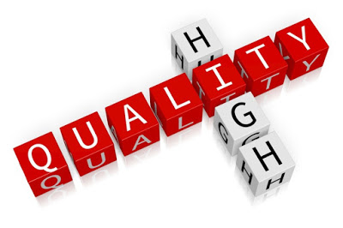

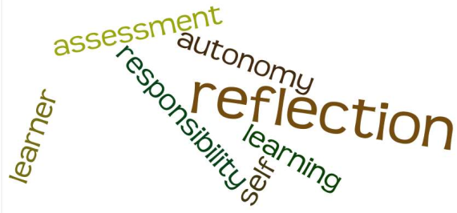
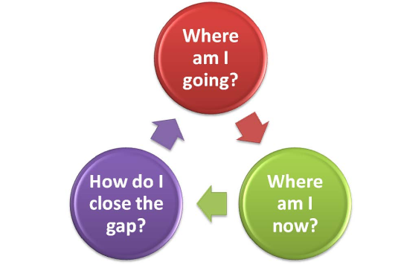



7 Principles of effective feedback
Nicol and Macfarlane-Dick (2006)

Slide 7
Enhancing Assessment and Feedback practice in HE: Self-Regulatory Approach
EAT Framework and Assessment Tool (Evans 2013, 2016)
The key aim of assessment feedback should be to support students to become more self-regulatory in managing their own learning as part of sustainable assessment practice; a focus on three core areas is recommended:
Assessment Literacy
Assessment Feedback
Assessment Design
Enhancing Assessment and Feedback practice in HE: EAT (Evans 2016 Evans Assessment Tool)

Slide 8
Principles and practice - 1
Assessment Literacy
Good Feedback helps clarify what good performance is (goals, criteria, standards).
  To what extent do learners on your course have opportunities to engage actively with goals, criteria and standards before, during and after assessment?

Slide 9
Activity 3
Watch this short video clip about students talking about assessment criteria.
What challenges do their views imply?

Slide 10
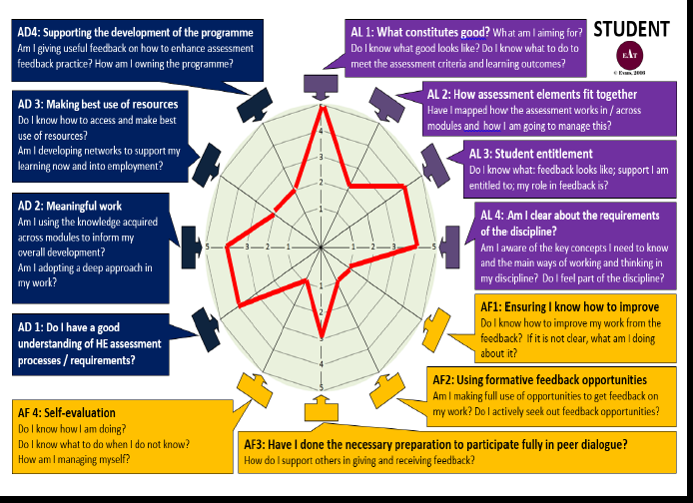

Slide 11
Student feedback focus group and student activities
GOOD PRACTICE: You might provide
‘Exemplars’
Student-friendly criteria sheets
Discussion about goals/criteria/standards in class (before an assignment)
Subject specific checklist
Assessment exercises peer-marked against the criteria

Slide 12
Benefits of Self-Regulation
The construct of self-regulation refers to the degree to which students can regulate aspects of their learning (Pintrich and Zusho, 2002)
Evidence showing that learners who are more self regulated are more effective learners (Zimmerman and Schunk, 2001)
Giving feedback is cognitively more demanding than receiving feedback hence peer feedback accelerates learning (Nicol, 2009)
Feedback - if done well is the most powerful enhancement to learning (Biggs and Tang, 2007, 2011)
Quality of feedback can be problematic as staff student ratios deteriorate (Barker 2011). Students who engage in regulatory activities are less dependent on external teacher support (Zimmerman and Schunk, 2004)
Students become empowered and develop the self regulation skills needed to prepare them for learning outside of University and throughout life (Hounsell 2007)

Slide 13
Promoting Engagement
Students as:
Change and research partners
Self regulators
Self and co-assessors
Engagement beyond the University-post course consciousness (Bass, 2012)

Slide 14
Self-Regulatory Approach
Assessment Literacy- ‘feed in’
How do we create a ‘shared understanding’ of the requirements of assessment?
Assessment Feedback – ‘feed forward’ and ‘feed up’
How are we maximising opportunities to apply what has been learnt? E.g. within context of programme and in future learning gains in employment
Assessment Design - fostering an inclusive and collaborative partnership
How can we create opportunities for students to co-own their programme with lecturers/tutors, to be active contributors rather than seeing assessment as something that is done to them (Evans 2016) ?

Slide 15
References
Biggs J and Tang C (2011) Teaching for quality learning at university, OU Press.
Brown,S. (2007) ‘Feedback and Feed-Forward’ Centre for BioScience Bulletin, 22 (Autumn 2007)
Campbell A and Norton L (eds) (2007) Learning, teaching and assessing in Higher Education, Learning Matters
D J Nicol & D Macfarlane-Dick, ‘Formative assessment and self-regulated learning: A model and seven principles of good practice” in Studies in Higher Education (2006), Vol 31(2), 199-218
Evans, C (2013) Making Sense of Assessment Feedback Practice in Higher Education is published in Review of Educational Research and is available to download free.
Evans, C (2016) Evans Assessment Tool (EAT). University of Southampton
HE Academy Feedback toolkit (Accessed 26.02.17)
https://www.heacademy.ac.uk/hea-feedback-toolkit There are links from here to other
pages that may be useful
Hounsell, D. (2007) Towards more sustainable feedback to students. In D.Boud & N.Falchikov (Eds), Rethinking assessment in higher education (pp. 101-1113). London UK:Routledge
Sadler, D.R.(20100. Beyond Feedback: Developing student capability in complex appraisal. Assessment and Evaluation in Higher Education, 35, 535-550
Waring, M., & Evans, C. (2015). Understanding Pedagogy: Developing a Critical Approach to Teaching and Learning. Abingdon, Oxford: Routledge.

