Slide 1

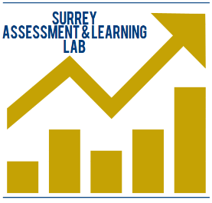

Student engagement with feedback
Dr Naomi Winstone
Senior Lecturer in Higher Education, National Teaching Fellow
University of Sussex
15th May 2018
From transmission to transformation: Maximising the impact of assessment feedback through staff-student partnerships
Dr Naomi Winstone
Senior Lecturer in Higher Education, HEA National Teaching Fellow
Director, Surrey Assessment & Learning Lab
@DocWinstone
Notes:
https://www.youtube.com/watch?v=2m3K2IbSJhE
https://www.youtube.com/watch?v=QuLaQoQP9oo

Slide 2

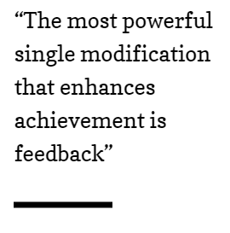
Feedback is power…
John Hattie, 1992, The Power of Feedback
Notes:
The only thing that matters is what students do with it. No matter how well the feedback is designed, if students do not use the feedback to move their own learning forward, it’s a waste of time.

Slide 3
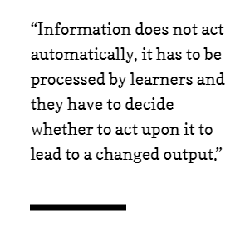

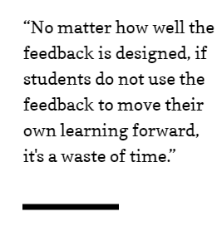
Feedback is power… BUT
David Boud and Elizabeth Molloy, 2013, Rethinking models of feedback for learning: The challenge of design.
Dylan Wiliam, 2014, Is the feedback you’re giving students helping or hindering?
Notes:
Effectiveness about what educator or student does?

Slide 4

Models of feedback
The ‘Old Paradigm’: Feedback as Comments
One-way transmission of feedback
Focus on style and detail of comments; presentation of feedback
David Carless, 2015, Excellence in University Assessment

Slide 5

Models of feedback
“…in institutional discourse feedback has rather curiously become seen as synonymous with summative comments after the fact…Assessment-related artefacts, such as university feedback sheets, are officially produced to reify feedback”
Kay Sambell, 2016, Assessment and Feedback in Higher Education: Considerable Room for Improvement?

Slide 6

Models of feedback
The ‘New Paradigm’: Feedback as
Dialogue
Focus on active engagement and the effect of feedback on students’ work
David Carless, 2015, Excellence in University Assessment

Slide 7

The student perspective

Slide 8

The staff perspective
Notes:
Grade justification
timing

Slide 9

A partnership approach
“We're paying for education so it's not our, sort of responsibility to engage with feedback because we're paying for it”
-- Undergraduate Economics student
Winstone, Medland, Bourne, Rees & Niculescu (in prep)
“I assume [students] are educated enough to deal constructively with the feedback they receive – otherwise they should not be at my university anyway”
Carless & Winstone (forthcoming, 2019)

Slide 10
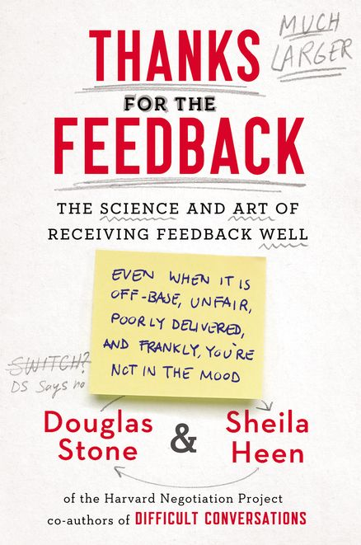
“Interesting. When we give feedback, we notice that the receiver isn’t good at receiving it. When we receive feedback, we notice that the giver isn’t good at giving it.”
Stone and Heen (2014,
p. 3)

Slide 11

We’re all human

Slide 12

Do you have TAA Deficiency?
We’re all human
(Howell & Shepperd, 2013)

Slide 13

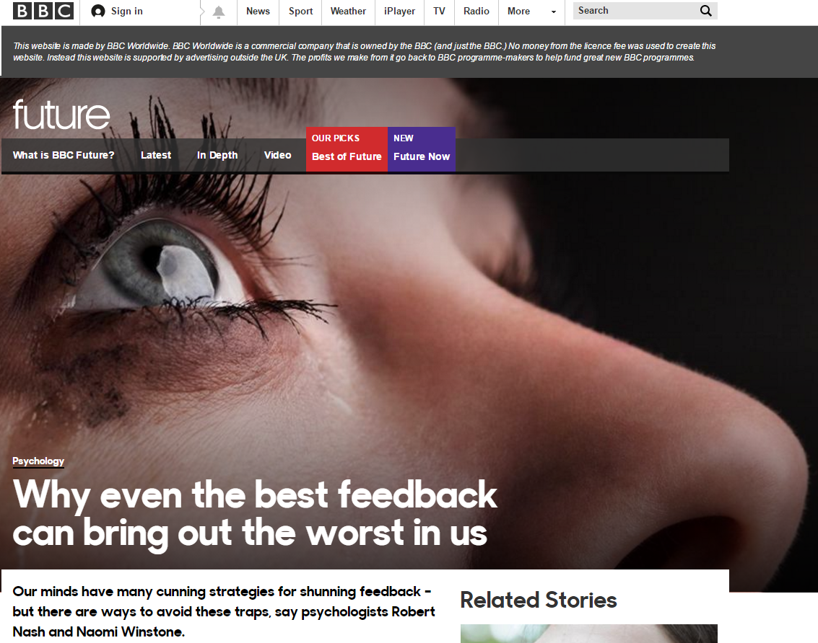
We’re all human

Slide 14
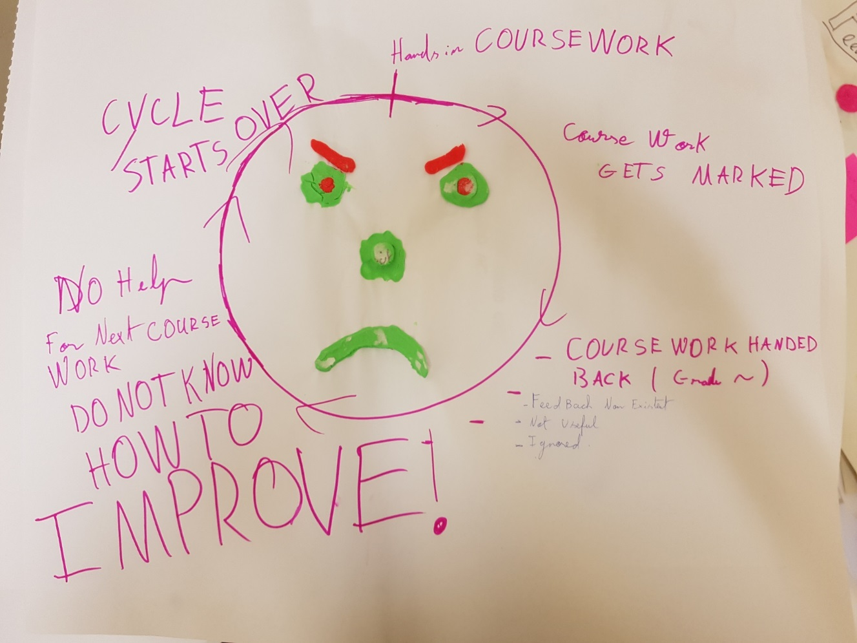
We’re all human
Winstone, Rees, Niculescu & Medland (in prep)

Slide 15
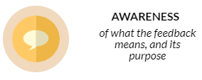
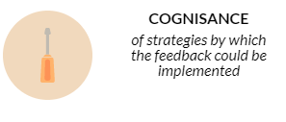
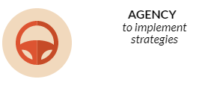
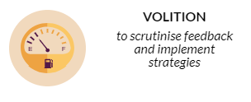
Why it can be difficult to use feedback
Winstone, N.E., Nash, R.A., Rowntree, J., & Parker, M. (2017). “It’d be useful, but I wouldn’t use it”. Barriers to University students’ feedback seeking and recipience. Studies in Higher Education, 42(11), 2026-2041.
Notes:
Grade justification vs learning
Opportunity- when does feedback come?

Slide 16
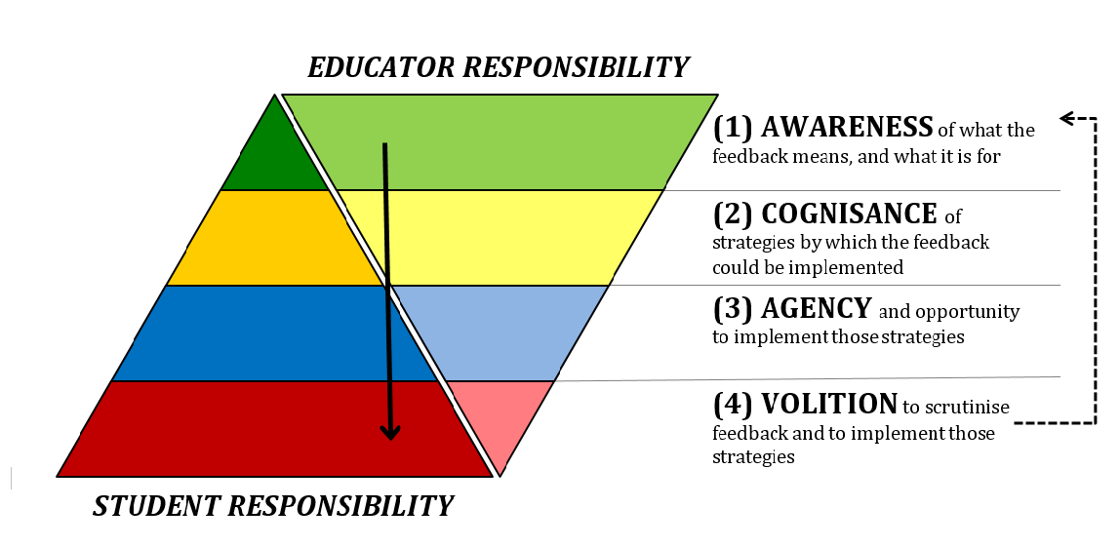
Responsibility sharing
Nash, R.A., & Winstone, N.E. (2017). Responsibility sharing in the giving and receiving of assessment feedback. Frontiers in Psychology, 8, 1519.

Slide 17


Dialogue and shared purpose
“Students potentially have access to a limitless pool of feedback opportunities during their time at university, but this is a resource to be drawn down and implemented through a process ultimately driven by the student themselves, not something to be merely “received”.
(Winstone & Pitt, 2017)
Winstone, N. E., & Pitt, E. (2017). Feedback is a two-way street, so why does the NSS only look one way? Times Higher Education, 2332 , 30.

Slide 18

Building Feedback Literacy
“students should be trained in how to interpret feedback, how to make connections between the feedback and the characteristics of the work they produce, and how they can improve their work in the future”
(O’Donovan, Rust & Price, 2016, p. 940)

Slide 19
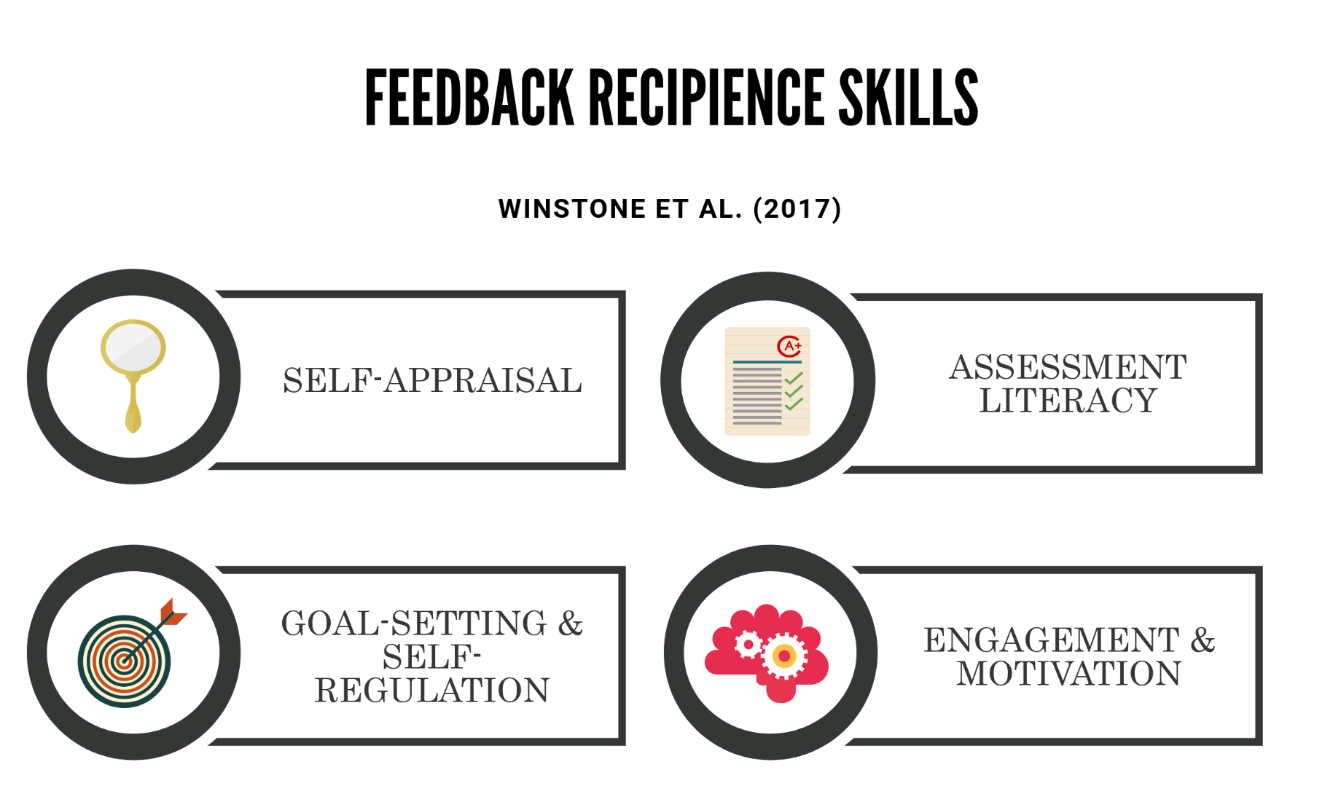
Recipience processes
Winstone, N., Nash., R., Parker, M., & Rowntree, J. (2017). Supporting learners’ engagement with feedback: A systematic review and a taxonomy of recipience processes. Educational Psychologist, 52, 17-37.
Winstone, N., Nash., R., Parker, M., & Rowntree, J. (2017). Supporting learners’ engagement with feedback: A systematic review and a taxonomy of recipience processes. Educational Psychologist, 52, 17-37.

Slide 20
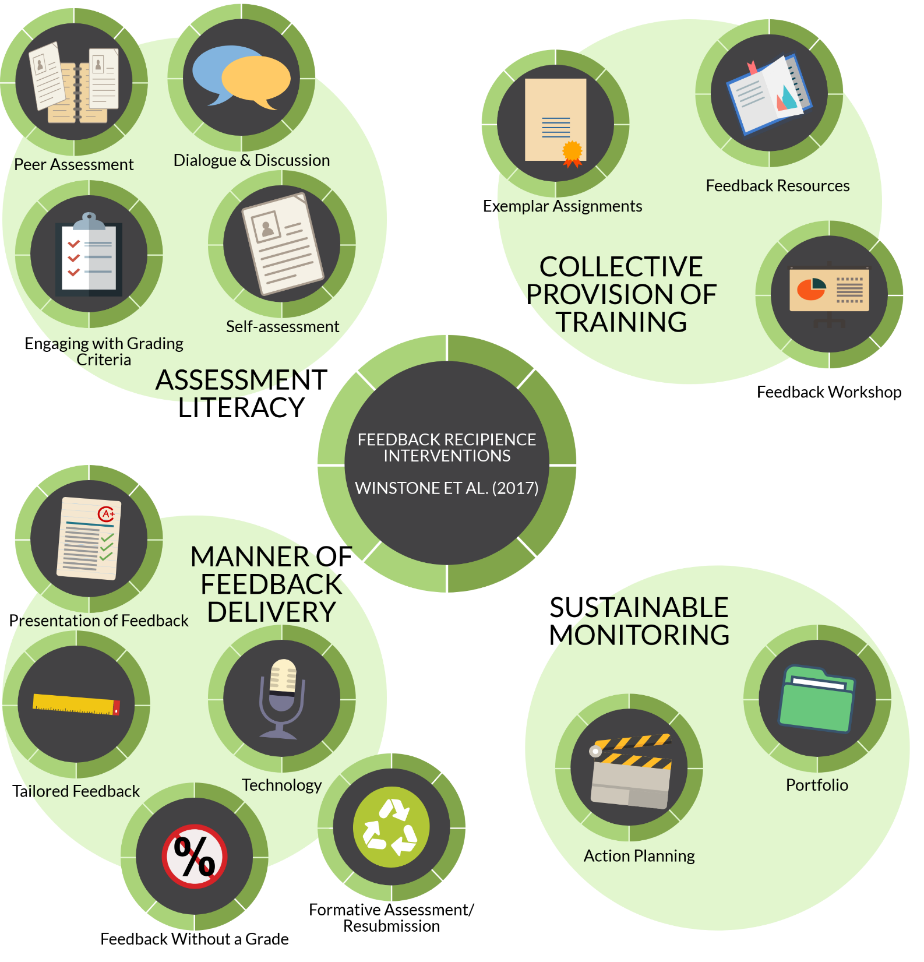

Slide 21

Feedback guide
Feedback workshop
Feedback portfolio
http://tinyurl.com/hea-deft
Winstone & Nash (2016). The Developing Engagement with Feedback Toolkit (DEFT). York, UK: Higher Education Academy.

Slide 22
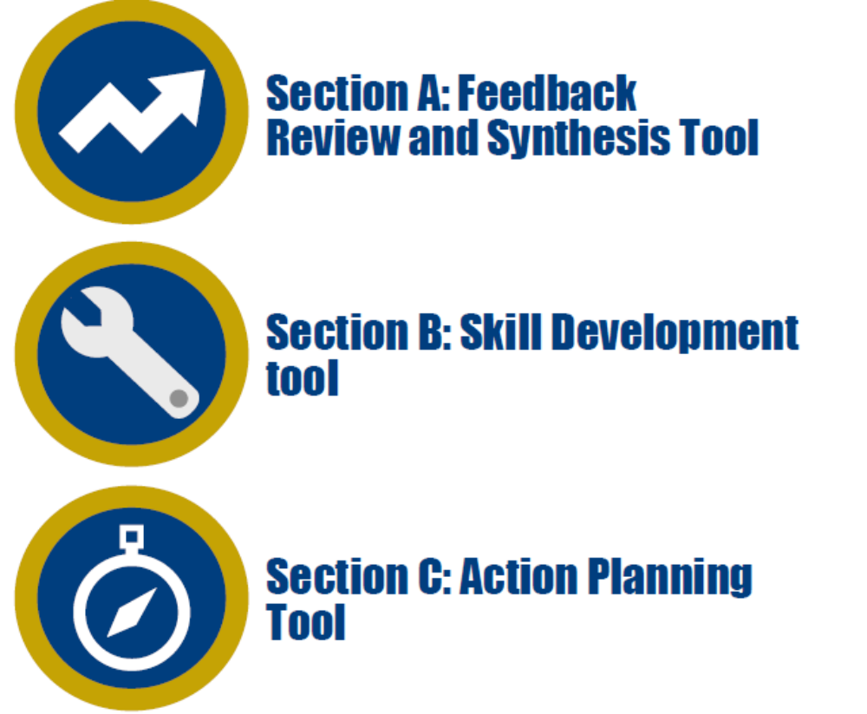



FEATS
https://tinyurl.com/FEATSportfolio

Slide 23
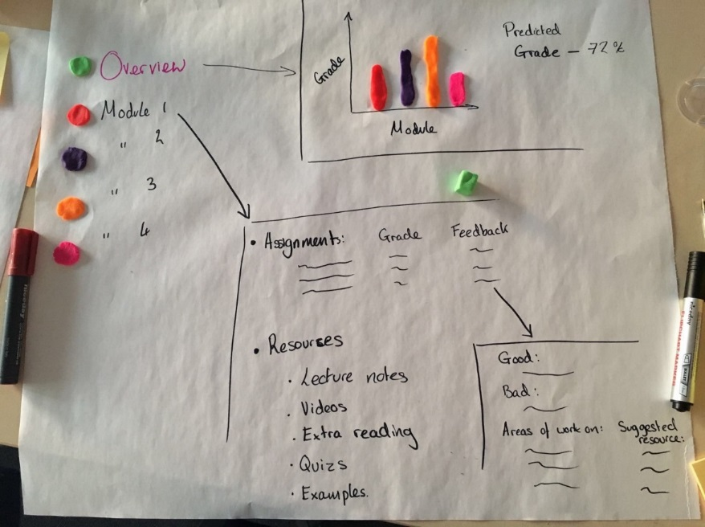
FEATS: Student co-design

Slide 24
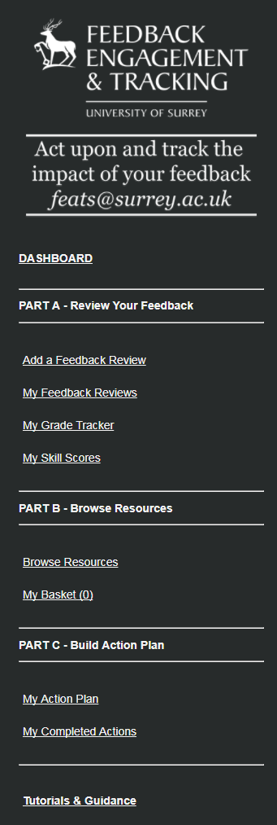
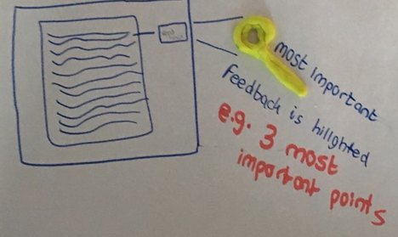
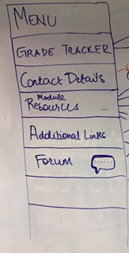
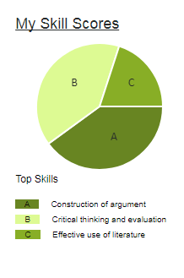
Student co-design

Slide 25
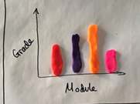
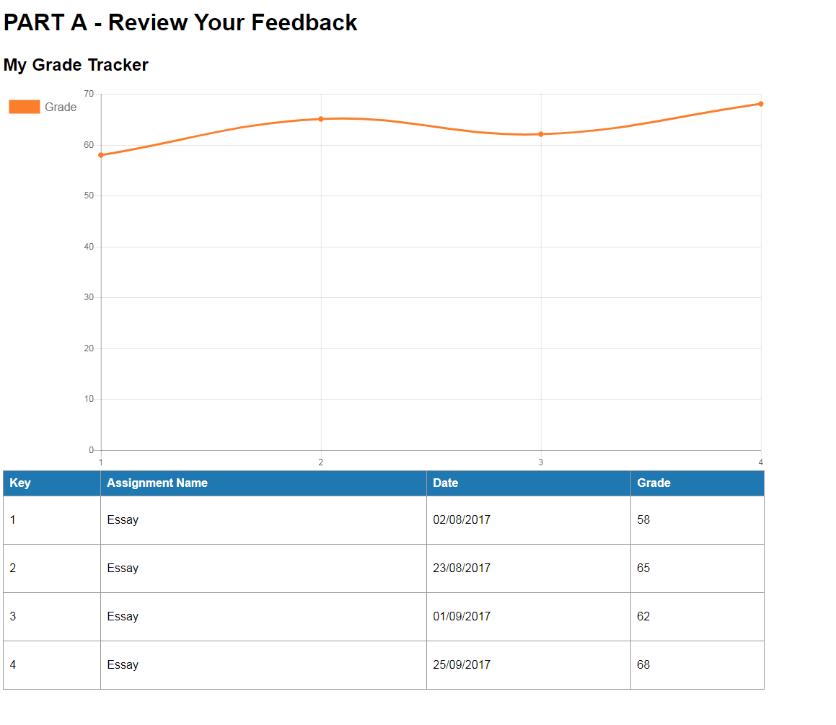
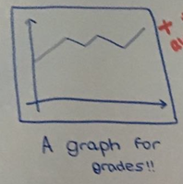
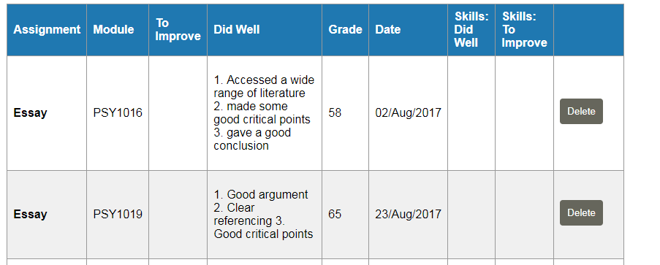
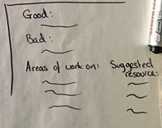
Student co-design

Slide 26


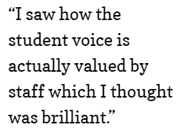

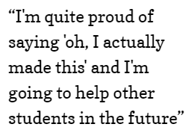
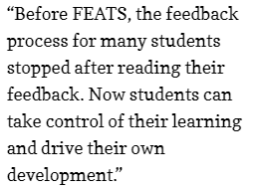
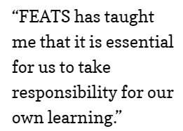

Outcomes

Slide 27
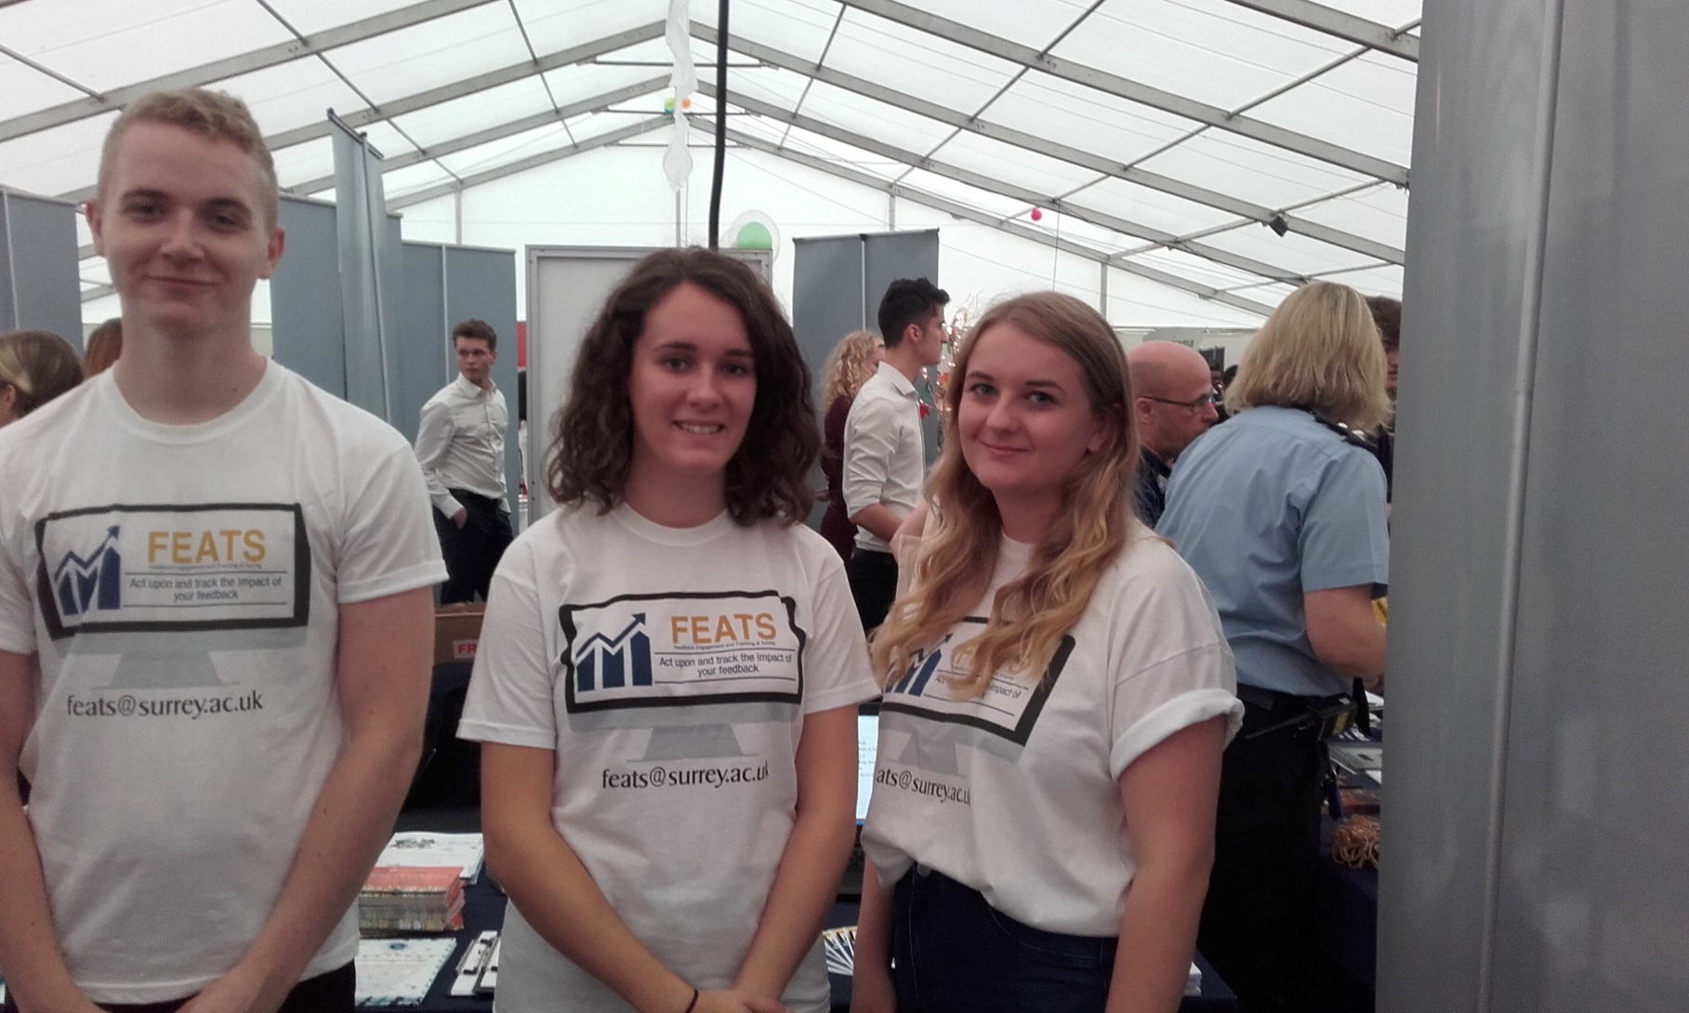
Power through Partnership

Slide 28




Acknowledgements
Collaborators:
Prof David Boud (Deakin University, Australia)
Prof David Carless (University of Hong Kong)
Dr Rob Nash (Aston University)
Dr Emma Medland (University of Surrey)
Roger Rees, Irina Niculescu, Ceri Hitchings (University of Surrey)
Research Assistants:
Mike Parker
James Rowntree
Georgina Mathlin
Emily Papps
Jessica Bourne
Joshua Best

