Slide 1
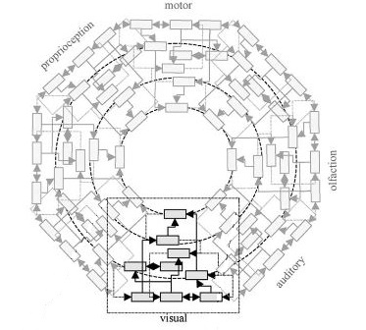

Feeding the model:
Simon Bowes
S.C.Bowes@sussex.ac.uk
The Bayesian Brain hypothesis and teaching

Slide 2

Change Blindness
Examples from Ronald A. Rensink, University of British Columbia
http://www2.psych.ubc.ca/~rensink/

Slide 3
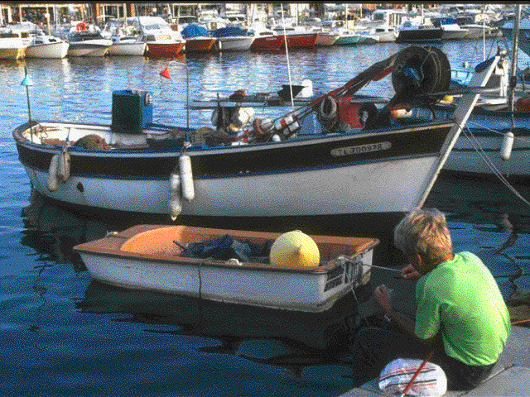
Change Blindness 2

Slide 4
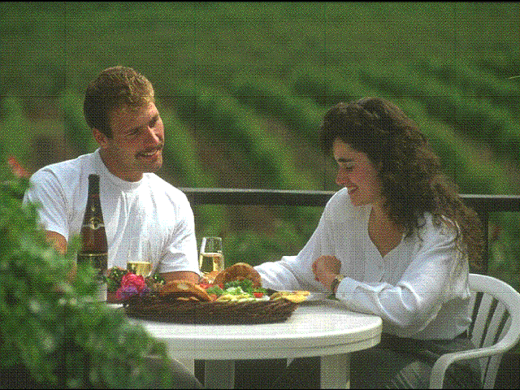
Change Blindness 3

Slide 5

Sine Wave Speech
SWS 1
Clear 1
SWS 2
Clear 2
Examples from Matt Davis, MRC Cognition and Brain Sciences Unit, University of Cambridge
http://www.mrc-cbu.cam.ac.uk/people/matt-davis/personal/sine-wave-speech/

Slide 6
Background
Me:
Teaching language, academic skills and cognitive science.
Researching in philosophy of cognitive science.
  Putting theory into practice and practice into theory.
Aims:
To put the practice of feedback in teaching in a broader theory of feedback (to feedback into the practice of feedback).
To introduce a currently fashionable theory of mind where feedback dynamics are central.
To break down the distinction between skills training and knowledge transfer.

Slide 7
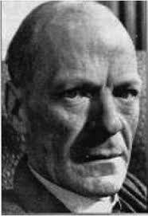
Knowing
know-how vs know-that
what I can do vs what I can explain
practical vs propositional
explicit vs implicit
top-down vs bottom-up
But, skills and conceptual knowledge work together.
e.g. learning to drive, learning grammar
Also, we don’t do well with students who come with undeveloped study and academic skills.
And, in the ‘rabidly changing world,’ adaptive skills are more important than static knowledge.

Slide 8
(non-linear) History
Behaviourism (Skinner) – reinforced structures
Constructivism (Piaget) – learning builds on experiences from innate foundations using social scaffolding
Cognitivism (Chomsky) – ‘little scientist’ modules, building information processing systems (on top of innate structure)
(Back to a ‘black box’ theory – input / anything that fulfils the functional role defined by the programme / output.
Social constructivism (Vygotsky) – learning internalises structures built through cultural development
Affordance theory (Gibson) – learning is gaining insight into the possibilities for action inherent in perception.
‘Enactivism’ (E.g. Clark, Friston, Kirsh) – Embodied, Embedded, Enactive, Extended, Expectational

Slide 9
Out with it
Old theory – learning has happened when knowledge has been ‘programmed’ in, so that inputs are correctly transformed to outputs. The model is an internal representation of the world which ‘stands in for’ the world in mental operations.
New theory – learning has happened when we have developed the resources to direct attention to the correct aspects of experience, including using ‘cognitive actions’ so as to make the world part of the act of cognition.
The ‘model’ directs attention to relevant parts of input, and gives expectations as to what input should occur following particular actions. Differences between the expected and the actual outcome of actions (surprises) update the ‘model.’

Slide 10
Plastic students
The brain learns to mimic the structure of the world
“If the brain has evolved to recapitulate the causal structure of its environment, in terms of its sensory infrastructures, it is interesting to reflect on the possibility that our visual cortices reflect the hierarchical causal structure of our environment.” (Friston, 2003, p. 1341)

Slide 11
Plastic students
Synaptic and structural plasticity subserves procedural and perceptual learning in adults.
“In the post-developmental period, synaptic plasticity is an important functional attribute of connections in the brain and is thought to subserve perceptual and procedural learning and memory.” (Friston, 2003, p. 1329)

Slide 12
Plastic students
Externalist, embodied - learner intervenes with the environment to extract information from it in order to update ‘models’ used as the basis of future action
“In active learning, the learner can intervene upon the environment to select the next datum sampled. For example, experimental scientists select the next experiment they run to extract useful information from the world.” (Jacobs & Kruschke, 2011, p. 18)

Slide 13
A Bayesian stance
The brain doesn’t calculate probabilities. It samples the environment to build a ‘model.’ (Probability theory describes ‘ideal’ state after infinite sampling.)
Role of attention in sampling: driven by the current model, feedback loops broken by surprises.
Apply feedback here, guiding learning through well-designed tasks, using concepts as a way of drawing attention to information present but unnoticed in perceptual input.
This allows generalisation – domain specific skills acquired through practice do not generalise unless a higher-level concept is applied.

Slide 14
Feedforward
Projection of an outcome is ‘fed forward’ - Act and be surprised by failure to achieve the anticipated outcome, update expectations, try again etc., until automated, fluent.
Feedback happens at the updating of expectations stage.
Implications:
  Process learning: Task based curriculum, activity based lessons, teach concepts and use them, together with models of task achievement, to draw students attention to the gap between output and intention.
  Training in skills required to demonstrate competence, e.g. give a presentation, need to be embedded in the curricullum.
  Don’t be surprised if students don’t see/hear what seems obvious to you. They are merely ‘novelty blind.’

Slide 15
Works Cited
Friston, K., 2003. Learning and inference in the brain. Neural Networks, Volume 16, p. 1325–1352.
Jacobs, R. A. & Kruschke, J. K., 2011. Bayesian learning theory applied to human cognition. Cognitive Science, Volume 2, pp. 8-21.

