Slide 1
Supporting independent learning through Immediate Peer Feedback
Prof. Alison Sinclair
Dr. Lorraine Smith

Slide 2
Independent
Undergraduate Research
Projects
- BSc Life Sciences

Slide 3
“A graduating level capstone experience”
Roy Soc Biol.

Slide 4
Independent

Slide 5

Isolation
… run out of steam …

Slide 6
Inspiration
from
Post Graduate Research
Supervision

Slide 7
Research
Group Presentation
Peer Feedback

Slide 8
National Union of Students Charter on Assessment and Feedback
Developing students’ abilities to peer review and self-reflect are important skills for future employment, as well as deepening their own learning.

Slide 9
Higher Education Academy Feedback Toolkit
Feedback from peers is more likely to be given in language they can understand
… and causes them to review and question their personal beliefs.

Slide 10
Apply
to the undergraduate model

Slide 11
4-5 cycles
Research
and
Feedback

Slide 12

“… this is the data I found …”

Slide 13
“… how did you control for … ?”

Slide 14

Develop
Reflective
Practice

Slide 15
“Feedback from my peers has been invaluable”
Notes:
I enjoyed this delivering method of teaching –
For the student feedback there was some stress about the verbal presentations but they also appreciated that this was very helpful preparation for an assessed presentation later in the year and
A typical quote that the immediate feedback has been invaluable is shown here.

Slide 16
“I cannot recommend them enough for future students ”
Notes:
And when I saw the feedback that “I cannot recommend them enough for future students” I decided I stuck my head above the parapet and decided try to roll out the approach for more students.

Slide 17
Aims
extend practice
further
evaluation
Notes:
A group size of 4-6 students seemed ideal – personal, everyone contributed to each session within a 2-hour window.
To expand this approach to more students it was apparent that I needed to interest other faculty

Slide 18
May 2017
Workshop
Biochemistry and Biomedical Science Faculty
Notes:
I ran a workshop to present the approach to 8 members of the Biochemistry and Biomed Sci faculty. I presented the student feedback, the pedagogy behind the approach and a worked example of the approach.

Slide 19
Faculty Concerns:
“Silent students”
“Harsh critique”
“Students who fail to
prepare”
Notes:
I then asked what they considered stumbling blocks to be ….
They identified two
The potential of a lack of questions and comments from students
And
The possibility of feedback with harsh critiques within it

Slide 20
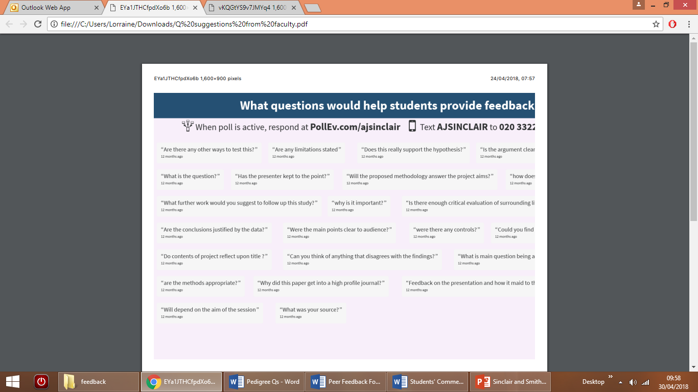
Suggestions from workshop
Are the methods appropriate?
Do contents of project reflect upon title?
Does this really support the hypothesis?

Slide 21
Approach - Themed Weeks
Suggested theme for meeting | Week | Suggested topics for some Qs
1 intro | 1 | Presentation style feedback What is the hypothesis/question?
2 identifying sources | 3 | Reliability of sources What is the rationale for the project?
3 analysing sources | 5 | Research Methods Data analysis Controls and variables
4 analysing sources | 7 | Research Methods Data analysis Statistical analysis and relevance
5 practice talk | 9 | Presentation style feedback Summary questions Student feedback survey
6 assessment | 11 | faculty Q based on assessment criteria, data and conclusions presented

Slide 22
Resource Bank
of
Question outlines
Notes:
So, I collected in suggested question “prompts” for the type of feedback and questioning that faculty would consider appropriate and
I teamed up with Dr Lorraine Smith to generate a resource bank of comments and question outlines that can used as a support for faculty to have to provide to students in case of silence and to guide the tone of feedback and questions

Slide 23

Background to Project Topic
1) Summarise the aspects of biology that will be covered within this project
2 ) What were the main laboratory methods used in the primary research for this topic?
3) What do you hope to find out once you have completed the project?
4) Is your research question likely to be broadly accepted for all participants/ subjects and for all varieties of intervention used?

Slide 24
Rationale for Project
1) What are the social / economic / other* implications for this research?
2) What is your interest in this project based on? / Why are you interested in X?
3) Are there ethical considerations to be made during your research, if so what are they?
4) What is your hypothesis?

Slide 25
Reliable Sources & Excluding Bias
1) How might the author(s) of the research papers you are using, exert bias?
2) How did you determine the reliability of the sources used?$
3) How can you ensure that you exclude bias within your writing?
4) What steps will you use to exclude bias when interpreting and reporting data?

Slide 26
Research Methods
1) Where there are contradictions in the findings of research papers, how do you propose to manage these in your report?
2) How did you decide to use the specific sources you have?
3) Have you found examples of cause and consequence other than in your main title? (eg age relatedness or geographical clusters). If so, how will you incorporate these into your report?
4) How are you managing your primary sources and recording the main points from each one?

Slide 27
Data Analysis
1) Does the data provide support for or cause you to reject your hypothesis?
2) What methods have you used to analyse your data?
3) What trends or patterns have you discovered within the data?
4) Are there any anomalies or outliers to the findings?

Slide 28
Controls & Confounding Variables
1) What are you looking for as controls in the experiments of the research papers you are using?
2) What confounding variables have you discovered in the research papers, and how much of an impact are they having on the experimental data?
3) How have the researchers limited the impact of confounding variables in their experiments?
4) Have you analysed a figure from a research paper and thought that it was inadequately controlled? Please provide an example.

Slide 29
Statistics Qs
1) How have you evaluated the statistical tests used in the research papers used? Are you con-fident that the appropriate tests have been used?
2) What statistical tests have been used in the research papers used and are the findings significant?
3) Where there are differences in significance between papers (ie one paper finds a significant difference and another paper does not); what could be underlying reasons for this?
4) What will you do if you find that the statistics are not significant – how does this impact your research query?

Slide 30
Summary Questions
1) If there was one thing you would do differently what would it be and why?
2) What are the biggest challenges facing researchers in this field?
3) What was the most challenging aspect of the project and why?
4) What do you feel are the most pertinent next avenues for research/ next research questions?

Slide 31
Evaluation Q and responses
Five Questions
Scale of 1-5;
1 least and 5 most

Slide 32
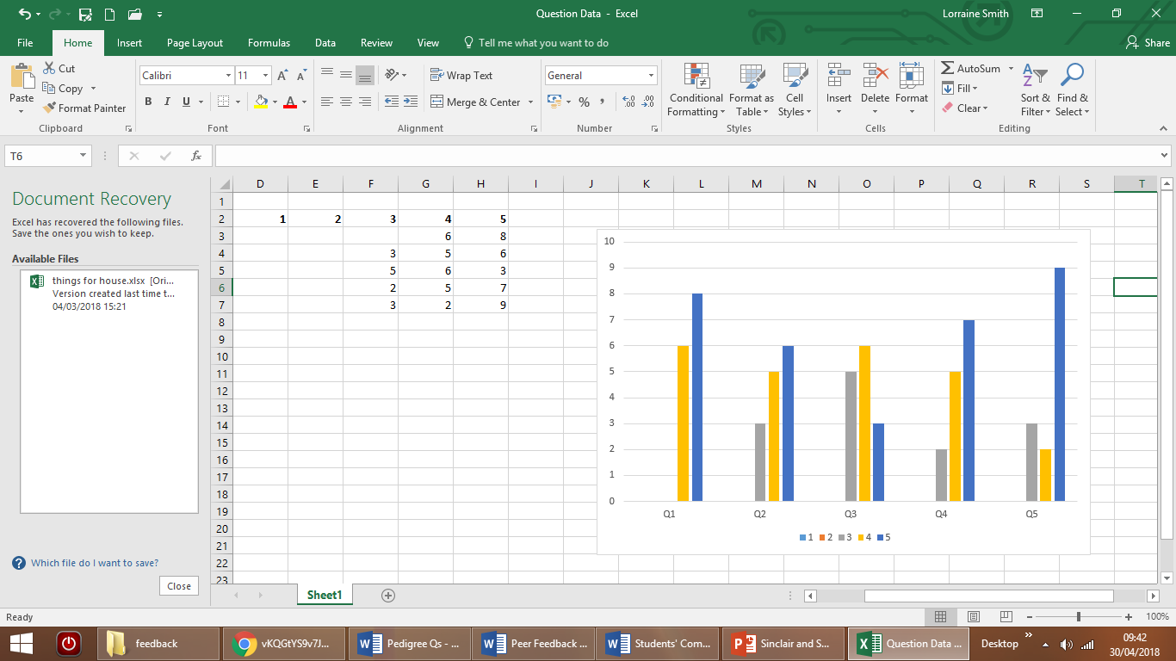
Evaluation Q and responses
1. Did you find the regular presentations helpful for the progress of your project?
Number of students that responded
100% of students responded 4/5:
presentations helped their progress
Questions

Slide 33
Evaluation Q and responses
2. Did you find the feedback and questions for your peers helpful for your project?
Number of students that responded
Number of students that responded
79% of students responded 4/5:
providing feedback & Qs helped their project
Questions

Slide 34
Evaluation Q and responses
3. Did you find providing feedback and questions for your peers helped you follow their project?
Number of students that responded
Number of students that responded
64% of students responded 4/5: fewer
said feedback & Qs helped follow others
projects
Questions

Slide 35
Evaluation Q and responses
4. Did you find providing feedback & questions for your peers helped you reflect on your own research & presentations?
Number of students that responded
Number of students that responded
86% of students responded 4/5:
providing feedback & Qs helped them to
reflect on their own projects
Questions

Slide 36
Evaluation Q and responses
5. Did you find the regular presentations help to build your confidence?
Number of students that responded
Number of students that responded
78% of students responded 4/5: regular
presentations helped build confidence
Questions

Slide 37
Student feedback quotes
Doing the presentation forced me to have mini deadlines which helped me to get my project written. Feedback from [my tutor] and peers has been invaluable.
I like the regular contact and feedback. I have friends whose supervisors have a lot less contact time and are struggling.
I found the regular meetings motivating to do enough new and adequate research. Feedback was very useful in developing presentation skills and new concepts.
Regular presentations helped build confidence and time-keeping skills.

Slide 38
Resource to guide
undergraduate students to use
Immediate Peer Feedback
to support independent projects
& develop reflective practice
Notes:
To summarize:
We develop an approach to enable faculty to encourage students undertaking independent research projects to use immediate peer feedback
Students are supported by the need to prepare and deliver the presentations and the immediate feedback that they receive
Students also develop reflective practice through the process of providing feedback.

Slide 39

Notes:
Audience suggestions of Q for students to use please
https://www.polleverywhere.com/free_text_polls/YXccacbyncVsv2Q

Slide 40
Thank you
… with contributions
from Dr Richardson,
Dr Parthasarathy &
Prof Scharlman
Final year BSc students

