Slide 1
The role of peer review in communities of practice
Dr Wendy Maples, BA, MA, PhD, SFHEA
Associate Tutor, ‘Academic Development’

Slide 2
The role of peer review in communities of practice
Communities of practice
Learning as becoming
Assessment as learning
What is peer review and how does this assessment practice support learning
Three examples of different forms of peer review
Good practice and benefits

Slide 3
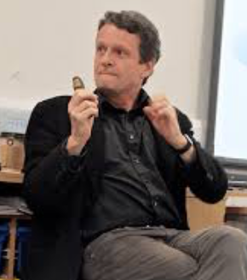
Communities of practice
Social constructivist position: learning takes place through and establishes communities of practice
Etienne Wenger

Slide 4
Learning engendered through communities of practice:
Scholarship communities (academic practices across and between disciplines)
Discipline communities (theories, concepts, methods)
Students are engaged in the process of moving from novice to expert through practice

Slide 5

Learning as acquisition?
According to Reid Hoffman (LinkedIn co-founder), ‘teaching students information… is "no longer critical" (THE World Academic Summit, THE, 28 Sept. 2016)’
c DIS/Internet

Slide 6
Learning as becoming?
Academic acculturation:
  Active, independent learners, engaged in (self-) reflective practice
  Critical thinkers: able to use generic academic and discipline-specific tools, concepts, criteria, evaluation (know and understand modes)
  Capable practitioners: able to enact/apply disciplinary practice (know and understand methods)
Notes:
This approach signals a shift away from learning facts and dates and statistics and towards more critical thinking – and the ability to utilise disciplinary concepts, make sound, reasoned judgments and to measure, evaluate and explain to others the issues and ideas of our fields. In terms of my field, I hope students don’t just learn about social science (though I want that too), I hope they BECOME nascent social scientists.

Slide 7
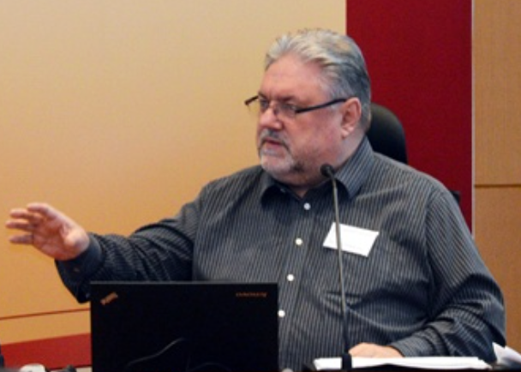
Assessment ~ learning
Boud suggests we:
  increase our employment of assessment as a learning process (through formative assessment) and
  better indicate to students the importance we as academics place on critical thinking and, especially, reflective practice
David Boud
Notes:
David Boud’s seminal (1990) article on assessment Distinguished between summative (demonstrating achievement) and formative (producing learning)

Slide 8
Why?
Acknowledge what we implicitly (and perhaps explicitly) tell students we value through our assessment selections
To engender accord between what we value as academics and our teaching practices

Slide 9
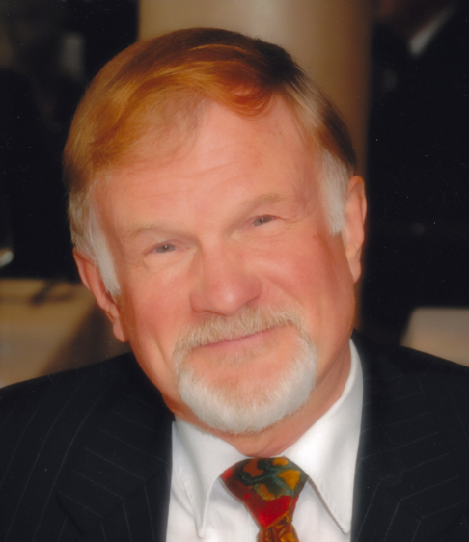
What is student peer assessment?
Peer assessment is ‘an arrangement in which individuals consider the amount, level, value, worth, quality, or success of the products or outcomes of learning of peers of similar status (1998, p. 250).’
Keith Topping
Notes:
Keith Topping
But not an accurate representation of either:
assessment as learning, or
the dialectical process of peer assessment

Slide 10
Peer assessment includes:
Individual or group assessment
Formative and/or Summative assessment
Peer Marking/Grading
Peer Review: focus is on formative comments and feedback/feedforward

Slide 11
A simple peer review model
A reviews
B reviews
C reviews
D reviews
E reviews
Each student is responsible for two reviews and their assignment will be reviewed by two peers.

Slide 12
Where is the learning?
Student A produces a piece of work that demonstrates knowledge/understanding/application of X
Students D and E assess the piece of work
Student A reads the assessment of their work (and, hopefully, uses the feedback to improve subsequent work)
In the meantime, Student A assesses the work of Students B and C…

Slide 13
Where is the learning?
Learning follows feedback from (multiple peers)
Peer feedback
Peer feedback
Peer feedback
According to Cho and MacArthur (2010), where a student receives feedback from multiple peers, they increase the number of ‘complex’ revisions to their work (over and above the depth and number of revisions following single expert feedback)

Slide 14
Where is the learning?
According to Li, Lui and Steckelberg (2010), where a student provides high quality feedback to others, their own work improves, (even when the quality of earlier drafts is controlled for). The inverse correlation is also true.
Peer 1
Peer 2
Peer 3
Learning follows provision of feedback to others

Slide 15
Where is the learning?
Li, Lui and Steckelberg also found ‘no significant relationship…between the quality of the feedback students received and the quality of their own final [revised work] (2010, p. 525).
‘Acculturation’
Learning follows
internalisation
of practices, concepts and criteria
for assessment
Notes:
findings are particularly exciting
What this suggests again is that a) the process of engaging as an ASSESSOR was more predictive of improved performance than the feedback – whether of an expert or weak peer b) and that peer assessment systems may need to worry less about some students ‘suffering’ poor feedback from colleagues.

Slide 16

For your consideration…
To be able to consider and evaluate others’ work, students must understand:
  The assignment instructions, indicative content
  The assessment criteria, including levels of achievement
  How to apply the criteria
Students engage in the process of becoming members of the academic community of practice
Notes:
‘Learning follows internalisaton of practices, concepts and criteria required to do the assessment. Let’s just explore this a little more, -- and think back to Wenger.

Slide 17
Learning → becoming: e-Learning and Teaching Enhancements
e-LATE is a 15-week online professional development module for social science academics
Core principle: the best way to understand the student experience is to ‘be a student’ (Greg Benfield) – authentic learning (John Seely Brown)
Peer review is the primary formative and summative assessment, introduced at the start…

Slide 18
eLATEd about peer review?

Slide 19

eLATEd about peer review?
c The Simpsons

Slide 20
eLATE Peer Review
Explained (both pedagogically and practically) from the start
Resistance was anticipated and gently managed
Assignment assessment criteria and peer review administration were scaffolded through a series of activities

Slide 21
e-LATE: what happens?
Students are introduced to and practice a range of online learning activities
Students create an ‘e-tivity’ (drawing on e.g. Salmon, gamification, Khan, etc.)
Their e-tivity is assessed using a simple set of criteria by two peers (with oversight from tutors)
Students revise their activity after receiving feedback and further reflecting on their learning, and…
In a ‘mini’-conference setting, present their e-tivity to the whole group
The group votes for the ‘best’ e-tivity (using set criteria)
Notes:
Core assignment: production of an ‘e-tivity’ design that can be shared with others
Peer reviewed in terms of its: practicality (can it be done?); appropriateness and meaningfulness to cohort (is it relevant, interesting?); pedagogic foundations
Feedback/forward offered in ‘OU’ style
Peers assess whether the e-tivity is: excellent, appropriate, inappropriate or incomplete (broadly: distinction, pass, fail)

Slide 22
What e-LATE students say:
“It is quite an empowering experience but there was probably an element of nerves prior to getting that feedback which probably applies to all of us, not just undergraduates – they may well feel better from getting feedback from a fellow student than feedback from a tutor.”

Slide 23
What e-LATE students say:
“...doing the assessment [of another’s work] makes you understand more about the subject yourself, perhaps even more so than writing your work [because] it gives you a position of responsibility to somebody else.”

Slide 24
What e-LATE students say:
“[It was]…helpful for me to see how other students wrote their [e-tivities] and it really did help ... me out … a lot: ...I’ve always felt that students can learn as much if not more from each other than they can from some teachers, and I think that reflective learning is central to that. And I think that reflecting can be more effective if it’s done by people at the same level.”

Slide 25
e-LATEd?

Slide 26

e-LATEd?
c The Simpsons

Slide 27
Start writing fiction (OU, FutureLearn)
Informal MOOC = Foundation/1st semester undergrad
Content comprises A/V, readings, semi-structured forum discussions, multiple choice quizzes and creative writing activities
Entirely peer assessed: peer review of short fiction
  Integral to module function (there are no tutors)
  V. limited ‘training’, focus on support and encouragement

Slide 28

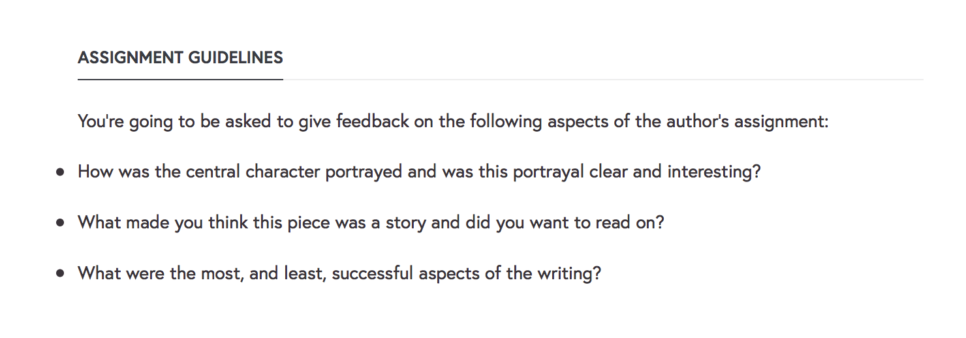
Start writing fiction - peer review
© The Open University

Slide 29
Student comments on reviewing
A1‘I feel a bit nervous reviewing other people’s work.’
L2 ‘me too’
J3 ‘Let the focus be the work and not the author. We’re all developing writers. If what we write is unclear, it takes another set of eyes to see the gaps we’ve left.’ …
M4 ‘I found it hard to review other people’s stories so I focused on whether I understood the story and the portrayal of the main character.’

Slide 30

Student responses to being reviewed
R5 ‘My feedback was very helpful, always good to see how my writing is seen in someone else’s eyes ☺’
D6 ‘…[K8], I appreciate your points and will learn from your observations. I would really like to turn it into a story with a plot. …’
J7 ‘Reading the posts in this [forum] it does seem that reviewers have generally taken great care to be helpful in their comments and to encourage us all to carry on writing.’
© The Open University

Slide 31


Student feedback on reviews
© The Open University

Slide 32
Academic Development
Foundation module on core academic skills, supported through bespoke and OER online resources and activities and face-to-face seminars
Mainly traditional assessments, with formative and summative feedback and marking by tutor

Slide 33
Academic development – peer review
Student presentations evaluated by peers
Students encouraged to include peer evaluations in their self-reflections
‘Add-on’: Vote for the most useful peer comments received (SurveyMonkey poll)

Slide 34

Peer reviews
Qualitative feedback very limited.
Despite encouragement to focus on content, most comments focused on style
Indicative marks mostly highly conservative (limited range)

Slide 35
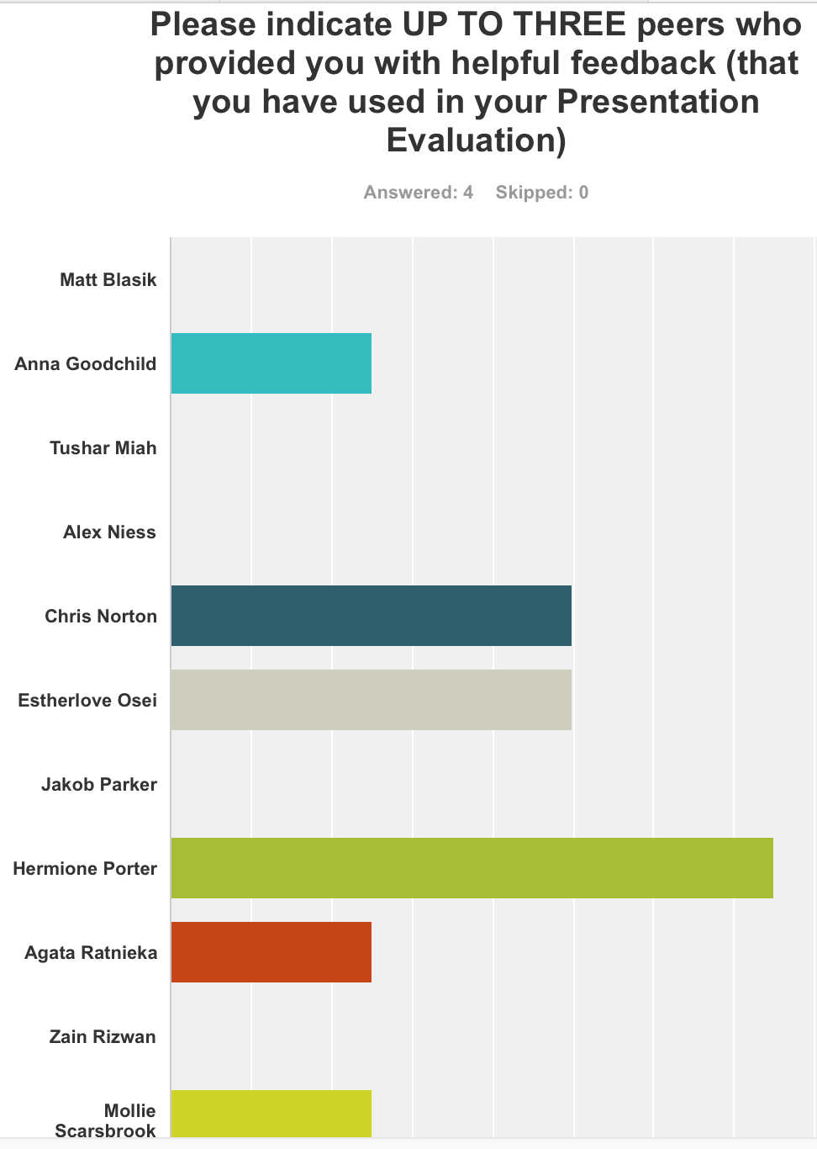
Reviewing the reviews
Students seemed enthused about the SurveyMonkey poll
Poll took less than 1 min to complete
Less than a quarter of students responded (2.75/13 on average)
Students identified as helpful were given a chocolate reward
https://www.surveymonkey.co.uk/r/8XB7CLP

Slide 36
How do we know it’s good?
Quantitative measure: high correlation of marks, comparing peer assessors with each other and with experts (Falchikov and Goldfinch, 2000; Li et al, 2015).
Higher grade correlation associated with, e.g.
  Well-specified criteria
  Student defined and well understood criteria
  Individual (rather than group work being assessed)
  Assessors and assessees randomly matched (limits friendship/bias)
  Assessors being not anonymous
  Assessors giving both qualitative comments and marks
  Significantly high correlation: Students being co-producers of marking criteria (see Ashenafi, for a summary)
Notes:
Dyadic (discursive) engagement in exploring understanding of assessment more useful than ‘observation’/reading alone

Slide 37
How do we make it better?
More qualitatively (and experience tallies well with the literature), engagement encouraged by:
  A transparent pedagogical rationale
  A meaningful/authentic assignment that is integral to the wider course (assessment as learning) (see Tillema, Leenknecht and Segers,2011)
  Clear guidance on what is expected and evaluative criteria (or programme of co-production)
Notes:
Dyadic (discursive) engagement in exploring understanding of assessment more useful than ‘observation’/reading alone

Slide 38
What are the benefits?
Peer review’s dual role (of assessed/assessor) is pedagogically beneficial:
  ‘By better ensuring students read the criteria by which they and their peers are assessed, deeper insights into … [module content and] the learning process are achieved, thus moving the student further towards independent learning. (see also Nicol, Thomson and Breslin, 2014)
  ‘It brings students together in a shared responsibility for each other’s learning.
  ‘Where collaborative practice is established [early on] … this can further help with creating an effective learning community (Maples and Parsons, 2014).’
Notes:
Dyadic (discursive) engagement in exploring understanding of assessment more useful than ‘observation’/reading alone

Slide 39
The role of peer review in communities of practice
Peer review means:
  Aligning our academic values and practices with our teaching
  Sharing assessment with students (as assessors or perhaps co-producers)
  Challenging ourselves and students to engage at a deeper level with assessment as learning
  Reconsidering learning as becoming and thereby engaging in the construction (widening and development) of our academic communities of practice actively to include novices/learners.

Slide 40
Thank you
Dr Wendy Maples
w.maples@icloud.com
www.wendymaples.com
Wendy Maples (LI)

