Slide 1
Learning from Lived Experience: Students and Service users as co-producers of knowledge
University of Sussex Teaching and Learning Conference 2017

Slide 2
Introduction – Our Presentation
Service user involvement has been mandatory in social work education since 2002 (Warren, 2007)
Academics may be loathe to share the design/delivery of student learning (Braye, 2000) whilst similarly ignoring the ‘emotional dimension ‘(Munro, 2011) - thereby failing to prepare social work students for complex practice challenges (Green and Wilks, 2009).
Rapid growth of technology creates a different threat to traditional academic expertise, producing a potential reluctance to engage with new technologies in the face of greater student proficiency (Wheeler, 2015)
Our presentation will demonstrate how we embedded inclusivity into the design and delivery of BA and MA modules

Slide 3
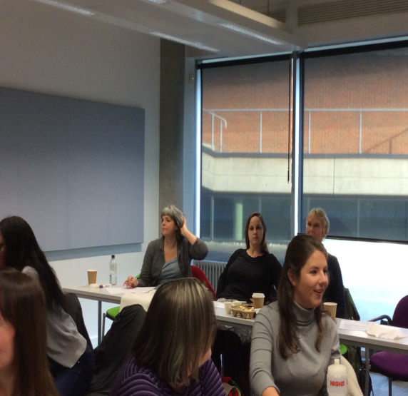
Service User and Carer Involvement in Human Development & Social Relationships (HDSR)
Jill Scholl and Debs Pawley
Service user role in the module
Narratives
Intervention – Interviewing
Assessment

Slide 4
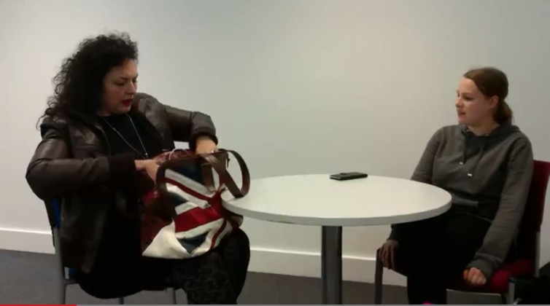
Student Involvement in HDSR
Maria Redoles Rios (MASW1)
Purpose and context of the film: https://www.youtube.com/watch?v=JjissmqVjRs

Slide 5
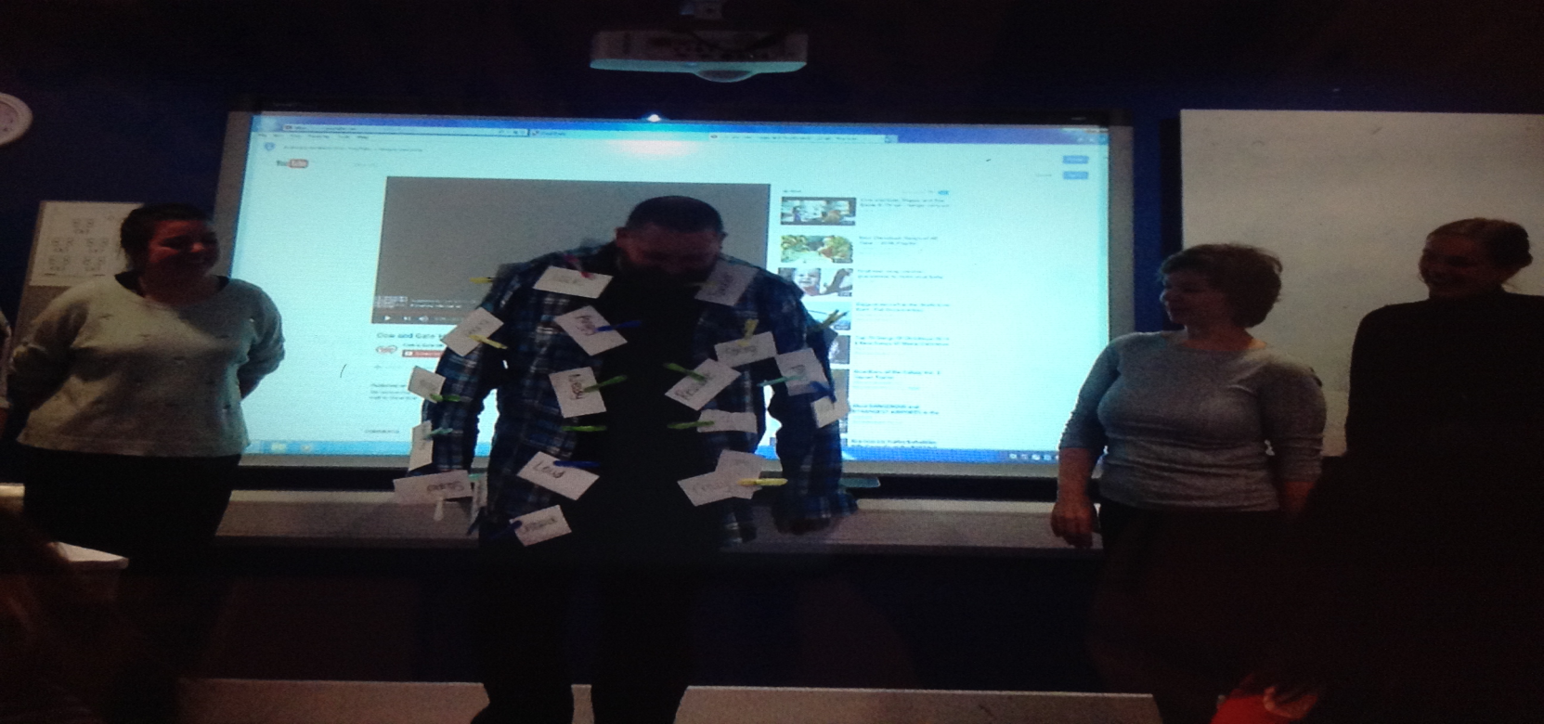
Thinking about Stigma
Lorna Miller-Cooper and Olivia Benge (MASW1)

Slide 6
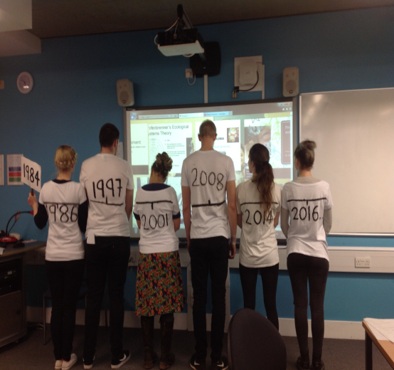
Service User and Carer Involvement in Human Growth and Development (HGD)
Stanford Manzini
Service user role in the module
Narratives
Intervention – Interviewing
Assessment

Slide 7

Student Involvement in HGD
Darren Hoole; Alice Marjot; Hannah Chisnall (BASW1)
Reflections on the use of narrative (Alice Marjot)
Working with a ‘real person’ (Hannah Chisnall)
Working in a group to produce online assessment (Darren Hoole and Hannah Chisnall)
https://www.youtube.com/watch?v=wuwRNd-hHt8

Slide 8
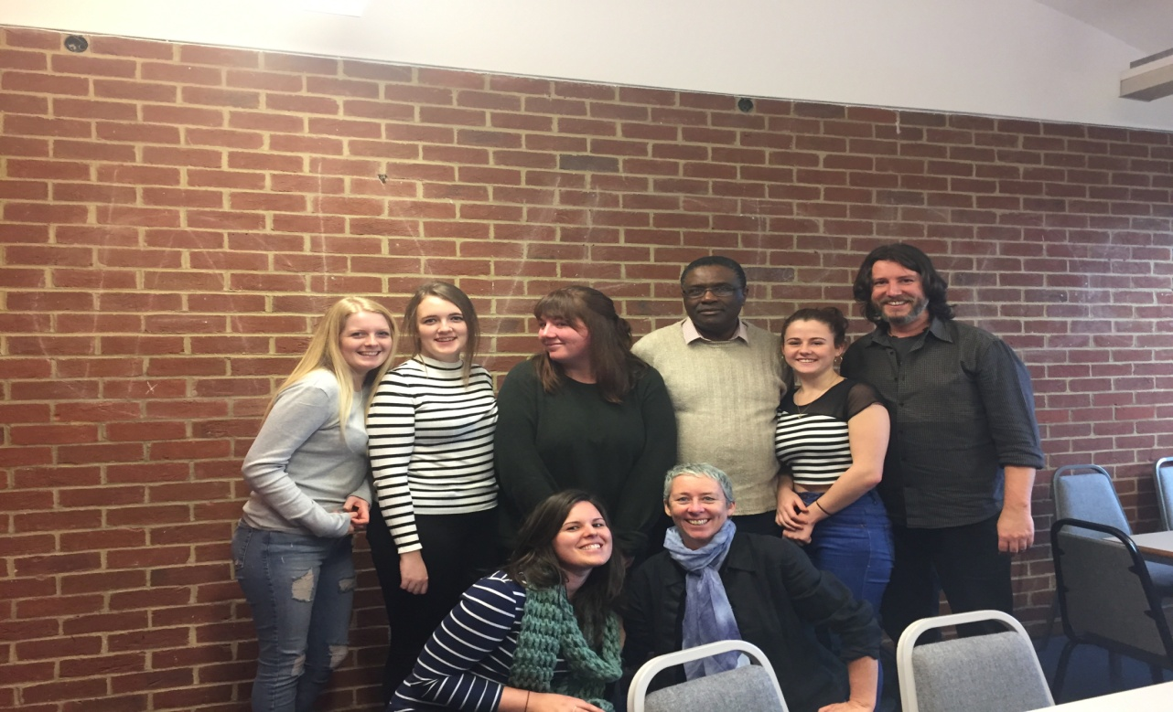
Summing Up…..
Thank you for Listening to Our Presentation!

