Slide 1

Four Seasons of
Flipped Learning

Slide 2


Background
The foundation to Biosciences course is in its second year (at Sussex) and students were taken on with a varied academic background
Lower grade A levels in Sciences
Access to HE in Sciences
The biosciences foundation year cohort are diverse both in terms of their prior academic exposure to biology and in terms of their learning needs, so teaching and learning strategies adopted must reflect this. As well as ensuring students are academically able in both biology and chemistry this course must also prepare students for HE study, including the ability to engage in independent study.
IB in Sciences
BTEC in Sciences
EFL
High grade A levels in Sciences

Slide 3

Background
When designing teaching and learning strategies for this cohort it was important to pitch it high enough to allow those who progress parity with the high achieving students that enter in year 1
Current academic qualification
The flipped classroom is a pedagogical model in which the typical lecture and homework elements of a course are reversed.
Students have content to ‘learn’ at home, while in-class time is devoted to exercises, projects, or discussions.
Students
entering
in year 1
Majority of
students
entering Fd

Slide 4
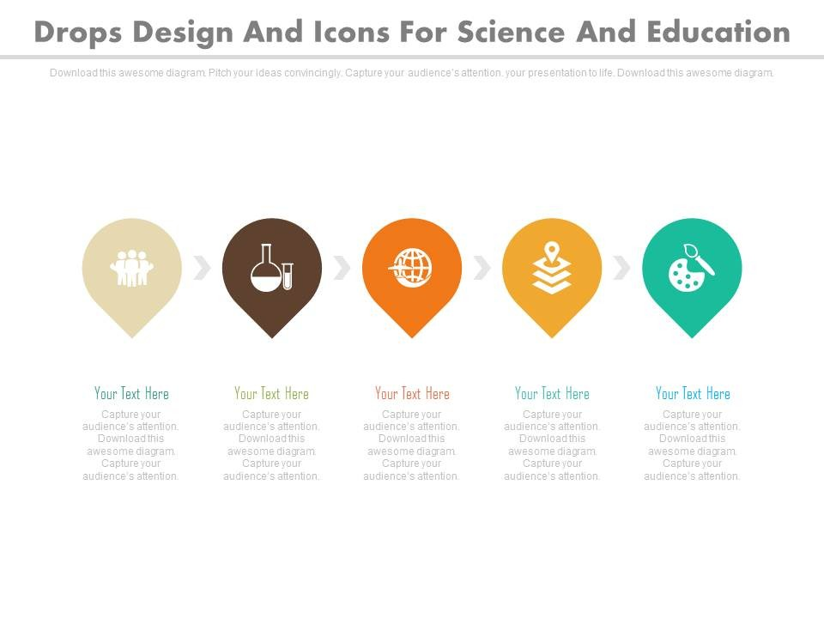
For these reasons, a four-way flipped approach was trialled this year to support learners with many different needs, in a number of different ways. These included:
1) journal papers to pre-read before workshops;
2) availability of lecture notes prior to (and recordings after) lectures;
3) basic reading handbook & pre-seminar slides for Study Skills;
4) online study module for IT.
Students engaged with and rated the usefulness of these resources very differently. This talk will explore the specific outcomes and insights gained from each flipped method trial from the point of view of the lecturer and the student.

Slide 5
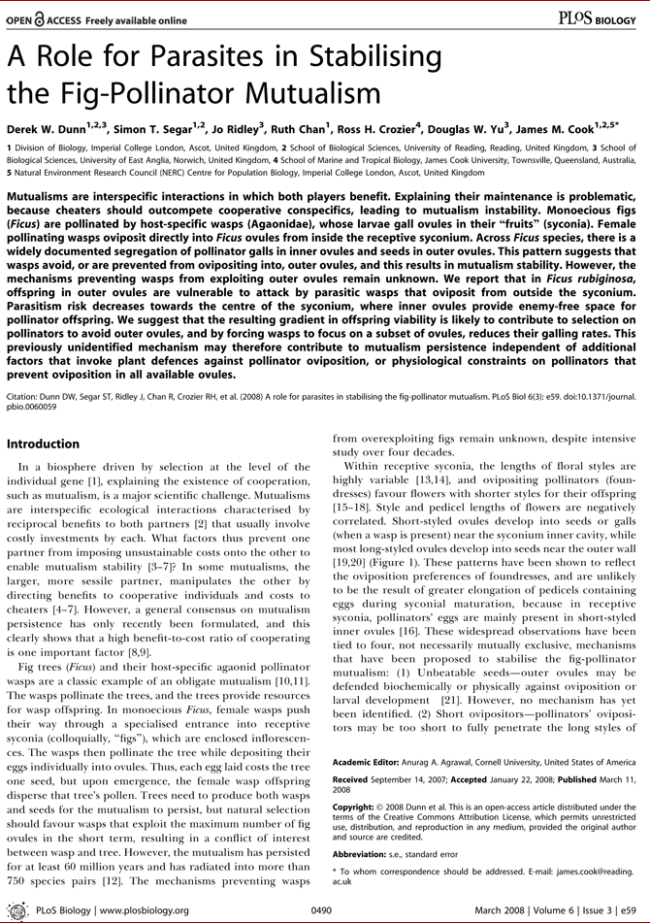
1) Journal Papers - Method
Pre-reading is a pre-requisite for the majority of seminars in HE, so this strategy was introduced to students to support the transition to HE as well as to prepare them for the seminars.
Scientific articles were provided to students via web links on Study Direct at least 1 week prior to their seminar.
Promotes equality, independent learning & allows students to take an individual approach to learning
Introduces students to scientific concepts & terminology & allows questions to be posed that can be answered in the taught sessions

Slide 6
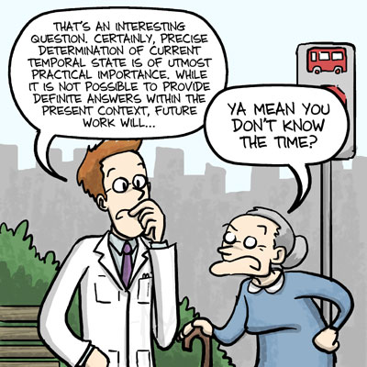
1) Journal Papers
– Engagement & Outcome
Approx 1/3rd of students in workshops said they had read the paper before turning up & those that had done the reading were:
- more engaged
- asked better questions
- gained much more from the sessions
The taught sessions were designed to support abstract writing and analysis of figures in scientific papers, both aspects of their first assessed task for this module

Slide 7
1) Journal Papers - Evaluation
To understand how well the papers were used it is important to appreciate how the workshops were attended
128 students
94% went to 1 or more session
43% went to all 3
55 students

Slide 8
1) Journal Papers - Evaluation
1) Of the responders, more students are reading the articles than not, but it could be that some are deciding on the one they will write about & reading that one only
2) When students are doing the pre-reading they are seeing some benefit in the workshop, some more than others.

Slide 9
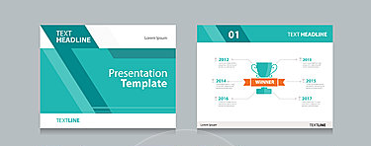
2) Lecture Notes - Method
A basic support method recommended by the university is to provide lecture materials to students prior to lectures because it familiarises students with concepts and terminology, and to record lectures for students to review.
All slides have been uploaded to Study Direct the week before delivery, recordings uploaded within 48 hours* and engagement with them has been queried by survey.
Promotes equality, independent learning & allows students to take an individual approach to learning
Introduces students to scientific concepts & terminology & allows questions to be posed that can be answered in the taught sessions

Slide 10
2) Lecture Notes - Evaluation
This makes sense & is good to know, since different topics will be familiar to different students, so it allows students to manage their own learning needs
Of the responders, more students have occasional use of slides before lectures
2) When students are using the materials pre-lecture they are finding this supports their understanding of the topics

Slide 11
2) Lecture Notes - Evaluation
Of the responders, more students are looking back at the recordings of the lecture than the slides before the lecture
More students are finding that reviewing the recordings of the lecture are supporting their learning (& revision) more than previewing the lecture slides

Slide 12

3) Study Skills Handbook &
Preparatory Material via Slides - Method
This strategy was introduced to students to support the transition to HE.
Relevant Study Skills texts were photocopied from a number of books and presented to students as a reader handbook in week 1, and also provided online as a pdf. Links to this handbook (& to supplemental reading) was provided in the module handbook, week by week.
Slides were provided to students on Study Direct at least 1 week prior to their taught session, to promote understanding of the concepts, so that seminars could be more of a discussion about the topics.
Promotes equality, independent learning & allows students to take an individual approach to learning
Introduces students to study skills concepts & terminology & allows questions to be posed that can be answered in the taught sessions

Slide 13
3) Study Skills Handbook & Preparatory Material via Slides – Engagement & Outcome
Two specific and outcomes from engagement with the reading were the Pass/Fail presentation and the first fully assessed essay.
Presentation = ☺
Essays = ☹ (insufficient engagement with creating an argument, suggesting these articles had not been read or understood well.)

Slide 14
3) Study Skills Handbook - Evaluation
Of the responders, more students had occasional use of pre-reading in the handbook before seminars
2) More students said they helped to some degree than did not help

Slide 15
3) Study Skills Preparatory Material via Slides - Evaluation
Of the responders, >60% engaged with the slides to some extent
2) More students said they helped to some degree than did not help

Slide 16


4) IT Learning Materials & Test
- Method
Worth 16% of a 15C module
Get 70% (or above) in all 3 tests
By this deadline
Least attempts gains highest marks
Promotes equality, independent learning & allows students to take an individual approach to learning
Promotes success for all, sense of achievement – since all students can gain high marks

Slide 17
4) IT Learning Materials & Test
– Engagement & Outcome
130 students were enrolled at this time
Only 62 gained 100%
16 took at least one of the tests late or
did not take at least one of the tests
12% late / NS
47% gained 70%/> 1st
time
in all 3 tests

Slide 18
4) IT Learning Materials & Test
- Evaluation
In the Portfolios for Study Skills (to which these marks contributed) there were themes in students’ reflections:
When I used the learning materials I did better in tests than when I didn’t use it
Students benefited from reviewing the learning materials and it enabled them to gain higher grades than without
I took the (1st) test without studying because I thought I knew how to use it (Word) but discovered I didn’t know it as well as I thought (<70%).

Slide 19
4) IT Learning Materials & Test
- Evaluation
The 38%??
52% of responders said they never used the online learning materials.
Of the responders, a higher proportion did not use the learning material
2) Of those that did use them, more students said they helped to some degree than did not help

Slide 20
Interpretations & Conclusions
Student Ratings
Reviewing lecture recordings
Previewing lecture notes
Pre-reading journal papers (before seminars)
Pre-reading specified reading in a handbook (before seminars)
Previewing learning material from slides (on Study Skills before seminars)
Online learning materials for IT
Perceived impact on grades?
Is it assessed?
Complacency?

