Slide 1
Padlet
Creating a padlet and embedding in Study Direct

Slide 2
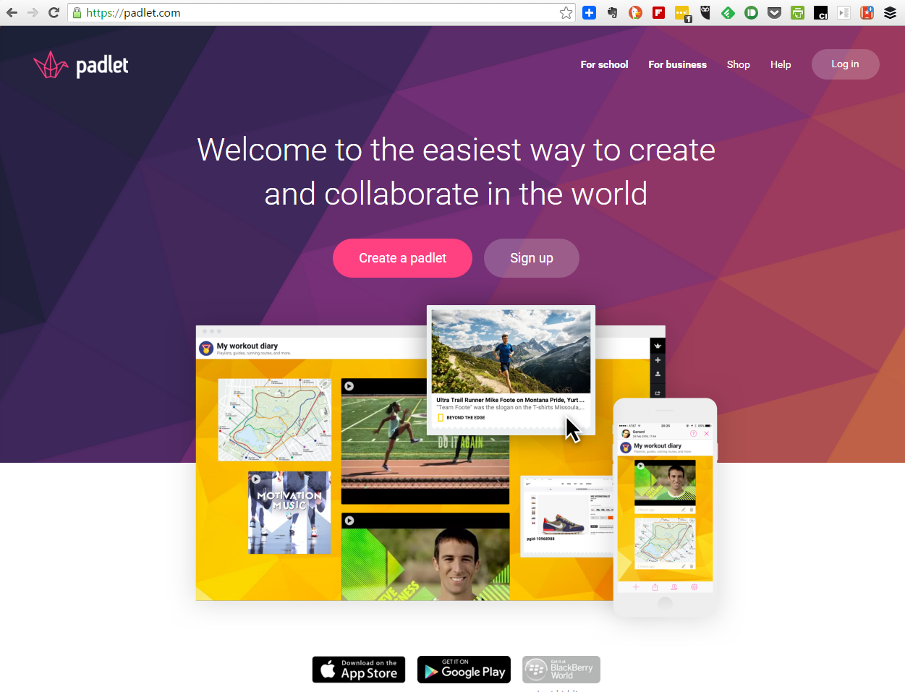

Slide 3
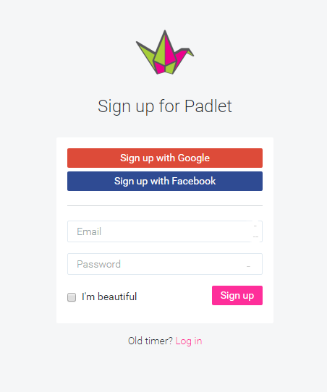

Slide 5

Home Page
Create a new padlet
Login or sign up
Share / Export
< Modify this Padlet

Slide 6

Title, Description etc.
Background colour/design
Freeform, Stream or Grid
Visiblity, Editors, Moderation
Email when posts added?
Change URL
Login (or only 24 hours)
Copy with or without posts
Delete the Padlet

Slide 7
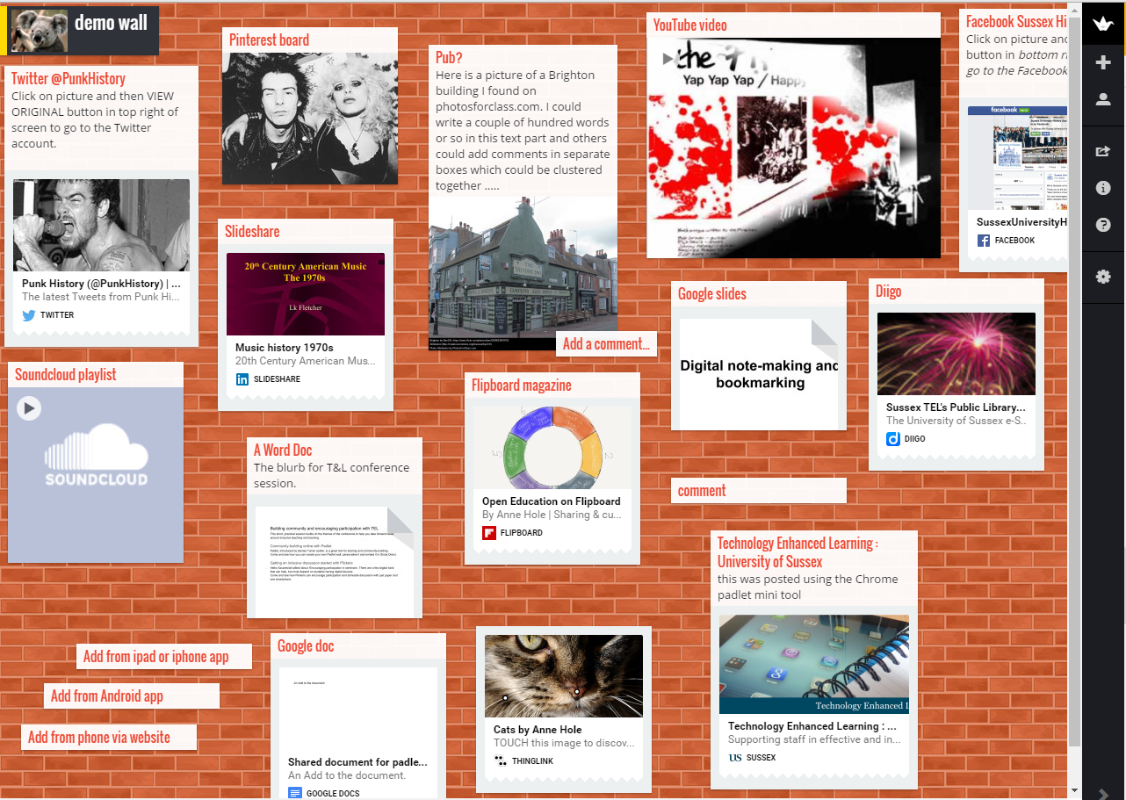

Slide 8
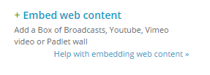

Slide 9
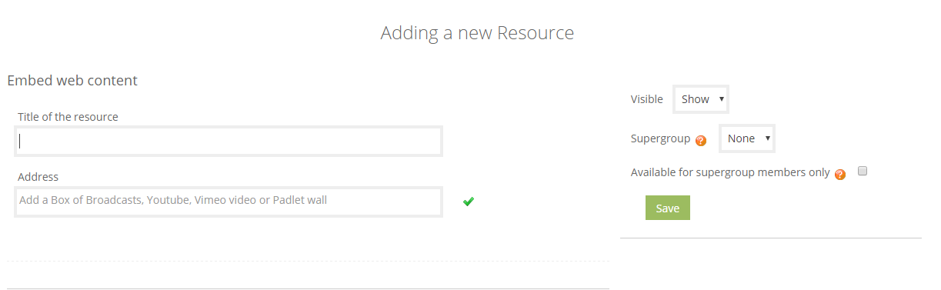

Slide 10
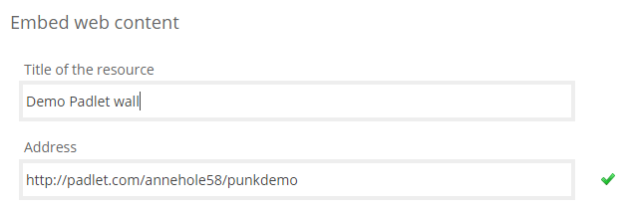

Slide 11
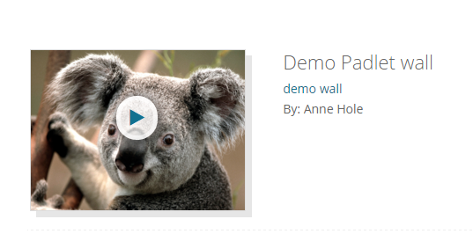

Slide 12
