Slide 1
The Pursuit of Meaningful Learning
Professor Buge Apampa
Director of Pharmacy

Slide 2

Buge Apampa
1981
Bachelor of Pharmacy
1st Class Hons.
University of Benin Nigeria
1982
Pre-registration Pharmacist
1983
In Northern Nigeria
1st time ever for One year National Service at a Specialist Hospital
“Be the change you want to see in the world” Gandhi
2005-2013
Back to Academia
Clinical Lecturer
Medway School of Pharmacy University of Kent
1991
Registration with the RPSGB
2004-2005
Seeking a new challenge Project Director & Community Pharmacy Lead WELHAT PCT
1988
PhD Pharmacology
University of Manchester
2007-2010
Deputy Head of School Medway
2002-2004
PCT GP Practice Pharmacist
2004-2006
Aston Uni PG Diploma Clinical Pharmacy
1992-2004
Pharmacy Manager
2016
Made history!
Appointed 1st
Sussex
Professorial Teaching Fellow
2013
Dream Job!
Moved to Sussex
To set up Pharmacy Course
2008
Kent Uni
PGCHE
2017
Team Teaching Excellence Award
2014
Professional Recognition
MFRPSII
2012
Kent Science Faculty Teaching Prize
“There’s no greater agony than bearing an untold story inside you” Maya Angelou

Slide 3

The Pursuit of Meaningful Learning
Explore the concept of meaningful learning
The Environment
The Curriculum
The Student

Slide 4
Meaningful versus Rote Learning
Learning related to previous knowledge
Integrated with previous learning
Can be applied to novel situations and used in problem solving
E.g. predicting side effects of morphine by linking to the general effects of morphine on the body
Verbatim memorization
Cannot be applied to novel situations
E.g. remembering abstract facts like side effects of morphine without relating them to the general effects of morphine on the body
“Education is what remains after one has forgotten what one learnt in school”

Slide 5
Meaningful Learning
Meaningful Learning
Active:
Involved
Reflective:
Portfolio
Collaborative:
Cooperative
Authentic:
Context
Goal Directed:
Learning Outcomes

Slide 6
Meaningful Learning: Student Performance
Performance – a product of ability, motivation and situational factors (Heider)
Ability - student’s aptitude for learning
Motivation - product of their desire and commitment to learning
Situational factors - the learning community and resources

Slide 7
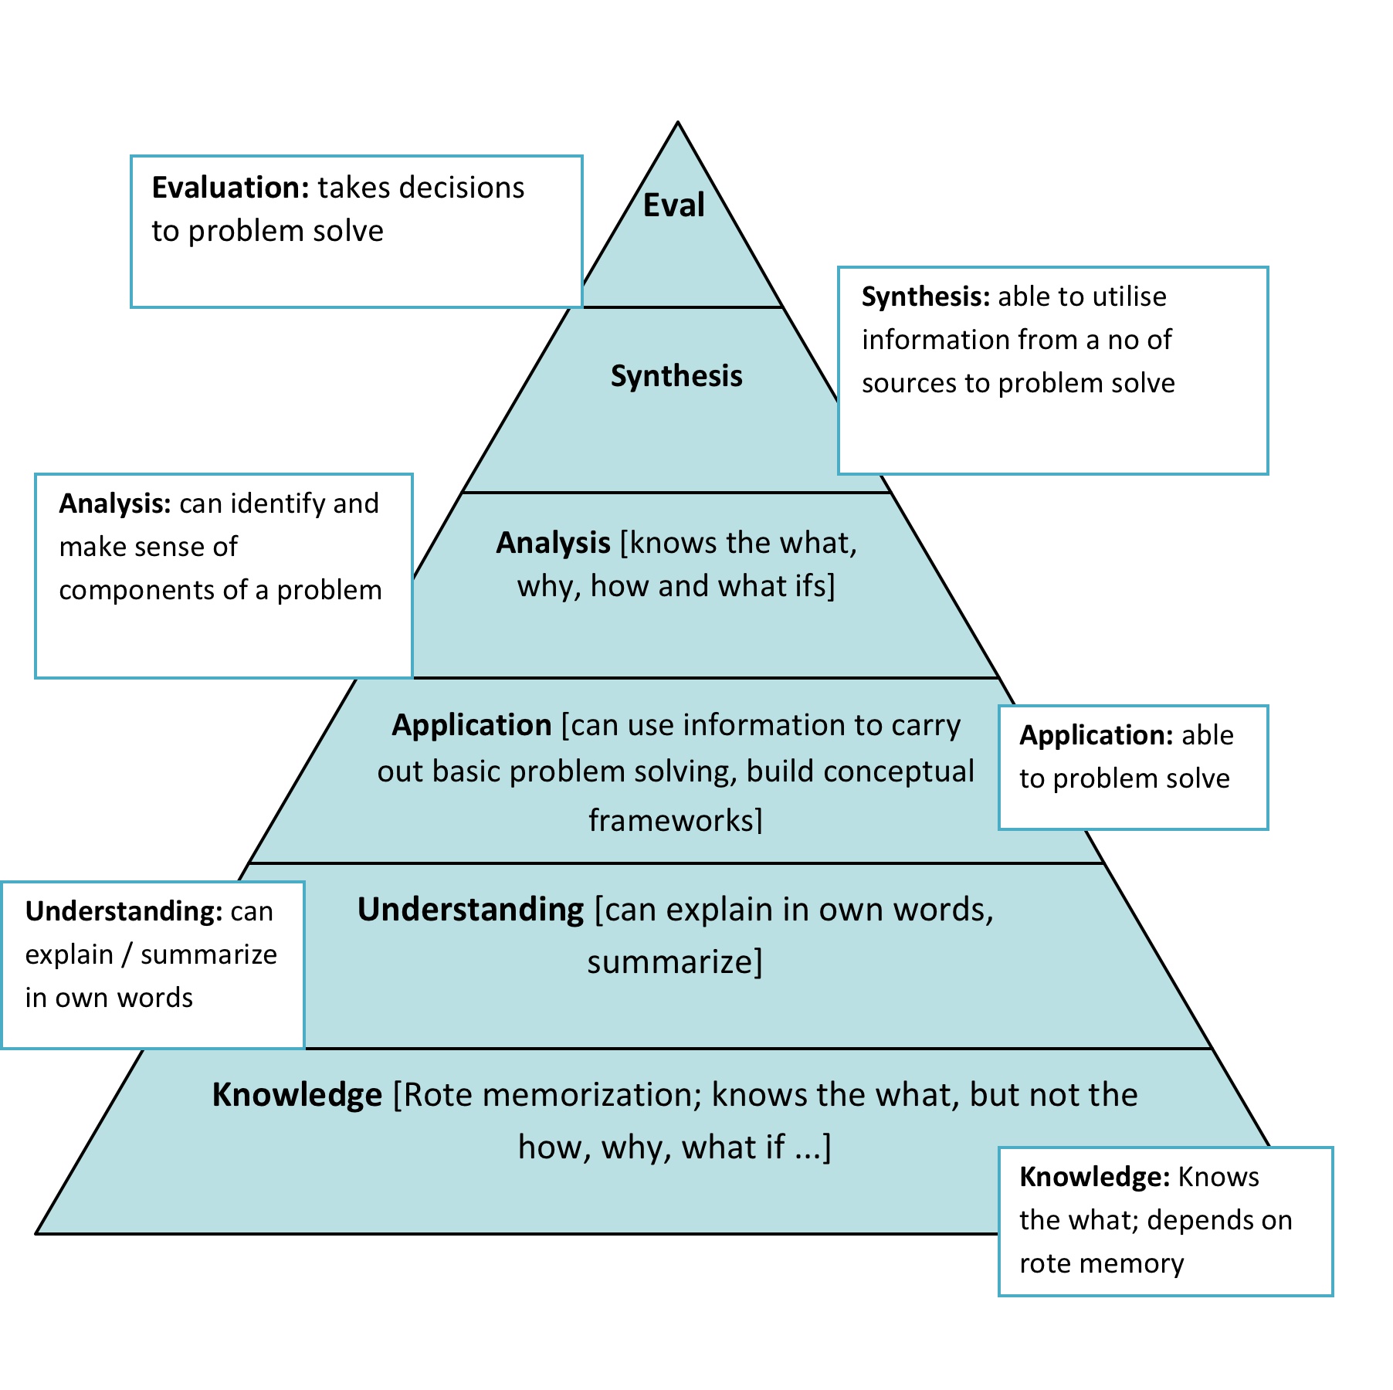
Use Bloom’s Taxonomy

Slide 8
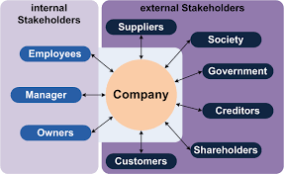
The Pursuit of Meaningful Learning:
1. The Environment
Genuine stakeholder consultation
Employers
Employees
Students/Graduates
Patients/Public
University colleagues
GPhC – Future Pharmacist standards
  Co-construction of curriculum to ensure post graduation focus through meaningful learning

Slide 9

Stakeholder Advisory Group
Values based admissions
Intraprofessional Learning
Clinical Research
Expanding roles for future pharmacists
IPL at the Bedside
HEKSS Educational & Practice Supervisors
Professional Skills Development
The Trainee Voice
High Quality Graduates

Slide 10

Patient Public Consultative Group
Communication Skills
Preparedness to Listen
Consultation Skills
Patient Education
Public Health Role
Patients as Teachers
Robust Volunteer Recruitment Process
Standard Operating Procedures
More regular meetings

Slide 11
The Trainee Voice
More Clinical Skills Training
More & Longer Placements
National Curriculum
More Calculation Practice
IPL with Patients & HCP
Contextualised Learning
Portfolio & CPD Support
Interactions with Expert Patients
Support for Pre-registration Training

Slide 12
The Pursuit of Meaningful Learning:
2. The Curriculum
Optimising curriculum design in Higher Education
A key to delivering an inclusive learning, teaching and assessment experience
“Science is built with facts as a house is with stones. But a collection of facts is no more science than a heap of stones is a house” Pioncare

Slide 13
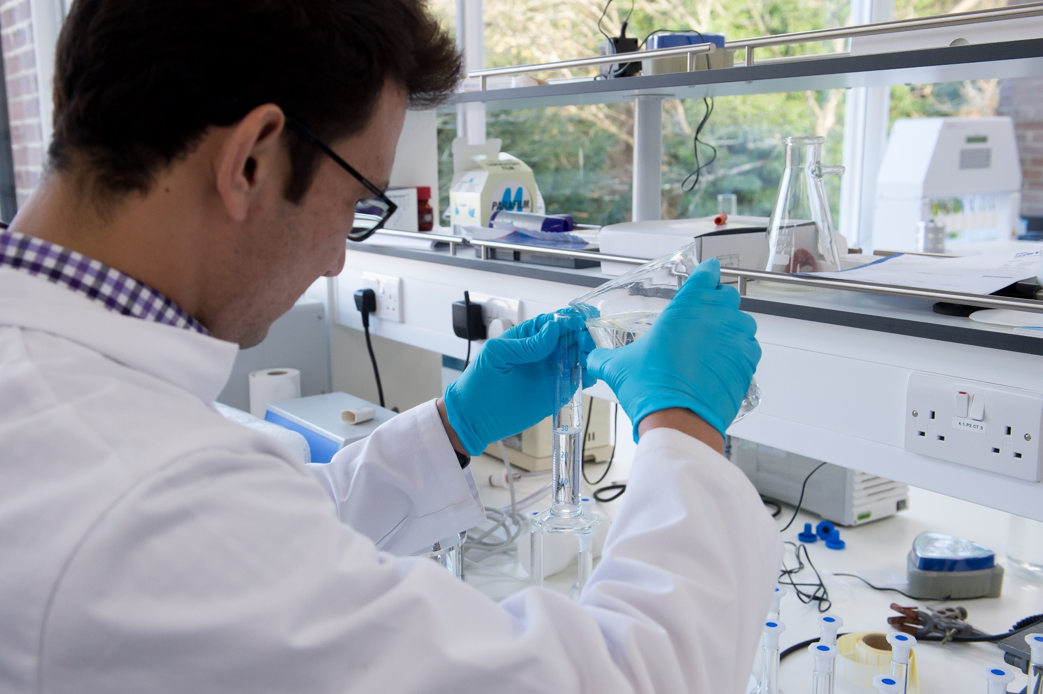
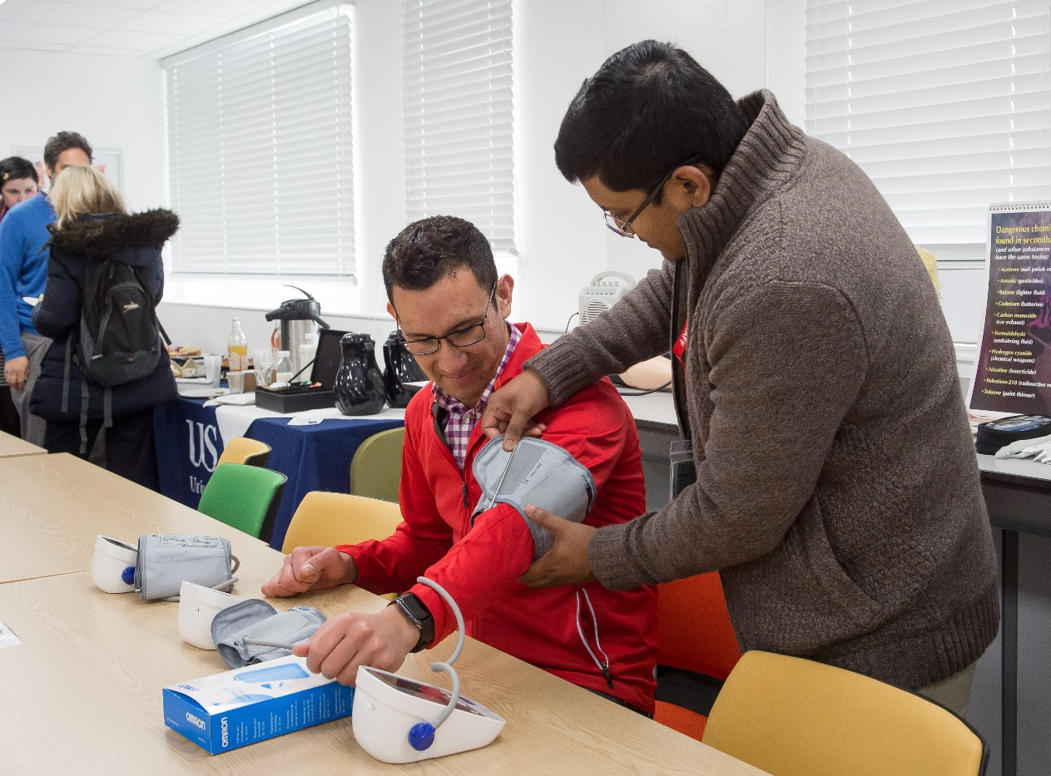

Curriculum Design:
The Heart of Effective Teaching & Learning
Developing a transformative outcomes focused curriculum
Avoiding “Too much content, not enough thinking, too little FUN”
Defining the core curriculum
“What the student must know; what they must be able to do and how they must behave”

Slide 14
MPharm Curriculum Design
Transformative Outcomes Focused Curriculum
Body Systems Based
Horizontal & Vertical Integration
Spiral
Progressive
Community Service Learning
Developing the Dispositions & Qualities
Compassionate Pharmacists who Care
Critical Thinking Skills
Intellectual Curiosity & Creativity
Drive to Excel
Discovery of New Knowledge
Embedding Professionalism

Slide 15
Developing the ‘Dispositions’ for a Challenging Career
Sussex Pharmacy
Will to Benefit Society: Cultural Competency & Community Service
Will to Learn & Explore: Inspirational Curriculum; Intellectual Curiosity & Creativity
Preparedness to Listen & Commitment to Really Care: Patient & Public Safety
Drive to Excel:
Research Ready Graduates; Creation of New Knowledge

Slide 16
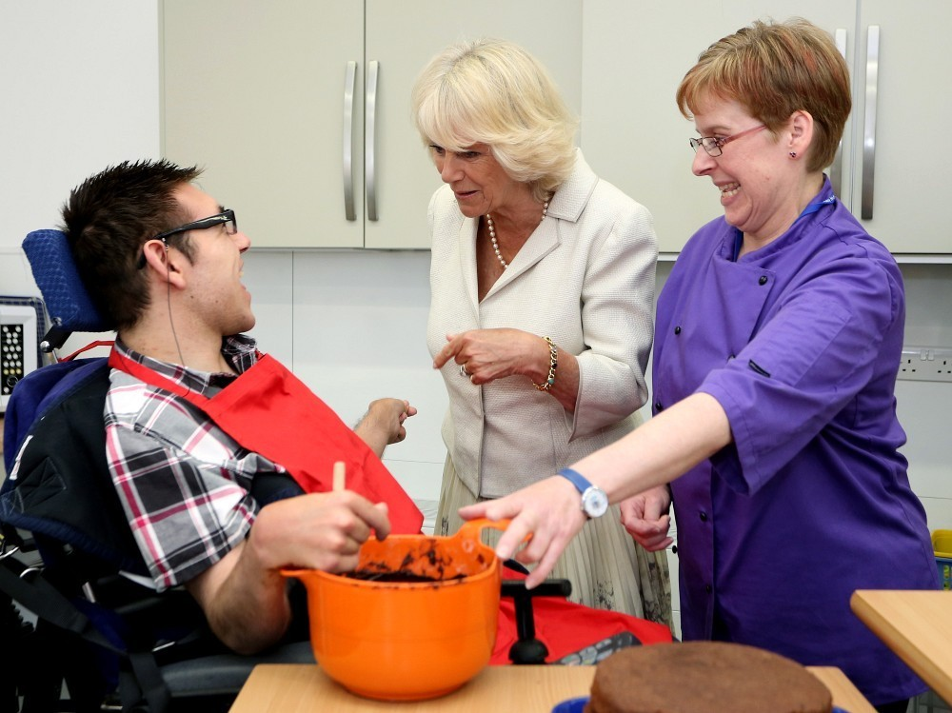
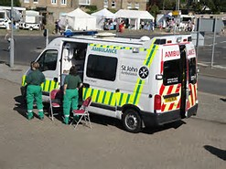
Developing the Dispositions:
Meaningful Learning in Action
Cultural Competency Scheme
Altruism
Empathy
Values
Social Justice
Self Development
Positive contribution to local community

Slide 17

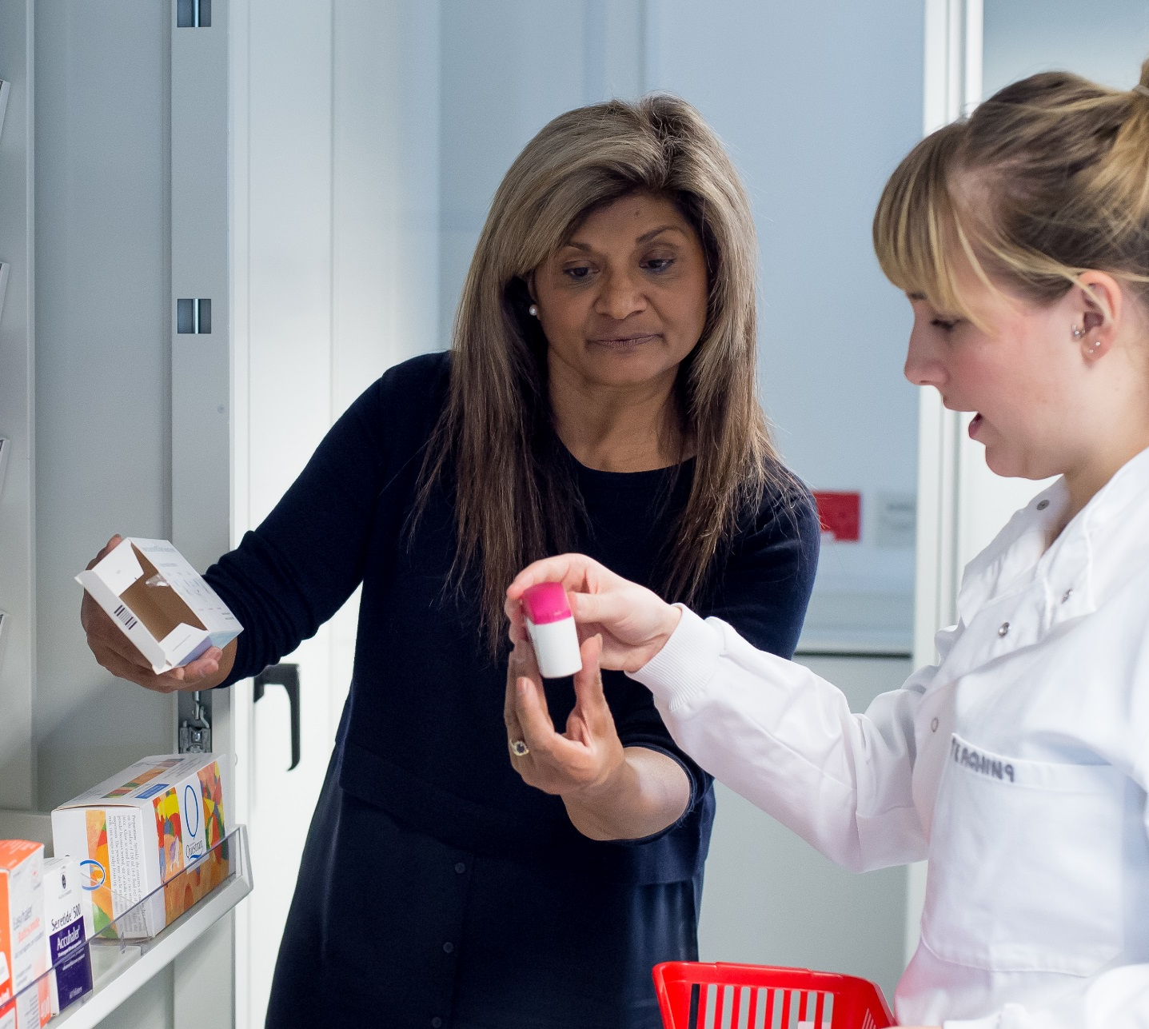
Developing the Dispositions:
Meaningful Learning in Action
Patient as Teacher Scheme
Communication skills
Consultation skills
Empathy
Self-confidence
Professionalism
Notes:
.

Slide 18

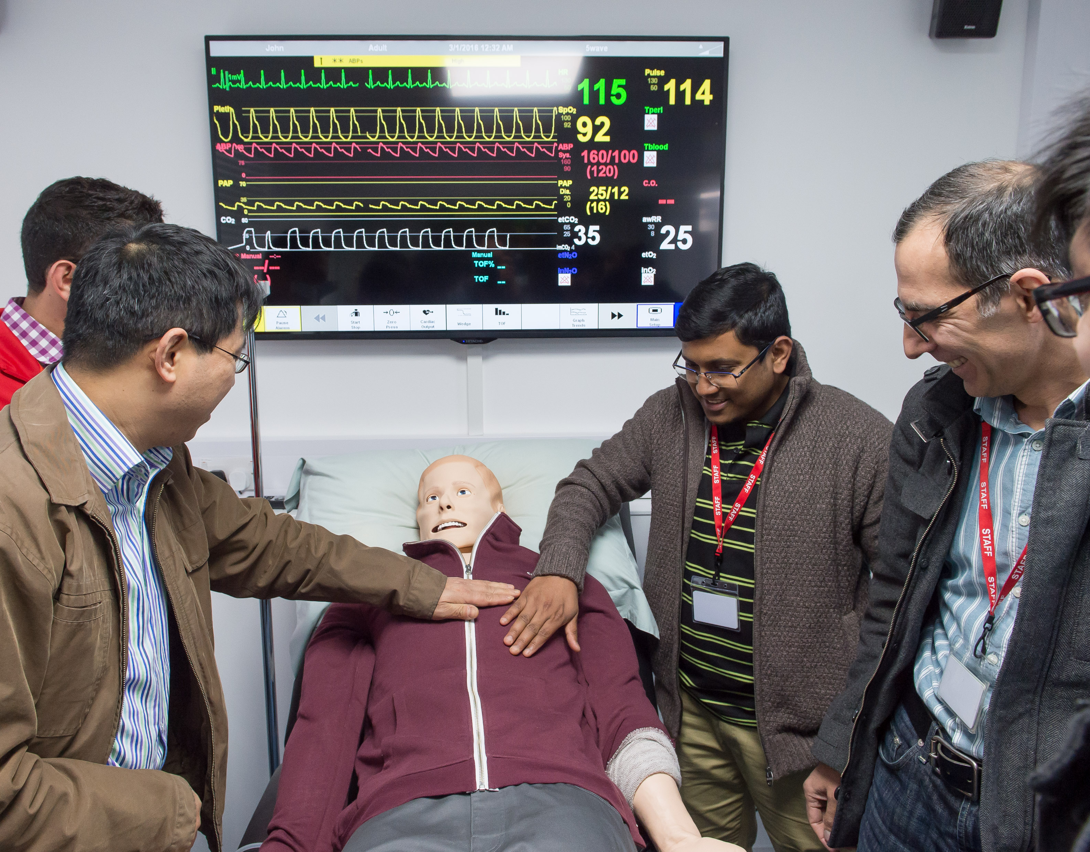
Meaningful Learning in Action:
The Right Experience
Practice Experiences
Multidisciplinary learning
Intra-professional learning
Inter-professional Learning
Experiential learning at the bedside
E-portfolio
Quality Enhancement

Slide 19


The Pursuit of Meaningful Learning:
3. The Student
Difference in the nature of learning
Require support to adjust to self-directed learning
Responsibility to support the process of learning not just cover content of learning

Slide 20


‘Knowledge is experience, everything else is just information’.

Slide 21


The Student: Transitioning to HE
Didactic lectures - primary pedagogy of University Education
Student is but a passive observer
Knowledge transfer from one set of notes (the academic’s) to another (the student’s), without passing through the mind of either.
“How we teach is much more important than what we teach and nothing reduces enthusiasm for a subject faster than poor teaching” DiCarlo (2009)

Slide 22

Teaching Students to Learn
Passive lecture format - boring, tedious & monotonous
Do not attempt to cover content
Students need time and space to examine the subject matter, content and process their learning
Context more important than content
Make classes interactive & FUN!
’No one is engaged or inspired when practising the ancient art of sleeping with their eyes open’.

Slide 23
Some Barriers to Meaningful Learning
Motivation
Poor engagement
Accessibility to staff
Classroom culture
Attainment
Low understanding of assessment criteria
Ineffective feedback
Differential learning styles
Didactic teaching
Homogenous networks
‘I never teach my pupils; I only attempt to provide the conditions in which they can learn’.
Albert Einstein

Slide 24


Slide 25
Fostering Meaningful Learning
Questions
What, why, how, when , what if…
Constructivism
Enable Students to construct their own knowledge
Conceptual Framework
Facilitate conceptual frameworks for learning
ACTIVE Learning
TBL
Tutorials
TED talks
Think Pair Share…
Glossaries
Poll Everywhere
Habits of Excellence
‘Understanding is the residue of thinking’

Slide 26
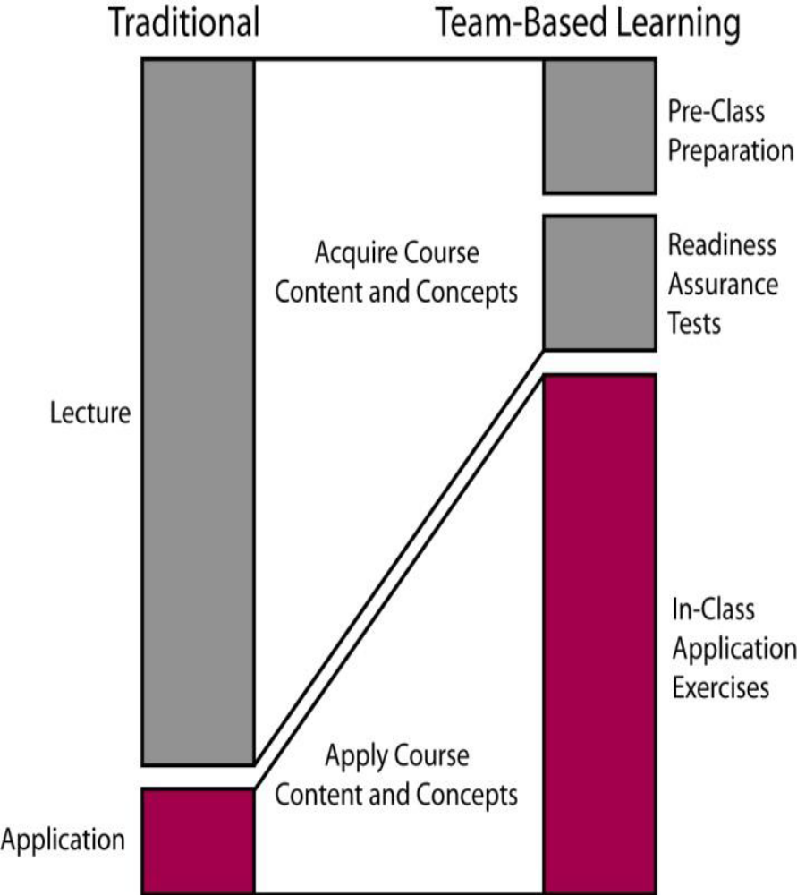
MPharm Teaching & Learning Strategy
Case Based Learning
Team Based Learning
Student Engagement- Readiness
Assurance Process
Immediate Feedback assessment Technique
Constructivism
Peer to Peer Learning
Technology Enhanced Learning
“Knowledge is of no value unless you put it into practice”

Slide 27
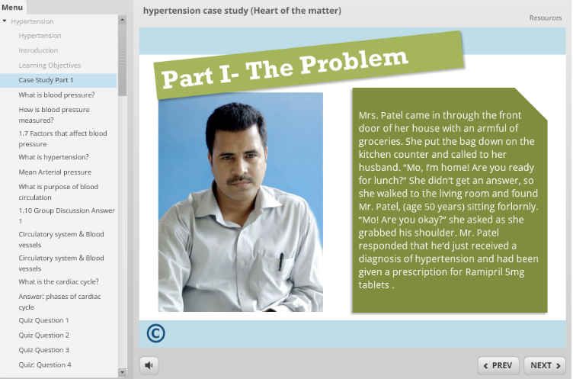
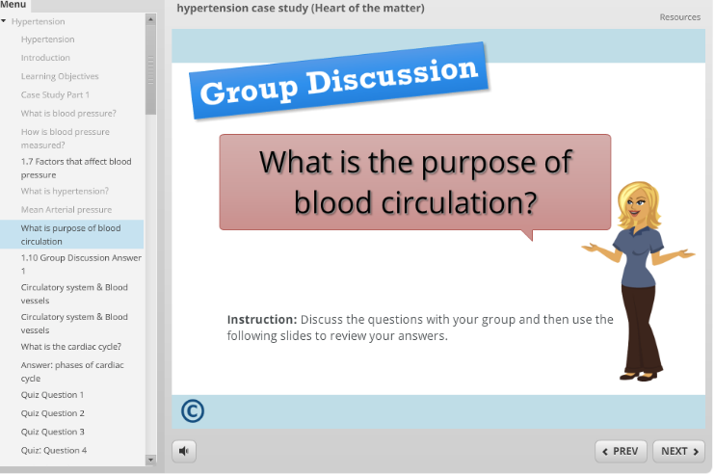
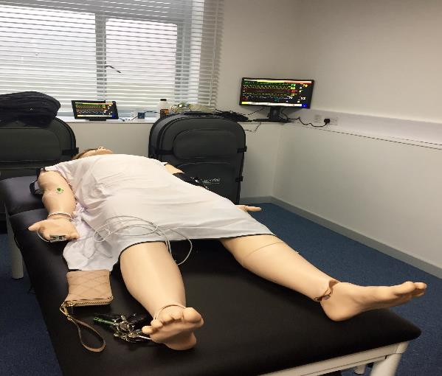
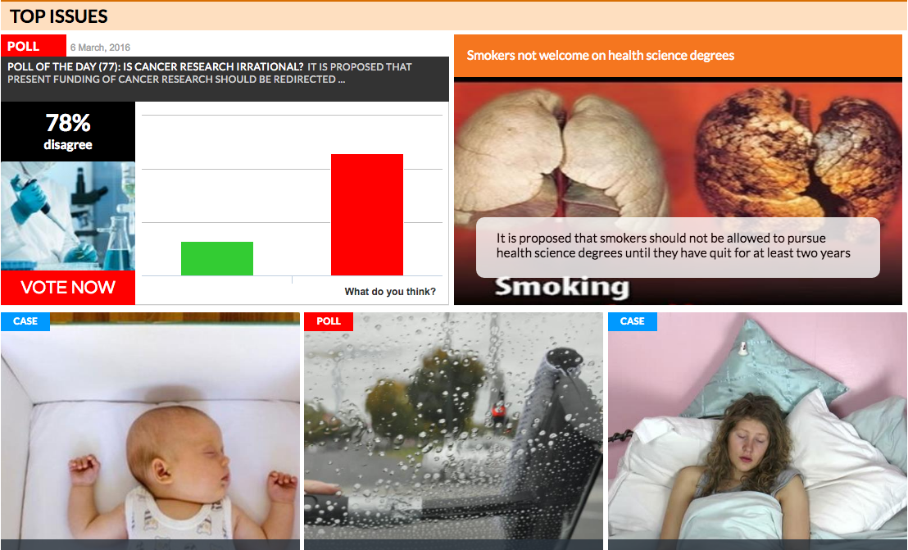
Technology Enhanced Learning

Slide 28


Learning in the MPharm Curriculum
Learning underpinned by core curriculum of body system themes, core clinical problems & core medicines
Multidisciplinary curriculum development team ensure theme-based learning across disciplines
Integration sessions support theme-based learning
Connections between subjects emphasised
Students progress from conceptual to integrative competence

Slide 29
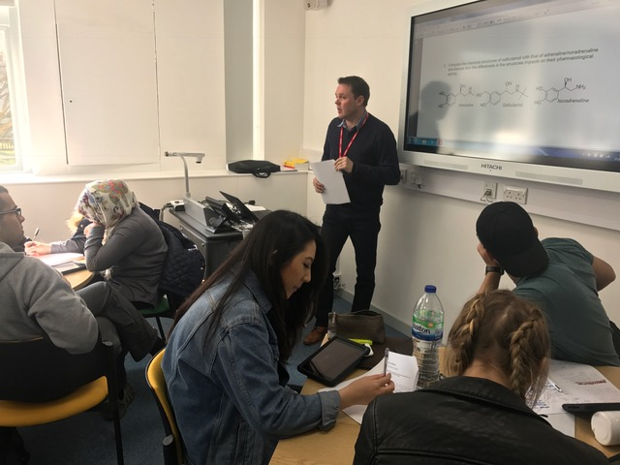
Pharmacy Integrated Curriculum
People Systems & Medicines
Biology & Physiology
Medicinal Chemistry
Pharmaceutics
Therapeutics
Pharmacology
Professional & Clinical Skills

Slide 30
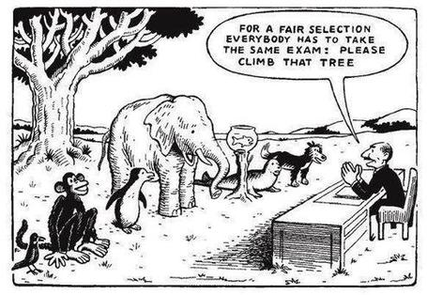
Assessments…
Self Awareness
Self evaluation
Self Directed Learning
Feed forward versus Feedback
Peer assessment
Transparent assessment criteria

Slide 31

MPharm Assessment Philosophy
Assessment FOR Learning
Assessment AS Learning
Assessment OF Learning

Slide 32
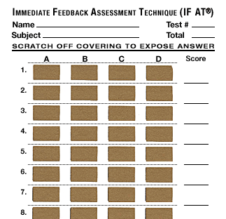
MPharm Assessment Strategy
Flexible hybrid of assessments
Diagnostic, Formative & Summative
Assessment Blueprint; standard setting
Patient & Public Safety- High Stake Pass/Fail
Competency assessments – demonstrating employability skills
Millers triangle – assessing levels of competence

Slide 33
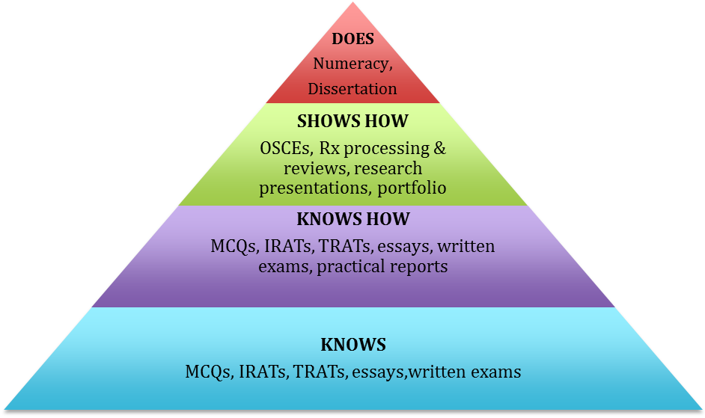
Assessment Framework: Millers Triangle
Behaviour
Cognition

Slide 34
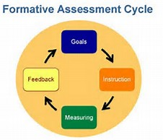
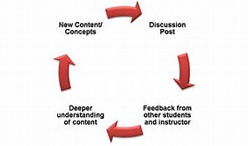
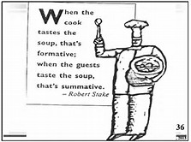
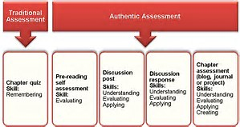
The Sussex Pharmacy TBL Assessment

Slide 35
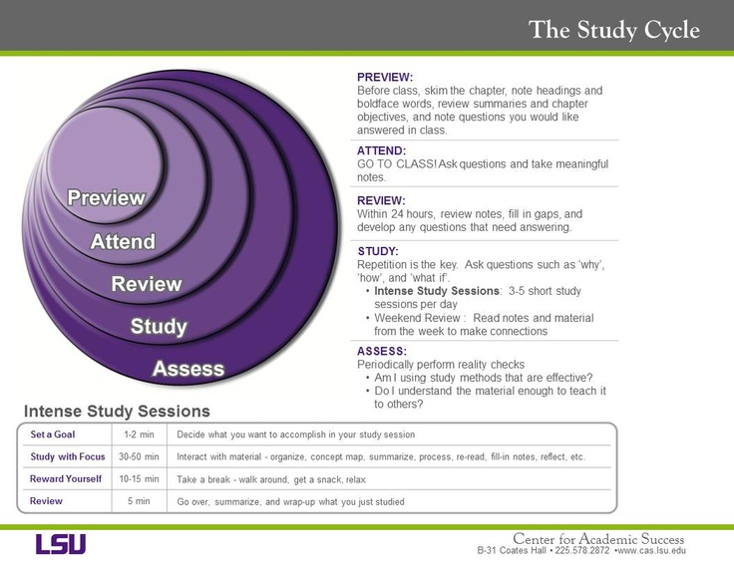
More Direct Support: Study Cycle

Slide 36
Importance of Feedback
Timing
Face-2-Face
FAQs
Likely Mistakes
Features of a good answer
Assessment criteria

Slide 37
Power of
Face-to-Face Communication
Explain
assessment criteria
Explain evidence of attainment
Relationship to learning
outcomes
Impact of body language, tone, eye contact, repetition
Meaningful
Learning
‘Inspiring and motivating students is far more important for long-term success then delivering information’

Slide 38
Phil Race’s Hint & Tips
1. Capture your reflections
7. Make good use of praise
Make
Learning
Happen
2. Find out where your learners are at
6. Keep talking about links to assessment
3. Keep watching how others teach
5. Get learners talking
4. Make students’ targets clear and interesting

Slide 39
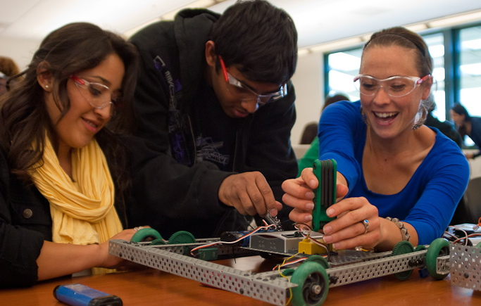
Finally…
Students will change their attitudes and behaviours regarding learning
If taught how to learn and held accountable for their learning
However, we must reduce content, increase critical thinking exercises and make learning FUN!!
‘Students may forget what you said or forget what you did, but will never forget how you made them feel’

Slide 40
The Sussex Pharmacy Course
Meaningful
Learning
Verbalising Concepts
Fellow
Higher Education Academy
Read Literature on Teaching & Learning
Define as major course objective
Peer to Peer Teaching
Teach the way we Research
Support study skills
Inspirational Teaching

Slide 41


THANKS. ANY QUESTIONS

