Slide 1

‘How I stopped worrying and learned to love technology’: A Novice’s Guide to Using Technology in teaching
Dr Denise Turner
Department of Social Work and Social Care
April 2016

Slide 2

What this talk is NOT about
Becoming highly proficient at using technology
Advice from an ‘Expert.’
How to use Technology without getting negative feedback or courting disaster
Lots of snazzy acronyms and software ideas

Slide 3
Why Talk About Technology?
‘We will maximise the effective use of emerging techniques and technologies to enhance the learning experience, alongside teaching that embraces innovative methods and spaces’ (University of Sussex, Strategic Plan)
In teaching professional programmes like Social Work:
“E-professionalism …involves the ability to understand and use’ and make meaning of ‘online postings & interactions, including blogs, images, videos , tweets and more.’ (BASW Social Media Policy, 2012)

Slide 4

“Not only must educators contend with huge demands on their time and energy, they now have to cope with rapidly changing environments while learning to use a bewildering array of emerging technologies” (Wheeler, 2015)

Slide 5
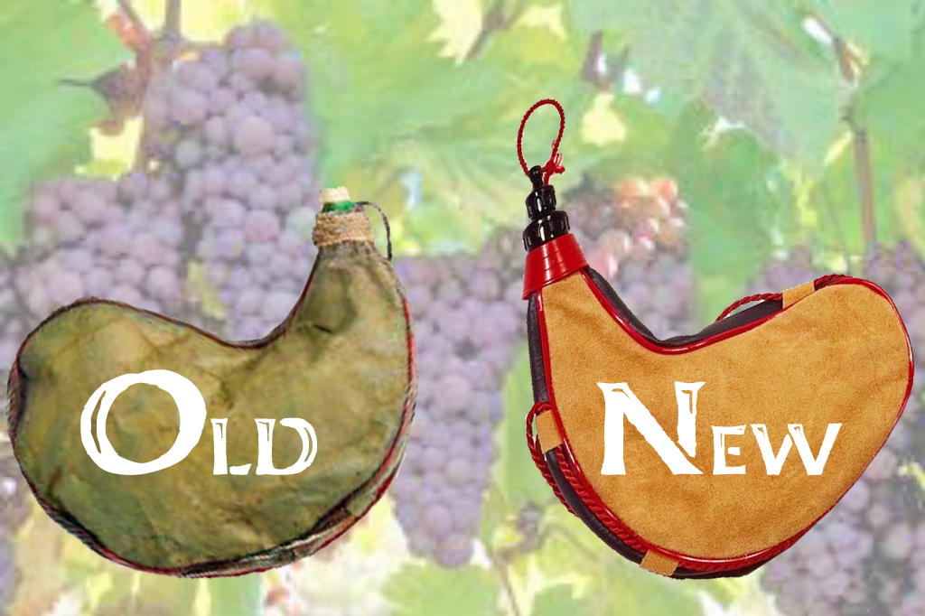
Old wineskins?
“In …Universities, the new wine expectations are being let down by old wineskins. Outside and beyond the walls…society has new priorities that were unknown even a decade ago. These have arrived with such rapidity they have caught the conservative, slow to change…education system off guard and ill – prepared to respond. The old wineskins are leaking at the seams and about to burst”. (Wheeler,2015)

Slide 6
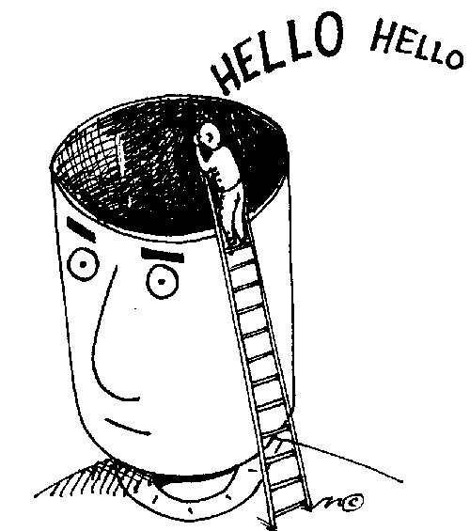
“Teachers are acutely aware of their own lack of knowledge and fear having their ignorance exposed” (Wheeler, 2015)

Slide 7
Sound Familiar?
Spend five minutes with the person next to you discussing:
Hopes about using technology
Fears about using technology
Remember these for later exercise!

Slide 8

Taking Risks?
“Teaching is a creative profession where we should be able to take risks and innovate. Often this doesn’t happen because there is simply not enough time, and teachers can be risk averse, avoiding failure by maintaining tried and tested methods” (Ken Robinson, TED talk 2013)

Slide 9
What this talk IS about
Exposing Ignorance
Taking Risks
Demonstrating some resources
Showcasing advantages and pitfalls

Slide 10

Three Resources
Using Twitter in Teaching
Using Padlet for Group Assessment
Designing an App for Interview and Assessment

Slide 11

Why?
Simply applying technology because it’s new and shiny, or because ‘everyone else is doing it’, is always a mistake (Wheeler, 2015).

Slide 12

Twitter
Pedagogy in the digital age is profoundly social, involving the negotiation of meaning and the co-construction of knowledge. It is about learning together. True pedagogy is where educators transport their students to a place where they will be amazed by the wonders of the world they live within’ (Wheeler, 2015)

Slide 13
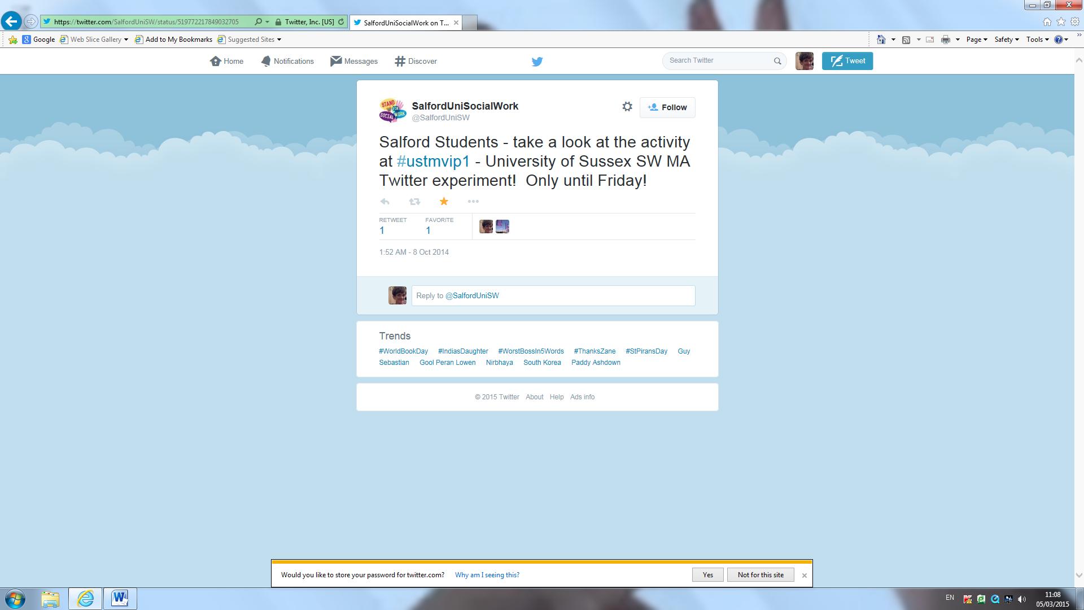
#USTMVIP1

Slide 14

#USTMVIP Storify
https://storify.com/burrblog/ustmvip1-3

Slide 15
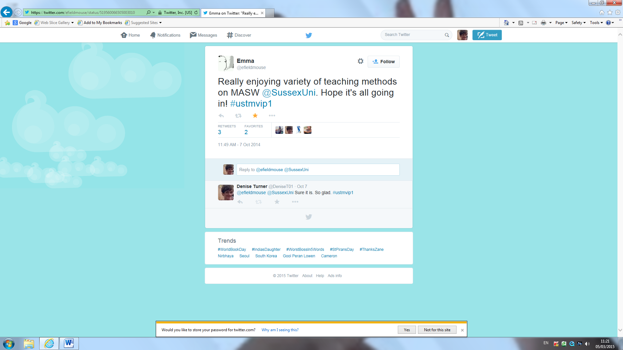
Feedback

Slide 16
So What?
Self – Regulated Learning (Steffens, 2008) The creation of communities of practice where students learn through developing and sharing, often outside the formal University setting
Paragogy (Corneli, 2012) Peer learning and production of knowledge; co-construction

Slide 17

Using Padlet in Group Assessment
Human Growth and Development (BASW1) and Human Development and Social Relationships (MASW1)
Both assessed via Group presentation and students also required to complete 500 word reflection on group process

Slide 18
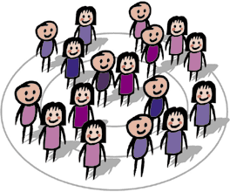
Group Assessment Using Padlet
http://padlet.com/awmh20/s8hoz00uzc6r

Slide 19

And including Video Reflection…
http://padlet.com/groupcsussex15/opuz8h10bibv

Slide 20
[Why] is this a Good Thing?
Connectivism (Siemens, 2002) – Where to find knowledge, distributing knowledge, locating knowledge in networks NOT individuals.
Heutagogy (Hase & Kenyon, 2007) Enabling students to build confidence in developing their own skills and teaching them to critically evaluate these

Slide 21
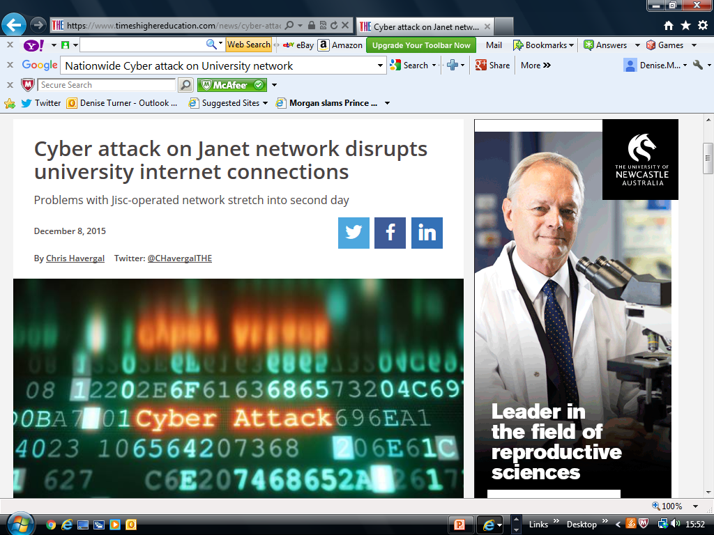
What happens when it goes wrong?

Slide 22
Feedback
‘Padlet is not a suitable tool for Assessment.’
Personally I think Padlet is amazing. It broadens the horizons immensely for presentations allowing a lot more creativity and participation. The video, leaflet, and the poster timeline were all done, in part, as a result of exploring alternatives to powerpoint…It also made us work together. It wasn't possible to say "everyone make a mini powerpoint and we'll just bang 'em all together". We had to actively pool information so that it was on one page in a concise, coherent manner. This required a lot of teamwork.

Slide 23
Hopes and Fears
Remember what you shared earlier about hopes and fears?
See if you can post these to the Padlet wall:
http://padlet.com/s_burr/sussex

Slide 24

Designing an App
‘Egan’ exercise on BASW2 and MASW1
Need to integrate the processes and deliver the recording more efficiently
Focus Groups

Slide 25

Top Tips
When you integrate technology do it with a strong rationale - know why you are using it.& be able to tell students
Use your creativity and take some risks
Don’t necessarily expect positive feedback
Have a back up plan when the internet fails!
AND ABOVE ALL …..

Slide 26
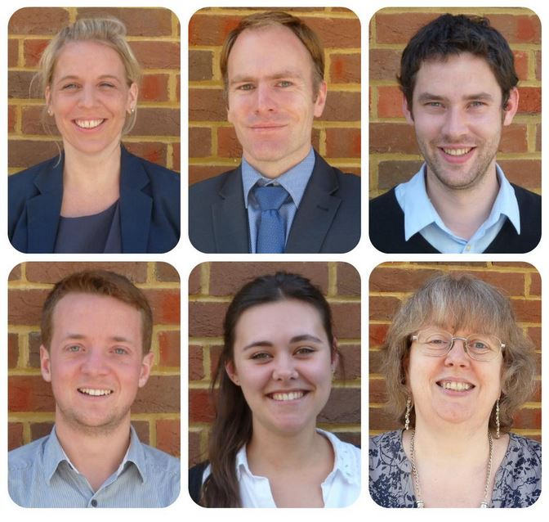
Make friends with your Learning Technologist!

Slide 27
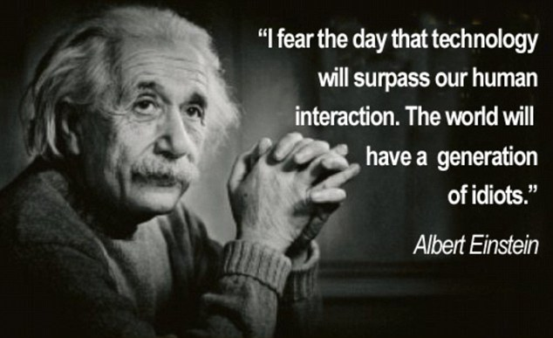
And (almost) Finally…

Slide 28
And (actually) Finally…..
Teachers are now preparing students for a world of work that has yet to be invented. It is not sensible, nor is it sustainable to continue to apply old methods. When students leave…and enter into that yet- to be- invented world, they will need to be equipped with a range of skills and literacies the preceding generation did not require...they will need to be digitally ready and technologically literate, probably beyond the experience and knowledge of their teachers and tutors’ (Wheeler, 2015)

Slide 29
Thank you for listening & participating….
Mail to D.M.Turner@sussex.ac.uk
Twitter: DeniseT01
References:
British Assoc. of Social Workers (2012) : BASW Social Media Policy. Available at: http://cdn.basw.co.uk/upload/basw_34634-1.pdf
Corneli, J (2012) Paragogical Practice. E.learning & Digital media, 9 (3) 267 -272
Hase, S & Kenyon, C (2007) Heutagogy: A Child of Complexity Theory. Complicity 4 (1)
Robinson, K (2013) How to escape educations death valley. TED talk. Available at : https://www.youtube.com/watch?v=wX78iKhInsc
Siemens, G (2002) :Connectivism Available at: http://www.elearnspace.org/.
Steffens, K (2008) Technology Enhanced Learning Environments for Self Regulated Learning: A Framework for Research. Technology, Pedagogy & Education 17 (3) 221 -232
University of Sussex- ‘Our strategy: Making the Future: Available at: https://www.sussex.ac.uk/webteam/gateway/file.php?name=our-strategy-making-the-future-2013-18.pdf&site=271
Wheeler, S (2015) Learning with ‘e’s: Educational theory & practice in a digital age . Crown House Publishing, Caernarvon.

