Slide 1

briefing for external examiners
February 2025
Oliver Craig, Head of Academic Quality and Partnerships
Anna McCall, Academic Regulations Manager
Safak Karakulak, Academic Quality & Partnerships Assistant
Division of Student Experience

Slide 2
WELCOME AND INTRODUCTION
Role of the External Examiner
Quality assurance of the assessment procedure
Summary of the examination and assessment regulations
Example Exam Board papers and application of the regulations
Annual report, fees and expenses

Slide 3
ROLE OF THE EXERNAL EXAMINER
External Examiners…
“…comment impartially and informatively on academic standards, student achievement and assessment processes for all provision that leads to the award of credit or a qualification.”
“…play an important role in identifying good practice and making recommendations for enhancement of assessment policies and procedures.”
“…contribute to … maintaining academic standards and alignment with the relevant national qualifications framework, Characteristics Statements and their alignment with Subject Benchmark Statements, and any other requirements, such as those from PSRBs or funding bodies.”
(UK Quality Code, 2018)
Notes:
In the first part of this section I will provide a overview of the role of the EE. I will then move on and talk about our marking and moderation processes.
Acknowledge that there will be a range of experience in the room and some Ees may have been doing this for years and others new to the role. Therefore, providing quite a broad overview, as well as some of the key details of the role.
The roll of the EE is outlined in our EE handbook (summarised in paper 1).
Put link in chat: External Examiners : Academic standards : Academic Quality and Partnerships : University of Sussex
The EE role provides an important quality assurance function in HE institutions, and is one that is incredibly valuable to Sussex.
Key quotes from the UK Quality Code, which summarise the overarching function of the role…
To provide impartiality on the University’s academic standards, and award and assessment processes.
to identify areas of good practice and making recommendations for enhancement of assessment procedures (being a critical friend)
to ensure that the University’s academic standards and processes align with external reference points – such as the relevant QAA subject benchmark statements and FHEQ descriptors. (having a familiarity with those external reference points, as well as the University’s internal QA processes is important to the role.)

Slide 4
ROLE OF THE EXERNAL EXAMINER
Consider the extent to which exam, assessment and award processes are rigorous
Support the University to ensure that standards are appropriate for awards
Review standards of student performance and comparability with other institutions
Consider whether assessment processes measure student achievement rigorously and fairly
Notes:
More specifically:
These points come from the EE handbook…
External examiners will:
Support the University in ensuring that standards set are appropriate for the University’s awards – and align to sector-wide standards
Review and report on student performance – and the comparability with students on similar courses in other HE institutions
Provide consideration of how rigorous our assessment and award processes are..
Particularly ensuring that processes have been conducted fairly and equitably for students, in accordance with the University regulations and policies
Consider whether those processes measure student achievement rigorously and fairly against learning outcomes and marking criteria.

Slide 5
ROLE OF THE EXERNAL EXAMINER
External Examiner Key Duties:
External Moderation - review a sample of assessed work for modules within your remit.
Scrutinise and approve draft examination papers and large weighted assessment tasks:
  Normally includes large weighted assessments at FHEQ 5-7.
  School to provide instructions for accessing tasks along with their marking strategy/criteria.
Notes:
In practice:
Carry out external moderation – come back to this in the second half of the presentation.
EE should be given an opportunity (annually) to scrutinise and approve draft examination papers and assessment tasks for large weighted assessments such as essays.
We don’t define ‘large weighted’ in our EE handbook – and schools may interpret this differently – however, as a general rule we would be referring to assessments weighted over 30% at FHEQ5-7 (to be consistent with our moderation process).
This will be managed differently in each school – but the school should be giving instructions on how to access and comment on assessment tasks.
School to advise you of school’s marking strategy

Slide 6
ROLE OF THE EXERNAL EXAMINER
External Examiner Key Duties:
Attend the main meeting of the relevant Progression and Award Board (PAB):
  At least one External Examiner who has attended the main PAB must also attend the resit PAB meeting.
Reporting:
  Verbal report at the PAB.
  Submit an annual report to Academic Quality and Partnerships (AQP).
  Sign a Statement of Compliance.
Notes:
Attend the main PAB – the main exam board where awards are given (we call them PABs)
Finalist for UG (June)
End of year PAB (October) for PGT
Anna will discuss our exam board processes later on.
Report back to Sussex:
Verbal report at Progression and Award Board (PAB)
Submit an annual report to Academic Quality and Partnerships
Report on appropriateness of the standards we have set
Student performance
Processes for exam and assessments
Appropriateness of assessments and whether they enable students to meet LOs
Marking criteria is consistent and appropriate
Sign a statement of compliance confirming that the University’s assessment regulations and policies have been complied with.
We will discuss later on how reports feed into our quality enhancement processes.

Slide 7
ROLE OF THE EXERNAL EXAMINER
External Examiners should meet annually with students to assist in:
  understanding the context of the academic provision;
  gaining a general impression of the competence of the students;
  and obtaining feedback on the student experience.
New External Examiners can be assigned a mentor.
Notes:
Student meetings:
School should give you an opportunity to meet with students in order to facilitate your role.
Used to be that we did that when the external examiners visited Sussex for exam boards – but now that many exam boards take place online, that’s less common. However, you should have an opportunity to meet with students at some point.
Mentor:
New EEs should be assigned a mentor, who is a more experienced external examiner in the relevant School. If you’re new to external examining and you haven’t been given this opportunity and you’d like one – please let us know and we will speak to the school and ensure that is actioned.

Slide 8
Quality assurance of assessment: assessment setting, marking and moderation
Marking, Moderation and Feedback Policy
Anonymous marking
Mark checking
Internal moderation:
  Review a sample of assessed work for assessments weighted over 30% for FHEQ 5-7
  Sample includes 10% of scripts, subject to a minimum of 7 and a maximum of 25 marked assessments. The sample must represent all classification bands and include all fails.
  Marks and feedback may not be changed at this point. This process checks for consistent application of the marking process.
  The sample will be selected automatically for e-submission assessments.
Notes:
Covered under paper 2
Provide a link to the Marking, Moderation and Feedback Policy in the chat: https://www.sussex.ac.uk/webteam/gateway/file.php?name=marking-moderation-and-feedback.pdf&site=457
All marking is anonymous by candidate number (where possible – may not apply to assessments such as presentations)
Sussex has a process of marks checking, for example double marking or benchmarking. The practice will vary by School – and your School should give you information about it’s marking process.
Following marks checking – internal moderation:
Assessments weighted over 30% FHEQ 5-7
The sample for moderation includes between 7 and 25 assessments (that’s 10% of assessments on a large cohort of 70 students or above, up to a maximum of 25 assessments, or a minimum of 7 assessments (whichever is the higher).
The sample will include scripts from all marking bands, PLUS all fails.
To note that Marks and feedback cannot be changed by the internal moderator, as the process checks for consistent application of the marking process.
The sample will be automatically selected for e-submissions. For offline submissions – the School will select the sample using the above criteria.

Slide 9
Quality assurance of assessment: assessment setting, marking and moderation
External Moderation:
  External Moderator reviews the same sample as the internal moderator.
  Confirm that marking and internal moderation processes have been conducted appropriately, based on the marks and feedback provided in the sample.
  Marks and feedback may not be changed at this point. This process checks for consistent application of the marking process.
External Examiner should have access to:
  A copy of the assessment task and marking criteria.
  Access to course and module materials.
  Access to the full marks register for the cohort.
  Internal moderator comments about the sample of assessments.
Notes:
Following internal moderation – a sample would be sent to the EE for external moderation…
EE reviews the same sample as the IM
Role will be to confirm that the marking and internal moderation processes have been conducted appropriately based on the marks and feedback provided.
As with internal moderation – marks and feedback may not be changed at this point.
TO NOTE:
It is not possible to change individual marks and feedback through the moderation process AND we cannot ask you to adjudicate between markers.
If the EE is dissatisfied with the marking and feedback (e.g. there is an issue with the marking or inconsistent feedback):
Please discuss concerns with the School (marker/module convenor)
May reject a sample – which will prompt the School to do a full or partial remark depending on the issue (e.g. partial to address a specific issue), which will re-start the marking and moderation process.

Slide 10
Quality assurance of assessment: assessment setting, marking and moderation
Accessing Moderation Samples:
Offline assessments (e.g. unseen exams)
  School to provide instructions for accessing offline assessment samples and providing feedback
Formal E-submissions (e.g. Canvas Turnitin)
  Students submit to Canvas (https://canvas.sussex.ac.uk)
  Moderation samples accessible via Sussex Direct (https://direct.sussex.ac.uk/)
  External Examiners should receive an email notification to their Sussex email address
Notes:
Providing brief instructions here – not full instructions.
TO NOTE: we have received feedback from External Examiners that it would be useful to provide more detailed instructions on how to access moderation samples. We are taking this on board and we are currently looking into this.
External Examiners might receive samples in different ways, depending on the assessment and how it’s been set up on our system.
For offline submissions (e.g. unseen exams and presentations)
Samples might be accessible in different ways (e.g. BOX, Canvas, mail)
School to provide instructions for accessing samples and instructions for providing feedback and acceptance of sample.
For formal e-submissions (e.g. Canvas Turnitin)
Student submit to Canvas
Samples are accessed via our online portal – Sussex Direct
EE will receive an email notification to your Sussex Email address when an e-submission is ready to view in Sussex Direct – suggest setting up an auto-forward to your institution email address.
There will be a link in the email to Sussex Direct.
EE can also log directly into SxD using your Sussex user details (e.g. an000)

Slide 11
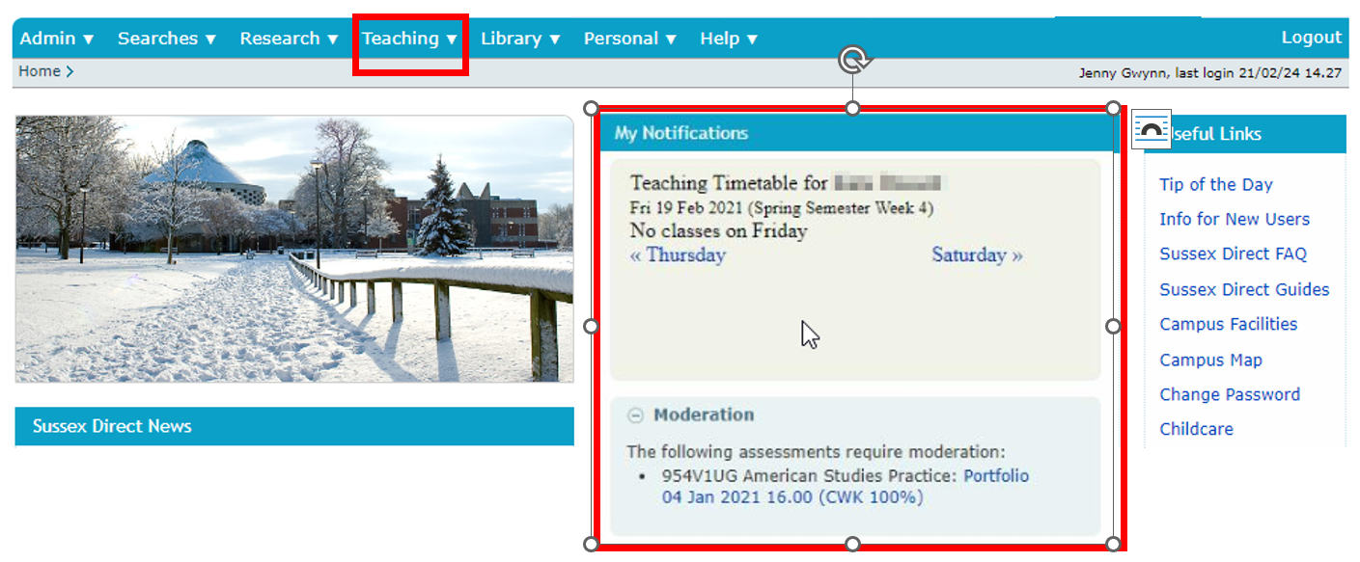
Quality assurance of assessment: assessment setting, marking and moderation
Notes:
Either click on ‘Teaching’ and navigate through to the moderation page. Alternatively if samples are ready for moderation, they will show under ‘my notifications’.
EEs will be able to ‘View the Scripts’ in the sample – which will take them through to the submissions on Canvas.
However, EEs will need to navigate back to Sussex Direct to accept the sample and provide any moderation comments.

Slide 12
Summary of progression and awards regulations – ALL
Cycle of assessment | A student registered for a module will be deemed to have attempted the module. An assessment cycle includes one first/ initial attempt (opportunity) and one resit attempt (opportunity).
Resit | A further attempt of those elements of assessment within a module that have not been passed. This is usually within the same academic year and does not require additional teaching and learning.
Sit | This is where a student is permitted to retake an assessment(s) as if for the first time on the basis of an approved Exceptional Circumstances claim. This is usually within the same academic year and does not require additional teaching and learning.
Discretionary 2nd resit | One discretionary second resit may be offered up to a maximum of 60 credits. A discretionary second resit may not be given where the stage has already been repeated.
Repeat stage | A repeat of a stage of study means that a student restarts all the modules associated with the stage as if for the first time, takes part in all teaching and learning and takes all assessment. All previous marks and credit relating to the repeat stage are removed from the student record for progression and award purposes. Entitlement for repeat of stage 1 and discretionary thereafter including the final stage (UG and PG) and foundation level. Equity for all students in stage 1. Academic judgement for other stages.
Resit marks | Where a resit/sit is taken the mark achieved will stand, even where lower. Where it is not taken the original mark will stand. Resit marks are capped at pass threshold at the level of the assessment.
Notes:
Cycle of assessment is an IA plus resit and this is usually exhausted before repeat offerstudy butwithout attendance, and the Board may offer second resits up to 60cr without attendance in the following year. Where there is a significate vol of failed credit, the EB has discretion to offer a repeat is in full and all previous marks wiped from record. A repeat is as if for the first time, so marks are uncapped and there is an IA and resit cycle. Repeats are usually for a whole stage of study but can also be for a semester. EC will be shown on EB papers and usually lead to a further sit without penalty, rather than setting aside or consideration at borderline.

Slide 13
Summary of progression and awards regulations – ALL
Accepted exceptional circumstances | Students experiencing short-term, unexpected circumstances that are beyond their control that negatively impacts their ability to study, prepare or complete an assessment or exam may submit an Exceptional Circumstances (EC) claim. No marks will be set aside. Students may be given an uncapped sit opportunity as a result of evident impact on module assessment, as determined by the PAB, to demonstrate full potential. Where EC relates to a penalty for late submission, the penalty will be removed. Equity for all students and does not confer unfair advantage as a result of sit.
Compensated credit | PAB may automatically compensate module(s), up to a maximum of 30 credits per stage, with a marginal fail mark. The relevant uncapped stage mean in the stage must be achieved as follows: UG: uncapped stage mean of 40% Integrated Masters: the uncapped mean must be 50% or more in the final stage (level 7/ stage 4) of the course. Masters: uncapped stage mean of 50% The mark for the compensated module(s) will remain as the actual mark achieved for progression and award purposes and the credits awarded.
Condoned credit | The PAB has the discretionary authority to award up to a maximum of 30 condoned credits in the final award stage where: • The course learning outcomes have been met, and • The relevant uncapped stage mean in the final stage has been achieved as follows: UG: uncapped stage mean of 40% Integrated Masters: uncapped stage mean of 50% Masters: uncapped stage mean of 50% A maximum of 30 credits may be granted via a combination of compensation and condonement in the final award stage.
Exit awards | Lower level awards to be given as exit awards where these have been validated as a coherent academic award for the individual course. Embedded within principles of Academic Framework to award achievement when learning outcomes met.
Individual Inequitable Outcome | The PAB may request an exception for an individual student where the strict application of the regulations would result in an unintended, manifestly unfair outcome for a student(s). PVC may accept or reject IIO requests to maintain academic standards.
Notes:
Marginal fail marks are auto compensated 35-39% + stage mean of 40, or 45-49% plus stage mean at pass threshold – not Board decision but will appear on the EB papers at the end of the stage (i.e. not where there are further fails). Students may optionally resist for a capped mark. The FVM will be used for progression purposes but not award classification. We have facility within the regs for the EB to request an IIO to approve an action outside regs – this is where the normal application of regs has a perverse outcome, for example where the student has a number of EC so hasn’t had a fair opportunity to complete the assessment – about sense of natural justice, recorded centrally and reported annually.

Slide 14
Summary of progression and awards regulations – UNDERGRADUATE
Credit requirement for progression (undergraduate) | 40% uncapped stage mean plus 120 credits (which may include a maximum of 30 credits given by compensation and/or trailed credits where criteria met). Ensures stage mean achieved across stage.
Trailed resit | This is where a student is permitted to progress to the next stage of study with up to 30 credits of outstanding failed module(s). The student is registered for the outstanding credit alongside their study in the next stage, no additional teaching and learning is required for the trailed module. The resit assessment will be taken in the reassessment period for the module.
Credit requirement for award (undergraduate Bachelors) | At least 360 credits at the prescribed level • of which at least 90 credits must be at FHEQ level 6 or above • and a capped stage mean of 40% or more, in the final stage. This may include condoned and compensated credit. Calculated using the following algorithm: Stage 2 mean based on all 120 credits with a weighting of 40% Stage 3 mean based on all 120 credits with a weighting of 60%
Undergraduate award classification | Undergraduate awards will be classified using the following overall framework: First Class Honours: An overall weighted grand mean of 70 – 100% Upper Second Class Honours: An overall weighted grand mean of 60 – 69% Lower Second Class Honours: An overall weighted grand mean of 50 – 59% Third Class Honours: An overall weighted grand mean of 40 – 49%
Undergraduate borderline zone | The University operates a borderline zone at each of the classification boundaries. The PAB will uplift an award to into the higher classification if the student has: • A grand mean mark of up to 1% below the classification boundary, and • 50% or more of the final stage credit that contributes to the award is in the higher classification band. Exceptional circumstances do not provide grounds for reclassification of an award.
Notes:
Paper 3 provides a summary of key points and terminology within our P&A Regs. These slides will be available after the briefing to refer back to. Sx operate a 0-100 marking scheme with some pass/ fail assessments. Sector norm pass mark and credit requirements per stage apply, plus an uncapped stage mean at the pass threshold for progression. To note – where accredited by PSRB there may be course specific regulations such as all tasks have to be taken and passed/ some modules excluded from compensation etc.

Slide 15
Summary of progression and awards regulations – POSTGRADUATE
Credit requirement for continuation to dissertation/ major project submission (postgraduate) | Minimum of 60 credits must be achieved by the Summer PAB. Where fewer than 60 credits have been achieved at the first attempt by the Summer PAB, the dissertation/project will be deferred to the January Semester 1 assessment period of the following academic year. Where 60 credits or more have been achieved at the first attempt by the Summer PAB, the dissertation/project will only be deferred to the Semester 1 assessment period of the following academic year where the PAB confirms that the resits/sits of the taught modules should be completed prior to submission of the dissertation/project. The Summer PAB may offer a choice of a repeat stage or resits/sits of the taught modules. This enables a repeat stage to be taken within the maximum period of registration
Credit requirement for award (postgraduate Masters) | A student who is registered for the award of Masters Degree will be considered for the award on completion of: • Not less than 180 credits at the prescribed level • Of which at least 150 credits must be at level 7 • A capped stage mean of 50% or more across the stage This may include condoned and compensated credit.
Postgraduate award classification | Postgraduate awards will be classified using the following overall framework: Distinction: An overall grand mean of 70 – 100% with 50% of the credit at 70 or above Merit: An overall grand mean of 60 – 69% with 50% of the credit at 60 or above Pass: An overall grand mean of 50 – 59%
Postgraduate borderline | The University operates a borderline zone at each of the classification boundaries. The PAB will uplift into the higher classification if the student has: • A grand mean mark of up to 1% below the classification boundary, and • 50% or more of the credit that contributes to the award in the higher classification band
Notes:
PGT is single stage, so no formal progression point, however, we require at least 60cr taught modules to be passed before a student continues to DIS / PRO OR there may be requisite modules such as research methods. PAB can require deferral of DIS to following January.

Slide 16
Quality assurance of assessment: Assessment Boards
Module Assessment Boards (MAB)
Marks assurance
Historical trends – distribution of marks and statistical data
Confirmation of external moderation
Recommend remedial actions for problematic set of marks
External Examiner attendance not required for quoracy, may be consulted
Notes:
No EE attendance but you may be consulted on MAB recommendations for a set of marks, e.g. re-weighting where problematic. Sets of marks only taking to MAB where complete and full QA undertaken, i.e. where a sub-set of marks are held the module results will also be held.

Slide 17
Quality assurance of assessment: Assessment Boards
Progression and Award Boards (PAB)
Consider progression and award
Candidates noted where no further discussion required
Consider borderline candidates
Apply condoned credit
Consider impact of Exceptional Circumstance, offer sit as appropriate
Awards and exit awards
External Examiner attendance required for quoracy
Notes:
PABs are anon and no advocacy on behalf of individuals is permitted. Decisions are metrics and evidence based. A member of Ac Registry will attend either the pre-Board or main PAB (or both) to support the application of regs

Slide 18
Classification (UG)
Undergraduate awards will be classified using the following overall framework:
An overall weighted grand mean of 70 – 100% | First Class Honours
An overall weighted grand mean of 60 – 69% | Upper Second Class Honours
An overall weighted grand mean of 50 – 59% | Lower Second Class Honours
An overall weighted grand mean of 40 – 49% | Third Class Honours
Notes:
Note for a standard Bachelors, stages 2 and 3 are weighted 40/60. Some courses are 4 years and include an integrated YAB which is weighted 32/20/48. An integrated Masters 24/36/39.

Slide 19
Borderline (UG)
143. The University operates a borderline zone at each of the classification boundaries.
144. The PAB will uplift an award to into the higher classification if the student has:
• A grand mean mark of up to 1% below the classification boundary, and
• 50% or more of the final stage credit that contributes to the award is in the higher classification band.
145. Exceptional circumstances do not provide grounds for reclassification of an award.
Notes:
UG borderline based on proximity and preponderance of credits. Automatic raise where 1% proximity and 50% in higher class. No discretion and EC are not grounds to re-classify

Slide 20
Classification (pGT)
Postgraduate awards will be classified using the following overall framework:
An overall grand mean of 70 – 100% with 50% of the credit at 70 or above | Distinction
An overall grand mean of 60 – 69% with 50% of the credit at 60 or above | Merit
An overall grand mean of 50 – 59% | Pass
Notes:
Note the two requirements at PGT of the grand mean and predonderance of credits in the higher class – we don’t stipulate whether this must be the DIS or PRO

Slide 21
Borderline (PG)
97. The University operates a borderline zone at each of the classification boundaries.
98. The PAB will uplift into the higher classification if the student has:
• A grand mean mark of up to 1% below the classification boundary, and
• 50% or more of the credit that contributes to the award in the higher classification band
99. Exceptional circumstances do not provide grounds for reclassification of an award.
Notes:
No discretion

Slide 22
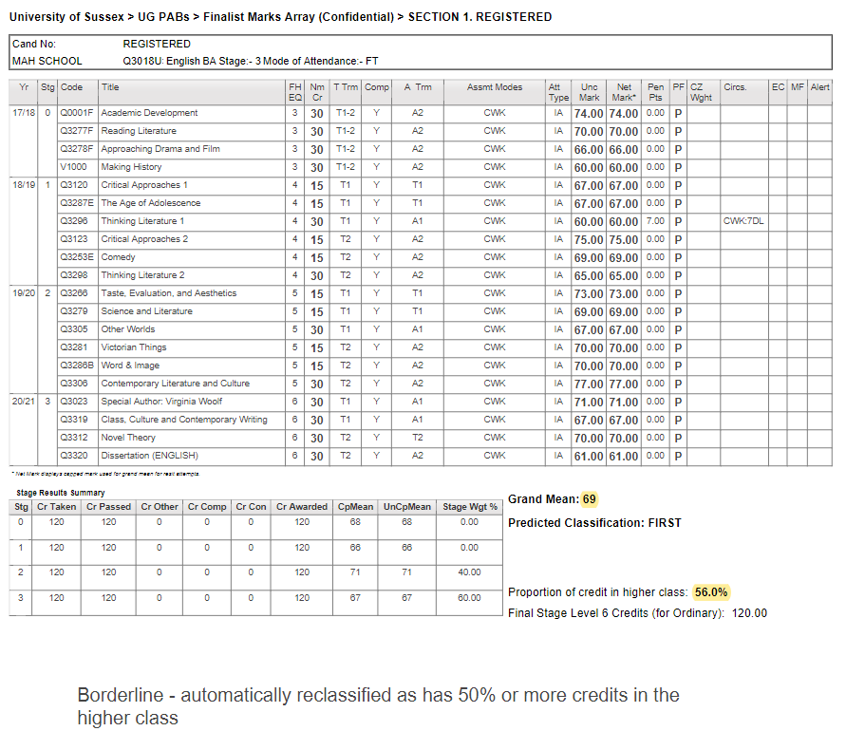
Example student array
Notes:
Example of student mark profile (referred to as an ‘array’). One student per page anonymised. We’ll go through the sections and code. PAB will only pause on students where a decision needs to be made.

Slide 23
UG Array Example 1 – lower left
Notes:
Zooming in on the lower left-hand side we have a nice summary of the number of credits acquired per stage of study, including imported RPL credit and compensated credit. We can see this student took a foundation year (stage 0), but level 5 and 6 are those that contributed towards classification weighted 40/60.

Slide 24
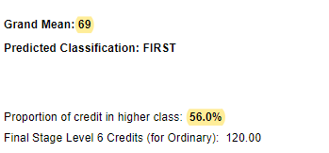
Ug example array 1 – lower right
Notes:
The lower right-hand side gives a narrative summary of weighted grand mean contributing to class, and percentage of credits in higher class. It will also show the number of credits at level 6 i.e. eligibility for an Ordinary (without honours) degree

Slide 25
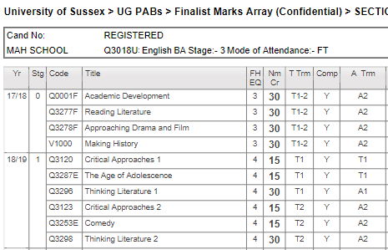
ug example array 1 – top right
Notes:
Top right gives us info about the student, their candidate number, course, mode of attendance.

Slide 26
ug example array 1 – top right
FHEQ: Frameworks for Higher Education Qualifications (Level)
Notes:
So going through the columns – FHEQ level of module

Slide 27
ug example array 1 – top right
Nm Cr: Number of credits
Notes:
Number of credits for the module, noting that Sussex operates in multiples of 15

Slide 28
ug example array 1 – top right
T Trm: Term module taught
Notes:
When the module was taken – most modules are semesterised, but a small number are long/thin taught across two terms

Slide 29
ug example array 1 – top right
Comp: module can be compensated
Notes:
Most modules are eligible for compensation, unless there is a PRSB restriction and this is hard coded into the system. This means the system will auto apply comp at end of stage where marginal fail, so for UG120cr and stage mean of at least 40

Slide 30
ug example array 1 – top right
A Trm: Assessment term
Notes:
Sussex has 3 assessment blocks which includes August resits. We can see that the first few long/thin module is assessed in the May assessment block. There are also modules in this example which are assessed in term-time, e.g. coursework.

Slide 31
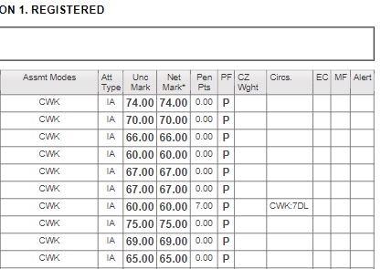
ug example array 1 – top left
Att type: Attempt type
Notes:
Moving across the columns we have detail on whether the assessment was an Initial Attempt (IA), a Resit or a Sit (this is where exceptional circumstances are upheld and the assess is as if for the first time)

Slide 32
ug example array 1 – top left
Pen Pts: Penalty Points
Unc Mark: Uncapped Mark
Notes:
Capped and uncapped marks are shown. There is a 7 day late period and sliding scale of late penalties, 5% up to 24hrs late, 10% between 24hr and 7 days. Students with Reasonable Adjustments can submit in the late period without penalty. Late penalties not applied where this would bring the module below the pass threshold and require a resit or prevent progression, as the student has evidenced that they have academically passed.

Slide 33
ug example array 1 – top left
PF: Pass/ Fail

Slide 34
ug example array 1 – top left
EC: Exceptional Circumstances
Notes:
Exceptional circumstances can be claimed for late submission, non-submission or poor performance or ‘impairment’. Where an assessment is impaired, the EB will look at the student’s overall performance, max PoR and classification if they are in the final stage. A further sit may be offered if deemed in the interest of the student, but if for example the mark is not out of line and a further sit would have no material impact on classification, the EC will be ‘noted’ but no further sit given.

Slide 35
ug example array 1 – top left
Academic Misconduct Flag
Notes:
Typical penalty for upheld Academic Misconduct is to set assessment mark to zero. PAB usually recommends resit for a capped mark. A mark may be held if the investigation is still in progress.

Slide 36
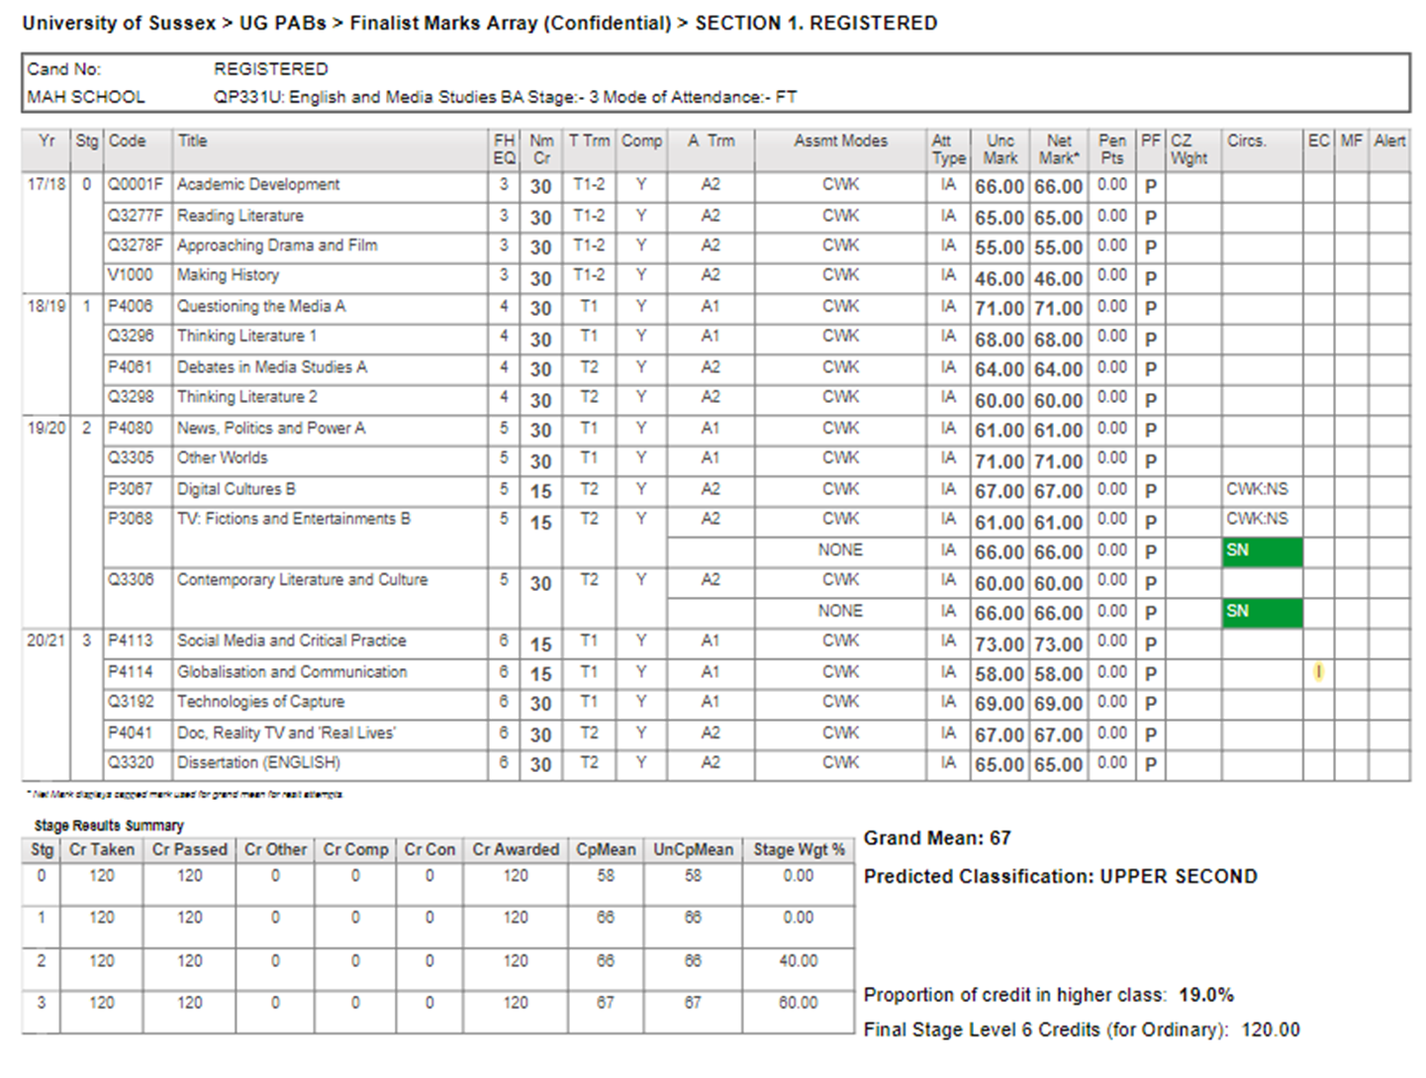
Example 2 student array
Impairment – consider whether impaired mark is out of line and offer sit if appropriate.
EC: Exceptional Circumstances
Notes:
So moving on to a different student. In this slide we see the exceptional circumstances flag for impairment. PAB has discretion to allow the student a further uncapped optional sit and will apply school strategy.

Slide 37
Example 2 student array
Impairment – consider whether impaired mark is out of line and offer sit if appropriate.
Notes:
Zooming in we can see that this mark is a little out of line and a higher mark could potentially put them into the borderline zone, although unlikely as a just x1 low weighted module. PAB has discretion here, but should set out its strategy at start of meeting.

Slide 38
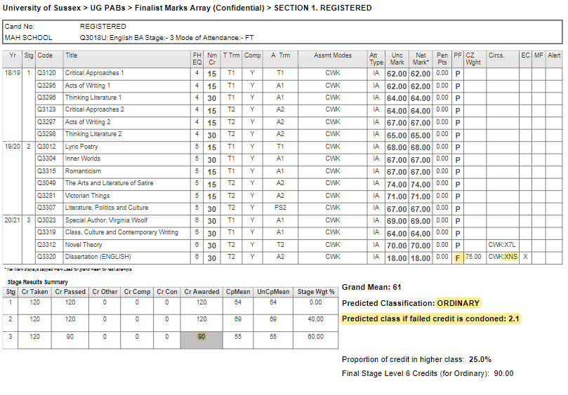
Example 3 student array
30 credits failed – consider condoning 30 credits. As has EC, optional resit will be uncapped sit.
Notes:
In this example, the student has failed 30cr, let’s zoom in on next slide…

Slide 39
Example 3 student array
30 credits failed – consider condoning 30 credits. As has EC, optional resit will be uncapped sit.
Notes:
So, we can see that there is an accepted non-submission. The PAB has discretion to apply condonement at the award stage so that they have the full amount of credit for an honours degree at there is no delay to the award. Where stu have condoned credit they are given an optional resit for capped mark, but because they have EC PAB can offer condonement with optional sit. Note max comp + condonement is 30cr per stage. Student must have stage mean of 40 and PAB ensures that course level LO are met.

Slide 40
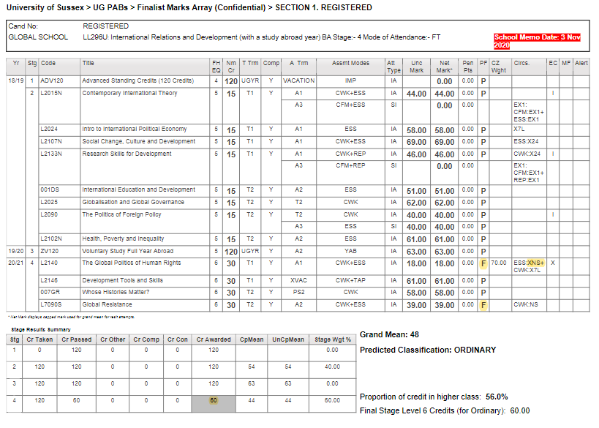
Example 4 student array
60 credits failed – too many to condone. Offer resit/sit, consider offering choice of resit/sit or repeat stage. Note mark for 30 failed credits in compensation zone (i.e. only needs to pass other 30 credits).
Notes:
In this example the student has failed 60cr in final stage.

Slide 41
Example 4 student array
60 credits failed – too many to condone. Offer resit/sit, consider offering choice of resit/sit or repeat stage. Note mark for 30 failed credits in compensation zone (i.e. only needs to pass other 30 credits).
Notes:
Note automatic compensation hasn’t been applied as volume of passed credit too low, despite a marginal fail mark of 39. Student has EC for non-sub on one assessment task. Student can be awarded an Ordinary degree to allow them to attend graduation, with optional sit of module with EC. Marks for passed assessments will be carried forward and conflated. This student has taken a voluntary YAB which was passed but is zero weighted in the classification.

Slide 42
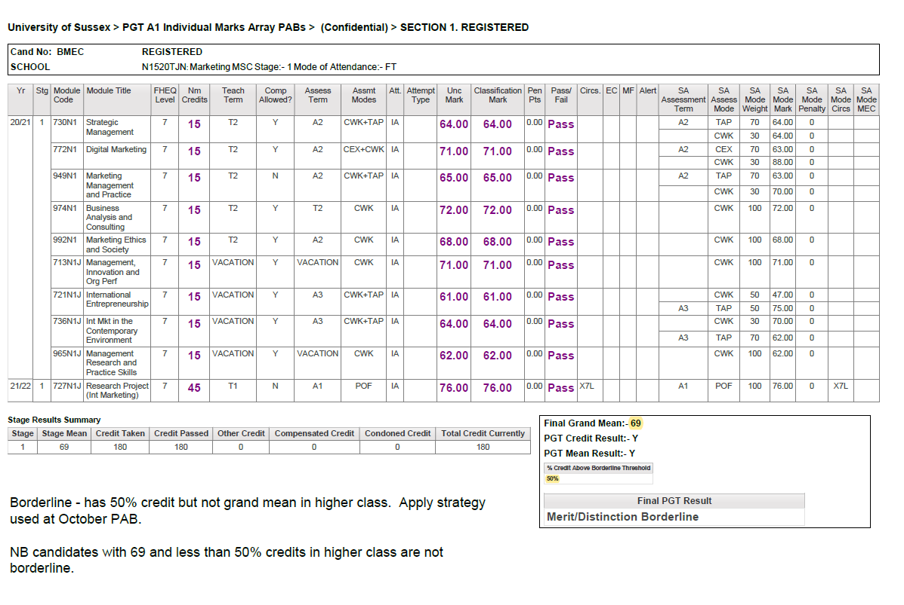
EXAMPLE 5 PGT array 1
Notes:
We’ve focused on UG so here is a PGT example

Slide 43
PGT array 1
Notes:
We can see that they are borderline with a grand mean within 1%. Note the 2 criteria for PGT awards

Slide 44
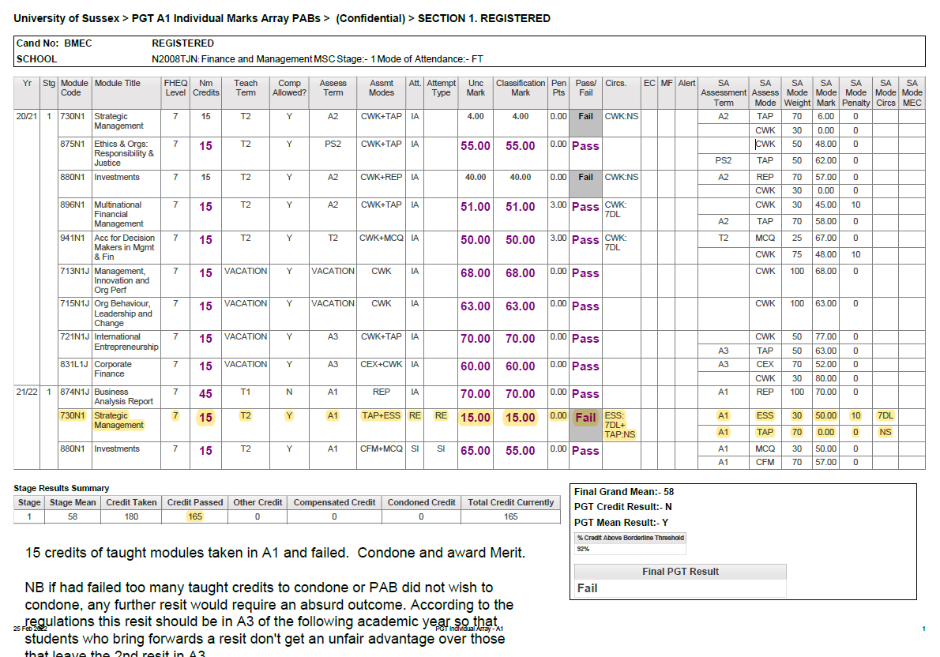
EXAMPLE 6 PGT array 2
Notes:
In this example the student has 165cr

Slide 45
PGT array 2
Notes:
This stu had 15cr of resits which they have failed at the resit attempt. PAB has discretion to condone here to issue award. A further resit would take the student beyond the max PoR, so could request IIO.

Slide 46
External examiner annual reports
Each appointed External Examiner must complete the Report Form for the course and modules they are appointed to within 6 weeks of the PAB;
All external examiners should complete the External Examiner Statement of Compliance usually at the Progression and Award Board (PAB);
Schools read each report and complete an action plan;
Generic issues of concern and areas of good practice arising from external examiner reports are included in the annual external examiner overview report. These are considered as part of Annual Course Review.

Slide 47
External examiner fees and expenses
Annual fee which covers all the duties that have been carried out on behalf of the University, paid centrally on receipt of the external examiner annual report;
Expenses can be paid throughout the year as appropriate. Expenses will be paid independently from the annual fee and require a Visitor Expense Claim form to be completed. Receipts for all expenses should be provided with the claim form and be submitted to the designated school administrative contact.

Slide 48
SUPPORTING DOCUMENTS and information
Guidance and forms for External Examiners:
External Examiners : Academic standards : Academic Quality and Partnerships : University of Sussex
Exam and Assessment Regulations:
Regulations for examinations and assessment : Academic standards : Academic Quality and Partnerships : University of Sussex
Queries:
externalexaminers@sussex.ac.uk

