Slide 1

Annual Teaching and Learning Conference 2016
Classroom games in economics teaching: reflections on student engagement and inclusion
Dimitra Petropoulou,
Department of Economics, BMEc

Slide 2
I. Why am I running this workshop today?
Growing interest in the pedagogical use of online games in Economics
Since 2013 I have embedded a number of different games into Advanced Microeconomics and facilitated the use of games in International Trade and on Applicant Visitor Days
In 2015 I received funding by TEL to embed multiplayer computerised games into Advanced Microeconomics, so as to facilitate large-scale collaborative learning
Opportunity to discuss how games can stimulate inclusion, among other benefits/demonstrate use of a game
20/04/2016
Classroom games in economics teaching

Slide 3
Session Structure
Why use classroom games in Economics teaching?
Types of economics games
  Computerised games
  Hand-run games
  Homework games
Achieving learning outcomes through classroom games
Games as a means of stimulating student inclusion
What the students think
20/04/2016
Classroom games in economics teaching

Slide 4
I. Why classroom games in Economics?
Wide tradition in gaming, simulation and role-play in teaching
Economics has developed into an experimental science, with many Universities (and soon BMEc) investing in dedicated economics experimental laboratories for research purposes
Economics games/teaching experiments typically derive from research experiments based on specific economic models, designed to test specific behavioural hypotheses
Economic games/teaching experiments can be used to:
  illustrate economic principles
  critically discuss limitations of economic theory
  Familiarise students with research in the field
20/04/2016
Classroom games in economics teaching

Slide 5
I. Why classroom games in Economics?
Games can be a fun way for students to engage with economics principles
They can also be a great motivator for delving further into the subject, getting to grips with subsequent technical material and critiquing the theory
Can allow tutor to draw from students’ diverse backgrounds and experience, stimulating inclusion and enriching the experience for the whole class
Can stimulate student attendance, encourage interaction even in non-interactive seminars
20/04/2016
Classroom games in economics teaching

Slide 6
Evidence on use of economics games?
A number of studies try to determine the benefits of using classroom experiments.
RCT methodology: lecturer and module fixed, students randomly assigned to a treatment group (with experiments) and a control group (without experiments); compare performance
  Ball, Eckel and Rojas (2006): experiments improved the overall mark on the final examination, especially for female students
  Emerson and Taylor (2004): boosted microeconomics students’ scores on a standardised economics test; narrowed gender gap
  Durham, McKinnon and Schulman (2007), Emerson and Taylor (2004): experiments benefit read-write learners less than those who prefer learning by doing.
20/04/2016
Classroom games in economics teaching

Slide 7
II. Types of Classroom games
Hand-run experiments:
Conducted in class by the tutor (potentially with assistants)
Face to face live interaction – can involve physical activity
Excellent for engagement
Vary in complexity: electronic polling vs sophisticated games with more interaction
Vary in number of players (but usually a max of around 60)
Vary in level of undergraduate being targeted
Vary in the level of time required
Easy to tailor/tweak, even on the spot
Materials for a range of games publically available
Require preparation, coordination; inherent unpredictability may lead to variation in student experience
20/04/2016
Classroom games in economics teaching

Slide 8
II. Types of Classroom games
Computerised experiments:
Work very well with large cohorts (hundreds of students)
Ease of use, but requires an IT lab
Particularly useful when multiple interactions are required between randomly matched participants (while keeping track of decisions/payoffs)
Allows random matching of participants
Preserves a degree of anonymity – safer choice for some learners
Interaction via the software, rather than face-to-face
Results are immediately available to stimulate discussion
A large selection of computerised experiments are available online
But…many experiments are standardised with limited ability to tailor
Experiments may run as fast as the slowest student – pace issues
Risk of technical problems
20/04/2016
Classroom games in economics teaching

Slide 9
II. Types of Classroom games
Homework experiments:
Students play computerised games either with each other or with computerised counterpart (robot) in a time slot in advance of the session
Results of the game shape discussion in the session
Needs to be computerised
Less control: cannot guarantee students will participate
Perhaps incentivise participation, or embed into formal assessment
20/04/2016
Classroom games in economics teaching

Slide 10
Case 1: Hand-run game
20/04/2016
Classroom games in economics teaching

Slide 11
I. Rules of the game
Several teams of players
Each player receives 2 black and 2 red cards
Black cards have no value; red cards are worth £4
The game will comprise of a number of rounds
In each round, each player will give 2 cards, face down, to the team leater at your table
Players’ decisions remain private
Each player should try to maximise his earnings
09/04/2016
Applicants Day
11

Slide 12

Earnings
For each red card you keep you get £4 (nothing for black cards)
The total number of red cards collected will be counted and everyone will earn this number of pounds (£)
Hence:
09/04/2016
Applicants Day
12
20/04/2016
Classroom games in economics teaching

Slide 13
2. Let’s do some analysis
This game is known as The Public Goods game
In economics, pure public goods are characterised by two features:
  Non-excludability
  Non-rivalry
Playing a red card amounts to contributing to a public good
09/04/2016
Applicants Day
13
20/04/2016
Classroom games in economics teaching

Slide 14
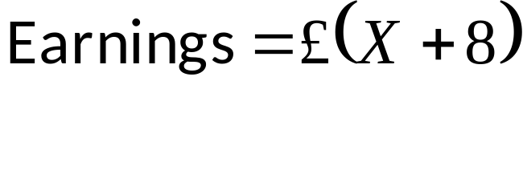
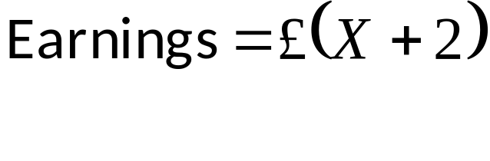
Private incentives
Is it ever a good idea to play a red card?
Let X be the total number of red cards played by others in the group (society)
If you keep your red cards, then your earnings are:
If you contribute your red cards, then earnings are:
Given the actions of all others, it is privately optimal not to contribute i.e. to free-ride!
09/04/2016
Applicants Day
14
20/04/2016
Classroom games in economics teaching

Slide 15
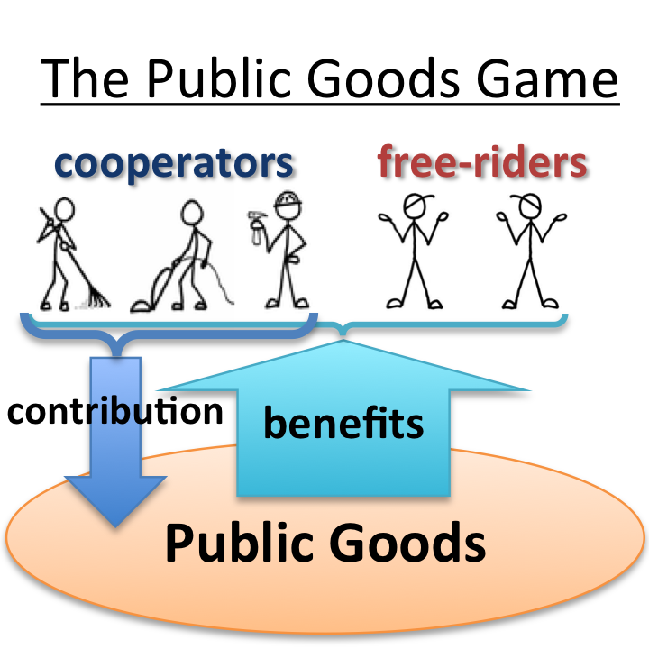
The Public Goods Game

Slide 16
But what is socially optimal?
If everyone acts on their private incentives and free-rides, then everyone gets a score of only £8
  In a society of 10 people, total benefits would be £80
If everyone were to contribute, then each individual would get £20.
  In a society of 10 people, total benefits would be £200
If the 10th person were to free-ride, then 9 people get £18, and he gets £18+£8 = £26
  While he gains, society at large gets only £188
It is thus socially optimal for everyone to contribute!
09/04/2016
Applicants Day
16
20/04/2016
Classroom games in economics teaching

Slide 17
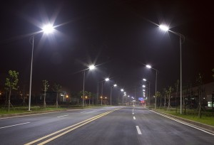


3. Real world applications?
Street lighting:
Campaigns/protests:
National defence:
09/04/2016
Applicants Day
17
20/04/2016
Classroom games in economics teaching

Slide 18
4. Twist to the game
The public good is National Defence
At the end of 5 more rounds, the winning team invades the others and confiscates their earnings!
The losing team members get 0, except…
…the 2 richest individuals in the losing team keep their wealth.
09/04/2016
Applicants Day
18
20/04/2016
Classroom games in economics teaching

Slide 19
5. Pro-social behaviour
While it is privately optimal to free-ride, in most rounds some contribute. Why might this be?
  Fairness?
  Altruism?
  A signal to others, to encourage contributions?
  A sense of civic duty?
09/04/2016
Applicants Day
19
20/04/2016
Classroom games in economics teaching

Slide 20
How might we foster cooperation?
Incentives? Changing the value of the red card?
  e.g. tax incentives to contribute to charities
Penalties? Naming and shaming? Role of enforcement?
  e.g. fines/imprisonment for tax evasion.
“Matching gifts” for fund-raising campaigns, based on contributions of employees.
What if cooperation cannot be sustained?
  Government provision
09/04/2016
Applicants Day
20
20/04/2016
Classroom games in economics teaching

Slide 21
Case 2: Computerised Game
20/04/2016
Classroom games in economics teaching

Slide 22
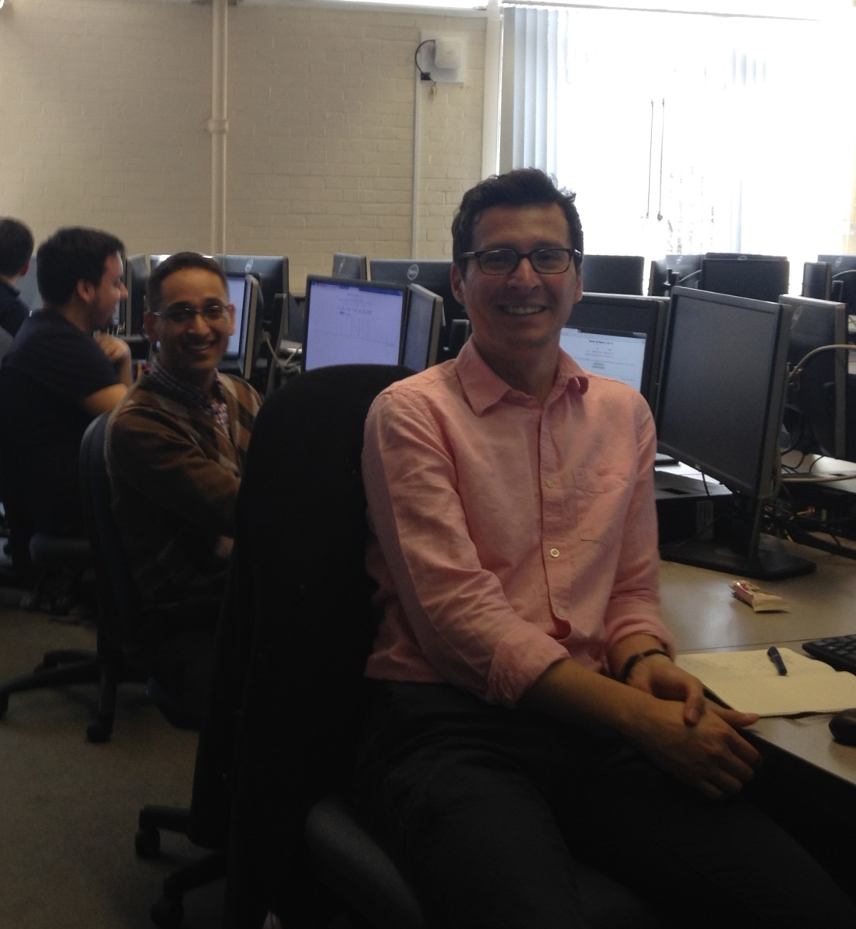
2015 TEL funded online game
Dimitra Petropoulou
Ani Silwal
Edgar Salgado-Chavez
20/04/2016
Classroom games in economics teaching

Slide 23
What we did
I: Market research into multi-player online games
  Flexibility: ability to modify features of the game
  Ease of use: time constraints
  Real time display of results: discussion; link to seminar
II: Devised games for the 2014-15 cohort
III: Tested games with the 2013-14 cohort
IV: Ran the real thing! Prize awarded
V: Linked results to subsequent seminar discussion
20/04/2016
Classroom games in economics teaching

Slide 24
Key issues when assessing sites
Can we edit the game?
Maximum number of players?
Minimum number of players?
How long will the game take?
Played by individuals or in a group?
Game played simultaneously?
Are instructions for students provided?
Are instructions for tutors provided?
Ease of use?
Browser requirements?
Online registration for students?
Scope? Potential games?
Can results be saved online etc?

Slide 25
What did the games involve?
Opted for games based on those by Charles Holt, University of Virginia
http://veconlab.econ.virginia.edu/admin.htm
Students log-on – simple instructions
Random (blind) matching of 2 (or more) students
Students make decisions in ‘rounds’ of each game…their decisions mutually determine ‘profits’ (strategic interdependence)
20/04/2016
Classroom games in economics teaching

Slide 26
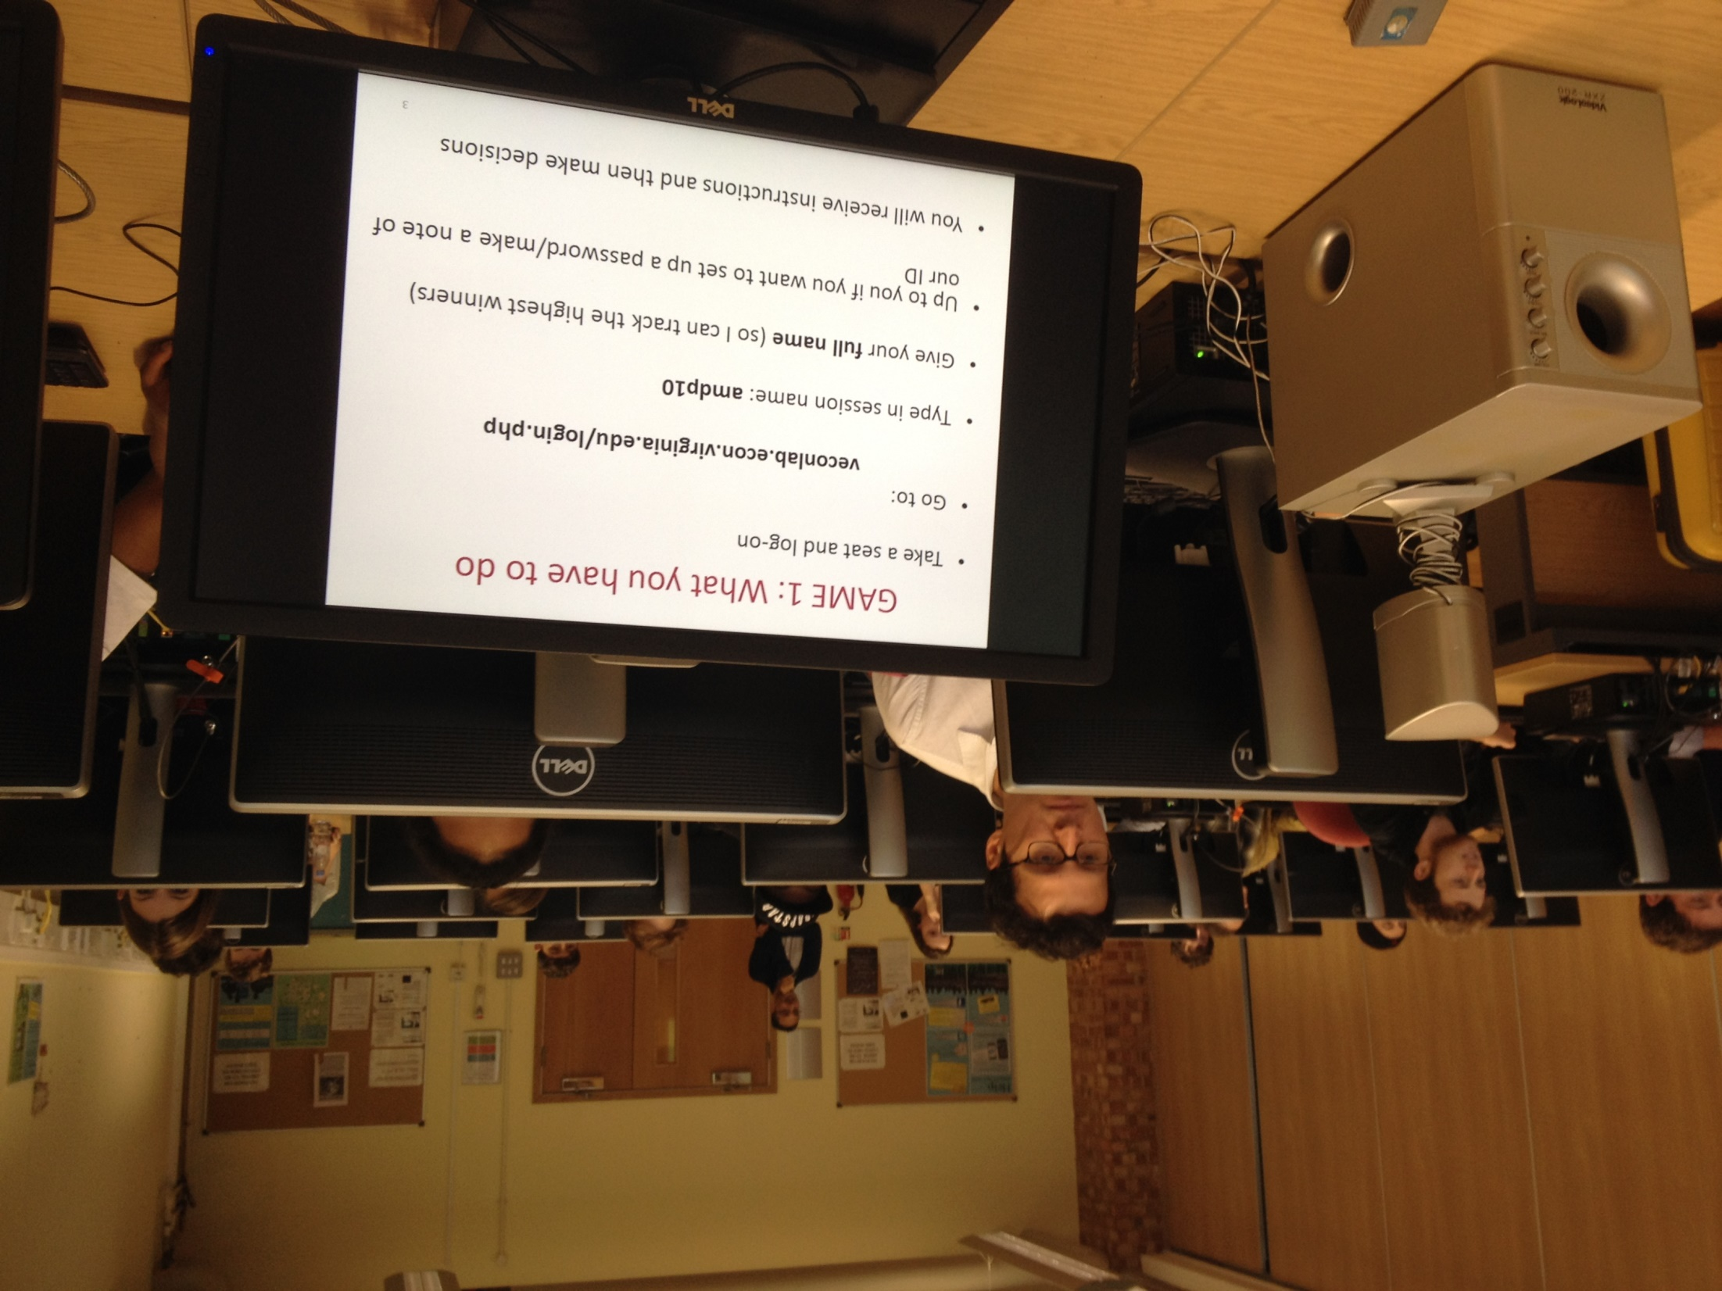

Slide 27

Example: Game 1
12 rounds of iterated Prisoner’s Dilemma (same partner)
Decisions and profits revealed after each round
Players know which round is the final round

Slide 28
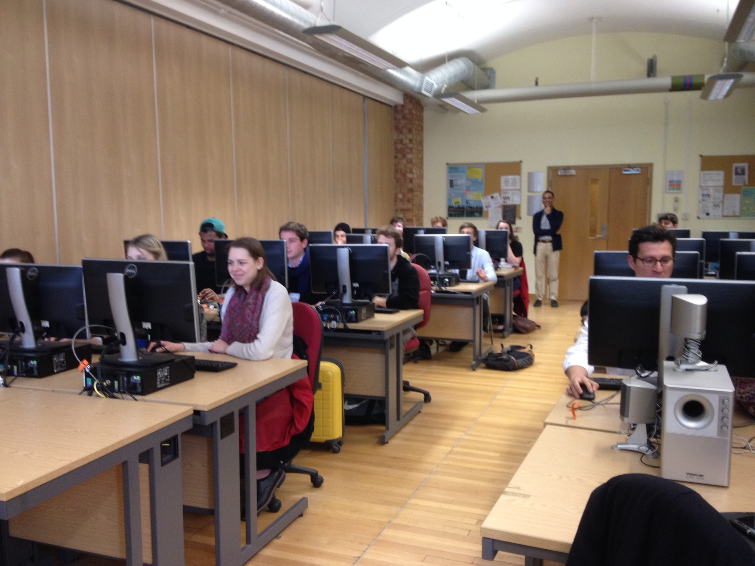
Students in Action

Slide 29
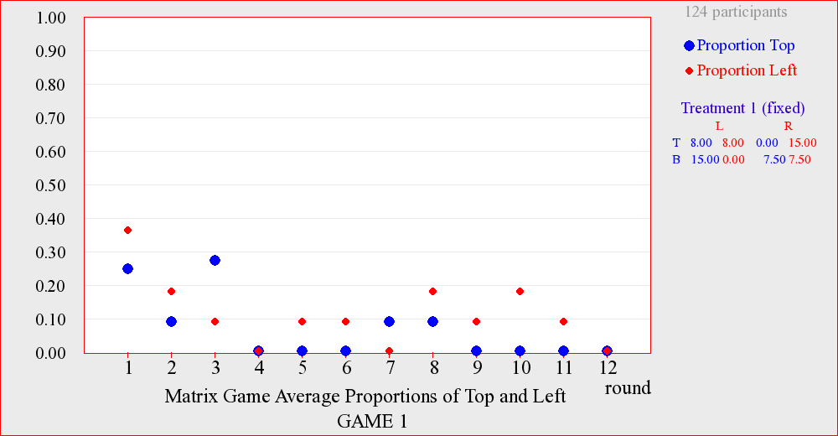
Results

Slide 30
Example: Game II
Monopoly
  No interaction – aim to find optimal quantity of production, given market conditions
Duopoly
  Strategic interaction
  Could set a high quantity to force down market share of rival…but if both do so, price and profits fall
  Scope for tacit collusion
Oligopoly (4 firms)
  Tacit collusion more difficult

Slide 31
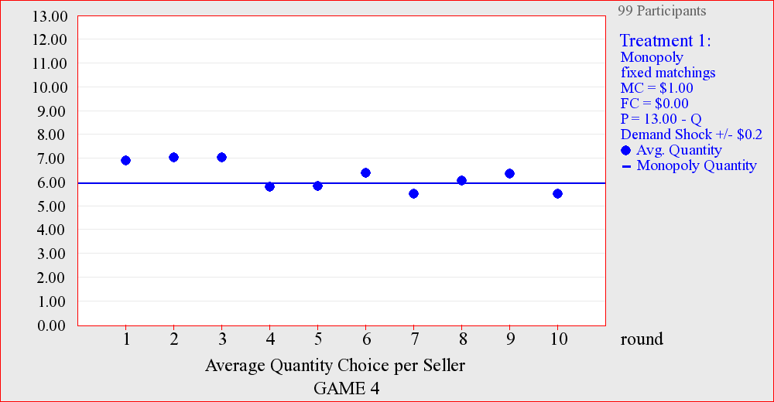
Monopoly Results

Slide 32
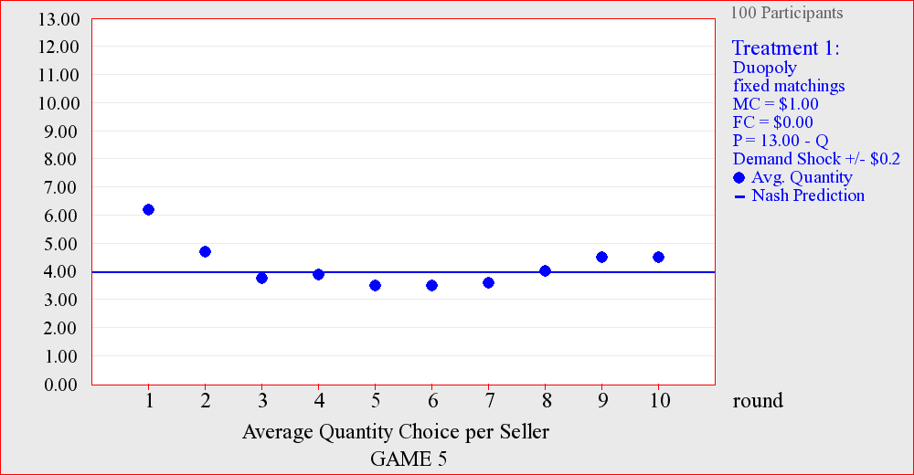
Duopoly Results

Slide 33
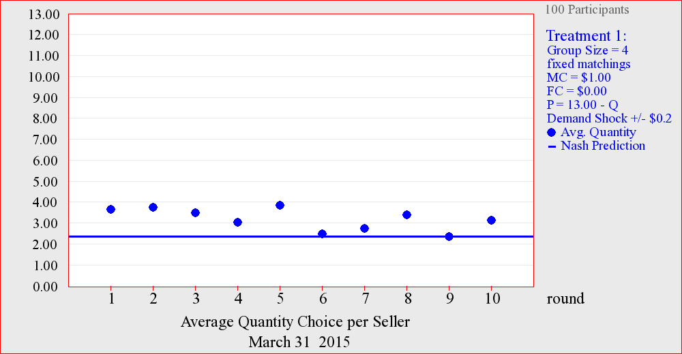
Oligopoly Results

Slide 34
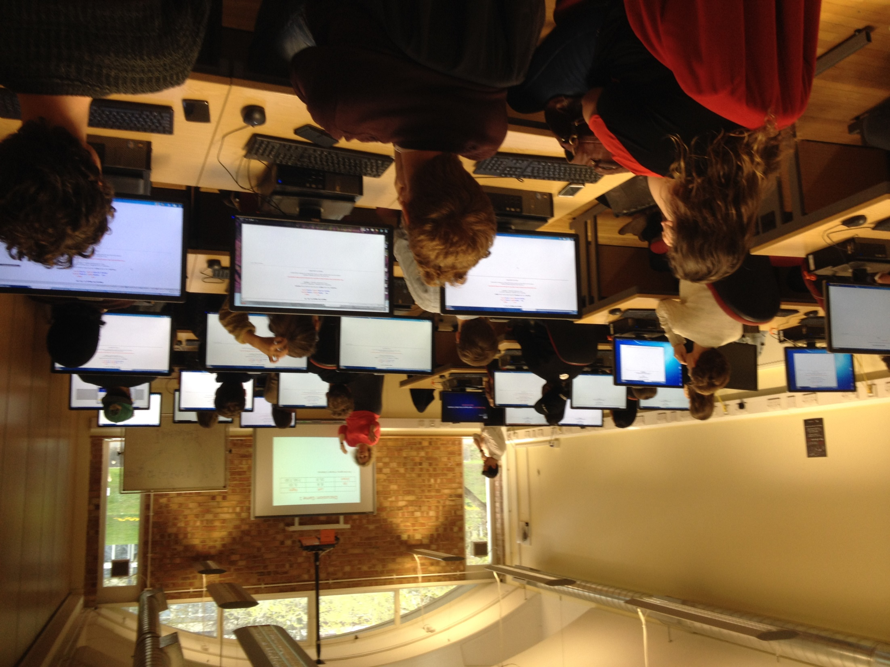
Debriefing

Slide 35
III. Achieving learning outcomes through games
Importance of planning
Care in how much information given to students
Flexibility required to deal with unexpected game outcomes
Avoid reinventing the wheel – many games available and come with spreadsheets, materials, advice on how to interpret different outcomes, advice on the debrief
Post-game debrief is key: drawing inferences from the classroom game, and linking it to the syllabus/lectures
20/04/2016
Classroom games in economics teaching

Slide 36
IV. Games as a means of stimulating inclusion
Exploiting diversity of students when designing classroom games
Example: International trade game
  Internationalisation of student body can serve as an asset
  Draw on own country experience during debriefing
  Enriches learning experience of the whole group
Example: Hand-run vs Computerised game
  Cultural differences can shape how students respond to the game
  Willingness to participate
20/04/2016
Classroom games in economics teaching

Slide 37
What the students had to say
20/04/2016
Classroom games in economics teaching

Slide 38
MEQ feedback
  “Use of games to teach topics has been great.” (2013 – 14)
  “The seminar structure was more interactive” (2013 – 14)
  “The games played in class were very useful, especially the car auction” (2013-14)
  “The games in the seminars made the theory much more applicable to real life, which was great!” (2013 – 14)
  “One of the best features was the online game, it was an entertaining and practical way of observing and interacting with microeconomic theory.” (2014-15)
  “…the online game Dimitra organized was very helpful” (2014 – 15)
  “While I appreciate the inclusion of practical games and examples, I feel that including these at the expense of focus on technical material could be detrimental. I would suggest that these were still included, but as additional contact hours.” (2014 – 15)

Slide 39
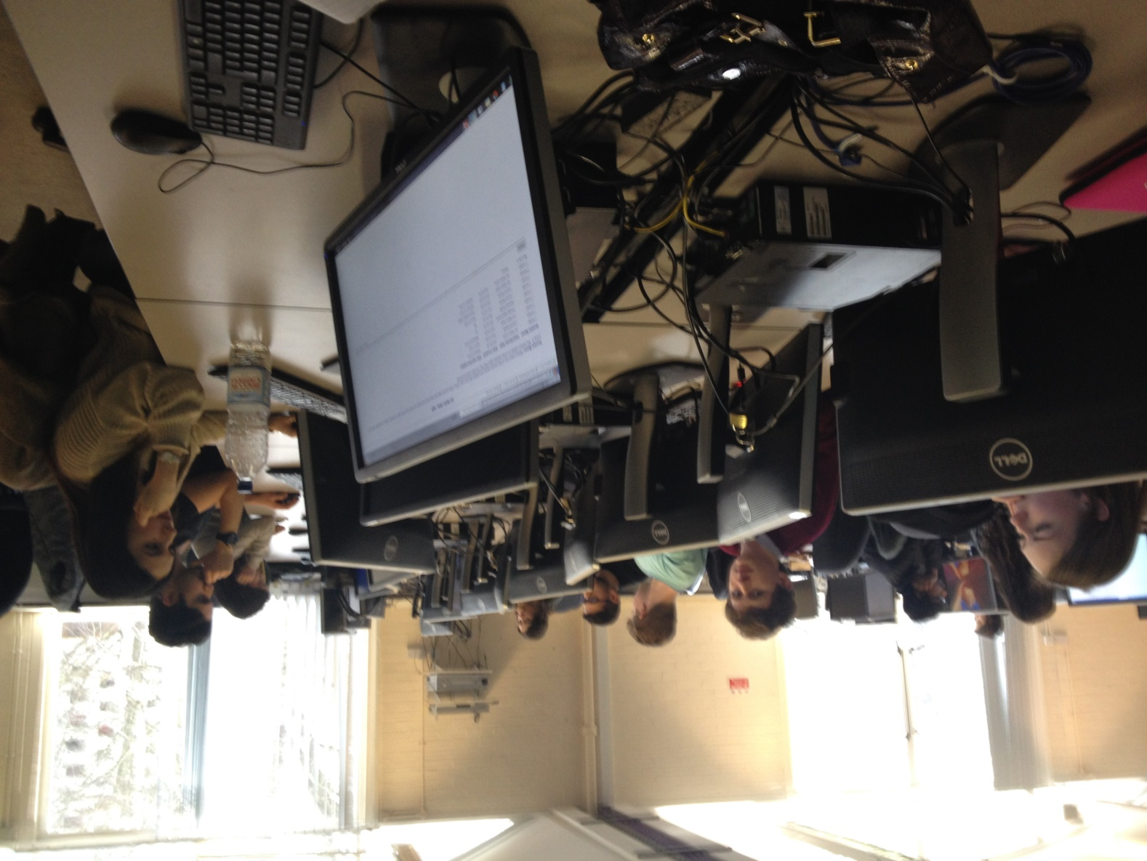
Thank you!

Slide 40
References
Ball, S.B., Eckel, C. and Rojas, C. (2006) ‘Technology Improves Learning in Large Principles of Economics Classes: Using Our WITS’, American Economic Review, 96(2), 442–446.
Durham, Y., McKinnon T. and Schulman, C. (2007) ‘Classroom Experiments: Not Just Fun and Games’, Economic Inquiry, 45(1), 162–178.
Emerson, T.L.N. and Taylor, B.A. (2004) ‘Comparing Student Achievement across Experimental and Lecture-Oriented Sections of a Principles of Microeconomics Course’, Southern Economic Journal, 70(3), 672–693.
20/04/2016
Classroom games in economics teaching

