Slide 1

Meeting the Informational Needs of Older People and their Carers in Health and Social Care Settings
Timothy B. Kelly, PhD
Professor of Social Work &
Associate Dean for Research

Slide 2
Topics for the evening
Why is providing information to older people and carers so important?
What happens in the real world?
What are some of the reasons professionals do not always give information?
What do older people say they want and who do they want it from?
What can and should we be doing as health and social care professionals?

Slide 3
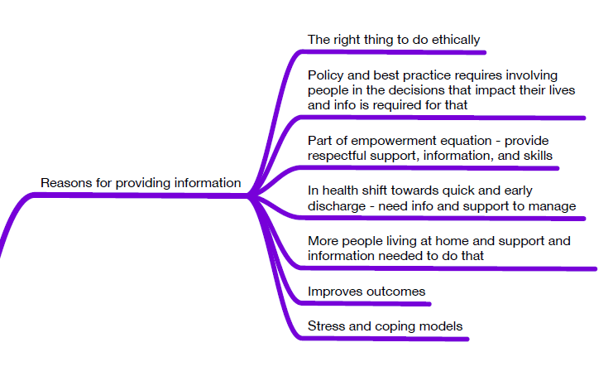

Slide 4
Stress and Coping Model
Background & Context
Primary Stressor
Secondary Role Strains
Secondary Intrapsychic Roles Strain
Outcomes
Mediators
Coping
Social Support
Based on Pearlin et al (1981)

Slide 5
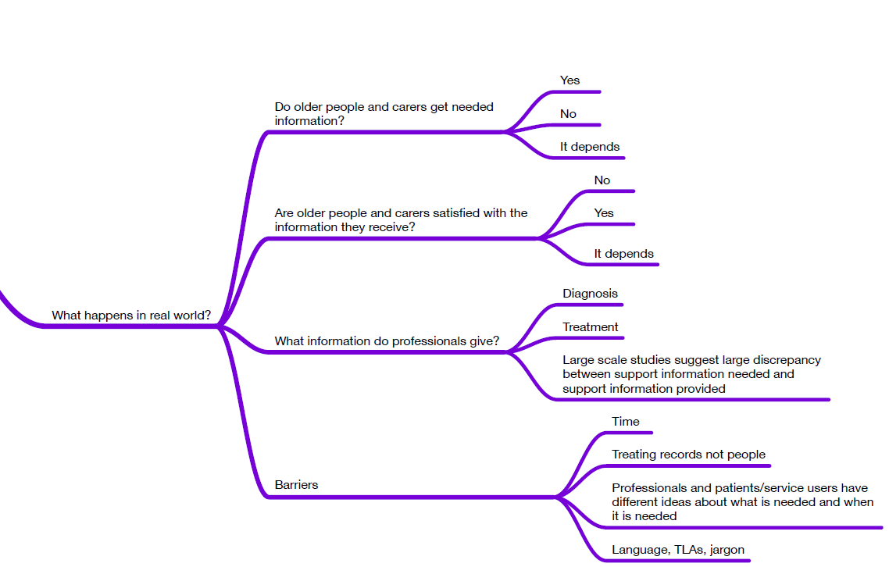

Slide 6
Selected Findings from Barret (2005)
 | Day care (% respondents) | Social club (% respondents)
Did not get enough help with the day-to-day tasks they were unable to do alone | 24 | 27
Had difficulty getting the help they wanted from the services | 30 | 29
Needed help and did not know whom to contact | 42 | 31
Did not know where to get help with looking after someone else | 78 | 63
Did not know where to get financial help to stay at home | 56 | 58
Did not know where to get help with changes to the home to make it easier to live in | 50 | 53

Slide 8
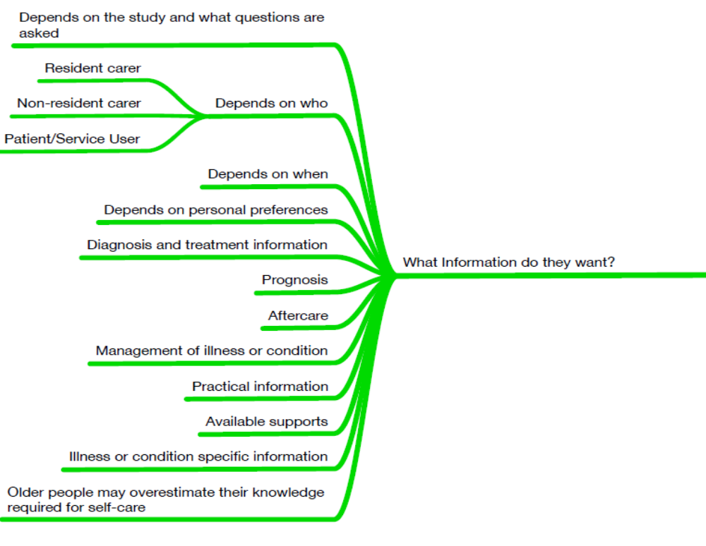

Slide 9
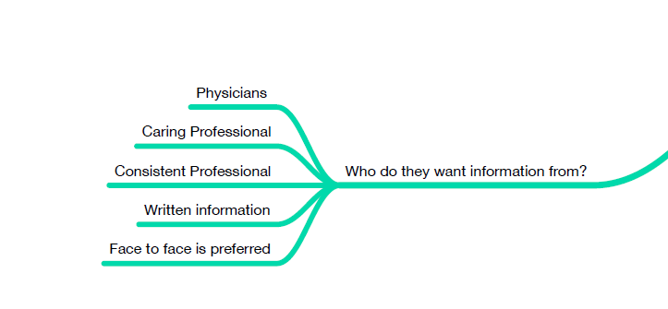

Slide 10
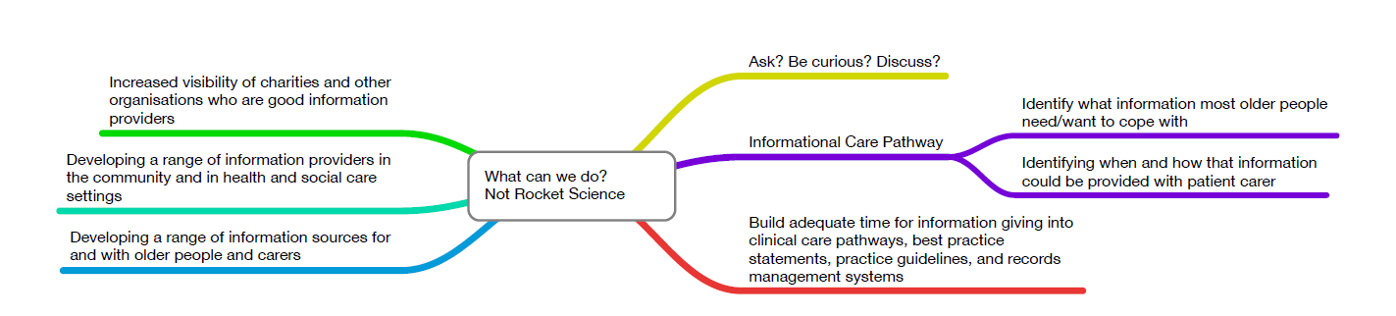

Slide 11
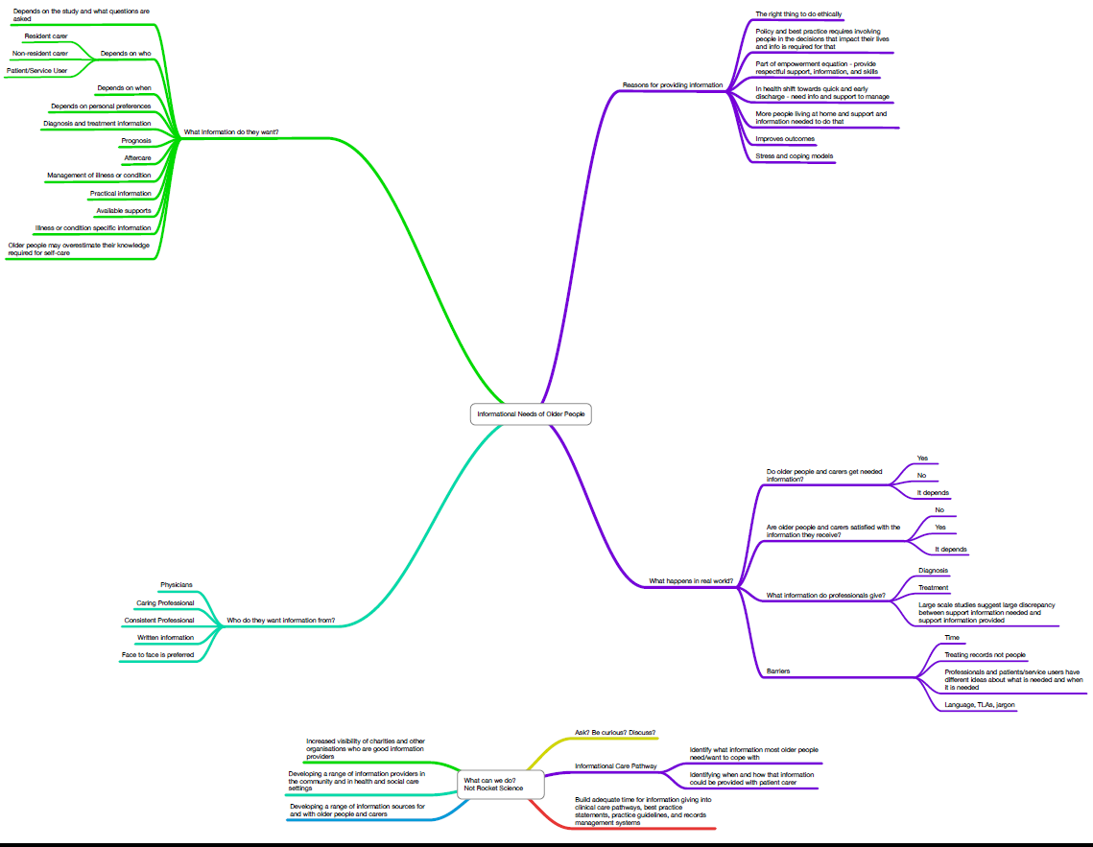
Thanks for listening. Now lets talk!

Slide 12
References
Badzek, L., Hines, S. C., & Moss, A. H. (1998). Inadequate self-care knowledge among elderly hemodialysis patients: assessing its prevalence and potential causes. ANNA Journal, 25(3), 293-300.
Barrett, J. (2005). Support and information needs of older and disabled older people in the UK. Applied Ergonomics, 36(2), 177-183.
Barrett, J. (2009). Designing websites to meet older peopleâ¿¿s information needs. (U513930), The University of Reading (United Kingdom), England. Retrieved from http://link-to.dundee.ac.uk/dundee/docview/899743943?accountid=10606 ProQuest Dissertations & Theses: UK & Ireland: Social Sciences database.
Capel, S., Childs, S., Banwell, L., & Heaford, S. (2007). Access to information and support for health: some potential issues and solutions for an ageing population. Health Informatics Journal, 13(4), 243-253.
Cawthra, L. (1999). Older people's health information needs. Health Libraries Review, 16(2), 97-105.
Cortes, T. A., Wexler, S., & Fitzpatrick, J. J. (2004). The transition of elderly patients between hospitals and nursing homes: improving nurse-to-nurse communication. Journal Of Gerontological Nursing, 30(6), 10.
Davidson, P. M., Macdonald, P., Moser, D. K., Ang, E., Paull, G., Choucair, S., . . . Dracup, K. (2007). Cultural diversity in heart failure management: findings from the DISCOVER Study (Part 2). Contemporary Nurse: A Journal for the Australian Nursing Profession, 25(1-2), 50-62. doi: http://dx.doi.org/10.5172/conu.2007.25.1-2.50
Dieterle, U., & Becker, C. (2011). Health Information for the Elderly and Their Caregivers: A Training Toolkit for Public Libraries. Journal of Consumer Health on the Internet, 15(2), 132-148. doi: http://dx.doi.org/10.1080/15398285.2011.573332
Dodge, J. S. (1969). Factors Related to Patients' Perceptions of Their Cognitive Needs. Nursing Research, 18(6), 502&hyhen;513.
Ekestrom, M., & Schubert, V. (1997). To let the family participate in the care of the dying patient [Swedish]. Nordic Journal of Nursing Research & Clinical Studies / Vård i Norden, 17(3), 25-29.
Ekeström, M. L., & Schubert, V. (1997). [Letting family participate in care. A study on relatives' experience with a palliative geriatric care department]. Vård I Norden, 17(3), 25-29.

Slide 13
Emery, D., Cowan, A. M., & Heyes, B. J. (2003). CarePlus: a home and community focused source for health and social care information. Health Informatics Journal, 9(3), 131-135.
Enlund, H., Vainio, K., Wallenius, S., & Poston, J. W. (1991). Adverse drug effects and the need for drug information. Medical Care, 29(6), 558-564.
Ernstmann, N., Jaeger, J., Kowalski, C., Pfaff, H., & Weißbach, L. (2013). [Elderly prostate cancer patients : Patient information and shared decision making.]. Der Urologe. Ausg. A.
Fokker, A. M., & de Baat, C. (1993). [Promotion of oral health in the elderly. Use of a videotape]. Nederlands Tijdschrift Voor Tandheelkunde, 100(1), 33-34.
Friis, L. S., Elverdam, B., & Schmidt, K. G. (2003). The patient's perspective: a qualitative study of acute myeloid leukaemia patients' need for information and their information-seeking behaviour. Supportive Care In Cancer: Official Journal Of The Multinational Association Of Supportive Care In Cancer, 11(3), 162-170.
Gane, L. W., Iosif, A.-M., Flynn-Wilson, L., Venturino, M., Hagerman, R. J., & Seritan, A. L. (2010). Assessment of patient and caregiver needs in fragile X-associated tremor/ataxia syndrome by utilizing Q-sort methodology. Aging & Mental Health, 14(8), 1000-1007. doi: http://dx.doi.org/10.1080/13607863.2010.501066
Giacalone, A., Blandino, M., Talamini, R., Bortolus, R., Spazzapan, S., Valentini, M., & Tirelli, U. (2007). What elderly cancer patients want to know? Differences among elderly and young patients. Psycho-Oncology, 16(4), 365-370. doi: http://dx.doi.org/10.1002/pon.1065
Giacalone, A., Talamini, R., Fratino, L., Simonelli, C., Bearz, A., Spina, M., & Tirelli, U. (2009). Cancer in the elderly: The caregivers' perception of senior patients' informational needs. Archives of Gerontology and Geriatrics, 49(2), e121-e125. doi: http://dx.doi.org/10.1016/j.archger.2008.10.004

Slide 14
Giacalone, A., Talamini, R., Spina, M., Fratino, L., Spazzapan, S., & Tirelli, U. (2008). Can the caregiver replace his/her elderly cancer patient in the physician-patient line of communication? Supportive Care In Cancer: Official Journal Of The Multinational Association Of Supportive Care In Cancer, 16(10), 1157-1162. doi: 10.1007/s00520-008-0406-4
Gott, C. M. (2001). Sexual Activity and Risk-Taking in Later Life. Health & Social Care in the Community, 9(2), 72-78.
Greenhalgh, J., Knight, C., Hind, D., Beverley, C., & Walters, S. (2005). Clinical and cost-effectiveness of electroconvulsive therapy for depressive illness, schizophrenia, catatonia and mania: systematic reviews and economic modelling studies. Health Technology Assessment, 9(9), iii.
Griffiths, K. M., & Crisp, D. A. (2013). Unmet depression information needs in the community. Journal of Affective Disorders, 146(3), 348-354. doi: 10.1016/j.jad.2012.09.018
Grymonpre, R. E., & Steele, J. W. (1998). The medication information line for the elderly: an 8-year cumulative analysis. The Annals Of Pharmacotherapy, 32(7-8), 743-748.
Harrington, V., Lackey, N. R., & Gates, M. F. (1996). Needs of caregivers of clinic and hospice cancer patients. Cancer Nursing, 19, 118-125.
Hickey, M. (1990). What are the needs of families of critically ill patients? A review of the literature since 1976. Heart & Lung: The Journal Of Critical Care, 19(4), 401-415.
Hileman, J. W., & Lackey, N. R. (1990). Self-identified needs of patients with cancer at home and their home caregivers: a descriptive study. Oncol Nurs Forum, 17, 907-913.
Hirakawa, Y., Kuzuya, M., Enoki, H., & Uemura, K. (2011). Information needs and sources of family caregivers of home elderly patients. Archives of Gerontology and Geriatrics, 52(2), 202-205. doi: http://dx.doi.org/10.1016/j.archger.2010.03.019
Houts, P. S., Yasko, J. M., Harvey, H. A., & et al. (1988). Unmet needs of persons with cancer in Pennsylvania during the period of terminal care. CANCER, 62, 627-634.
Hughes, L. C., Hodgson, N. A., Muller, P., Robinson, L. A., & McCorkle, R. (2000). Information needs of elderly postsurgical cancer patients during the transition from hospital to home. Journal of Nursing Scholarship, 32(1), 25-30. doi: http://dx.doi.org/10.1111/j.1547-5069.2000.00025.x
Husband. (2000). Diagnostic disclosure in dementia: an opportunity for intervention? International journal of geriatric psychiatry, 15(6), 544
Jewell, S. (1996). Clinical. Elderly patients' participation in discharge decision making: 2. British Journal of Nursing, 5(17), 1065-1071.
Jewell, S. (1996). Elderly patients' participation in discharge decision making: 2. British Journal Of Nursing (Mark Allen Publishing), 5(17), 1065-1071.
Jones, R. A., Morrow, G. D., Morris, B. R., Ries, J. B., & Wekstein, D. R. (1992). Self-perceived information needs and concerns of elderly persons. Perceptual And Motor Skills, 74(1), 227-238.
Koskenniemi, J., Leino-Kilpi, H., & Suhonen, R. (2013). Respect in the care of older patients in acute hospitals. Nursing Ethics, 20(1), 5-17.
Kupper, N. M., Schreurs, H., Ten Klooster, P. M., Bode, C., & Van Ameijden, E. J. C. (2011). Prevention for elderly people: Demand-oriented or problem-oriented. Health Policy, 102(1), 96-103.
Lane, P., McKenna, H., Ryan, A., & Fleming, P. (2003). The experience of the family caregivers' role: a qualitative study. Research And Theory For Nursing Practice, 17(2), 137-151.
Lapane, K. L., Goldman, R. E., Quilliam, B. J., Hume, A. L., & Eaton, C. B. (2012). Tailored DVDs: A novel strategy for educating racially and ethnically diverse older adults about their medicines. International Journal of Medical Informatics, 81(12), 852-860. doi: 10.1016/j.ijmedinf.2012.09.007

Slide 15
LARSON, C. O., NELSON, E. C., GUSTAFSON, D., & BATALDEN, P. B. (1996). The Relationship Between Meeting Patients' Information Needs and their Satisfaction with Hospital Care and General Health Status Outcomes. International Journal for Quality in Health Care, 8(5), 447-456. doi: 10.1093/intqhc/8.5.447
Mallen, C. D., & Peat, G. (2009). Discussing prognosis with older people with musculoskeletal pain: a cross-sectional study in general practice. BMC Family Practice, 10, 6p. doi: http://dx.doi.org/10.1186/1471-2296-10-50
Marzanski. (2000). Would you like to know what is wrong with you? On telling the truth to patients with dementia. Journal of medical ethics, 26(2), 108.
McCartan-Quinn, D., McAleer, E., & Naqvi, I. (1996). Service quality: a satisfaction survey of the elderly. International Journal of Health Care Quality Assurance, 9(3), 4-10.
Naylor, M. D., & Shaid, E. C. (1991). Content analysis of pre- and post- discharge topics taught to hospitalized elderly by gerontological clinical nurse specialists. Clinical Nurse Specialist CNS, 5(2), 111-116.
Neuberger, J. (2000). The educated patient: new challenges for the medical profession. Journal of Internal Medicine, 247, 6-10.
Nguyen, G. T., & Bellamy, S. L. (2006). Cancer information seeking preferences and experiences: disparities between Asian Americans and Whites in the Health Information National Trends Survey (HINTS). Journal Of Health Communication, 11 Suppl 1, 173-180.
Percival, J., & Hanson, J. (2005). 'I'm Like a Tree a Million Miles from the Water's Edge': Social Care and Inclusion of Older People with Visual Impairment. The British Journal of Social Work, 35(2), 189-205. doi: http://dx.doi.org/10.1093/bjsw/bch178
Posma, E. R., van Weert, J. C. M., Jansen, J., & Bensing, J. M. (2009). Older cancer patients' information and support needs surrounding treatment: An evaluation through the eyes of patients, relatives and professionals. BMC Nursing, 8, 1-1. doi: 10.1186/1472-6955-8-1
Resnick, R. R. (2004). Resources for the elderly and their caregivers. Journal of Hospital Librarianship, 4(3), 1-14.
Robben, S., van Kempen, J., Heinen, M., Zuidema, S., Olde Rikkert, M., Schers, H., & Melis, R. (2012). Preferences for receiving information among frail older adults and their informal caregivers: a qualitative study. Family Practice, 29(6), 742-747. doi: 10.1093/fampra/cms033
Scott, J. T., & Thompson, D. R. (2003). Assessing the information needs of post-myocardial infarction patients: a systematic review. Patient Education and Counseling, 50(2), 167-177.
Shih, S., Gau, M., Lo, C. K., & Shih, F. (2005). Health Needs Instrument for hospitalized single-living Taiwanese elders with heart disease: triangulation research design [corrected] [published erratum appears in J CLIN NURS 2006 Jul;15(7):933]. Journal of Clinical Nursing, 14(10), 1210-1222. doi: http://dx.doi.org/10.1111/j.1365-2702.2005.01201.x

Slide 16
Smith, J., & Liles, C. (2007). Information needs before hospital discharge of myocardial infarction patients: a comparative, descriptive study. Journal of Clinical Nursing, 16(4), 662-671. doi: http://dx.doi.org/10.1111/j.1365-2702.2006.01689.x
Su, S. S., & Conaway, C. W. (1995). Information and a Forgotten Minority: Elderly Chinese Immigrants. Library & Information Science Research, 17(1), 69-86.
Suhonen, R., Nenonen, H., Laukka, A., & Välimäki, M. (2005). Patients’ informational needs and information received do not correspond in hospital. Journal of Clinical Nursing, 14(10), 1167-1176. doi: 10.1111/j.1365-2702.2005.01233.x
Vernooij-Dassen, M., Van Hout, H., Hund, K., Hoefnagels, W., & Grol, R. (2003). Information for dementia patients and their caregivers: what information does a memory clinic pass on,and to whom? Aging & Mental Health, 7(1), 34-34.
Wei, C., Xueqin, L., & Xiaoyan, S. (2012). Qualitative research on nursing needs of elderly stroke patients [Chinese]. Chinese Nursing Research, 26(3C), 787-789.
Williams, G. O., Gjerde, C. L., Haugland, S., Darnold, D., Simonton, L. J., & Woodward, P. J. (1995). Patients with dementia and their caregivers 3 years after diagnosis. A longitudinal study. Archives Of Family Medicine, 4(6), 512-517.
Wilson, K., Pateman, B., Beaver, K., & Luker, K. A. (2002). Patient and carer needs following a cancer-related hospital admission: the importance of referral to the district nursing service. Journal of Advanced Nursing, 38(3), 245-253. doi: http://dx.doi.org/10.1046/j.1365-2648.2002.02173.x

