Slide 1

Quality over quantity
Interaction can enhance research use in social work (and it may not have to be time and resource intensive!)
Milena Heinsch
Lecturer Social Work
The University of Newcastle
Milena.Heinsch@Newcastle.edu.au

Slide 2
The “swampy lowlands” of social work
“In the varied topography of professional practice, there is a high, hard ground overlooking a swamp. On the high ground, manageable problems lend themselves to solutions through the use of research­ based theory and technique. In the swampy lowlands, problems are messy and confusing and incapable of technical solution. The irony of this situation is that the problems of the high ground tend to be relatively unimportant to individuals or society at large, however great their technical interest may be, while in the swamp lie the problems of greatest human concern” (Schon, 1987, p. 1).
Notes:
As a social work student, I remember coming across Donald Schon’s classic work, Educating the Reflective Practitioner, where he wrote:
“In the varied topography of professional practice, there is a high, hard ground overlooking a swamp. On the high ground, manageable problems lend themselves to solutions through the use of research­ based theory and technique. In the swampy lowlands, problems are messy and confusing and incapable of technical solution. The irony of this situation is that the problems of the high ground tend to be relatively unimportant to individuals or society at large, however great their technical interest may be, while in the swamp lie the problems of greatest human concern.”
I could relate to this metaphor of the ‘messy and confusing’ ’swampy lowland’ that Schon described much more than to the ‘high, hard ground’. But when I began to work in the ‘swampy lowlands’ of hospital social work, I realised that there was an expectation that I find a ‘technical solution’ to the problems I was dealing with, and that the nuanced, contextual, empathic language I was using did not seem to hold as much weight as the technical language of my medical colleagues. This often left me with a nagging sense that I was somehow inferior to them. While it may not have been accurate to conclude that I was inferior, the power difference implied by the metaphor of the ‘high ground’ vs ‘swampy lowland’ was certainly present in the hierarchy of knowledge promoted by the hospital’s evidence-based practice agenda.

Slide 3
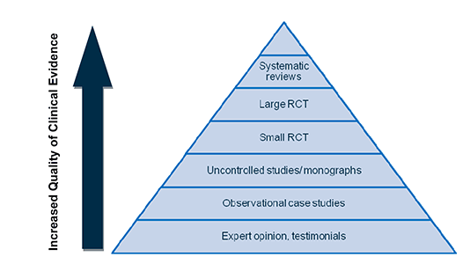
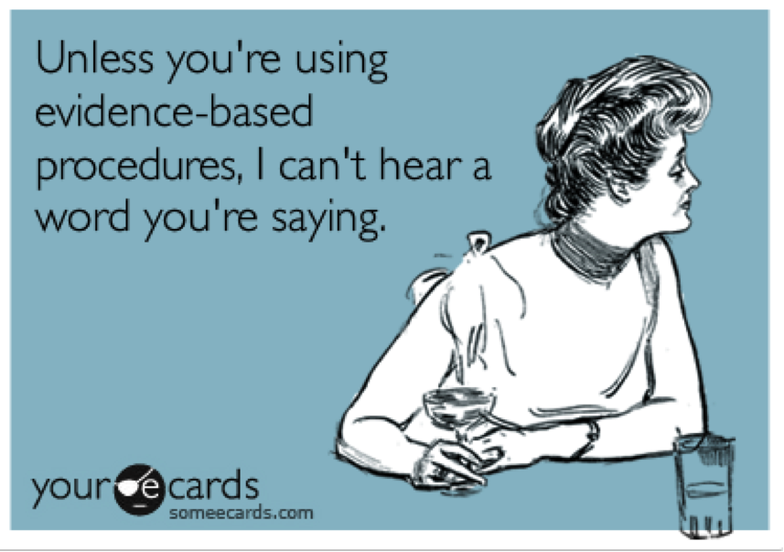
The evidence-based practice hierarchy
Notes:
In Australia, and in many other countries including the UK, evidence-based practice has become the dominant paradigm in the delivery of health and social services. As many of you probably know, evidence-based practice ranks knowledge according to a hierarchy of evidence. In a strict application of this hierarchy, knowledge from systematic reviews and randomised controlled trials is considered to be the highest form of evidence, the “gold standard”, while qualitative and participatory research tends to sit at the bottom of the hierarchy. This hierarchy of knowledge is also reflected in the language of evidence-based practice, with the term ‘inner science’ often used to refer to knowledge at the top of the hierarchy and ‘outer science’ used to refer to knowledge at the bottom. Similar colloquial terms that are sometimes used are “hard” science and “soft” science. This language is not neutral; ‘it is infused with meaning, power and status’ . Hierarchies are the quintessential manifestation of power’. They signify ‘whose knowledge matters’, and whose does not, irrespective of how important the questions being asked are to society.

Slide 4
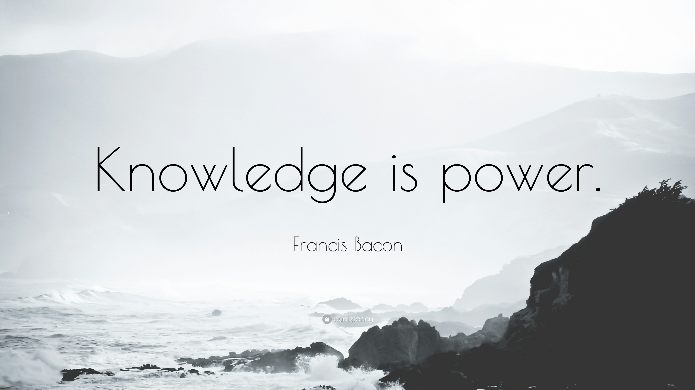
…but some knowledge holds greater power than other knowledge
Notes:
My point is that, while knowledge is power, some knowledge has greater power than other knowledge. In today’s society the value and importance of knowledge is determined by what we call the ‘knowledge economy’. The knowledge economy implies that there is a market for certain forms of knowledge, especially knowledge that produces tangible outcomes which can be turned into economic profit. The thing is, not all forms of knowledge can be turned into economic profit. In order to make a profit from knowledge, it needs to be transformed into a ‘product’, that can be marketed, packaged, bought, and sold. This often means simplifying it, so that it can be generalised and applied in a range of settings.
In order for knowledge to have commercial value, it also needs to be made scarce. Despite the vast amount of knowledge being produced nowadays, access to this knowledge often depends on some kind of payment in the form of royalties and license fees. How many times have you found an interesting article on Google only to click on it and find you have to pay $20 pounds to access it? Making knowledge artificially scarce in this way excludes a significant proportion of society from benefiting from it. Davis talks about this in his recent book called The Death of Public Knowledge. He suggests that there has been an erosion of shared, publicly accessible knowledge, and that this has worrying implications for democracy.

Slide 5
Social work’s “guilty knowledge” … “not the coin of the realm”
“Social work knowledge is formed from the humble stuff of lived experience and values”. These “are the heartlines of the profession”. They “have existed from the beginning and have remained strong within the recesses of daily practice. Like veins of ore in bedrock, they glimmer quietly for all who are willing to see. Because the material lodged in these rich veins is not the official coin of the realm, it forms the guilty knowledge of social work” (Weick, 1999, p. 35).
Notes:
So, where does social work knowledge fit within this rather profit-driven and utilitarian view of knowledge? Through the narrow lens of the ‘knowledge economy’, the ‘messy’, contextualised knowledge that forms the basis of much social work practice becomes devalued. Anne Weick described this beautifully in her article ‘guilty knowledge’ (1999). In this article, she provides a heartfelt and vibrant description of social work’s deep and expansive knowledge; a knowledge that, she says, is…
formed from the humble stuff of lived experience and values”. She says, these “are the heartlines of the profession”. They “have existed from the beginning and have remained strong within the recesses of daily practice. Like veins of ore in bedrock, they glimmer quietly for all who are willing to see” (Weick, 1999).
Sadly, Weick went on to say, that ‘this colourful, passionate, emotion-filled’ knowledge ‘is not the official coin of the realm, and so it forms the ‘guilty knowledge’ of social work’ (p. 35). Today, almost two decades later, Weick’s words could not hold more relevance. For, although knowledge has become the coin of the realm, the knowledge that is recognised within the ‘knowledge economy’ tends to be from a different mint.

Slide 6

The ‘Scientification’ of social work
Notes:
In an effort to enhance the value of its knowledge ‘currency’, in the mid twentieth century, social work attempted to distance itself from emotion and subjectivity, by embracing the scientific approaches of the social sciences. It was hoped that these scientific approaches could correct the bias that was thought to reside in social workers’ direct knowledge of people and their lives. Since then, social work has developed an impressive research profile of its own, and it is completely understandable and important that social work should take its rightful place in the research community. However, the push to gain distance from the emotional, subjective elements of practice has led to an unfortunate division in social work between practitioners, who operate in the universe of values and researchers, who operate in a parallel world of facts. This separation has been highlighted as a key reason why social work practitioners underutilise research, out of a sense that the knowledge produced in the research world is not suitable for addressing the complex social and emotional problems they face in their day-to-day practice.

Slide 7

Developing a “third way” for knowledge in social work
Notes:
Rather than rejecting scientific approaches altogether, several social work authors have suggested that we need to create a ‘reformulated conception’ of evidence-based practice, or a “third way” of knowledge production that is more flexible and value-based. Morley and Ife suggested that we could achieve this by fostering genuine dialogue between researchers and practitioners that enables them to ‘name the world together’. They argue that this kind of dialogue requires humility and denies ownership of knowledge; it requires ‘letting go’ of the need to control and surrendering to uncertainly; it is based in a fundamental belief that ‘what is important is that we are human and that this lived experience is valued above all else’. I want to talk more about this dialogue – and what it might look like – in the second half of the seminar.

Slide 8
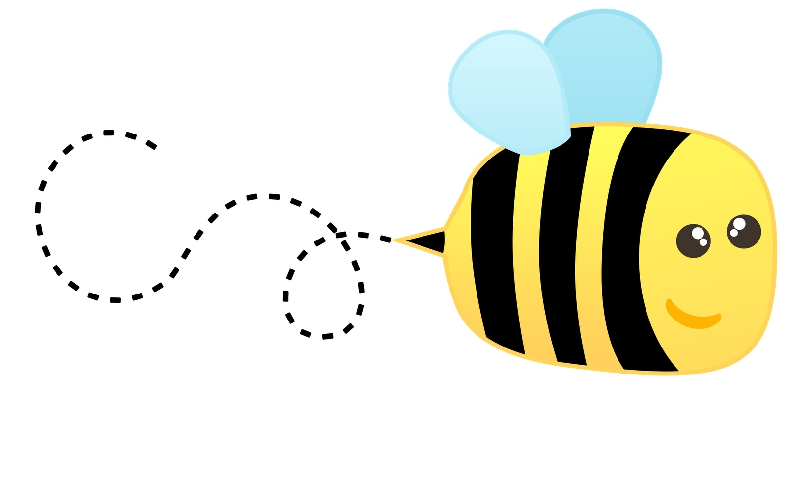
Buzz session

Slide 9

Interaction and research use in social work
Notes:
I was speaking earlier about the importance of fostering dialogue between researchers and practitioners. The notion of dialogue is very relevant to the shift that is taking place in the relationship between academic knowledge and the larger world. Today, there is an increased emphasis on engagement between research and society and, between research and practice. This emphasis is based on an assumption that stronger links between research and practice will lead to the production of more relevant research that is more likely to be used and will therefore make a genuine contribution to society. And as I mentioned before this contribution is often viewed in economic terms. The problem is that, while many people have enthusiastically taken up the general message that linking research with practice is good, relatively little attention has been paid to actually finding out what kind of engagement - what kind of dialogue - between research and practice actually leads to research use. The literature that does exist tends to describe engagement between researchers and practitioners as a time-consuming and resource-intensive process. These factors have often been put forward as key reasons why researchers and practitioners find it difficult to engage in joint activities that foster research use. Today, I want to share with you some of the findings of my PhD research, which examined how researchers in social work conceive, explain and experience the research utilisation process, whether they perceive that there is a relationship between engagement with practice and research use by practitioners. And if so, how this engagement might best lead to research use in social work.

Slide 10
definitions
Research use
Instrumental use | Use of research to directly develop content or direction of policy/programs
Conceptual use | Use of research to provide new ideas, understanding or concepts that influence thinking about policy/programs
Symbolic use | Use of research to justify or lend weight to pre-existing preferences and actions
“People do not utilise research the way they utilise a hammer. The whole process through which research penetrates the sphere of organisational decision making is…fluid and diffuse” (Weiss, 1981)
Weiss, C. (1981). Measuring the use of evaluation. In J. Ciarlo (Ed.), Utilization evaluation. Beverly Hills, CA: Sage Publications
Notes:
Before I begin, let me clarify what I mean when I speak about research use. For me, research use is neither straight forward nor linear. As Weiss (1981) a leading authority in the area stated: “People do not utilise research the way they utilise a hammer”. The process by which research influences decision making is fluid and diffuse”
Like Weiss, I conceptualise research use on a continuum that extends from instrumental use, where research findings have a decisive impact on decisions, to conceptual use where the impact of research is much more diffuse or cognitive.
In relation to engagement, I defined this very broadly as any form of contact between researchers and practitioners that facilitated research ‘use’ by practitioners in some way.

Slide 11
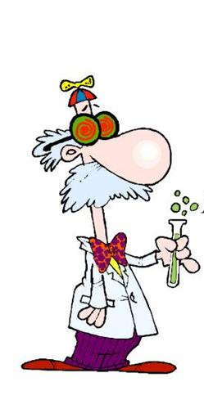
methods
Study population: Australian researchers publishing in social work journals
Mixed methods:
Survey (n=60)*
Telephone interviews (n=26)
*Heinsch, M., & Gray, M. (2016). Making research count: What Australian social work researchers think. Australian Social Work, 69(4), 428-442.
Notes:
I used a mixed methods approach, which included a survey and interviews with Australian researchers who had published in social work journals. I identified these researchers by conducting a search of articles published in social work journals over a 10-year period (1997-2007) and identifying researchers with an Australian address. My search identified 144 researchers. These researchers were emailed an invitation to participate in an electronic survey and 60 researchers responded to this survey. Researchers were also given the option of participating in a follow-up telephone interview, and 26 researchers chose to be interviewed. Today, I will speak only about the findings of the interviews, but the results of the survey have been published and I have provided the publication details on the slide.

Slide 12
Findings: how did researchers view research use?
“I mean it’s a socially embedded process ... It’s not just the researcher produces the research and then people apply it” (R14).
Notes:
So how did researchers view research use? Participants described research use as a socially engaged process, and many showed a preference for terms like ‘translation’, which they thought inferred more bidirectional movement and more negotiation of knowledge between research and practice. Participants tended to speak about research use as resulting from their engagement with practitioners at some point during the research process. Some spoke about the importance of early consultation to ensure that their research focus and questions were practice relevant. Many also discussed the need to provide feedback and keep practitioners involved throughout the research process, although several participants emphasised the importance of not becoming ‘over involved’ with practice, as they thought this could limit researcher independence and critical thinking.

Slide 13
Forms of research use
Conceptual use
“I’m really more interested in getting people to think rather than getting people to do stuff ... getting practitioners to stop and say, ‘I wonder what that’s about, I wonder how ...’ but not telling them what to do” (R22).
Notes:
Although I didn’t ask participants to specify different forms of research use, their responses tended to reflect the three key forms of use identified by Weiss - conceptual, symbolic and instrumental. The most common form of use reported was conceptual use. This was generally viewed as the uptake of new ideas that led to changes in the way practitioners thought about their work. For many participants, their first and foremost goal was not to influence behaviour, but to encourage practitioners to think and take notice of new ideas. Many spoke about critical thinking and active engagement with research as a necessary precursor to future action.

Slide 14
Symbolic use
“So there was a bit of argy-bargy and we sort-of said, well, we’re going to publish anyway. So why don’t we work together and find out how we can phrase this in a more positive way, for you to take back to your people” (R4).
Notes:
Discussions about symbolic use often related to negative experiences, where research had been rejected when it was not in line with organisational expectations or preconceived ideas. Some participants were able to work around this by collaborating with practitioners to find a more positive way of framing their findings. This highlights the importance of engagement as a mediating factor, that allows practitioners to negotiate and jointly interpret knowledge with researchers to make it more suitable to their practice context whilst still retaining the original intentions of the research.

Slide 15
Instrumental use
“I would be feeding back all the time. Really early on, before anything was published from the study, the practitioners started changing what they did ... that just started happening because they knew that’s what was coming out of the study and it shifted practice in a really profound way” (R8).
Notes:
Instrumental research use was most difficult to identify because participants were often unsure how directly their research had been taken up in practice. Instrumental use tended to occur when research had been transformed into a useable format, such as a tool kit or model that had direct practical application. It was also more likely to occur when the outcomes of the research were achievable. However, Instrumental use was also significantly facilitated by engagement, particularly by continuous feedback and involvement of practitioners throughout the research process. For one participant, providing regular verbal feedback about her research findings to practitioners led to immediate and profound changes in decision making by these practitioners. This suggests that engagement has the potential to significantly speed up the utilisation process, particularly when compared to more traditional methods of dissemination via publication for instance.

Slide 16
what forms of engagement were most effective at facilitating research use?
The power of strong ties: “trust” “commitment” “friendship” “equality”
“I think a strong connection just speeds it [research utilisation] (sic) up and strengthens it—gives it a stronger, more resilient, more robust starting foundation…so you can go further faster because you’re building on pre-existing understandings” (R2).
Notes:
So what kind of engagement was most likely to facilitate research use by practitioners? A key finding of my research was that strong ties were particularly effective at facilitating research use. Strong ties were described using words like ‘trust’, ‘commitment’, ‘friendship’, and ‘equality’. Several researchers spoke about sharing a ‘common worldview’ or a ‘pre-existing understanding’ with practitioners, which they thought accelerated the use of their research by practitioners.

Slide 17
Strong ties overcoming competing priorities
“…having strong, personal relationships makes it easier ... to navigate those disjunctions between what they have to do for their pay and what you have to do for your pay” (R17).
Notes:
All participants viewed strong ties as crucial for navigating the disjunctions and the differing priorities across research and practice settings. Strong ties were thought to enable open and frank communication, making it easier to overcome barriers and identify solutions.

Slide 18
Strong ties challenging and changing practice
“If scientists are agents of change, then that change can only happen in the context of relationships. Our aim is challenge, to get people thinking and influence their practice, but to do that you have to have strong relationships” (R22).
Notes:
This ability to communicate candidly with practitioners was also considered essential for achieving change in practice. Several participants thought that practitioners were more open to new ideas and more willing to be challenged in the context of a strong relationship.

Slide 19
Strong ties developed through ‘trigger encounters’
“We go in and smash it and have fun. We don’t turn up in our suits and all that, we just turn up in our jeans and our Converse [sneakers or joggers] (sic) and we’re relaxed and we swear and carry on, we go out and get pissed with them and all that, we’re human” (R22).
INFORMAL
FUN
RELAXED
Notes:
So how did researchers develop these strong connections with practitioners? Several participants reported having a background in practice, which they said had allowed them to develop strong and lasting relationships with the practitioners they had worked with. However, others also spoke about their experiences of building new practice connections. Of particular interest was the finding that some researchers described critical encounters that enabled them to develop strong ties very quickly. These encounters – which I will refer to as ‘trigger encounters’ – tended to be informal and relaxed, and involved fun social activities like sharing a coffee or a glass of wine. The informal nature of these activities deconstructed power differentials between researchers and practitioners and helped to built trust.

Slide 20
Emotionally arousing
“So I’ve been interested in how we can ‘stir the possums’ a bit to create an emotional connection to an issue because I think that when people feel a set of emotions in response to something that’s going on then you’ve got a greater capacity to communicate to them about the significance of the issue” (R6).
Notes:
‘Trigger encounters’ were also characterised by a higher state of emotional arousal. For example one researcher spoke about deliberately ‘stirring the possums’ by speaking about a controversial topic or making a provocative comment to produce an emotional reaction by practitioners, and then he would engage directly with that emotion, which he felt enhanced their critical engagement with the research material.

Slide 21
Intimate, Personal, unguarded
“So I bought the kids in and we had a cup of coffee. So they sort of got to see me, which is not very professional I know ... Anyway she still raves about how good my kids were. Oh my God, it must have been a good day!” (R4).
Notes:
Trigger encounters also tended to be intimate and personal. Researchers spoke about being unguarded, making eccentric remarks, and including practitioners in their personal lives in some way. For example, one researcher recounted an occasion when she had to take her children to an initial meeting with a practitioner. This allowed the practitioner to ’see her’ in a more personal light, and enabled her to build rapport quickly, creating a strong foundation for their ongoing collaboration.

Slide 22

philos ( “friend”)
Notes:
So, to sum up, the ‘trigger encounters’ described by participants had a particular quality – they were informal, emotionally arousing and intimate. Interactions that had these qualities tended to enable researchers to forge strong connections with practitioners quite quickly. This isn’t surprising really. As social workers, we understand the power a single personal encounter can have. We understand the role of emotion, and of informal engagement, in building rapport. We are experts in making exactly the kinds of links that can facilitate change, and we are experienced at making them quickly. Krackhardt referred to these kinds of interactions as philos - Greek word for “friend”. He argued that philos ties, which are characterised by emotional intensity and intimacy, are more likely to facilitate knowledge uptake than ties characterised only by frequent interactions. It is possible that the ‘trigger encounters’ described by participants in my study help to speed up the development of philos ties, meaning that research use may require fewer resources and less investment of time than previously thought. It will be interesting to continue to explore the role of ‘trigger encounters’ in the research utilisation processes. In my opinion, social workers, with their deep and expansive knowledge about relationships are uniquely placed to examine the role of interaction in facilitating research use.

Slide 23

Notes:
The challenge for social work will be to recognise the value of our knowledge and the contribution it can make in extending the narrow focus of the knowledge economy towards a more inclusive knowledge society. The “swampy lowlands” that social workers inhabit may be messy, but they are also a rich and fertile place, where relationships between organisms are complex and dynamic, and where productivity and innovation is high. The swamp is the place where all life began, and where it returns, for food, shelter and connection. It is precisely the place where social work should be. The thing to remember is that the swamp we inhabit is intimately connected to the many other ecosystems that surround it, and that feed into it. Systems theory tells us that no ecosystem – whether ‘high hard ground’ or ‘swampy lowland’, can survive alone. All ecosystems are interconnected, and it is the movement and exchange between them that makes life possible. By continuing to create movement and fostering exchange with the diverse knowledge systems that surround us, we will avoid stagnation and ensure that the waters of our swamp continue to run fresh and clear.
Thank you.

Slide 24
Buzz session

